Slide 1
Reducing Foot Ulcer Risk Through Screening and Patient Education.
A collaborative approach between the patient and clinician in populations with limited resources

Slide 2
Introduction
Aisha Jones
Final year physical therapy student at UNC- Chapel Hill.
Special interests in geriatrics and wound care.
Noticed a need for screening and education in rural settings.
Diabetes in Latin America

Slide 3
Foot Ulcer Risk Examination tool
Developed by compiling the literature and evidence on best methods to assess risk of developing foot ulcers.
Seven categories of assessment, including a short patient survey.
Each item is worth one point and score is totaled at the bottom.
Intervention is then carried out based on category of risk the patient is stratified into.

Slide 4
Flowchart

Slide 5
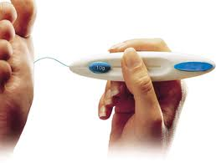
Sensation screening
Evidence does not support the use of clinical examination for sensation screening.
Monofilaments are the “gold standard.”
10g (5.07) monofilament is used in the diabetes population.
diaped.co.uk

Slide 6
Patient Education
Outside flap
Inside flap

Slide 7
Questions?

