Slide 1
An Overview of Aquatic Physical Therapy
Kathryn H Pegg, UNC DPT 2012
The majority of the content within this presentation is in the “notes” section at the
bottom of each slide.

Slide 2
Objectives
Understand the basic properties of water and how these properties are the foundation for aquatic physical therapy techniques.
Identify specific aquatic physical therapy techniques.
Create a plan of care utilizing aquatic physical therapy for an orthopedic or neurological patient.
Identify and synthesize current research related to the eligibility of a patient for aquatic physical therapy and subsequent transfer of that patient from water-based therapy to land-based therapy.
Understand reimbursement for aquatic physical therapy.

Slide 3
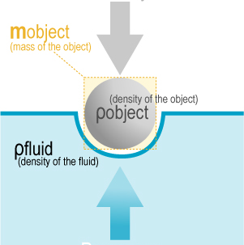
Properties of Water
Buoyancy
GRAVITY
=
BUOYANCY
Notes:
The density of the human body is less than that of water. For this reason, the body is forced upward when placed in water.¹ Likewise, increased water depth creates increased water density and therefore an increased upward moment on the body, otherwise known as buoyancy.¹
Buoyancy is an effective tool for aquatic physical therapy for two main reasons:
1) Buoyancy allows the body to be un-weighted as compared to the body’s weight on land. Have you ever heard of body weight supported treadmill exercises for patients post stroke? A similar goal can be achieved in the water. The patient will experience decreased weight bearing through the joints secondary to buoyancy. Orthopedic patients who have weight bearing restrictions can use the water as a safe environment to perform exercises without overloading the affected joint. Lastly, morbidly obese patients may benefit from the decreased strain of body weight felt in the water secondary to buoyancy. When a therapist works with a morbidly obese patient, he/she may find that the buoyancy of water allows him/her to have better control of the patient’s extremities. The patient may also be safer in the water because of decreased falls risk.
2) Buoyancy can increase or decrease the difficulty of exercise. For example, walking or running in the water is easier in deeper water because the patient experiences more buoyancy. Therefore, therapists can provide graded progression of exercise from deeper to shallower water as the patient improves over time.
Caption: The first picture demonstrates the relationship between gravity and buoyancy that allows the body to experience decreased mass as demonstrated in the second picture.
(picture on left adapted from http://en.wikipedia.org/wiki/Buoyancy, picture on right from http://www.visualphotos.com/image/2x3519390/woman_in_bikini_floating_in_pool)

Slide 4
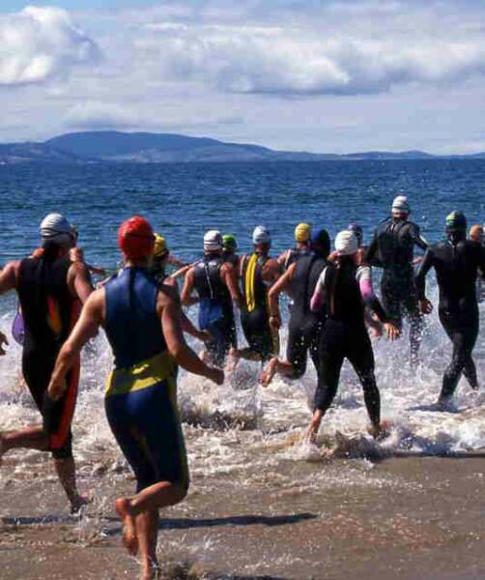
Properties of Water
Viscosity
The viscosity of water leads to an increased Moment of Inertia compared to on land.
Notes:
Viscosity is defined as “the magnitude of internal friction specific to a fluid during motion.”¹ With increased speeds of movement, the body must negotiate increased water viscosity. Likewise, with decreased speeds of movement, the body does not have to negotiate as much water viscosity. This property of water allows for a unique way to progress patients during the POC. In the water, more speed requires a greater increase in muscle activation as compared to on land.
The Moment of Inertia is the amount of resistance on an object when it is slowing down or speeding up.¹ In the water, the body experiences a greater moment of inertia than on land due to the increased viscosity of water compared to air. In other words, the individual must exert more energy to speed up, slow down, and to change the direction of a moving body part in the water. This quality of water is beneficial to therapy because it requires greater muscle co-activation while also providing a more challenging environment for quick open-chain and closed-chain activities.
Caption: Have you ever run from the beach into the ocean? Have you noticed that once you enter the ocean, it is harder to run? It becomes harder to force one leg in front of the other because of the increased viscosity of the water compared to on land. This increased water viscosity creates more drag and therefore requires more muscle activation!
(picture from http://www.active.com/triathlon/Articles/3-Drills-for-Open-Water-Swimming.htm)

Slide 5
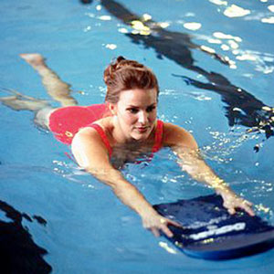
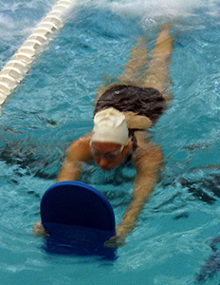
Properties of Water
Drag
Vs.
Notes:
Drag is an important tool for aquatic physical therapy because it can make an exercise more difficult for a patient. For example, when performing walking in the water, a patient wearing a bathing suit will experience less drag than a patient wearing a big t-shirt and shorts. The patient in the big t-shirt and shorts will have to work harder to walk the same speed as the patient wearing the bathing suit.
Caption: The position of the kick board in the first picture is more streamlined and therefore causes less drag than demonstrated with the position of the kickboard in the second picture. Which swimmer do you think is working harder?
(left picture from http://www.realbeauty.com/health/fitness/water-workouts-2, right picture from http://www.finisinc.com/blog/drills/working-the-legs-with-tombstone-kicking)

Slide 6
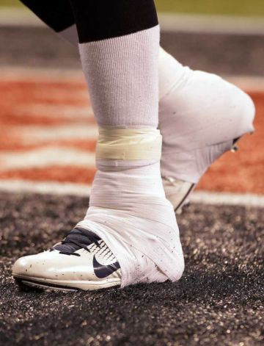
Properties of Water
Hydrostatic Pressure
Vs.
Notes:
Hydrostatic pressure has the ability to aid in resolving edema of injured extremities.¹ Sue Falsone, PT, ATC of the Los Angeles Dodgers uses hydrostatic pressure to relieve edema after ankle injuries in her baseball players.² Sue asks the players go into the deepest part of the pool (approximately 12 feet deep) and perform “bobs” up and down from the bottom of the pool (up to breathe and back down to the bottom). The environment provides hydrostatic pressure to the ankle while the movement requires a pumping action of the ankle which further promotes a decrease in edema. Hydrostatic pressure is greater at increased water depths. Therefore, the aquatic environment provides a symmetrical pressure gradient with standard units that is difficult to achieve on land.
Have you ever noticed that sometimes it is harder to breathe when standing in deep water? The increased difficulty is due to the effects of hydrostatic pressure on the lungs and on the diaphragm.⁴ Because of this phenomenon, the water may be an appropriate environment to challenge cardiopulmonary patients (particularly patients with obstructive pulmonary disease) and to practice diaphragmatic breathing exercises.⁴ Similarly, researchers have found that immersion in water to the level of the xiphoid process causes an increase in hydrostatic pressure within the lower extremities, which elicits a 58-70% increase in pulmonary capillary volume.^{4, 7}
Caption: The hydrostatic effects of water on the ankle have the potential to act similarly to an ace bandage on land.² The water does not posses qualities of restriction, as does an ace bandage. The lack of restriction allows the ankle to perform more dynamic movements while maintaining pressure. Cold water temperatures may also assist in promoting decreased edema.
(picture on left from http://www.prweb.com/releases/hydroworx/worldseries/prweb1523964.htm, picture on right from http://galleries.buffalonews.com/photo.php?gname=gallery_1328466832.txt&item=2)

Slide 7
The Aquatic Environment for Orthopedic Conditions
Buoyancy decreases stress through weight bearing joints
Warm water decreases muscle tension/aides in muscle extensibility
*Hydrostatic pressure challenges cardiovascular endurance during non-WB stages of recovery
Hydrostatic Pressure decreases edema and increases joint stability
Water viscosity and drag increase the difficulty of exercises
Water viscosity creates increased time for correction of balance errors, therefore patient may have decreased fear of falls
Notes:
Buoyancy allows for decreased stress through weight bearing joints. The amount of stress reduction depends on the water depth.
*Refer to evidence table on the Effects of Running in Water versus Running on Land for an explanation of the metabolic effects of exercise in the water versus the metabolic effects of exercise on land.

Slide 8
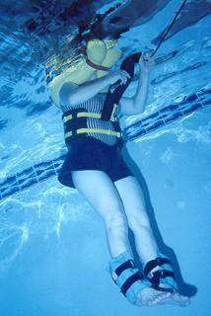
The Aquatic Environment for Orthopedic Conditions
The aquatic environment can have a pain reducing effect
The patient can begin interventions earlier; for example a patient that is partial weight bearing can begin ambulating earlier in the water. Likewise, a patient with COPD can receive soft tissue massage to his or her back without having to lie in prone.
The therapist has the ability to access the patient from a multi-dimensional perspective, which allows improved access for the following:
PNF Techniques
Joint Mobilizations
Muscle Energy Techniques
Soft Tissue Massage
Traction
Manual Stretching
Notes:
Pain reduction in the aquatic environment may be achieved by multiple factors including the relief of muscle tension, the thermodynamic effects of water temperature, or the gate control theory. The gate control theory suggests that by stimulating the skin at the site of pain, sensory receptors may override the signals sent by the pain receptors. The gate control theory is thought to play a major role in the analgesic effects of therapeutic electrical stimulation.
Along with improved access to the patient’s entire body, the therapist may also benefit from the buoyancy of the patient’s body because it will decrease the physical strain on the therapist during the above listed interventions.
Traction can be easily performed by providing the patient with UE or cervical floats and by placing the patient upright in deep water. Further traction can be achieved by placing weights around the patients ankles or hips.
Caption: If you look closely, the patient in this picture is wearing floating devices around her neck and has weights around her ankles, creating traction through her axial skeleton.
(Picture from http://www.aquaticcare.net/bigact11.htm)

Slide 9
The Aquatic Environment for Neurological Conditions
Decreased Fear of Falls
Increased time for correction of balance errors
Sensory Integration
Pain Reduction
Decreased Weight Bearing
Control of Tone and Spasticity
Psychological Effects
Notes:
The aquatic environment is a wonderful setting for patients who are at increased risk for falls. The increased time for correction of balance errors is due to the increased viscosity of water as compared to on land, which makes it take longer to get from point A to point B.⁴ A good way to think about this concept is to imagine that you are diving into a pool… what happens? The water eventually slows you down. The increased time for the correction of balance errors helps patients to get over their fear of falling. After getting over this fear, the patient may participate more willingly in aquatic balance interventions which can translate to improved balance on land.⁴ Many aquatic physical therapy techniques use manual turbulence of the water to increase balance challenges and promote increased use of the ankle, hip, and stepping strategies.⁴
The water is the perfect environment to incorporate sensory integration, a common intervention for diagnoses such as autism spectrum disorders, complex regional pain syndrome, and hemiplegia secondary to CVA. Although symptoms of autism vary along the autism spectrum, many children born with autism are considered to be “sensory seeking”. The hydrostatic pressure of water provides a whole-body input to these patients which is often calming and may improve the patient’s behavior outside of the water. Sensory integration is also an appropriate intervention for patients with abnormal postural control. The sensory stimulation of hydrostatic pressure, water temperature, and viscosity sends increased afferent input to the brain and promotes postural awareness.⁴ Susan Falsone, PT, ATC for the Los Angeles Dodgers, uses the aquatic environment to promote opening up of the anterior chest and proper alignment of the shoulders in her baseball players.
Pain reduction in the aquatic environment may be achieved by multiple factors including the relief of muscle tension, the thermodynamic effects of the water temperature, or the gate control theory. The gate control theory suggests that by stimulating the skin at the site of pain, sensory receptors may override the signals sent by the pain receptors. The gate control theory is thought to play a major role in the analgesic effects of therapeutic electrical stimulation.
Researchers have found a reduction in tone and in spasticity of patients with SCI after participation in aquatic therapy. Specifically, researchers have found that when compared to matched controls, patients receiving aquatic therapy interventions in adjunct to standard therapy on land required significantly less oral baclofen intake than the control patients who received only standard therapy on land.^{4,8} Oral baclofen is a medication that is often used to decrease tone.
The aquatic environment has the potential to promote beneficial psychological effects such as increased confidence secondary to the ability to participate in certain activities which are impossible on land. For example, patients with neurological conditions such as diplegic CP, CVA, or SCI may be able to walk in the water although they may be unable to walk on land.

Slide 10
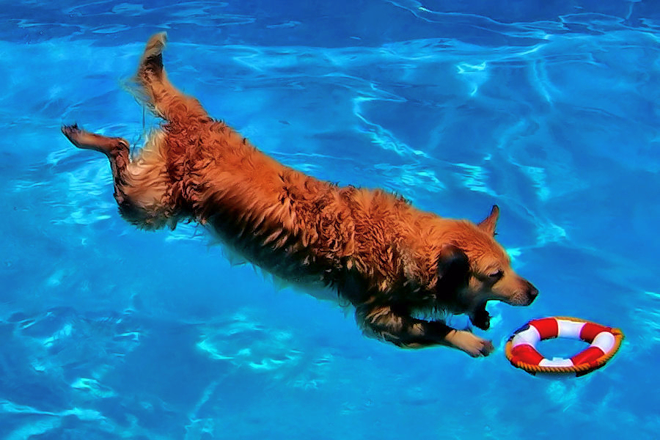
Aquatic Physical Therapy Techniques

Slide 11
The Halliwick Method
Main concepts:
Water provides impedance. When a patient loses balance in the water he/she has increased time to react compared to on land.⁴
Rotational torques are created by the interaction between gravity and buoyancy, termed metacentric effects. These torques can be used to manipulate targeted connective tissues.⁴
The buoyancy of water provides an easier way to change position as compared to on land, which can have a positive impact on the vestibular system.⁴

Slide 12
The Halliwick Method
The Halliwick Method focuses on movement around a particular axis as opposed to movement in a particular plane.⁴
The link below illustrates the following:
1. How closed chain rotation of the left hip can be facilitated by trunk stability and movement of the right hip.
2. How one can perform active movement of the right hip with isometric contractions of the left hip. These exercises would be helpful for a patient with OA of the left hip.
http://www.youtube.com/watch?v=MhGLrkPmP7Q&feature=related
Notes:
The official Halliwick program promotes a graded increase in activity challenges, in mechanical impact, and in physiological demands.⁴ The method emphasizes proper respiratory function as well as the stability and mobility of targeted joints.

Slide 13
The Halliwick Concept
The following clip demonstrates how stabilization of the shoulder complex can be achieved through movement of the trunk and of the lower extremities. This would be an appropriate functional intervention for a gymnast returning to sport after complications caused by shoulder instability. This intervention can be made more difficult by decreasing the water depth.
http://www.youtube.com/watch?v=WSyFk6vA&list=UUDCfEUe3lkn3zeOzyNhWX3Q&index=10&feature=plcp

Slide 14
Ai Chi
The main goal of Ai Chi is to achieve increased range of motion and mobility through exercise and relaxation.⁴
Ai Chi is described as slow, rhythmic, and fluid, with a strong emphasis on diaphragmatic breathing techniques.⁴
Ai Chi promotes balanced and centered body movements, as one foot is planted on the bottom of the pool at all times (very similar to Tai Chi).⁴
Particular patient populations which may find Ai Chi beneficial include patients with fibromyalgia and multiple sclerosis (MS).

Slide 15
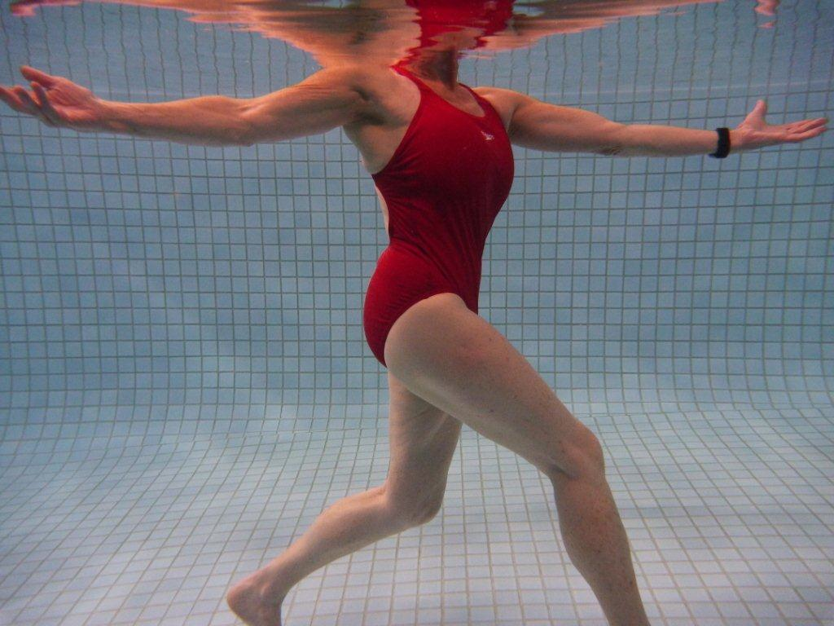
Ai Chi
The following video is a demo of an Ai Chi exercise session. Notice how the exercises are performed slowly and how the participant has one foot planted on the bottom of the pool at all times. Focusing on stability, ROM, and relaxation can be very affective for patients with MS. Patients with MS often exhibit heat intolerance, so the temperature of the pool must be controlled.
http://www.youtube.com/watch?v=anplxTKNIHI&feature=related

Slide 16
The Bad Ragaz Ring Method
The Bad Ragaz Ring Method is a resistive aquatic physical therapy technique that focuses on the chain reaction that occurs between joints; the direction, velocity, and intensity of movements in one joint influences neighboring joints to create a pattern of continuous movement.⁴
In Bad Ragaz, equilibrium is achieved in one of two ways:
Active Counterforce (Thrust): The patient elicits a counteractivity to stop the continuous movement.
Activated Passive Counterforce: The patient uses parts of his or her own body to restrict continuous movement.

