Slide 1
The Bad Ragaz Ring Method
Notes:
The above excerpt was taken from Aquatic Exercise for Rehabilitation and Training by Lori Thein Brody and Paula Richley Geigle.⁴
Active counterforces are the main focus for therapeutic exercise.⁴

Slide 2
The Bad Ragaz Ring Method
Proprioceptive Neuromuscular Facilitation (PNF) techniques can be incorporated into the Bad Ragaz method.⁴
The “ring” component of Bad Ragaz refers to the use of floatation devices to help stabilize the body in the water. Floatation devices are placed around the patient’s neck and hips (at approximately S2) and sometimes around the patient’s, ankles depending upon the exercise.⁴
Exercise progression can be achieved through increasing ROM, moving handholds from more proximal to more distal, increasing the speed of motion, lengthening the body’s lever arm, using equipment to increase drag, and by using less air in floatation devices.⁴
Notes:
PNF is defined as “a method of promoting or hastening the response of the neuromuscular mechanism through stimulation of the proprioceptors.”^{4,9} PNF techniques involve refined hand placements to stimulate certain neuromuscular movement patterns.

Slide 3
The Bad Ragaz Ring Method
This video demonstrates how the Bad Ragaz Ring Method can be used in conjunction with PNF patterns of the UE’s in order to promote neuromuscular facilitation of agonist and antagonists in non-synergistic patterns. From the point of view of the therapist, this method may take a lot of strain off of the therapist’s body as compared to repetitive PNF on land.
http://www.youtube.com/watch?v=DXPDXvKSH5o

Slide 4
The Bad Ragaz Ring Method
This video demonstrates how a patient may use trunk extension, rotation, and lateral flexion to promote continuous movement in the water. The therapist’s point of stability forces movement around a long lever arm, making the exercise more challenging for the patient. This exercise would be appropriate for a patient with non-structural scoliosis.http://www.youtube.com/watch?v=8ZNVyBfvT18
Notes:
Non-structural scoliosis involves a reversible lateral curvature of the spine, as compared to a structural scoliosis which is an irreversible curvature of the spine.¹⁰

Slide 5
Watsu
Watsu is similar to Ai Chi in that it promotes flowing movement patterns in coordination with proper breathing techniques.
The method is meant to be performed in warm water (90 to 94 degrees F) in order to achieve a relaxing effect.⁴
The patient is positioned in supine or sitting while being rhythmically moved through specific patterns to promote increased ROM, increased flexibility, reduced muscle guarding, and reduced muscle spasms.⁴
Notes:
It must be noted that in order to document that you performed “Watsu,” a certification is required. Watsu is the only technique described in this module that currently requires a special certification.
Components of Watsu can be performed as part of the warm-up or warm-down during an exercise session.

Slide 6
Watsu
Watsu has been shown to have a positive effect on the following conditions:
Orthopedic: Restricted ROM, weakness, guarding, pain, and edema.⁴
Neurological: Spasticity, hypotonicity, restricted ROM, weakness, and deconditioning.⁴
Patients who suffer from psychological issues associated with chronic physical disability may experience “calming of the nervous system, improvement in circulation and breathing, and enhanced overall relaxation.”⁴ Patients also report a decrease in signs and symptoms of general anxiety.⁴

Slide 7
Watsu
This video features a typical Watsu session. Notice how both the patient and the therapist are relaxed, allowing the patient’s body to flow from position to position. This technique is very intimate and requires a professional relationship between the therapist and the patient.
http://www.youtube.com/watch?v=55GG44KK3x4&feature=related
Notes:
Caption: Watsu is often used with pregnant women to promote relaxation and to reduce pain from childbearing.
(Picture from http://www.energyflowing.com/watsuphotos.html)

Slide 8
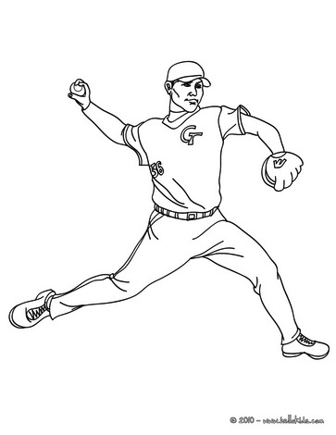
Orthopedic Case
Meet Jacob….
Jacob is a 27 year old right-handed minor league baseball pitcher who presents with right anterior shoulder pain secondary to impingement and GIRD (glenohumeral IR dysfunction). Jacob’s right shoulder is elevated and forward compared to his left. Jacob also presents with a forward head, rounded shoulders, decreased cervical lordosis, and an anteriorly tilted pelvis.
Notes:
Key points to keep in mind…
1) GIRD occurs often in baseball pitchers secondary to the extreme ER motion and forward moment placed on the glenohumeral joint. Over time, the glenohumeral head may sit anteriorly in the socket due to shortening of the anterior shoulder muscles/IR’s while the posterior shoulder musculature may experience degeneration due to the extreme wear and tear of the eccentric deceleration phase required of the ER’s during the baseball pitch. The posterior joint capsule may become extremely tight which further pushes the head of the humerus anteriorly within the glenoid cavity. Both the IR’s and the ER’s may become weak due to an abnormal length-tension relationship.¹⁹ An anterior and elevated position of the humeral head may increase anterior subacromial impingement.
2) When the pelvis is tilted anteriorly, the abdominals are placed at an abnormal length-tension relationship. Therefore, the abdominals may be weak and the pitcher may not be reaching the full potential of his core muscles to increase pitch force. Weakness of the abdominals may cause the pitcher to rely more on force from his upper extremity.
(Picture from http://www.hellokids.com/c_21882/coloring-page/sport-coloring-pages/baseball-coloring-pages/baseball-pitcher-coloring-page)

Slide 9
Orthopedic Case
Components of a Possible Aquatic Exercise Program for Jacob…
Shoulder Stability
Shallow water (2-3 ft) walking on hands with body parallel to water’s surface
Standing, palm down on kick board, push board down in water (shoulder retraction/depression)
Manual therapy to anterior shoulder musculature in warm water
Posture Training
Prone (with snorkel) IR/ER with tactile cues for peri-scapular activation
Exercises with back against wall or physical turbulence applied to peri-scapular muscles
Notes:
*There are MANY varying aquatic exercise programs that could be created for Jacob. The above example only shows a select few. That being said, what other components, besides those listed on the previous slide, would you have wanted to evaluate in order to create a more thorough problems list for Jacob?
Shoulder stability exercises may be enhanced in the water by allowing the patient to support his or her body weight in the water while controlling body movements on the wall or surface of the pool with his or her upper extremities. Shoulder depression of a kick board into the water not only requires the patient to keep the shoulder down and back, but the exercise also requires dynamic stability of the shoulder to prevent the board from slipping beneath the patient’s hand.
Manual therapy to the anterior shoulder musculature performed in warm water may help to elongate the anterior shoulder musculature and to improve both the length tension relationship of the surrounding muscle and the position of the humeral head in the glenoid cavity.
Posture training may be enhanced in the water due to the increased sensory input of the water which encourages the patient to open up the chest musculature. By positioning the patient prone in the water (with floatation devices and snorkel) the therapist has manual access to the patient’s posterior shoulder musculature and the anterior chest wall/shoulders are pushed posteriorly by buoyancy. By re-positioning the patient with floatation devices, AROM, PROM, AAROM, and resisted ROM can be achieved. The patient may perform ROM exercises with his back against the wall in order to stabilize the scapula and promote use of the peri-scapular musculature. Similarly, the therapist may provide the patient with physical turbulence to the posterior scapular stabilizers in order to promote tonic activation during functional exercises.

Slide 10
Neuro Case
Meet Jessica…
Jessica is a 35 year old female who has recently been diagnosed with relapsing and remitting multiple sclerosis (MS). Jessica went to see a neurologist after suffering from a fall at school where she is a 4th grade teacher. Signs and symptoms leading up to her diagnosis included loss of sensation in bilateral lower extremities, decreased strength and motor control in bilateral lower extremities, heat intolerance, and extreme fatigue. Since the diagnosis, Jessica is feeling better and only has slightly decreased strength (4/5 gross LE) but still experiences heat intolerance and fatigue. What would be an appropriate aquatic exercise program for Jessica?
Notes:
Key points to keep in mind….
1) Research has shown that patients with MS who participate in aerobic exercise and strengthening programs when they are NOT having exacerbations show decreased severity of exacerbations, an increased rate of recovery post exacerbations, decreased fatigue, improved ambulation, and increased quality of life.^{11,12,13}
2) Heat intolerance is an obstacle which discourages many patients with MS from exercising. Due to the increased conductance of water compared to air, controlling the temperature of the water is key for the success of aquatic exercise in patients with MS. If the water is too warm then the patient may experience symptoms of heat intolerance, but if the water is too cold then the patient may experience increased spasticity.¹³ The Aquatic Physical Therapy Section of the APTA suggests that patients with MS may benefit from water temperatures between 82 and 88 degrees F, but between 92 and 96 degrees F for patients with increased tone or spasticity. Ultimately, the temperature of the water depends on the patient and on the type of activity that will be performed in the water (cooler water for vigorous exercise, warmer water for relaxation).
3) Due to the symptoms of chronic fatigue, it is important that the patient be taught methods of energy conservation and that her exercise program incorporate appropriate amounts of rest along with a controlled progression.¹³
(Picture from http://www.arthursclipart.org/people/people/page_07.htm)

Slide 11
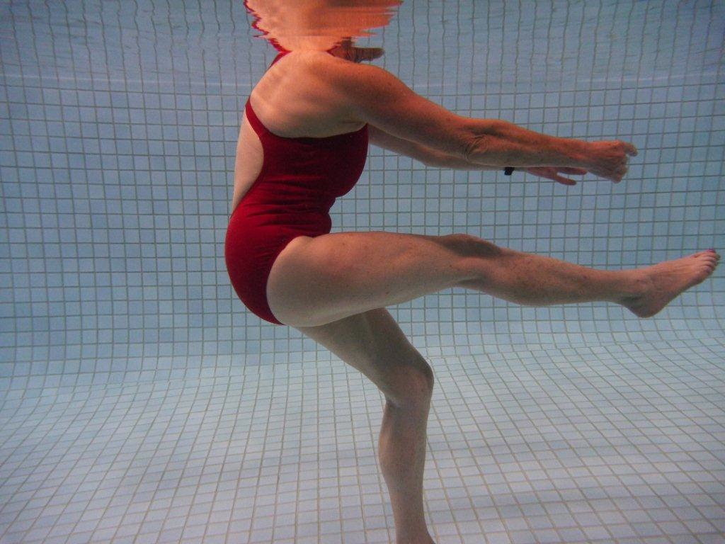
Neuro Case
Components of a Possible Aquatic Exercise Program for Jessica…
Balance Program
Ai Chi
Strengthening Program
LE Strengthening with resistive equipment (functional step ups)
UE Strengthening with resistive equipment (paddles, weights)
Bad Ragaz Ring Method (trunk stability)
Graded Walking Program
Build Endurance
Sensory Integration
Motor Control
Notes:
Jessica should participate in aquatic therapy 3-4 times per week and land exercise 2-3 times per week. The above program is a SUGGESTED program but there are many other similar aquatic programs that would benefit Jessica. What other components, besides those listed on the previous slide, would you want to evaluate in order to create a more thorough problem list for Jessica?
Strengthening Program:
LE Strengthening exercises may include functional step ups (front and side to side). The step up may be progressed over time using water depth, speed, intensity, and frequency. The step ups may be made more functional by asking Jessica to perform dual tasks such as saying the ABC’s backwards while doing the step ups, or by holding a cup of water while performing step ups. LE strengthening may also include hip flexion, hip extension, and hip abduction with the use of ankle weights or floatation devices for graded progression.
UE Strengthening may include the use of resistive paddles or weights during water walking and during step up exercises, as well as over-head lifting exercises to emulate classroom activities. Jessica may feel more comfortable performing overhead lifting activities in the water because if she drops the objects, she will not have to worry about the consequences. Also, Jessica can practice improved biomechanics during lifting with the aid of proprioceptive input from the water. Jessica may perform UE strengthening exercises with her back against the side of the pool to further encourage proper biomechanics (input of wall on periscapular musculature promotes shoulder stabilization).
Jessica may benefit from the Bag Ragaz Ring method to address trunk stability (as featured in video link earlier in PPT). Increased trunk stability will aid Jessica in the future as she experiences variable degrees of weakness in the extremities.
Walking Program:
Jessica may benefit from a graded walking program, beginning in deeper water (less body weight due to buoyancy) and progressing to decreased water depth over time. Jessica’s walking program should also be progressed in terms of duration, intensity, and frequency, as would a walking program on land. Jessica may appreciate walking in the aquatic environment not only due to the decreased heat intolerance, but also due to the decreased risk of falls and the increased sensory input of the water (beneficial considering that she has a loss of sensation in bilateral LE’s).
(Picture from http://www.fusionphysiotherapy.com.au/aichi.asp)

Slide 12
When should the patient be transitioned back to land-based therapy?
The Initial Evaluation is performed on land and goals are established for function on land.
Once the land goals are established, another set of goals for water can be established to directly enhance the patient’s progress towards the land goals.
Both land and water goals should be assessed regularly.
Discharge from the water may be dependent upon the patient’s progress towards goals on land and in the water and is unique for each patient and for each patient diagnosis.
Notes:
The information in the above slide was obtained from a presentation at CSM (2012) by Yasser Salema and Ellen Goodwin.¹⁵
Also, if after approximately two weeks the pt. is NOT making progress towards the established goals on land, he or she should be re-assessed and may be discharged from aquatic therapy.¹⁶

Slide 13
Reimbursement for Aquatic Physical Therapy
Medicare will generally only reimburse for one-on-one and NOT for group aquatic therapy.
Medicare/Medicaid will allow a private practice to rent a specific portion of a community pool for aquatic physical therapy purposes (May 7, 2008).
The Aquatic Therapy billing code (97113) is the ONLY code used to bill for aquatic therapy.
Patient’s may be denied coverage if the documentation is inadequate to justify the patient’s need or if the third party payer globally denies all reimbursement for aquatic physical therapy (in which case, the payer should be educated on the current research supporting the beneficial effects of aquatic therapy).
Notes:
The information in the above slide was obtained from the Aquatic Therapy Section of the APTA.¹⁸
Although the “Aquatic Therapy” billing code (97113) is only the 14th most popularly used code in physical therapy practice, making up less than 1% of all codes used, reimbursement for the “Aquatic Therapy” billing code is over 1%, at 1.75% (in 2006). This statement shows that the “Aquatic Therapy” code has a higher reimbursement rate than many other commonly used codes.¹⁷
According to Safety Standards established by The Aquatic Therapy and Rehab Institute, therapists should not be allowed to be in the water treating patients for more than four continuous hours per day.¹⁸

Slide 14
Indications and Contraindications
Contraindications
Indications
Bowel Incontinence
Open Wound/Colostomy, Tracheotomy, G-Tube
Uncontrolled Hyper/hypotension
Autonomic Dysreflexia
Uncontrolled Seizures
Pain and Edema Control
Gait Training/WB Precautions
Strength/Coordination
Balance and Posture Training
Relaxation/ROM
Sensory Integration
Recreation/Participation
Aerobic Capacity
Notes:
The above lists were obtained from Debbie Thorpe’s “Aquatic Intervention” lecture presented in Kinesiology.

Slide 15
Precautions
Significant Cognitive Impairment
Vertigo/nausea
Incontinence
Ear infections
Hearing aides
Contact lenses
Behavior problems
Fear of water
Chlorine sensitivity
Small open wounds
Abnormal BP
Angina
Uncontrolled Diabetes
IV lines, heplocks
NG tubes
MS
Absence of cough
Notes:
The above precautions were obtained from Debbie Thorpe’s “Aquatic Intervention” lecture presented in Kinesiology.

Slide 16
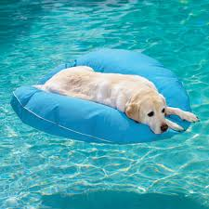
In Conclusion…
The aquatic environment is an incredibly under-utilized setting for physical therapy!
Knowledge about the beneficial qualities of the aquatic environment will help therapists provide optimal care for their patients.
The aquatic environment can be utilized in many capacities for specific patient populations.

Slide 17
Resources
Aquatic Therapy Section of the APTA (www.apta.org)
Aquatic Therapy University
http://www.aquatic-therapy-university.com/
ActiveForever.com (Aquatic Therapy Equipment)
http://www.activeforever.com/c-16-aquatic-fitness.aspx
Isokinetics, Inc. (Aquatic therapy Equipment)
http://www.isokineticsinc.com/category/Aquatics

Slide 18
References:
1) Tracy A Dierks, Kurt T Manal, Joseph Hamill, and Irene Davis. Lower Extremity Kinematics in Runners with Patellofemoral Pain during a Prolonged Run. Medicine and Science in Sports and Exercise, 2011 Vol. 43, No. 4 Pg. 693-70
2) Sue Falsone PT, MS, SCS, ATC, CSCS, COMT, Integrated Performance Training Using the Water for the Overhead Athlete, Combined Sections Meeting 2012: Chicago, Feb 8-11, 2012
3) Kathryn H Pegg, For female runners between the ages of eighteen and thirty with patellofemoral pain who are attempting to make a return to sports, does a combined program of running in water and running on dry land decrease the prevalence of re-injury more so than a program of solely running on land? Fall, 2011, EBP
4) Lori Thein Brody and Paula Richley Geigle, Aquatic Exercise for Rehabilitation and Training, Copyright 2009 by Lori Thein Brody and Paula Richley Geigle
5) Beth Ennis, PT, EdD, PCS, ATP, Using Aquatic Therapy to Treat Children with Autism Spectrum Disorders, CSM Chicago, 2012
6) By Andrea Bates, Norm Hanson, Aquatic Exercise Therapy, Copyright 1996 By Saunders
7) H. Lollgen, G V Nieding, R Horres, Respiratory and Hemodynamic Adjustment During Head Out Water Immersion, Int J Sports Med 1980; 01(1): 25-29
8) Kesiktas, The Use of Hydrotherapy for the Management of Spasticity, Neurorehabil Neural Repair, 2004 vol. 18 no. 4 ph. 268-273
9) Knott and Voss, Proprioceptive Neuromuscular Facilitation: Patterns and Techniques, Copyright 1968 by Hoeber Medical Edition, Harper and Row, NY
10) Susan B. O’Sullivan, National Physical Therapy Examination Review & Study Guide 2012 Edition

Slide 19
References:
11) Dr Jack H. Petajan MD, PhD E,duard Gappmaier PhD,, Andrea T. White PhD, Mark K. Spencer PhD, Lizbeth Mino MS, Richard W. Hicks PhD, Impact of aerobic training on fitness and quality of life in multiple sclerosis, Annals of Neurology, 1996, Vol. 39 No. 4, pages 432–441, 1996
12) LJ White, SC McCoy,, V Castellano, G Gutierrez1, JE Stevens, GA Walter, and K Vandenborne, Resistance Training Improves Strength and functional Capacity in Persons with Multiple Sclerosis, Multiple Sclerosis, 2004;10;668
13) U Dalgas, E Stenager, and T Ingermann-Hansen, Review: Multiple sclerosis and physical exercise: recommendations for the application of resistance-, endurance- and combined training, Mult Scler, 2008 vol. 14 no. 1 35-53
14) Roehrs, Tammy G. MA, PT, NCS; Karst, Gregory M. PhD, PT Effects of an Aquatics Exercise Program on Quality of Life Measures for Individuals with Progressive Multiple Sclerosis, Journal of Neurologic Physical Therapy, 2004, Issue: Volume 28(2), p 63–71
15) Yasser Salema and Ellen Godwin, Aquatic Therapy for Individuals with Neurological Disorders, PPT, Combined Sections Meeting 2012 Chicago Illinois Feb. 8-11, 2012
16) Establishing an Acceptance and Discharge Criteria for Aquatic Therapy, May 23, 2011. http://www.aquatictherapist.com/index/2011/05/establishing-an-acceptance-and-discharge-criteria-for-aquatic-therapy.html, Excerpt From “How to Successfully Launch an Aquatic Therapy Practice” Accessed March 2, 2012
17) How frequently is aquatic therapy billed to Medicare Part B? Answers to statistical questions about aquatic therapy use, November 07, 2009 http://www.aquatictherapist.com/index/2009/11/how-frequently-is-aquatic-therapy-billed-to-medicare-part-b-answers-to-statistical-questions-about-a.html, Accessed March 2, 2012
18) Aquatics Physical Therapy Section, American Physical Therapy Association, Copyright 2012 by the Aquatic Physical Therapy Section. http://www.aquaticpt.org/about-aquatic-physical-therapy.cfm, Accessed March 2, 2012
19) Goerge Davis, Robert Manske, Todd Ellenbecker, and Kevin Wilk, Glenohumeral Internal Rotation Deficit (GIRD): The Thrower's Demise, CSM Chicago, 2012

