Slide 1
Dance Injury Prevention
Katie Volkerding, SPT
2012 DPT Capstone Project
University of North Carolina at Chapel Hill

Slide 2
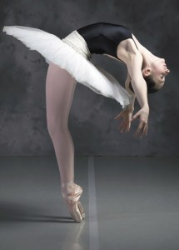
Presentation Objectives
Understand the prevalence of overuse dance injuries and common injuries among dancers
Demonstrate an understanding of both intrinsic and extrinsic risk factors for overuse dance injuries
Have a better understanding of biomechanical risk factors to consider when screening for risk of injury
Learn ways to develop effective injury prevention programs

Slide 3
Outline
Injury Prevalence
Common Overuse Injuries
Extrinsic Risk Factors
Intrinsic Risk Factors
Physical Fitness
Supplemental Training
Examination Recommendations
Injury Prevention Recommendations
Conclusion

Slide 4
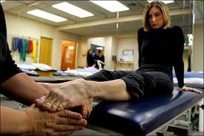
Prevalence of Injuries in Dancers
Prevalence rates 67-95% (Fuhrmann et al, 2010)
1/2 of all professional dancers report a chronic injury (Fuhrmann et al, 2010)
Dance schools report up to 77% adolescents injured in academic year
Majority of injuries are overuse
60-75% (Thomas & Tarr, 2009)
Most of these occur in LE
(Gamboa et al, 2008)
Notes:
Majority of studies report prevalence of professional dancers in 80% range.

Slide 5
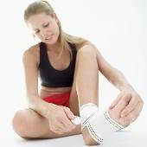
Common Overuse Injuries
Low Back Pain
Iliopsoas Tendinitis (“Snapping” hip)
Patellofemoral Pain
Stress Fractures
Tibia
Fibula
Metatarsals
Foot/Ankle Tendinopathies
Achilles
Flexor Hallucis Longus
Posterior Tibialis
(Solomon et al, 2000)
Notes:
LBP: hyperlordotic posture, excessive lumbar extension, improper turnout position increases anterior pelvic tilt and lumber lordosis
Iliopsoas Tendinitis: result of repetitive hyperflexion, hyperextension movements at the hip
Patellofemoral Pain: may be affected by increased Q angle (greater than 15 deg), tight hamstrings, IT band, patellar hypermobility
Patellar tendinitis (jumper’s knee) also due to repetitive jumping movements
Stress Fractures: overuse; nutrition important for bone health
Achilles: excessive pronation/supination; pronation “whipping effect”, training errors, not getting heels down to stretch Achilles during quick jumps
FHL: Usually female ballet dancers due to pointe work (excessive plantar and dorsiflexion); serves as accessory push off muscle
Post Tib: overpronation

Slide 6
Extrinsic Injury Risk Factors
Training Errors (Macintyre & Joy, 2000)
Consider class, rehearsal, performance schedule
Sudden increase in intensity, duration, or frequency
Failure to allow adaptation to new training levels
Floor Surface
“Sprung” vs. hard floor (Hackney et al, 2011)
Jumper’s Knee (Solomon et al, 2000)
Footwear
Lack of support and shock absorption
Pointe shoes
Notes:
Training Errors:
Dancers should try to allow at least 1 day for rest, so body can recover. Sudden increase in training causes fatigue, more likely to get injured.
Floor Surface:
Study by Hackney et al (2011) compared the stiffness of bilateral LEs among ballet dancers performing sautés on a low-stiffness sprung floor and a high stiffness floor comprised of wood over concrete. The authors found increased stiffness in the lower extremities in the sprung floor condition, suggesting that some of the force of landing was absorbed by the sprung floor, rather than the participants themselves. This same group of researchers found similar results when dancers performed a grand jeté or leap in a different study
Dancing on hard surface compared to sprung floor has been related to increased risk of developing jumper’s knee due to body absorbing forces, little absorption from the hard floor

Slide 7
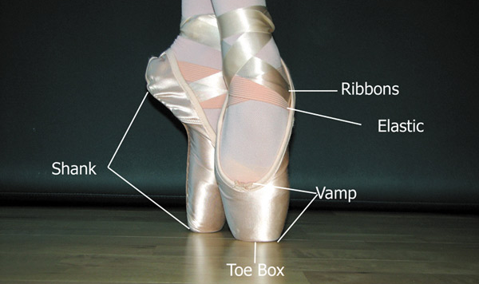
Pointe Shoes
Notes:
If dancers tie ribbons too tight around ankle, this may increase risk of Achilles tendinopathy.
Dancer needs 90 degrees plantarflexion to go en point. The majority of weight is borne by first toe while en pointe.
Need 90 degrees plantarflexion for pointe

Slide 8
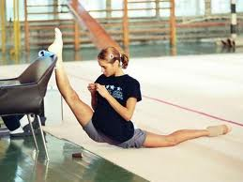
Intrinsic Risk Factors
Age
Gender
Nutritional and Hormonal Status
Biomechanical Factors
Physical Fitness

Slide 9
Age
Dancers of all ages at risk
Overuse injuries more prevalent with increasing age (Leanderson et al, 2011)
More traumatic injuries in younger dancers (Nilsson et al, 2001)
Ankle Sprains (4x greater in dancers age 26 & under)
Consider adolescent growth spurt
Muscle tightness
Notes:
Nilsson et al (2001) did retrospective study of injury reports over 5 year period of dancers aged 17-47.
During adolescent growth spurt, relative tightness in lateral quads, hamstrings, IT Band. This increases risk of patellofemoral pain

Slide 10
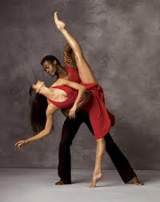
Gender
Few differences noted in adolescents
Differences noted in professional dancers
Traumatic injuries more common in males
75% of knee injuries in males
Thigh/hip injuries more common in females

Slide 11
Nutritional and Hormonal Status
Female Athlete Triad
Disordered Eating
Up to 50% in professional dancers (Hincapie & Cassidy, 2010)
Loss of muscle mass, early muscle fatigue
Menstrual Disturbances (Amenorrhea)
Lower estrogen increases risk of stress fractures (Macintyre & Joy, 2000)
Low bone mineral density (Osteoporosis)
Stress Fractures
Patient Education
Begin at a young age
Notes:
Dancing stresses thinness. Psychosocial variables should be considered.
Disordered eating and menstrual disturbances common in dancers, bone mineral density not well studied.

Slide 12
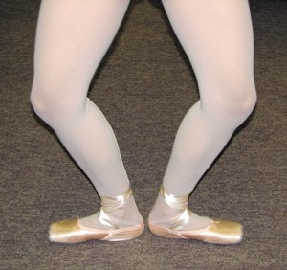
Biomechanical Factors
Dance emphasizes hip flex, ABD, ER > IR, ADD
Adaptive shortening, weakening of antagonists (Milan, 1994)
“Turn Out”
From hips down or floor up?
What happens when dancers “force” their turnout?
Low back and LE injury associated with greater “compensated” turnout (Coplan, 2002)
Notes:
Hip: Muscle imbalances
(glut med, IT Band)
Turn Out:
Coplan¹⁹ found that ballet dancers have a greater risk of injury if they assume a turnout position that is greater than their available bilateral passive hip external rotation range of motion. 30 college-level dancers participated in the study, and the comparison between each dancer’s first-position turnout and measured passive hip external rotation range of motion was called “compensated turnout”. Dancers with a self-reported history of low back or lower extremity injury had a mean compensated turnout of 25.4 degrees, compared to the non-injured dancers who had a mean compensated turnout of 4.7 degrees¹⁹.
Pronation from forcing turnout can cause difficulty as the dancer supinates her foot to go en pointe or relevé¹³.
Flexor halluces longus and tibialis posterior tendons become repeatedly overstressed, which contribute to tendinopathies.
Increased pronation correlated to Achilles tendinopathy, causes a “whipping effect” and is hypothesized to decrease blood flow to the Achilles tendon¹⁸. This whipping of the Achilles tendon would occur repeatedly as the dancer goes en pointe¹³.

Slide 13
“Rolling In”
Notes:
Not only contributes to LBP and tendinopathies in foot/ankle but to knee injury as well. Excessive pronation and “forcing” turnout leads to:
Increased Q angle and Valgus stress
Increased lumbar lordosis

Slide 14
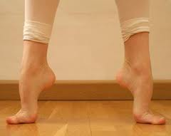
More Biomechanical Factors
Kinetic Chain Dysfunctions
Previous ankle sprains (Milan, 1994)
Asymmetry
Check functional movements (ex: relevé)
ROM
Joint Play
Muscle Imbalances
Quads/Hamstrings
Notes:
Previous ankle sprain may lead to reduced subtalar motion, leading to injury. The abnormal supination/pronation stress the tendons that stabilize the foot/ankle.

Slide 15
Physical Fitness
Aerobic Capacity
Anaerobic Capacity
Flexibility
Body Composition
Muscular Strength & Endurance
Notes:
Like all athletes, want to evaluate fitness levels in order to determine impact on injury/injury prevention.
Some studies have reported dancers’ fitness levels to be close to healthy sedentary adults! So the interest in this area has become greater in recent years.

Slide 16
Aerobic Capacity
Significant correlation between poor aerobic capacity and risk of injury (Angioi et al, 2010)
Ballet class and cardiorespiratory gains (Koutedakis & Jamurtas, 2004)
Barre work = low to moderate intensity
70-80% VO₂Max in center but only lasting ~3 minutes
Notes:
13 elite female ballet dancers, mean age 19 years, in study by Angioi et al. All participants were in a touring performance group with classes and daily rehearsals on top of their performances. The researchers collected various fitness measures including percent body fat, flexibility, vertical jump, press-up test, plank test, and the Dance Aerobic Fitness Test. These measures were collected at baseline, and injury reports were collected over the following 15 weeks. Results showed that 8 of the 13 dancers sustained overuse injuries with the majority being to the foot/ankle. Researchers found a significant positive correlation between the number of injuries sustained and the recorded heart rate at the end of the Dance Aerobic Fitness Test.

Slide 17
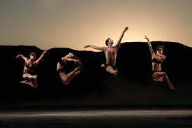
Anaerobic Capacity
Impact on injury not widely studied
Lower relative and mean power than other athletes (Kenne & Unnithan, 2008)
Jump height one of best predictors of aesthetic competence in modern dancers (Angioi et al, 2009)
Notes:
Ballet and Modern are primarily anaerobic activities
Adolescent ballet dancers demonstrate lower relative and mean power during a Wingate Anaerobic Test than basketball players of comparable age
Combination of jump height and upper body muscular endurance are best predictors of aesthetic competence in modern dancers (Angioi et al, 2009)

Slide 18
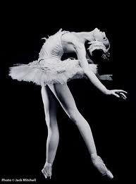
Flexibility & Body Composition
Flexibility imbalances may be problematic
Excessive joint laxity without adequate muscular support may predispose dancer to injury
Very lean dancers more prone to injury
Lower %Body Fat = longer recovery time (Angioi et al, 2010)
Female Athlete Triad
Notes:
Angioi et al (2010) significant negative correlation between the length of time a dancer modified her activity following injury and her percent body fat.

Slide 19
Muscular Strength & Endurance
Lack of strength = Increased risk of injury
Greater LE strength preseason associated with decreased risk of injury during season (Gamboa et al, 2008)
Foot/ankle injuries most common
Low back injury correlated with quad/hamstring strength ratio (Koutedakis & Frischknecht, 1997)
Lack of muscular endurance leads to fatigue, increasing risk of injury
Notes:
Gamboa et al (2008) reviewed adolescent dance medical records over 5 year period and found significant differences between injured and non-injured dancers.

Slide 20
Supplemental Training
Negative impact on aesthetic quality or performance?
Research says No
Valid measures needed
12-week intervention of aerobic and strength training beneficial to dance performance and fitness parameters among modern dance students
Koutedakis et al (2007)
Weekly 1-hr circuit and interval training for ballet dancers improved performance
Twitchett et al (2011)
Impact on injury prevention?
More research is needed!
Notes:
Dance world weary to adopt supplemental training programs for fear that they may affect dancers’ aesthetic appearance.
Studies have shown that supplemental training is effective in enhancing fitness parameters and dance performance without impacting aesthetic quality, but no research has examined correlation between supplemental training and incidence of injury.
Koutedakis et al (2007): Modern dancers (mean age 19 years) were randomly assigned to an intervention or control group. Outcome measures assessed included percent body fat, flexibility, VO₂ max, leg strength, and a dance performance test specifically designed for the study. The 12-week intervention consisted of 20-40 minutes of aerobic activity such as swimming or jogging 2-3 times per week at 70-75% age-predicted HR max. Up to three 50-min sessions of strength training were completed each week that progressed from low resistance with high repetitions to high resistance with low repetitions. Following the 12 weeks, significant improvements in dance performance, VO₂ max, leg strength, and flexibility were found within the intervention group only.
Twitchett et al (2011): examined the effects of a fitness training program on the aesthetic quality in classical ballet dancers. The intervention group underwent weekly one-hour training sessions that included aerobic interval training, circuit training, and whole body vibration. Dance proficiency was measured using a four-minute sequence, and the intervention group demonstrated a significantly greater increase overall in performance compared to the control group.

Slide 21
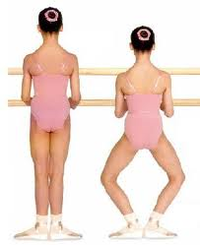
Examination Recommendations
PMH: previous injury?
Kinetic Chain Dysfunction
Assess intrinsic and extrinsic risk factors
Biomechanical Factors
Aerobic Capacity and Muscular Strength
Evaluate functional dance movements
Asymmetries
Flexibility or Strength Imbalances
Left: Demi plié in first position
Right: Relevé in first position
Notes:
(Basically summarize the info presented and put it into practical use)
Refer to pictures – common movements for dancers you would likely want to evaluate.

Slide 22
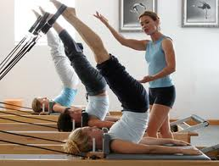
Injury Prevention Recommendations
Patient Education
Nutrition
Body Composition
Address Training Errors
Supplemental Training
Aerobic Training
Cycling
Swimming
Strength Training
Resistance Training
Pilates
Consider Training Schedule; Use caution initially to avoid overuse
Notes:
Supplemental Training 2 days/week. Better in place of dance, not in addition to training.
Running is questionable if dancer has never really run before. Want to check form before making it part of an exercise plan – don’t want to create a new injury.

Slide 23
Conclusions
Overuse injuries are common among dancers of all ages
Prevention should begin at an early age
Consider both intrinsic and extrinsic factors that contribute to injury
Supplemental training is recommended for improved performance and fitness
More research on the impact of supplemental training on injury prevention is needed

Slide 24
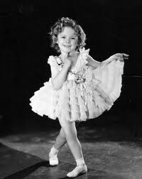
Questions??
Thank You!

Slide 25
References
Fuhrmann TL, Brayer A, Andrus N, McIntosh S. Injury prevention for modern dancers: A pilot study of an educational intervention. J Community Health. 2010;35:527-533.
Koutedakis Y, Jamurtas A. The dancer as a performing athlete: Physiological consideration. Sports Med. 2004;34:651-661.
Gamboa JM, Roberts LA, Maring J, Fergus A. Injury patterns in elite preprofessional ballet dancers and the utility of screening programs to identify risk characteristics. Journal of Orthopaedic and Sports Physical Therapy. 2008;38:126-136.
Thomas H, Tarr J. Dancers’ perceptions of pain and injury: positive and negative effects. Journal of Dance Medicine and Science. 2009;13:51-59.
Leanderson C, Leanderson J, Wykman A, et al. Musculoskeletal injuries in young ballet dancers. Knee Surg, Sports Traumatol, Arthrosc. 2011;19:1531-1535.
Nilsson C, Leanderson J, Wykman A, Strender LE. The injury panorama in a Swedish professional ballet company. Knee Surg, Sports Traumatol, Arthrosc. 2001;9:242-246.

Slide 26
References
Angioi M, Brodrick A, Koutedakis Y, et al. Does physical fitness affect injury occurrence and time loss due to injury in elite vocational ballet students? Journal of Dance Medicine and Science. 2010;14:26-31.
Kenne E, Unnithan VB. Knee and ankle strength and lower extremity power in adolescent female ballet dancers. Journal of Dance Medicine and Science. 2008;12:59-65.
Angioi M, Koutedakis Y, Metsios GS, Twitchett E, Wyon M. Association between physical fitness parameters and aesthetic competence in contemporary dancers. Journal of Dance Medicine and Science. 2009;13:115-123.
Koutedakis Y, Frischknecht R, Murthy M. Knee flexion to extension peak torque ratios and low-back injuries in highly active individuals. Int J Sports Med. 1997;18:290-295.
Koutedakis Y, Hukam H, Metsios G, et al. The effects of three months of aerobic and strength training on selected performance-and fitness-related parameters in modern dance students. Journal of Strength and Conditioning Research. 2007;21:808-812.
Twitchett EA, Angioi M, Koutedakis Y, Wyon M. Do increases in selected fitness parameters affect the aesthetic aspects of classical ballet performance? [abstract]. Med Probl Perform Art. 2011;26:35-38.

Slide 27
References
Macintyre J, Joy E. Foot and ankle injuries in dance. Clinics in Sports Medicine. 2000;19:351-368.
Hackney J, Brummel S, Becker D, et al. Effect of sprung (suspended) floor on lower extremity stiffness during a force-returning ballet jump. Medical Problems of Performing Artists. 2011;26:195-199.
Hackney J, Brummel S, Jungblut K, Edge C. The effect of sprung (suspended) floor on leg stiffness during grand jeté landings in ballet. Journal of Dance Medicine & Science. 2011;15:128-133.
Hincapie CA, Cassidy JD. Disordered eating, menstrual disturbances, and low bone mineral density in dancers: A systematic review. 2010;91:1777-1789.
Milan KR. Injury in ballet: A review of relevant topics for the physical therapist. Journal of Orthopaedic and Sports Physical Therapy. 1994;19:121-129.
Carcia CR, martin RL, Houck J, Wukich DK. Achilles pain, stiffness, and muscle power deficits: Achilles tendinitis. Journal of Orthopaedic and Sports Physical Therapy. 2010;40:A1-A26. Doi:10.2519/jospt.2010.0305.
Coplan JA. Ballet dancer’s turnout and its relationship to self-reported injury. Journal of Orthopaedic and Sports Physical Therapy. 2002;32:570-584.
Solomon R, Brown T, Gerbina PG, Micheli LJ. The young dancer. Clinics in Sports Medicine. 2000;19. Doi: 10.1016/S0278-5919%2805%2970234-9.

