Slide 1
Hyperbaric Oxygen Treatment
Adjunctive Use for Diabetic Ulcers
Libby Vaughn, SPT UNC Chapel Hill

Slide 2
Objectives
At completion of this module, students will:
  Review the process of wound healing
  Review integument examination
  Identify physical therapy practice patterns
  Review staging and grading of different skin ulcers
  Understand the pathophysiology of diabetic foot ulcers (DFU)
  Understand the indications for HBOT use with DFUs
  Understand the barriers of HBOT
  Understand the current challenges with reimbursement
  Be aware of statewide resources for HBOT

Slide 3
Wound Healing
Stages
Inflammatory Phase
  Initial response to injury
  Day 1-4 post injury
  Characterized by rubor (redness), tumor (swelling), dolor (pain), calor (heat)
  In wounds closed by primary intention, lasts 4 days
  In wounds closed by secondary or tertiary intention, continues until epithelialization is complete
Proliferative Phase
  Day 4-42
  Granulation tissue
  Gain in tensile strength
Remodeling Phase
  6wks-1 year
  Scar flattens
Wound Care Essentials, 2008

Slide 4
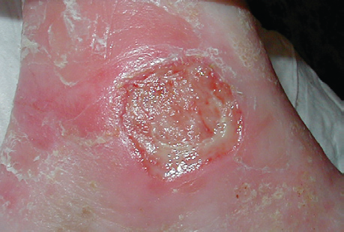
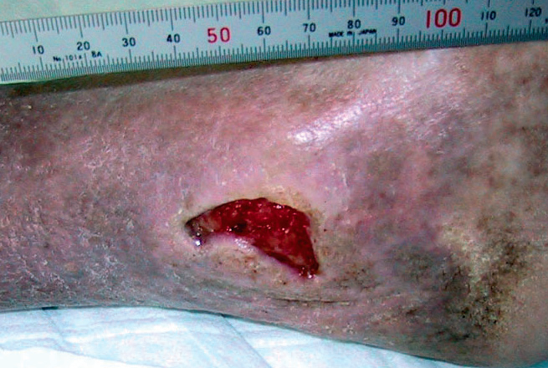
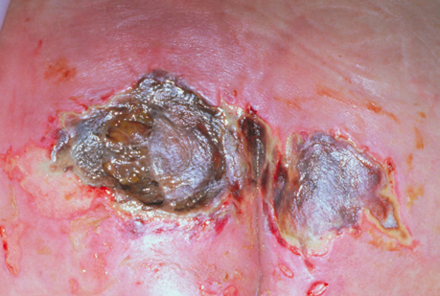
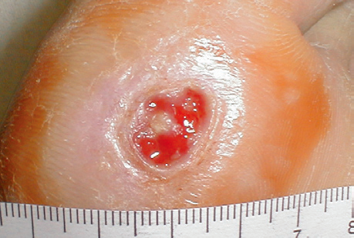
The Basics of Wound Management
Patient assessment
    PMHx may indicate cause and identify complicating factors
Skin assessment
    History, temperature, appearance, texture
Wound assessment
    Location, size, color, drainage, odor, periwound area, wound margins, pain, dressing management
    Type - arterial, pressure, venous insufficiency, neuropathic
Wound bed management
    How to treat the wound?
Documentation management
    Organization, consistency, CMS compliance
Arterial
Venous
Pressure
Diabetic
Hess, 2005

Slide 5
Integument Exam
Techniques
  Observation, palpation, photograph, thermography
Edema
Hydrosis
Changes in Nails
Changes in Skin
Changes in Skin Color
  Cherry Red, cyanosis, pallor, yellow, liver spots, brown
Types of Lesions
  Flat spot, palpable elevated solid mass, elevated lesions with fluid cavities
Other Systems
  Circulatory, respiratory, sensory, musculoskeletal, neuromuscular, functional
Hess, 2005

Slide 6
Integument Practice Patterns
Pattern A
  Primary prevention/risk reduction for integument disorders
Pattern B
  Impaired integument integrity due to superficial skin involvement
Pattern C
  Impaired integument integrity due to partial thickness skin involvement and scar formation
Pattern D
  Impaired integument integrity due to full-thickness skin involvement and scar formation
Pattern E
  Impaired integument integrity due to skin involvement extending into fascia, muscle, or bone, and scar formation
    APTA, 2003

Slide 7
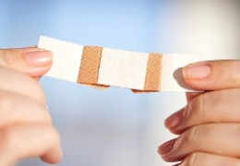
Skin Ulcers
Types of skin ulcers
  Arterial
  Venous
  Decubitus
  Neuropathic
Does it matter?
  Almost all skin ulcers benefit from similar treatments but to cure a wound, you have to know where it comes from

Slide 8
Ulcers | Arterial | Venous
Etiology | Arteriosclerosis obliterans Artheroembolism | Vascular incompetence Venous hypertension
Appearance | Irregular, smooth edges Minimum to no granulation Usually deep | Irregular: dark pigmentation, sometimes fibrotic, good granulation, usually shallow, possible pitting edema
Location | Distal lower leg: toes, feet, lat. malleolus, ant. tibial area | Distal lower leg, med. malleolus
Pedal pulses | Decreased or absent | Usually present
Pain | Painful, esp with elevation, intermittent claudication | Little pain, comfort with elevation
Drainage |  | Mod to large amounts of exudate
Gangrene | May be present | Absent
Signs | Trophic changes, pallor of foot on elevation, dusky rubor on elevation, thin and shiny skin - hairless | Edema, stasis dermatitis, possible cyanosis on dependency, normal skin temp

Slide 9
Ulcers | Neuropathic | Pressure
Etiology | Diabetes, nerve damage | Pressure, shear force, or friction
Appearance | Pinkish-red, brownish-black, calloused surrounding skin | Pink, red, brown or black, depending on stage
Location | Plantar forefoot | Iliac crests, sacrum, elbows, heels, ankles, occiput
Pedal pulses | Decreased or absent | present
Pain | Can be painless | Painful
Drainage | Small to moderate | Small to moderate
Gangrene | Possible | Possible
Signs | Pain, redness, shiny skin over distal lower extremity, trophic changes, numbness | Unblanchable red skin that may form a blister

Slide 10
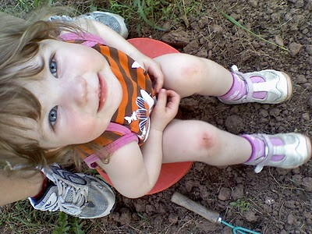
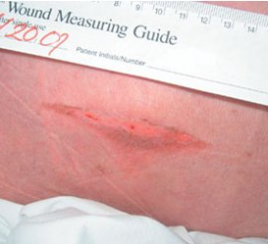
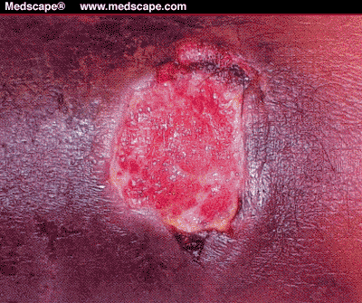
Stages for Arterial and Venous Skin Ulcers
Superficial – loss of epidermis. Local first aid, wash and keep clean.
Partial thickness – loss of dermis, epidermis or both. Usually heal but may scar.
Full thickness – dermis and epidermis. Extensive destruction with necrosis or damage to underlying structures such as muscle, tendon or bone.

Slide 11
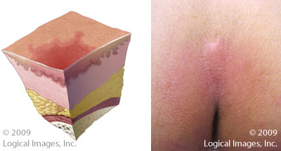
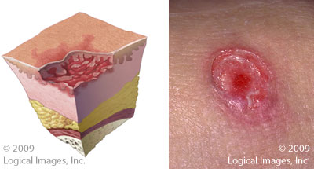
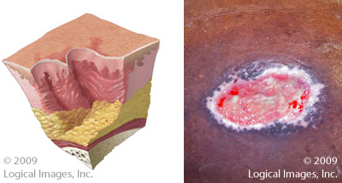
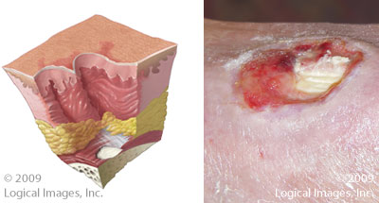
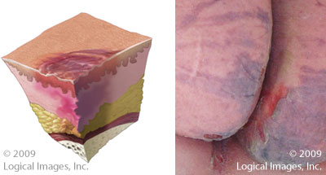
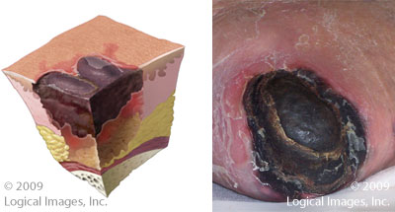
Stages for Pressure Ulcers
Stage l: Skin is intact with an area of nonblanching erythema.
Stage ll: Partial-thickness skin loss with loss of the epidermis and some of the dermis. It appears as a shallow ulcer with a red-pink color. No slough or necrotic tissue is present in the base.
Stage lll: Full-thickness loss of skin with damage to or necrosis of subcutaneous tissues. visible, but muscle, tendon, or bone is not seen. Tunneling or undermining may be present.
Stage lV: Full-thickness loss of skin with extensive destruction, tissue necrosis, and damage to bone, muscle, or other supporting structures that are exposed.
Suspected Deep Tissue Injury: Area of localized, discolored intact skin that is purple or maroon-red in color. May include skin that is painful, firm, boggy, or that has a different temp compared to the surrounding skin.
Unstageable Pressure Ulcers: Full-tissue thickness loss in which the base of the ulcer is covered by slough or an eschar and, therefore, the true depth of the damage cannot be estimated until these are removed.

Slide 12
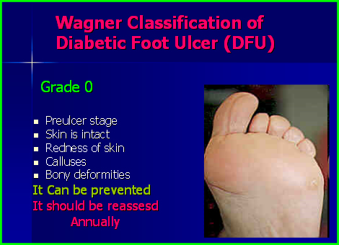
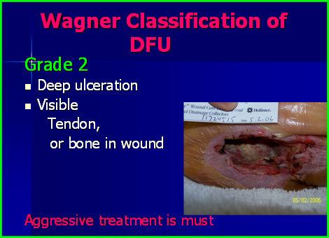
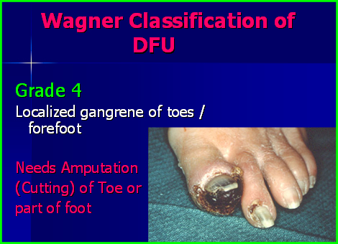
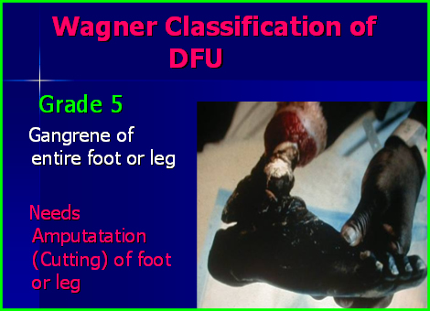
Staging for Diabetic Foot Ulcers
Wagner Wound Classification System
  Provides a grade for the foot ulcer, using depth and presence of osteomyelitis or gangrene
    0 = pre or postulcerative lesion
    1 = partial/full thickness ulcer
    2 = probing to tendon or capsule
    3 = deep with osteitis
    4 = partial foot gangrene
    5 = whole foot gangrene
Armstrong, 2011

Slide 13
Diabetic foot ulcers… it’s complicated
Poor
Nutrition
Smoking
Pressure
points
Wound
Infection
Diabetic
Foot Ulcer
Poor
circulation
Kidney
Failure
Alcohol
Abuse
Neuropathy

Slide 14

WHY SHOULD Diabetic Foot Ulcers MATTER TO YOU?
Chances are you will have a patient with type II diabetes and chances are they will develop a foot ulcer

Slide 15
Important Numbers
25.8 million people (8.3% of the US population) are living with DM
  10-15% of this population will develop at least 1 foot ulcer
  These people are 15 times more likely to require a lower-extremity amputation (LEA)
  70% of all non-traumatic LEAs are due to foot ulcers
Incidence of DM rose 48% between 1997 and 2007
Direct hospital costs of diabetes, per patient per year
  $5,200 DM alone
  $15,300 DM plus foot ulcer
  Accounts for $1 of every $10 spent on healthcare
Mortality rates
  Diabetic patients with foot ulcers have 47% increased risk of mortality as compared to diabetic patients without foot ulcers
Driver, 2010

Slide 16
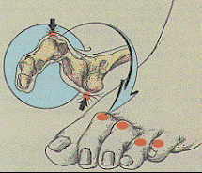
Pathophysiology of Diabetic Foot Ulcers
Peripheral neuropathy
  30-50% total diabetic population
  Affects motor, autonomic and sensory nervous system
    Autonomic – anhidrosis (lack of sweating/oil production) results in dry, cracked skin that is susceptible to bacteria. Decreased sympathetic vascular tone increases distal arterial blood flow resulting in increased capillary pressure and edema
    Sensory – loss of protective sensory input reduces awareness
    Motor – creates a muscle imbalance towards toe hyperextension causing increased pressure under metatarsal heads
Notes:
Bowering

Slide 17
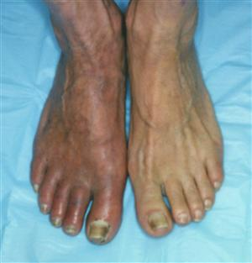
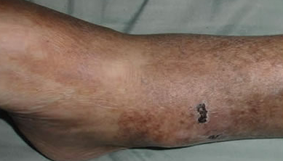
Pathophysiology of Diabetic Foot Ulcers
Peripheral vascular disease
  Ischemia from blocked blood vessels
    2-3 times more likely with DM

Slide 18
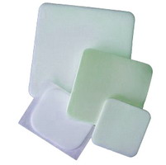
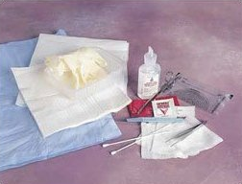
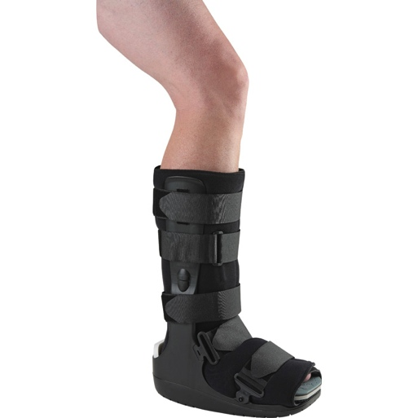
Standard Treatment for Diabetic Foot Ulcers
Standard wound care
  Dressing to maintain moist environment
    May include foam, silver, alginate, hydrocolloids or hydrogels
  Off-loading
    bedrest, crutches wheelchairs
    boots, surgical shoes, half-shoes
    devices such as the removable cast walker and total contact casting
  Debridement
    Sharp, autolytic, enzymatic, mechanical, biodebridement

Slide 19
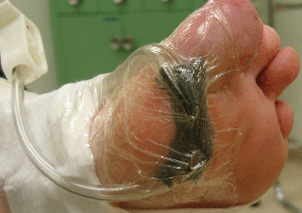
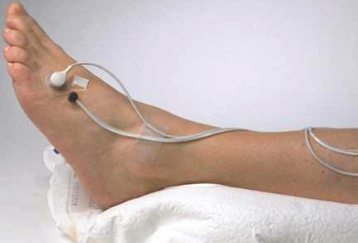
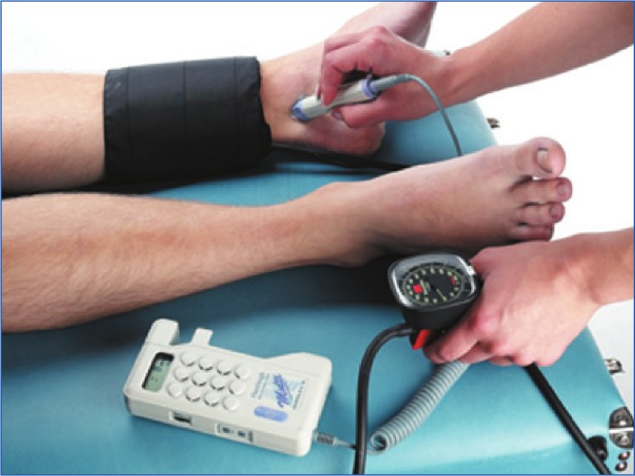
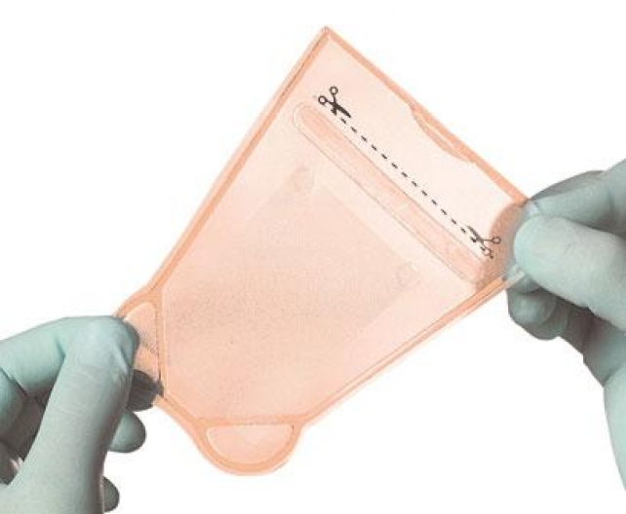
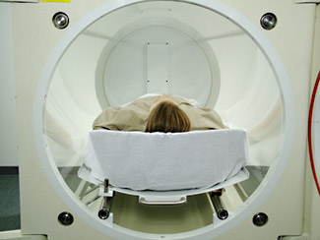
Adjunctive Therapies
Negative Pressure Wound Treatment (NPWT)
  Wound Vac system drains exudate and maintains moist wound environment
E-Stim
  Polarity accelerates wound healing and stimulates cell growth
Ultrasound
  Degranulates of mast cells and stimulates fibroblasts for collagen secretion
Living skin donation
  Maintains moist environment and provides bioscaffold for skin regeneration
Hyperbaric Oxygen Therapy (HBOT)

Slide 20
Risk for Lower Extremity Amputation
80,000 diabetes-related LEAs per year
Patients with diabetes are 15 times more likely to have at least 1 LEA
Associated costs
  $30,000-$60,000 for initial amputation
  $43,000-$60,000 in costs 3 years following amputation
  Life-long cost over $500,000
22% annual mortality rate for diabetic patients with LEAs
As many as 85% of diabetes-related LEAs can be prevented through aggressive treatment
Wu, 2007

Slide 21
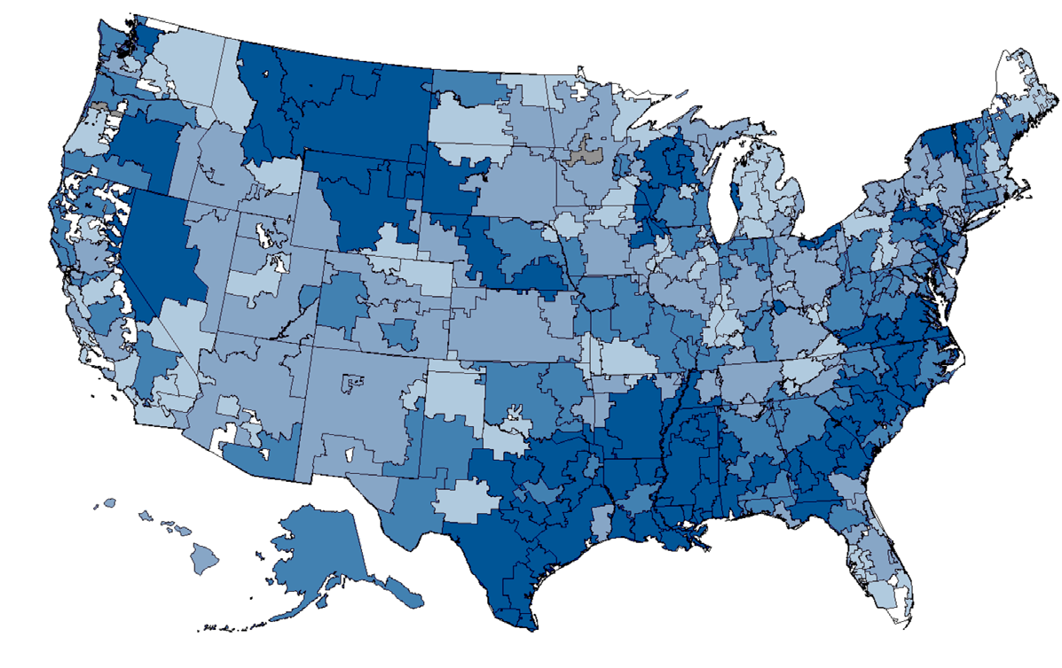

diabetes-related lower foot amputation per 100 Medicare beneficiaries for 2006-2008
Hey North Carolina – looking a little blue
Margolis, 2011

Slide 22

Hyperbari-WHAT?!
(The not-so-Standard treatment)
Hyperbaric Oxygen Therapy (HBOT)
  Short-term, high-dose oxygen inhalation treatment
    ⬆ oxygen diffusion rate to promote healing
    ⬆ partial pressure of body tissue
  Patient breathes 100% oxygen at a level higher than atmospheric pressure
  Course of treatment
    5 days/week
    1 hour “dive”
      5 minutes to reach compression
      50 minutes treatment
      5 minutes decompression
Bishop, 2012

Slide 23
Oxygen – The Key to Wound Healing
Boyle and Dalton…two guys who have a lot to say about gas
  Dalton’s Law says that we can increase the inspired concentration of oxygen if we deliver air or 100% oxygen under increased surrounding pressure.
  Boyle’s law says that as the surrounding pressure increases the volume of the alveolus will decrease, concentrating the gas molecules (↑density) making more molecules available per unit volume.
  More gas molecules to diffuse from the alveolus to the blood.
Sheridan, 1999

Slide 24
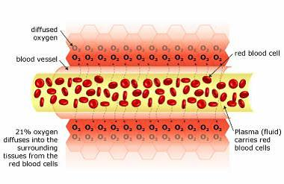
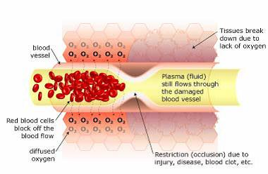
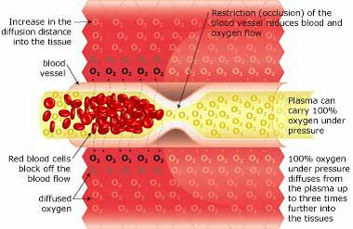
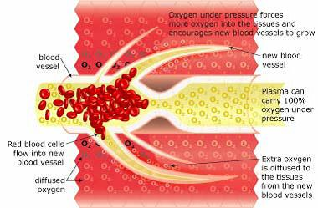
Normal blood flow
Restriction with anemic tissue damage
Restriction with oxygenated plasma flow
Oxygenated plasma flow with blood vessel sprouting
Sheridan, 1999
Notes:
Sheridan, R. L. (1999). Hyperbaric oxygen treatment: A brief overview of a controversial topic. Journal of Trauma: Injury, Infection, and Critical Care, 47(2), 426.

Slide 25
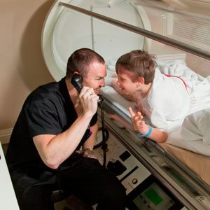
When is it Used?
Indications - Undersea and Hyperbaric Medical Society (UHMS)
  Air or gas embolism, carbon monoxide poisoning, gas gangrene, compartment syndrome, decompression sickness, chronic wounds, anemia, necrotizing fasciitis, osteomyelitis, radiation injury, skin grafts, and thermal burns
Indications under review
  Autism, cerebral palsy, epidural abscess, hearing loss, multiple sclerosis, inflammatory bowel syndrome, psoriasis.
Undersea and Hyperbaric Medical Society (UHMS)
Notes:
Undersea and Hyperbaric Medical Society (UHMS) website accessed from http://membership.uhms.org/

Slide 26
Effect of HBOT on Diabetic Foot ulcer treatment
★ Overall reduction in lower extremity amputation ★
Plasma oxygen saturation
  More readily used than hemoglobin-bound oxygen
  Passes unchanged between arterial to venous circulation
  Increases angiogenesis
  Promotes cell proliferation
  Increases tissue oxygen tension
    ⬇ Infection
    ⬆ vasoconstriction
      ⬇ edema
Wunderlich, 2000

Slide 27
Evidence for Efficacy
Kalani (2002)
  Non-randomized, cohort study
  HBOT lead to increased healing rates, decreased amputations and decreased mortality at 3 years post treatment
    Only considered “chronic diabetic ulcer” – not stage or grade
    Only looked at relatively small ulcers
  N= 23
Bilbault (2003)
  Prospective, randomized study
  Measured Wagner I, II and III ulcers
  HBOT doubles mean healing rate, decreasing length of hospitalization
  N= 28
Abidia (2003)
  Randomized control study
  HBOT resulted in increased healing, decreased amputation and increased quality of life at 6 weeks, 6 months and 1 year following treatment
  N=18
  Initial higher costs of treatment were offset by long-term cost saving

Slide 28
Evidence for Efficacy
Kaya (2008)
  Non-randomized cohort study
  Wagner II, III, IV
  HBOT increased wound healing and decreased amputation rates
  N=184
Londahl (2010)
  Double-blind, placebo-controlled
  HBOT increased long-term health related quality of life as compared to a placebo
  Significantly improved post-treatment levels of the mental health summary score, social functioning and role limitations due to physical and emotional health
  Decreased amputations
  N=94
Chen (2010)
  Dose-dependent healing rates
  Adjunctive HBOT improved wound healing and decreased amputation rates with a minimum of 10 HBOT sessions
  Considered Wagner III and IV ulcers
  Did not define “wound healing” and was unclear if partial healing was considered
  N= 44

Slide 29
Barriers to Care
Knowledge and attitudes about HBOT
  <10% of primary care physicians feel they have a good understanding of HBOT
Access to care
  Limited resources nation-wide
  MDs less likely to refer for HBOT treatment
  Limited insurance reimbursement
Cost of the equipment
  Single-unit chambers average $400,000
  Multi-chamber facilities can have a capital cost over $1 million
Cost of the treatment
  Full-course of 40 treatments average $20,000
    $5,166 per quality-adjusted life-year
  Limited reimbursement through insurance
Time intensive
  1 hour every day for 40 consecutive days
Needs more research
Evans, 2010

Slide 30
Insurance and CMS Woes
Costs per stage
  Wagner 1 & 2 - $1929
  Wagner 3 - $12,255
  Wagner 4 & 5 - $27,721
CMS reimbursement rates for HBOT
  $100-$250 for private clinics
  Up to $1000 in hospitals
  Will only reimburse for Wagner III and greater
    Patient must also prove failed attempted standard wound care
Foot ulcer represent 24% of total diabetes-related medical costs
Margolis, 2011

Slide 31
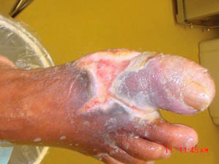
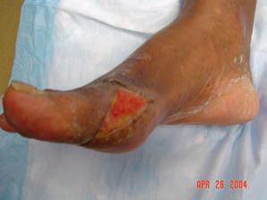
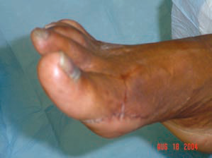
Case Study #1
History: 64-year-old female, PMHx NIDDM, infected diabetic foot ulcers on (R) hallux and MTP joint. Ulcers present for >2 months. Prior treatment with topical antibiotic and regular dressing changes.
Assessment: Sharp debridement of Wagner III ulcer, positive for osteomyelitis.
Management Challenges: Unmanaged blood glucose levels
Plan: 40 1-hour HBOT treatments; 5 days/week for 8 weeks
Outcomes: No additional antibiotics were needed. Wound completely closed in 16 weeks and remains closed.

Slide 32
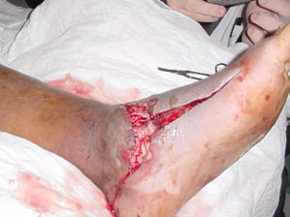
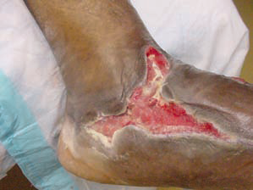
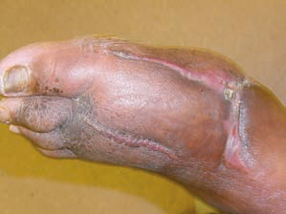
Case study #2
History: 45 y/o male with a large circular blister on the dorsal aspect of the left foot, fever and chills. Sharp debridement of necrotizing fasciitis, and
release of compartment syndrome. PMHx: DM, s/p TMA of right foot secondary to gangrene.
Assessment: Wagner IV ulcer with tunneling connecting dorsal and plantar foot positive for osteomyelitis
Management Challenges: Prevention of further necrotizing destruction and loss of limb.
Observations and Plan: 40 1-hour HBOT treatments; 5 days/week for 8 weeks
Outcome: 13 HBOT treatments received with additional daily wound care with ionic silver. Wound closed with full epithelialization in 47 days.

Slide 33
North Carolina Resources
Mountain/Piedmont Region
Children's hyperbaric Center
667 Peak Rd
Creston NC 28615
336-385-1775
336-385-1676 (fax)
www.miraclemountain.org
Ashville Integrative Medicine
832 Hendersonville Road
Ashville, NC 28803
828-252-5545
828-281-3055(fax)
www.docbiddle.com
Park Ridge Wound Care
50 Hospital Drive, Suite 1-B
Hendersonville, NC 28792
828-650-6822
855-774-5433
www.parkridgehealth.org
Wound Therapy Center
445 Biltmore Avenue, 2nd Floor
Asheville, NC 28801
828-213-4615
828-213-4615
Valdese General Hospital
720 Malcolm Boulevard
Valdese, NC 28690
828-874-2251 x181
828-580-7563
www.blueridgehealth.org
Presbyterian Center Wound Care
200 Hawthorne Lane
Charlotte, North Carolina 28204
704-384-4098
www.presbyterian.org
Charlotte Metro Hyperbarics
14330 Oakhill Park Lane, Suite 140
Huntersville, NC 28078
704-875-7189
704-875-3581 (fax)
www.hboinfo.com/ncarolina.htm
Mission Hospital Wound Healing Clinic
7 Yorkshire St
Asheville, NC 28803
828-213-4600
888-737-0098
828-213-4611 (fax)
www.missionhospitals.org/wound-healing
Carolinas Wound Care Center
1601 Abbey Pl., Ste. 105
Charlotte, NC 28209
704-512-5360
www.carolinashealthcare.org/cmc-mercy-wound-care-center
The Center For Wellness
1258 Mann Drive, #100
Matthews, NC 28105
704-847-2022
704-847-1830 (fax)
www.cfwellness.com

Slide 34
North Carolina Resources
Piedmont Region
Duke Center For Hyperbaric Medicine Trent Dr., Building CR2
Box 3823 Durham, NC 27710
919-684-6726
919-684-8111
dukedivemedicine.org/
FirstHealth Wound Care
155 Memorial Drive
Pinehurst, NC 28374
910.715.5901
910.715.5902 (fax)
www.firsthealth.org
Rex Wound Healing Center
2916 Blue Ridge Road
Raleigh, N.C. 27607
919-784-2580
919-784-2581 (fax)
www.rexhealth.com
Rex Wound Healing Center - Knightdale
6602 Knightdale Blvd.
Knightdale, N.C. 27545
(919) 747-5300
Breath of Life Treatment Center
103-A Brady Court
Cary, NC 27511
919-469-2000
919-469-2090(fax)
www.breathoflifetreatment.com
Carolina Hyperbarics
8300 Health Park, Suite 134
Raleigh, NC 27615
919-720-4377
919-720-4381(fax)
www.nchbo.com
Scotland Wound Healing Center
500 Lauchwood Drive
Laurinburg , NC 28352
910-291-7710
910-291-7710 (fax)
www.scotlandhealth.org
The Wound Care Center
Union Medical Plaza
1423 E. Franklin St., Ste. B
Monroe, NC 28112
704-290-5020
www.carolinashealthcare.org
UNC Wound Healing Center
101 Manning Drive, 2nd Floor
Chapel Hill, NC 27514
919-843-1900
919-843-4922 (fax)
www.unchealthcare.org/site/woundmanagement/
Undersea and Hyperbaric Medical Society
21 West Colony Place, Suite 280
Durham, NC 27705
919-490-5140
877-533-8467
919-490-5149 (fax)
membership.uhms.org/
WakeMed Wound Care
3000 New Bern Ave
Raleigh, NC 27610
919-350-7876
www.wakemed.org

Slide 35
North Carolina Resources
Eastern Region
Vidant Wound Healing Center
608 South Academy
Ahoskie , NC 27910
www.vidanthealth.com
BeachCare Urgent Care
5059 Highway 70 West
Morehead CIty, NC 28557
252.808.3696
252.808.2022 (fax)
www.beachcaremedical.com
Hyperbaric Health
6303 Oleander Dr Ste 102a
Wilmington, NC 28403-3577
954-980-5185
910-313-1323 (fax)
Wound Healing Center
618 South Pierce Street
Eden, NC 27288
336-623-9711
www.morehead.org
Comprehensive Wound Care, Inc.
204 Airport Road
Kinston, NC 28501
252-527-9928
www.cwckinston.com
Southeastern Wound Healing Center
103 W. 27th St
Lumberton, NC 28358
910-738-3836
www.srmc.org

Slide 36
Patient Tips for Foot Ulcer Prevention
INSPECTION
Look at your feet from all sides, everyday, including the space between your toes
Look for dry patches and cracks in the skin and moisturize daily
Call your doctor if you see white, moist, wrinkly skin – especially between your toes
Check for cuts, blisters, corns, calluses, swelling, ingrown toenails, or places that are red or pale
BATHING
Wash your feet daily in warm water. Test the temperature with your wrist or elbow to avoid burning your feet
Do not soak your feet. Soaking can dry out your skin
Dry your feet with a soft towel, making sure to dry between each toe
Apply a good moisturizing lotion to your feet after every wash
Spaces between the toes should be kept very clean and dry.
CORNS AND CALLUSES
Use a pumice stone on dry skin to gently file down mildly callused areas
Wear good-fitting shoes with clean socks
Avoid do-it-yourself chemical corn or callus removers
Do not use corn pads
Never use a razor blade or other sharp objects to remove a callus

Slide 37
Patient Tips for Foot Ulcer Prevention
TOENAILS
Cut toenails after bathing, when they are soft and easy to trim
Never cut the nail too short
Do not use sharp objects to poke or dig under the toenail or around the cuticle.
Call your doctor about any ingrown or split toenails
SHOES
Wear shoes and socks at all times to protect and support your feet, even in the house
Wear shoes with thick rubber soles
Avoid pointy shoes
Avoid slip-on shoes
Each time you put on your shoes, shake them out and then carefully feel inside for stones or other objects
Shop for shoes in the late afternoon, when your feet are at their largest
Wear new shoes for only short periods each day at first
CIRCULATION
If you smoke, stop
Exercise regularly, 30 minutes at least three times per week
Avoid using heating pads or hot water bottles - use wool socks to keep your feet warm instead

Slide 38
References
  Wound care essentials : Practice principles (2008). In Ayello E. A., Baranoski S. (Eds.), . Philadelphia: Wolters Kluwer Health/Lippincott Williams & Wilkins.
  Abidia, A. A. (2003). The role of hyperbaric oxygen therapy in ischaemic diabetic lower extremity ulcers: A double-blind randomised-controlled trial. European Journal of Vascular and Endovascular Surgery, 25(6), 513-518.
  Armstrong, D. D. G. (2011). An overview of foot infections in diabetes. Diabetes Technology & Therapeutics, 13(9), 951-957.
  Bilbault, P. (2003). Hyperbaric oxygenation accelerates the healing rate of nonischemic chronic diabetic foot ulcers: A prospective randomized study. Diabetes Care, 26(8), 2378.
  Bishop, A. A. J. (2012). Diabetic foot ulcers treated with hyperbaric oxygen therapy: A review of the literature. International Wound Journal, 9(3), 1-10.
  Chuck, A. A. W. (2008). Cost-effectiveness and budget impact of adjunctive hyperbaric oxygen therapy for diabetic foot ulcers. International Journal of Technology Assessment in Health Care, 24(02), 178.
  Driver, V. R., Fabbi, M., Lavery, L. A., & Gibbons, G. (2010). The costs of diabetic foot: The economic case for the limb salvage team. Journal of the American Podiatric Medical Association, 100(5), 335-341.
  Evans, A. W. (2010). Hyperbaric oxygen therapy and diabetic foot ulcers. Canadian Family Physician, 56(5), 444.
  Fife, C. C. E. (2011). Discussion: Hyperbaric oxygen: Its mechanisms and efficacy. Plastic and Reconstructive Surgery (1963), 127, 142S-143S.

Slide 39
  Guo, S. (2003). Cost-effectiveness of adjunctive hyperbaric oxygen in the treatment of diabetic ulcers. International Journal of Technology Assessment in Health Care, 19(4), 731.
  Hess, C.T. (2005). Wound Care: Clinical Guide (5th ed). Philadelphia, PA: Lippencott Williams & Wilkins.
  Hunter, S. S. (2010). Hyperbaric oxygen therapy for chronic wounds. Advances in Skin & Wound Care, 23(3), 116-119.
  Jeffcoate, W. W. J. (2003). Diabetic foot ulcers. The Lancet (British Edition), 361(9368), 1545-1551.
  Kalani, M., Jorneskog, G., Naderi, N., Lind, F., & Brismar, K. (2002). Hyperbaric oxygen (HBO) therapy in treatment of diabetic foot ulcers. long-term follow-up. Journal of Diabetes and its Complications, 16(2), 153-158.
  Lipsky, B. B. A. (2011). Response to comment on: Lipsky and berendt. hyperbaric oxygen therapy for diabetic foot wounds: Has hope hurdled hype? diabetes care 2010;33:1143-1145. Diabetes Care, 34(6), e111-e111.
  Lipsky, B. B. A. (2010). Hyperbaric oxygen therapy for diabetic foot wounds: Has hope hurdled hype? Diabetes Care, 33(5), 1143-1145.
  Londahl, M. M. (2010). Hyperbaric oxygen therapy facilitates healing of chronic foot ulcers in patients with diabetes. Diabetes Care, 33(5), 998-1003.
  Löndahl, M. M. (2011). Hyperbaric oxygen therapy improves health-related quality of life in patients with diabetes and chronic foot ulcer hyperbaric oxygen therapy improves quality of life. Diabetic Medicine, 28(2), 186-190.
  Londahl, M., Landin-Olsson, M., & Katzman, P. (2011). Hyperbaric oxygen therapy improves health-related quality of life in patients with diabetes and chronic foot ulcer. Diabetic Medicine : A Journal of the British Diabetic Association, 28(2), 186-190.
  Margolis DJ, Malay DS, Hoffstad OJ, et al. Incidence of Diabetic Foot Ulcer and Lower Extremity Amputation Among Medicare Beneficiaries, 2006 to 2008: Data Points #2. 2011 Feb 17. In: Data Points Publication Series [Internet]. Rockville (MD): Agency for Healthcare Research and Quality (US); 2011

Slide 40
  O'Reilly, D. (2011). A prospective, double-blind, randomized, controlled clinical trial comparing standard wound care with adjunctive hyperbaric oxygen therapy (HBOT) to standard wound care only for the treatment of chronic, non-healing ulcers of the lower limb in patients with diabetes mellitus: A study protocol. Trials, 12(1), 69.
  Peters, E. J. G. E. J. G. (2012). A systematic review of the effectiveness of interventions in the management of infection in the diabetic foot interventions for infection in the diabetic foot. Diabetes/metabolism Research and Reviews, 28, 142-162.
  Roeckl-Wiedmann, I., Bennett, M., & Kranke, P. (2005). Systematic review of hyperbaric oxygen in the management of chronic wounds. The British Journal of Surgery, 92(1), 24-32.
  Sheridan, R. L. (1999). Hyperbaric oxygen treatment: A brief overview of a controversial topic. Journal of Trauma: Injury, Infection, and Critical Care, 47(2), 426.
  Snyder, R. J., & Hanft, J. R. (2009). Diabetic foot ulcers--effects on QOL, costs, and mortality and the role of standard wound care and advanced-care therapies. Ostomy/wound Management, 55(11), 28-38.
  Vaneau, M. (2007). Consensus panel recommendations for chronic and acute wound dressings. Archives of Dermatology (1960), 143(10), 1291-4.
  Vermeulen, H. H. (2005). Systematic review of dressings and topical agents for surgical wounds healing by secondary intention. British Journal of Surgery, 92(6), 665-672.
  Watson, J. M., Kang'ombe, A. R., Soares, M. O., Chuang, L. H., Worthy, G., Bland, J. M., VenUS III Team. (2011). Use of weekly, low dose, high frequency ultrasound for hard to heal venous leg ulcers: The VenUS III randomised controlled trial. BMJ (Clinical Research Ed.), 342.
  Wu, S. C., Driver, V. R., Wrobel, J. S., & Armstrong, D. G. (2007). Foot ulcers in the diabetic patient, prevention and treatment. Vascular Health and Risk Management, 3(1), 65-76.
  Wunderlich, R. R. P. (2000). Systemic hyperbaric oxygen therapy: Lower-extremity wound healing and the diabetic foot. Diabetes Care, 23(10), 1551-1555.

