Slide 1
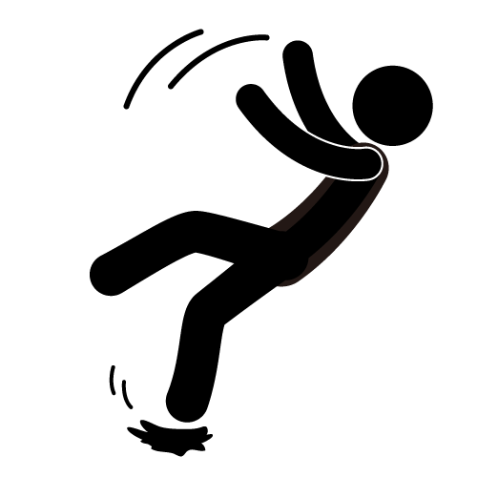
Reducing Falls in Older Adults after Stroke
Natalie Lawler, SPT
UNC-Chapel Hill

Slide 2
Objectives
The learner will:
Understand basic stroke-specific etiologies for falls in individuals in inpatient rehabilitation
Have a general overview of available interventions commonly used in the clinic
Understand, more in-depth, three common interventions aimed at decreasing stroke-related falls in inpatient rehabilitation.
Understand and apply training parameters for balance training and the importance to cater those to each patient.

Slide 3
Falls after Stroke
Falls are the most common complication after stroke (Schmid et al 2010)
27% of persons with stroke will sustain a hip fracture on the paretic side; consequential fear of falling → less mobility → secondary complications (Weerdesteyan et al 2008)
Caretaker stress and patient anxiety and depression after a fall (Weerdesteyan et al 2008)
Notes:
Only 2-10% of elderly persons are likely to sustain a hip fracture as compared to 27% of older adults with stroke
Secondary complications include cardiopulmonary issues, integumentary issues, progressive weakness and atrophy

Slide 4
Etiology of Falls After Stroke
Reduced muscle tone, paralysis and hypoesthesia on involved side (Tsur, Segal 2010)
Lower functional status, history of anxiety, lower NIHSS scores (Schmid et al 2010)
Limited social support, nonuse of walking aid, minimal grip strength on affected side (Baetens et al 2011)
Lower FIM scores at admission (Forrest et al 2012)
Inability to integrate somatosensory, visual and vestibular information adequately (Bonan et al 2004)

Slide 5
Etiology of Falls After Stroke
In IP rehab, most common cause of falls were patients acting against recommendations due to cognitive impairments (Weerdysteyan 2008)
In community dwelling persons, those who walked <4,000 steps daily were more likely to have a fall (Weerdesteyan 2008)
Decreased performance on balance and functional assessment tests (Simpson 2011)
Reduced between-limb synchronization of COP during quiet stance due to motor limb impairment (Mansfield 2012)
Notes:
Simpson-lower CCSE scores,, TUG, BBS, 6MWT, ABC Scale
Stroke is often not the only disease process and co-morbidities should be considered on an individual basis

Slide 6
(Weerdesteyn et al 2008 )
For ADLS: quiet stance despite internal (reaching, weight shifting) and external perturbations
Ambulation: coordinated muscle movement for forward progression, adequate foot clearance, and stability of the stance limb
Complex ambulation: avoid obstacles using cognitive judgment and dual-task ability

Slide 7
How Do We Prevent Falls?
Static and Dynamic balance training
Ankle-Foot Orthoses
Neurodevelopmental Treatment
Functional Electrical Stimulation with Gait Training
Body-weight Supported Treadmill Training
Vitamin Supplements
Upper extremity training
Biofeedback Training

Slide 8
Static Balance Training
Definition: training to help maintain postural support in quiet stance with adequate weight shifting ability and postural reactions

Slide 9
Dynamic Balance Training
Definition: Training to maintain an adequate base of support and upright position despite external perturbations; postural reaction training

Slide 10
Static and Dynamic Balance Training
(Marigold et al 2005) RCT
Tested effectiveness of agility program compared to control to improve balance, postural reflexes, and decrease falls
Agility program showed significant improvements in BBS, TUG, Simple Reaction Time, and had decreased falls at follow-up
Notes:
Program consisted of exercises to challenge dynamic balance including:
Tandem Stance, SLS, standing perturbations, sit-to-stand, rapid knee raise in standing

Slide 11
Static and Dynamic Balance Training
(Cheng et al 2001) RCT
Tested effectiveness of symmetrical body-weight distribution training as compared to a control
Duration, symmetrical weight shift, and decrease in falls at follow-up (6-months) were significantly different in the training group
Notes:
Training was achieved through static standing and also achieving symmetry during repetitive sit-to-stand

Slide 12
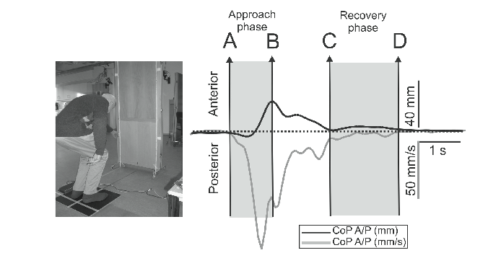
Static and Dynamic Balance Training
(Tsaklis et al 2012)
Pilot study to determine the effects of weight-shift training with visual feedback on improving functional balance and postural support
Convenience sample pre and post-test→no control group
Significant improvements in quiet stance, forward reaching tasks, BBS scores

Slide 13
Ankle-Foot Orthoses
Defintion: a device used to align the foot and ankle properly, manage plantar flexion tone or provide dorsiflexion assistance
Notes:
As we all know it can greatly improve the biomechanics of transfers, standing and gait

Slide 14
(Kobayashi et al 2012)
Effects of [custom made thermoplastic]AFO on center of mass in 5 subjects
Gait analysis: noted a more vertical displacement of COM
More efficient gait pattern with use of AFO, especially during stance phase
Requires larger RCT study to make definitive conclusions
Notes:
Pilot study
One of our big concerns with patients with hemiplegic stroke is the COM. It can be a huge determinant of a person’s balance and kinematics. Additionally the COM can account for energy cost during gait or balance activities
AFO had full length foot plate and posterior wall

Slide 15
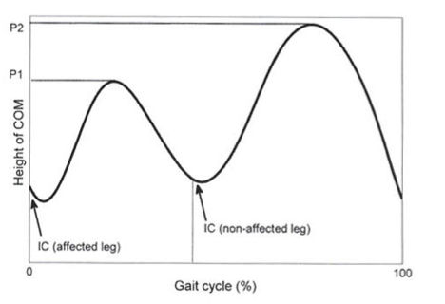
(Kobayashi et al 2012)
Notes:
This represents the peaks in center of mass in the patients with hemiplegia. The vertical peak is less pronounced in the affected lower extremity. Also the asymmetry leads to inefficiency in reciprocal movements

Slide 16
(Tyson et al 2013)
Collected RCTs that focused on parameters of balance, gait and mobility
Found the immediate effects of AFOs to improve balance, gait and mobility
Limitations: no long-term effects determined
Notes:
Systematic review and pooled meta-analysis
I think this brings forward an important point—that the AFO is a tool for compensation for weakness or tone, it does not facilitate strengthening of weakened lower leg muscles, only provides compensatory stability or optimal positioning

Slide 17
(Fatone et al 2009)
Looked at length of footplate to determine ideal kinematics
Compared use of:
no AFO
articulated AFO with 90 deg PF stop & full length foot plate (conventionally aligned)
Articulated AFO with 90 deg PF stop & aligned tibia vertical, shoe heel height compensated AFO
Articulated AFO with tibia vertical, ¾ length foot-plate, and ¾ length AFO
Notes:
Next I wanted to point out some structural components to the actual AFO that can contribute to ideal kinematics of the affected lower extremity
The study used a quasi-experimental design with repeated measures

Slide 18
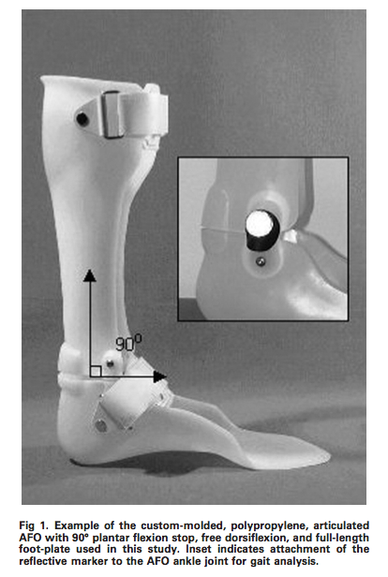
(Fatone et al 2009)

Slide 19
(Fatone et al 2009)
Measured sagittal plane kinematics at ankle and knee
Results favored articulating AFO with PF stop, with full length foot plate to optimize knee kinematics in early stance (prevent hyperextension)

Slide 20
Upper Extremity Training
Definition: Utilization of the upper extremity to aid in balance control during static and dynamic activity

Slide 21
Upper Extremity Training
(Waller et al 2012) Case Series
Explored effectiveness of training with bilateral upper extremities in improving balance control
Training consisted of 5 tasks for 1 hour sessions 3x/week for 6 weeks:
1. grasp, forward reach and release ball in bucket
2. grasp, reach forward through hoop and release ball in bucket
3. grasp with pronated forearm and supinate to place hoop ball on horizontal pole
4.grasp with palmar grasp, flex and abduct arm to place hoop ball on horizontal pole
5. grasp peg ball with supinated wrist, reach forward and place peg in elevated peg board
Notes:
These reaching activities require a dual-tasked ability to maintain proper postural control as well as lean outside of the base of support to employ balance challenges

Slide 22
Upper Extremity Training
(Waller et al 2012) Case Series
Scores for Sensory Organization Test, BBS, ABC Scale, and directional control of rhythmic weight shift improved from baseline to post-training testing.

Slide 23
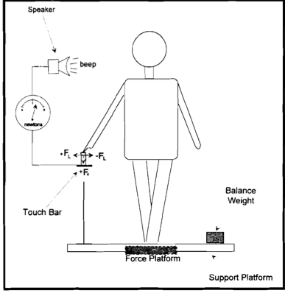
(Jeka et al 1997)
Impact of light touch as a balance aid
Notes:
Not specifically related to stroke, but important to consider when choosing appropriate assistive device
Actually used individuals with Parkinson’s disease

Slide 24
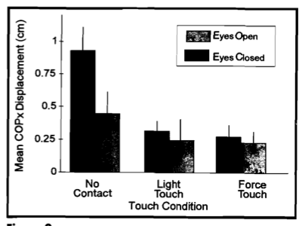
(Jeka et al 1997)
Notes:
As you can see the center of gravity displacement was more pronounced without any contact with the touch bar, whereas there was an increased stabilization with the light touch and force touch.
The extra proprioceptive input aids in realigning the body and increasing awareness of body in space
This can be compared to when one is doing anything in single leg stance such as stretching the quadriceps, oftentimes even just a light touch is enough to stabilize the center of gravity and re-focus balance

Slide 25
Training Parameters (Hornby et al 2011)
Largest improvements in lower extremity motor function are achieved in the first three months after stroke
Task-specific training to increase skill acquisition and retention
Amount of Practice: large amounts of practice are encouraged for skill refinement (i.e. Gait training encourages 1,000-2,000 steps per session)
Intensity: Higher intensity preferred to gain aerobic benefits and neuromuscular demand. Also tied to neural excitability for better walking
Notes:
Hornby et al

Slide 26
References
Tsur A, Segal Z. Falls in stroke patients: risk factors and risk management. Isr Med Assoc J. 2010 Apr;12(4):216-9.
Schmid AA, Wells CK, Concato J, Dallas MI, Lo AC, Nadeau SE, Williams LS, Peixoto AJ, Gorman M, Boice JL, Struve F, McClain V, Bravata DM. Prevalence, predictors, and outcomes of poststroke falls in acute hospital setting. J Rehabil Res Dev. 2010;47(6):553-62.
Weerdesteyn V, de Niet M, van Duijnhoven HJ, Geurts AC. Falls in individuals with stroke. J Rehabil Res Dev. 2008;45(8):1195-213. Review.
Baetens T, De Kegel A, Calders P, Vanderstraeten G, Cambier D. Prediction of falling among stroke patients in rehabilitation. J Rehabil Med. 2011 Oct;43(10):876-83.
Bonan IV, Colle FM, Guichard JP, Vicaut E, Eisenfisz M, Tran Ba Huy P, Yelnik AP. Reliance on visual information after stroke. Part I: Balance on dynamic posturography. Arch Phys Med Rehabil. 2004 Feb;85(2):268-73.
Forrest G, Huss S, Patel V, Jeffries J, Myers D, Barber C, Kosier M. Falls on an inpatient rehabilitation unit: risk assessment and prevention. Rehabil Nurs. 2012 Mar-Apr;37(2):56-61.
Simpson LA, Miller WC, Eng JJ. Effect of stroke on fall rate, location and predictors: a prospective comparison of older adults with and without stroke. PLoS One. 2011 Apr 29;6(4):e19431. doi: 10.1371/journal.pone.0019431.

Slide 27
References
Mansfield A, Mochizuki G, Inness EL, McIlroy WE. Clinical correlates of between-limb synchronization of standing balance control and falls during inpatient stroke rehabilitation. Neurorehabil Neural Repair. 2012 Jul-Aug;26(6):627-35.
Marigold DS, Eng JJ, Dawson AS, Inglis JT, Harris JE, Gylfadóttir S. Exercise leads to faster postural reflexes, improved balance and mobility, and fewer falls in older persons with chronic stroke. J Am Geriatr Soc. 2005 Mar;53(3):416-23.
Cheng PT, Wu SH, Liaw MY, Wong AM, Tang FT. Symmetrical body-weight distribution training in stroke patients and its effect on fall prevention. Arch Phys Med Rehabil. 2001 Dec;82(12):1650-4.
Tsaklis PV, Grooten WJ, Franzén E. Effects of weight-shift training on balance control and weight distribution in chronic stroke: a pilot study. Top Stroke Rehabil. 2012 Jan-Feb;19(1):23-31.
Kobayashi T, Leung AK, Akazawa Y, Hutchins SW. Effect of ankle-foot orthoses on the sagittal plane displacement of the center of mass in patients with stroke hemiplegia: a pilot study. Top Stroke Rehabil. 2012 Jul-Aug;19(4):338-44.
Tyson SF, Kent RM. Effects of an Ankle-Foot Orthosis on Balance and Walking After Stroke: A Systematic Review and Pooled Meta-Analysis. Arch Phys Med Rehabil. 2013 Feb 12. doi:pii: S0003-9993(13)00118-4. 10.1016/j.apmr.2012.12.025.
Fatone S, Gard SA, Malas BS. Effect of ankle-foot orthosis alignment and foot-plate length on the gait of adults with poststroke hemiplegia. Arch Phys Med Rehabil. 2009 May;90(5):810-8. doi: 10.1016/j.apmr.2008.11.012
Jeka JJ. Light touch contact as a balance aid. Phys Ther. 1997 May;77(5):476-87.
Hornby TG, Straube DS, Kinnaird CR, Holleran CL, Echauz AJ, Rodriguez KS, Wagner EJ, Narducci EA. Importance of specificity, amount, and intensity of locomotor training to improve ambulatory function in patients poststroke. Top Stroke Rehabil. 2011 Jul-Aug;18(4):293-307.
McCombe Waller S, Prettyman MG. Arm training in standing also improves postural control in participants with chronic stroke. Gait Posture. 2012 Jul;36(3):419-24. doi: 10.1016/j.gaitpost.2012.03.025. Epub 2012 Apr 21.

