Slide 1
Patellofemoral Pain Syndrome: Assessment and Intervention Strategies
Donna Dean, SPT
2013 DPT Capstone Project
University of North Carolina at Chapel Hill

Slide 2
Learning Objectives
Develop a clear understanding of the definition for different etiologies of PFPS.
Evaluate a patient with PFPS in an organized and efficient approach.
Review special tests and outcome measures that are evidence-based for this population.
Understand evidence-based interventions for different etiologies.

Slide 3
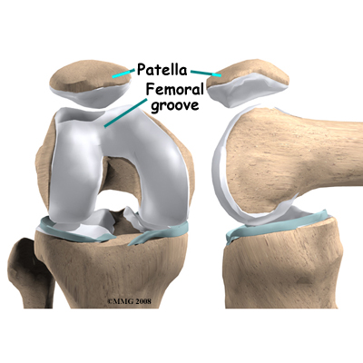
Anatomy Review

Slide 4
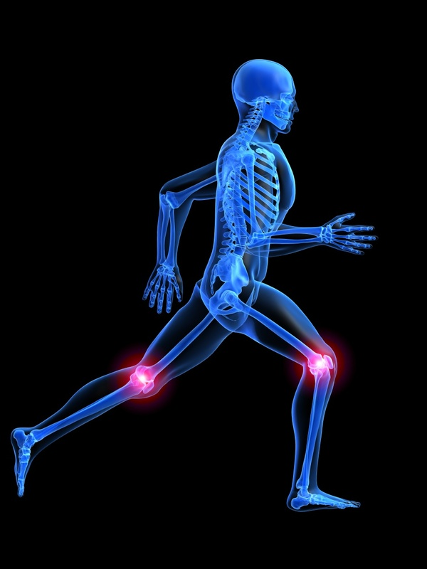
Patellofemoral Pain Syndrome aka…
“Anterior knee pain”
“Runner’s knee”
Subset: Chondromalacia patellae
Notes:
Discuss defn of chondromalacia patellae – abnormal-appearing cartilage causing irritation and pain on the underside of the patella, can be caused by patellar malalignment or maltracking, tight soft tissue, etc but cartilage damage NOT always found in all cases of PFPS

Slide 5
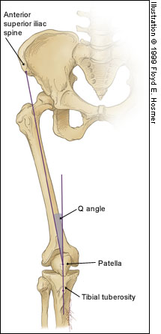
PFPS – What is the cause?
Unknown etiology
Suggested theories:
Abnormal patellar tracking and/or
malalignment
Abnormal soft tissue forces
Muscle dysfunction
Increased Q angle
Tight hamstrings, ITB, quadriceps
femoris, and/or gastrocnemius
Abnormal tibial and femoral rotation
Excessive foot pronation
Notes:
Abnormal soft tissue forces: tight lateral retinaculum,
Muscle dysfunction: delayed reflex of the VMO and/or abnormal VMO:VL ratios, weakness of knee extensors, hip abductors, hip external rotators, and/or gluteal muscles
Abnormal tibial and femoral rotation: meaning tibial varum driving pronation or femoral antetorsion causing increased hip IR

Slide 6
Populations affected
One of the most frequent complaints in the outpatient setting - both athletic and nonathletic populations affected
Affects 25% of the general nonathletic population (Johnston & Gross, 2004; Whittingham et al., 2004)
Occurs in all age groups, although most common in adolescents and young adults (Johnston & Gross, 2004)
More common in females than males (Dolak et al., 2011; Earl & Hoch, 2011)
Notes:
Females – cause may be because of increased Q angle due to a wider pelvis

Slide 7
Symptoms
Insidious onset of anterior or retropatellar pain associated with:
Ascending/descending stairs
Prolonged sitting
Prolonged walking
Squatting
Running
Hopping/jumping
Palpation of patellar facets
Compression of patella
Notes:
This is indicative of a condition that obviously impacts everyday activities.

Slide 8
Assessment: Diagnostic Criteria
PFPS is often considered a diagnosis of exclusion after ruling out competing diagnoses(Cook, 2010)
Strongest combination of tests, LR+ of 4.0* - 2 of the 3 positive findings for pain during:
resisted quadriceps muscle contraction
and/or squatting
and/or palpation of patellar facets (Cook, 2010)
*This is only after ruling out other possibilities

Slide 9
Special tests to rule out competing diagnoses
Meniscal injury – Apley’s compression test, Joint line tenderness
ACL injury – Lachman’s test
PCL injury – Posterior drawer test
MCL and LCL instability – Valgus and Varus stress tests
Medial plica syndrome – Mediopatellar plica test

Slide 10
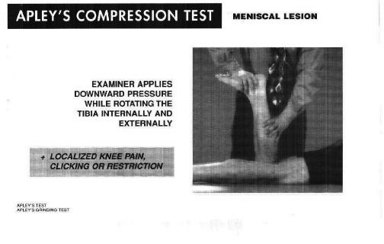
Special Tests
Apley’s Compression Test
+ knee pain, clicking

Slide 11
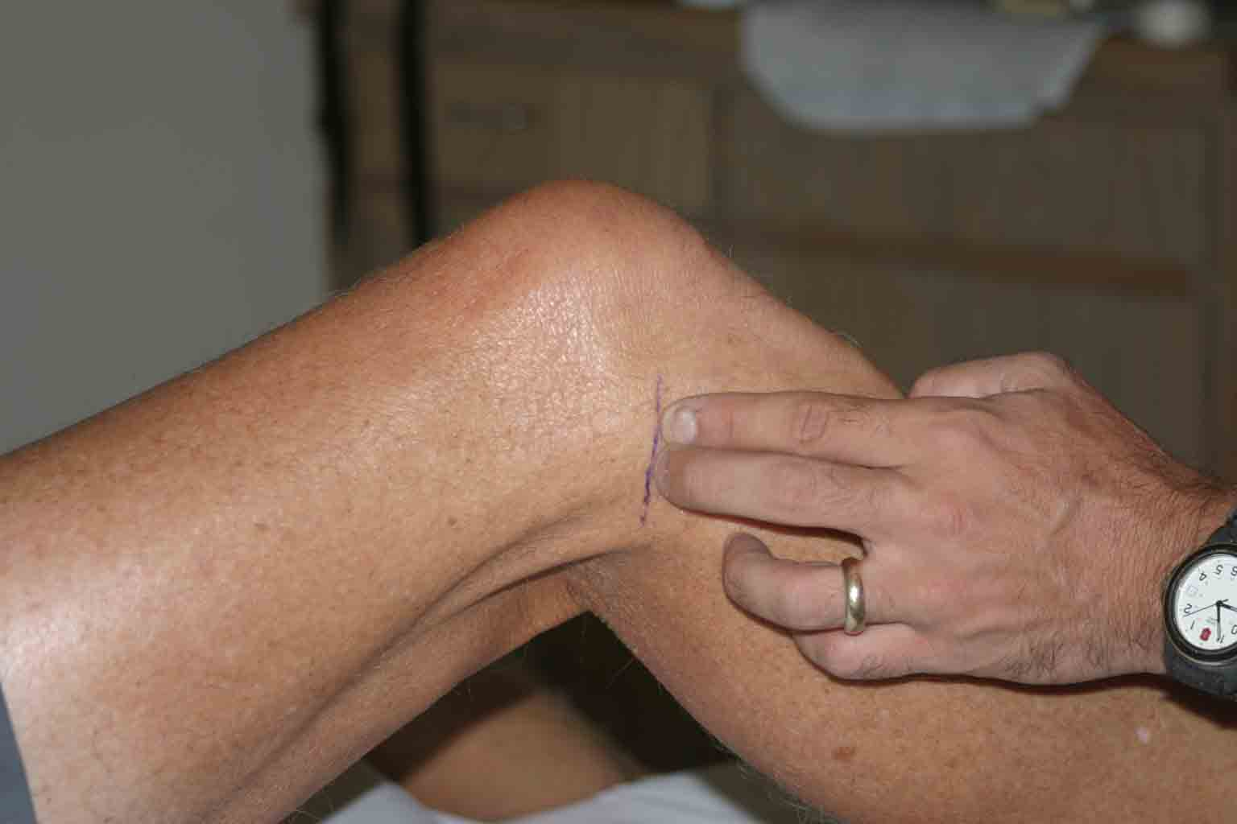
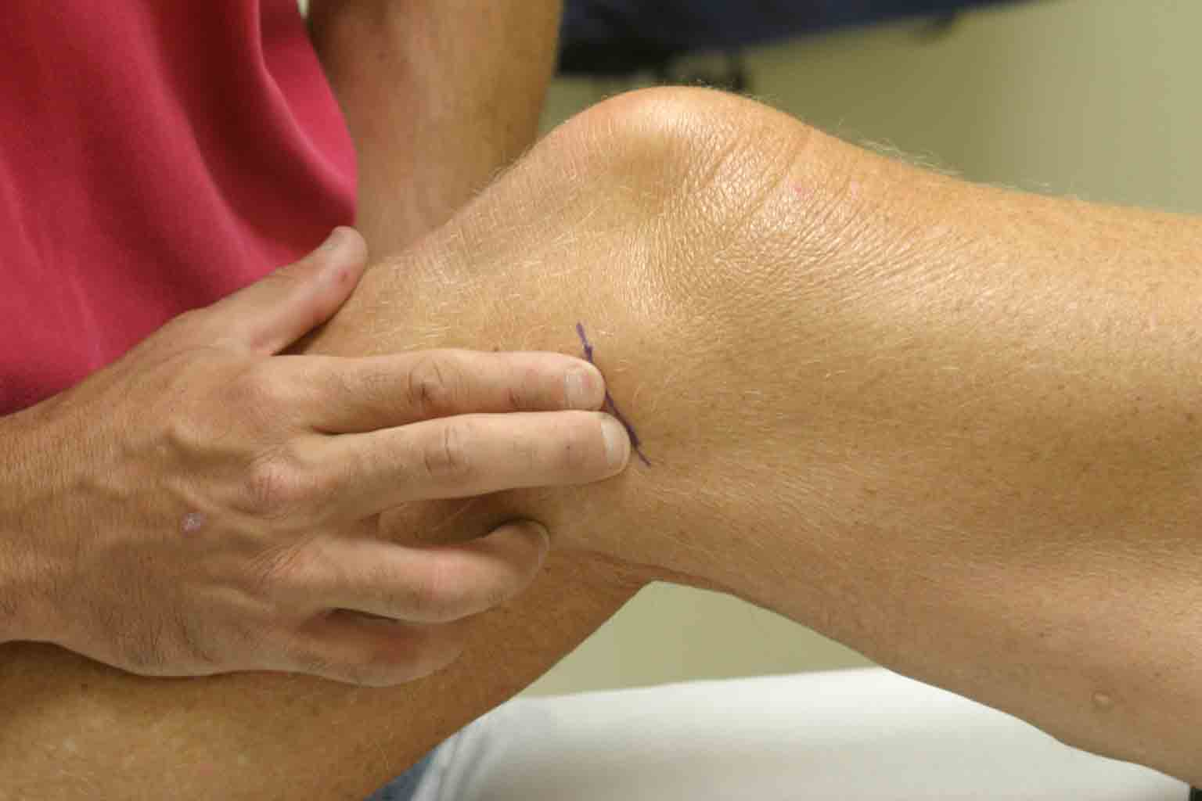
Special Tests
Joint line tenderness
+ pain with palpation

Slide 12
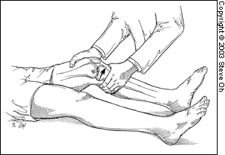
Special Tests
Lachman’s test – knee flexed 20-30°
+ excessive anterior translation of the tibia on the femur with an absent/diminished end point

Slide 13
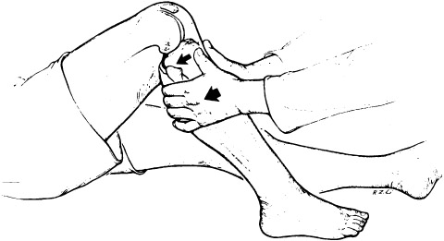
Special Tests
Posterior drawer test
+ excessive posterior translation of the tibia on the femur

Slide 14
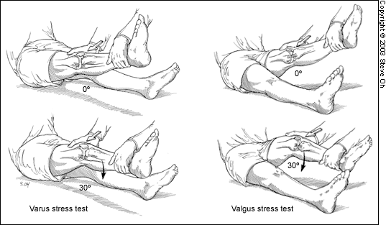
Special Tests
Valgus and Varus stress tests at 0° and 30° knee flexion
+ excessive movement, pain
Notes:
Stabilize at knee and use force at ankle (picture shows putting force at knee, this is wrong)

Slide 15
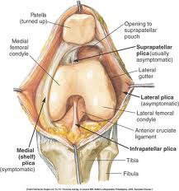
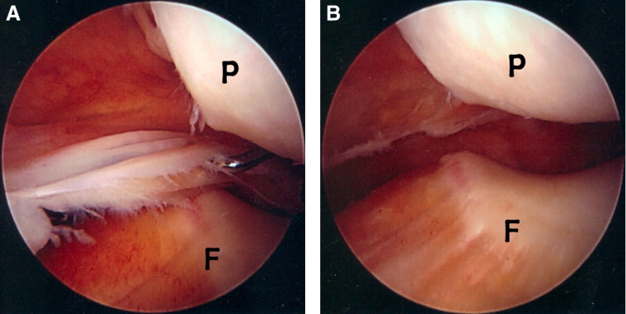
Special Tests
Mediopatellar plica test
Kim et al., 2007
+ tenderness with manual
force in extension,
pain diminished at 90° flexion
Notes:
The MPP originates on the medial wall of the knee joint, runs obliquely down in coronal plane, and inserts into the medial synovial lining of the infrapatellar fat pad. While applying manual force to the inferomedial patellofemoral joint with the examiner’s thumb, the examiner identifies the presence of tenderness. If this tenderness is markedly diminished at 90° of flexion with maintaining manual force, the MPP test is considered to be “positive.” The rationale of the MPP test can be proved by arthroscopic examination through the superolateral portal. The MPP is located on the medial femoral condyle during knee extension. When manual force is applied to the inferomedial patellofemoral joint, the pathologic MPP is inserted and squeezed between the patellar and medial femoral condyle. The entrapped MPP slips away from the medial condyle at 90° of flexion even with maintaining manual compression. The pathologic plica pictured in A has a thickened edge and is trapped between the patella and medial femoral condyle; B is showing after plica is excised with shaver and no longer entrapped

Slide 16
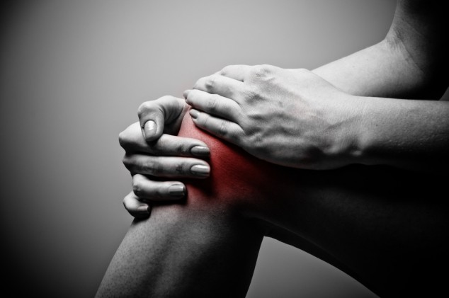
Specific areas to assess for PFPS:
Strength
Flexibility
Patellar malalignments
Foot mechanics

Slide 17
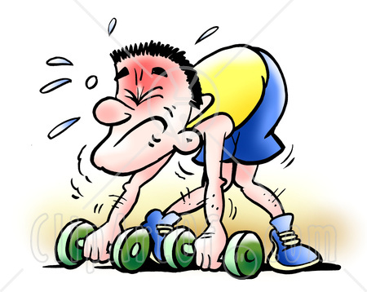
Strength
Determine what is weak…
MMT:
Quadriceps
Hip external rotators
Hip abductors
Gluteal muscles

Slide 18
VMO activation and VMO:VL ratios
VL is often found to fire prior to the VMO in pts with PFPS during functional tasks (Boling et al., 2006, Cowan et al., 2002)
This may lead to lateral tracking of the patella by action of the VL (Akbas et al., 2010)
Pts with unilateral PFPS had bilaterally lower VMO:VL ratios (Souza & Gross, 1991)
In pts with PFPS, the VMO+VML contributed significantly less to the knee extension torque than the VL (Makhsous et al., 2004)
Can PT make a difference in the VMO:VL ratio?
Notes:
Souza – Presence of diminished VMO:VL ratios in both knees for pts with unilateral PFPS suggests abnormal muscle activation may interact with other factors to explain cause of PFPS such as structural abnormalities (foot deformities, leg-length discrepancy, patellar asymmetry) or activities that place asymmetrical demands on LE (running on uneven surface, jumping involving push-off with only one LE)

Slide 19
How PT affects the VMO:VL ratio
A comprehensive PT program incorporating VMO retraining with biofeedback resulted in improved VMO:VL timing (Cowan et al., 2002)
What if you do not have access to a biofeedback system?
USE THE EVIDENCE!

Slide 20
How PT affects the VMO:VL ratio
Isotonic quadriceps contractions produce larger VMO:VL activity compared to isometric contractions (Souza & Gross, 1991)
A WB rehabilitation program (with no focus on specific VMO activation) integrating balance, stretching, and strengthening exercises normalized the onset of the VMO relative to the VL, decreased pain, and increased function (Boling et al., 2006)
Notes:
Discuss use of WB exercises in first 40° of knee ROM because of decreased patellar compressive forces in this range, as well as idea that WB excs in this range simulate everyday fctnal tasks and require additional musculature other than quads; wall slides, mini squats, lateral step downs, monster walks, forward lunges, stretching
VMO:VL timing improves after training quadriceps muscle as a whole, potentially no need to isolate or focus on VMO

Slide 21
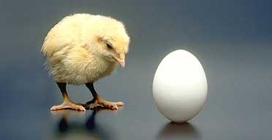
Hip abductor and hip external rotator strengthening
Chicken or the egg?
It is unknown whether
hip weakness causes or
is the result of PFPS (Bolgla et al, 2008)
Isolated hip abductor and external rotator muscle strengthening decreases pain (Earl & Hoch, 2011; Dolak et al., 2011) and improves function in females with PFPS including long-term benefits (Khayambashi et al., 2012)
A hip-strengthening program may decrease prevalence and recurrence of PFPS in sedentary women (Fukuda et al., 2012)

Slide 22
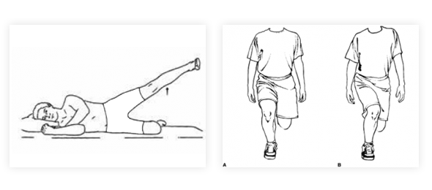
Hip-strengthening program
Include hip abduction and hip external rotation exercises
Include hip extension exercises if this area is weak as well
Focus on proper form and alignment
See the Assessment Tool for therapeutic exercises!
Notes:
Hip abductors:
Sidelying: clamshells (ABD and ER), hip abduction (knee extended, hip slightly extended and 25° ER)
Standing: isometric hip ABD into wall (hip neutral, knee flexed 90°), monster walks, hip ABD against elastic band around ankles
Hip external rotators:
Quadruped: using ABD and ER to lift leg (keeping knee flexed 90°)
Seated: hip ER against elastic band around ankle
Standing: isometric hip ER into wall (hip and knee flexed 90°)

Slide 23
Weight-bearing or Non-weight-bearing exercises?
Both WB and NWB exercises decrease pain and increase muscle strength and function in males 18-35yo with PFPS (Herrington & Al-sherhi, 2007)
NWB exercises help isolate and strengthen hip musculature prior to WB exercises and functional training for patients with PFPS (Mascal et al., 2003)
Notes:
Herrington – multiple-joint WB: seated leg press, single-joint NWB: seated knee extension; Mascal – 2 case reports

Slide 24
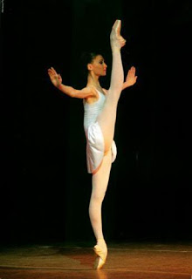
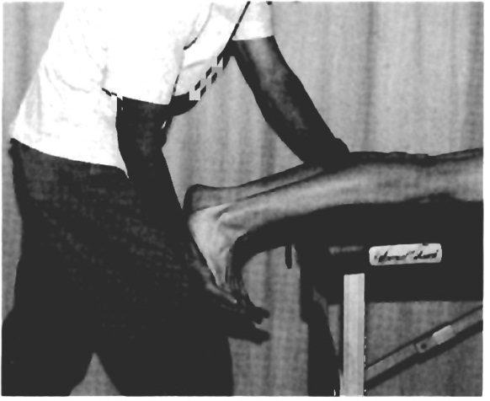
Flexibility
TFL/ITB
Ober’s Test
Hamstrings
90/90 Test
Quadriceps
Modified Thomas Test
Gastrocnemius Gross, 1995
Patient prone with feet hanging off
plinth and leg extended, firmly push
into DF to test for tightness
Notes:
Ober’s – pt SL, bottom leg flexed at hip and knee for stability, top leg is passively abducted and extended, leg is slowly lowered but will not fall to the table if contracture is present in ITB, be sure to stabilize at pelvis
90/90 – pt supine, brings hip and knee to 90 flexion, attempts to extend leg, should be no more than 20 flexion after attempting full ext or contracture of hams
Modified Thomas – suping with knees bent over edge of table, pt flexes one knee into chest and holds onto it while other leg remains hanging and should remain at 90 flexion, if knee extends slightly then contracture present in rectus femoris

Slide 25
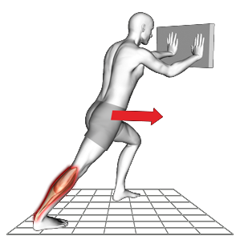
Stretching
Warm up soft tissue structure
ITB stretch
Sidelying or Standing
Hamstring stretch
Supine or Seated
Quadriceps stretch
Supine or Standing
Gastrocnemius stretch
Standing
Notes:
ITB – Ober’s position, have patient contract isometrically into your hand for 5sec, relax and you push their leg down gently while other hand is stabilizing pelvis, repeat 3x; can also stand with one foot behind the other and lean into wall away from the back leg; also can use a foam roller in SL
Hams – 90/90 position and extend leg vigorously to stretch or place towel around plantar surface and stretch extended leg; can also reach for one foot at a time seated
Quads – standing or prone, hold dorsal aspect of foot bringing as clost to buttocks as possible keeping hip neutral (no f/e) and posteriorly rotate pelvis
Gastroc – see pic, be sure to fully extend back leg and push heel down; can get more of soleus by bending back knee slightly keeping heel on ground

Slide 26
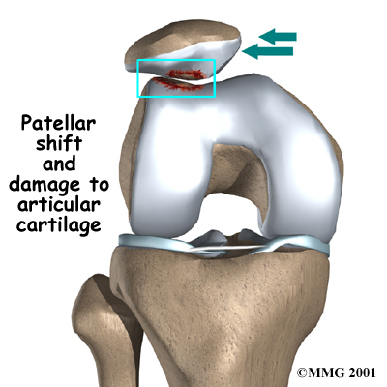
Patellar malalignments
Glide
Rotation
Tilt
Notes:
Remember…decreased contact area increases contact pressure

Slide 27
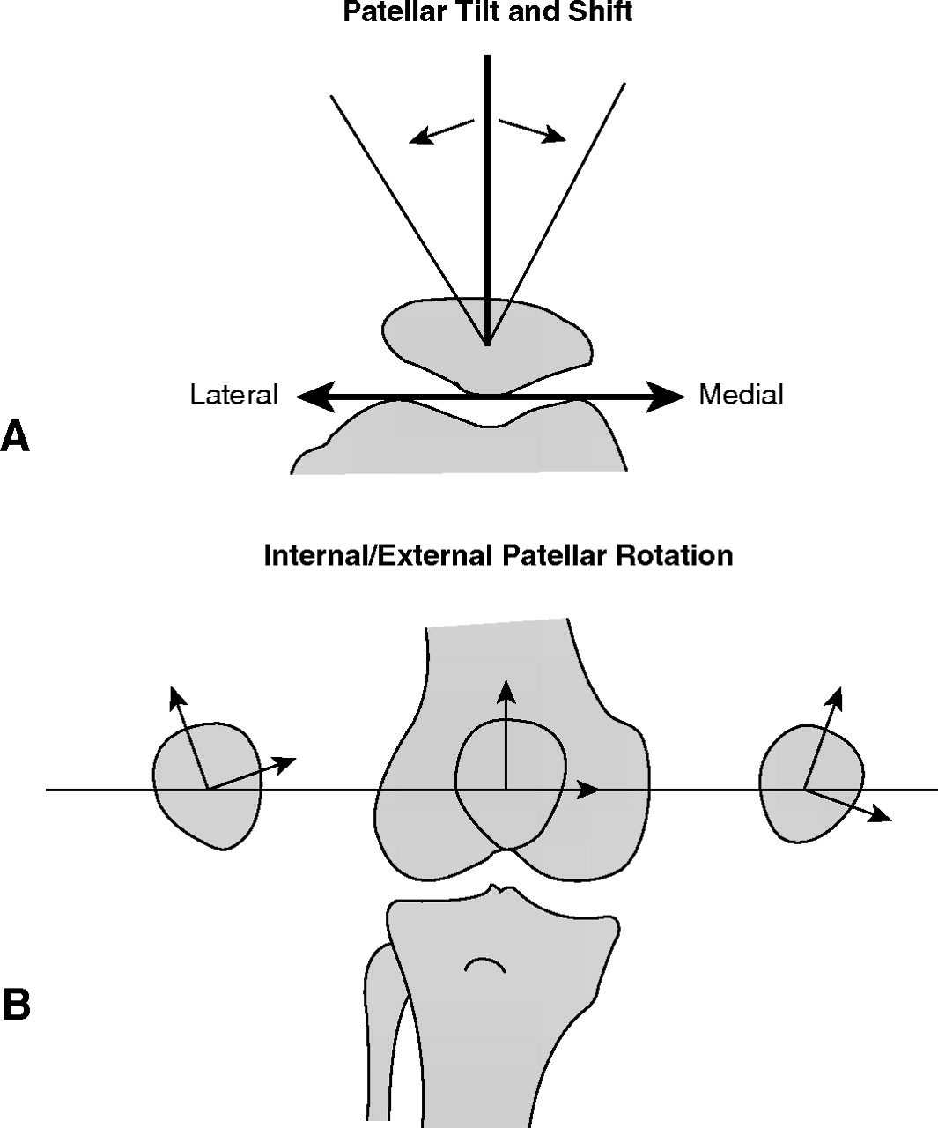
Visual assessment
With the patient in
supine, look for glide,
tilt, and rotation of the
patella
Assess for patella
alta with the
patient sitting and
knees in 90° flexion
Notes:
Lateral/medial glide
Lateral/medial and posterior tilt (posterior tilt can cause infrapatellar fat pad impingement)
External/internal rotation
Patella alta – patella should face forward and rest on distal end of femur, with patella alta it is angled upward and becomes more aligned with the anterior surface of the femur

Slide 28
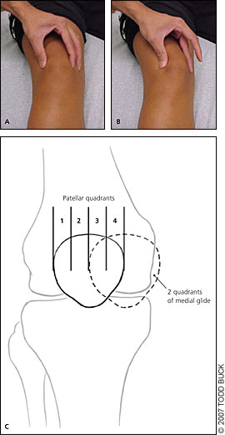
Assess passive mobility
Medial glide:
if patella is displaced…
<1 quadrant =
tight lateral structures
>3 quadrants =
hypermobility

Slide 29
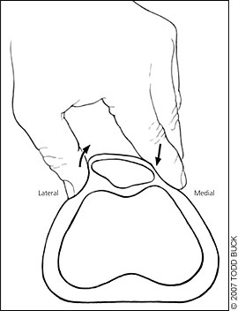
Patellar tilt test
Elevate lateral aspect of patella to test for tight lateral structures

Slide 30
Assess dynamic tracking
The patella may appear
properly aligned statically,
but then deviate during
terminal extension

Slide 31
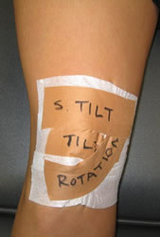
Patellar taping
McConnell technique –
Restricted medial glide: correct by placing tape from lateral border of patella and pull just past medial femoral condyle
Lateral tilt: correct by placing tape from midline of patella to medial femoral condyle to
lift lateral border and stretch tight
structures
Lateral (external) rotation of inferior
pole: tape from the middle inferior
pole upward and medially

Slide 32
Patellar taping
Kinesio Taping Method
“…designed to facilitate the body’s natural healing process while allowing support and stability to muscles and joints without restricting the body’s range of motion.” (www.kinesiotaping.com)
Elastic and latex-free, can be worn 3-7 days before changing
Addition of kinesio taping to a conventional exercise program does not improve outcomes in patients with PFPS (Akbas et al., 2011)

Slide 33
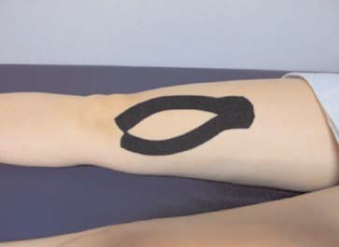
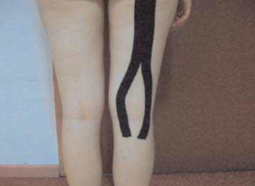
Quadriceps, VMO, ITB, Hamstrings
(Akbas et
al.,2011)

Slide 34
Does taping realign the patella or utilize the “pain gate” theory?
It remains unclear!
It also unknown whether patellar taping facilitates (Whittingham et al., 2004) or decreases (Ng & Cheng, 2002) VMO activity
Notes:
Mechanical – actually moving patella into better alignment with femoral groove
Neural – pain gait theory: larger touch/pressure fibers inhibiting smaller pain fibers
Myofascial – providing passive stretch to these structures

Slide 35
Evidence for patellar taping
McConnell method combined with exercises had greater improvement in pain and function than placebo taping + exercises or exercises alone (Whittingham et al., 2004)
Immediate decrease in pain in patients with PFPS, regardless of how it was applied - medial, neutral, or lateral (Wilson et al., 2003)
Many studies suggest taping provides pain relief, but there is much controversy on how this is achieved!
Notes:
Wilson – unlikely taping works by altering patellar position mechanically since all groups had decrease in pain (particularly since lateral and neutral taping methods had greater degree of pain relief than medial glide); simple application of tape to the knee may be what has analgesic effect; only glide was assessed in this study, not rotation or tilt

Slide 36
Foot mechanics
Patellofemoral malalignment has been associated with excessive subtalar joint pronation during stance phase of gait (Saxena & Haddad, 2003)
Excessive foot pronation defined as:
>9° calcaneal valgus for rearfoot angle
<141° longitudinal arch angle in bilateral WB (Johnston & Gross, 2004)
Rearfoot eversion
Related to tibial internal rotation and hip adduction (Barton et al., 2012)

Slide 37
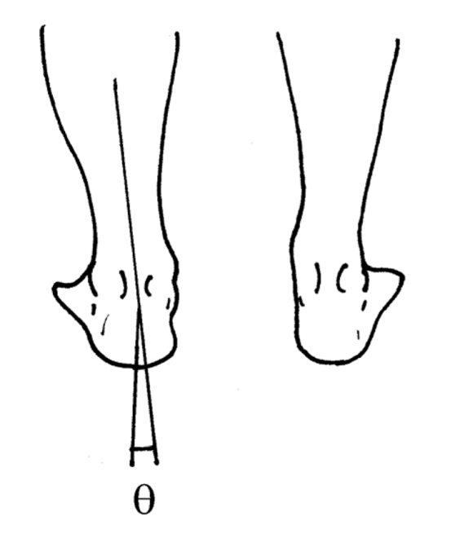
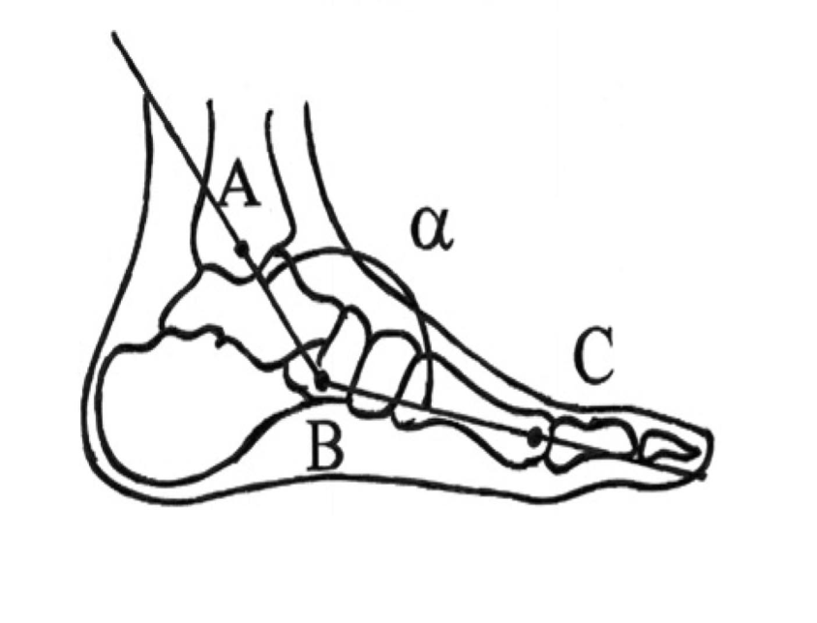
How do you objectively measure?
Rearfoot angle – the acute
angle between the midlines
of the calcaneus and distal
leg in bilateral WB
Longitudinal arch angle –
navicular tubercle as axis,
obtuse angle from medial
malleolus to first
metatarsal head
(Johnston & Gross, 2004)
(Johnston &
Gross, 2004)
Notes:
Sometimes it is very easy to visually assess a patient who pronates, but for documentation purposes it is always a good idea to have actual measurements

Slide 38
Foot orthotics
Orthotics
Purpose is to limit excessive foot pronation, thus reducing excessive tibial and femoral internal rotation that leads to lateral patellar displacement (Johnston & Gross, 2004)
3 major driving forces of pronation: tibial varum, forefoot varus, and tight triceps surae (Gross, 1995)
Orthotic should include:
Support for the concavity of the medial longitudinal arch
Medial rearfoot post when tibial varum is present
Medial forefoot post when forefoot varus is present (Johnston & Gross, 2004)
Notes:
Discuss working with Mike in clinic and seeing firsthand that these are truly the 3 main driving forces of pronation

Slide 39
Foot orthotics
Custom-fit foot orthotics improve pain and stiffness after 2 weeks and physical function after 3 months (Johnston & Gross, 2004)
Soft orthotics with medial forefoot and rearfoot rubber wedges combined with an exercise program showed significantly greater reduction in pain than exercise alone (Eng & Pierrynowski, 1993)

Slide 40
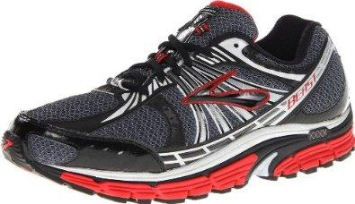
Shoe recommendations
Semicurved- or straight-shaped last
Combination or board last
Firm midsole density
Firm stiffness of the heel counter
No heel flare
Firm stiffness of the rearfoot portion (Johnston & Gross, 2004)

Slide 41
INTERVENTIONS REVIEW
Increasing VMO activation and normalizing VMO/VL ratio
Strengthening hip abductors and external rotators
Patellar taping
Foot orthotics
Topics and interventions not covered: lumbopelvic manipulation, patellar bracing, thoracic ring shift, failed load transfer in the pelvis, surgical interventions

Slide 42
Evidence that PT works for PFPS!
A 6wk program of PT interventions showed beneficial results for pain and function significantly greater than a placebo regimen (Crossley et al., 2002)
Arthroscopy included with an HEP had no advantages over the HEP alone (Kettunen et al., 2007)
Notes:
Crossley – PT consisted patellar taping, retraining of the VMO, gluteal muscle strengthening, and soft tissue stretching; randomized, double-blinded, placebo-control trial; possible that an even greater effect could occurred if a PT program had been tailored to each individual
Kettunen – HEP provided by a PT including LE strengthening and stretching; direct healthcare costs were higher as well as indirect healthcare costs due to sick leave in arthroscopy group; arthroscopy cannot be recommended for pts with chronic PFPS

Slide 43
Multimodal approach
Determine all driving forces behind the pain
PFPS is likely the result of a dynamic dysfunction of the interaction between the lumbopelvic region, hip, knee, and foot (Lowry, 2008)
Modify activities
Are activities adding fuel to the fire?
Determine appropriate progression for magnitude, frequency and duration of exercises
Pay attention to proper alignment and normal tracking during all activities!
Notes:
Proper alignment – describe Mary’s technique of taping a tape measurer to patella and letting hang down for visual of how knee is tracking over toes

Slide 44
Outcome measures for PFPS
Visual Analog Scale or Numeric Pain Rating Scale
Anterior Knee Pain Scale
Also known as the Kujala Scale
Lower Extremity Functional Scale
Notes:
AKPS – 13 questions, 6 specifically asking about activities often associated with anterior knee pain and others asking about pain, swelling, limp, etc
LEFS – 20 questions about person’s difficulty level in performing everyday tasks, used to evaluate functional impairment of a pt with a disorder of one or both LE

Slide 45
References
Dolak KL, Silkman C, McKean JM, Hosey RG, Lattermann C, Uhl TL. Hip strengthening prior to functional exercises reduces pain sooner than quadriceps strengthening in females with patellofemoral pain syndrome: a randomized clinical trial. J Orthop Sports Phys Ther. 2011 June;41(8):560-570.
Earl JE, Hoch AZ. A proximal strengthening program improves pain, function, and biomechanics in women with patellofemoral pain syndrome. Am J Sports Med. 2011 Jan;39(1):154-63.
Fukuda TY, Melo WP, Zaffalon BM, Rossetto FM, Magalhaes E, Bryk FF, Martin RL. Hip posterolateral musculature strengthening in sedentary women with patellofemoral pain syndrome: a randomized controlled clinical trial with a 1-year follow-up. J Orthop Sports Phys Ther. 2012;42(10):823-30.
Song C, Lin Y, Wei T, Lin D, Yen T, Jan M. Surplus value of hip adduction in leg-press exercise in patients with patellofemoral pain syndrome: a randomized controlled trial. Phys Ther. 2009 May;89(5):409-18.
Chiu JKW, Wong YM, Yung PSH, Ng GYF. The effects of quadriceps strengthening on pain, function, and patellofemoral joint contact area in persons with patellofemoral pain. Am J Phys Med Rehab. 2012 February;91(2):98-106.
Bolgla LA, Malone TR, Umberger BR, Uhl TL. Hip strength and hip and knee kinematics during stair descent in females with and without patellofemoral pain syndrome. J Orthop Sports Phys Ther. 2008 January;38(1):12-18.
Khayambashi K, Mohammadkhani Z, Ghaznavi K, Lyle MA, Powers CM. The effects of isolated hip abductor and external rotator muscle strengthening on pain, health status, and hip strength in females with patellofemoral pain: a randomized controlled trial. J Orthop Sports Phys Ther. 2012 Jan;42(1):22-29.
Boling MC, Bolgia LA, Mattacola CG, Uhl TL, Hosey RG. Outcomes of a weight-bearing rehabilitation program for patients diagnosed with patellofemoral pain syndrome. Archives of Phys Med and Rehabil. 2006 November;87(11):1428-1435.
Roush JR, Curtis Bay R. Prevalence of anterior knee pain in 18-35 year-old females. Int J Sports Phys Ther. 2012 Aug;7(4):396-401.

Slide 46
References
Whittingham M, Palmer S, Macmillan F. Effects of taping on pain and function in patellofemoral pain syndrome: a randomized control trial. J Orthop Sports Phys Ther. 2004 Sep;34(9):504-10.
Wilson T, Carter N, Thomas G. A multicenter, single-masked study of medial, neutral, and lateral patellar taping in individuals with patellofemoral pain syndrome. J Orthop Sports Phys Ther. 2003 Aug;33(8):437-43.
Paoloni M, Fratocchi G, Mangone M, Murgia M, Santilli V, Cacchio A. Long-term efficacy of a short period of taping followed by an exercise program in a cohort of patients with patellofemoral pain syndrome. Clin Rheumatol. 2012 Mar;31(3):535-9. Epub 2011 Nov 3.
Ng GY, Cheng JM. The effects of patellar taping on pain and neuromuscular performance in subjects with patellofemoral pain syndrome. Clin Rehabil. 2002 Dec;16(8):821-7.
Johnston LB, Gross MT. Effects of foot orthoses on quality of life for individuals with patellofemoral pain syndrome. J Orthop Sports Phys Ther. 2004 Aug;34(8):440-8.
Barton CJ, Levinger P, Crossley KM, Webster KE, Menz HB. The relationship between rearfoot, tibial, and hip kinematics in individuals with patellofemoral pain syndrome. Clinical Biomechanics. 2012 Aug;27(7):702-5.
Eng JJ, Pierrynowski MR. Evaluation of soft foot orthotics in the treatment of patellofemoral pain syndrome. Phys Ther. 1993 Feb;73(2):62-8.
Lowry CD, Cleland JA, Dyke K. Management of patients with patellofemoral pain syndrome using a multimodal approach: a case series. J Orthop Sports Phys Ther. 2008 Nov;38(11):691-702.
Yosmaoglu HB, Kaya D, Guney H, Nyland J, Baltaci G, Yuksel I, Doral MN. Is there a relationship between tracking ability, joint position sense, and functional level in patellofemoral pain syndrome? Knee Surg Sports Traumatol Arthrosc. 2013 Jan 30. [Epub ahead of print].
Kettunen JA, Harilainen A, Sandelin J, Schlenzka D,Hietaniemi K, Seitsalo S, Malmivaara A, Kujala UM. Knee arthroscopy and exercise versus exercise only for chronic patellofemoral pain syndrome: a randomized controlled trial. BMC Medicine. 2007 Dec 13;5:38.
Piva SR, Fitzgerald GK, Wisniewski S, Delitto A. Predictors of pain and function outcome after rehabilitation in patients with patellofemoral pain syndrome. J Rehabil Med. 2009 Jul;41(8):604-12.

Slide 47
References
Cook C, Hegedus E, Hawkins R, Scovell F, Wyland D. Diagnostic accuracy and association to disability of clinical test findings associated with patellofemoral pain syndrome. Physiother Can. 2010 Winter;62(1):17-24.
Souza DR, Gross MT. Comparison of vastus medialis obliquus:vastus lateralis muscle integrated electromyographic ratios between healthy subjects and patients with patellofemoral pain. Phys Ther. 1991 Apr;71(4):310-6.
Herrington L, Al-Sherhi A. A controlled trial of weight-bearing versus non-weight-bearing exercises for patellofemoral pain. J Orthop Sports Phys Ther. 2007 Apr;37(4):155-60.
Cowan SM, Bennell KL, Crossley KM, Hodges PW, McConnell J. Physical therapy alters recruitment of the vasti in patellofemoral pain syndrome. Med Sci Sports Exerc. 2002 Dec;34(12):1879-85.
Akbas E, Atay AO, Yuksel I. The effects of additional kinesio taping over exercise in the treatment of patellofemoral pain syndrome. Acta Orthop Traumatol Turc. 2011;45(5):335-41.
Makhsous M, Lin F, Koh JL, Nuber GW, Zhang LQ. In vivo and noninvasive load sharing among the vasti in patellar malalignment. Med Sci Sports Exerc. 2004 Oct;36(10):1768-75.
Gross MT. Lower quarter screening for skeletal malalignment—suggestions for orthotics and shoewear. J Orthop Sports Phys Ther. 1995 Jun;21(6):389-405.
Kim SJ, Lee DH, Kim TE. The relationship between the MPP test and arthroscopically found medial patellar plica pathology. Arthroscopy. 2007 Dec;23(12):1303-8.
Mascal CL, Landel R, Power C. Management of patellofemoral pain targeting hip, pelvis, and trunk muscle function: 2 case reports. J Orthop Sports Phys Ther. 2003 Nov;33(11):647-60.
Saxena A, Haddad J. The effect of foot orthoses on patellofemoral pain syndrome. J Am Podiatr Med Assoc. 2003 Jul-Aug;93(4):264-71.
Crossley K, Bennell K, Green S, Cowan S, McConnell J. Physical therapy for patellofemoral pain: a randomized, double-blinded, placebo-controlled trial. Am J Sports Med. 2002 Nov-Dec;30(6):857-65.
Magee DJ. Orthopedic Physical Assessment. 5th ed. St. Louis, MO: Saunders Elsevier, Inc; 2008:727-843.

Slide 48
References
Pictures: Accessed Jan-April 2013
http://www.aafp.org/afp/2007/0115/p194.html (slide 3, 28, 29, 30)
http://www.eorthopod.com/content/chondromalacia-patella (slide 3)
http://www.eorthopod.com/content/patellofemoral-problems (slide 3, 26)
http://exercisesforinjuries.com/runners-knee-exercise-program/ (slide 4)
http://www.aafp.org/afp/1999/1101/p2012.html (slide 5)
http://www.4shared.com/photo/PYnAzSn-/apleys_compression_test.html (slide 10)
http://meded.ucsd.edu/clinicalmed/joints.htm (slide 11)
http://www.aafp.org/afp/2003/0901/p907.html (slide 12, 14)
http://www.genu-centrum.com/knee-testing/2/ (slide 13)
http://quizlet.com/11882888/knee-ocs-flash-cards/ (slide 15)
http://www.proprofs.com/flashcards/cardshowall.php?title=english-4-sat-vocabulary-words-lesson-2 (slide 17)
http://running.competitor.com/2012/10/injury-prevention/beating-runners-knee_143 (slide 16)
http://rightfitchicago.com/blog/wp-content/uploads/2012/08/590img.png (slide 22)
http://beginnerballerina.blogspot.com/ (slide 24)
http://www.myprecisionfit.com/test/resultStretching?testResultId=2ebdbf51-6d27-4cd0-ad32-87c05957a89b (slide 25)
http://ajs.sagepub.com/content/34/5/749/F3.expansion (slide 27)
http://www.beantownphysio.com/pt-tip/archive/mcconnell-taping.html (slide 31)
http://www.englishexercises.org/makeagame/my_documents/my_pictures/2011/oct/958_question_clipart.gif (slide 34)
http://www.brooksrunning.com (slide 40)
http://backandneck.about.com/od/paincharts/ig/Visual-Assessment-Tools/Visual-Analog-Scale-VAS.htm (slide 44)
http://thebeeskneesaquiltingbee.blogspot.com/2012_05_01_archive.html (slide 50)

Slide 49
Special thanks to:
Mike Gross, PT, PhD
Lori Von Alten, PT, LAT, ATC, CPI
Mary Draize, PT
Mike Lewek, PT, PhD

Slide 50
Questions?

