Slide 1
rehabilitation Considerations for the Overhead athlete
Paige Kensrue SPT

Slide 2
Objectives
Review the anatomy and biomechanics of the shoulder and how they relate to the overhead (OH) athlete
Review specific OH sport motions
Understand bony and soft tissue adaptations that occur with repetitive OH motion
Understand the importance of the kinetic chain in OH motions

Slide 3
The Big idea!
Understand specific rehabilitation considerations for the OH athlete in terms of strengthening, ROM, and proprioception.

Slide 4
Anatomy

Slide 5
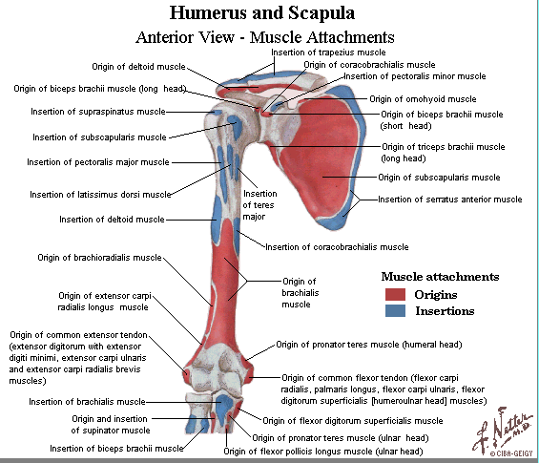
Anatomy
*Netter Images
Notes:
The clavicle is the only thing attaching the scapula to the rest of the skeleton!
Rotator Cuff:
-supraspinatus → Origin: supraspinous fossa , Insertion: superior facet of the greater tubercle
-subscapularis → Origin: subscapular fossa, Insertion: lesser tubercle
-infraspinatus → Origin: infraspinous fossa, Insertion: middle facet on greater tubercle of humerus
-teres minor → Origin: superior portion of lateral border of scapula, Insertion: inferior facet of the greater tubercle
Other muscles to consider:
biceps attaching and becoming part of the synovial membrane
traps (O: ext occipital protuberance, superior nuchal line, spinous processes of C7-T12; I: lateral 1/3 clavicle, acromion, spine of scap)
pec minor (O: 3-5 ribs near costal cartilages; I: coracoid process of the scapula)

Slide 6
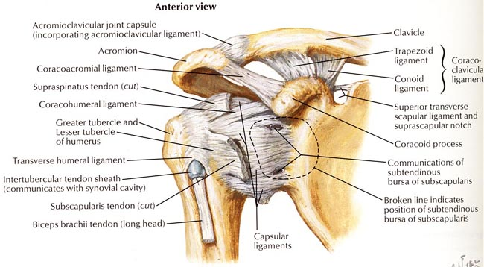
Anatomy
Passive Joint Stabilizers!
GH ligaments
GH capsule
Inferior ligament pouch
*Netter Images
Notes:
Don’t forget the ligaments and SA space!
Capsular ligaments: superior, inferior, middle
Inferior ligament “pouch” gets a lot of attention → going to be important in restraining humeral head motion during abd and ER
Middle ligament: resists anterior translation during mid-range abd
**Posterior capsule tightness can result in translation of the humeral head out of the center of the joint
SA space:
Supraspinatus tendon
Subacromial bursa
Capsular ligament
Synovial membrane

Slide 7
AnatomY
Serratus Anterior
Traps
RTC muscles
Rhomboids
Levator Scapula
*Netter images
Notes:
ALSO can’t forget about the scapula!
Muscles:
Levator scapula → Origin: transverse processes C1-4, Insertion: superior portion of medial border of scap
Rhomboids → Origin: spinous process C7-T1; T2-5, Insertion: medial border of the scapula
Serratus anterior → Origin: external surface of lateral ribs 1-8, Insertion: anterior surface of medial border of scapula
Teres Major → Origin: dorsal surface of inf angle of scap, Insertion: intertubercular sulcus of humerus
Deltoid → O: lateral 1/3 clavicle, acromion and spine of scap, I: deltoid tuberosity of humerus
***The resting position of the shoulder girdle depends on SC ligaments, upper trap, levator scap, SCM, fascia, atmospheric pressure, thoracic spine alignment, muscular linkage from C and T spine (The Athletic Shoulder)

Slide 8
Biomechanics
Joint Motion and Muscle Action

Slide 9
Joint Motion
Glenohumeral Joint
Most important thing during OH motion is to keep the head of the humerus compressed to the glenoid fossa during arm motion
Normal ROM
Flexion: 180°
IR/ER: 90° in each direction
Abduction: 180° (Magee, 2008)
OH athlete’s ROM
GIRD (Wilk, 2002, 2009; van der Hoeven, 2006; Burkhart, 2003)
Notes:
-GH joint → normal ROM Achieved with BALANCED muscle action (Wilk, 2000)
-Causes of GIRD
humeral retrotorsion
soft tissue posterior capsule tightness due to microtrauma
muscle properties and muscle strain
-GIRD: can cause shift in the humeral head instant center of rotation to an anterosuperior position during forward flexion and a posterosup position in ER and cocking (Kibler 2012).
-predictive of labral injury, elbow and shoulder injury
-dose and exposure-dependent
-recommended to think of a 20deg diff b/w sides to indicate GIRD (can be as little as 11) or >10% diff vs. contralateral side (van der hoeven)
***Average baseball pitcher: 129.9° of ER and 62.6° IR (Wilk, 2002)
***Average elite junior tennis player: 103.7° of ER and 45.4° IR (Andrews) but less total motion arc
-GIRD can be ok as long as the ratio of GIRD: ER gain is equal to 1 (Burkhart)

Slide 10
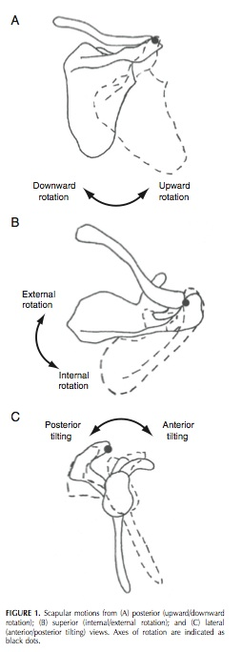
Scapulothoracic Motions
(Borich, 2006)
Notes:
Borich diagram of scapular movements

Slide 11
Joint Motion
Scapulothoracic Joint
Motions of the scapula align the glenoid fossa with the humeral head (Phadke, 2009)
Motions at AC and SC joints
With arm elevation
Upward rotation: 1° for every 2° until 120° elevation then 1-1 (Reinold, 2009)
Posterior tilt ~20-40°
ER 15-35°
Notes:
-Scapula used to “set the table”
-ScapThor joint
Max joint congruency
Stable base for GH motion
Arm elevation in healthy subjects = clavicle elevating, retracting and post rotating
Upward rotation, IR, and posterior tilting of scap occur at AC joint (Phadke, Reinold)

Slide 12
Muscle Action
Glenohumeral
Deltoid
Supraspinatus
Infraspinatus and teres minor
Subscapularis
Scapulothoracic
Serratus anterior contributes to ALL scapular movements(Reinold, 2009)
Trapezius
Pectoralis minor
Rhomboids and levator scapulae
Notes:
-Deltoid: Prime mover for arm elevation and abduction; Rotator cuff provides stability during deltoid muscle action (Phadke, 2009; Reinold, 2009)
-Supraspinatus: Compression, ER, abduction (smaller elevation ranges – Reinold, 2009)
-Subscap, infra, and teres minor all have inferior line of pull to limit superior translation of humeral head in glenoid fossa (Phadke, Reinold) – normal = 1-2 mm of superior translation
-Infra and teres minor: prevent anterior translation– important for OH athletes with anterior instability by providing joint compression & ER (Reinold, 2009)
-infra and teres minor also provide ER that occurs with arm elevation to clear greater tubercle (Phadke)
-subscap: joint compression, IR, can act as additional abductor with middle and inferior bands (Reinold)
**These specific muscle actions help to orient the head of the humerus in the glenoid fossa during motion:
Arthrokinematics of GH joint
Scaption
0-30° → superior translation of head of humerus
30-60° → inferior
60-90° → superior or inferior (Reinold)
-the other muscles attached to the scapula work in concert with the serratus anterior to provide the appropriate scapulothoracic motions
- serratus: Upward rotation, posterior tilt, external rotation
- traps:
Upper: scapular upward rotation and elevation
Middle: retraction
Lower: upward rotation and depression; posterior tilt and external rotation (Reinold, 2009)
**Upper and lower trapezius and serratus anterior = scapula upward rotation (Phadke, Reinold)
-Pec minor: Downward rotation, internal rotation, anterior tilt (Phadke, 2009; Reinold, 2009)
-during throwing → serratus anterior accelerates scapular movement during acceleration phase and stabilizes medial border and inf angle to prevent winging and ant tilt
**passive tension in pec minor can alter the normal mechanics seeing as its action opposes the normal scapulothoracic motion
-rhomboids and levator: Retraction, downward rotation, elevation (Reinold, 2009)
-As you can see, there are many different muscular attachments between the spine, scapula, humerus and clavicle

Slide 13
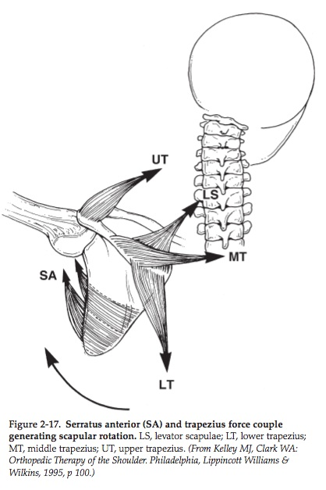
Scapulothoracic Force Couples
(Andrews, 2008)
Notes:
-Figure depicting how the traps, levator and SA all work together to provide motion at the scapulothoracic joint

Slide 14
Sport-specific demands

Slide 15
Sport-Specific Demands
Baseball
Pitching and throwing
Daniel Bard pitch (GO HEELS!)
Tennis
Serve and overhead strokes
Federer serve
Volleyball
Serve and spike
Slow motion spike
Don’t forget others like swimming, football and handball!
Notes:
**First step → knowing what you’re working with! Must be able to understand the biomechanics of the athlete’s motion!
-angular velocities for baseball throwing range from 6500 -7200 deg/sec and that can cause an anterior humeral distraction force of 1-1.5x athlete’s body weight (Yildiz)
-IR angular velocities for tennis serve can reach 1370-2420 deg/sec (Athlete’s Shoulder)
-For volleyball, eccentric control needed during all phases to compress humeral head; supra, infra and teres minor eccentrically control humeral head translation (Marello)
-focusing on these three motions, but there are certainly other sports that involve OH activity (swimming, football, handball, softball, javelin throwing, football, etc)
-these three tasks are all relatively similar and usually will present with similar patterns

Slide 16
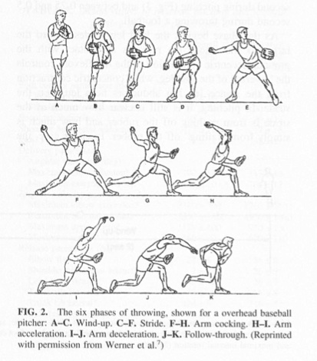
Phases of Pitching
(Wilk, 2000)
Notes:
A-C: wind-up – low muscle activity (Athlete’s Shoudler)
C-F: stride
F-H: Arm cocking – SA and trap muscles with mid deltoid and supraspinatus keep humeral head congruent
H-I: Arm acceleration – shoulder experiences inc in forces (max ER/hor abd) and subscap, lat, pec major are active to provide stability; infra and teres minor very active
I-J: Arm deceleration – kinetic energy left over transferred to shoulder; posterior musculature help to decelerate (teres minor, subscap)
J-K: Follow-through
-Wilk’s biomechanics of throwing article gives a great description of these phases and their intricacies including muscle activation at each of the phases which is a bit beyond the extent of this presentation but easily accessed!

Slide 17
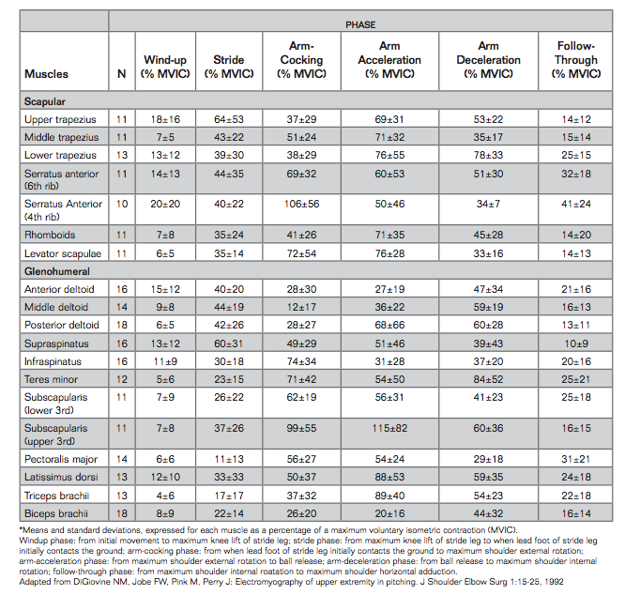
Notes:
-Table from The Athlete’s Shoulder detailing force of contraction of muscles broken down by pitching phase
-Detailing from the slide before where the muscles are working the most throughout the pitching motion
-Arm-cocking phase: Compared to healthy pitchers, those with ant instability will show more activity from biceps, infra and supra

Slide 18
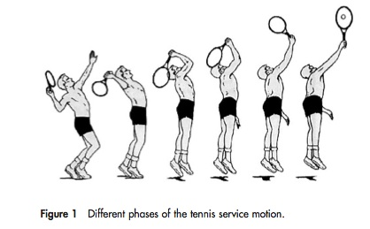
Phases of Tennis Serve
(van der Hoeven, 2006; Kibler, 2006)
Notes:
Wind up: start of motion to ball release
Early cocking
Late cocking – ball release to max shoulder ER
Acceleration: max shoulder ER to racket contact with ball
Follow-through: racket contact to finish of stroke
(The Athlete’s Shoulder)

Slide 19
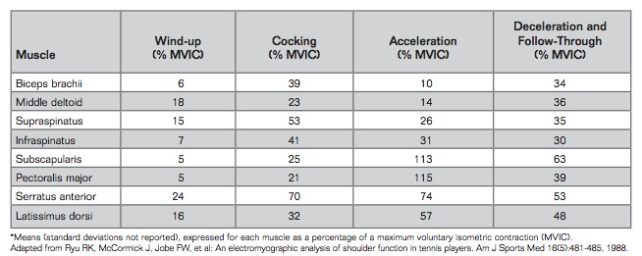
EMG Muscle Activity for Tennis Serve
(Andrews, 2009)
Notes:
From same chapter in The Athlete’s Shoulder depicting the strength needed!

Slide 20
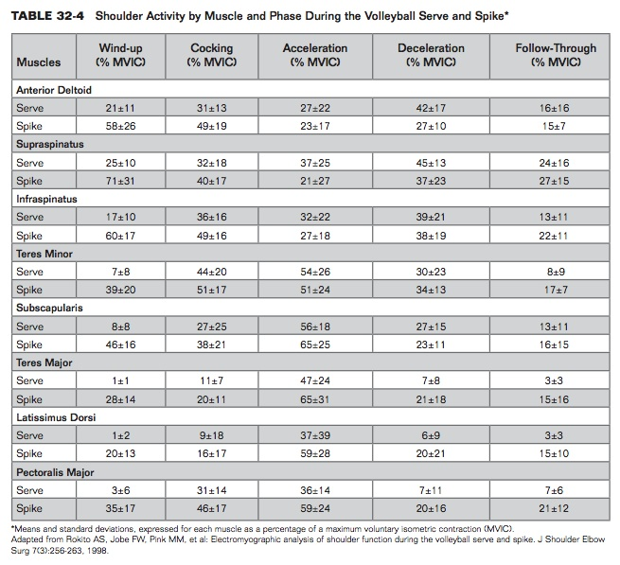
Notes:
-forces are not as high, but involve the same principles
-forces are the highest in ALL of these motions during the cocking/acceleration/deceleration phases!

Slide 21
the OverHead athlete
Humeral torsions
Altered length-tension relationships
Rotator cuff strengthening
Proprioception
Kinetic Chain/Linking
Notes:
Things to consider in while planning the treatment of an overhead athlete
-humeral versions → adaptations of the dominant arm
-altered LT relationships → scapular dyskinesia and effects on muscle performance
-RTC strengthening → not as easy as you think! Incorporate role of fatigue and eccentrics and then advance to plyo!
-joint position sense and proprioception → can’t forget about this!! ; knowing where the arm is in space so that muscles fire appropriately
-kinetic chain/linking → the rest of the body plays a role too!

Slide 22
Humeral TORsion

Slide 23
Humeral torsion
Humeral head retroTORSION
Osseous adaptive changes that occur in OH athletes affecting the torsional angle of the humerus (Crockett, 2002; Pieper, 1998)
Beneficial adaption allowing for increased ER before soft tissue restraint (Sabick, 2005; Crockett, 2002)
Due to repetitive stress on humerus during throwing motion and muscle action (Pieper, 1998; Sabick, 2005)
Greatest change between 12-13 yrs when growth plates are open (Wilk, 2009)
Notes:
**This is important to consider when you think about an OH athlete with suspected posterior capsule tightness…could it be that there humerus bony anatomy has actually changed and adapted to their activity???
-Normal amount of torsion = 27-33 deg (Sabick)
-This has implications with GIRD and IR deficits that can be found in OH athletes → always have to consider the TOTAL ARC OF MOTION
-Previous thought that the altered arc of motion is a physiologic adaption of shoulder due to repetitive microtrauma that stretches the ant capsule and tightens the post capsule = ant translation of the humeral head in glenoid fossa (Crockett)
-humeral head retroversion: more posteriorly directed humeral head axis relative to the elbow axis (Sabick)
-stresses put on the anterior capsule and ligaments occurs later in the cocking phase than in those without the osseous adaption (Sabick)
-Muscles providing the torque on the shoulder and at the elbow during the cocking phase can create forces in opposite directions (IR at the shoulder from the subscap, pec,

Slide 24
Humeral Retrotorsion
(Pieper 1998)

Slide 25
Humeral torsion
Sabick et al. 2005
Amount of repetitive torque can cause growth plate injuries
Crockett et al. 2002
The adaptation comes from the repetitive activity
Pieper et al. 2005
The increased retrotorsion can actually be HELPFUL to OH athletes!
Notes:
-Sabick: young baseball pitchers looking at growth plate injuries due to ER torque → Torque of 17.7 Nm in ER
*at end of cocking phase → eccentric IR from lats, subscap and pec proximally at the humerus while the elbow is still experiencing ER torque
-Crockett: humeral head retroversion of 40 deg vs 23 in non-throwing; Same torsion in non-dominant arms of OH athletes vs. controls
Significant humeral head and glenoid retrotorsion in dominant shoulder of OH athletes
-Pieper: humeral head retroversion of 9.4 deg
those without shoulder pain = 14.4 deg
7.62 more degrees than control
Significant increase in retrotorsion of throwing arm vs. non-throwing arm
***Found torsional angles increased in players without shoulder pain

Slide 26
Altered Length-Tension Relationships

Slide 27
Altered L-T Relationships
Slight deviations in positions of the shoulder can cause malalignment of GH muscles and alter muscle forces (Meyers, 2005; Cools, 2007)
Muscle Strength
Delayed muscle firing (Kennedy, 2009)
The scapula!
Protraction/Retraction strength ratio (Merolla, 2010; Smith, 2006)
Thoracic spine kyphotic posture (Seitz 2011; Kabaeste, 1999)
Notes:
-Deviations occur because the scapula has a direct effect on the orientation of the glenoid and scapular stabilizers are likely the first muscles to become weak!
*Meyers et al = study that found inc scap upward rotation needed for clearning impingement and inc IR = decreased SA space and inability to clear the greater tubercle
-Muscle strength of traps: if there is an alteration in muscle strength → altered scapular movement
*Cools et al = study in healthy OH athletes: alteration to these ratios for the trap muscles can cause decreased neuromuscular coordination and therefore malpositioning of the scapula
UT/MT and UT/LT ratios → 1.23 – 1.36 (Cools 2007)
MT/LT ratio → 0.92 – 1.09 (Cools 2007)
*Kennedy ***First line of rehab action = correct abnormal muscle firing to address delayed onset of LT and SA
-Protraction/retraction ratio:
*Merolla et al = in VB players with shoulder pain, found increased infraspinatus strength with retracted scapula (scapular reposition test which we talk about later)
*Smith = protraction lengthens the lats and puts pec major in shortened position
- Thoracic posture : Kabaeste’s study found that slouched posture = less upward rotation and posterior tilt while increasing IR throughout arm abduction in scapular plane

Slide 28
Altered L-T of deltoid and supraspinatus
(Kebaetse, 1999)
Notes:
-can see from this picture that with kyphotic thoracic posture, the scapula tilts anteriorly and is internally rotated putting the deltoid and supraspinatus in a shortened position
-how many athletes do you see with rounded shoulders???

Slide 29
Altered Length-Tension Relationships
Scapula, scapula, scapula!
Scapular dyskinesia a.k.a. SICK scapula
Scapular malposition
Inferior medial border prominence
Coracoid pain and malposition
DyKinesis of scapular movement (Burkhart, 2003)
Types of SICK scapula
I: inferior medial border prominence (example)
II: medial scapular border prominence
III: prominence of the superiomedial border
Notes:
-the scapula is the attachment site for 17 muscles involved in UE motion!!!
-SICK scapula = overuse muscular fatigue syndrome (Burkhart) → already talked about it *I: caused by weak LT, lats, serratus ant; tight pecs
II: weak serratus, rhomboids, traps; tight humeral rotators
III: overactive levator scap and upper trap; imbalance of force coupling (McMorris)
-protraction of the scapula can result in dec subacromial space, increased strain on ant/inf GH ligament, decreased arc of GH elevation, dec in isometric abduction/elevation strength (smith 2006) (tate 2008)
-thoracic spine kyphotic posture is associated with decrease in subacromial space and decrease in scap post tilt = altered L-T relationships (Seitz 2011)

Slide 30
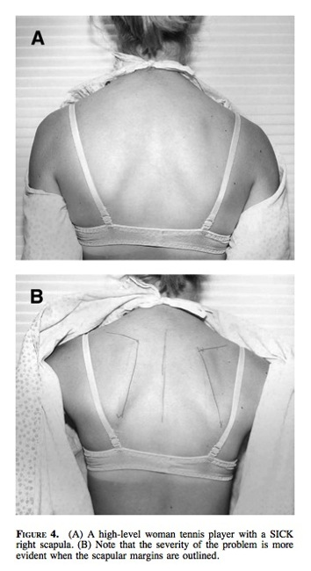
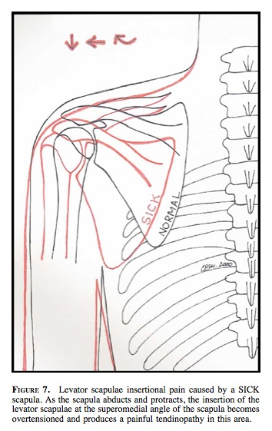
(Burkhart, 2003)
Notes:
-can see the prominence of the R shoulder once the borders have been outlined
-also can see that the R (dominant) shoulder appears to be lower than the other shoulder
-can see from the sketch the movement of the scapula to become depressed, protracted, and upwardly rotated

Slide 31
Altered L-T Relationships
Special testing of the scapula (Burkhart, 2003)
Scapular assistance test (SAT)
Assist upward rotation
+ test = relief of symptoms
Scapular retraction test (SRT)
Manually positioning and stabilizing entire medial border during active abduction
+ test = increased strength with stabilization or decreased pain symptoms
Notes:
-SAT: manually stabilizing the upper medial border and rotating the inferomedial border as arm is abducted
-SRT gives the scapula posterior tilt, ER and retraction of the scap to restore the L-T relationships of the RTC muscles and deltoid and also encourages upper thoracic extension (Tate, Burkhart)

Slide 32
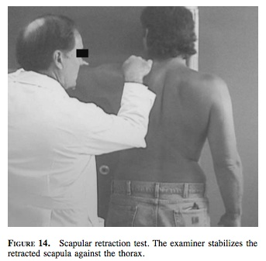
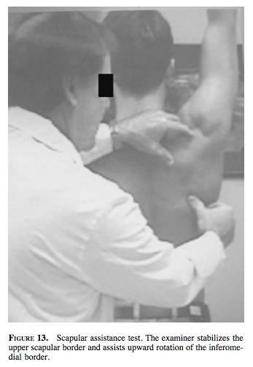
SRT and SAT Testing
(Burkhart, 2003)

Slide 33
Strengthening

Slide 34
Strengthening
Not all strength training is created equal!
Different methods required for strength training OH athletes vs. other shoulder patients
GH rotational and scapulothoracic strength ratios are going to be different! (Wilk 2009)
Consider what the muscles need to do during the motion
Notes:
-GH rotational strength and baseball pitcher
ER should be at 65% of IR strength
ER : IR ratio should range from 66-75%
*most likely going to see that the IR are stronger than ER, even might have some ER atrophy
-ST strength and baseball pitcher
Protraction : Retraction = 87%
Elevation : Depression = 27%
-Consider the charts we had in the beginning of the presentation depicting the contraction %ages in the different stages – can be a great clue of what to test and then what to strengthen

Slide 35
Strengthening
Thrower’s Ten Program (Wilk 2002, 2009)
Implemented in intermediate stage of rehab
Includes exercises for the shoulder, wrist and elbow
ER/IR at 0° and 90° abduction and side-lying
Scaption
Push-ups and press-ups
Elbow flexion/extension
Wrist flexion/extension, supination/pronation
Prone exercises for scapulothoracic musculature
Notes:
-popular program that can be initiated early in the rehab progression
-targets the muscles that are providing the dynamic stability to the GH joint
These are great to get the athlete started…but what else do we need to look at with strengthening??

Slide 36
strengthening
Fatigue
Can cause superior translation of humeral head during initiation of abduction (Wilk 2009)
Causes altered kinematics, force couples and muscle activation patterns (Joshi, 2011)
Decreased sensorimotor and proprioception activity (Tripp, 2004)
A relationship exists between fatigue, neuromuscular control and proprioception (Bowman, 2006)
Notes:
-conflicting evidence on scapular upward rotation (Joshi) – some say that it increases but some also see a decrease
-altered kinematics
Decrease in scapular post tilt and ER
Increased protraction (Wilk 2009)
Increase clavicular retraction (Joshi)
Scapular upward rotation (?)
-increased scapular ant tilt associated with fatigue = loss of GH IR (Wilk 2009)

Slide 37
Fatigue
Tripp et al. 2004
Functional fatigue program produced increased proprioceptive error
Bowman et al. 2006
Fatigue caused increase in deceleration time during throw
Szucs et al. 2009
Altered clavical and scapulothoracic positioning
Joshi et al. 2011
Force couple between LT and infraspinatus altered with glenohumeral ER fatigue
Notes:
-Tripp: functional fatiguing of actual throwing to simulate sport requirements = errors in joint reposition tests
Bowman: functional fatiguing of throwing showed inc in deceleration time which the authors think is a protective mechanism for the muscles so that inc time = less force required by the muscles to slow down the motion (they performed testing in machine)
Szucs: fatigued using a push up with a plus to target the SA and LT and found that inc UT activation resulted in clavicle elevation and therefore scapular upward rotation
Fatiguing of the SA and LT resulted in increased UT activity
Joshi: used prone GH ER for fatiguing exercise and found inc upward rotation of scapula during ascending phase of D2 PNF pattern
*** how much worse is the fatigue from actual sport participation than these lab-induced situations! (add mental fatigue!)
Must train muscular endurance in scapular stabilizers (Kennedy, 2009)
Specific endurance exercises (Wilk 2002, 2009) → want to make the exercises specific to the muscles that are going to be worked/fatigued during play! Think about the muscles with the most MVIC’s and what part of the motion

Slide 38
Fatigue
Infraspinatus
Teres Minor
Serratus Anterior
Subscapularis
Lower Trapezius
THE MOST BANG FOR YOUR BUCK
Video
Notes:
Look at exercises where you are getting the most amount of muscle activity out of the muscle you are targeting
-most EMG activity of infra found performing prone horiz abd with ER
-most EMG activity of teres minor in S/L ER (Andrews)
-for serratus anterior – dynamic hug, push-up with plus, flexion/horiz add/ER diagonal exercise
-subscap: D2 exercises (drawing the sword)
-lower trap: prone horiz abd with full ER; abduction in line with fibers of trap
-also want to consider strengthening these muscles in their functional positions → 90 deg of abd (Andrews)

Slide 39
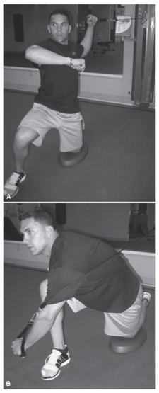
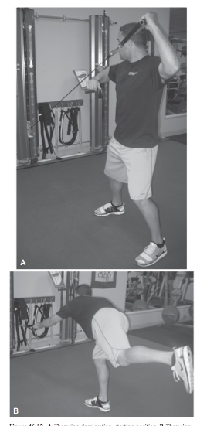
Fatigue
Notes:
Going to want to fatigue the muscles FUNCTIONALLY
Throwing motion
Chopping
D1/D2 patterns→ like that in the exercise video

Slide 40
Fatigue
Video
Notes:
-high reps and low weight to target muscular endurance

Slide 41
Strengthening
Eccentrics
Need the appropriate balance of strength (Kennedy, 2009)
Concentric ER : Eccentric IR during arm-cocking phase (Yildiz, 2006)
Concentric IR : Eccentric ER during deceleration phase (Noffal, 2003; Kennedy, 2009)
Notes:
-”functional ratio” of eccentric ER to concentric IR
-Eccentric and concentric strength → in looking at OH athletes, this is a major thing to consider because this can determine how well the muscles are able to work against the demand being placed on them
*suggested in The Athlete’s Shoulder that anterior musculature (accelerators) concentrically strengthened and posterior (decelerators) eccentrically trained
-For the baseball throwing motion (and likely all these overhead activities) the IR strength is going to be greater than the ER (Trasik 2008) – but have to ask relative to concentric or eccentric action
-ratios of around 1 for the dominant arm (Yildiz) for eccentric ER to concentric IR which is less than the 2:1 ratio for eccentric IR/concentric ER
***combination of dec ER eccentric strength and inc in IR strength (Noffal and Yildiz)
**Demonstrate with throwing motion

Slide 42
Eccentrics
Noffal 2003
Lower ratio eccentric ER strength : concentric IR strength - indicating that athletes are gaining in one area and not the other
Yildiz et al. 2006
Different ratios are found based on the phase of throwing
Arm-cocking phase
Deceleration phase
Notes:
Noffal: tested conc and ecc strength of non-dom and dominant shoulder and found peak torque values in IR/ER
Found greater eccentric ER strength than concentric IR strength with ratios > 1
Lower ratios in athletes vs. non-athletes
Lower ratios between athletes and non-athletes indicate that athlete has greater strength gains in IR concentric strength without similar gains in ER eccentric strength
Yildiz: tested cadets for IR/ER strength ratios
* arm-cocking = eccentric IR/Concentric ER
2.09 in dominant arm
1.58 in non-dominant arm
*deceleration = eccentric ER/concentric IR
1.03 in dominant arm
1.19 in non-dominant arm
- Implications for increase eccentric ER to compensate for massive increase in concentric IR

Slide 43
Eccentrics
Video
Notes:
-exercises where you facilitate the concentric part of the motion and then they perform the eccentric part
-can use a higher weight for these
-alter the speeds so that you are building strength with slower movement but then making it functional and including the actual speed of the OH motion

Slide 44
Plyometrics
**Used in the advanced strengthening phase (Wilk, 2009)
Quick stretch of muscle from eccentric action to concentric action (Davies, 2001; Wilk 2002, 2009)
Eccentric phase → amortization phase → concentric phase
Dynamic neuromuscular stabilization (Carter, 2007)
May facilitate neural adaptations to enhance proprioception, kinesthesia, and muscle performance
Notes:
-definition: Refining ability to perform maximal muscle effort in minimal amount of time (Carter, Davies)
Stretch-shortening cycle of OH activities – Davies
-enhance reflex joint stabilization by integrating spinal and brainstem levels of reflex control (Griffin)
-eccentric (stretching) → amortization (transition between eccentric and concentric) → concentric (Pretz, Wilk and others)
-plyometrics are postulated to be most effective for “group 1” muscles: flex, add, IR → pecs, lats, subscap
-baseball: cocking phase = stretch to provide the kinetic energy that is then placed into throwing of the ball; the same can be said for volleyball and tennis even though the cocking phases are shorter (Davies)
-rebound force response: when storage of kinetic energy converts to increased muscle work – dependent on time, magnitude of the stretch, velocity of the stretch and muscle fiber type
- best when the eccentric prestretch is short, with short ROM and occurs quickly at a high velocity and intensity to elicit fast- twitch fibers
- cocking phase followed by the massive eccentric control needed during the follow-through to stop the motion
**contraindications to plyo → inflammation or soft tissue pain

Slide 45
Plyometrics
Heiderscheit et al. 1996
Increase in concentric/eccentric strength
Swanik et al. 2002
Plyometric training improved performance on reposition and kinesthetic testing
Carter et al. 2007
Significant increase in throwing velocity
Peters et al. 2007
No weakness, pain or muscular fatigue at end of tx
Notes:
-Heiderscheit: used isokinetic and plyometric groups who trained for 2x/wk for 8 weeks for NON-ATHLETE females
No change in throwing distance
No significant change in kinesthesia
-Swanik: Div I swimmers incorporated plyometrics into other training; suggested that with no strength gains..this should be used when strength is established already
Improved contraction time (time to peak torque)
-Carter: Div I baseball players separated into regular cardio/strength group and plyo group (2x/wk for 8 weeks of ballistic six ex) – saw no sig differences in strength gains
-Peters: case study of middle school pitcher with plyos targeting IR, ER, OH and pitching motions

Slide 46
Plyometrics
Ballistic 6 Exercises (Pretz)
ER with theraband @ 0° shoulder abduction
ER with theraband @ 90° shoulder abduction
Overhead “soccer throw-in” with medicine ball
90/90 ER side-throw
Deceleration baseball throw (can be done standing or half-kneeling) Example
Baseball throw
Notes:
-made to mimic the phases of the throwing motion where RTC needs to work the hardest: cocking, deceleration, and follow-through phases (pretz)
-smaller weight ball for the 1-hand exercises and more weight for the 2-handed exercises
Progression
3x10 with 2lb/6lb ball
3x15 with 2.5lb/8lb ball
3x20 with 2.5lb/10lb ball

Slide 47
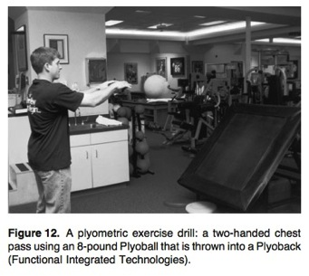
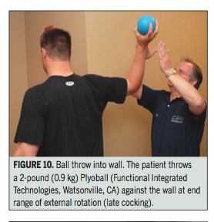
PlyometriCS
Wilk et al. 2002, 2009
Two-handed exercises using trampoline
Progress to one-handed drills
Notes:
-Two-handed exercises
i.e. chest pass, OH soccer throw, side-to-side throw, side throws
-one-handed exercises
i.e. standing one-handed throws in functional throwing position, wall dribbling, plyometric step-and-throws

Slide 48
PlyometriCS
Video
Notes:
-videos
90/90 prone ball catch/release for posterior strengthening
90/90 reverse catch (Chapter 35)
Trampoline exercises
Ball on wall

Slide 49
Proprioception

Slide 50
Proprioception
Somatosensory system
Proprioceptive mechanoreceptors located in the glenohumeral ligaments and labrum (Safran, 2001)
Helps to promote dynamic stability of the joint (Wilk, 2002)
Microtrauma might affect this feedback loop (Safran, 2001)
Components (Tripp, 2006)
Kinesthesia
Joint position sense (active or passive)
Neuromuscular control
Notes:
Somatosensory system = provides info concerning the orientation of body segments relative to one another and the support surface (Griffin)
Related to capsular tension**
-mechanoreceptors: pacinian corpuscles, meissner corpuscles, GTOs, muscle spindle cells, Ruffini nerve endings, free nerve endings (Griffin)
-at the spinal level = dynamic muscular stabilization
**when training neuromuscular control – can look at both open and closed chain exercise (but the athlete is generally in the OPEN CHAIN so make sure thes are performed correctly..think about progressing from closed-chain to open-chain)
-open chain: facilitate dynamic control and kinesthetic awareness
-closed chain: static stability and stimulates neuromuscular proprioceptors for static control

Slide 51
Proprioception
Safran et al. 2001
Suggest that shift in capsular tension affects proprioceptive input
Tripp et al. 1998
Less accuracy and greater variability with scapular positioning in OH athletes
Rogol et al. 1998
Exercise training can improve joint position sense
Myers et al. 2006
Exercise training can improve joint position sense in OH athletes!
Notes:
-Safran proprioception testing: threshold for detecting passive movement
*Pitchers who reported having pain performed poorly in proprioception testing
-Tripp: found less accuracy and greater variability with scapular positioning (IR, post tilting, upward rotation, etc.)
Baseball players less accurate in reposition tests in ball-release position than arm-cocking phase
Mid-range vs. end-range motions
**at mid-range motions, needing that muscular dynamic stability!!
**capsular tension at end ranges provide more proprioceptive input
-Rogol: only looked at push-ups and bench press…we can get so much more specific!!
*significant decrease in amount of error for active/passive joint reposition testing
-Myers: pain can be a major factor in decreased proprioception
found that re-establishing tension in the capsule and ligaments can improve joint position sense
shoulder plyometrics in swimmers were beneficial; eccentric loading!
repeating perturbation tasks

Slide 52
Proprioception
What to do
Rhythmic stabilization
Proprioceptive neuromuscular facilitation (PNF) patterns
Closed-chain → open-chain of the UE (Wilk, 2002, 2009; Griffin, 2003; Andrews, 2009)
Mix it up!
Use the motor patterns of the sport-specific movement (Griffin, 2003)
Notes:
Facilitate agonist/antagonist co-activation (Wilk 2009)
Rhythmic stabilization can be performed throughout the throwing motion in supine/sitting/standing and with scapula protracted/retracted
**example with Angela L
CKC exercises help to facilitate activation of the articular receptors (Wilk 2009)
i.e. weight-shifting, wall push-ups, etc.
Using an unstable surface
Mix it up!
Angles
Speeds
Rhythmic stabilization: at varying angles throughout throwing motion or during PNF pattern
*vibration with body blade while rotating

Slide 53
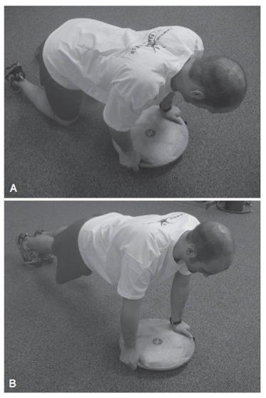
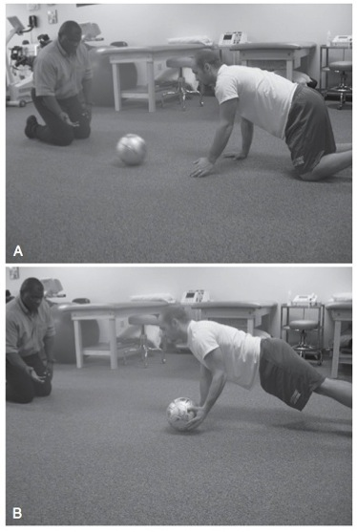
Proprioception
Notes:
-walk outs on a step
-can progress these exercises with using bosu ball/wobble board

Slide 54
Proprioception
Video

Slide 55
The Kinetic Chain

Slide 56
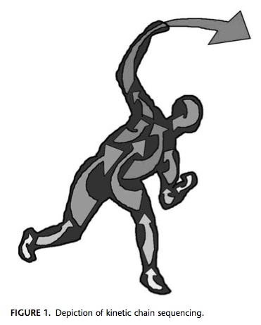
Sequence of Force Generation
(Sciascia, 2012)

Slide 57
Kinetic Chain
Not just the shoulder!
All OH activities have contributions from core and LE’s (Kibler, 2012; Kennedy, 2009; Burkhart, 2003; Sciascia, 2012)
Sequential linking of all the body segments (Kibler, 2000; van der Hoeven, 2006)
Provides power and force before the swing/throw
Motor programming (Kibler, 2012)
Length-dependent pattern
Force-dependent pattern
Notes:
54% of total force created by hips/leg/trunk for throwing (van der Hoeven 2006,Sciascia); 50-55% of force in tennis serve
-sequential linking: the ground, legs and trunk = force generators; shoulder = funnel and force generator; arm = force delivery mechanism (Burkhart)
***the force comes from the hip and trunk counter-rotation/rotation movement
-Motor programs (Kibler 2012): result in trunk and LE muscle activation before moving the UE creating a proximal base to not disturb equilibrium
length-dependent: operate locally at one joint, resist joint perturbations, result in co-contraction force coupling
force-dependent: harmonize motions of several joints, coordinate joint motions, use agonist/antagonist force couple activation to generate force
**these programs rely on proprioceptive and sensory input in order to promote proper activation
-For tennis: found that those players with a deeper knee bend (generating more force through LE) had less IR torque when shoulder in max ER (Andrews)
*without adequate knee bend = 23-27% increase in rotational forces at the shoulder and elbow (Sciascia)
-Can start early → focus on synchronizing hip and shoulder motions
-If there are ROM restrictions in the core and LEs, could get compensation from the shoulder!

Slide 58
Kinetic Chain
Leg and trunk (Burkhart, 2003)
Core (Sciascia, 2012)
Thoracolumbar fascia
A CHAIN of events
Weakness of hip abductors or trunk flexors →
Increased lumbar lordosis in acceleration →
Arm placed behind the body →
Arm in hyperabduction/ER position
Notes:
-Leg and Trunk
Stable base for arm rotation
Rotational momentum for force generation
-Core
Segmental spinal stability for local trunk strength and balance
Efficient transfer of the energy from LE to UE
-Fascia = ultimate connection between low back and shoulder that provides 3D support with connections to abdominal muscles as well (Sciascia)
***Tennis-specific adaptations (Kibler 2000)
Excessive trunk lean
Leading with the elbow

Slide 59
Kinetic Chain
Training can start early (Kennedy, 2009)
Check to see if there are ROM deficits in anywhere along the kinetic chain (Kennedy, 2009; Burkhart, 2003; Sciascia, 2012)
Look for asymmetries, compensations, etc.
Notes:
Common testing
Flexbility: LB, trunk, LE
Stability and balance in 1-legged stance
1-leg squat
1-leg step up/down
-Burkhart
* in 1-leg stance look for trendelenburg sign of hip dropping

Slide 60
Kinetic Chain
The Les, trunk and hips can all influence scapular movement
Progression of KC exercises (Kibler, 2012)
Pelvis control over planted leg (negative Trendelenburg sign)
Effective hip and trunk extension
No substitutions!
Notes:
-KC exercises for regaining scapular motion
*Hip extension and trunk rotation with scapular retraction
*Hip and trunk rotation with scapular retraction
-rotation and counter-rotation of the body with the arm = momentum

Slide 61
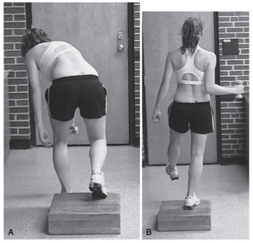
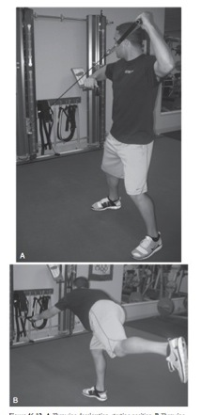
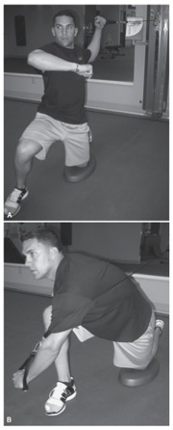
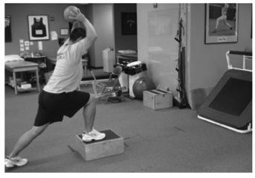
Kinetic Chain exercises
Notes:
Incorporate the whole chain into the movements!!
This is where the really fun part comes in!
-can progress by standing on dynadisc, changing speed,

Slide 62
Return-To-Sport

Slide 63
Return-to-sport
Dependent on the restoration of the physiologic patterns and biomechanical motions in the kinetic chain of function (Kibler, 2012)
Throwing athlete should reach 4 goals in their overall rehabilitation (Wilk, 2009)
If athlete has SICK scapula presentation, should be 50% improved in position before starting return-to-sport program (Burkhart, 2003)
Notes:
IT DEPENDS
-4 goals set for starting an interval throwing program
Satisfactory clinical exam
Non-painful ROM
Satisfactory isokinetic test results
“Appropriate” rehabilitation progress

Slide 64
Return-to-sport
Ellenbecker’s proposed tennis program
Ball progression
Stroke progression (groundstrokes to serve)
Interval throwing program (Wilk, 2009)
Gradually increase quantity, distance, intensity, and types of throws to facilitate proper mechanics
2 Phases:
Phase 1 → long-toss program 45-180 ft
Phase 2 → off-the-mound program
Notes:
-another specific throwing program in handout packet – Duke sports med
******Technique analysis is CRITICAL

Slide 65
Conclusions
The shoulder has A LOT of components
The OH athlete likely will have ROM that is different from other shoulder patients
Strengthening should focus on the demands of the sport and OH motion
Proprioception training is important to keep the athlete out of the training room later
Don’t forget the rest of the body!
Notes:
-Scapula is arguably THE most important thing to pay attention to with OH athletes!
-Strengthening → including concentric/eccentric muscle action; muscular endurance; plyometric training to mimic the transition between concentric to eccentric actions during the motion
-Those ROM deficits could be due to bony changes and not just a tight capsule! → always want to figure out why the athlete has the ROM deficit and if that is what is pathological!

Slide 66
THANK YOU!
Committee members: Mike Essa and Nicole Fox
Mike McMorris
Jon Hacke
Mike Gross
Betsy Frederick & Angela Gisselman

