Slide 1
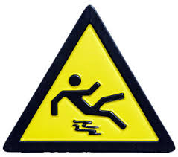
No Tumbles for Tyrrell!
Erin Hopper and Sarah Yancey

Slide 2
Falls?!? Are they even a big deal?

Slide 3
“Fun” Fall Facts
1 out of 3 adults over the age of 65 who live at home will fall each year¹
20-30% of those who fall will suffer injuries such as lacerations, brain injuries, or hip fractures
By age 90, one in four women and one in eight men will likely sustain a hip fracture from a fall²
Mortality post fracture is estimated between 10-20% with 50% resulting in permanent disability^{3,4}
Every 29 minutes, an older adults dies from a fall¹
Falls in the geriatric population accounted for $30 billion in direct medical costs in 2010⁵
Notes:
Falls represent a major threat to elderly patients and continue to create a huge public health problem
By 2030, 20% of Americans will be 65 or older
1 out of 2 adults over the age of 80 will fall each year

Slide 4
Where are people likely to fall?⁶
60% of falls occur in home
30% in the community
10% in institutions (i.e. nursing homes)
Notes:
Elderly adults may not take as many precautions when ambulating in the home. May feel more comfortable and safe in the home, leading to a false sense of security.

Slide 5
Multifactorial Causes^{3,7,8}
Decreased strength
Impaired balance and coordination
Vision impairment
Dizziness
Orthostatic hypotension
Environmental obstacles
Polypharmacy
Cognitive impairment
Impulsive behavior
Notes:
15% of all falls are unavoidable and would happen to anyone in any age group; 15% are due to a single precipitating event, such as a stroke or an episode of syncope; and the remaining 70% are due to multifactorial causes (Shubert)⁸

Slide 6
So are ALL elderly people at risk for falls?!?!

Slide 7
All Individuals 65 and older Should be Screened⁸
"Have you fallen in the past year?"
If a patient states that he or she has experienced 2 or more falls or has sustained an injury from a fall, the patient is considered to be at risk of falling.
Has the patient had an acute fall?
If the patient comes to the provider because of a fall, the patient is considered to be at risk of falling.
Does the patient have difficulty with walking or balance?
If the patient has difficulty performing the "Timed Up and Go" (TUG) or has a slow walking speed, the patient is considered to be at risk of falling.
Notes:
The American Geriatrics Society (AGS) advocates for all individuals aged 65 years and older to be screened for risk of falling.
Less than half of the Medicare beneficiaries who fell in the previous year talked to their health care provider about it (CDC STEADI) – VERY important to screen!
The AGS recommends a brief screening tool that includes 3 questions (patients are considered to be at a greater risk if they answer yes to one or more)

Slide 8
Important Risk Factors⁸
Previous falls
Balance impairments
Decreased muscle strength
Vision impairment
>4 medications or psychoactive medications
Gait impairment
Notes:
If a patient screens positive from the previous questions, they are fall related factors should be assessed
From a systematic review of 33 studies that assessed risk factors and falls or falls with injury, the factors identified in the greatest number of studies are listed (factors associated with the greatest relative risk)

Slide 9
Other Risk Factors for Falls⁸
Depression
Dizziness
Orthostatic hypotension
Functional limitations or limitations in activities of daily living (ADL)
Disabilities
Age > 80 years old
Female
Low body mass index
Urinary incontinence
Cognitive impairment
Arthritis
Diabetes
Pain
Notes:
The greater the number of risk factors, the more likely a fall will occur, ranging from 8% risk for one factor to 78% risk for 4 or more factors.

Slide 10
Intrinsic vs. Extrinsic Risk Factors¹
Intrinsic | Extrinsic
Advanced Age | Lack of Stair Handrails
Previous Falls | Poor Stair Design
Muscle Weakness | Lack of Bathroom Grab Bars
Gait & Balance Problems | Dim Lighting or Glare
Poor Vision | Obstacles & Tripping Hazards
Postural Hypotension | Slippery or Uneven Surfaces
Chronic Conditions (arthritis, diabetes, stroke, Parkinson’s, incontinence, dementia) | Psychoactive Medications
Fear of Falling* | Improper Use of Assistive Device
Notes:
Many older persons experience psychological difficulties directly related to the fall
Excessive fear of falling can cause seniors to limit their participation in physical and social activities, so that they become physically deconditioned, socially isolated, and depressed.²⁶

Slide 11
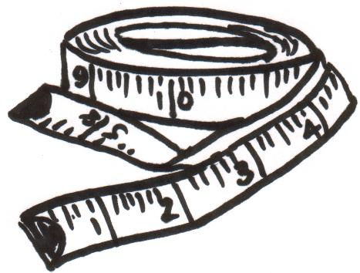
Functional Assessments¹
Help to further categorize level of risk after screening is complete and risk factors are identified
Timed “Up and Go” Test (TUG)
30 Second Chair Stand Test
4-Stage Balance Test
Measuring Orthostatic Blood Pressure
Notes:
The Centers for Disease Control has incorporated the AGS guidelines into the STEADI (Stopping Elderly, Accidents, Deaths, and Injuries) tool.
The STEADI was developed for health care providers who treat older adults, not just PTs
The STEADI provides the extra step of incorporating functional assessments with the screening questions to help further categorize level of risk.
Balance assessments we will use at the Senior Center – modifing the chair stand and 4-Stage Balance Test
Many more balance and gait assessment - Berg Balance Scale, BESTest, Tinetti Performance Oriented Mobility Assessment, Functional Reach, Dynamic Gait Index, Functional Gait Assessment, Four Square Step Test
Also several balance questionnaires: Activities-Specific Balance Confidence (ABC) Scale, Modified Falls Efficacy Scale (MFES)
Multifactorial fall risk assessment tools have recently been developed - Falls Risk Assessment Tool For Older People, Multifactorial Tool to Identify Multiple Fallers, and
Falls Risk Assessment Tool

Slide 12
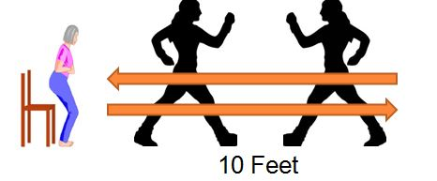
Timed “UP and Go Test” (TUG)^{9,10}
Participant is allowed a practice trial and allowed to use their regular assistive device
Participant is instructed to:
Stand from an arm chair
Walk three meters (~10 ft) at a usual, safe pace
Cross the line marked on the floor
Turn around
Walk back to the chair
Sit down
Using a stopwatch, record in seconds the time it takes to complete the task
Remember do not talk to the participant while they are completing the test

Slide 13
Timed “UP and Go Test” (TUG)
Cut-Off Scores
14 seconds is the cut-off value - designates those elderly adults who are at a higher risk for falls⁹
Fall Risk | Timed “Up and Go” Test (TUG)
High | >14 seconds
Moderate | 12-14 seconds
Low | <12 Seconds
Notes:
Scott et al – systematic review from 2007¹⁵

Slide 14
LET’S PRACTICE!!

Slide 15
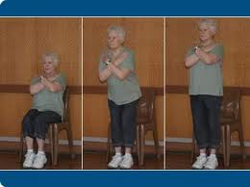
Five Times Sit to Stand Test (FTSS)¹⁶⁻¹⁹
Use a straight-backed firm chair
Place chair in front of a wall
Instruct person to stand up and sit down as quickly as possible five times with their arms folded across their chest
Using a stopwatch, record in seconds the time from the initial sitting position to the final standing position at the end of the fifth stand
Allow a maximum of two minutes to complete the test
Record whether the person was unsuccessful/successful and time in seconds
Notes:
Chair should be about 43 cm high with no armrests

Slide 16
Five Times Sit to Stand Test (FTSS)
Inability to perform the chair rise test more than doubles the risk of falling in high risk older adults⁸
The chair stand test is able to help predict mortality and institutionalization across a broad spectrum of functional statuses in community-dwelling elderly¹⁷
Strength AND visual contrast sensitivity, lower limb proprioception, tactile sensitivity, simple foot reaction time, postural sway, body weight, and reported pain, anxiety, and vitality were all found to be significantly associated with sit to stand performance²⁰
Notes:
Guralnik - time to walk 8 ft, ability to stand with feet together, in semi-tandem stance, in tandem stance, and chair stand test¹⁷
FTSS is an excellent, functional, quick, and easy assessment to administer that will evaluate multiple processes, not just strength, in older adults that might contribute to an increased risk of falls.

Slide 17
Five Times Sit to Stand Test (FTSS)
Cut-Off Scores
Greater than 15 seconds is the optimal cut-off time for predicting recurrent fallers using the FTSS in healthy community-dwelling elders²¹
Fall Risk Category | FTSS
High | >15 seconds
Moderate | 12-15 seconds
Low | <12 seconds

Slide 18
You know what time it is…LET’S PRACTICE!!

Slide 19
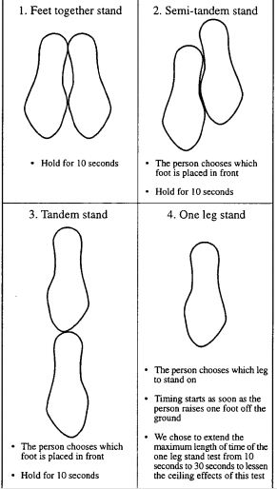
Four-Test Balance Scale^{15,22}
No practices or use of assistive devices
Test is carried out in bare feet
Help the person assume each foot position
Participant indicates when ready to begin unaided
If the participant is unable to assume the position, do not continue and mark as a failed task
Participant must hold each position for 10 seconds before progressing to the next task
Timing is stopped if:
Participant moves feet from the desired position
Assessor provides assistance to prevent a fall
Participant touches a wall or another external object for support
Notes:
Four timed static balance tasks of increasing difficulty that should be completed without assistive devices
“Try to stand in each position for 10 seconds, you can hold your arms out or move your body to help keep your balance but don’t move your feet. Hold this position until I tell you to stop.”

Slide 20
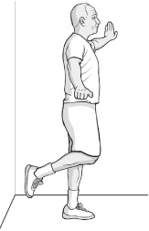
Four-Test Balance Scale
An older adult who can not hold the tandem stance for at least 10 seconds is at an increased risk of falling¹
An older adult who can not balance on one foot for at least 5 seconds has a significantly greater risk of injurious falls⁸
Able to discriminate balance over a wide range of health status in community-dwelling older adults^{24,25}

Slide 21
Four-Test Balance Scale
Fall Risk Category | Four-Test Balance Scale
High | Unable to Hold Tandem Stance 10 seconds
Moderate | Holds Tandem Stance for 10 seconds, but Holds One Leg Stance <10 seconds
Low | Holds One Leg Stance >10 seconds

Slide 22
MONKEY SEE, MONKEY DO… LET’S PRACTICE!!

Slide 23
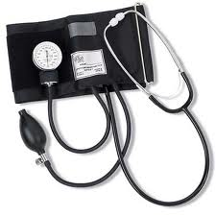
Measuring Orthostatic Blood pressure¹
Have the patient lie down for 5 minutes.
Measure blood pressure and pulse rate.
Have the patient stand.
Repeat blood pressure and pulse rate measurements after standing
1 minute
3 minutes
A drop in systolic BP of ≥ 20 mm HG, or in diastolic BP of ≥10 mm HG, or experiencing lightheadedness or dizziness is considered abnormal

Slide 24
So what if we find our elderly patient is at risk for falls?!?!

Slide 25
Preventing Falls¹
Providers should focus FIRST on these modifiable risk factors:
Lower body weakness
Difficulties with gait and balance
Use of psychoactive medications
Poor vision
Problems with feet and/or shoes
Home hazards

Slide 26
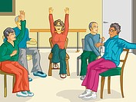
Evidence-Based Fall Prevention Programs⁸
Matter of Balance
Stepping On
Otago Exercise Program
Fallproof!
Tai Chi: Moving for Better Balance
Stay Active and Independent for Life (SAIL)
Notes:
Injury Prevention and Control Center of the Centers for Disease Control and Prevention in collaboration with the Administration on Aging advocates for the above programs
Otago – a set of leg muscle strengthening and balance retraining HOME exercises designed specifically to prevent falls¹⁵
Has been shown to reduce the number of falls and number of injuries resulting from falls by 35%
Home exercise programs may be more economical and allow greater access for rural elderly than group fall prevention programs

Slide 27
Home/Environment Modification
RISK FACTORS
Clutter
Remove clutter, cords, throw rugs!
Poor lighting
Use nightlights to brighten bedrooms, halls and bathrooms
Handrails
Best to have handrails on BOTH sides. Fix loose handrails.
Items that are hard to reach
Keep things you use often stored in an easy to reach place
Obstacles in walking paths
Always keep objects off the floor
Bathroom issues
Use a nonslip mat in the tub or shower
Install a grab bar next to the toilet and in the bathtub or shower

Slide 28
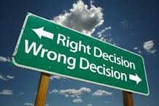
Behavioral Modification³
Using good judgment
Decrease risky behaviors (i.e. climbing on roofs, taking long walks in the neighborhood alone)
Wearing shoes in the house
Getting up slowly after laying or sitting down
Not rushing to answer the phone or doorbell
Using appropriate assistive device
Notes:
Behavioral modification for the caregiver may also be important. For example do not allow elderly person to use bathroom independently late at night.³
Many older adults may be resistive to using assistive devices, must thoroughly explain why they are important!

Slide 29
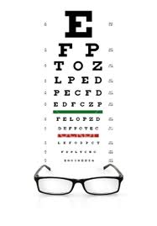
Medical Management⁸
Polypharmacy
Impaired vision
Impaired cognition
Abnormal heart rate or rhythm
Orthostatic hypotension
Impaired proprioception and sensation
Neurological impairment
Notes:
Consider referral to the appropriate health care provider if the patient has the following risk factors that put the patient at high risk of falling

Slide 30
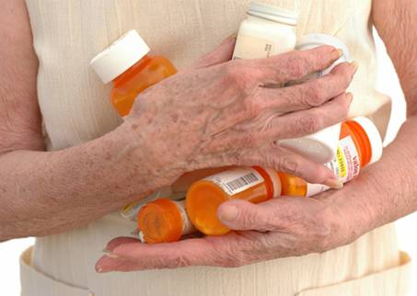
Medication Management¹
Eliminate medications if there is no active indication
Reduce doses of necessary medications (i.e.- antihypertensives) to the lowest effective dose
Avoid prescribing medications where risk of side effects outweigh the benefit (i.e. skeletal muscle relaxants)
Important to reduce or eliminate:
Psychoactive drugs (i.e. – benzodiazepines)
Medications that have an anticholinergic side effects
Sedating OTC medications (i.e. Tylenol PM – contains Benadryl)
Notes:
Elderly are more susceptible to anticholinergic adverse effects – blurred vision, dizziness, confusion, drowsiness, constipation, weakness, rapid heart rate
Anticholinergic agent is a substance that blocks the neurotransmitter acetylcholine in the central and peripheral nervous system

Slide 31
Specifics For Tyrrell
16.4% of persons in Tyrrell County are 65+ ²⁷
Unintentional injuries (excluding MVAs) are Tyrrell County’s 4th leading cause of death²⁸
White females have the highest mortality
Lack of fall prevention services in rural areas
Home safety assessments by PTs/OTs are not often feasible in rural settings because of the scarcity of providers.
Provide home safety checklist and modification tips to seniors in the area
We all have a role in preventing falls!

Slide 32
References
See Word Document for References!

