Slide 1
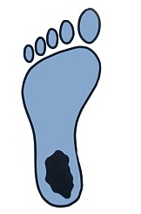
A Third-Year DPT Student TELLS ALL
ALEX Smith GORMLEY
BS, ECU 2008
DPT Candidate, UNC 2013

Slide 2
Objectives
Making yourself a strong candidate NOW!
The Application Process
The Interview Process
Q & A

Slide 3
A Little About Me...
Born in Greenville
Graduated in 2004 from JH Rose
Attended ECU on Tennis scholarship from 2004 - 2008
Received a BS in Rehab Studies in Dec. 2008
Pro at Cary Tennis Center 2009-2010
Entered UNC DPT Program Fall 2010
Just got married 12-28-12!
Currently living in Washington, DC
Will graduate this August and take the boards in July

Slide 4
Notes:
Not here to promote UNC’s program over ECU’s. I think they are both awesome! However, all of the information included in this Powerpoint pertains to UNC’s DPT program.

Slide 5
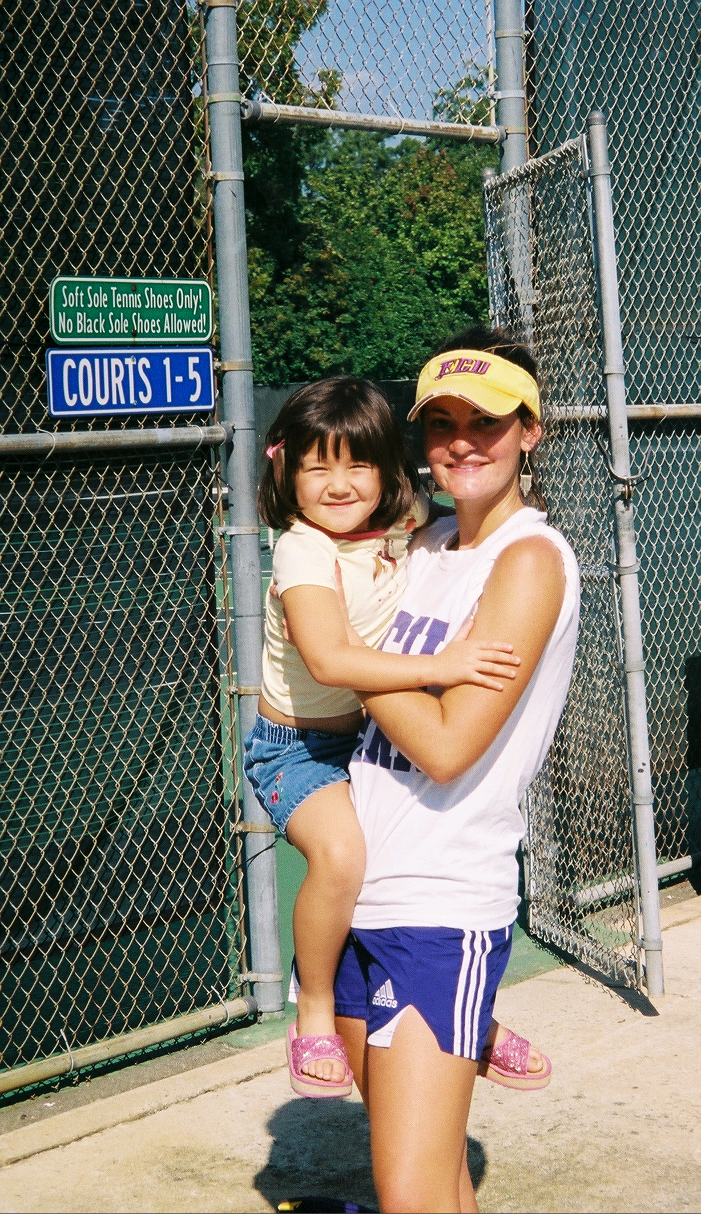
What Can You Do NOW
to Make Yourself a Strong Candidate LATER
Make “A”s—especially in pre-requisites
Start preparing NOW for GRE
Shadow PTs-make an impression
Build relationships with professors who can later write recommendations
Volunteer in meaningful ways (but guard your study time)
Keep-up with current events that relate to health care
Stay in shape!

Slide 6
Make “A”s in Your Prerequisite Courses
UNC
General Chemistry I with Lab (4 hrs.)
General Physics I and II with Lab (8 hrs.)
Intro Statistics (3 hrs.)
Biology I with Lab (4 hrs.)
Anatomy with Lab (4 hrs.)
Physiology (3 hrs.)
General Psychology (3 hrs.)
Exercise Physiology (3 hrs.)
ECU
General chemistry I and II with lab (8 hrs.)
General physics I and II with lab (8 hrs.)
Statistics (3 hrs.)
Exercise science statistics NOT acceptable
Biology (12 hrs.) to include:
8 hours of biology
1 semester of Human or Mammalian Physiology with lab
OR 4 hours of biology plus 2 semesters of Human A&P with Lab
College algebra or higher
Psychology (6 hrs.)
DPT admissions. Med.unc.edu Web sitehttp://www.med.unc.edu/ahs/physical/programs/DPT/DPT%20admissions
Admission information. ecu.edu Web site. http://www.ecu.edu/cs-dhs/pt/admissions.cfm
Notes:
In RED are the prereq’s that are exactly the same. Most of you will be applying to both ECU and UNC, so note the significant differences.
MY ADVICE: Make sure you take the Pre-Reqs for BOTH! While some of you will be lucky enough to get into both programs, some of you will get in one program and not the other.

Slide 7
So, I have taken (and done well) in all Prerequisites…. does it matter what I major in?
“What’s the best major for the DPT program at UNC?”
Notes:
Although in my class a good majority did major in Exercise phys/EXSS, half of the other majors were something other than EXSS. I interviewed a member of the admissions committee at UNC and when I asked her about majors she said, “We want students to major in something they can do WELL in!” You need to major in something that you can get A’s in and then really put a lot of effort into doing well in the prereqs class. Further, the admissions committee often likes seeing majors other than EXSS because they feel it makes the student more diverse.
Keep in mind while that EX Phys. may appear overly represented among those accepted, they are even more over-represented in those that applied. 100% of the Archeology and Rehab Studies majors who applied were accepted!

Slide 8
As long as you have the Prerequisites…. UNC DPT doesn’t care what you major in
3.8%
7.8%
46.1%
15.4%
19.3%
ECU DPT Class of 2013
Notes:
Although in my class a good majority did major in Exercise phys/EXSS, more than half of the other majors were something other than EXSS. I interviewed a member of the admissions committee at UNC and when I asked her about majors she said, “We want students to major in something they can do WELL in!” You need to major in something that you can get A’s in and then really put a lot of effort into doing well in the prereqs class. Further, the admissions committee often likes seeing majors other than EXSS because they feel it makes the student more diverse.

Slide 9
Choose the major you can do really well in!
(in a field you might want to work in.)

Slide 10
What about those letters of Recommendation?
They DO carry a lot of weight with the admissions committee.
Admissions committee has already cleared you academically when reading these.
Get people that KNOW you to write a GOOD one
One recommendation from someone in PT and 1 recommendation from someone in academia
“Coach-them-up when talking about you”
Give them your resume with your experiences and activities. Tell them what you do well so they can write about it.
You need to stand out!

Slide 11
Advice from a member in Admissions…
“Be honest about your academic skills: PT School is HARD!”
“Make sure you have the qualities it takes to be a good PT”
7 core values of good PT’s: accountability, altruism, compassion/caring, excellence, integrity, professional duty, social responsibility.¹
“We want to see well-rounded students… evidence that you can be successful with your school work while still pursuing other things.”
Being on a sports team, leadership roles in organizations, work, etc.
“We like diversity: what makes you different?”
Service learning/study abroad trips, change of career, first member of your family going to college, major other than EXSS or basic science.
Source¹: Professionalism & core values. PTCAS.org Web site. http://www.ptcas.org/Professionalism/

Slide 12
How to Apply?
PT Centralized Application Service (PTCAS)
http://www.ptcas.org/Deadlines/
Notes:
The PTCAS is an APTA service that allows applicants to use a single application and one set of materials to apply to multiple PT programs.
Some programs may require additional materials, such as supplemental applications.

Slide 13
Centralized Application Process
ALL course work MUST be completed by the end of the fall semester in which you are applying
Application deadline is generally mid-October
letters of recommendation, transcripts, and verified observation hours
Highly recommended that you get your application in early
Cost is ~ $85.00
**All info is based on this past year’s information. Make sure you continue to monitor the PTCAS website and all school’s you are interested in just in case there are any changes.**
Notes:
The PTCAS is an APTA service that allows applicants to use a single application and one set of materials to apply to multiple PT programs.
Some programs may require additional materials, such as supplemental applications.

Slide 14
UNC’s Application Process
The UNC DPT Admissions Committee initially screens all applications.
UNC receives approximately 500 applicants for 30 slots!
6%
Notes:
Only 6% get in. So maybe you need to major in something that you can also fall back on or that you could possibly go to grad school in later. The admissions committee initially screens all applications that come in. Usually UNC has about 450-500 applicants. Those who do not have the minimum requirements are automatically cut.

Slide 15
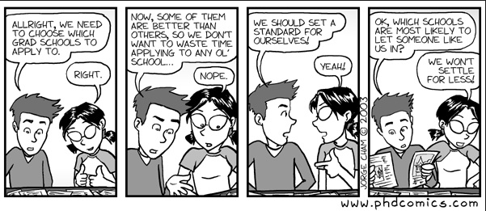
UNC’s Application Process
If you don’t have the minimum GPA and GRE requirements, then you don’t make it to the next stage
3.2 overall GPA; 3.2 prerequisite GPA
Minimum 20th percentile for each section of the GRE
~250 students cut after this round for not having the grades or GRE
Notes:
Those who do not have the minimum requirements are automatically cut.

Slide 16
UNC DPT Admission Statistics
Admission is increasingly competitive.
Source: DPT admissions. Med.unc.edu Web sitehttp://www.med.unc.edu/ahs/physical/programs/DPT/DPT%20admissions

Slide 17
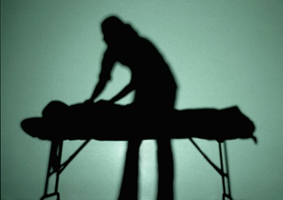
Shadowing is Critical
VARIETY of setting is more important than # of hours
Like to see at least 3 different settings with equal time spent in each
Ex. Acute care, inpatient rehab, outpatient ortho, neuro
75 hours minimum
Most students have between 150-200 hrs.
Major in something that requires an internship because it can be difficult to find PT’s to shadow
Ex. Rehab Studies, PreHealth Professions,
Notes:
I majored in Rehab Studies and as a part of my major I had to do a 450 hour internship. I did it through a PT at the hospital here. It was GREAT! I was able to get numerous hours in acute care and outpatient care and it counted toward my coursework. Plus because I put in so many hours I was able to establish a strong relationship with a PT who later wrote me a great letter of recommendation.

Slide 18
Is WHERE you received your degree important?
Notes:
Will compare the various schools where my classmates attended undergrad.

Slide 19
My Awesome Class: UNC DPT 2013

Slide 20
Where did we go to School?
15.4
3.8%
30.7%
34.6%
34.6%
30.7%
15.4%
Notes:
Only 20% in class of 2015 went to UNC-CH
In-State Students: 73%
Out of State: 27% Class of 2015 has ~36% out of state students
Female: 81%
Male: 19% HOWEVER, Class of 2015 has 50% males and 50% females!

Slide 21
Tuition and Fees: UNC 2011-2012
NC Resident:
$6,120 per semester
$12,240 per year (not including summer sessions)
Non-Resident:
$13,963 per semester
$27,926 per year (excluding summer sessions)
**Visit page 5 of this website for more info: http://www.unc.edu/finance/fd/c/sa/docs/11_12_tuitionfees.pdf**
Duke (Private Schools)
~$29,000 per year (tuition)
Estimated $21,000 cost of living
$50,000 per year!
There are numerous scholarships/awards/grants available through UNC DPT
http://www.med.unc.edu/ahs/student-services/pt-scholarships
Notes:
I will end up with 75-80 grand in student loan debt

Slide 22
The Interview Process
Notes:
Will explain how the interviews are set up at UNC and ECU. How long? Who interviews you? That “Meet and Greet”

Slide 23
UNC’s “Meet and Greet”
Notes:
The day before interviews UNC holds a “Meet and Greet” for the applicants. It is not mandatory! It is a couple hours long and is a come and go as you please type thing. There are no professors there but there are many current 2nd and 3rd years EAGER to meet you. It is okay to have a drink or two but DO NOT GET DRUNK. You NEED to be fresh for your interview (there are many people vying for your spot) plus there will be current students there who may interview you the next day. You want to make a good impression on them.)
This is a really enjoyable way to meet other applicants who may one day be your classmates.

Slide 24
Interview Day!
You choose a morning (~8 AM) or afternoon session (1 PM).
Are you a morning person? When will you perform best?
1 interview with a current student and a professor
1 interview with just a professor
Student Question and Answer Session with at least 2 of the faculty
Tour and general info about the PT Dept.
*At ECU, I did early interviews so the experience was a bit different, but was structured very similarly.
Student interview, interview with a professor, and a round table interview with 4 professors.

Slide 25
Interview Tips
BEFORE: PRACTICE, PRACTICE, PRACTICE!
Make your mistakes in a MOCK interview
Stay up-to-date with what is going on in healthcare, specifically how it relates to PT (general understanding)
Direct Access Issues
Working with the underserved
Health Disparities
“Affordable Care Act”
Listen to questions carefully and be brief and to the point with your answers
No rambling
1.5-2 mins max
Source: Physical therapy interview questions and tips for a great first impression. PT Connect Web site.
http://www.physical-therapy-connect.com/physical-therapy-interview-questions.html
Notes:
Those majoring in Public Health may have an advantage in the interview process because they have an academic background in health problems, health policy and health programs. I took 2 public health courses here at ECU and that helped me tremendously in my interview.

Slide 26
Interview Tips
Have questions you want to ask THEM (at least 2-3)
It will show you have done your research and will help you stand out
The better your questions, the better impression you will make!
Ex. “I saw on your website that your PT program puts great emphasis on research. Can you tell me a little bit more about research opportunities that students have?”
Provide examples that make you stand out.
Describe service-learning trips, talk about the languages you speak, explain why you chose your unusual major, etc.
Dress well, articulate your answers, make direct eye contact, and use their name in your questions/answers.
“Well Dr. K…”
Source: Physical therapy interview questions and tips for a great first impression. PT Connect Web site.
http://www.physical-therapy-connect.com/physical-therapy-interview-questions.html
Notes:
The better your questions, the better impression you will make!

Slide 27
Sample PT Questions…
Why do you want to be a PT?
Do not say (or write about in your essay), “I tore my ACL in middle school and loved my PT, which is why I want to be one” or “I want to help people.”
Can you tell me what you know about Direct Access and how it relates to PT?
They will ask questions similar to this so know what health care issues are currently impacting PT
Can you explain why some of your prerequisite grades were a little bit lower than your other grades?
Source: PT school interview questions. Calpoly.edu Web site. http://healthprofessions.calpoly.edu/interview_questions/physical_therapy.html

Slide 28
More Sample Questions…
What have you learned from your clinical experience (shadowing)?
What qualities do you see in yourself that relate to you as a professional?
What is your greatest accomplishment?
What is something people tell you that you need to work on?
Prepare answers to these questions and even if you don’t get the exact ones, you’ll probably still be able to better answer similar ones.
Source: PT school interview questions. Calpoly.edu Web site. http://healthprofessions.calpoly.edu/interview_questions/physical_therapy.html
Notes:
I have DPT interview handouts to take on their way out.

Slide 29
http://pinterest.com/uncucs/

Slide 30
Ecu.interviewstream.com

Slide 31
QUESTIONS?
Notes:
Q and A session with the students

Slide 32
T
T
H
A
N
K
S
!
I would really appreciate it if you could compete the post-quiz.
Just fold it together with your pre-quiz and put it on the table on your way out.

Slide 33
THANK YOU and GOOD LUCK!
If you need anything or think of any questions that were not answered here today, please do not hesitate to contact me. I would love to help!
Alex Smith Gormley
alexandra_smith@med.unc.edu
(252)916-1586

Slide 34
Special Thanks…
Lisa Johnston, PT, MS, DPT
UNC DPT Professor
Karen McCulloch, PT, PhD, NCS
UNC DPT Professor
Jon Hacke, PT, MA, DPT OCS
UNC DPT Professor
Mike McCammon, BA, MA
ECU Exercise Physiology Professor

