Slide 1
Bilateral Pole Walking:
Benefits & Considerations in
Adult Fitness & Rehabilitation
-Debra Gerber, PT
Notes:
Although use of a staff, hiking stick or single pole has been around for thousands of years, the emergence of the use of two poles as a fitness intervention became more popular in the mid 20th century, primarily in Finland – one account credits a PE teacher, Leena Jääskeläinen, promoting “walking with ski poles” for her lessons in the mid-1960’s.
Bilateral pole walking, or walking with a pole in each hand, has evolved and gained in popularity over the past 50+ years, especially in Europe For the remaining presentation I will refer to ‘bilateral pole walking’ simply as ‘pole walking,’ but please keep in mind I am referring to two poles and not one.

Slide 2
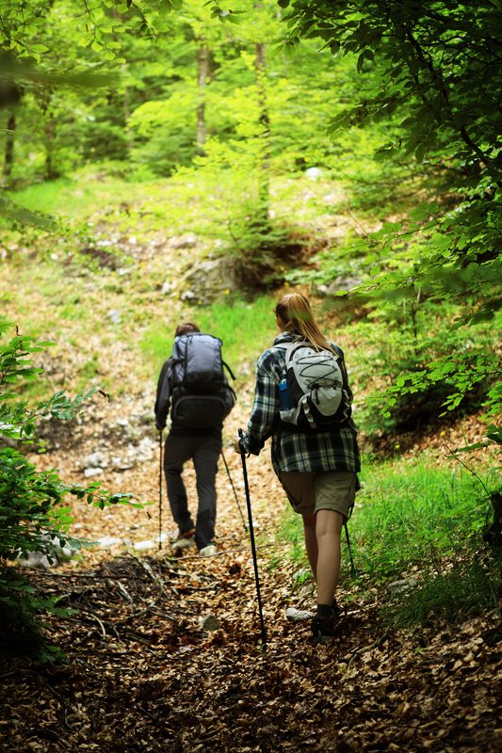
Notes:
The manufacturing of hiking or trekking poles has been around since the 1960s, and consumer demand may have arisen as an offshoot of using ski poles for walking. Pole designs and availability have continued to expand and evolve over time.

Slide 3
Nordic Walking Prevalence
( Pantzer, 2010)
Notes:
Nordic walking is a walking fitness activity that is one of the more popular forms of pole walking. As of 2005, the worldwide estimate of active Nordic walkers was around 6 million, mostly in Europe.

Slide 4
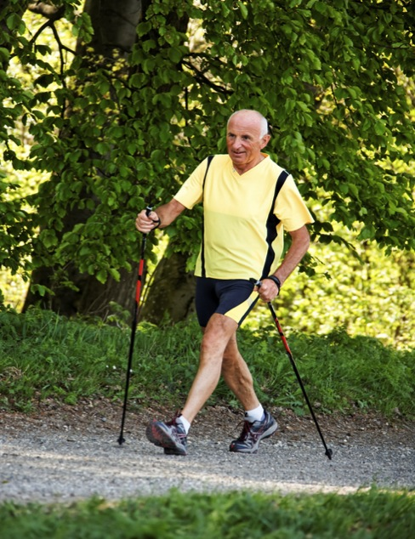
Notes:
Nordic walking, as described by the International Nordic Walking Association (INWA), uses poles to assist in propelling the body forwards, thereby increasing the use of the upper trunk and arm muscles. Pole placement is on the diagonal and is placed behind the forward foot for push-off in a bilaterally coordinated pattern. When the walking surface is on asphalt or sidewalks, a rubber tip is recommended, either bell-shaped or a specialized bootie that has a diagonal edge that is facing backwards for push-off.

Slide 5
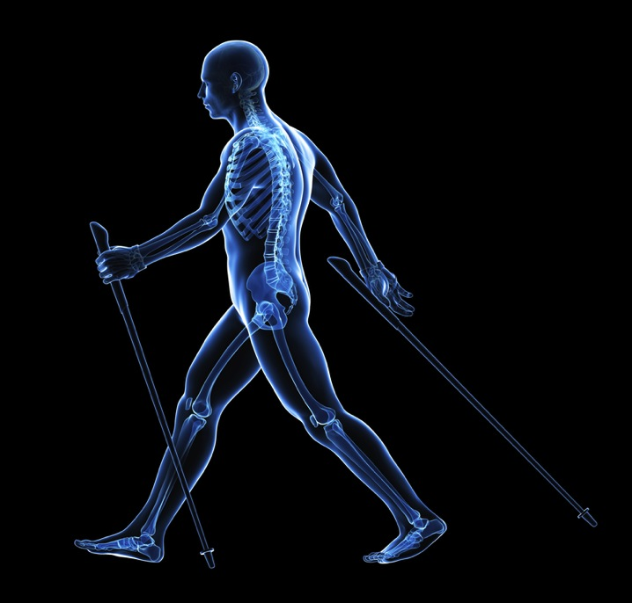
Notes:
The INWA emphasizes correct walking technique, posture, and the correct use of poles to reap the optimum benefits of Nordic walking. As a part of proper Nordic walking technique, note here the open hand at the end of the backward reach phase.
In addition to the INWA, there are several affiliated and independent organizations and websites that provide additional teaching and certification in Nordic and pole walking methods. Nordic walking certifications appear to be center-based rather than inter-affiliated between organizations. In pole walking research, the use of certified Nordic walking Instructors is not consistently identified. There is no licensure requirement to teach this intervention. There appears to be a range of instructional beliefs and positions, as witnessed when googling Nordic walking or pole walking on the Internet. Some of these resources are included in a handout provided as a supplement to this presentation. My recommendations would be to utilize your skills as physical therapists to individualize the best methods for yourself and the individuals that you work with, and to seek out additional information according to your interests.

Slide 6
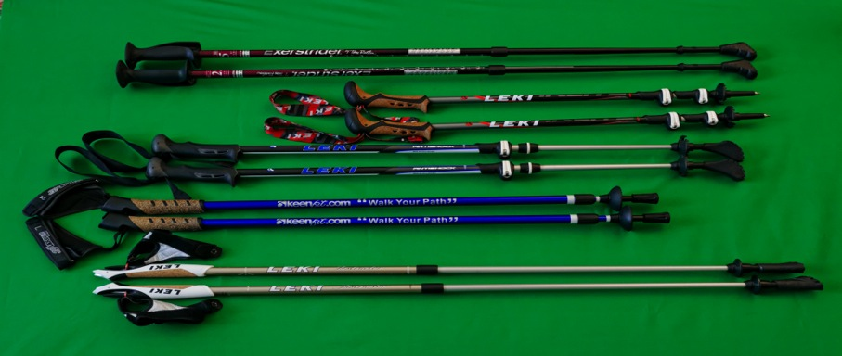
Bilateral Pole Walking
Equipment
Notes:
The basic equipment involved in pole walking is, of course, a pair of poles - but there are multiple factors to consider in the choice and use of the equipment for matching the individual’s comfort, fitness level, and goals.

Slide 7
Bilateral Pole Walking
Hiking poles?
Trekking poles?
Walking poles?
Nordic walking poles?
Handle design?
Adjustability?
Wrist strap?
Pole Height?
Pole Weight?
Shock absorption?
Pole Tip?
Poling method?
Notes:
Pole walking may include the use of hiking poles, trekking poles, or Nordic walking poles. The type of pole, pole height and weight, type of pole tip, level of wrist support, handle design, degree of pole shock absorption or stiffness, and poling technique add layers of variation that need to be considered for optimum use.

Slide 8
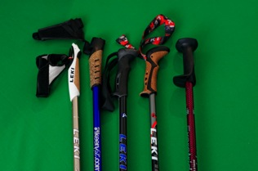
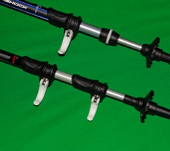
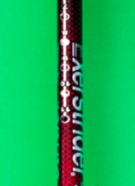
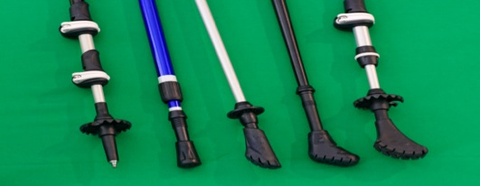
Bilateral Pole Walking
Handle Design? Wrist strap?
Adjustability?
Pole Tip?
* Poles Courtesy of Leki, KeenFit, & Exerstrider
Notes:
Looking further at pole features, the picture in the upper left shows some examples of different methods to adjust pole height – from a levered “quick lock systems” - which is my personal favorite for ease of use - to a twist-and-tighten mechanism, to a push button adjustment similar to how walkers are adjusted. There are also poles that can be purchased that are non-adjustable fixed-height, which are not shown here.
The upper right picture shows two types of poles that have left and right semi-glove wrist straps,. The next two have simple adjustable straps that need to be donned and tightened similar to ski pole strap application, and to the far right the red pole does not have a strap, but has a wider handle and a wider “shelf” edge at the top of the handle.
The pole tips range from the pointy carbide tips that are good on soft hiking trails, sand, and snow – note the variety baskets just above the tips on three of the poles. The rubber tips are for sidewalks and asphalt surfaces, with the slanted “Nordic walking tips” designed for push-off behind the forward foot with the lower edge facing backwards.

Slide 9
What kind of walking poles are best? Which method is best?
Consider:
• level of physical function
• personal goals
• environment/setting
• ease of use
• equipment costs
Poles courtesy of Leki, KeenFit & Exerstrider
Notes:
Product choice and poling methods are based upon individual functional abilities and goals, the environment or terrain chosen for poling, personal comfort and ease of use, and the equipment costs.
It is important to have a sense of the wide range of applications, adjustments, and modifications that bilateral pole walking may have – this may apply not only in looking at different personal and clinical applications, but in understanding the variability of results in published studies on pole walking as well.
Following this presentation, you will have a chance to explore equipment variations and try out poling techniques with walking poles that have been donated to the UNC PT Department by several manufacturers. Before this practice activity, however, I wanted to share more information from scientific review and research on the effects and considerations for adult pole walking interventions.

Slide 10
Notes:
Before going on to looking at the research of pole walking effects in the elderly population, let’s stop here and take a closer look at the equipment and learning more about the features and uses of different types of poles.
[10 minutes for demo/ activity, continue w/ ppt]

Slide 11
Bilateral Pole Walking Effects & Evidence
Young, Middle, and Older Adult Studies
Notes:
The next part of this presentation will look at some of the current research studies on the effectiveness of pole walking interventions in the young, middle-aged (36-55), and older adult populations (>60+) in fitness and rehabilitation studies.

Slide 12
Bilateral Pole Walking Effects- Searching the Research
Terms
• Nordic walking
• pole walking
• walking with poles
• polestriding
• Exerstriding
• trekking with poles
• hiking with poles
Studies (21)
Cross-sectional (8)
CTs (4) and RCTs (7)
Review (1)
Systematic Review (1)
Countries (14)
Europe(13), Japan(3), USA (3), Canada (2), Australia (1)
Notes:
In looking for research studies investigating BPW effects for adults, Nordic walking retrieved the most responses, but other terms also yielded some results. The 21 studies that were determined most relevant for this presentation have quite the international flavor and bear witness to its greater popularity and support thus far in European countries. Evidence table summaries of these studies are included as handouts (or as pdfs on the capstone website).

Slide 13
Bilateral Pole Walking:
Young Adults (20-35 yrs)
Notes:
Let’s start by looking at a few pole walking studies in the young adult population. These studies were primarily cross-sectional studies that looked into the aerobic and biomechanical differences between walking with and without poles.

Slide 14
BPW: Young adult studies (5)
◆ Significant ⬆ (p<0.05) in cardiovascular benefits w/ no change in RPE
-(Saunders, 2008)
⬥ ⬇ RPE (p<0.05) -(Jacobsen, 1999
◆ Uphill walking, preferred pace - ⬆ UE mm activity 95%
⬇ LE mm activity 15%
-(Foissac, 2008)
◆ Downhill walking – significant ⬇ (p<0.05) knee jt forces during single leg support phase btw 10-16%
-(Schwameder, 1998)
Notes:
The studies reviewed here highlight the potential of decreased ratings of perceived exertion (RPE), increased aerobic capacity, increased UE mm activation, and reduction of knee joint forces with some poling methods.
• On an easy to moderate hiking trail, the use of trekking poles at a self-selected pace showed a significant increase in the aerobic markers of oxygen consumption, ventilatory efficiency, and heart rate paired with no changes in perceived exertion when compared with walking trials – so basically, the pole trekking was more aerobic at a similar perceived effort. When looking at studies with elderly adults, which will be discussed later, the walking and pole walking endurance effects were similar, but RPE continued to be less with the poles.
• One uphill walking study demonstrated a “share the load” effect that enabled greater recruitment of the upper extremity muscles and a decrease in lower extremity mm demands when using hiking poles at a preferred pace.
•Another study by Jacobsen demonstrated a significant decrease in RPE when walking downhill with poles when compared to regular walking. When the poles were placed in front of the body when going down, a significant decrease in knee joint loading was demonstrated during the single leg support phase.
It may be self-evident, but it is important to realize that different applications of downhill pole use can either decrease knee joint load – such as when poles are placed forwards as demonstrated in this study – or increase knee joint load, such as continuing with the standard Nordic walking technique of push-off from behind the forwards foot.

Slide 15
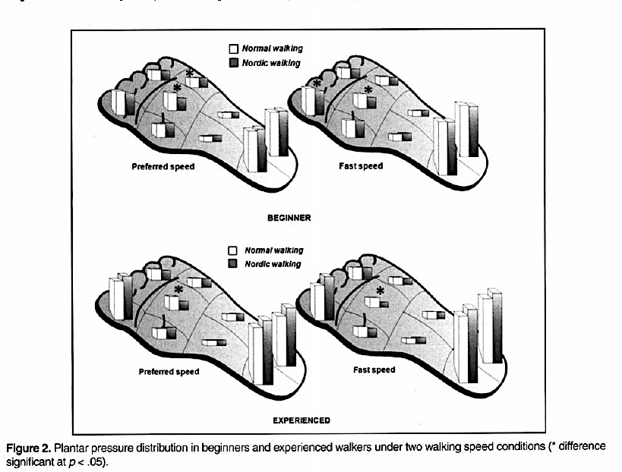
BPW: Young adult studies-  Plantar pressure distribution – ⬇central MT pressure
(Pérez-Soriano, 2011)
Notes:
Another interesting study investigated plantar distribution effects during walking and Nordic walking on 20 beginning Nordic walkers and 30 expert Nordic walkers. In both groups, there was a significant (P<0.05) pressure reduction of 30-35% in the central metatarsal area for the expert Nordic walkers and a 20-30% in the beginner walkers. In this depiction, the white vertical bars represent plantar pressure scores during regular walking and the adjacent darker bars represent when plantar pressure nordic walking. This study may have translation effects when considering individuals with frailer feet in order to reduce or to learn to reduce plantar pressure to the central metatarsal area.

Slide 16
Bilateral Pole Walking:
Middle-Aged Adults (36-60 yrs)
Notes:
Moving on to middle-aged and older adults studies, there are a greater number of higher quality pole walking studies This section will include some cross-sectional biomechanical studies, a systematic review that includes studies of both middle-aged and older adult populations, and a review of Nordic walking related injuries.

Slide 17
BPW-Middle Aged Adult Studies (10)
◆ Pole length study (Hansen, 2009)
• Self-selected pole length = 67.7±0.5% body height
• Uphill pole length – 63.3±0.65% body height
• 67%⬆ in energy expenditure in level NW than W
◆ Nordic walking, Walking, and Running (Hagen, 2011)
•LE loading forces not ⬇ in NW compared w/ W group
• § ⬇(p<0.05)peak vertical force & loading than Run Group
Notes:
Two cross sectional-studies looked at pole length with regard to energy expenditure and comfort and compared joint loading parameters with Nordic walking at various speeds compared with walking and running.
• A small study by Hansen of 12 Nordic walker practitioners in their early 50s, showed self-selected pole length tended to be around 68% of the body height, with shortening of poles on the uphill for the greatest comfort. For individuals walking on varying terrain, therefore, both the ease of pole adjustment and the ability to fine tune adjustments for optimum use may be an important factor in pole selection.
This study also found a significant increase in energy expenditure for Nordic walking on level terrain compared with walking
• Hagen’s study found that, contrary to the downhill walking study discussed earlier, there was not a significant decrease of lower extremity loading forces in Nordic walking when compared with walking. This study, however, involved a particular method of Nordic walking technique that emphasized a longer stride. Again, this demonstrates that the style of poling method used needs to match your individual purpose and consider the environment.
• Compared with running, the NW group demonstrated less LE loading than the running group, which is not too surprising.

Slide 18
BPW – Wrist Forces
• § ⬆ force to wrists w/ ⬆ in speed:
wrist safeguard considerations
-(Hagen, 2011)
Notes:
The study by Hagen also noted a correlation of wrist force increases as walking speed increased, as shown by this graph demonstrating increased walking speeds moving towards the right. This may increase the potential risk for wrist injury, and may need to be addressed through prevention exercises and assessment of pole handling, grip force and release, and shock absorption factors - such as pole weight and perhaps having a shock absorption feature in the poles.

Slide 19
NW- Review of injuries – (Knobloch, 2006)
Questionnaire Results – n=137 NW practitioners
Total NW injuries/1000 hours = 0.926
• UE (0.549) > LE (0.344) injuries
• Most frequent (0.206) – ulnar collateral lig distortion
> fall
• all resumed NW by 4 wks
Notes:
In looking for reviews of pole walking injuries, I found only one article specifically addressing this - a questionnaire review by Knobloch of 137 middle-aged Nordic walkers (53.5±12 years) looking at injury rates occurring during Nordic walking. Overall, the injury rate was considered very low, with the most predominant injuries occurring in the upper extremities. Within this group, distortion of the ulnar collateral ligament following a fall was the most common injury, possibly due to the pole handle forcing the thumb into abduction and extension. Recommended injury prevention efforts for this type of injury include attention to grip construction, poling method, and providing education, pole adjustments and NW technique changes as indicated. Clinical relevancy may also include decisions as to whether or not to use grip straps for some patients and, if so, make sure that the wrist straps are being used properly.

Slide 20
BPW – Systematic Review (Fritschi, 2012)
From 531 articles to N=14: 11 RCTs, 3 CTs
Quality assessment of studies (modified Delphi score)
Positive effects of PW
Physical activity – endurance & function
Psychosocial outcomes – quality of life
Well tolerated, safe exercise
Applicable to wide variety of individuals & pt pop
•Sedentary, breast cancer, fibromayalgia, chronic LBP, in- patient cardiac rehab, obesity management, PD
Notes:
A systematic review by Fritschi used a modified Delphi quality scoring method to focus on higher quality randomized controlled trials (RCTs) investigating pole walking health effects for middle aged and elderly adults. The authors suggest that PW research is “in its infancy,” as most of the articles that were reviewed had been published within the past 5 years, and concluded that at least one positive PW effect was found in all of the reviewed studies. Significant improvements were noted in measures of cardiorespiratory status, endurance, functional status, physical activity (PA) and quality of life (QoL) outcomes. Cardiorespiratory effects were the most frequently studied, with improvements in endurance cited as one of the most significant PW effects relative to the control groups.
In the evidence table handouts, I have included 4 randomized control trial studies and 2 controlled trial studies on middle-aged populations that were included in Fritschi’s systematic review – these include studies investigating pole walking interventions for sedentary females, and studies with individuals diagnosed with breast cancer, fibromyalgia, chronic LBP, inpatient cardiac rehabilitation, and obesity.

Slide 21
Bilateral Pole Walking:
Elderly Adults
(61+ yrs)
Notes:
Studies on pole walking interventions for the elderly have spanned from a small cross-sectional study on load dynamics to larger controlled and randomized controlled trials on general or diagnosis-related elderly parameters.

Slide 22
BPW Effects: Elderly (67.3±1.6 yrs)
Joint Load Dynamics Differences – NW & Walking
⬥ Level surfaces (NW) – § ⬇ L₄-L₅ shear force
§ ⬇ hip compression & shear force
§ ⬇ knee shear force
no § change in knee unloading
-Koizumi (2011)
Notes:
A small cross sectional study by Koizumi looked at differences in joint load dynamics in Nordic walking and walking with 5 elderly individuals. Based on data from force platforms and motion analysis, a significant reduction of L4-L5 shear force, hip compression and shear forces, and knee shear force was found with Nordic walking on level surfaces compared with walking. Knee unloading forces, however, demonstrated no significant change.
Although this is a small study, this was one of the first that I found that looked at hip unloading forces, and may have implications for use of pole walking with individuals with hip instability or hip pain.

Slide 23
BPW Effects: Elderly
12-wk controlled trial, n=65: 4 groups-W, NW, RES, C
⬥ NW & W endurance effects similar (12MWT), both had § ⬆ over RES & C groups (p=0.01)
⬥ Arm curl test:
RES group: Large effect size (1.15)
NW group : Moderate effect size (0.62)
W group: Small Effect size (0.18)
(Takeshima, 2013)
Notes:
A 12-week controlled trial of 65 community-dwelling elderly men and women demonstrated both Nordic walking and walking groups had significant group improvement as measured by the 12MWT, and between-group significant improvement (p<0.01) in endurance over the Resistive Exercise only group and the control groups (p<.001). In the arm curl test, a large effect size (ES) was seen in the RES group (1.15), a moderate ES for the NW (0.62), and a small ES for the W group (0.18).
This indicates that, while the resistive exercise group had the largest gains in upper extremity muscle strengthening of all the groups, the Nordic walking group also had more upper extremity strengthening benefits compared with walking.

Slide 24
BPW Effects: Elderly w/ COPD
3 mos RCT , n=60: NW & C groups
⬥ NW - § ⬆ (p=0.01) in 6MWT
⬥ NW - ⬆ mood status & active behaviors sustained @ 6 mo and 9 mo followup
(Breyer, 2010)
Notes:
A 3 month randomized control trial tracked the daily physical activity behaviors (by accelerometers) and compared endurance effects between two groups - a Nordic walking group and control group - of 60 elderly individuals with chronic obstructive pulmonary disease. The NW group was provided with a Nordic walking intervention 3x/wk, and both groups were offered COPD education sessions. Improvements noted in the Nordic walking group included: less exercise-induced dyspnea, improved mood status & healthcare related quality of life, decreased daily sedentary behaviors, and a significant increase in endurance as measured by the 6MWT, compared both at baseline and between groups. Even more important, these improvements were sustained at a 6 month and 9 month followup.

Slide 25
BPW Effects: Elderly & Parkinsons
6 month RCT, mild/mod PD, n=60: 3 groups-W, NW, FR
⬥ NW & W endurance effects similar, both had § ⬆ over FR group (p=0.02)
⬥ NW group (Motor fx subscale of UPDRS):
⬆ postural stability (p<.004))
⬆ gait pattern (p<.001)
⬆ stride length (p<0.05) (Reuter, 2013)
Notes:
Reuter compared the effects of three different types of intervention programs – Nordic walking (NW), walking (W), and a flexibility and relaxation (FR) program - with 60 older individuals in a mild to moderate stage of Parkinson’s Disease. Each group consisted of 20 subjects that participated in their designated activity (PW,W, or FR) for 70 minutes, 3 times weekly for 6 months. The interventions were taught and supervised by physical therapists with NW training. The sum-score of the unified Parkinson’s disease rating scale (UPDRS) showed significant improvements in both the NW and W groups (p=.02), particularly in the motor function subscale, with mean improvements for the NW group edging slightly higher than the W group. The NW group showed improved postural stability (p<.004), gait pattern (p<.001), and improved stride length (p<.05) than the other 2 groups.

Slide 26
BPW Effects: Elderly & Parkinsons
Reported injuries (non-serious) – ex induced hypotension (NW=2, W=1), falls (NW-4, W-4, FR=1), shoulder overuse injuries (NW=2)
Authors recommend ⬆ time allottment for learning & practicing NW technique < endurance measures
◆ ⬆ NW continued ex compliance @ 6 month followup
(Reuter, 2013)
Notes:
A few adverse effects were reported during this study, including exercise induced hypotension (NW=2, W-1), falls (NW-4, W-4, FR-1), and 2 shoulder overuse injuries (NW-2). None of these were considered serious injuries and were successfully managed.
The authors also discussed the need for a greater time allotment for the NW participants to learn and practice the NW technique, and that this may have limited the aerobic training opportunities compared with the W group. Interestingly, in a 6 month follow-up interview, all NW participants had continued to practice NW and formed training groups, with 50% of the NW spouses participating in NW as well. In the walking group, 60% reported continued walking 2-3x/wk with 30% taking up the pole walking.

Slide 27
BPW Effects: Elderly & Rehab Settings
◆ Cardiac rehab- pts w/mod to severe heart failure
⬥ 12 wk, n=54, Baseline – able to walk 10 min cont
⬥ NW § ⬆ in 6MWT (p=0.001), ⬆ grip strength (p=0.02)
-(Keast, 2013)
◆ In pt & out-PT elderly rehab – 20 min, n=30, 6 wk/BIW
⬥ NW & W groups ⬆ gait speed
⬥ NW effect size: 6MWT = 0.53 (mod)
gait speed effect = 0.68 (high)
⬥ NW 106% more efficient than walking (small) suggest 2MWT measures to ⬆ sensitivity
-(Figueiredo, 2013)
Notes:
Nordic walking intervention effects are also being studied in both the in-patient and out-patient rehabilitation environments. In two recent studies from Canada, a 12 week randomized controlled trial in an out-patient cardiac rehabilitation setting showed significant improvements in endurance, as measured by the 6 minute walk test, and in upper extremity strength as measured by grip strength over the standard exercise protocol used by this cardiac care system.
Another interesting study by Figueiredo looked at a shorter, one-on-one NW and W interventions provided by physical therapists. Looking at NW effects in an older and more physically challenged participant group, a randomized pilot trial (n=30) by Figueiredo compared a one-on-one supplemental 6 week NW and W intervention. The NW (n=14) and W (n=16) intervention was provided by a physical therapist for 20 minutes, 2x/week for 6 weeks, in addition to the in-patient or out-patient PT that the study participants were already receiving.

Slide 28
NW/W Elderly Rehab Setting
• n=30
• 78 yrs
• Majority walked w/ AD
• BBS – 39-44
(fall risk <46)
- (Figuereido, 2013)
44
Notes:
The median age in the Figuereido study was 78 years; over half of the patients were in an in-patient setting and the majority walked with a walker or cane. The authors suggest that a 2MWT might have provided more sensitive, relevant information for this population rather than the 6 MWT, and that a longer intervention period may have produced better results. Confounding factors relative to improvements include the concurrent physical therapy, but it is promising to note that even patients that need a walker or cane may be responsive to an aspect of pole walking as part of their rehabilitation.

Slide 29
Measuring BPW Effects
Endurance Measures – 2 MWT, 6 MWT, RPE
UE strength
Grip strength & 30 sec arm curl
Bench press & LD pull-down ex (Sprod, 2005)
Pain VAS
Balance, Agility – BBS, DGI, TUG
HRQoL and long-term ex fitness compliance
Notes:
Pole walking interventions studies provide a different piece of the puzzle in assessing beneficial effects, but the number of quality pole walking studies are limited, diverse, and utilize a wide array of outcome measures that may not adequately capture its benefits. For example, in several studies the 30-second arm curl test was used as a general measure of upper body strength, which is a component of the Senior Fitness Tests. While improvements in the arm curl outcome measures were shown after pole walking interventions in several studies, more specific shoulder and upper extremity measures through dynamometry or other consistent measures may yield more meaningful results, such as the bench press or Latissimus dorsi pull-down tests that Sprod used as UE strength measures in her pole walking study with individuals with breast cancer.
Consistent walking endurance measures that are sensitive to the baseline skill levels, such as the 2MWT or 6MWT would also provide better between-study comparisons, along with Ratings of Perceived Exertion and Pain Scales. Agility tests and balance tests like the Berg Balance Scale, Dynamic Gait Index and Timed Up-and Go might also be useful, as well as measures of Healthcare Related Quality of Life and questionnaires or logs to measure long-term exercise fitness compliance.

Slide 30
“The use of my walking sticks has enabled many extra miles of walking over the years – not only did it help my security, but it allowed me to walk and observe the sky, trees, birds, and ducks in flight. I confidently greeted fellow walkers and didn’t need to slow down. The last 5 years has found me needing to use these sticks to avoid falling – mainly in the parks and open areas. I’m now 91 years old and feel proud to engage in more walking as well as other activities.”
The use of
Notes:
Take a look at the videos of DeDee, a 91-year old woman who has used her “walking sticks” for her neighborhood walks for over 5 years, on my capstone website. Notice that she does not use the poles in a strict bilateral coordination pattern, but she uses the poles in a rhythm that suits her and gives her more confidence when walking outdoors. In DeDee’s case, she has adapted the poling method that is the most comfortable for her. In assessing the best poling method and equipment to suit the individual, it is important to understand that there may be several adaptations that may be done to tailor to the individual, and as skills improve – or decline - there may additional refinements that could be made for optimum effects for the individual. Note the improvements in her gait in comparison to her walking without her poles.
I asked DeDee to relay a little more about her experience over the years using her walking sticks. Here’s what she said.

Slide 31
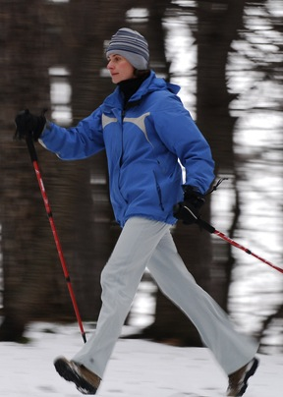
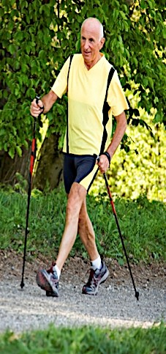
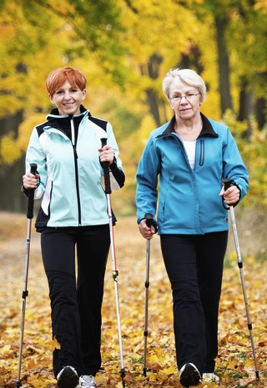
Notes:
In summary, my hope is that this presentation will spur you to learn more about bilateral pole walking as a potential fitness activity and as a possible intervention to support rehabilitation. Emerging research, while not making as grand of a claim of benefits as what is reported on some Internet sites, nonetheless show significant benefits in endurance, less RPE, and improved arm strengthening effects for adults. Other benefits, such as improved confidence, better balance when walking, and improved coordination are anecdotal but not yet effectively captured in higher quality research studies.

Slide 32
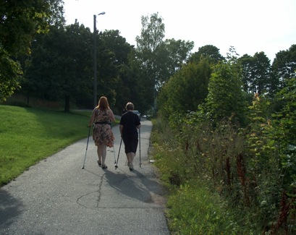
NOW IT’S YOUR TURN!!!!
Notes:
You will now have an opportunity to experiment with pole walking techniques personally. In addition to learning a personal fitness option, it also helps to experience an intervention on your own before applying and adapting it for others. (or, if you are listening to this on the capstone website, I hope you will utilize the resource information, grab a pair of poles and be able to practice on your own. Have fun!)

