Slide 1
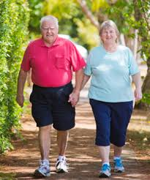
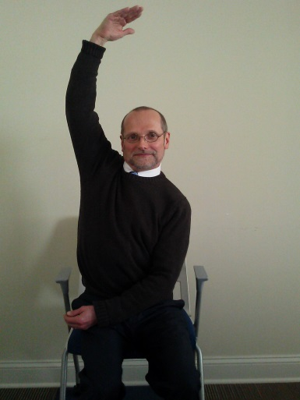
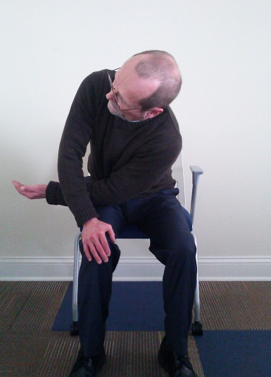
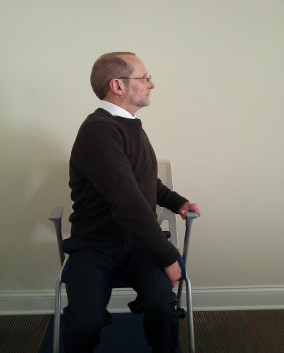
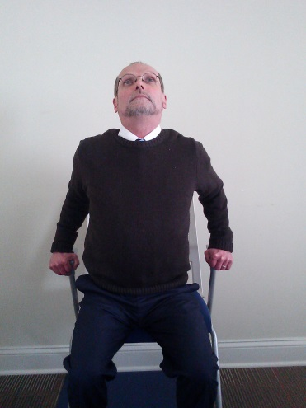
BREATHE
BREATHE
BETTER
LIVE BETTER
Living With COPD
THREAD NEEDLE
Place right hand on knee. Thread left arm under right, rest left elbow as close to right knee as you can.
Do you struggle with...
Doing your shopping?
Playing with grandchildren?
Enjoying family outings?
If, so, these stretches will help!
MERMAID
Reach right arm up and reach overhead to the left.
FOR ALL EXERCISES:
HOLD FOR 3 DEEP BREATHS
REPEAT ON OTHER SIDE
DO EACH SIDE 2 TIMES
DO EACH MORNING AS PART OF
GETTING READY FOR THE DAY
TWIST
Place right hand on outside of left knee. Twist body to turn and look over left shoulder.
CHEST OPENER
Place both hands on armrests (or thighs), squeeze elbows together gently and lift chest, lift head slightly.
STOP if any of these exercises cause pain, shortness of breath or a racing heart rate. Call your MD if the symptoms do not resolve with rest.

