Slide 1
Live Better… BREATHE BETTER
PRESENTED BY: Michelle Green, MS, PT
Maximizing the role of Physical/Occupational Therapy in the management of persons with COPD
Notes:
This presentation demonstrates the new capabilities of PowerPoint and it is best viewed in Slide Show. These slides are designed to give you great ideas for the presentations you’ll create in PowerPoint 2010!
For more sample templates, click the File tab, and then on the New tab, click Sample Templates.

Slide 2
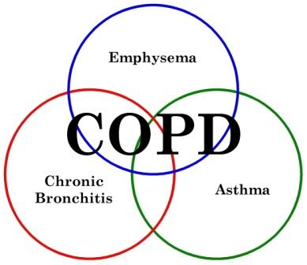
It negatively impacts quality of life.

Slide 3
OBJECTIVES
*Discuss literature supporting ROM/Stretching for improved COPD management
* Review specific exercises supported by available research which could be added to the management of a person with COPD
*Review the pathophysiology of COPD
* Review various types of breathing techniques beneficial for COPD
WILL DO
WILL NOT DO

Slide 4
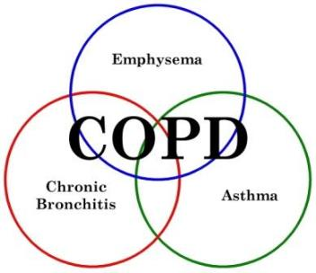
IS IT A REHAB ISSUE?
Notes:
What Is Obstructive Lung Disease?
People with obstructive lung disease have shortness of breath due to difficulty exhaling all the air from the lungs. Because of damage to the lungs or narrowing of the airways inside the lungs, exhaled air comes out more slowly than normal. At the end of a full exhalation, an abnormally high amount of air may still linger in the lungs.
The most common causes of obstructive lung disease are:
Chronic obstructive pulmonary disease (COPD), which includes emphysema and chronic bronchitis
Asthma
Bronchiectasis
Cystic fibrosis
Obstructive lung disease makes it harder to breathe, especially during increased activity or exertion. As the rate of breathing increases, there is less time to breathe all the air out before the next inhalation.

Slide 5
IS IT A REHAB ISSUE?
Harnett County has
16% higher incidence in COPD rate/100,000
then average in other NC counties
Reducing LOS in acute care hospitals
Quality Indicators though ACA
G Codes
YES!
Reducing
re-admissions
Thru emergency department
Notes:
What Is Obstructive Lung Disease?
People with obstructive lung disease have shortness of breath due to difficulty exhaling all the air from the lungs. Because of damage to the lungs or narrowing of the airways inside the lungs, exhaled air comes out more slowly than normal. At the end of a full exhalation, an abnormally high amount of air may still linger in the lungs.
The most common causes of obstructive lung disease are:
Chronic obstructive pulmonary disease (COPD), which includes emphysema and chronic bronchitis
Asthma
Bronchiectasis
Cystic fibrosis
Obstructive lung disease makes it harder to breathe, especially during increased activity or exertion. As the rate of breathing increases, there is less time to breathe all the air out before the next inhalation.

Slide 6
CURRENT
STANDARD OF CARE

Slide 7
WHAT INTERVENTIONS ARE BEING DONE CURRENTLY?
WHAT IS THE STANDARD OF TREATMENT?

Slide 8
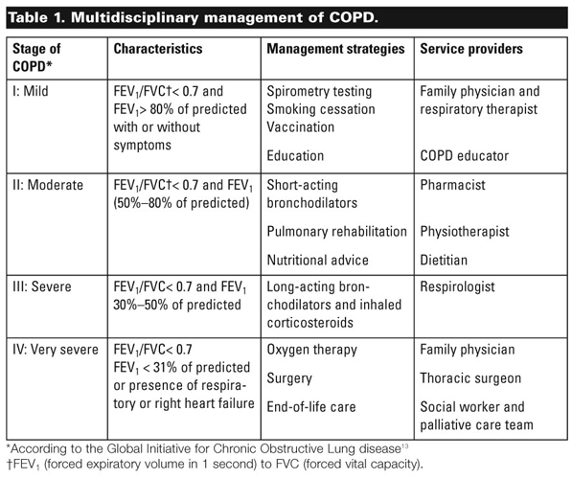
CURRENT STANDARD OF CARE
Reference: www.goldcopd.com
Global Initiative for Chronic Obstructive Lung Disease

Slide 9
Other Recommendations:
American College of Sports Medicine (ACSM) Guidelines for COPD:
Aerobic exercise (riding a stationary bike or walking) and resistance exercise (lifting a light weight with the arms or legs) can help restore and maintain functional independence in COPD.
(http://www.acsm.org/docs/current-comments/exerciseforpersonswithcopd.pdf)
WEB MD:
Lower Body including walking/bike and strength; Upper Body strength; Breathing Muscle Training
(http://www.webmd.com/lung/copd/pulmonary-rehabilitation-for-copd)
U.S. Department of Health & Human Services
Pulmonary physioltherapy for exercise, strength and breathing muscle training
(http://www.guideline.gov/content.aspx?id=23801)

Slide 10
Can we do more???

Slide 11
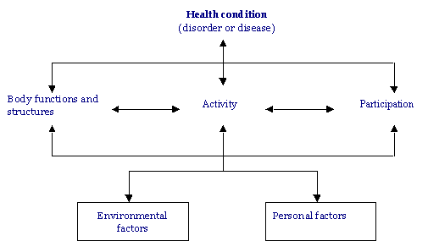
APTA VISION 2013:
Transforming society by optimizing movement to improve the human experience
ICF MODEL
INTERNATIONAL CLASSIFICATION OF FUNCTION

Slide 12
TRADITIONALLY….. INTERVENTIONS DELIVERED BY THERAPISTS HAVE BEEN
ICF MODEL
INTERNATIONAL CLASSIFICATION OF FUNCTION
If a patient is limited in walking distance, we assist and monitor them in walking. Aiming to walk a greater distance. Is that fixing the problem?

Slide 13
COPD
Limits Home/Family Activity
Limited Activity Tolerance, Limited walking distance
IF….
Health Condition
Participation Limitation
Activity Limitation

Slide 14
WHY????
COPD
Limits Home/Family Activity
Limited Activity Tolerance, Limited walking distance
IF….
DYPSNEA
Impairment
WHAT, at the level of the body structures and function (impairment) causes the DYPSNEA.
Health Condition
Participation Limitation
Activity Limitation

Slide 15
WHY????
COPD
Limits Home/Family Activity
Limited Activity Tolerance, Limited walking distance
IF….
DYPSNEA
Impairment
IS STRENGTH TRAINING OF THE ARMS AND LEGS APPROPRIATE, TARGETED INTERVENTIONS WHICH WILL CHANGE DYPSNEA ?
Health Condition
Participation Limitation
Activity Limitation

Slide 16
WHY????
COPD
Limits Home/Family Activity
Limited Activity Tolerance, Limited walking distance
IF….
DYPSNEA
Impairment
WHAT, at the level of the body structures and function (impairment) causes the DYPSNEA.
Health Condition
Participation Limitation
Activity Limitation
THAT IS WHAT WE TREAT!

Slide 17
NEED TO FOCUS OUR INTERVENTIONS HERE….
ANSWERING
THE “WHY”
LEADS US TO TARGETED TREATMENTS
ICF MODEL
Werner AS, Use of the ICF Model as A Clinical Problem-Solving Tool in Physical Therapy and Rehabilitation Medicine. Phys Ther 2002: 82:11; 1098-1107

Slide 18
CLINICAL
MANIFESTATIONS

Slide 19
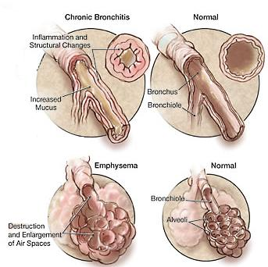
OBSTRUCTIVE LUNG DISEASE
Notes:
What Is Obstructive Lung Disease?
People with obstructive lung disease have shortness of breath due to difficulty exhaling all the air from the lungs. Because of damage to the lungs or narrowing of the airways inside the lungs, exhaled air comes out more slowly than normal. At the end of a full exhalation, an abnormally high amount of air may still linger in the lungs.
The most common causes of obstructive lung disease are:
Chronic obstructive pulmonary disease (COPD), which includes emphysema and chronic bronchitis
Asthma
Bronchiectasis
Cystic fibrosis
Obstructive lung disease makes it harder to breathe, especially during increased activity or exertion. As the rate of breathing increases, there is less time to breathe all the air out before the next inhalation.

Slide 20
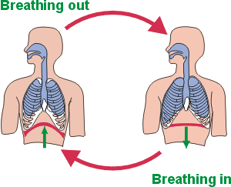
NORMAL BREATHING
INHALATION:
Domed-Diaphragm lowers and flattens. Intercostals contract and lift the ribs, volume of the chest increases and air fills lungs.
Notes:
Air becomes trapped in floppy alveoli and lungs enlarge over time
Enlarged lungs press on diaphragem, even at rest, this progressively flattens the diaphragm which becomes rigid
Intercostals shorten, ribs get stuck/rigid and no longer collapse on exhalation
Without the exhalation, they feel as if there isn’t anough breath and inhale before the exhale is complete.
Continuously, they take pre-mature breaths and the lungs become more and more over inflated
The over production of mucus and inflammation continues, increasing resistance to air flow, walls between air sacs collapsed. The lungs react by enlarging to grab more air and exhalation is even more difficult.

Slide 21
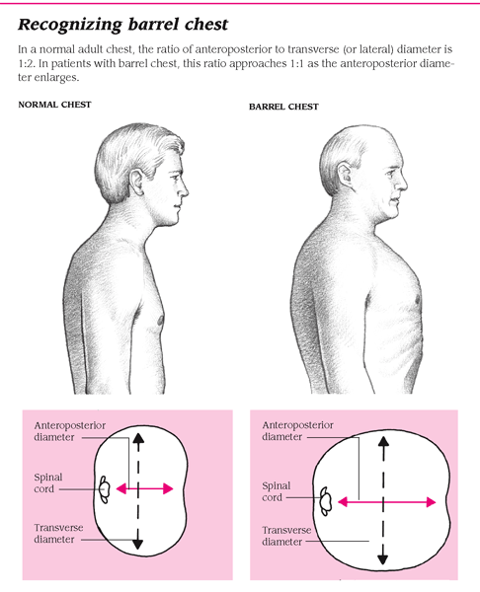
WHAT DOES COPD LOOK LIKE?
Notes:
In normal breathing, there is a rise of the diaphragm with exhalation and a flattening with inhalation. The diahragm and intercostals produce the movement for normal breath
Chest is chronically enlarged. The tightness in the intercostals prevents full exhalation and early inhalation. The feeling is breathlessness and at times near suffocation.

Slide 22
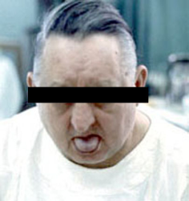
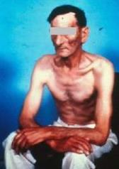
WHAT DO OUR COPD PATIENTS LOOK LIKE?
1
2
DUSTY COLOR
HYPOXIA
HYPERCAPNIA
CARDIAC ENLARGEMENT
USE OF ACCESSORY MUSCLES TO BREATH
INC. co2 RETENTION
PURSED LIP BREATHING
INCREASED MUCUS
SPEAKS IN SHORT SENTENCES
USE OF ACCESSORY MUSCLES TO BRATH
WHEEZING
BLUE BLOATERS
PINK PUFFERS
The faces of persons living with COPD

Slide 23
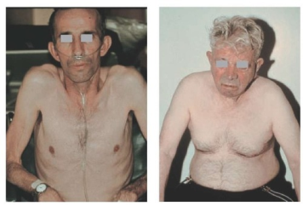
DYPSNEA is Multifactorial Changes in Chest Mechanics are a Causative Factor
PERIPHERAL MUSCLE CHANGES
Increased use of accessory muscles
Intercostals become shortened
Scalenes and Pec Major Shorten
Flexibility in shoulders reduced
Shortened Pec Minor
POSTURAL CHANGES/DEFORMITIES
Elevated, protracted, abducted scapula
Medial rotation of the humerus
Kyphotic spinal deformities

Slide 24
DYPSNEA is Multifactorial Changes in Chest Mechanics are a Causative Factor
PERIPHERAL MUSCLE CHANGES
Increased use of accessory muscles
Intercostals become shortened
Scalenes and Pec Major Shorten
Flexibility in shoulders reduced
Shortened Pec Minor
POSTURAL CHANGES/DEFORMITIES
Elevated, protracted, abducted scapula
Medial rotation of the humerus
Kyphotic spinal deformities
All Lead to:
CHEST WALL STIFFNESS
DISADVANTAGED MUSCLE LENGTHS
INCREASED WORK ON NORMAL MUSCLES OF RESPIRATION
INCREASED WORK LOAD ON DIAPHRAGM
Putt 2008, Engel 2012, Zanotti 2011, Heneghan 2012

Slide 25
DYPSNEA is Multifactorial Changes in Chest Mechanics are a Causative Factor
PERIPHERAL MUSCLE CHANGES
Increased use of accessory muscles
Intercostals become shortened
Scalenes and Pec Major Shorten
Flexibility in shoulders reduced
Shortened Pec Minor
POSTURAL CHANGES/DEFORMITIES
Elevated, protracted, abducted scapula
Medial rotation of the humerus
Kyphotic spinal deformities
All Lead to:
CHEST WALL STIFFNESS
DISADVANTAGED MUSCLE LENGTHS
INCREASED WORK ON NORMAL MUSCLES OF RESPIRATION
INCREASED WORK LOAD ON DIAPHRAGM
Putt 2008, Engel 2012, Zanotti 2011, Heneghan 2012

Slide 26
PRIOR TO EXERCISE: 72 year-old female, works full-time RN, smoking since 17, stopped 8 years ago. Significantly limited by SOB.

Slide 28
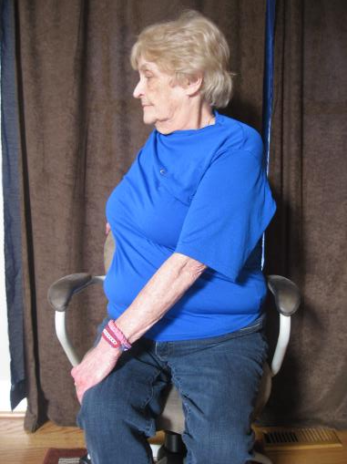
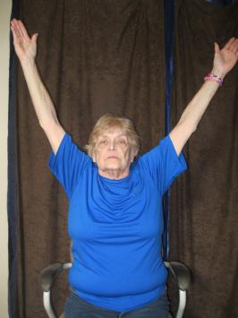

Slide 29
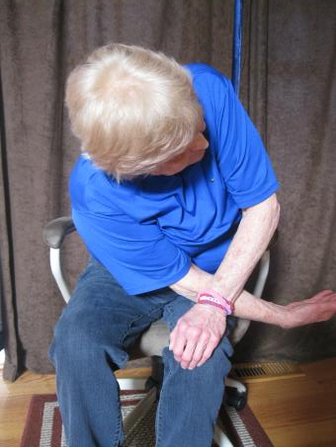
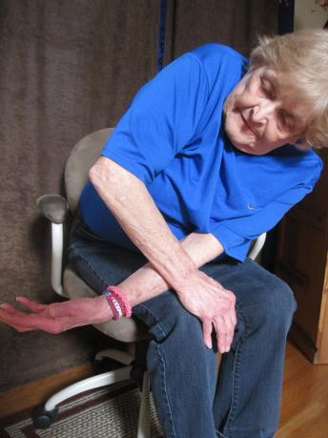
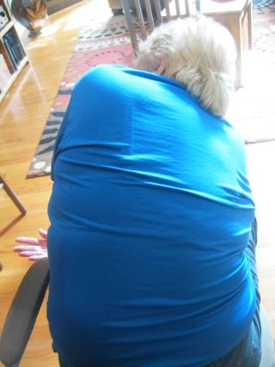

Slide 31
DOES RESEARCH SUPPORT INTERVENTIONS TO ADDRESS THESE ISSUES?

Slide 32
DOES RESEARCH SUPPORT INTERVENTIONS TO ADDRESS THESE ISSUES?
Heneghan 2012-
“…disappointing trend in COPD management”
-Less Musculoskeletal Research
-More Pharmacological research
-Elusive ‘exercise’ recommendations
“32% have skeletal muscle dysfunction…[we} can impact”.

Slide 33
Literature Support for Addition of ROM/Stretching
Zanotti 2011:n=20
OMT with PR better outcomes than PR alone.
Improved 6 MWT, Decreased RV
OMT had dec. RV on its own
Subjects reported “improved ease of breathing’ no test
Engel 2012: n=15
Soft Tissue/Manipulation vs. EX
No significant difference in distance walked between sham and EX, DID improve when SM added. SM & EX together decreased dypsnea rating scores. EX improved FVC, but not FUNCTION
Systematic Reviews:
Langer, 2009 (n=103): No ROM recommendations because no studies involving ROM to include
Malagutti 2009: n=26
Increased ability to expand chest wall, (lower ribs/abdominal cavity) correlated with improved pulmonary function tests (incentive spirometry)
Putt 2008: n=10
Contract-Relax for the Pec Major.
Improved ROM & Vital Capacity
No Functional Tests or QoL Measures
Leelaryngrayub 2009: n=1
Trunk rotation, Pec stretching, lateral thoracic stretch sidelying, thoracic extension improved ETV, Dypsea Rating and Chest Expansion. No OOB
Engel 2007: n=20
Normals. Manual Therapy & Exercise Group increased FVC and FEV after manual therapy and even more after exercise. Give before EX!

Slide 34
The SHORT STORY…..
GOOD….
Studies HAVE been done showing benefit of ROM and manual therapy to the trunk, spine, UE and rib cage.
Benefits shown in COPD and in normals.
BAD….
Studies have been of *questionable quality
*had low numbers
*poorly define interventions
*limited use of functional outcome/ Q of L measures

Slide 35
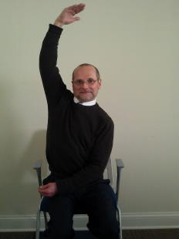
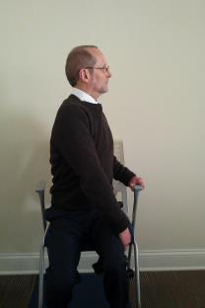
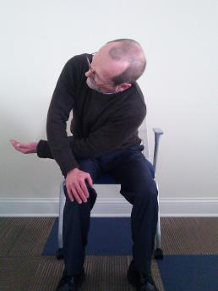
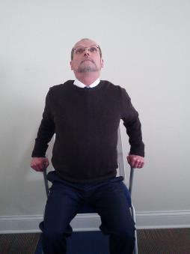
APPLICATION: Targeted Exercises to Directly Impact MS Changes
THREAD
NEEDLE
CHEST
OPENER
MERMAID
SEATED
TWIST

Slide 36
APPLICATION
Hospital, Outpatient Clinic, HEP, Other Diagnosis

Slide 37
APPLICATIONS
Acute Care: prior to walking, instruct in the ‘warm-up” stretches, educate on importance and provide HEP handout for carryover at home.
Outpatient: prior to initiation of exercise, perform ‘warm-up” exercises. Review HEP handout and encourage them as part of daily ADL activity to ease breathing throughout the day
Other Diagnosis?
REMEMBER…. Strength and ROM exercises should primarily be specific to counteract impact of disease process….. then whole body with goal of general conditioning.

Slide 38
Thank You
What’s Your Message?

