Slide 1
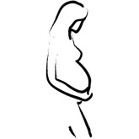
Standard of care through pregnancy
Capstone Presentation
Stephanie Lawson
April 22, 2014

Slide 2
OBJECTIVES
1. Identify proper nutritional needs to be addressed during pregnancy.
2. Identify proper exercise guidelines to follow during pregnancy.
3. Define at risk nutritional and exercise behaviors for the pregnant women.
4. Integrate knowledge attained and synthesize information for community educational purposes in Guatemala.
5. Describe standard of care during pregnancy with regards to number of visits, tests, and red flags.

Slide 3
Preconception¹
5 Things that are most important for preconception health care:
Folic Acid
Medical conditions under control
Vaccinations
No smoking or drinking
Avoid toxic substance
Notes:
Every woman should be thinking about her health whether or not she is planning on becoming pregnant
1. Take 400-800 micrograms of folic acid every day
2. Stop smoking and drinking alcohol
3. Get medical conditions under control (asthma, diabetes, oral health, obesity, and epilepsy)
4. Make sure vaccinations are up to date and communicate with doctor about over-the-counter-prescriptions
5. Avoid contact with toxic substances

Slide 4
Genetic Counseling¹
Genetic counseling may be used under the following circumstances:
Family history
Miscarriages
Child with inherited disorder
Woman 35 or older
Positive test results
Ethnic background
Related by blood
Notes:
Genetic counseling may be recommended for a number of reasons. Single gene disorders can run in families.
Genetic counseling may be used under the following circumstances:
1. Family history of genetic condition, birth defect, chromosomal disorder or cancer
2. Two or more pregnancy losses, a stillbirth, or a baby who died in infancy
3. A prior child with a known inherited disorder, birth defect, or intellectual disability
4. A woman who is 35 years or older
5. Test results that suggest a genetic condition is present
6. One’s ethnic background increases risk of getting or passing on a genetic disorder
7. People related by blood that want to have children together

Slide 5
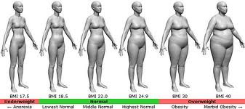
Obesity²
Excess weight is associated with several pregnancy complications including:
High Blood Pressure
Preeclampsia
Preterm Birth
Gestational Diabetes
Notes:
Excess weight of the mother is associated with several pregnancy and childbirth complications including high blood pressure, preeclampsia, preterm birth, and gestational diabetes
There is also an increased risk of birth injury and C-section delivery
Obesity increases the risk of birth defects, especially neural tube defects.
Obesity can also make it harder for the health care provider to monitor the baby with ultrasound to hear the baby’s heartbeat.

Slide 6
Underweight²
Increased risk of having a low birth weight baby
Increases risk of preterm birth
Notes:
There is an increased risk of having a low birth weight baby
These low birth weight babies are at risk for problems during labor and may have health or behavioral problems
Being underweight increases risk of preterm birth

Slide 7
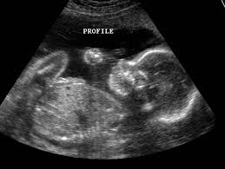
Doctor Visits^{3,5}
Series of around 12 visits
There are many tests the woman must complete during pregnancy ranging from a CBC to a glucose screening test
Ultrasonography is used in testing for the baby
Notes:
There are a series of around 12 visits through pregnancy (more if it is a higher risk pregnancy).
Visits start when the woman is 6-8 weeks pregnant and continue every 4 weeks after that
There are many tests the woman must complete during pregnancy ranging from a CBC to a glucose screening test
Ultrasonography is used in testing for the baby. Early ultrasound can help determine accurate gestational age.
Early in pregnancy, tests include complete blood count (CBC), blood type, urinalysis, urine culture, rubella, hepatitis B, hepatitis C, STDs, HIV, and TB. Hepatitis B and C infect the liver and can be passed from the woman to the child if infected. Later in pregnancy, women have a repeat CBC, Rh antibody test, glucose screening test, and Group B streptococci (GBS).⁵ Glucose screening test measures level of glucose (sugar) in your blood. High glucose levels may be a sign of gestational diabetes. This test is done at 24-28 weeks of pregnancy. GBS is a bacteria that can be passed onto the baby.⁴ Diagnostic tests are also available to test for birth defects.

Slide 8
Vitamins⁴
Folic Acid
Omega – 3 Fatty acids
Iron
Notes:
Folic acid should be taken to decrease risk of birth defects
Omega-3 fatty acids help with vasodilation, inhibition of thrombosis, and reduction in inflammation
Iron is important during pregnancy to maintain the increase in red blood cell mass and meet oxygen requirements of uteroplacental circulation

Slide 9
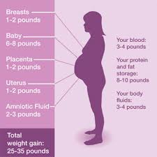
Body Changes⁷
Normal weight gain is 25-30 lbs
Cardiac output increases 30-50%
Total blood volume increases 20-40%
Blood pressure overall should not change
The increase in estrogen contributes to joint laxity
The rectus adominis muscle is separated at the linea alba as the stomach grows
20-50% of women suffer some degree of incontinence
Notes:
Normal weight gain is 25-30 lbs for single pregnancy, but can be 50-60 lbs for a multiple pregnancy
Cardiac output increases 30-50%
Total blood volume increases 20-40%
Blood pressure drops at the beginning of pregnancy, but then returns to pre-pregnancy levels. Blood Pressure should NOT get higher than pre-pregnancy levels.
The increase in estrogen contributes to joint laxity
The rectus adominis muscle is separated at the linea alba as the stomach grows
20-50% of women suffer some degree of incontinence

Slide 10
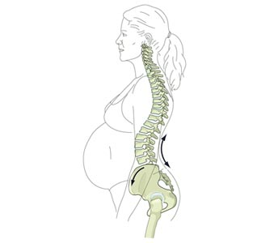
Postural changes⁷
Forward head
Rounded shoulders
Hyperextended knees
Pronated feet
Widened base of support
Increase cervical, thoracic, and lumbar curves
Notes:
http://www.edcampchiropractic.com/wp-content/uploads/2010/02/pregnant-diagram.jpg
Ask what postural dysfunctions or problems will they typically see?

Slide 11
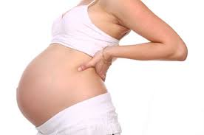
Postural Dysfunction⁷
Postural dysfunction can cause
Thoracic outlet syndrome
Carpal tunnel syndrome
Low back pain
Lumbar or sacral root irritation
Pubic separation
Occasional parasthesias
Worsening of pre-existing conditions (like scoliosis or spondylolisthesis)

Slide 12
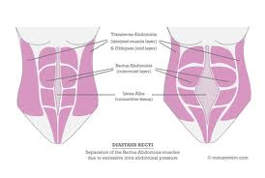
Physical Therapy⁸
PT’s can help with:
Posture Correction
Pain management strategies
Provide external supports
Create general exercise programs
Modalities can assist with treatments
Diastasis Recti
Notes:
Diastasis Recti should be examined at umbilical level and above and below. If the distance is greater than 2 fingers, exercises and/or wraps and supports should be started immediately

Slide 13
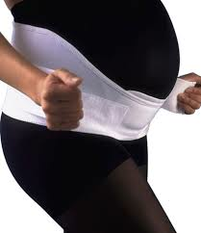
Back Pain⁸
Several tips for managing back pain include:
Avoid carrying objects on one hip (asymmetry)
Avoid crossing legs
Carry loads in the middle
Change positions frequently
Get muscles ready to move
Support lumbar spine
Watch body mechanics with ADL’s
Notes:
Low Back Pain is common during pregnancy and during postpartum period
Several tips for managing back pain include:
Avoid carrying objects on one hip (asymmetry)
Avoid crossing legs
Carry loads in the middle
Change positions frequently
Get muscles ready to move
Support lumbar spine
Watch body mechanics with ADL’s

Slide 14
Nutrition⁹
Sensible and well-balanced meals combined with regular physical fitness is still the best idea for good health during pregnancy
Notes:
Doctors recommend that women should gain 2-4 lbs in the first trimester, and 3-4 lbs per month of the 2nd and 3rd trimesters.
Most women need about 300 more calories per day the last 6 months of pregnancy than they did pre-pregnancy. These calories need to be full of nutrients!
Pregnant women should drink 10 cups of fluid daily.

Slide 15
Physical Activity⁹
Vital in maintaining health and well being during pregnancy.
Keeps the heart, bones, and mind healthy.
At least 2.5 hours of moderate intensity aerobic activity a week
Notes:
Vigorous intensity before can continue with okay from doctor

Slide 16
Physical Activity Benefits⁹
Ease and prevent aches and pains of pregnancy
Better prepared for labor and recover faster
Lose weight easier following delivery
Improve sleep
Emotional health can improve
Risk of preterm delivery decreases
Notes:
(better self-esteem and lower risk of anxiety and depression)

Slide 17
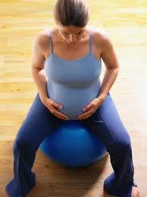
Low Impact Activities⁹
Walking
Swimming
Dancing
Cycling
Low impact aerobics
Notes:
Low impact activities at a moderate level of effort are comfortable and enjoyable
Low impact activities include:

Slide 18
Low Impact Activities to Avoid
Kickboxing
Soccer
Basketball
Ice Hockey
Horseback riding
Skiing
Gymnastics
Notes:
Women should avoid activities where they can get hit in the abdomen or at an increased risk of falls, like

Slide 19
Tips to Follow while Exercising⁹
Start slowly, progress gradually, and cool down slowly
RPE should be based on the pregnant woman being able to talk
Exercising on the woman’s back is contraindicated after the first trimester
Avoid jerky, bouncy, or high-impact activities
Ligaments are more lax and thus can increase risk of injury
Avoid exercising at high altitudes
Drink lots of fluids before, during, and after exercising
Avoid extreme heat or humidity
More frequent rest breaks may be required

Slide 20
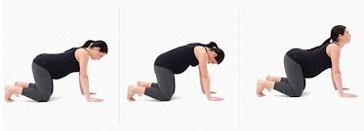
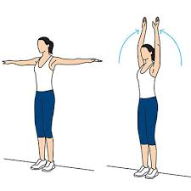
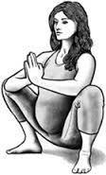
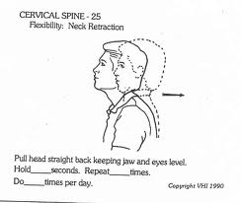
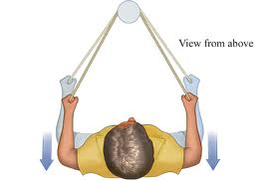
Key exercises while Pregnant⁸
Cat-Camel
Wall Angels
Thoracic Push/Pull Exercise
Deep Squat
Cervical Retractions
Scapular Strengthening

Slide 21
Red Flags during Exercise⁹
Dizziness
Headache
Chest pain
Calf pain or swelling
Abdominal Pain
Blurred Vision
Fluid leaking from vagina
Vaginal bleeding
Contractions
Less fetal movement

Slide 22
Pelvic Floor Exercises⁹
Pelvic Floor muscles support the rectum, vagina, and urethra in the pelvis
Toning these muscles with pelvic floor exercises will help the woman push during delivery and recovery from birth
Incontinence issues also decrease when women tone their pelvic floor muscles
Women should hold 5-10 seconds, 10-15x, 3x a day
PT’s or doctors should instruct pregnant women on how to perform pelvic floor muscle contractions correctly

Slide 23
When to call the doctor¹⁰
CALL THE DOCTOR OR MIDWIFE AS SOON AS POSSIBLE IF SHE IS:
Bleeding or leaking fluid from the vagina
Swelling in the face, hands, or fingers
Severe or long-lasting headaches
Have discomfort, pain, or cramping in the lower abdomen
Have a fever or chills
Are vomiting or have persistent nausea
Feel discomfort, pain, or burning with urination
Have problems seeing or blurred vision
Feeling dizzy
Suspect the baby is moving less than normal after 28 weeks of pregnancy
Have thoughts of harming herself or her baby
Notes:
When a woman is pregnant she should not wait to call the doctor or midwife if something is bothering or worrying her. Sometimes physical changes can be signs of a problem.
Bleeding or leaking fluid from the vagina
Have sudden or sever swelling in the face, hands, or fingers
Severe or long-lasting headaches
Have discomfort, pain, or cramping in the lower abdomen
Have a fever or chills
Are vomiting or have persistent nausea
Feel discomfort, pain, or burning with urination
Have problems seeing or blurred vision
Feeling dizzy
Suspect the baby is moving less than normal after 28 weeks of pregnancy
Have thoughts of harming herself or her baby

Slide 24
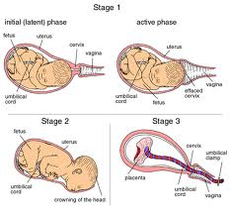
Labor and Delivery¹¹
Stage 1 Prelabor
Stage 1 Active Labor
Stage 1 Transition
Stage 2 Labor: Delivery
Stage 3 Labor: Afterbirth
Notes:
Stage 1 Prelabor – initiation of uterine contractions lasting up to 15 seconds, spaced 10-30 minutes apart, dilation of the cervix to 3 cm
Stage 1 Active Labor – Cervical dilation greater than 2 cm, progressing to 8 cm, and contractions lasting up to 45 seconds, with interval 5-10 minutes apart
Stage 1 Transition – The cervix dilates from 8 to 10 cm with contractions lasting for 90 seconds at intervals of 1-2 minutes. Once fully dilated, the mother is supposed to feel the urge to push
Stage 2 Labor: Delivery – Complete cervical dilation with spontaneous expulsion efforts by the mother that end with the birth of the baby. Normal timing for this stage is 1-2 hours for a primigravida and ¼- 1 hour for a multigravid female
Stage 3 Labor: Afterbirth – The placenta, amniotic sac, and umbilical cord are expelled within 1 hour
The newborn baby suckling at the breast stimulates oxytocin release from the posterior pituitary enhancing the uterine contractions that result in expulsion.

Slide 25
Doctors or Midwives?¹¹
Physicians attended 91.5% of births in the US
Midwives attended 7.9% of births in the US
Notes:
In 2006
Certified nurse midwives are registered nurses who have completed advanced studies in women’s health care and midwifery.
Most midwives practice in hospitals and birth centers and they are licensed in all 50 states and certified by national examination.
There are also certified professional midwives. They are nationally credentialed, direct-entry midwives. They are educated in midwifery schools and/or through apprenticeship.
Midwives provide services that are very holistic in nature focusing on all parts of treatment
that include monitoring physical, psychological, and social well-being of the mother throughout the child-bearing cycle; providing the mother with an individualized education, counseling, and prenatal care with continuous hands on assistance during labor and deliver as well as postpartum support for mother and baby; minimizing technological interventions and identifying and referring women to a physician if necessary

Slide 26
Hospital Birth¹¹
In 2006, hospital births accounted for 99% of all births in the United States
Lots of options are available in a hospital if anything were to go wrong
Notes:
A woman who is delivering in a hospital is wise to develop a birth plan – which is a communication tool that outlines the woman’s priorities and concerns, while helping caregivers provide respectful and appropriate care. A good birth plan is brief and flexible, but can change because of the unpredictable nature of the birth process and likely to be disregarded by most busy health care professionals.

Slide 27
Home Birth¹²
Women will give birth in their home
Assisted by a midwife.
During labor, the health care provider will periodically (instead of continuously) monitor the woman’s temperature, pulse, blood pressure, and baby’s heart rate
Women may choose a home birth for many reasons, including:
Wanting to give birth in a familiar, relaxing environment
Desire to wear their own clothes, take a shower or bathe, eat, drink, and move around freely during labor
Desire to control their own labor position or other aspects of the birthing process
Desire to give birth without medical intervention, such as pain medication
Cultural or religious norms or concerns
A history of fast labor
Lower cost
Notes:
Home Vs. Hospital Birth
Planned home births were associated with fewer maternal interventions including epidural analgesia, electronic fetal heart rate monitoring, episiotomy, and operative delivery
Women who had home births were less likely to experience lacerations, hemorrhage, and infections
Neonatal outcomes of planned home births revealed less frequent prematurity, low birthweight, and assisted newborn ventilation
Planned home births were associated with significantly elevated neonatal mortality rates

Slide 28
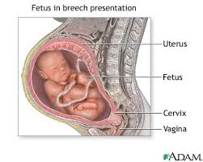
Possible Complications¹⁴
Preterm (premature) labor, when labor starts before 37 completed weeks of pregnancy
Nuchal Cord – the cord is wrapped around the baby’s neck
The baby is in the breech position (head up, bottom down; sideways; or feet first)
Birth injuries
Some of these problems can result in a Caesarean Section Delivery

Slide 29
Postpartum¹⁵
Labor and delivery is a very hard, traumatic, and exhausting time for a woman. Pregnant women should focus on the baby and recovering their own bodies following birth.
Women can expect to lose 10 pounds right after giving birth and as fluid decreases.
Gradual weight loss over several months is safest, especially with breastfeeding.
A healthy diet and physical activity will aid in weight loss. Exercise should begin gradually and progress slowly.
Be mindful that women may experience the “baby blues” following childbirth. Women may feel sad, weepy, and overwhelmed as they return home. All these emotions come from changing hormones, anxiety about caring for the baby, and lack of sleep.

Slide 30
Mayan Culture¹⁶
Prenatal care is limited
Mayan mothers deliver in her home, surrounded by a midwife, her husband, and ayudantes (helpers)
Group decisions are made instead of just by the birth attendant
The partera’s (midwife) role is similar to the role of midwife in many cultures
The newborn is not handled with a sense of delicacy or not much effort to support his/her head
Mother and baby remain inside the home for 7 days
Babies are held all the time except when they are asleep
Notes:
She provides instructional and emotional support to the mother, receives the baby upon birth and cuts the umbilical cord
Babies are not aware enough at this point to feel pain

Slide 31
POPULATION | United States¹⁷ | Guatemala¹⁸
Median Age Average Male Female | 37.6 years 36.3 years 39 years | 21 years 20.4 years 21.7 years
Birthrate | 13.42/1000 | 25.46/1000
Deathrate | 8.15/1000 | 4.82/1000
Life Expectancy Average Male Female | 79.56 years 77.11 years 81.94 years | 71.74 years 69.82 years 73.76 years
MOTHER | UNITED STATES¹⁷ | GUATEMALA¹⁸
Mother’s Mean Age | 25 | 20.3
Maternal Mortality | 21 deaths/100,000 | 120 deaths/100,000
Infant Mortality | 6.17/1000 births | 23.51/1000 births
Fertility | 2.01 | 2.99

Slide 32
References
Pregnancy and Preconception Health. Womenshealth.gov. http://www.womenshelath.gov/pregnancy/before-you-get-pregnant/preconception-health.html. Accessed March 12, 2014.
Good Health Before Pregnancy: Preconception Care. The American College of Obstetricians and Gynecologists. http://www.acog.org/~/media/For%20Patients/faq056.pdf?dmc=1&ts=20140317T1233031095. Accessed March 12, 2014.
Akkerman D, Cleland L, Croft G, Eskuchen K, Heim C, Levine A, Setterlund L, Stark C, Vickers J, Westby E. Institute for Clinical Systems Improvement. Routine Prenatal Care. Updated July 2012.
Sfakianaki A. Prenatal vitamins: A review of the literature on benefits ad risks of various nutrient supplements. Formulary. 2013 Feb;48(2):77-82.
Routine Tests in Pregnancy. The American College of Obstetricians and Gynecologists. http://www.acog.org/~/media/For%20Patients/faq133.pdf?dmc=1&ts=20140317T1305081368. Accessed March 12, 2014.
Kirkham C, Harris S, Grzybowski S. Evidence-Based Prenatal Care: Part I. General Prenatal Care and Counseling Issues. Am Fam Physician. 2005 April;71(7):1307-1316. http://www.aafp.org/afp/2005/0401/p1307.html. Accessed March 12, 2014.
Figuers C. The Childbearing Year. Duke’s Women’s Health Class at Duke University School of Medicine. May 7, 2013.
Figuers C, Pannullo A. Prenatal and Postpartum Examination and Interventions. Duke’s Women’s Health Class at Duke University School of Medicine. May 16, 2013.
Pregnancy – Staying healthy and safe. Womenshealth.gov. http://www.womenshealth.gov/pregnancy/you-are-pregnant/staying-healthy.html. Accessed March 12, 2014.
Pregnancy complication. Pregnancy. Women’shealth.gov. http://womenshealth.gov/pregnancy/you-are-pregnant/pregnancy-complications.html . Accessed April 13, 2014
Irion J and Irion G. Women’s Health in Physical Therapy. 2010. Lippincott Williams & Wilkins, a Wolters Kluwer business. Baltimore, MD.
Labor and delivery, postpartum care. Mayo Clinic. http://www.mayoclinic.org/healthy-living/labor-and-delivery/in-depth/home-birth/art-20046878. Accessed April 13, 2014.
Wax JR, Lucas FL, Lamont M, Pinette MG, Cartin A, Blackstone J. Maternal and newborn outcomes in planned home birth vs planned hospital births: a metaanalysis. Am J Obstet Gynecol. 2010 Sep;203(3):243.
Childbirth Problems. Medline Plus. http://www.nlm.nih.gov/medlineplus/childbirthproblems.html. Accessed April 13, 2014.
Pregnancy – Recovering from birth. Womenshealth.gov. http://www.womenshealth.gov/pregnancy/childbirth-beyond/recovering-from-birth.html. Accessed March 12, 2014.
McGann B. Maya Childbirth Traditions in a Medical Pluralist Society: An Ethnomedical Perspective. http://www.academia.edu/386087/Maya_Childbirth_Traditions_in_a_Medical_Pluralist_Society_An_Ethnomedical_Perspective. Accessed April 21, 2014.
United States. The World Factbook. CIA. https://www.cia.gov/library/publications/the-world-factbook/geos/us.html . Accessed April 13, 2014.
Guatemala. The World Factbook. CIA. https://www.cia.gov/library/publications/the-world-factbook/geos/gt.html. Accessed April 13, 2014.

Slide 33
Questions??

