Slide 1
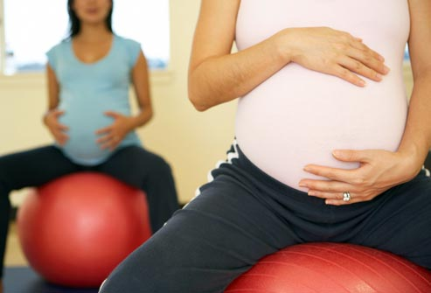
Exercise During Pregnancy & The Role Of Physical Therapy
Presented by:
Chenin D. Duclos, SPT
DPT Capstone Presentation
Division of Physical Therapy
UNC– Chapel Hill

Slide 2
Learning Objectives
Review current exercise guidelines and investigate level of adherence among pregnant women
Understand current research-based effects of exercise during and after pregnancy
Become familiar with women’s behaviors, barriers, and information sources about exercise during pregnancy
Discuss our role as interdisciplinary, healthcare practitioners in the promotion of exercise during pregnancy and explore the use of the Physical Activity Vital Sign
Become familiar with the role of physical therapy, specifically Women’s Health PT, during pregnancy: who to refer, when to refer and how we can help
Meet the Women’s Health PT’s in your area

Slide 3
In the absence of either medical or obstetric complications, pregnant women are recommended to accumulate 30 minutes or more of moderate-intensity exercise on most, if not all, days of the week.¹
Notes:
This is the most current set of guidelines, published in 2002, established the ACOG, which is the exact same recommendation for non-pregnant women.
These recommendations are the same postpartum and in fact, although ACOG reports that no adverse effects have been noted with rapid resumption of exercise postpartum – it is advised to resume former activities gradually
There are of course absolute (certain heart and lung disease, placenta praevia after 26 weeks, incompetent cervix, risks for premature labor…) and relative (orthopedic concerns, severe anemia, extreme underweight or overweight, poorly controlled diabetes, seizures, thyroid disorders…) contraindications to aerobic exercise. Every women should have an evaluation and obtain clearance from their healthcare provider before beginning exercise program.
“One continuous session and multiple shorter sessions (of at least 10 minutes) are both acceptable to accumulate desired amount of daily exercise. ” according to ACSM

Slide 4
What Is Moderate Exercise?¹⁻⁴
50-70% of maximum heart rate (MHR)
12 -14 on Borg Rating of Perceived Exertion Scale (6-20; RPE)
3-5 metabolic equivalents (Mets)
What To Say To The Patient?
“Somewhat hard”
Be able to carry on a conversation
4-6 on a scale of 1-10 (1 = extremely easy, 10 = extremely hard)
Brisk walk, speed your HR and breathing, but not out breath
Use HR?
Notes:
What is moderate and how will our patients know that is what they are doing? how does HR fit in? Nancy and I talked about many women having questions about HR. Has anyone discussed how to find heart rate with their patients for exercise performance? What do you typically say?
CLEARLY, the most difficult part of exercise regime to prescribe is intensity – plus variation in literature. As I researched this topic I found lots of variation with what CDC, US Dept of HHS, ACSM (American college of sports medicine), and WHO report as moderate exercise. (In my readings: moderate was 3-4, 3-5, 3-6 Mets depending on author and although CDC reports moderate intensity exercise is 50-70% max heart rate, O’Toole et al provides a summary of new ACOG & ACSM guidelines states that moderate exercise is 60-90% of MHR (which to me seemed high)
According to Center for Disease Control and Prevention - Moderate Exercise is 50-70% of MHR or 12 -14 RPE (how hard you feel like you are working) - equates to “somewhat hard” or 4-6 on scale of 1 -10
MET is the ratio of a person's working metabolic rate relative to their resting metabolic rate.
Women coming into WBWC are going different levels of experience with exercise and determining heart rate. Many may need help figuring out what moderate exercise really is. That first visit with them (when exercise is addressed) is a perfect opportunity to teach them how to figure it out how to gauge their exercise intensity. Ideas of what to tell them -
CONSIDER THIS THOUGH: many hemodynamic changes are occurring during pregnancy (increased in blood volume, HR, stroke volume, cardiac output and decrease in systemic vascular resistance). There is conflicting evidence on maternal heart rate response to steady, submaximal exercise during pregnancy. In light of this, heart rate monitoring to guide exercise intensity during pregnancy is actually difficult.
CONSIDER: research suggests that women have a tendency to report lower RPE’s compared to objective, reliable measures of exercise intensity (VO2 max: max aerobic capacity)
In light of these findings, use best clinical judgment – individual patient experience with exercise, being accustomed to monitoring heart rate, and assessing how hard they are working and exercise effects on their body. Would you still use HR?

Slide 5
How To Use Heart Rate
34 yo > beginner > resting heart rate = 60 bpm
OPTION 1:
Simple, Easy to use
Step 1:
220 – age = MHR →
220 – 34 = 186
Step 2:
Training % x MHR→
(50-60%) x 186 = 93 – 112 bpm
OPTION 2:
Karvonen Formula
Step 1:
MHR – RHR = HRR→
186 – 60 = 126
Step 2:
(HRR X training %) + RHR→
(126 x (50-60%)) + 60 = 123 – 136 bpm
There is a difference. How to choose?
Notes:
One way to be proactive -> teach women how to find their pulse, calculate heart rate and use formula to figure out a target heart rate zone
If you decide that HR zone is a good gauge → (and we are having this discussion because how hard our patients work is important. Of course every bit counts, but increased intensity (ACOG recommended levels) is correlated with the benefits) what formula to use and teach patients?
Simple formula which some authors refer to as out dated: 220 –age = MHR x intensity (93 – 112)
Vs. Karvonen Formula: which considers heart rate reserve (the difference between MHR and RHR) Factoring in RHR provides information about cardiovascular fitness. This provides a better target heart rate. (above example - 123-136)
We see actually a big difference.
If we changed the example above to 90 bpm – less CV fitness (we know normal RHR is 60 -100 bpm and typically lower RHR corresponds with better CV fitness), our results would be → the same for simple formula and 108 – 118 for Karvonen Formula
TAKE HOME MESSAGE: Karvonen Formula is more accurate to determine THR zone and factors in CV fitness; however simple formula easier perhaps for patients to determine.

Slide 6
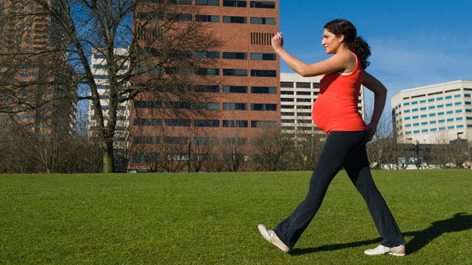
Do Pregnant Women Follow These Guidelines?⁵⁻⁷
11%, 14%, 17%
Unfortunately … NO
Notes:
We know guidelines, how to determine intensity, curious to know adherence rates. As healthcare providers, if we have evidence-based research about an intervention that improves wellness and QOL, we hope our patients will adhere to our recommendations. Turns of the answer is “NO” – women are not following rec, guidelines for exercise during pregnancy and in fact those that exercised prior to pregnancy often drop way back.
1. Gjestland et al:
Performed a study in 2013 providing questionnaires to 3482 women in Norway at mid pregnancy (17- 21 weeks), 32 weeks, 8 weeks and 2 years post partum;
Purpose: 1) describe exercise-level mid pregnancy; 2) examine sociodemographic variables (age, parity, education, marital status, smokers, pre-pregnancy BMI) associated with exercise; 3) analyze the association between exercise in mid-pregnancy and low back pain, pelvic girdle pain and depression in pregnancy week 32
Method: how often (never, up to or > 3 days/week)? How strenuous (sweating and breathing)? How long (10 min to >60 min)? Inquired about LBP (12th rib →gluteal fold with/without leg pain) and PGP (posterior iliac crest →gluteal fold with/without pain in pubic symphysis and radiating to thigh), and depression
Results: 14.6% exercised >/= 3x per week, at moderate intensity for at least 20 min (GUIDELINES); 40% exercised 1-2x per week; ~30% exercised <1x per week; women that exercised >3x per week or 1 -2 x were primiparous and higher education levels.
Positives: minimal exclusion criteria, large study population and high response rate → believe represents the pregnant population
2. Evenson et al:
2004 – (US study - has also done research here at UNC!!)
Purpose: investigate participation and characteristics of leisure activities among pregnant women. Authors report a nationwide survey describing the epidemiology of leisure activity during pregnancy had not been performed since 1988
Method: pooled data from ~ 2000 pregnant women (18-44 yrs – through a surveillance system); activity was assigned with METS, women described their leisure activity in the past month and then were categorized into (sufficient, insufficient or inactive)
Results: less than 1/6 met guidelines in past month (with walking, swimming laps, weights lifting, gardening, aerobics); largest group was that inactivity group; 2/3 reported “any leisure activity” which was on average 2 hrs per week total and was walking (but perhaps not at moderate intensity, doesn’t fall into sufficient category)
Additional results: many women treat pregnancy like a “pause” reducing exercise or even stopping after 18 weeks (even thought exercised before pregnancy) (Univ of Vermont: 41 % before → 14% by third trimester); sedentary remain sedentary; good news is many are not preforming the activities that ACOG recommends avoiding (contact sports, vigorous racquet sports etc.). We can feel security women are choosing safe activities.
Highlights/Importance: WALKING was the top activity for pregnant and non-pregnant women, followed by swimming, and gardening, and indoor conditioning, which included activities such as aerobics, weight lifting, and home exercises. Support Walking group? Comfortable shoes? Have PT watch gait – prevent pain? Homestead pool?
3. Haakstad et al: (2009)
Purpose: used questionnaires to 467 women (again Norway) to identify exercise participation during pregnancy in third trimester
Results: 50/467 ( <11%) followed ACOG guidelines; 25% exercised <1x per week; of the 262 (more than half) that reported non-exercisers before pregnancy only 9 of that group started to exercise during pregnancy
Highlight: again see sedentary staying sedentary

Slide 7
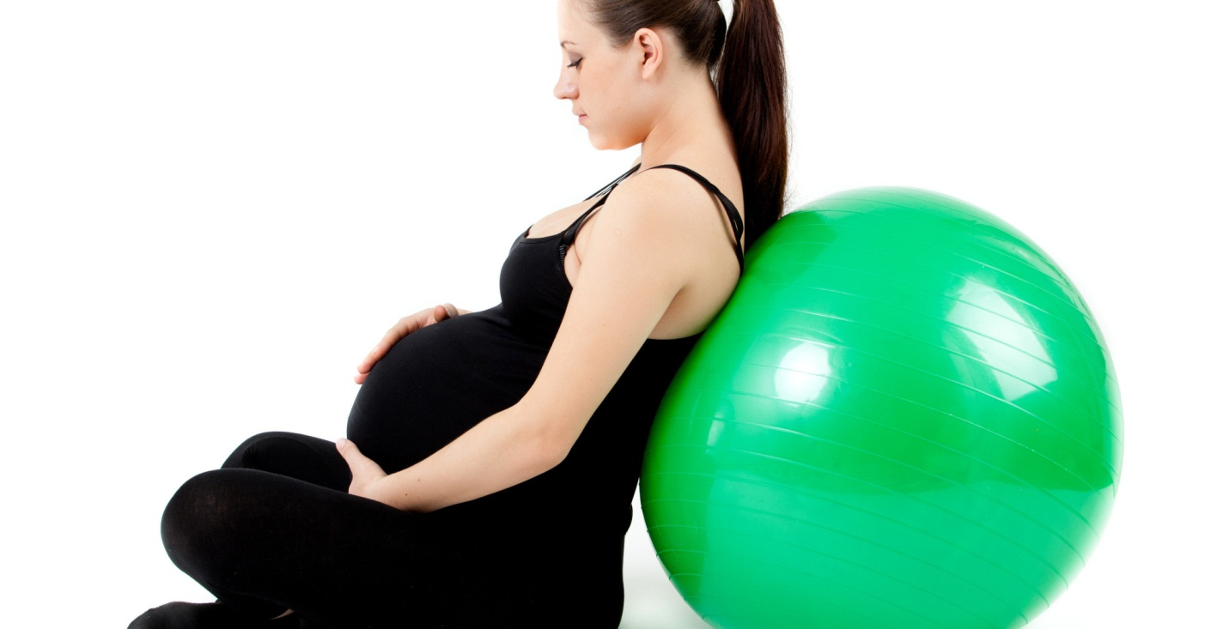
Why Exercise During Pregnancy?^{5,8-15}
REDUCE
gestational diabetes, preeclampsia, preterm birth, depression, anxiety, MSK pain,
medical intervention during labor
IMPROVE
maternal glucose, well-being, self-image, self-esteem, labor time
MAINTAIN
participation in your work , healthy weight for you and your baby
Notes:
So…why are we concerned that women are not participating? What are the benefits they are missing out on?? (refer too 3 evidence tables for a more in-depth review of this literature)
1. Gjestland et al:
In their survey found that ~ 50% of women reported LBP and PGP (we know it is common), and 8% reported depression in pregnancy at week 32
RESULTS: women that reported exercise >/= 3x per week during mid pregnancy were significantly less likely to experience PGP in late pregnancy (and there was a tendency towards a dose-response comparing 1-2 x with > 3x)
Women that reported exercise 1-2x per week were significantly less likely to report LBP and depression
As always consider bias (no clinical diagnosis of LBP or PGP; self-report exercise)
2. Chuntharapart (2008)
Supervised prenatal yoga 3x per week
Increased maternal comfort, decreased pain during labor and after delivery, and shorter labor time compared to regular nursing care
3. Barakat 2011:
Participation in moderate PA throughout pregnancy
RESULTS: improves maternal perception of health status; women in experimental group reported better health status ("very good"), gained less weight (yet, still within recommended amount), and experienced less type I lacerations during birth.
4. Stafne 2011:
12 week exercise program (60 min supervised, 2x 45 min HEP)
EG reported less sick leave and disability due to pain which the authors associate with women being able to handle the pain better.
5. Barakat 2012:
EG group women that did develop GDM despite exercise, had a 58% reduced risk of having a baby with macrosomia and 32% reduced risk of caesarean delivery. Lastly, gestational age at delivery was the same for EG and CG.
6. Barakat 2011:
moderate-intensity exercise program during pregnancy
improved levels of maternal glucose tolerance, a slightly lower total weight gain, and lower prevalence of GDM.
7. Grananth 2003:
Compared aquatic and land
Results: reported less low back pain and less sick leave due to back pain compared to land-based therapy.
8. Beddoe (2009):
Yoga intervention
EG reported significant decreases in pain and decrease in interference in daily activity from baseline measurements and compared to women in their third trimester
Women in their third trimester reported greater stress reductions and trait anxiety, although all women had a decrease in perceived stress compared to baseline scores.
9. Robledo-Colonia (2012):
3 month supervised exercise (3x 60 min classes) starting at 16-20 weeks gestation
Exercise during pregnancy significantly reduces depressive symptoms when compared with a control group

Slide 8
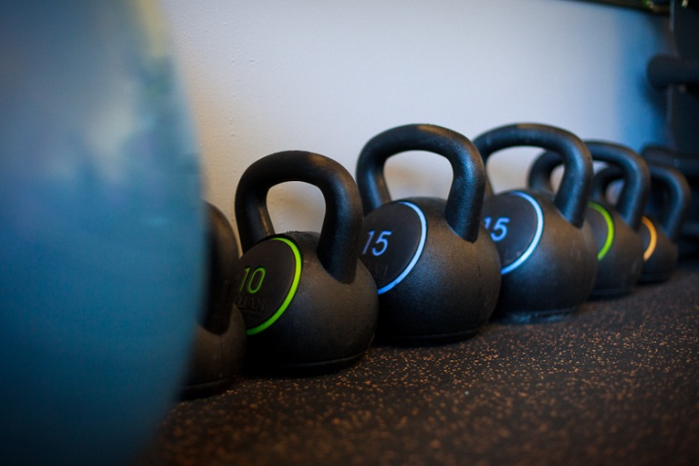
Barriers, Beliefs, Information Sources^{5-7,16-18}
Obstetric complaints
Lack of time
Too much effort to get started
Other commitments
Prepregnancy inactivity and health
Higher weight gain
Lack positive role models
Cultural variation
Advice from health provider to avoid
Residual dogma – Fear
Sociodemographic variables
Lack interest & options
Don’t want to alone, lack companion
Previous negative experiences
Access
Health conditions
Lack emotional support
Notes:
There are many benefits. We know that pregnancy is a time for many changes: social, biological, psychological and behavioral. In light of these changes, it seems likely that sticking to or starting an exercise routine would be a challenge for many pregnant women. Cleary there are barriers to participation. Pre-pregnancy exercisers are decreasing and even stopping, non exercisers are not starting. Many not doing enough to reap the benefits. Currently, evaluation of barriers is necessary (what are they?), so we can gain insight about how to help our patients overcome the barriers and understand where they are getting their information. How may we support our patients to break through those barriers and misconceptions?
What are your thoughts? What do you think or hear from your patients about why they don’t participate?
(Let’s take a look at the three articles we reviewed for adherence…which was quite low – and a few others…I sense a trend!)
1. Haakstad et al (2009): Norwegian study that looked at adherence saw that of the 416 that did not follow guidelines and were considered non-exercisers reported: top four reasons for lack of participation: obstetric complications (#1 -28%), insufficient time (#2 – 11%), too much effort to started (#3 – 10%), (other commitments) difficulties due to children and childcare (#4 ~10%), lack of interest, lack of exercise companion, lack of availability of exercise options, negative experience with exercise, no experience/never exercised, disease/handicap, fear of harm to the baby and advice from health professional to avoids; perhaps no partner is a barrier – 85% report exercising with another person
Prepregnancy inactivity was the strongest predictor of non exercising in later pregnancy
Higher weight gain and no positive social role models in childhood were significant barriers
Consider large cultural variation in attitude toward pregnancy
Advice to avoid or lack of discussion (only 36% received advice about exercise at least 1x – and who initiated the conversation?)
Residual dogma was not at the top of the list, but women did report fear of hurting their baby however we can be sure to tell them that **the ACOG guideline from 2002 states that no published studies have shown that, in the absence of medical complications, regular exercise during pregnancy will result in adverse effects on the fetus.
2. Gjestland et al (2013):
Other commitments was reported as barrier.
Researchers assessed role of sociodemographic variables (age, education, ethnicity, gender, marital status, family size): Found association with education, family size and pre-pregnancy BMI >30; women are more likely to exercise if no other children, more highly educated, less likely to be overweight (again we see other commitments and prepregnancy health/inactivity)
**Studies in the general population are consistent in this area, showing that higher education level reflects healthy living habits, including participating in regular exercise
3. Evenson et al:
prevalence of any leisure activity significantly increased with higher education, younger age and excellent – very good health compared with fair to good.
4. Gaston and Cramp (2011) performed a review of patterns and determinants: assessed 25 articles published between 1986 – 2009; all used self-report measures of exercise at multiple time periods before/after delivery to evaluation changes in behavior.
Overall, again confirm a decrease in frequency and intensity, few women meeting guidelines
Many variables came up, but seem to be inconsistences (i.e. 3 studies found younger age 2x more likely to meet guidelines, 4 studies found older age correlated with higher exercise levels, 7 found no association)
Only a few stood out as consistent predictors: education level, income level, race or ethnicity (“all studies investigating ethnicity indicated Hispanic and Asian women were most likely to be inactive” and women that preferred to speak English → 2x more likely to participate in sports/exercise compared to women that preferred speaking only Spanish), having other children, level of physically active prior to pregnancy.
5. Journal of Midwifery – Duncombe et al (2011, Denver Co; 158 women; prospective questionnaire at 16-23 weeks): assessed inter and intra-personal factors, and environmental.
Barriers: obstetric complaints (sick, fatigue, pain, body changes, uncomfortable), lack time, lack motivation, misconceptions about safety of baby (this information was often provided by friends and family and reported in non-exercisers); lack role models; lack emotional support (non-exercisers); weather, access
6. Journal of Midwifery - Clarke et al (2003 – UK; 57 women; prospective survey): looked at information sources and barriers
Again #1 barrier: maternal physical health (come see a PT! and PT’s need to promote exercise pre-pregnancy!)
#2 social/cultural discourse that renounce exercise during pregnancy
women report being unaware of the positive health outcomes
OVERALL SOURCES REPORTED:
Clarke et al report many received exercise advice at least 1x during pregnancy; <1/5 reported receiving advice from healthcare provider; more constant source is family, friends (and many were inaccurate perceptions of maternal exercise)
Duncombe et al: women reported information/misconceptions about safety of baby were was often provided by friends and family and reported in non-exercisers
Take Home Message:
Patient education is going to be key! Results highlight the importance of precise and updated information on exercise and physical activity, based on the current guidelines, to be distributed to pregnant women
AND Midwifes are in a perfect position to give necessary info and dispel some of the misconceptions that family and friends provide
Time and time again: physical limitations and comfort are barriers → need for exercise program and techniques to help women feel more comfortable – think PT ☺
HCP need to maintain awareness that certain populations may have more barriers than others (work commitments, other children, lack social network, direction, need idease, etc…, obstetric complaints- think PT before delivery!!)

Slide 9
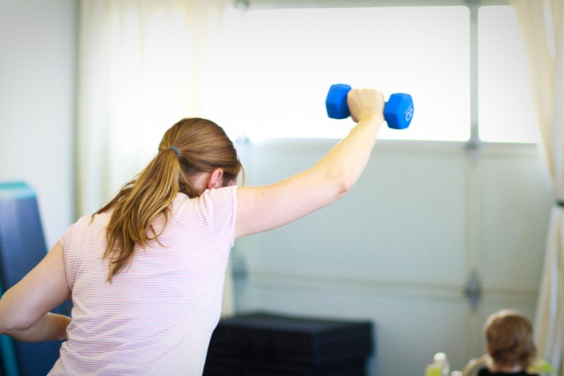
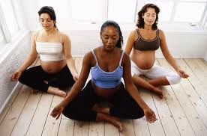
MOTIVATORS^{7,17,19}
Prevent Health Complaints
Increase Physical Fitness
Well-being & Happiness
Notes:
Many of those barriers and beliefs are not a surprise; what motivates women deserves just as much attention. A handful of the studies, discussing barriers looked at top motivators as well.
Haakstad et al: (Women in third trimester)
Surveyed 11% of the original group because they were the only ones that followed guidelines – resulting in decreased power of study, but something to consider)
What are the two main reasons you exercise? prevention of health complaints (60%); increasing physical fitness (50%); well-being and happiness(20%); appearance; relaxation/recreation; sports competitions; prevention of weight gain; increase self-confidence; decrease stress/depression; obligation and for social reason
2. Journal of Midwifery – Duncombe et al (2011, Denver Co; 158 women; prospective questionnaire at 16-23 weeks) Results demonstrate similarities, but a few others as well.
motivators: increase energy, weight control, sense of well-being, enjoyable, ease labor, sense of accountability from friends and family; other children facilitate their exercise behavior; access to parks/ trails
3. Downs et al (2004; retrospective study of 74 postpartum women): looked at #1 motivator before and after delivery
During pregnancy: improve mood
After delivery: assist with weight gain
TAKE HOME MESSAGE: understanding motivators gives us insight into what drives women to get out and move, to make time in the busy schedule, to go at it alone when may not have a companion. These are areas I think worth tapping into in order to help facilitate exercise participation, but really to help women achieve what they want to achieve in order to increase QOL. (if they want improved mood → recommend exercise – yes, but perhaps support/social group or mediation class etc.; bigger picture – improving their pregnancy experience)

Slide 10
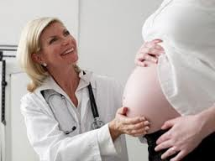
What Is Our Role?^{7,16,17,20-23}
We are obligated by our code of ethics and values
We are vigilant, skilled, knowledgeable
We have a valuable role
We are an open source
We are the first line
Notes:
We know what is recommended and that clearly women aren’t participating. We have a glimpse of barriers and also what motivates pregnant women to work hard to exercise despite MANY barriers. Where do we fit in?!
Haakstaed et al: states “researchers have suggested that health professionals play a valuable role in encouraging exercise behavior in their patients.” During pregnancy there are many visits to a HCP, so HCP are an “open source for providing information on the benefits of regular exercise during pregnancy.”
It is in American College of Nurse-Midwifes vision, mission and values (which is similar to PT’s COE and values) to use current EBP and the “advance the health and well-being of women and newborns”, promotes excellence and high clinical standards. Isn’t our duty to inform about the dangers of being inactive as well?
We’ve had extensive education and clinical training.
As healthcare providers we can be on the lookout for barriers; support, encourage our patients; give them the tools to make staying active a little easier.
Duncombe et al: “pregnant women need to receive current information and instruction, so they can make informed decisions with their healthcare providers about exercise routines that are just right for them!! Exercise that will enhance their health and address each women’s unique barriers (i.e. develop a routine; find comfortable, enjoyable activities)
WAYS TO SUPPORT: (Common barriers: obstetric complaints, time, too much effort, other commitments)
Educate:
Exercise health benefits for mother and fetus
Communicate guidelines
They are safe, reduce fear
Habits adopted during pregnancy → effect health for the rest of you life
Break barriers:
Brainstorm ways to manage time and overcome barriers (exercise with children, only need to do a little each day!)
If seems to daunting to get started → start small, give them ideas of easy, feasible activities (housework, gardening, aquatics, etc.) Haakstad et al: moderate amount of exercise may be achieved in a variety of ways, and that it is important to select activities that are enjoyable, fits into daily routines and for which high skills are not needed.
If they don’t know options: Expose them to the range of activities that exist (stationary biking, aquatics, walking, dancing, hike, prenatal yoga)
Find out what motivates them; Fun and enjoyable!
Haakstad et al reported 85% exercise with their partner, so what about single mothers or moms whose partners may not be interested for have time?? Refer to prenatal classes to build community.
Start a walking group!!: Walking was the most common activity performed in many studies: start a walking group! Guided- meet every X at this time. Does WBWC have an exercise group?
Maturi et al: RCT looking at the influence of pedometer on 12 week walking program postpartum. Women in the EG had significantly increased their activity; may recommend pedometer as motivation, affordable, accessible, simplistic, low literacy friendly and understandable
Remember cultural differences: increase activity for some if Spanish speaking group? Get around acculturation issue
Gaston and Cramp make some great suggestions: keep in mind your lower income patient, diverse cultural backgrounds and those with multiple children (This falls more in your hands during the first visit – recognizing barriers)
Start the discussion early–Increase counseling and education. How can we you that? Consider using the Physical Therapy Vital Sign as soon as they come in for their initial appt.

Slide 11
Physical Activity Vital Sign²⁴
Start The Conversation
Underscore The Importance
Establish A Baseline
Notes:
Have any of you heard of this tool? Do you use an activity tool? Something to consider…
Article written by Robert Sallis in Journal of Sports Medicine in 2011 called the PAVS the “fifth vital sign” – Not new news → being active and fit contributes to longevity and healthier live! We need to work towards this!
WHY DESIGNED?
PAVS was originally designed to address the increasing rates of obesity, lack of adherence to exercise guidelines among many individuals, and inadequate counseling from healthcare providers
There was a need for brief and valid tool, to be used but HCP to increase pt. education counseling and start this important discussion (We are working towards that now!! ☺)
WHAT IS IT?
PAVS: measures PA, simple quick, 2 questions, standardizable
Process include: just when you are taking traditional vital signs, ask these 2 questions:
“On average, how many days per week do you engage in moderate or greater physical activity (like a brisk walk)?
“On those days, how many minutes do you engage in activity at this level?
Then multiple these number to find out average min/week of moderate or greater physical activity
reported by each patient (rec is 150 per week). This gives you a baseline and you can assess what type to counseling they need to stay active an meet guidelines (do they need to slow down or get started?)
GOALS of Use:
Increase exercise counseling done by HCP
Get women thinking about exercise participation (the focus isn’t necessarily to change the behavior, but rather make the information available)
Overcome the barriers discussed
Start the conversation
Ask, assess, advice, assist, arrange (5 A’s model)

Slide 12
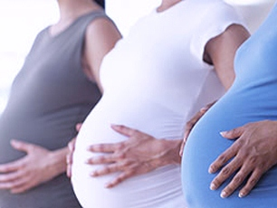
WAIT! There’s more…
What was the #1 Barrier??
Obstetric Complaints
Notes:
Referring back to our role as HCP, there was one important barrier that I want to address and focus our attention on.
Do remember the #1 barrier to exercise described by women in the studies reviewed?
That’s right!! Obstetric complaints were #1. Maternal health and comfort came up time and time again. And this is exactly where a PT fits in.
We know Obstetric complaints include: Nausea, Fatigue , Incontinence, Breast enlargement and tenderness, Back pain, Round ligament pain, Constipation
This is where PT comes in and you may CONSIDER referring to PT:
We can design exercise programs tailored to their individual needs-
And PT’s in general can work to educate women in their childbearing years about the importance of exercise → establish healthier exercise routines before pregnancy.
BUT the key here is really this #1 barrier reported by many, many women
And PT’s can help in this area

Slide 13
“Physical therapists are health care professionals who restore and improve movement and enable individuals of all ages to have optimal functioning and quality of life”²⁵
Notes:
Licensed, trusted professionals that promote health, wellness, fitness, assess risk factors, implement disease prevention measures, diagnose and manage movement dysfunction and enhance functional status
Functioning and QOL are so very important – many of use I’m sure have had personal experience with setbacks in which we couldn’t participate in an activity due to discomfort - during pregnancy we want our mama’s happy and support their participation in life
We have a very high level of knowledge regarding MSK conditions
Our Education: DPT, must pass a national exam, state licensure
Where we practice: hospitals, outpatient, inpatient, SNF, schools, fitness centers…
We are in perfect position to support women through pregnancy and help alleviate some of the pregnancy complaints that prevent women from being active
You may have considered referring women to PT after delivery (Nancy mentioned that might be that may be the case for incontinence, low/back pain, round ligament pain, diastasis recti), but perhaps consider during pregnancy too – to help get women feel more comfortable, and hopefully more likely to get out and be active, able to participate in meaningful activities

Slide 14
Did you know some physical therapists have specialized training to meet the unique needs of a WOMAN?²⁶
Notes:
You very well may already know this. I sure didn’t when I started school, which is one reason I wanted to explore this topic more.
The great thing is there are PT’s that are certified and trained in women’s health and have spent time deepening their knowledge of issues specific to women.
May be through year long residency programs, followed by certification exam, continuing education, special course. (i.e. Herman & Wallace Pelvic Floor series)
According to APTA’s Section on Women’s Health: “Physical therapists trained in the area of women’s health have further knowledge about issues directly related to women as they move through different stages of life, from childbearing years to the post menopausal period. Physical therapists can provide hands on treatment to address spinal and pelvic joint dysfunction, instruct in exercises to address muscle weakness and imbalance, and provide guidance and instruction related to modifications of activities of daily living that may be difficult during the prenatal and postpartum phase.”
Jenn and Elisha have different backgrounds and training in women’s health PT, feel free to ask them questions about their training, etc.

Slide 15
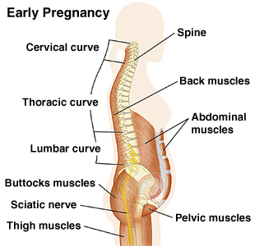
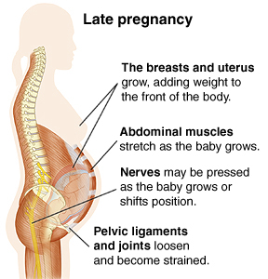
Physical Therapy For Women With...²⁶⁻³⁰
Back, sacral, hip, pelvic, rib pain
Pain in the neck or upper back
Sciatica, carpal tunnel, thoracic outlet or other nerve symptoms
Decreased ability to do normal daily activities
Desire to start or continue an exercise program
Postural impairments
Headaches
Weak or tight muscles
Urinary incontinence
Sexual dysfunction
Notes:
As we know, there are many physiological changes occurring during pregnancy: hormones changing, weight gain, postural changes → biomechanical stress → all of which can create discomforts or exacerbate preexisting ones.
According to APTA SOWH: women with any of the following can be REFERRED to PT during pregnancy, these complaints are not new to you I’m sure; however, these are the obstetric complaints that keep women from being active, cause discomfort intense enough to keep them from working. Women shouldn’t just have to suck it up and feel like these are normal aspects of pregnancy. If there is an intervention to help alleviate these complaints…then I say go for it!
Just talking MSK pain in low back an pelvis: Pain in the lumbar spine and pelvic girdle region is one of the most commonly reported complaints among pregnant women and is often referred to as “lumbopelvic pain” when not differentiated. It is estimated that 50-80% of women experience lumbopelvic pain at some point during pregnancy, and symptoms persist in up to 65% of women for as long as 12 months after delivery. Lumbopelvic pain during pregnancy is described by one-third of women as a severe problem and interferes with everyday activities such as walking, housework, exercise, leisure, sexual life, personal relationships, and caring for other children. Women with lumbopelvic pain report a decrease in job performance, and up to 52% of women take sick leave during pregnancy. Lumbopelvic pain often has considerable consequences on a women’s physical functioning and is correlated with a significantly lower health-related quality of life.
Growing evidence suggests that psychological determinates, such as stress, experienced in early pregnancy are strong predictors of developing lumbopelvic pain in later pregnancy.
Strong correlation between back pain in pregnancy with pain postpartum – negatively affect QOL
This is a big deal! What to address it early.
So what will a PT do??

Slide 16
PT Interventions For MSK Dysfunction in Pregnancy³¹
Positioning education
Postural exercise
Correction of pelvic asymmetry
External stabilization
Manual therapy
Self-management techniques
Patient education about benefits of exercise
Therapeutic exercise & proper exercise performance
Notes:
During Pregnancy, MSK concerns seem to get the most attention.
PT Options for MSK Dysfunction in Pregnancy include:
Positioning education
Postural exercise
Correction of pelvic asymmetry (manipulate, mobilize, muscle energy techniques)
External stabilization (belts)
Manual therapy/Soft Tissue Mobilization
Therapeutic Exercise & Performance Education (lifting, carrying, caring for other children; ergonomics at work)
Self management techniques (Posture, lifting, stability ball use, )
Patient education about benefits of Exercise
***Since these discussion if really a health promotion effort to support women to be more active during pregnancy → this is a reason to perform these interventions → increase comfort! Increase knowledge and awareness.
** For some evaluations and interventions (which ones Jenn?? Elisha?) PT’s may need to do a internal assessment; this needs approval from PCP during pregnancy
**Don’t forget how preexisting conditions factor into the mix!

Slide 17
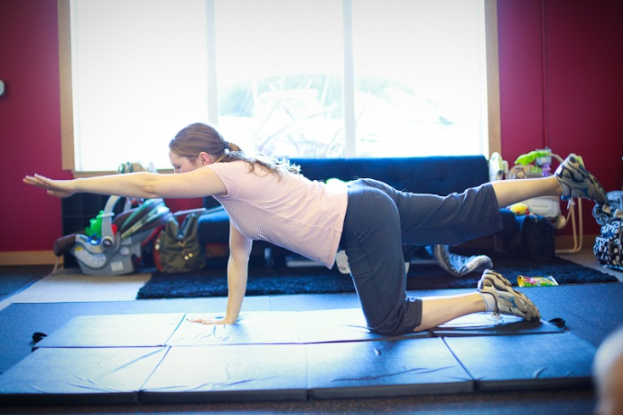
How Important Is Performance?^{8,27,29,30,32,33}
* VERY *
don’t want to provoke pain
Notes:
Want to touch briefly on the concept of exercise performance and why it is may actually benefit women to seek assistance from a PT vs unsupervised exercise (videotape, u tube, handout, maybe even a group class)
I was interested in this topic last semester because of my love for yoga and group classes. I was actually quite surprised about what I discovered…
(All the following studies were RCT, women with lumbopelvic pain during pregnancy or postpartum; refer to evidence table for more information)
Eggen 2012:
257 women
EG: supervised group exercise
CG: standard care (info and advice)
Results: no difference on prevalence and severity of LBP or PGP with group exercise – PERFORMANCE? Can the teacher keep a good eye?
2. Mens 2000
44 women (postpartum pelvic pain)
EG: self-directed via videotape (exercises to target diagonal trunk musculature)
CG: no exercise
Results: no increased effect with videotape on pelvic pain, in fact many women had pain increase and dropped out – PERFORMANCE??? Of course may not the right intervention and studies need to be carefully critiqued
3. Stuge 2004
81 women postpartum
EG: PT administered stabilizing exercise, HEP
CG: usual PT
Results: specific stabilization exercises reduce pain, improve QOL, improve functional abilities after childbirth with PGP → PT’s were able to watch performance closely
Take Home Message:
These studies highlight the important need for skilled, PT intervention and guidance and not just video instruction or a pamphlet with pictures. That may help some, but not for anyone and could actually exacerbate pain. PT’s are "exercise experts" that can reduce the risk of injury and improve quality of movement during exercise.
I wouldn’t discount group classes by any means and think they are great for many. Our job to make recommendations…
1. Martins 2013:
60 women
EG: group yoga class
CG: postural ed via pamphlet
Results: decreased pain intensity compared to self-guided postural orientation
2. Chuntharapat 2008
74 women (maternal comfort and labor pain)
EG: supervised yoga
CG: usual care
Results: increased maternal comfort, decreased pain during labor and after delivery, shorter labor times
Group classes may be for some, but not everyone. And this is where careful consideration takes place when you assess PA during evaluations: what is their familiarity with exercise? Do they have other MSK conditions? Sense of body awareness?
Consider: affordability and great social aspects
Additionally, in regard to pain → we need to assess what kind of support systems pts. have, knowledge of pain, coping strategies in order to keep pain from escalating and contributing to disability down the road.
Bakker et al, 2013 (267 women): Found the STRESS early on in pregnancy was strongly correlated with lumbopelvic pain later in pregnancy, coping skills and anxiety were not. Perhaps use psychosocial outcome measures and interventions that support mental and emotional well-being. Treat the whole individual and decreases stress! Yoga and group calls may be a perfect avenue.

Slide 18
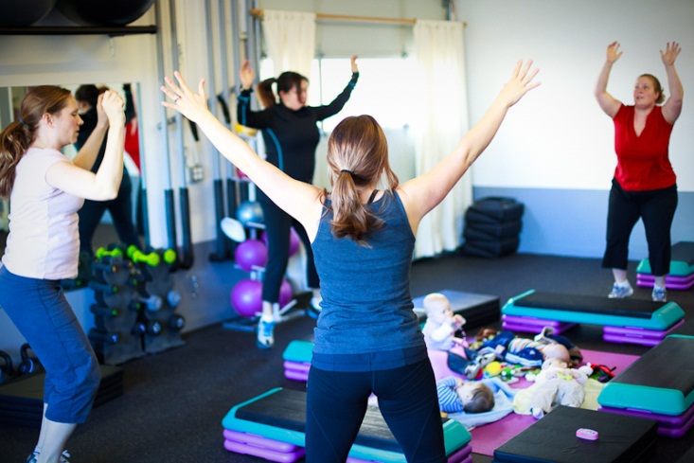
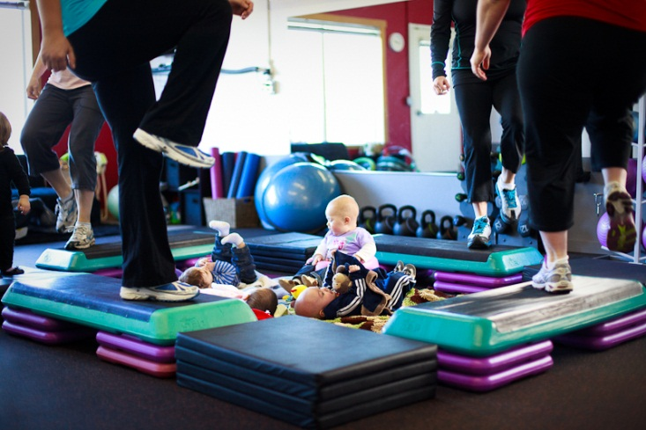
Physical Therapy After The Baby Is Born³¹
All the same MSK dysfunctions as during pregnancy
Address psychological well-being
Patient education & resources
Exercise programs tailored to NEW needs
Headaches
Endurance
Dyspareunia
Incontinence
Scar mobility
Varicosities
Diastasis rectus abdominus
Ergonomic, body mechanics, postural advice
Notes:
I know Nancy mentioned that you have patients that you refer to PT after the baby is born (we talked about incontinence, DRA or diastasis rectus abdominus and round ligament pain)
Why else to refer to PT after delivery?
All the same MSK issues discussed previously: (LBP, PGP, round ligament pain, sacrum, SI, neck, nerve symptoms, LE pain)
Address psychological well-being (80% mood fluctuations, 10-20% major depression)
Patient education and resources
Exercise appropriate an tailored to their needs → address weight gain, CV health, physically active women postpartum→ have less mood disturbances and increased sense of well-being
Headaches
Endurance
Dyspareunia (perhaps there was poor episiotomy healing)
Varicosities: hemorrhoids, Varicose veins (may do compression interventions)
Incontinence: urinary of fecal (early intervention is key here! At risk post partum if have during pregnancy)
diastasis rectus abdominus
Scar mobility (from cesarean)

Slide 19
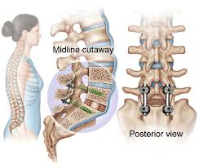
The Patient With Spinal Fusion: Labor & Delivery³⁴⁻³⁷
Assist with labor position ideas to deal with preexisting orthopedic conditions and ease labor
&
Promote continuous labor support
Notes:
I wanted to share with you with you a little bit about a educational lecture I attended at APTA CSM led by: Janet Chamberlin, PT, WCS Susan A. Steffes, PT, CD(DONA) – wonderful, knowledgeable, inspirational PT’s
Their discussion, Emerging Role of PT during labor and delivery, was really interesting and it raised my awareness to the challenges many women may have with natural child birth due to preexisting orthopedic conditions and challenges with positions or joint mobility, pain
The conditions that come to mind for me that may contribute to difficulties with movement and positioning during labor could be: Herniated disk, Spinal stenosis, SI dysfunction, Pubic symphysis separation, coccyx dysfunction, Spinal fusion, femoral neck injuries, hip labral tears, OA, RA, knee issues
Have you had experience with this and how does it change your approach?
I learned (which is your domain yes!) about the stages of labor (the stations) as well and how the maternal pelvis responds to childbirth and how it they way it moves (innominate, sacrum, hip joint, spine) to facilitate the process: sacral counternutation /lumbar flexion→ nutation of sacrum/lumbar extension → opening of the pelvic outlet→ widening of outlet
PT’s focus on proper biomechanics and when needed make adjustments to maintain comfort and healthy joint for patients, they also take into consideration psychosocial aspects of childbirth
PT’s can help brainstorm with you about labor positions in order to not aggravate certain conditions or provide support and guidance on MSK considerations
Or additionally assists their patients in labor support – Janet Chamberlin, PT, WCS and Susan A. Steffes, PT, CD(DONA) addressed how a recent systematic review of 15,000 women/21 RCTS
(Hodnett 2011 ) provided evidence that “skilled continuous labor support improves outcomes” for women and their babies. Compared with women that had no support → women with support
“Women with labor support:
28% less likely to have a cesarean section
31% less likely to use synthetic oxytocin to speed up labor
34% less likely to rate their childbirth experience negatively
Interestingly this support was not provided by someone in the women’s social network or clinical nurse. → so what this says to me is not a family member (different pressures, etc.) or a clinical nurse they haven't’ met, but someone to build a relationship with. Don’t know how WBWC works but, seems like a close knit family-group, doulas too build relatonships….so this I good news! And for a women with orthopedic condition, perhaps here PT would serve this purpose as well.
Take Home Message:
Some woman will benefit from the expert biomechanical advice from a PT and I sense an area for collaboration here and sharing insight, knowledge and experience to enable woman to have a better labor experience

Slide 20
Patient, Family, Midwives, WHNP’s, Lactation team, RN’s, LMBT’s, WBWC Support Staff, Phlebotomist, Lab team, Doulas, PT’s
It’s A Team Approach
Notes:
It really is a team effort to try and raise awareness about the benefits of exercise during pregnancy, how to get started, ideas and resources to make if accessible and fun….takes all of us: during initial eval and inquiry into PA, or as we are treating patients planning for a child. Or nearing delivery if there are MSK concerns that a PT can assist with to make natural delivery more likely…

Slide 21
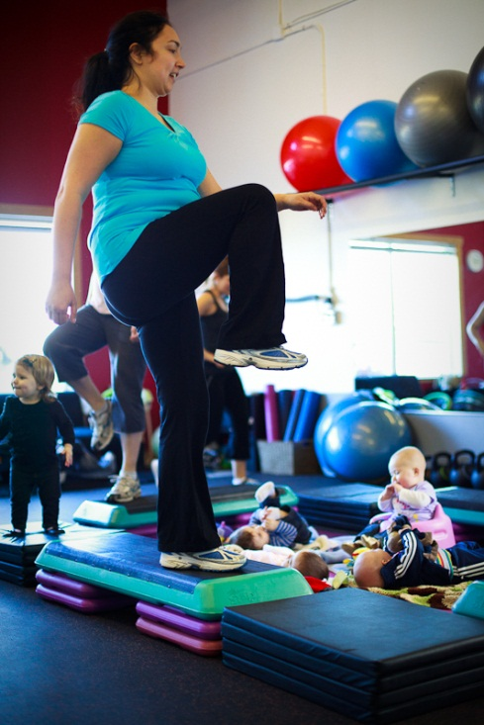
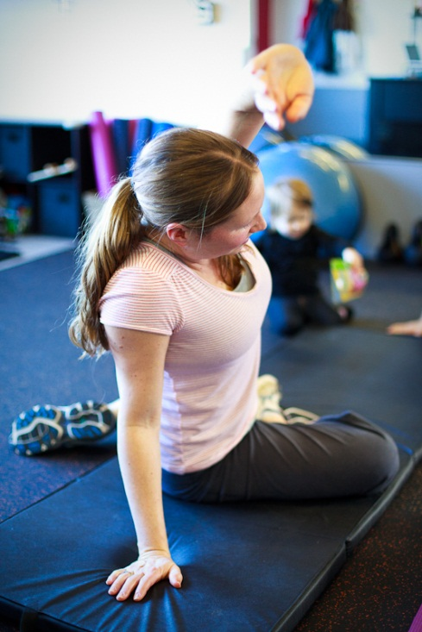
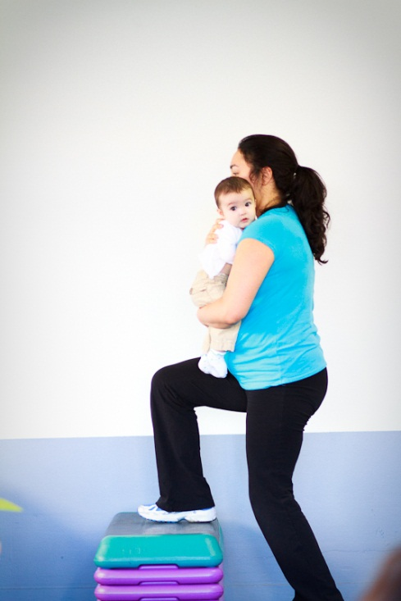
Take Home Messages
Notes:
Take Home Points:
In the absence of either medical or obstetric complications, pregnant women are recommended to accumulate 30 minutes or more of moderate-intensity exercise on most, if not all, days of the week
During pregnancy, women face many barriers and misbeliefs that keep them from following rec, guidelines for exercise during pregnancy and in fact those that exercised prior to pregnancy.
The number one barrier to exercise is obstetric complaints
We have a role to discover motivators, support, encourage, educate - we are in a valuable position
PAVS may be our first step in opening the discussion
Women’s Health Pt’s are “Physical therapists trained in the area of women’s health have further knowledge about issues directly related to women as they move through different stages of life, from childbearing years to the post menopausal period.” and are best suited to treat the unique needs of women during and after pregnancy
Consider consulting with PT for complex cases regarding labor positions
It takes a team to raise awareness and support our patients

Slide 22
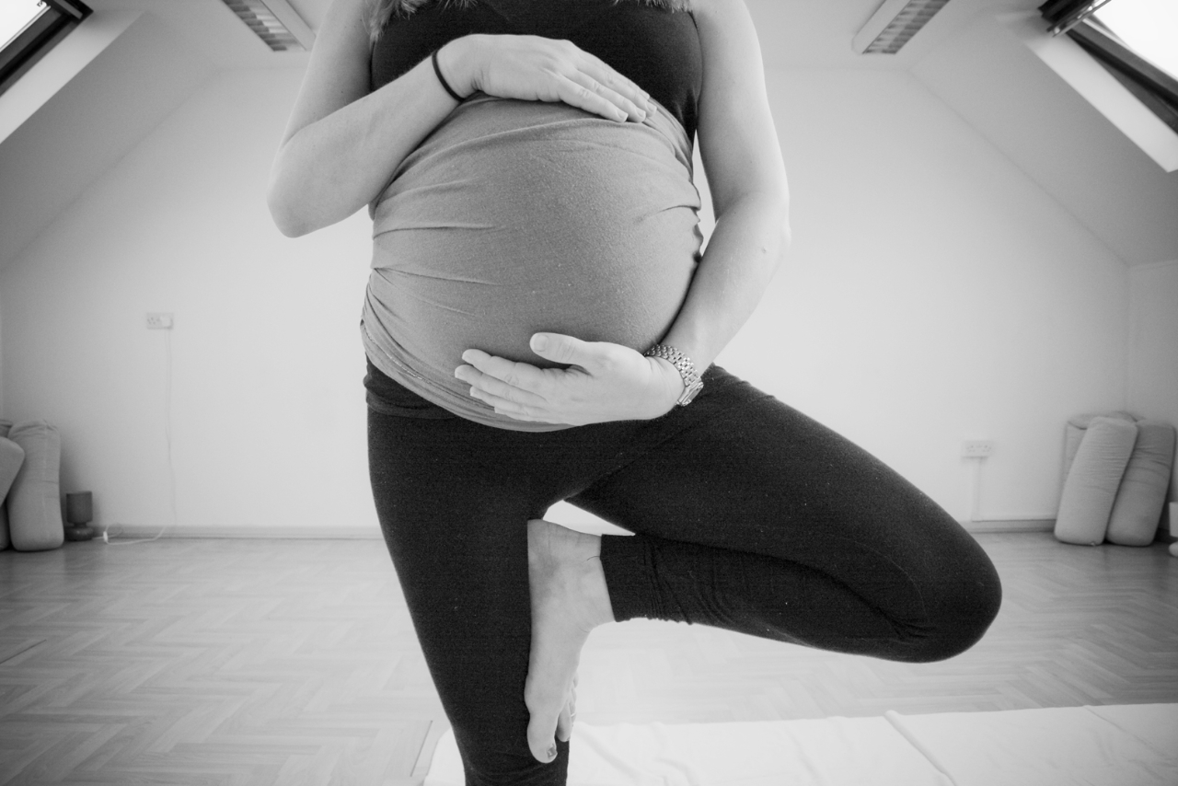
Questions

Slide 23
References
1. Committee on Obstetric Practice. ACOG committee opinion. exercise during pregnancy and the postpartum period. number 267, January 2002. american college of obstetricians and gynecologists. Int J Gynaecol Obstet. 2002;77(1):79-81.
2. U.S. Department of National Health and Human Services. Ch. 7. Additional considerations for some adults. Physical Activity Guidelines for Americans. Website. Available at: http://www.health.gov/paguidelines/guidelines/chapter7.aspx. Updated 2008. Accessed 3/15, 2014.
3. Centers for Disease Control and Preventions. Perceived exertion (Borg rating of perceived exertion scale). Physical Activity Website. Available at: http://www.cdc.gov/physicalactivity/everyone/measuring/exertion.html. Updated 2011. Accessed 3/15, 2014.
4. Centers for Disease Control and Prevention. Target heart rate and estimated maximum heart rate. Physical Activity Website. Available at http://www.cdc.gov/physicalactivity/everyone/measuring/heartrate.html. Updated 2011. Accessed 03/15, 2014.
5. Gjestland K, Bo K, Owe KM, Eberhard-Gran M. Do pregnant women follow exercise guidelines? prevalence data among 3482 women, and prediction of low-back pain, pelvic girdle pain and depression. Br J Sports Med. 2013;47(8):515-520. doi: 10.1136/bjsports-2012-091344; 10.1136/bjsports-2012-091344.
6. Evenson KR, Savitz DA, Huston SL. Leisure-time physical activity among pregnant women in the US. Paediatr Perinat Epidemiol. 2004;18(6):400-407. doi: 10.1111/j.1365-3016.2004.00595.x.
7. Haakstad LA, Voldner N, Henriksen T, Bo K. Why do pregnant women stop exercising in the third trimester? Acta Obstet Gynecol Scand. 2009;88(11):1267-1275. doi: 10.3109/00016340903284901; 10.3109/00016340903284901.
8. Chuntharapat S, Petpichetchian W, Hatthakit U. Yoga during pregnancy: Effects on maternal comfort, labor pain and birth outcomes. Complement Ther Clin Pract. 2008;14(2):105-115. doi: 10.1016/j.ctcp.2007.12.007; 10.1016/j.ctcp.2007.12.007.
9. Barakat R, Pelaez M, Montejo R, Luaces M, Zakynthinaki M. Exercise during pregnancy improves maternal health perception: A randomized controlled trial. Am J Obstet Gynecol. 2011;204(5):402.e1-402.e7. doi: 10.1016/j.ajog.2011.01.043; 10.1016/j.ajog.2011.01.043.
10. Stafne SN, Salvesen KA, Romundstad PR, Stuge B, Morkved S. Does regular exercise during pregnancy influence lumbopelvic pain? A randomized controlled trial. Acta Obstet Gynecol Scand. 2012;91(5):552-559. doi: 10.1111/j.1600-0412.2012.01382.x; 10.1111/j.1600-0412.2012.01382.x.
11. Barakat R, Pelaez M, Lopez C, Lucia A, Ruiz JR. Exercise during pregnancy and gestational diabetes-related adverse effects: A randomised controlled trial. Br J Sports Med. 2013;47(10):630-636. doi: 10.1136/bjsports-2012-091788; 10.1136/bjsports-2012-091788.
12. Barakat R, Cordero Y, Coteron J, Luaces M, Montejo R. Exercise during pregnancy improves maternal glucose screen at 24-28 weeks: A randomised controlled trial. Br J Sports Med. 2012;46(9):656-661. doi: 10.1136/bjsports-2011-090009; 10.1136/bjsports-2011-090009.

Slide 24
References
13. Granath AB, Hellgren MS, Gunnarsson RK. Water aerobics reduces sick leave due to low back pain during pregnancy. J Obstet Gynecol Neonatal Nurs. 2006;35(4):465-471. doi: 10.1111/j.1552-6909.2006.00066.x.
14. Beddoe AE, Paul Yang CP, Kennedy HP, Weiss SJ, Lee KA. The effects of mindfulness-based yoga during pregnancy on maternal psychological and physical distress. J Obstet Gynecol Neonatal Nurs. 2009;38(3):310-319. doi: 10.1111/j.1552-6909.2009.01023.x; 10.1111/j.1552-6909.2009.01023.x.
15. Robledo-Colonia AF, Sandoval-Restrepo N, Mosquera-Valderrama YF, Escobar-Hurtado C, Ramirez-Velez R. Aerobic exercise training during pregnancy reduces depressive symptoms in nulliparous women: A randomised trial. J Physiother. 2012;58(1):9-15. doi: 10.1016/S1836-9553(12)70067-X; 10.1016/S1836-9553(12)70067-X.
16. Gaston A, Cramp A. Exercise during pregnancy: A review of patterns and determinants. J Sci Med Sport. 2011;14(4):299-305. doi: 10.1016/j.jsams.2011.02.006 [doi].
17. Duncombe D, Wertheim EH, Skouteris H, Paxton SJ, Kelly L. Factors related to exercise over the course of pregnancy including women's beliefs about the safety of exercise during pregnancy. Midwifery. 2009;25(4):430-438. doi: S0266-6138(07)00045-9 [pii].
18. Clarke PE, Gross H. Women's behaviour, beliefs and information sources about physical exercise in pregnancy. Midwifery. 2004;20(2):133-141. doi: 10.1016/j.midw.2003.11.003 [doi].
19. Symons Downs D, Hausenblas HA. Women's exercise beliefs and behaviors during their pregnancy and postpartum. J Midwifery Womens Health. 2004;49(2):138-144. doi: 10.1016/j.jmwh.2003.11.009 [doi].
20. American College of Nurse-Midwives. The Story of ACNM: Website. Available at: http://www.midwife.org/Our-Mission-Vision-Values. Updated 2012. Accessed 3/15,2014.
21. American Physical Therapy Association. Vision 2020. APTA. Website. Available at https://www.apta.org/vision2020/. Updated 2014. Accessed 3/15, 2014.
22. Maturi MS, Afshary P, Abedi P. Effect of physical activity intervention based on a pedometer on physical activity level and anthropometric measures after childbirth: A randomized controlled trial. BMC Pregnancy Childbirth. 2011;11:103-2393-11-103. doi: 10.1186/1471-2393-11-103; 10.1186/1471-2393-11-103.

Slide 25
References
23. Ferreira CW, Alburquerque-Sendi NF. Effectiveness of physical therapy for pregnancy-related low back and/or pelvic pain after delivery: A systematic review. Physiother Theory Pract. 2013;29(6):419-431. doi: 10.3109/09593985.2012.748114; 10.3109/09593985.2012.748114.
24. Sallis R. Developing healthcare systems to support exercise: Exercise as the fifth vital sign. Br J Sports Med. 2011;45(6):473-474. doi: 10.1136/bjsm.2010.083469 [doi].
25. American Physical Therapy Association. Move Forward. APTA. Website. Available at: http://www.moveforwardpt.com/WhyTherapy/Mobility.aspx#.U03pNaJluSo. Updated 2014. Accessed 3/15, 2014.
26. Section on Women’s Health. Prenatal and Postnatal Periods. APTA. PDF made available by SOWH. Available at: http://www.womenshealthapta.org/. Accessed 3/15, 2014.
27. Bakker EC, van Nimwegen-Matzinger CW, Ekkel-van der Voorden W, Nijkamp MD, Vollink T. Psychological determinants of pregnancy-related lumbopelvic pain: A prospective cohort study. Acta Obstet Gynecol Scand. 2013;92(7):797-803. doi: 10.1111/aogs.12131; 10.1111/aogs.12131.
28. Olsson C, Nilsson-Wikmar L. Health-related quality of life and physical ability among pregnant women with and without back pain in late pregnancy. Acta Obstet Gynecol Scand. 2004;83(4):351-357.
29. Eggen MH, Stuge B, Mowinckel P, Jensen KS, Hagen KB. Can supervised group exercises including ergonomic advice reduce the prevalence and severity of low back pain and pelvic girdle pain in pregnancy? A randomized controlled trial. Phys Ther. 2012;92(6):781-790. doi: 10.2522/ptj.20110119; 10.2522/ptj.20110119
30. Martins RF, Pinto E Silva JL. Treatment of pregnancy-related lumbar and pelvic girdle pain by the yoga method: A randomized controlled study. J Altern Complement Med. 2013. doi: 10.1089/acm.2012.0715.
31. George S, Clinton S. Antepartum/Postpartum Module Resident Version. Centers for Rehab Services WomenRehab Physical Therapy Residency Program. Manual for WH Residency.
32. Stuge B, Hilde G, Vøllestad N. Physical therapy for pregnancy‐related low back and pelvic pain: A systematic review. Acta Obstet Gynecol Scand. 2003;82(11):983-990.
33. Mens JM, Snijders CJ, Stam HJ. Diagonal trunk muscle exercises in peripartum pelvic pain: A randomized clinical trial. Phys Ther. 2000;80(12):1164-1173.
34. Steffes S, Chamberlin J. Emerging Role of PT in Labor and Delivery. Presented at APTA – CSM, Women’s Health Sections. Las Vegas, NV. 2014.
35. Hodnett ED, Gates S, Hofmeyr GJ, Sakala C, Weston J. Continuous support for women during childbirth. Cochrane Database Syst Rev. 2011;(2):CD003766. doi(2):CD003766. doi: 10.1002/14651858.CD003766.pub3 [doi].

