Slide 1
Spina Bifida Treatment & Management
Casey Poff
April 2014
Notes:
Hello! My name is Casey, and I am going to talk to you about the treatment and management of spina bifida!

Slide 2
Learning Objectives
Discuss the common impairments that a child with spina bifida may have
Identify the factors that influence whether or not you should expect the child to walk
Discuss and practice intervention techniques
Discuss prevention and management strategies
Notes:
In the next hour, I plan on discussing the common impairments that a child with spina bifida may have and discuss prevention and management strategies for those impairments, identify the factors that influence whether or not you should expect the child to walk, and together we are going to try some different stretching and strengthening intervention techniques!

Slide 3
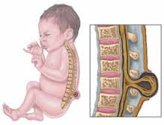
Spina Bifida
Defective development of any part of the spinal cord¹
Aperta
myelomeningocele
Occulta
Causes¹
Genetics
Teratogens
Nutritional deficiencies
Notes:
So, what is spina bifida? It is a defective development of any part, especially the lower segments, of the spinal cord. There are several different classifications of spina bifida, including aperta, which means visible or open, and occulta, which means hidden or not visible. A type of spina bifida aperta, myelomeningocele, is the most severe form of spina bifida, and it is what most of our “spina bifida patients” have. In myelomeningocele, parts of the spinal cord and nerves come through the open part of the spine and it causes nerve damage and other disabilities. This is the type of spina bifida we are going to be talking about today.
Some of the causes of spina bifida are thought to be genetic, teratogens (like alcohol intake by the mother during pregnancy, or taking anticonvulsant medicine—valproic acid—during pregnancy), and also poor nutrition (especially a diet low in folic acid!) Folic acid can be found in leafy vegetables, citrus fruits, beans, and whole grains…and also may be taken in the pill form.
Image credit: www.glogster.com

Slide 4
Impairments
Notes:
What makes spina bifida such a challenging diagnosis to treat, is that it presents in many different ways! There are numerous impairments that come along with this disease, and each child is going to have different combinations of impairments, and different levels of impairments. I am going to talk a little bit about the most common impairments seen in myelomeningocele.

Slide 5
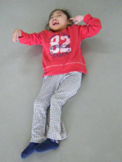
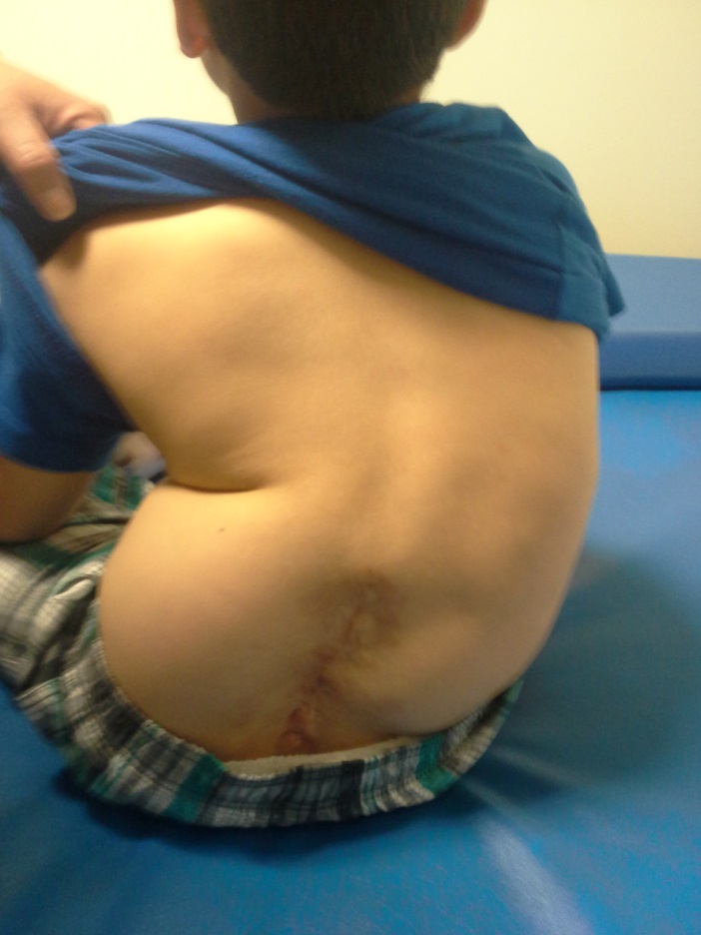
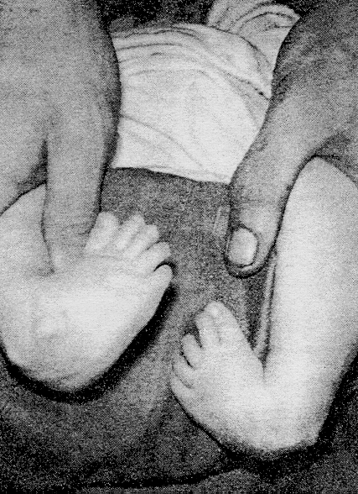
Impairments:
Musculoskeletal deformities¹
Notes:
Musculoskeletal deformities: many of these children are going to have joint contractures, limb deformities, abnormal posture, and osteoporosis.
What does this mean for us? These deformities are going to negatively affect their positioning, body image, weight-bearing in sitting and standing, activities of daily living and mobility, and they’re going to have to use more energy than their peers to perform these activities of daily living.
http://www.leckey.com/case-histories/yuna-sleepform/

Slide 6
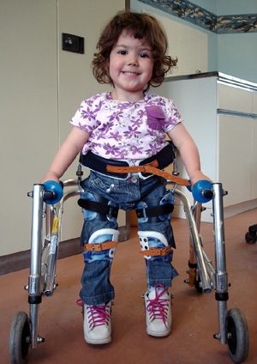
Impairments:
Motor paralysis¹
Notes:
Motor paralysis: this is based on lesion level. The muscles below the lesion level are going to be weak→ flaccid. One of our main focuses in physical therapy is going to be on strengthening the muscles that are innervated in order to maximize the child’s functional mobility.
http://www.johnflorence.com/

Slide 7
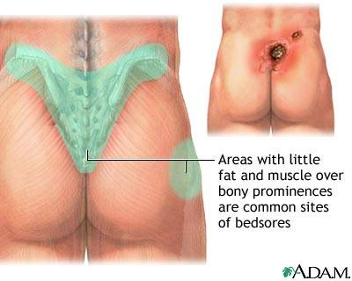
Impairments:
Sensory Deficits & Skin Breakdown^{1,5}
Notes:
Sensory deficits often don’t correlated with motor levels. Regardless, it is important to pay attention to where the child does and doesn’t have sensation in order to prevent skin breakdown. Skin breakdown occurs in 85-95% of all children with myelomeningocele by the time they reach adulthood.
http://plasticsurgery.about.com/od/reconstructiveprocedures/p/All-About-Pressure-Ulcers.htm

Slide 8
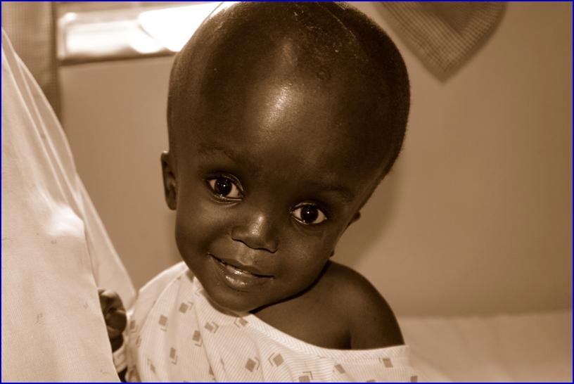
Impairments:
Hydrocephalus²
Notes:
25% or more of children with myelomeningocele are born with hydrocephalus, and another 60% develop it after surgical closure of their lesion.
http://dxline.info/diseases/hydrocephalus

Slide 9
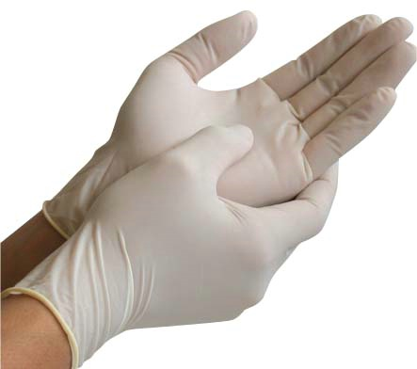
Impairments:
Latex Allergy^{3,4}
Notes:
Up to 73% of children with spina bifida are allergic to latex. So, we need to make sure anytime we use gloves with them, or resistance bands, that they are LATEX-FREE!
http://www.firstaidglobal.com/glovescatalog.htm

Slide 10
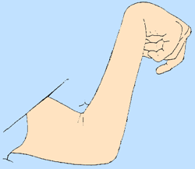
Impairments:
Spasticity¹
Notes:
Some of these children are going to have spasticity in some muscle groups, while other muscle groups might be flaccid. (demonstration:) so you’re going to feel tightness and resistance to motion at some joints, and when you increase the speed of passive range of motion, you’ll feel a greater catch – that’s the spasticity. Other muscle groups/joints might be completely limp – these are the flaccid muscles.
http://www.alzinfo.org/clinical-stages-of-alzheimers

Slide 11
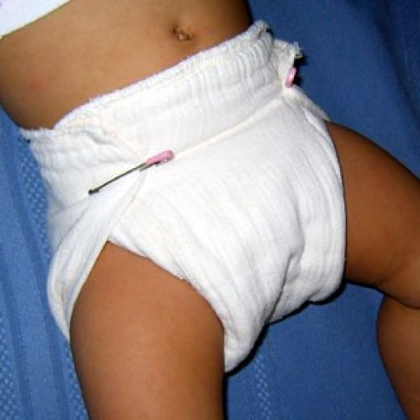
Impairments:
No bowel/bladder control¹
Notes:
Less than 5% of children with myelomeningocele develop voluntary control of their urinary and anal sphincter.
http://codyandchelseagroves.blogspot.com/2011/01/our-run-down-on-cloth-diapers.html

Slide 12
Functional Prognosis Should I expect this child to walk?
No/minimal hip flexion contracture⁸ ☺
Upper limb/hand function^{6,7} ☺
Typical cognition/intelligence^{6,8} ☺
Lumbosacral level lesions^{7,11} ☺
Visuospatial function⁷ ☺
Hip & knee extensor strength^{8,10} ☺
(and absence of the negative prognostic indicators on following slide) ☺
Notes:
The big question when we get a new patient with spina bifida is: Should I expect this child to walk? This is a difficult question to answer, and many different factors come into play. The things listed above are positive prognostic factors – things that, if they are present, lead to better outcomes as far as ambulation and mobility goes. These are the things we want to see!
Hip flexion contracture less than 20 degrees, or no contracture at all (demonstrate)
Good use of their arms and hands – this will allow for better ability to use assistive devices, help with transfers, etc.
Lumbosacral level lesions – so they have some muscle function in their legs. We especially want to see strength in (demonstrate) hip flexors, hip extensors, dorsiflexors, and knee flexors and extensors
Now, if you will also take a look at the handout in front of you…This shows a chart that can help you determine if you should expect the child to walk, and to what extent. From top to bottom, the chart shows highest functional ambulation to lowest functional ambulation.
Before we go over the chart, you’ll notice “muscle grades” – at the bottom of the handout these are defined.
Grade 1 = trace...if you put your hand on the muscle (demonstrate: biceps) and ask the child to (for instance) bend the elbow, you won’t see any movement, but you’ll feel a little twitch or contraction.
Grade 2 = poor…if you support the extremity (demonstrate w/ biceps), they are able to move it
Grade 3 = fair…the individual can move the extremity against gravity (demonstrate)
Grade 4 = good…they can hold against moderate resistance
Grade 5 = normal…they an hold against maximal resistance
So now, if you look at the chart….
Level 1: normal strength in lower extremities, but weak foot muscles, and good to normal plantar flexion strength (demonstrate: so they should be able to stand on their toes/walk on their toes). These are our community walkers, they are able to keep up with their peers.
Level 2: fair or less plantarflexion strength, so may or may not be able to go up on their toes; they are able to flex their knees against gravity (demonstrate) and maybe against resistance, and they have weak hip extension and abduction strength (demonstrate)—they may be able to move into these positions against gravity, or may need to be in a gravity minimized position to do so. These patients may also be community walkers, but use orthoses, and wheelchairs for long distances.
Level 3: good to normal hip flexion and knee extension strength (so can hold against moderate to maximal resistance in these positions), they may or may not be able to perform knee flexion against gravity, and have trace hip extension/abduction and below knee musculature (so if you ask them to kick their leg back, for instance, you may feel the muscle kind of twitch, but there will be no visible movement). These individuals may walk short distances, like down the hallway, with orthoses and walking aid, but use a wheelchair for outdoors and long distances.
Grade 4: may be able to flex the hip in a gravity-minimized position, and elevate their pelvis against gravity, but no muscle strength below the hips. These are our short distance walkers with orthoses and walking aid, though less so than level 3’s. They also use a wheelchair for indoor and outdoor use.
Level 5: no muscle activity in legs or hips. MIGHT walk a little during therapy, but use a wheelchair for their primary means of mobility.
Image credit:
http://vivecsharing.blogspot.com/2013/07/funny-pictures-of-smiley-faces.html

Slide 13
Functional Prognosis Should I expect this child to walk?
Hip flexion contracture⁸ ☹
Shunt revisions^{8,12,13} ☹
Obesity¹¹ ☹
Spasticity¹⁴ ☹
History/presence of hydrocephalus^{6,7} ☹
Pressure ulcers¹¹ ☹
Feeding/respiratory difficulty⁷ ☹
Severe scoliosis^{7,8} ☹
General low tone¹² ☹
Progressive neurological deterioration¹⁴ ☹
Thoracic level lesion (or above)¹² ☹
Notes:
And now, the things listed above are negative prognostic factors – things that, if they are present, lead to worse outcomes as far as ambulation and mobility goes.
Hip flexion contracture – if they have a contracture >20 degrees (demonstrate)
History of shunt revisions, particularly after age 2
Progressive neurological deterioration - If you’re seeing signs of worsening function
Thoracic level lesions – no muscle function in their lower extremities at all
Image credit:
http://www.clipartbest.com/animated-question-mark-gif
http://4vector.com/free-vector/free-vector-vector-clip-art-question-mark-icon-clip-art-104760
http://sweetclipart.com/simple-blue-question-mark-1146
http://pwhatley.wordpress.com/2008/06/26/and-still-it-keeps-coming-vp-somebody-stop-me-before-i-order-again/sadface/

Slide 14
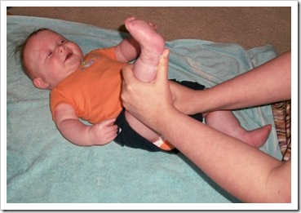
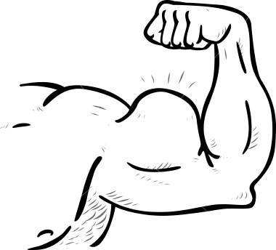
Interventions
Stretching
Positioning
Wheelchair
Supine
Prone
Education
Preventing skin breakdown/pressure ulcers
Signs of shunt malfunction
Exercise & healthy diet to prevent obesity
Strengthening
Endurance exercise
Notes:
Interventions. These are some of the key focuses for physical therapy: stretching, positioning, education (patients and caregivers), strengthening, and endurance exercises. We are going to go through these in more detail on the following slides.
Image credit:
http://masonsbjournal.blogspot.com/2012/06/part-of-physical-therapy-routine.htmlhttp://ww1.prweb.com/prfiles/2013/01/11/10475520/muscle-arm-jpg.jpg

Slide 15
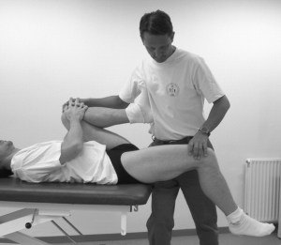
Stretching
Hip Flexors
Hamstrings
sf
Notes:
As physical therapists, one of the big issues we’re going to be working on with these patients is the prevention and management of contractures. Hip and knee flexion contractures are common (which also lead to crouch gait), hip abduction contractures, ankle plantar flexion contractures, and potentially upper extremity contractures as a result of spasticity or poor postural habits.
Ok! So now the fun part! We are going to practice all of these stretches on each other! So, if you would, find a partner…and then I’ll demonstrate up here and we can all practice for a couple of minutes on each other.
Image credit:
http://www.dinf.ne.jp/doc/english/global/david/dwe002/dwe00244.html#385
http://thesportsphysio.wordpress.com/2012/11/13/the-sporting-groin-part-1/

Slide 16
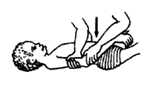
Stretching
Heel Cord
Elbow Flexors
dfg
Notes:
Image credit:
http://www.dinf.ne.jp/doc/english/global/david/dwe002/dwe00244.html#385

Slide 17
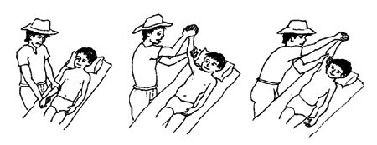
Stretching
Shoulders
Wrists
Notes:
Image credit:
http://www.dinf.ne.jp/doc/english/global/david/dwe002/dwe00244.html#385

Slide 18
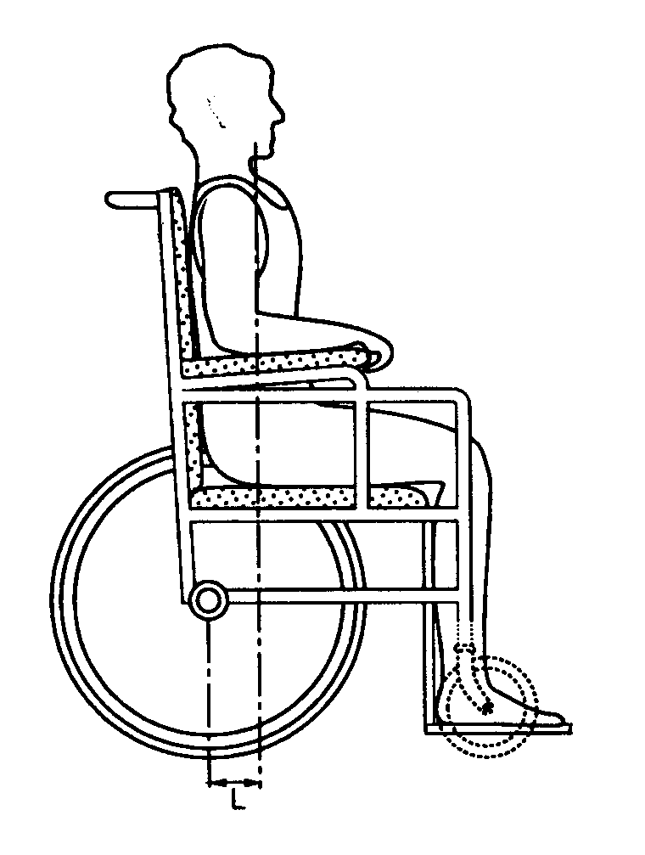
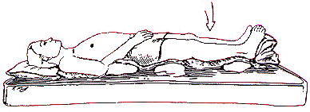
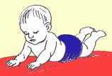
Positioning
Wheelchair
Supine
Prone
Notes:
- Ok, that’s all for stretching. Let’s come back together and talk about positioning.
Proper posturing is necessary in order to help the patient perform functional tasks, to minimize stress on joints and deforming forces, to permit the muscles to function at their optimal length, to minimize discomfort and chance for skin breakdown, and minimize the chances for joint contractures and musculoskeletal pain.
We want to keep them in neutral alignment to the best of our ability. This means: in sitting: head in neutral, elbows at 90 degrees (demonstrate), that natural curve of the spine, equal weight-bearing, hips at 90 degrees (demonstrate), knees at 90 degrees (demonstrate), ankles in neutral alignment, knees facing forward (not in or out – demonstrate). In supine: again, that neutral alignment, and using pillows to cushion bony prominences to prevent pressure sores. Prone: this is a great position to encourage play in—to help stretch the hip flexors and help prevent hip flexion contractures!
Image credit:
http://calder.med.miami.edu/pointis/relieve.html
http://www.assistireland.ie/eng/Information/Information_Sheets/Choosing_a_Standard_Self-Propelled_Wheelchair.html
http://www.cdc.gov/ncbddd/spinabifida/infant.html
-If they are favoring one side, put toys/etc. on the opposite side

Slide 19
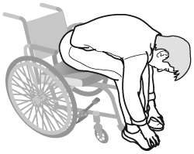
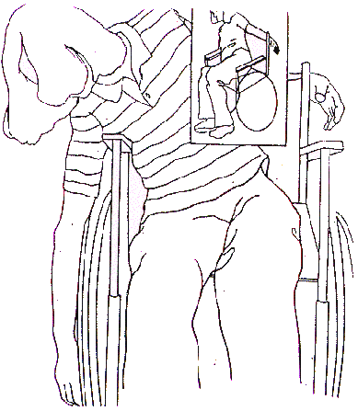
Preventing Pressure Ulcers¹
Pressure relief every 2 hours!
Skin inspections daily
Cushioning/padding over bony prominences
Notes:
As I mentioned earlier, skin breakdown occurs in 85-95% of all children with myelomeningocele by the time they reach adulthood. Causes of this:
there is a lack of oxygen to the tissues due to excessive pressure
Can be caused by improper fitting casts/orthotic devices
Excessive weight-bearing over bony prominences – for example, the sacrum and ischial tuberocities (bony part of the bottom) are common sites of pressure ulcers for wheelchair users
More commonly happen with individuals who are obese
And in Individuals with poor circulation
So, how do we help prevent pressure ulcers?
Help the patient develop awareness of what areas of their body that don’t have sensation, and encourage them to do skin inspections daily. If they can’t see the areas themselves, instruct a caregiver on how to do this.
Pressure relief through weight shifting—like in the pictures above—should be done AT LEAST every 2 hours. (Explain pictures)
It is also best to provide some cushion over bony prominences—such as the spine, ischial tuberocities (bony part of the bottom), and sacrum (point)
http://blog.birthbalance.com/?cat=36
http://calder.med.miami.edu/pointis/relieve.html
http://sci.washington.edu/info/pamphlets/msktc-pressure_relief.asp

Slide 20
Shunt Malfunction¹
Can lead to progressive neurological dysfunction
See signs/symptoms? Now what?
Signs of shunt malfunction
Changes in speech | Onset or worsening of scoliosis
Fever and malaise | Personality changes
Recurring headache | Decreased or static grip strength
Decreased activity level | Difficult to arouse in the morning
Decreased school performance | Decreased visuomotor coordination
Onset of or increased strabismus | Decreased visual acuity or diplopia
Changes in appetite and weight | Decreased visuoperceptual coordination
Incontinence begins or worsens | Onset or increased frequency of seizures
Notes:
Shunt malfunction is a very serious thing. It can lead to worsening function and have a lasting, negative impact on the individual’s life. Listed on this slide are signs and symptoms of shunt malfunction…changes in speech, fever, recurring headache, decreased activity, personality changes, malaise…any notable, unexplained changes in the child’s function, behavior, or health – think possible shunt malfunction. Immediately refer this patient to a doctor for further evaluation!

Slide 21
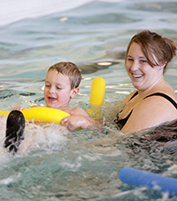
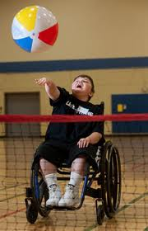
Preventing Obesity¹
Why is it common?
Why is it important to prevent it?
Prevention:
Exercise
Make it fun!
Diet
Healthy eating = family lifestyle
Notes:
Obesity…
Why is it common?
Obesity is common in these patients because impaired mobility often leads to an increasingly sedentary lifestyle, and therefore weight gain…the heavier they are, the more difficult it is to get around…and so there is a cycle of decreased mobility and increased weight gain.
Why is it important to prevent?
Obesity can complicate wheelchair fitting. It can affect independence and ability to perform transfers, mobility, and self-care activities. It can negatively affect self-image, and it also increases the risk for skin breakdown.
So how do we prevent this weight gain?
Through exercise and diet. Now the key to exercise it to make it fun! What does the individual enjoy to do? Swim? Toss a ball? Wheelchair races? Whatever the child enjoys to do – encourage him/her to do it! Make it fun. As far as diet goes, it is helpful for family members to model healthy eating habits, and make healthy eating a lifestyle for the whole family. Encourage the consumption of fruits, vegetables, and grains.
Image credit:
http://www.uwec.edu/newsreleases/11/apr/0420Pride.htm
http://www.cincinnatichildrens.org/service/o/ot-pt/aquatic-therapy/aquatic
http://goldfish2care4.com/goldfish-feeding.html

Slide 22
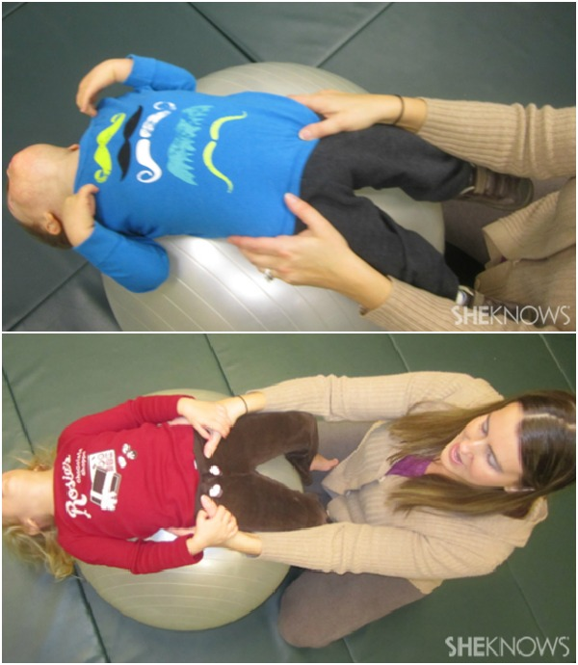
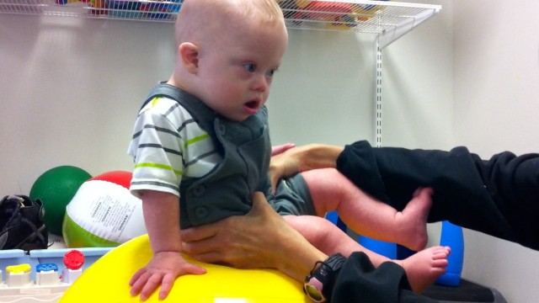
Strengthening: Young Children
Core
Notes:
Strengthening. We want to strengthen all innervated muscle groups!
I broke strengthening exercises up into strengthening for young children, and strengthening for adolescents and adults. Pictured here are some great ideas for strengthening back and abdominals for young children…balancing on the ball, having to stay upright, you can move them side to side a little, or rock the ball front to back. For more advanced patients, you can also do assisted sit ups (pictured on the right)…you can use a rocking motion to give momentum to help them sit up from this position.
Image credit:
http://www.milestonemom.com/how-to-make-your-child-physically-strong/
http://www.sheknows.com/how-to/articles/825727/5-exercises-kids-love

Slide 23
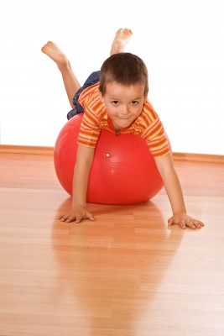
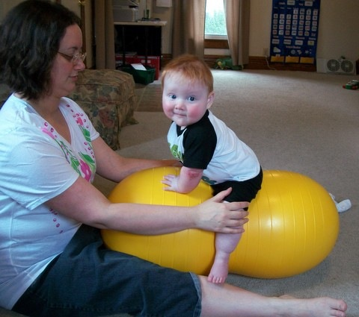
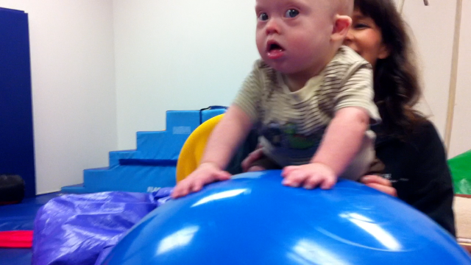
Strengthening: Young Children
Upper Extremities
Notes:
Here are some ideas for arm strengthening. Having them prop themselves up on the ball, or putting their belly on the ball and having them hold themselves up on their arms with their hands on the floor.
Image credit:
http://masonsbjournal.blogspot.com/2012/09/physical-therapy-with-peanut.html
http://noahsdad.com/learning-crawl-exercise-ball/

Slide 24
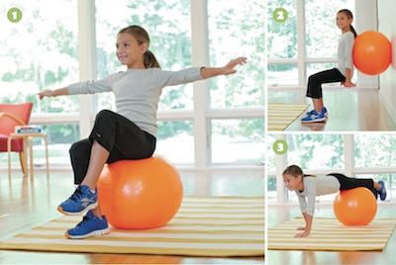
Strengthening: Young Children
Hip Flexors
Notes:
This is for advanced patients who do have at least “good” hip flexion strength. You can assist them by holding their hips, and have them march or bounce their feet off of the floor (or stool if you need some height in front of them).
Image credit:
http://starfishtherapies.wordpress.com/tag/therapy-ball/

Slide 25
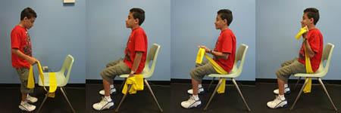
Strengthening: Adolescents & Adults
Elbow Flexors
Notes:
Alright, let’s get moving again! We are going to practice strengthening exercises for adolescents and adults together! I’ll demonstrate, and then we can all practice. We’re going to pass out resistance bands, and then we’ll get started.
Ok, the first exercise is to strengthen the elbow flexors (point). (explain while demonstrating) Now you try!
Image credit:
http://www.ncpad.org/239/1580/Exercises~for~Individuals~with~Spina~Bifida

Slide 26
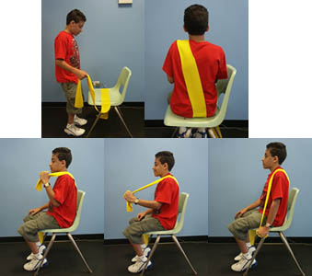
Strengthening: Adolescents & Adults
Elbow Extensors
Notes:
Now, elbow extensors (point)! (explain while demonstrating) Now you try!
Image credit:
http://www.ncpad.org/239/1580/Exercises~for~Individuals~with~Spina~Bifida

Slide 27
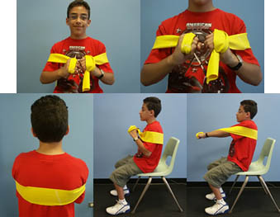
Strengthening: Adolescents & Adults
Chest
Notes:
Moving on to chest (point). (explain while demonstrating) Now you try!
Image credit:
http://www.ncpad.org/239/1580/Exercises~for~Individuals~with~Spina~Bifida

Slide 28
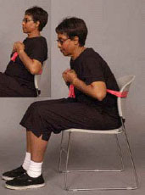
Strengthening: Adolescents & Adults
Core
Notes:
Now, abdominal strengthening. (explain while demonstrating) Now you try!
Image credit: http://www.oandp.org

Slide 29
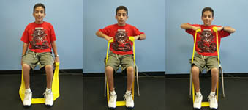
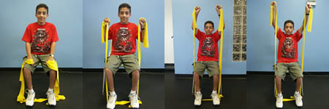
Strengthening: Adolescents & Adults
Shoulders
Notes:
Ok, shown on this slide are two exercises for shoulder strengthening. Let’s start with the top one (explain while demonstrating) Now you try!
Ok, now the bottom one. (explain while demonstrating) Now you try!
Image credit:
http://www.ncpad.org/239/1580/Exercises~for~Individuals~with~Spina~Bifida

Slide 30
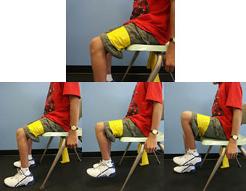
Strengthening: Adolescents & Adults
Hip Flexors
Notes:
The remaining of the exercises are for hip and leg strengthening. Of course, if your patient doesn’t have any use of their legs and can’t move through these ranges against gravity to begin with, you’re not going to strengthen these muscle groups with resistance bands! If they have the ability to move through the range in a gravity-minimized position, strengthen in that position, not against gravity.
Here we have hip flexor strengthening. (explain while demonstrating) Now you try!
Image credit:
http://www.ncpad.org/239/1580/Exercises~for~Individuals~with~Spina~Bifida

Slide 31
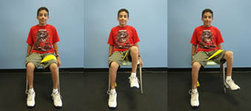
Strengthening: Adolescents & Adults
Hip Abductors
Notes:
Moving on to hip abductors. (explain while demonstrating) Now you try!
Image credit:
http://www.ncpad.org/239/1580/Exercises~for~Individuals~with~Spina~Bifida

Slide 32
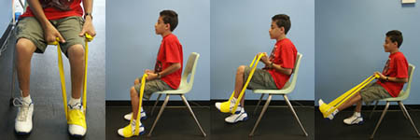
Strengthening: Adolescents & Adults
Hip Extensors
Notes:
And lastly, hip extensors. (explain while demonstrating) Now you try!
Image credit:
http://www.ncpad.org/239/1580/Exercises~for~Individuals~with~Spina~Bifida

Slide 33
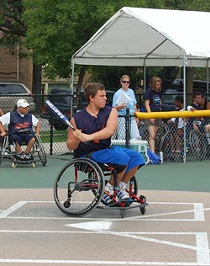
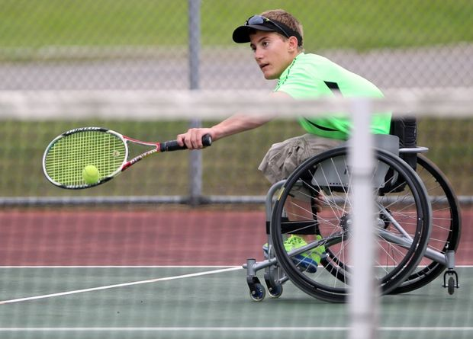
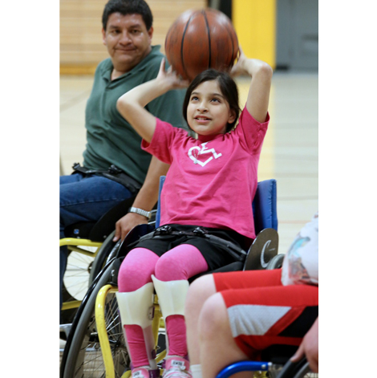
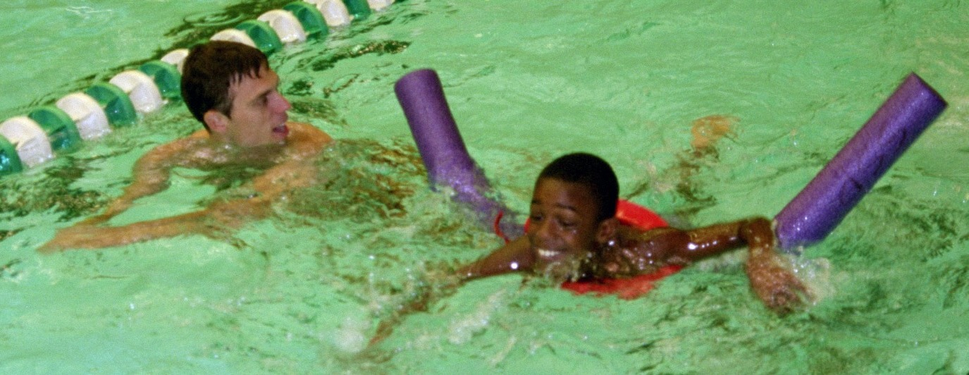
Endurance Exercises¹
sdfsd
Notes:
Endurance exercise is important for weight control and enhancing aerobic capacity/heart health. These individuals benefit from low-impact activities to minimize joint stress.
Like we talked about with the obesity slide, we want to figure out what activities the child enjoys—and gear exercise intervention toward things that are fun for that child! Swimming, tossing a ball, wheelchair races…use your creativity!
Image credit:
http://www.wdsra.com/Programs/adapted-sports.htm
https://www.msu.edu/~pedrazaj/adaptedsports/sports.html
http://www.northernillinois.usta.com/news/michigan_teen_plays_for_hs_tennis_team_in_wheelchair/
http://www.aspenmp.com/index.php/about-us/caf/lourdes-mack/
Physical activity is important to: improve fitness, balance, and coordination, maintain muscle length and increase muscle strength, provide opportunities for friendships, independence and improved self-esteem, prevent obesity, prevent constipation (http://kidshealth.schn.health.nsw.gov.au/fact-sheets/be-active-spina-bifida)
Swimming
Basketball, tennis, team sports…what are the child’s interests? Make it fun!

Slide 34
Questions?
Notes:
Image credit:
http://traciecook.wordpress.com/author/traciecook/

Slide 35
References
Campbell S, Palisano R, Orlin M. Physical therapy for children. 4th ed. Missouri: Elsevier Inc.; 2012: 598-604.
Reigel DH. (1991) Spina bifida from infancy through the school years. In F.L. Rowley-Kelly & D.H. Reigel (Eds.), Teaching the students with spina bifida. (pp. 1-28). Boca Raton, FL: CRC Press.
Shapiro E, Kelly KJ, Setlock MA, et al. Complications of latex allergy. Dialogues in Pediatric Urology. 1992; 15: 1-5.
Zsolt S, Seidl R, Bernert G, et al. Latex sensitization in spina bifida appears disease-associated. Journal of Pediatrics. 1999; 134: 344-348.
Shurtleff DB. (1986a) Decubitus formation and skin breakdown. In DB Shurtleff (Ed.), Myelodysplasias and exstrophies: Significance, prevention, and treatment. (pp. 299-312). Orlando, FL: Grune & Stratton.
Schoenmakers MA, Uiterwaal CS, Gulmans VA, et al. Determinants of functional independence and quality of life in children with spina bifida. Clin Rehabil. 2005; 19(6): 677-685.
Norrlin S, Strinnholm M, Carlsson M, Dahl M. Factors of significance for mobility in children with myelomeningocele. Acta Paediatr. 2003; 92: 204-210.

Slide 36
References
Danielsson AJ, Bartonek A, Levey E, et al. Associations between orthopaedic findings, ambulation and health-related quality of life in children with myelomeningocele. J Child Orthop. 2008; 2: 45-54.
Bar-Or O. Pathophysiological factors which limit the exercise capacity of the sick child. Medicine and Science in Sports and Exercise. 1986; 18: 276-282.
Agre JC, Findley TW, McNally MC, et al. Physical activity capacity in children with myelomeningocele. Archives of Physical Medicine and Rehabilitation. 1987; 68: 372-377.
Diaz Llopis I, Bea Munoz M, Martinez Agullo E, et al. Ambulation in patients with myelomeningocele: a study of 1500 patients. Paraplegia. 1993; 31(1): 28-32.
Bartonek A, Saraste H. Factors influencing ambulation in myelomeningocele: a cross-sectional study. Developmental Medicine & Child Neurology. 2001; 43: 253-260.
Oakeshott P, Hunt GM, Poulton A, Reid F. Open spina bifida: birth findings predict long-term outcome. Arch Dis Child. 2012; 97: 474-476.
Bartonek A. Motor development toward ambulation in preschool children with myelomeningocele—a prospective study. Pediatric Physical Therapy. 2010; 22: 52-60.

