Slide 1
Hippotherapy for Children
A Guide for Parents
Delane Frutiger Clark, PT
Shining Hope Farms

Slide 2
Purpose
To educate parents about hippotherapy as a physical therapy treatment to improve function in children who have neurological and musculoskeletal conditions.
To provide parents will sound information so they can make informed decisions about hippotherapy for their child.
Notes:
Children with neurological and musculoskeletal conditions often receive physical therapy improve their function. Hippotherapy is a physical therapy treatment that has potential to positively impact function. When one considers the growing number of hippotherapy programs, the resources a family commits to having their child participate in therapy, the appropriateness of HPOT for a child’s individual needs, and safety factors related to hippotherapy, it is important for parents to make informed decisions based on sound sources of information. The purpose of this presentation is : 1) to educate parents about hippotherapy and how it can be can be used as a treatment to improve function in children who have neurological and musculoskeletal conditions and 2) to provide parents with sound information to make informed decisions about hippotherapy for their child.
While hippotherapy is used by physical, occupational and speech therapists, the focus of this presentation will be the use of hippotherapy by physical therapists.

Slide 3
Learning Objectives
Parents will…
Gain knowledge about hippotherapy as a physical therapy treatment.
Understand the difference between hippotherapy and other horse-related activities for children.
Understand how hippotherapy is part of the child’s physical therapy plan of care.
Gain knowledge of the benefits of hippotherapy for children who have neurological and musculoskeletal conditions.
Be able to make an informed decision about hippotherapy for their child.
Notes:
There are five learning objectives for this presentation:
Parents will gain knowledge about hippotherapy as a physical therapy treatment to improve function in children with neurological and musculoskeletal conditions.
Parents will understand the differences between hippotherapy and other horse-related activities for children with disabilities.
Parents will understand how hippotherapy is part of the child’s physical therapy plan of care.
Parents will learn about the benefits of hippotherapy for children with neurological and musculoskeletal conditions.
Parents will be able to choose a qualified hippotherapy provider.

Slide 4
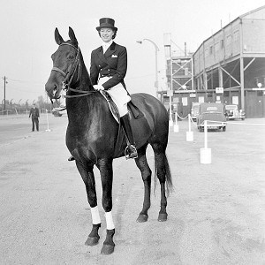
Hippotherapy: History
1952
Lis Hartel, whose legs were paralyzed from polio, won an Olympic silver medal in an equestrian event.
1960’s
In Europe, hippotherapy used with physical therapy.
1987
Physical and occupational therapists from North America went to Germany to learn more about hippotherapy.
1992
American Hipppotherapy Association (AHA).
Notes:
Photo Source: http://sport.uk.msn.com/olympics-2012/news/articles.aspx?cp-documentid=250237979
Let’s start with a bit of history…
The horse (also called an equine) has a long history of being used to improve physical and mental well-being. In the early 1900s, the horse was used for both therapeutic and recreational purposes, and in 1952, at the Helsinki Olympic games, Lis Hartel, a woman with leg paralysis from polio, won an Olympic silver medal in an equestrian event, called dressage. Lis led the way to establish horseback riding programs for individuals with disabilities across Europe.
1960’s In Austria, Germany, and Switzerland, hippotherapy was being used as an addition to physical therapy.
1987 A group of physical and occupational therapists from North America went to Germany to learn more about hippotherapy and to develop a program to educate therapists.
1992 The American Hipppotherapy Association was established to promote education, communication, and research among professionals using the movement of the horse as a treatment tool.

Slide 5

What Is Hippotherapy?
Use of the horse’s movement as a treatment tool by physical, occupational and speech therapists to improve function in people who have neurological and musculoskeletal conditions.
Goal is to improve function by decreasing impairments and increasing activity and participation.
Notes:
What is hippotherapy?
Hippotherapy is the use of the horse’s movement as a treatment by physical, occupational and speech therapists to address impairments, activity limitations and participation restrictions in people who have neurological and musculoskeletal conditions. The goal of hippotherapy is to improve a person’s function by reducing impairments and increasing activity and participation.

Slide 6
Hippotherapy: The Word
Comes from the Greek word “hippos” meaning horse.
Hippotherapy (HPOT) is a type of equine assisted therapy (EAT).
The word “equine” also means “horse”.
Equine assisted therapy and hippotherapy should not be confused with equine assisted activities (EAA) and therapeutic riding (TR).
Notes:
Hippotherapy is a funny sounding word, and the terminology associated with it can be confusing.
Hippotherapy comes from the Greek word “hippos” meaning horse and literally means “therapy with the help of the horse”.
Hippotherapy, which is abbreviated HPOT, is a form of equine assisted therapy used by physical, occupational and speech therapists.
The word “equine” also means “horse” and the words may be used interchangeably.
Equine assisted therapy (EAT) and hippotherapy should not be confused with equine assisted activities (EAA) and therapeutic riding (TR).

Slide 7
Hippotherapy and Therapeutic Riding: Differences
Service | Equine Assisted Therapy Hippotherapy | Equine Assisted Activities Therapeutic Riding
Purpose | To provide physical, occupational or speech therapy treatment aimed at improving function in people with disabilities. | To teach riding skills to people with disabilities.
Provider | Physical, occupational and speech therapists. Physical therapist assistants and certified occupational therapist assistants. Trained by American Hippotherapy Association (AHA). One-on-one treatment. | Certified riding instructors. Trained by Professional Association of Therapeutic Horsemanship International (PATH Intl.). One-on-one or group lessons.
Duration | Weeks or months. Determined by therapy plan of care and progress with therapy goals. | Life-long leisure or sport activity.
Notes:
Since many of the therapy programs that offer equine assisted therapy or hippotherapy also offer equine assisted activities or therapeutic riding, it is important to understand the differences.
Hippotherapy and therapeutic riding differ in many respects, but this table highlights the main differences that are related to purpose, provider, and duration.

Slide 8
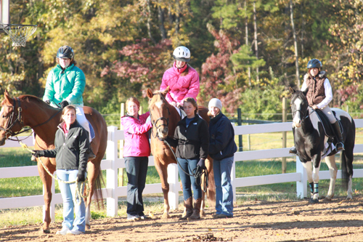
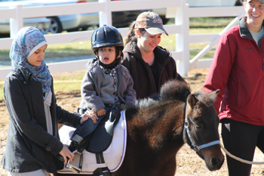
Hippotherapy and Therapeutic Riding: Similarities
Specially trained horses.
Providers with special training and certification.
May improve function in children with neurological conditions. (Whalen and Case-Smith, 2012; Zadnikar and Kastrin, 2011, Sterba JA, 2007; Snider et al. 2007)
Notes:
Hippotherapy and equine assisted activities do have similarities, though.
Both involve specially trained horses.
Both are provided by individuals with special training and certification.
Both have been reported by researchers to improve function in children with neurological conditions like cerebral palsy.
(Whalen and Case-Smith, 2012; Zadnikar and Kastrin, 2011, Sterba JA, 2007; Snider et al. 2007)

Slide 9
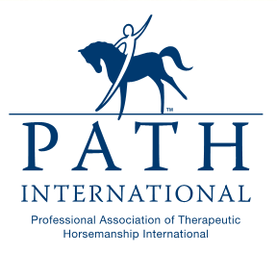

Who Can Provide Hippotherapy?
Physical, occupational, speech therapists, physical therapist assistants and certified occupational therapist assistants.
Therapists and assistants with AHA training that adhere to AHA and PATH Intl. standards.
Notes:
When considering hippotherapy for your child, remember only physical, occupational or speech therapists can use hippotherapy as a treatment.
Physical therapist assistants or certified occupational therapist assistants can also use hippotherapy as a treatment but only after the physical or occupational therapist has completed the child’s initial evaluation. The the physical or occupational therapist will also perform periodic re-evaluations to assess the child’s response to treatment and progress.
Also remember, look for therapists and assistants who have had training through the American Hippotherapy Association and who adhere to American Hippotherapy Association and Professional Association of Therapeutic Horsemanship International standards.

Slide 10
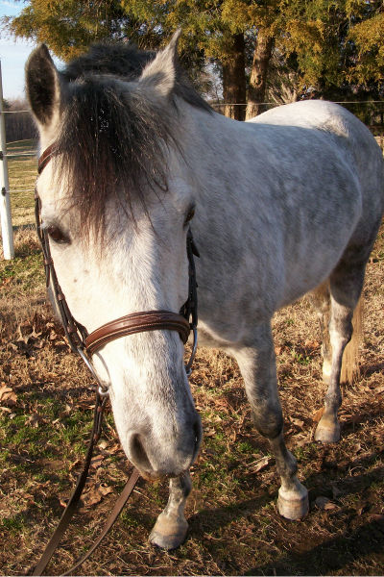
Why Use the Horse?
The horse’s movement is:
  Repetitive, rhythmic, and three dimensional.
  Transmitted to the child on top of the horse.
In response to the horse’s movement, the child actively uses his or her body to maintain balance and posture for a goal directed task.
Horse’s movement, child’s position, activities, and environment can be changed to provide challenge and target therapy goals.
May motivate the child.
Notes:
The horse’s movement or gait has characteristics that are similar to human movement or walking. It is repetitive, rhythmic and three dimensional.
When using the horse’s movement as a treatment tool, the horse’s movement is transmitted to the child positioned on top of the horse.
In response to the horse’s movement, the child uses his or her body to actively to maintain balance and posture or complete a goal directed task.
The horse’s movement, the child’s position, the activities, and the environment can be changed to challenge the child and to target therapy goals.
The interaction between the horse and child, may motivate the child to give greater effort and to try more challenging skills.

Slide 11
The Horse’s Movement or “Gait”
Walk
Used most frequently
4 beat gait
Trot
Used less frequently
2 beat gait
More rapid than the walk
Requires head and trunk control
Notes:
The horse’s movement or gait should be fluid, rhythmical, symmetrical and consistent. The horse’s gait may be changed to get a different response from the child.
The two gaits used in hippotherapy are the walk and the trot
The walk is the most common gait used for hippotherapy. It is a 4 beat gait with a rhythmical sequence of left hind leg, left front leg, right hind leg, right front leg movement.
The trot is used less frequently in hippotherapy. It is a 2 beat gait with diagonal pairs of legs moving forward at same time. The trot is more rapid than the walk, so the child must have adequate head and trunk control.

Slide 12
Reported Benefits of Hippotherapy
Arousal and Attention
Alignment
Balance
Coordination
Body Awareness
Bilateral Integration
Midline Body Orientation
Postural Control
Flexibility
Hip, Pelvic, and Spine Mobility
Muscle Tone
Strength
Circulation
Endurance
Respiratory Function
Speech and Language Skills
Problem Solving and Motor Planning Skills
Self confidence
Source: American Hippotherapy Association

Slide 13
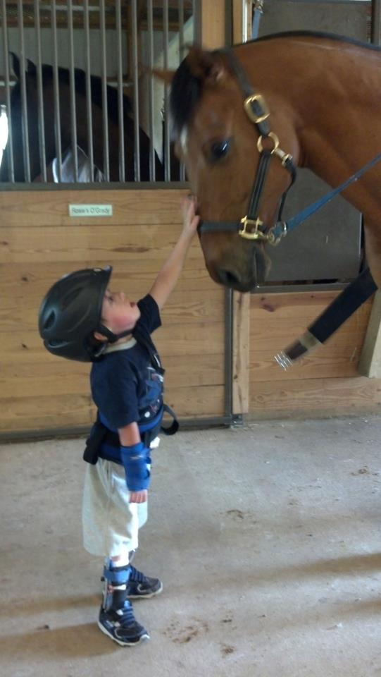
Who Might Benefit from Hippotherapy?
Children with:
Autism
Cerebral Palsy
Developmental Delay
Down Syndrome and other genetic disorders
Muscular Dystrophy
Spina Bifida
Spinal Cord Injury
Traumatic Brain Injury
Notes:
While this is not a complete list, children with the following conditions may benefit from hippotherapy.

Slide 14

Hippotherapy: Research Evidence for Children with Cerebral Palsy
Hippotherapy may improve:
Standing postural alignment. (Bertoti DB, 1988)
Energy expenditure and gross motor skills related to walking running, and jumping. (McGibbon et al. 1998)
Postural control and coordination. (Haehl et al. 1999)
Muscle symmetry and relaxation of muscle tone. (Benda et al. 2003)
Notes:
Hippotherapy is a physical therapy treatment that has gained popularity and has been reported to improve physical and psychosocial function. While hippotherapy may be viewed as engaging and enjoyable, physical therapists are obligated to base clinical decision-making on more than positive claims and anecdotal evidence.
In order to achieve the best physical therapy outcomes, it important to have research evidence to support a chosen physical therapy treatment. This slide and the next two slides highlight the research evidence supporting hippotherapy as a treatment to improve function in children with neurological and musculoskeletal conditions.
Research evidence for children with cerebral palsy:
Cerebral palsy is “a group of permanent disorders of the development of movement and posture, causing activity limitation, that are attributed to non-progressive disturbances that occurred in the developing fetal or infant brain”. Cerebral palsy is the most common cause of motor disability in children and the most common neurologic condition seen by pediatric physical therapists, so it is not surprising that the majority of research studies on hippotherapy have involved children with CP.
Researchers have reported that hippotherapy may improve… see the bulleted list on this and the next two slides. The lead researcher’s first name and the year of the study’s publication are in parentheses. The last three slides in this presentation provide references for the research studies.

Slide 15
Hippotherapy: Research Evidence for Children with Cerebral Palsy
Hippotherapy may improve:
Gross motor skills and functional performance including social function. (Casady and Nichols-Larsen 2004)
Muscle symmetry and gross motor function. (McGibbon et al. 2009)
Gross motor function, participation and psychosocial function. (Frank et al. 2011)
Balance, gross motor function, walking speed, stride length, and pelvic alignment (Kwon et al. 2011)

Slide 16
Hippotherapy: Research Evidence for Children with Cerebral Palsy
Hippotherapy may improve:
Head and trunk stability and reaching (Shurtleff et al. 2009; Shurtleff and Engsberg 2010; Shurtleff and Engsberg 2012)
Sitting balance. (Kang et al. 2012)
Gross motor function. (Chang et al. 2012)

Slide 17
Hippotherapy: Research Evidence For Children with Other Conditions
Hippotherapy may improve:
Gross motor function in children with Down syndrome. (Champagne and Dugas 2010)
Balance and functional performance in daily life skills in children with autism, cerebellar hypoplasia, cerebral palsy, developmental coordination disorder, Down syndrome, developmental delay, and visual impairment. (Silkwood-Sherer et al. 2012)
Trunk and pelvic alignment in children with brain injury, Guillain Barre syndrome, cerebral palsy, and cerebrovascular accident. (Encheff et al. 2012)
Notes:
While the literature supports hippotherapy for children with cerebral palsy, children with a variety of neurological and musculoskeletal conditions receive hippotherapy. Though the research studies are few, it is important to review the evidence for hippotherapy for children with conditions other than cerebral palsy.
For children with Down syndrome, hippotherapy has been reported to have a positive effect on gross motor function.
In a study involving children with balance problems related to a variety of neurological conditions, hippotherapy was reported to improve balance and functional performance in daily life skills.
Last, in a group of children with conditions including brain injury, Guillain Barre syndrome, cerebral palsy, and cerebrovascular accident, hippotherapy was reported to improve trunk and pelvic alignment.

Slide 18
What Additional Research Is Needed?
Studies…
  With a larger number of participants.
  With children who have different pediatric conditions.
  That determine the best intensity, frequency and duration.
  That examine the effects of hippotherapy on participation and quality of life.
  That examine the long term effects of hippotherapy.
Notes:
Despite encouraging evidence for hippotherapy to positively impact function, additional research is needed.
Studies with more participants (meaning larger sample sizes).
Studies examining the effects of hippotherapy on function in children with a variety of neurological and musculoskeletal conditions.
Studies that determine the best dosage (meaning intensity, frequency and duration) of hippotherapy.
Studies that investigate the effects of hippotherapy on participation and quality of life. Most studies measure impairments like muscle tone and balance and activities like sitting and walking, but to address all components of a child’s health and function, aspects of participation like psychosocial function and quality of life also need to be measured.
Studies that examine the long term effects of hippotherapy… after therapy has ended.

Slide 19
Hippotherapy May Not Be Appropriate for Children Who Have:
Active mental health disorder
Acute herniated disc
Allergies to horses
Atlanto-axial or spinal instability
Fractures
Hip subluxation or dislocation
Hemophilia
Neurological signs caused by Chiari II malformation or tethered spinal cord
Uncontrolled seizures
Urinary catheters
Wounds
Source: American Hippotherapy Association
Notes:
When parents are considering hippotherapy for their child, they also have to consider contra-indications to hippotherapy.
Hippotherapy may not be appropriate for children who have… (see bulleted list)

Slide 20
Hippotherapy May Not Be Appropriate for Children With:
Severe activity limitations
  Hippotherapy may be less effective for children who have difficulty sitting without support. (Hamill et al, 2007)
Medical instability
  Medical status and stability should be considered prior to initiating treatment. (Murphy et al. 2008)
Notes:
Severe activity limitations
Hamill et al. suggested that hippotherapy may be less effective for children with more severe activity limitations (Gross Motor Function Classification level V) and who have difficulty sitting without support.
Medical instability
Murphy et al. suggested that medical status and stability (illnesses and seizures) may affect a child’s response to hippotherapy and should be considered prior to initiating treatment.

Slide 21
Does Insurance Pay for Hippotherapy?
Some insurance plans pay.
Copay may be required.
Some insurance plans do not pay.
Some hippotherapy providers do not accept insurance.
Notes:
A common question that parents have about hippotherapy is whether insurance pays for treatment.
Some insurance plans pay for physical therapy using hippotherapy or “the horse’s movement as a treatment tool”; however, copays may be required.
Some insurance plans do not pay for hippotherapy and consider it an investigational or experimental treatment.
Some hippotherapy programs do not participate in insurance plans, and services have to be paid out-of-pocket.
For more information, contact your insurance representative and your physical therapy provider.

Slide 22
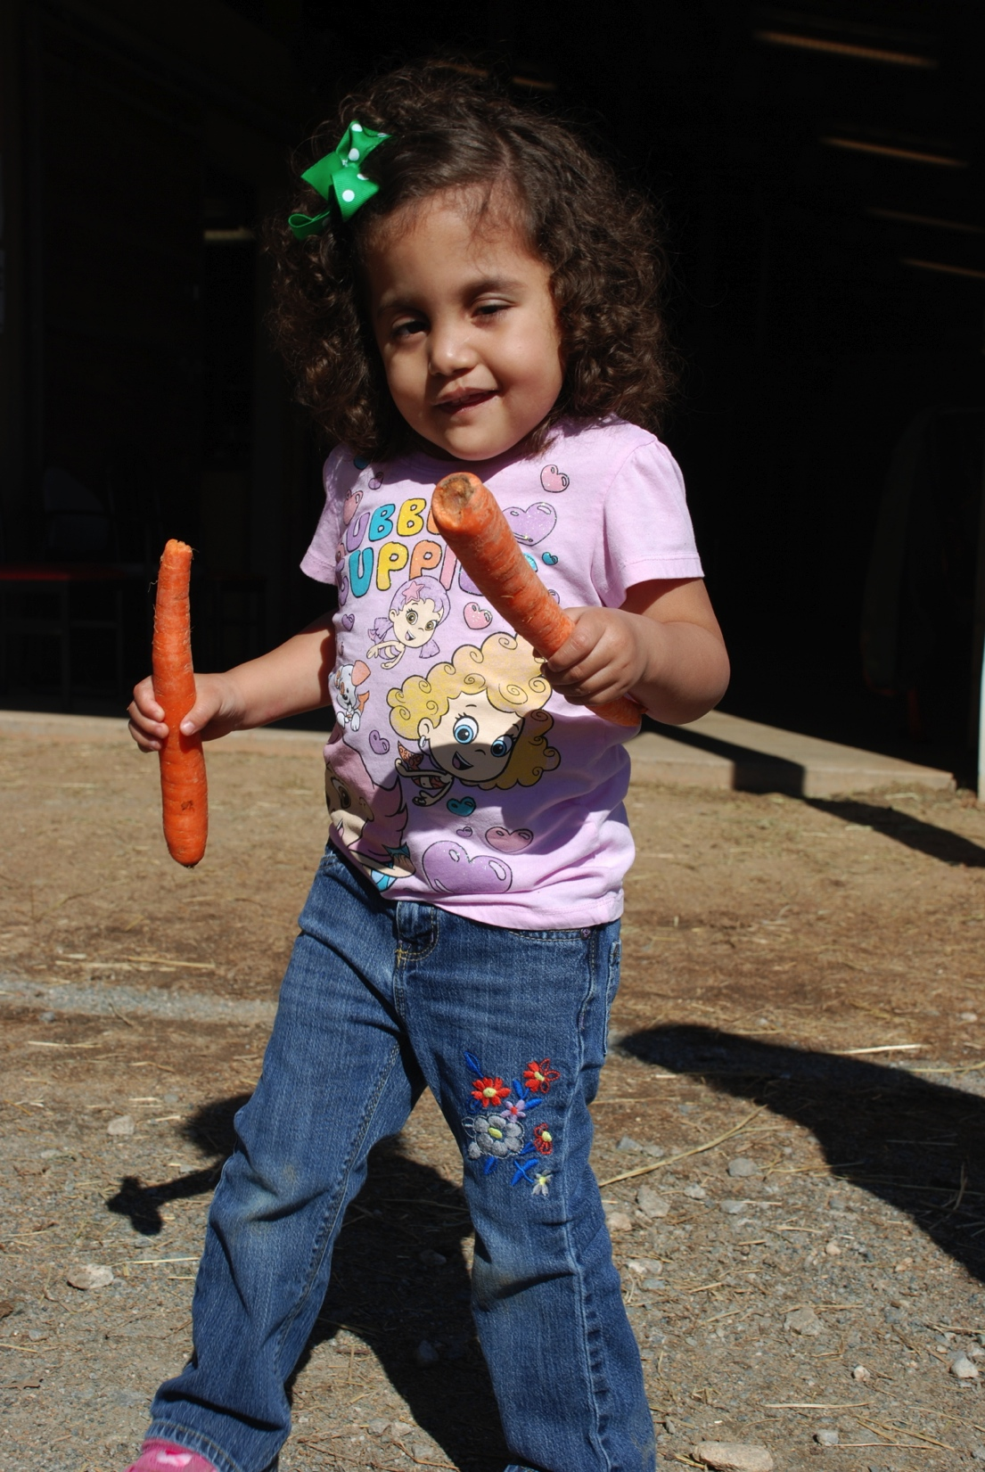
Hippotherapy: Getting Treatment Started
Doctor’s order.
Initial physical therapy evaluation.
Therapist will consider:
  Will hippotherapy be a useful treatment?
  Are there contraindications?
  What precautions should be taken?
  What are the potential benefits?
  Can the hippotherapy team meet the child’s needs?
If hippotherapy is the right treatment, a plan of care will be developed and treatment will be started.
Notes:
Getting services started:
Even though people in North Carolina have direct access to physical therapy, some insurance plans and most providers require a doctor’s order to receive physical therapy that includes hippotherapy.
After receiving a doctor’s order, the child will be evaluated by the physical therapist.
The therapist will consider the following:
Will HPOT be a useful treatment?
Are there contraindications?
What precautions should be taken?
What are the potential benefits?
Can the HPOT team meet the child’s needs?
If HPOT is appropriate, the therapist and family will develop goals (have to be functional, measurable and relevant to the child’s needs) and a plan of care so that treatment can get started.

Slide 23
Hippotherapy: Common Physical Therapy Outcome Measures
Bruininks Oseretsky Test of Motor Performance (BOT-MP)
Gross Motor Function Measure (GMFM)
Peabody Developmental Motor Scales, 2nd Edition (PDMS-2)
Pediatric Balance Scale (PBS)
Pediatric Evaluation of Disability Inventory (PEDI)
Notes:
For the initial evaluation and also for re-evaluations, the physical therapist may use different measures to evaluate balance, coordination, strength, fine and gross motor function, functional mobility, self-care skills, and social function.
Common measures used by physical therapists are the:
Bruininks Oseretsky Test of Motor Performance (BOT-MP) – To evaluate fine and gross motor skills, balance coordination, strength.
Gross Motor Function Measure (GMFM) – To evaluate gross motor skills.
Peabody Developmental Motor Scales, 2nd Edition (PDMS-2) – To evaluate fine and gross motor skills.
Pediatric Balance Scale (PBS) – To evaluate balance.
Pediatric Evaluation of Disability Inventory (PEDI) – To evaluate self care, mobility and social function.
The reason for administering these and other tests and measures are to get a baseline level of the child’s function and over time, determine if the child is making progress with treatment.

Slide 24
Hippotherapy: Prior to Treatment
The therapist will…
Select therapy horse and other team members.
Select appropriate equipment.
Determine how child will transfer on/off horse.
Select activities to be performed before, during, and after hippotherapy.
Determine how treatment will progress.

Slide 25
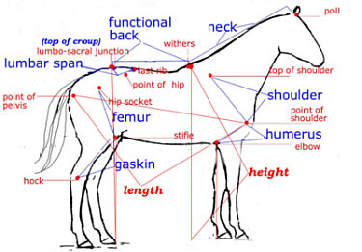
The Hippotherapy Horse
Good bone structure, musculature, body proportions, and movement.
Good “temperament”.
Well-trained.
Right size for child.
Child’s weight should not be > 20% horse’s body weight.
Notes:
After the evaluation has been performed, the therapist will select the hippotherpay horse. The hippotherapy horse should have good bone structure, musculature, body proportions, and movement quality. This is also known as conformation.
The horse must have a good “temperament” (meaning attitude, mood or behavior) and be highly trained to work with children who have disabilities
The horse should be the right size for the child. A good fit in more ways than one.
To protect the horse and the child, the child should not weigh more than 20% of the horse’s body weight.

Slide 26
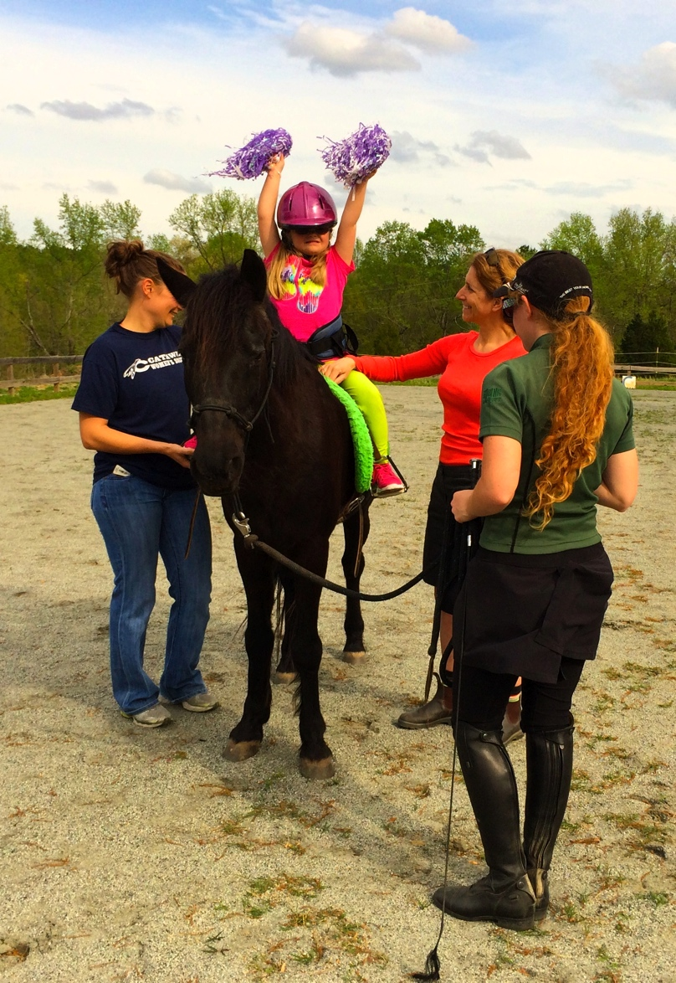
The Hippotherapy Team
Therapist
Leads therapy session, ensures child’s safety.
Horse Handler
Prepares horse, maintains control of horse, ensures safety.
Side Walker
Under therapist’s direction, assists with activities.
Horse
Should be responsive to horse handler.
Notes:
The HPOT team includes 4 key members:
Licensed Therapist or Therapist Assistant - Leads the therapy session, directs the horse handler and side walker and focuses on the child’s response and safety.
Horse Handler or Certified Riding Instructor - Prepares the horse for the therapy session, maintains control of the horse during the therapy session, and communicates with and advises the therapist or assistant about safety.
Side Walker - Under the therapist’s direction, assists with preparing the horse and the child for treatment and during treatment, assists with activities.
Horse - In addition to having good physical characteristics as mentioned in a previous slide, the horse should be well-trained and responsive to the horse handler.

Slide 27
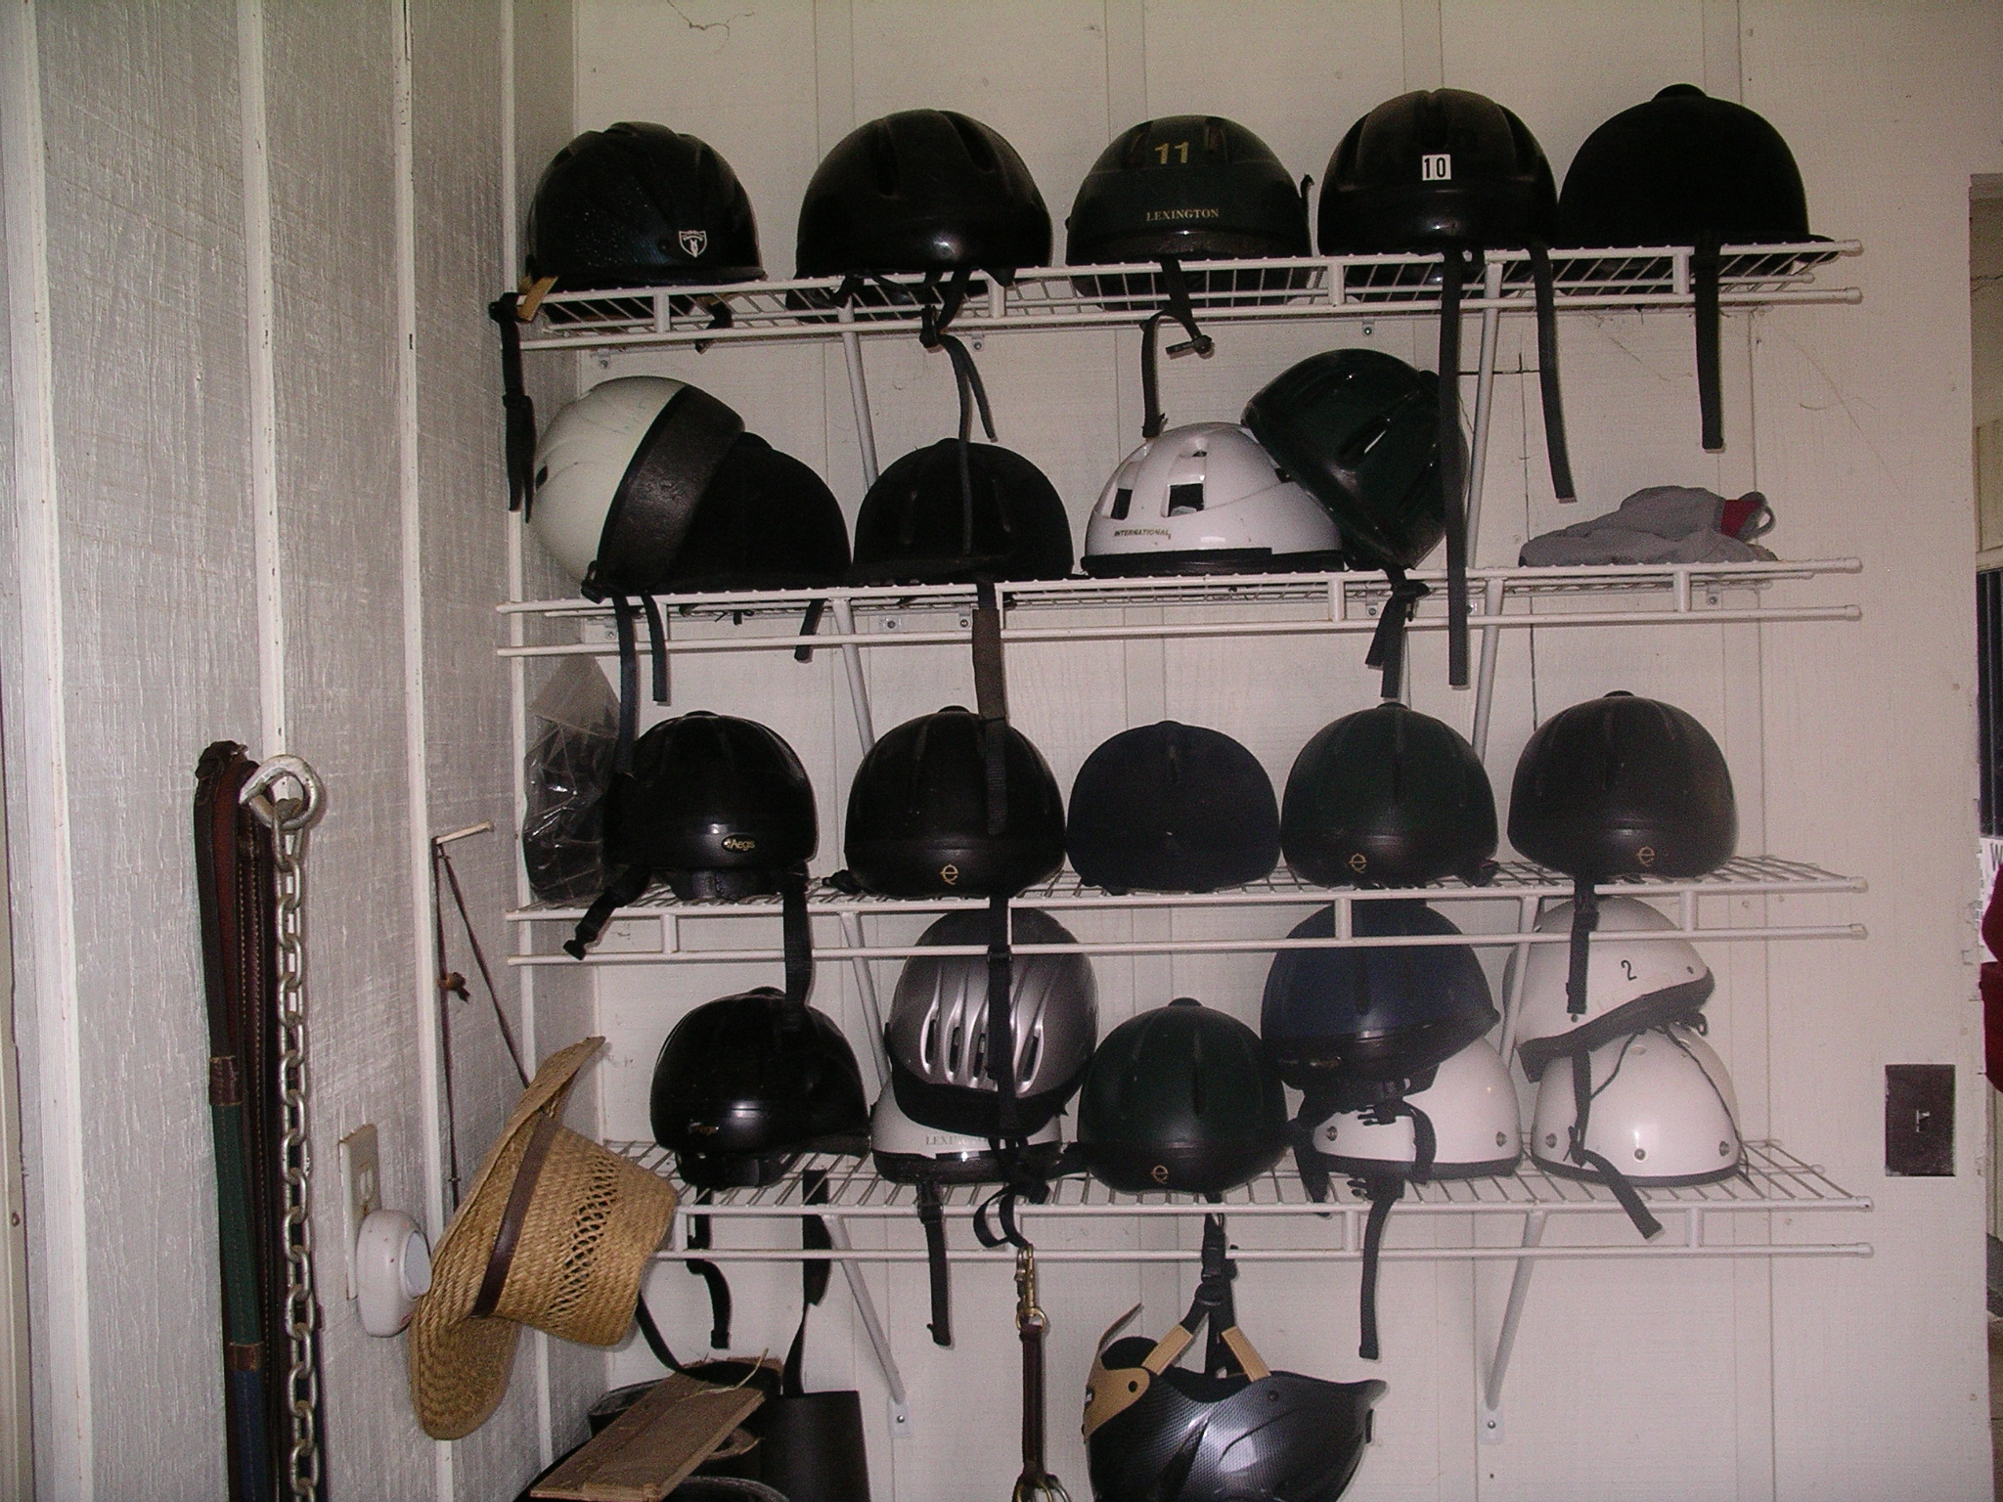
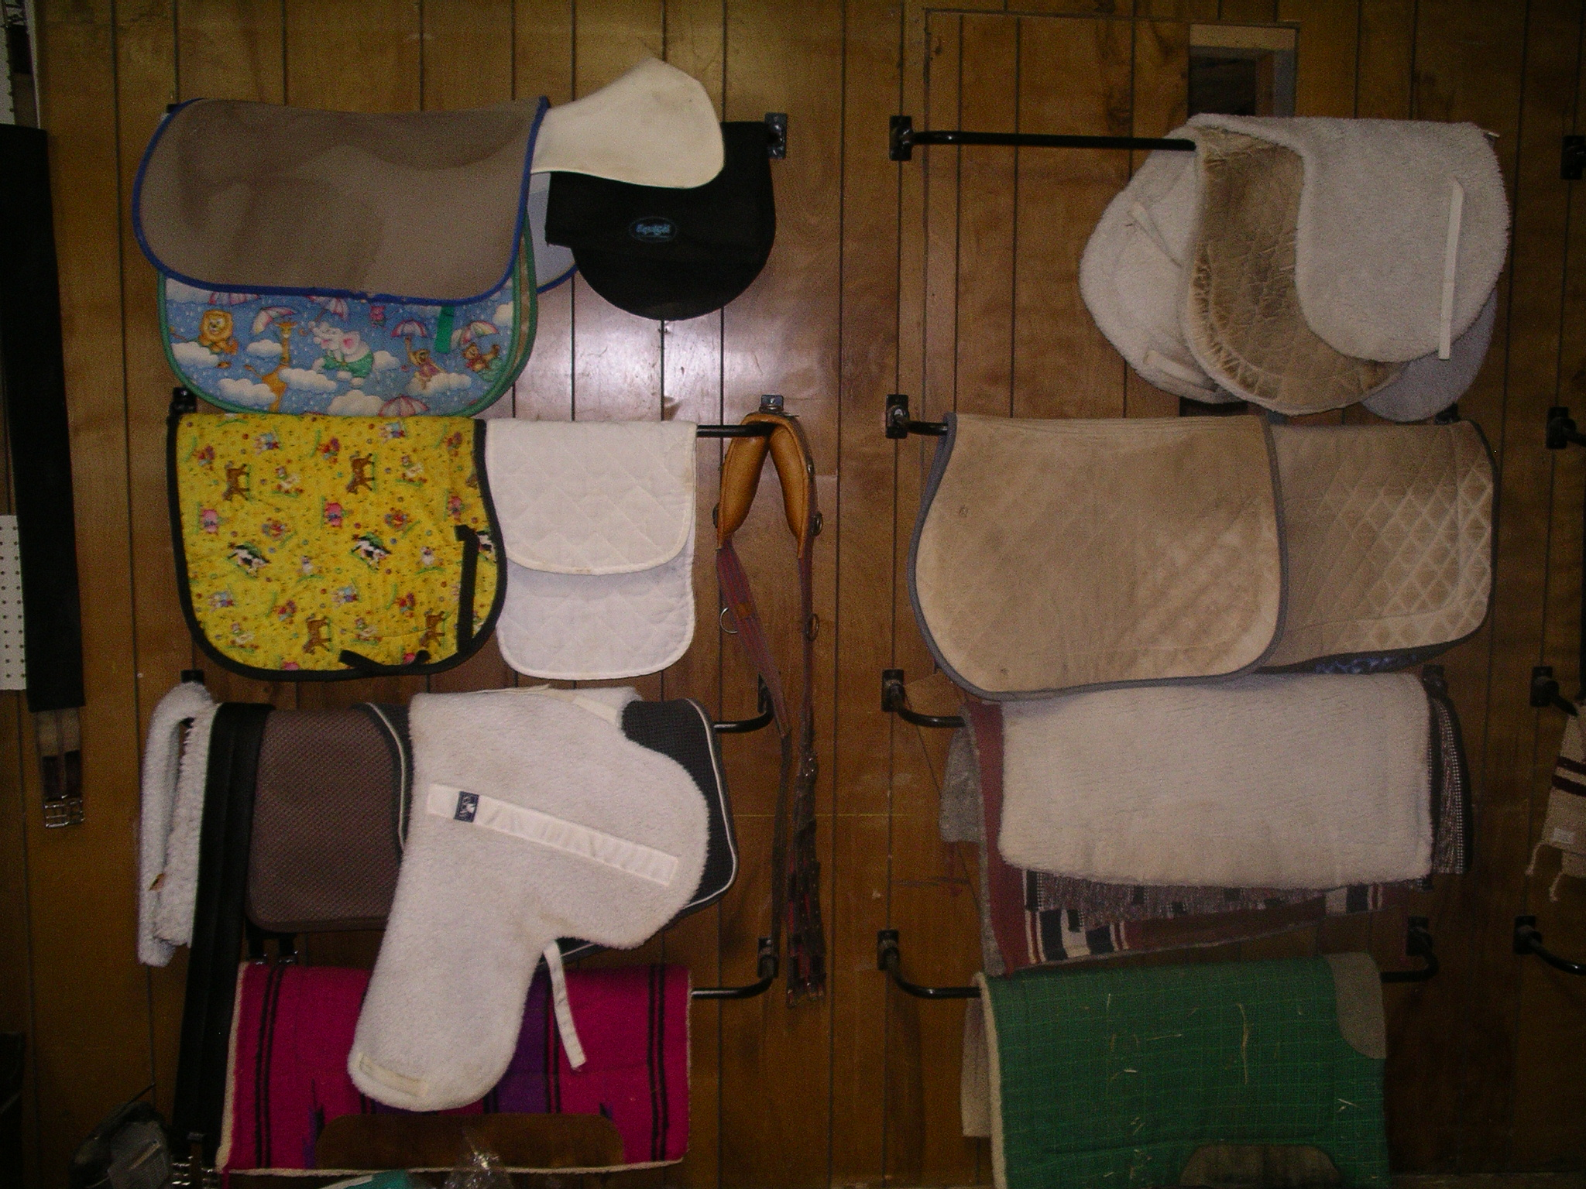
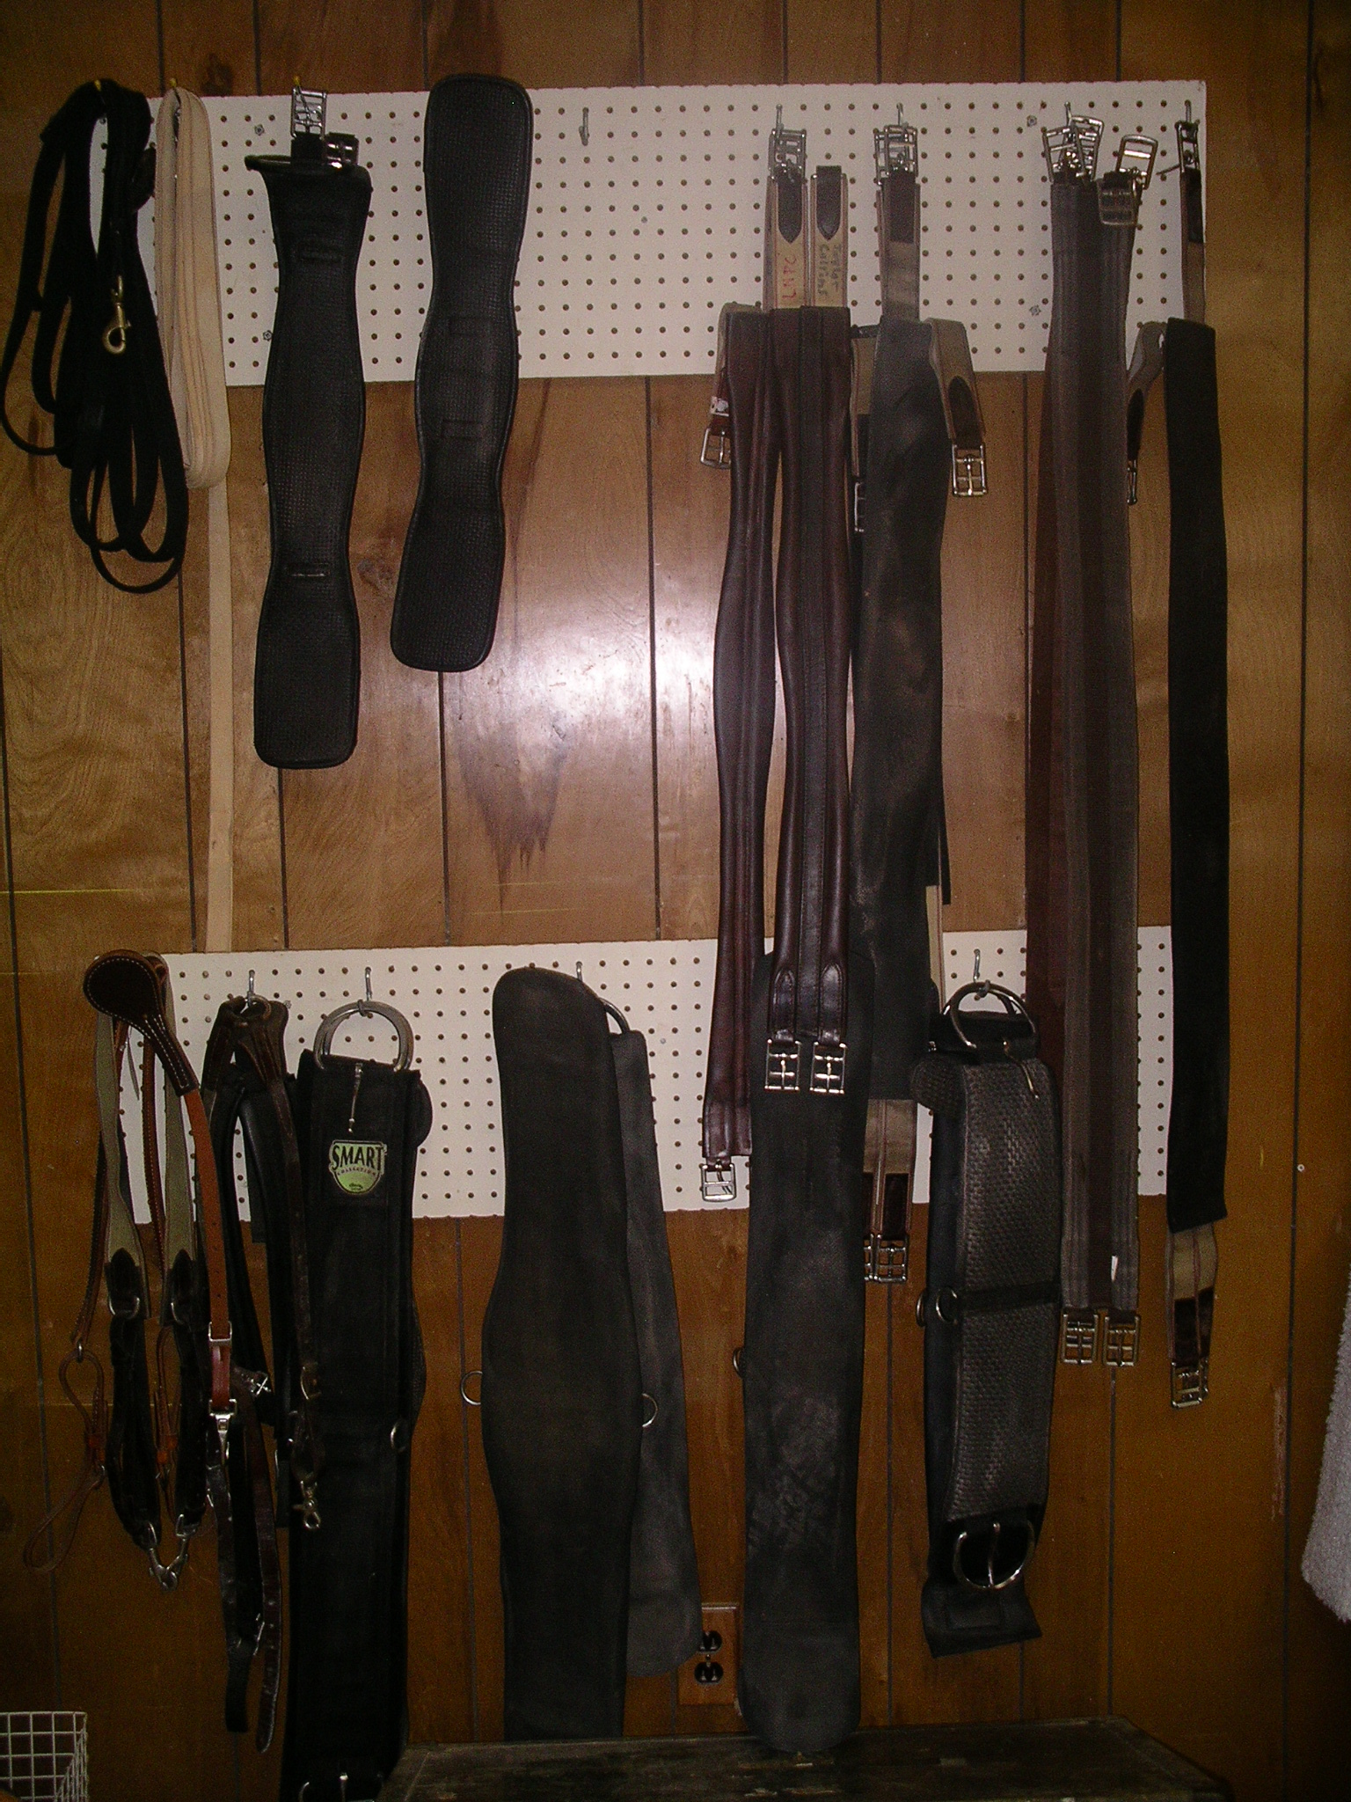
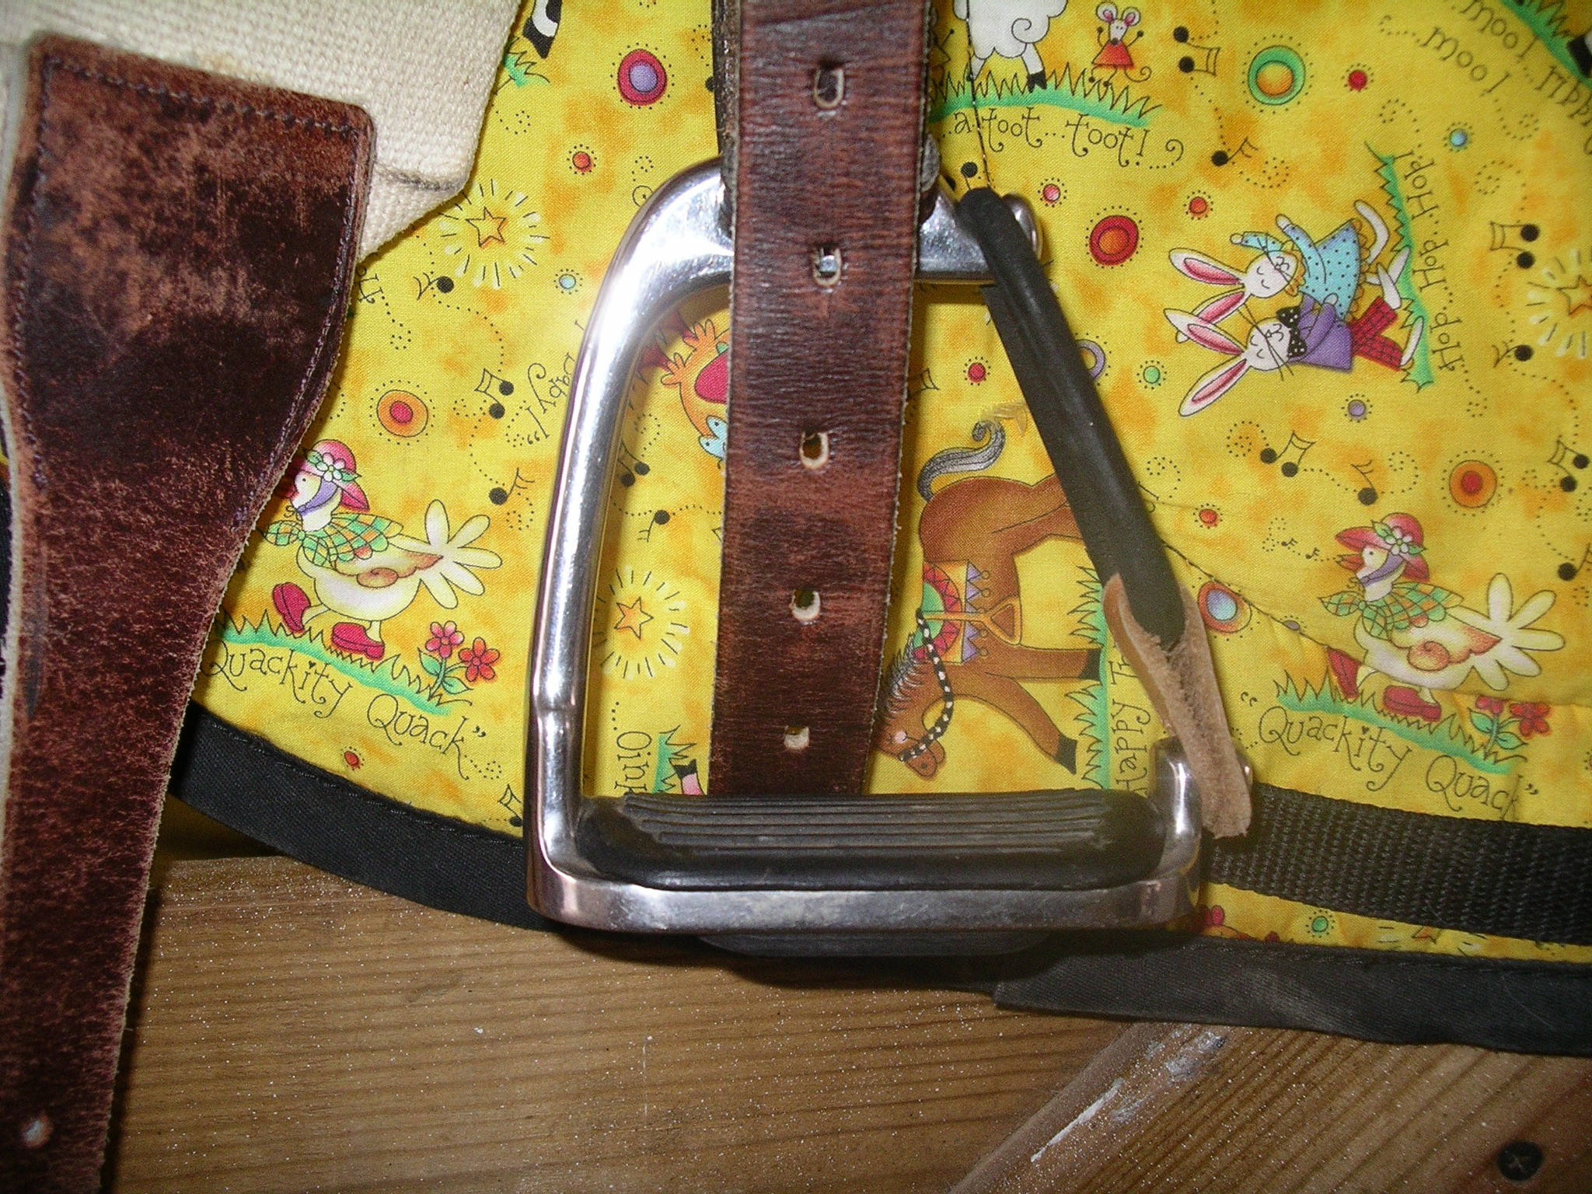
Hippotherapy Equipment and Tack
Helmets
Gait Belt
Safety stirrups
Pads
Saddles
Surcingles
Cinches and Girths
Lead Ropes
Reins
Halters
Bits and Bridles
Toys and Games
Notes:
Tack is another word for the equipment or the accessories used with horses.
Common equipment or tack used in hippotherapy is listed in the slide above.
First, all children must wear an approved helmet for head protection. Other equipment to ensure the child’s safety includes gait belts, safety stirrups and pads. With hippotherapy, it is common to only use a pad between the horse and the child. The reason for this is to minimize the distance between the horse and the child, so that the child can experience the horse’s movement without any dampening of the movement. In some cases, when the horse’s back needs more protection or when the child needs a more supportive surface, a saddle will be used.
Surcingles, cinches and girths help hold pads and saddles in place.
To control the horse and maintain the horse’s position, lead ropes, reins, halters, and bits and bridles are used.
To engage the child in different activities while on the horse, games and toys may be used.

Slide 28
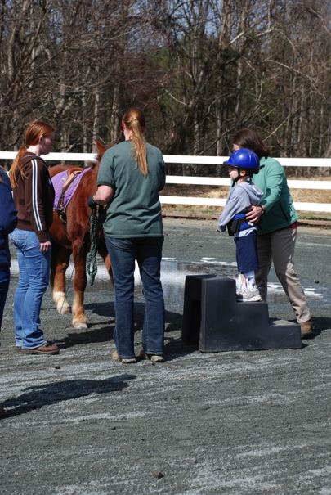
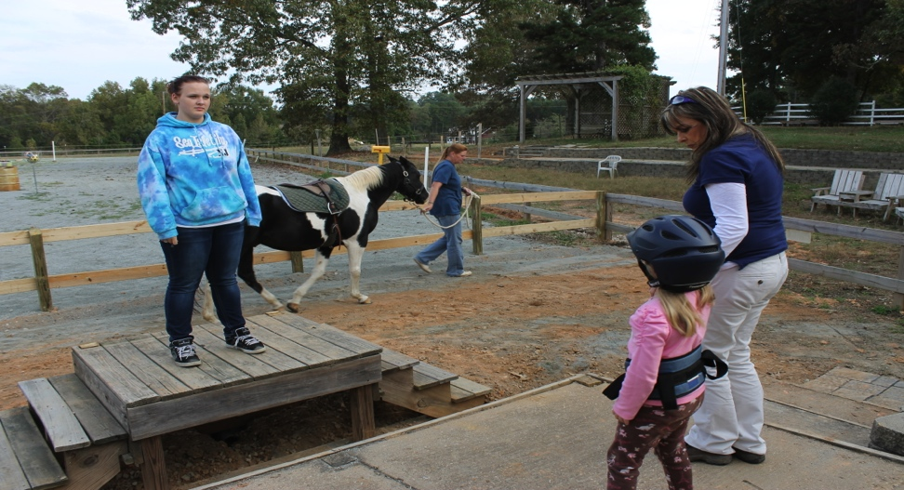
How Does a Child Transfer to the Horse?
Mounting step – Bigger children who can stand and walk.
Mounting ramp or platform – Smaller children or children who need more assist.
Notes:
Transfers are performed with the help of the therapist and if needed, the side walker.
A mounting step may be used for bigger children who can stand and walk.
A mounting ramp or platform may be used for smaller children or children who need more assistance. For example, children who are transferring from a wheelchair.
Transfers on and off the horse, provide the child with an opportunities to work on balance, coordination, and motor planning skills.

Slide 29
Positions on Horse
Forward sitting
Backward sitting
Side-sitting
Stomach lying
Back lying
Notes:
Once the child transfers to the horse, he or she may assume different positions on the horse. Common positions include: forward sitting, backward sitting, side sitting, prone or stomach lying, and supine or back lying.
The next 7 slides include pictures of the various positions used in hippotherapy. In combination with the horse’s movement, the positions allow the child to experience a variety of sensory input (somatosensory, vestibular, and visual) and use different responses (active movement and righting and equilibrium reactions) to maintain their balance and position and to accomplish goal directed tasks.

Slide 30
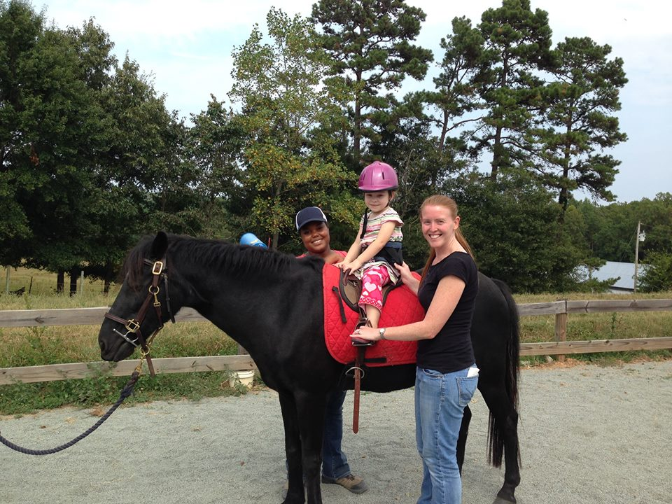
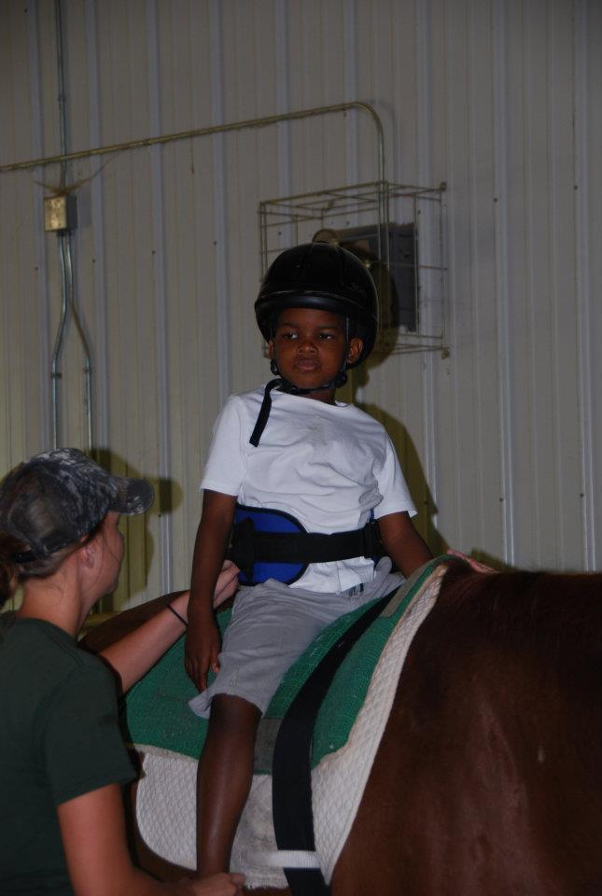
Forward Sitting
Notes:
Promotes:
Posterior pelvic tilt.
Opportunity to experience visual flow.
Requires less hip abduction and external rotation than backward sitting so may be better for children with adductor or inner thigh tightness.

Slide 31
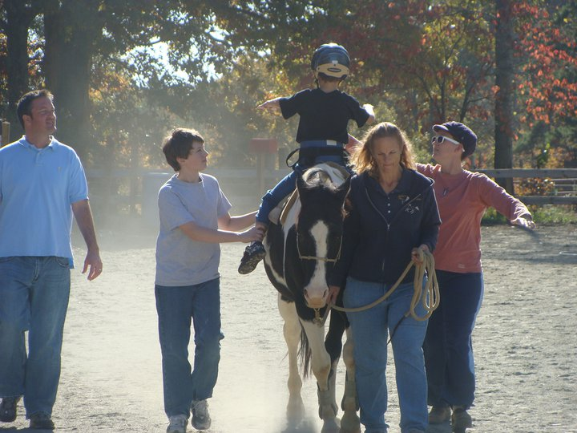
Backward Sitting
Notes:
Promotes:
Anterior pelvic tilt and trunk extension.
Different position for visual flow and sensory input.
Upper extremity weight bearing on the larger surface area of the horse’s rump.
A wider base of support so children must have sufficient hip abduction and external rotation.

Slide 32
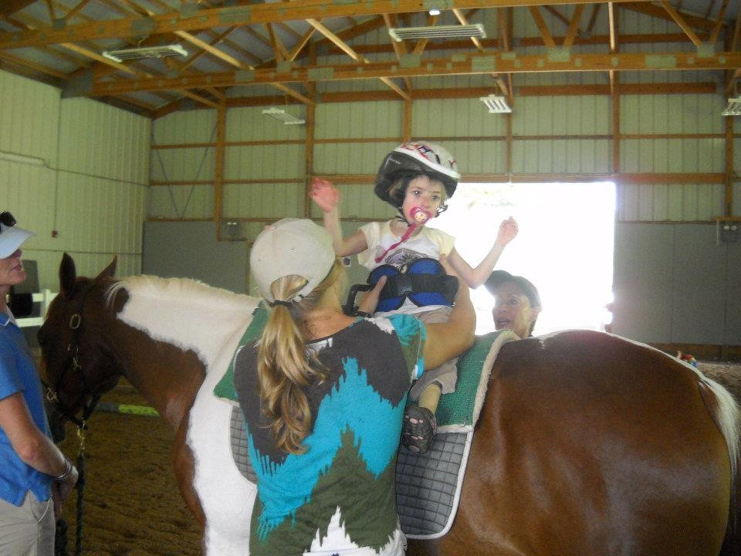
Side Sitting
Notes:
Promotes:
Lateral (left and right) pelvic weight shifts.
Increased balance challenge.
Use of trunk flexors or extensors, depending on the direction of the horse’s turn.
Lateral upper extremity weight bearing and scapular (shoulder blade) retraction and shoulder girdle stabilization.

Slide 33
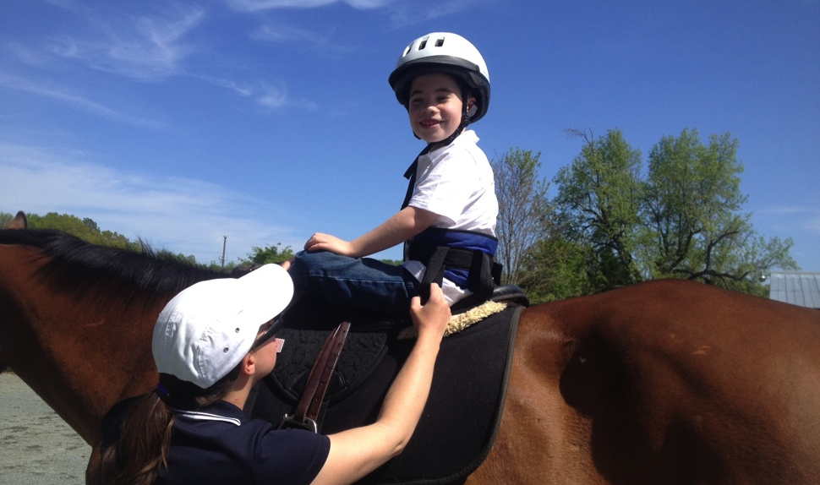
Modified Side Sitting
Notes:
In modified side sitting, one hip is externally rotated (turned out) and the hip and knee are flexed (bent).
Promotes:
Trunk/pelvic dissociation
Trunk rotation
Increased weighting bearing on one hip, depending on left or right side sitting position.
Trunk lengthening or shortening, depending on left or right side sitting position.

Slide 34
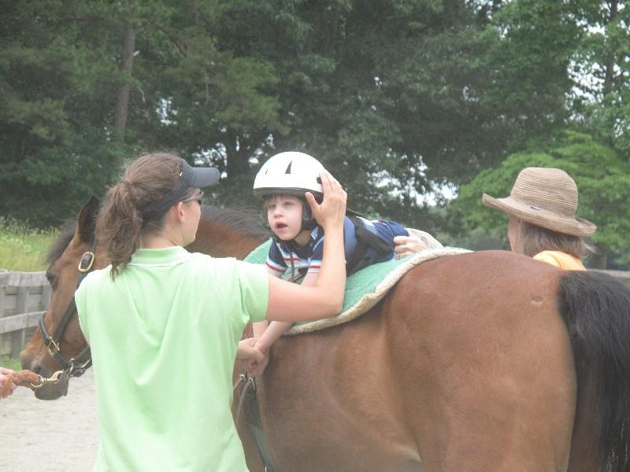
Lying On Stomach
(Prone Over Horse’s Barrel)
Notes:
Promotes:
Muscle relaxation
Head, trunk and hip extension
Elongation (stretch) of hamstrings
In this position, child can work on elbow propping.

Slide 35
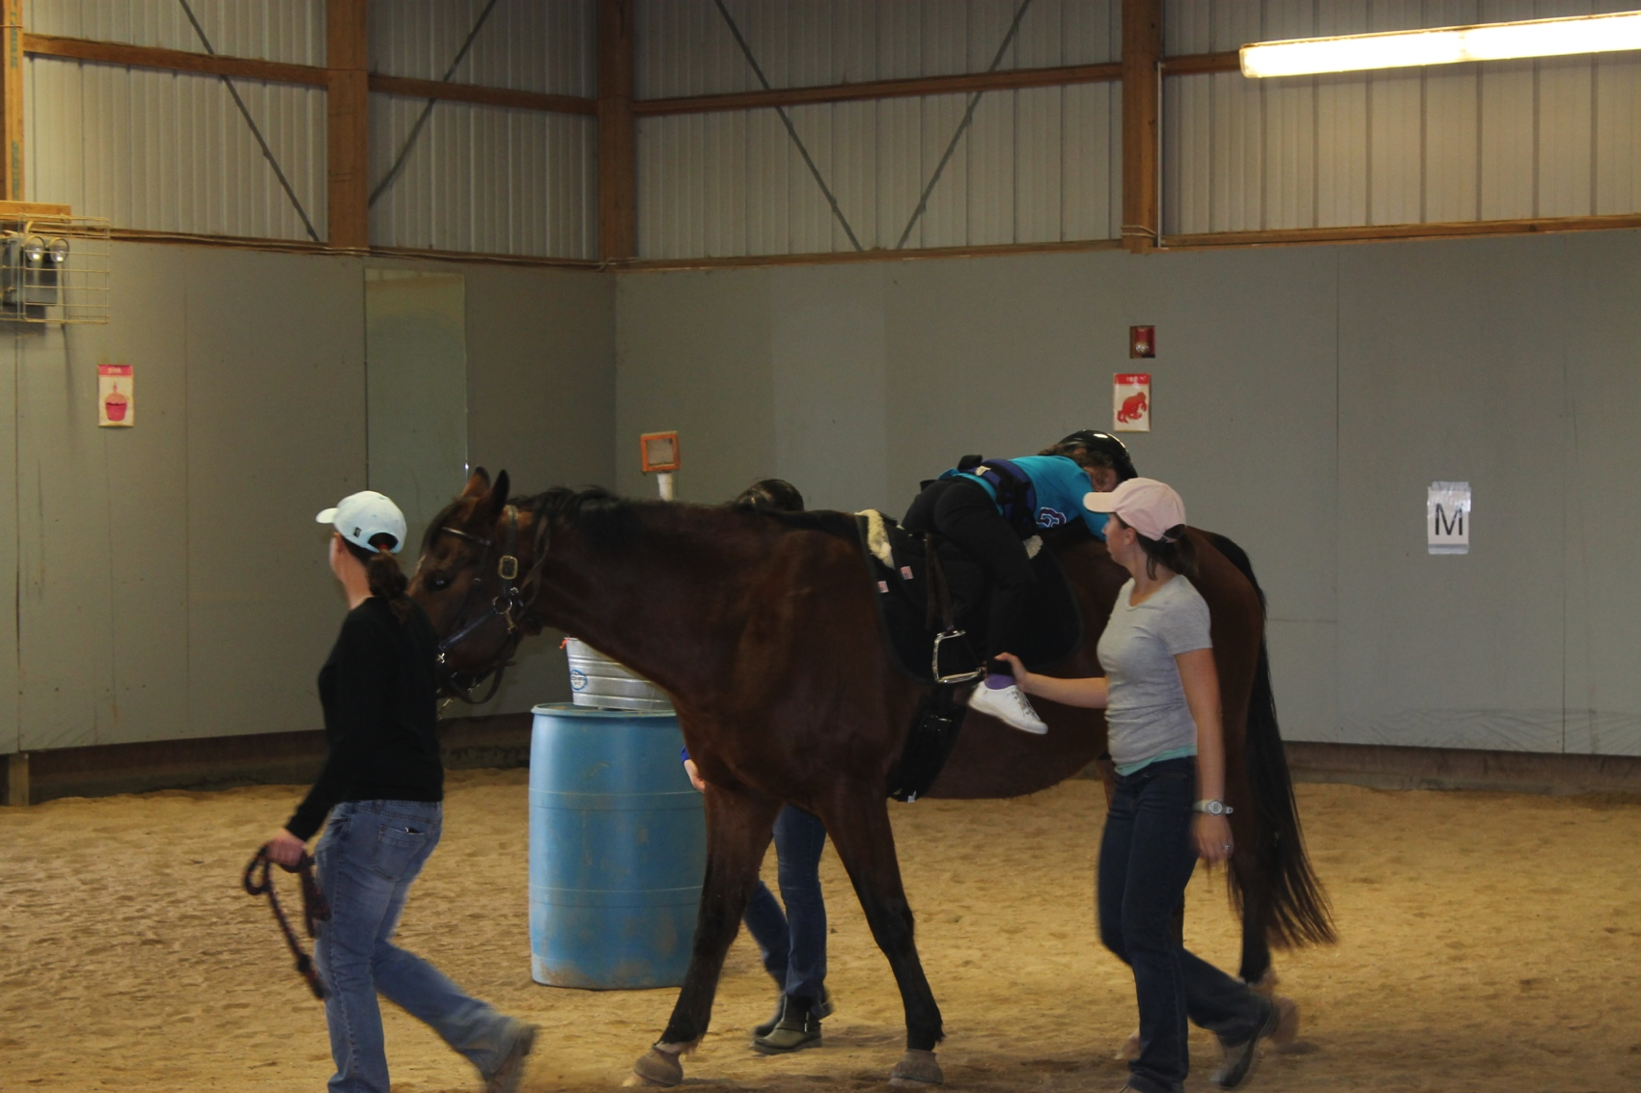
Lying On Stomach
(Prone On Horse’s Rump)
Notes:
Promotes:
Hamstrings or hip flexor stretch, depending on leg position.
Scapular retraction and shoulder girdle stabilization
In this position, child can work on elbow propping.

Slide 36
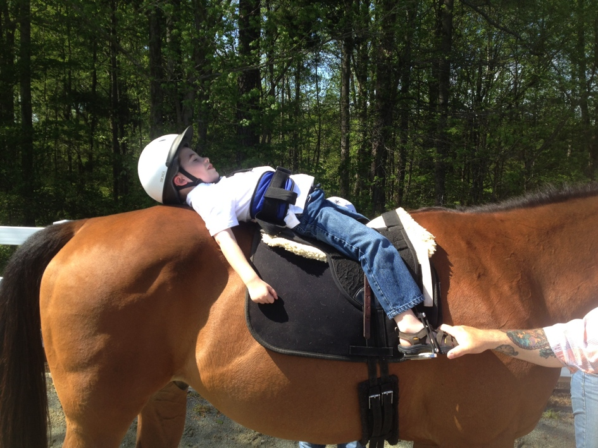
Lying On Back
(Supine On Horse’s Rump)
Notes:
Promotes:
Midline orientation
Pectoral (chest muscle) stretch
Rib cage expansion

Slide 37
Hippotherapy: Other Things You May See
Horse handler may lead horse from front or from back (“long lining”).
Horse may be led in different figures or patterns:
  Straight lines
  Turns
  Circles
  Serpentines
  Figure Eights
  Up and down hills/slopes
Therapist’s hands may support child and assist child with movements.

Slide 38
Hippotherapy: Typical Session
May take place in an outdoor or an indoor arena.
May be used at the beginning, middle or end of a therapy session.
Activities performed on and off the horse.
Other therapy equipment may be used.
Therapist documents therapy activities, the child’s response and the child’s progress towards therapy goals.
Notes:
You may be wondering what a typical session is like?
Treatment may take place in an outdoor or an indoor arena.
Hippotherapy may be used at the beginning, middle or end of a therapy session.
Therapy activities are performed on and off the horse. Activities are based on the child’s therapy goals. Activities may involve the head, trunk, pelvis, arms and legs. Activities are chosen to develop balance, coordination, flexibility, fine and gross motor skills, posture, range of motion, and strength.
In addition, other therapy equipment may be used. For example, steps, treadmills, and cycles may be used for aerobic training.
After each treatment session, the therapist will document all therapy activities, the child’s response and the child’s progress towards goals.

Slide 39
Hippotherapy: Sample Session
(Silkwood-Sherer et al. 2012)
Duration | Activity
5 minutes | Warm up. Child sitting forward. Horse led at walk along straight lines and gentle curves.
15-20 minutes | Activities to challenge balance and posture in forward sitting. Horse led in circles, weaving cones, and serpentine pattern. Starts and stops. Acceleration and deceleration. Uneven terrain. Progress the child from eyes open to eyes closed. Repeat with child backward sitting.
10-15 minutes | Child changes positions (forward, backward, and side sitting, supine, prone, all-fours, kneeling). Motor planning activities and arm and leg exercises (reaching tasks; use stirrups for sit-stand-sit and standing)
5 minutes | Cool down. Child sitting forward. Horse led at walk along straight lines and gentle curves.
Notes:
This sample session comes from a research study protocol (Silkwood-Sherer et al., 2012). Since treatment is individualized for every child, not all treatments will include these activities or this duration for activities. However, this sample represents the range of activities that can be performed during a hippotherapy session.

Slide 40
Hippotherapy: Treatment Length, Frequency, Duration
30-60 minute sessions
1-2 times per week
8-12 weeks or longer depending on the child’s needs, goals and progress
Notes:
Just like therapy provided in a clinic, the treatment length, frequency and duration depend on the child’s needs as outlined in the therapy plan of care but may also depend on the child’s insurance plan.
Treatment duration also depends on the child’s response to and progress with therapy.
To get the best response, children should attend all therapy sessions and participate in all activities outlined in the therapy plan of care, this may include a home exercise program.
Research has suggested that positive effects may be seen with sessions ranging from 30-60 minutes, 1-2 times per week for 8-12 weeks.
When a child meets his or her therapy goals, he or she will be discharged from therapy.

Slide 41
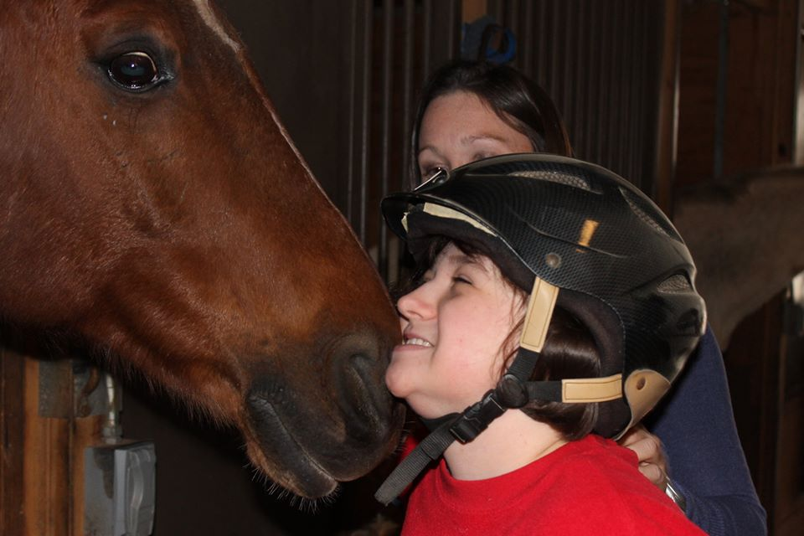
What Will My Child Do After Discharge?
Physical activities with family, at school or in community.
Equine assisted activities and therapeutic riding.
Notes:
The goal of therapy is to improve function.
With improved function it is anticipated that a child will be more independent and increase his or her participation in physical activity whether with the family, at school or in the community.
If your child responded well to hippotherapy and enjoyed the interaction with the horse, equine assisted activities and therapeutic riding should be considered.

Slide 42
Hippotherapy: Summary
Use of the horse’s movement as a treatment tool by physical, occupational and speech therapists.
Hippotherapy team should be well trained.
Child positioned on horse, responds to horse’s movement by actively using head, arms, trunk, pelvis, and legs to maintain balance and posture or perform a task.
Horse’s movement, child’s position, equipment, and environment can be changed to meet child’s therapy needs.
Hippotherapy is one part of larger therapy plan of care.
Goal is to improve function.
Notes:
Hippotherapy is using the horse’s movement as a treatment tool.
Hippotherapy is a physical, occupational and speech therapy treatment.
The horse’s movement is transmitted to the child and requires the child to respond actively to maintain balance and posture.
Different variables (the horse, child’s position, equipment, environment) can be changed to meet the child’s therapy needs.
For safe and effective treatment, the hippotherapy team must be highly trained and hippotherapy must be an appropriate treatment for the child.
Hippotherapy is one part of the child’s larger therapy plan of care.
Goal – Improve function! For example, better reaching, sitting, standing or walking.

Slide 43
Where Can I Find More Information?
American Hippotherapy Association (AHA) http://www.americanhippotherapyassociation.org
Professional Association of Therapeutic Horsemanship International (PATH Intl.) http://www.pathintl.org

Slide 44
Research Studies: References
Benda W, McGibbon NH, Grant KL. Improvements in muscle symmetry in children with cerebral palsy after equine-assisted therapy (hippotherapy). Journal of Alternative and Complementary Medicine. 2003; 9(6):817-25.
Bertoti DB. Effect of Therapeutic Horseback Riding on Posture in Children with Cerebral Palsy. Physical Therapy. 1988;68(10):1505-1512.
Champagne D and Dugas C. Improving Gross Motor Function and Postural Control with Hippotherapy in Children with Down Syndrome: Case Reports. Physiotherapy Theory and Practice. 2010; 26(8):564-571.
Chang HJ, Kwon J, Lee J, Kim Y. The Effects of Hippotherapy on the Motor Function of Children with Spastic Bilateral Cerebral Palsy. J Phys Ther Sci. 2012; 24 (12): 1277–1280.
Casady RL and Nichols-Larsen DS. The Effect of Hippotherapy on Ten Children with Cerebral Palsy. Pediatric Physical Therapy. 2004; 16:165-172.
Encheff JL, Armstrong C, Masterson M, Fox C. Hippotherapy Effects on Trunk, Pelvic, and Hip Motion During Ambulation in Children With Neurological Impairments. Pediatric Physical Therapy. 2012; 24:242-250.
Frank A, McCloskey S, Dole RL. Effect of Hippotherapy on Perceived Self-Competence and Participation in a Child With Cerebral Palsy. Pediatric Physical Therapy. 2011; 23: 301-308.
Haehl V, Giuliani C, Lewis C. The Influence of Hippotherapy on the Kinematics and Functional Performance of Two Children with Cerebral Palsy. Pediatric Physical Therapy. 1999;11:89-101.

Slide 45
Research Studies: References
Hamill D, Washington K, White OR. The effect of hippotherapy on postural control in sitting for children with cerebral palsy. Phys Occup Ther Pediatr. 2007;27(4):23-42.
Kang H, Jung J, Yu J. Effects of Hippotherapy on the Sitting Balance of Children with Cerebral Palsy: a Randomized Control Trial. J Phys Ther Sci. 2012; 24(9):833-836.
Kwon JY, Chang HJ, Lee JY, Ha Y, Lee PK, Kim YH. Effects of hippotherapy on gait parameters in children with bilateral spastic cerebral palsy. Arch Phys Med Rehabil. 2011; 92(5):774-779.
McGibbon NH, Andrade A, Widener G, Cintas HL. Effect of Equine-Movement Therapy Program on Gait, Energy Expenditure, and Motor Function in Children with Spastic Cerebral Palsy: A Pilot Study. Developmental Medicine and Child Neurology. 1998; 40:754-762.
McGee MC, Reese NB. Immediate effects of a hippotherapy session on gait parameters in children with spastic cerebral palsy. PEDIATR PHYS THER. 2009;21(2):212-218.
McGibbon NH, Benda W, Duncan BR, Silkwood-Sherer D. Immediate and long-term effects of hippotherapy on symmetry of adductor muscle activity and functional ability in children with spastic cerebral palsy. Arch Phys Med Rehabil. 2009;90(6):966-974.
Murphy D, Kahn-D'Angelo L, and Gleason J. The Effect of Hippotherapy Intervention on Functional Outcomes for Children with Disabilities: A Pilot Study. Pediatric Physical Therapy. 2008; 20:264-270
Shurtleff T, Engsberg J. Long-term effects of hippotherapy on one child with cerebral palsy: a research case study. British Journal of Occupational Therapy. 2012; 75(8): 359-366.

Slide 46
Research Studies: References
Shurtleff TL, Engsberg JR. Changes in trunk and head stability after hippotherapy, a pilot study. Physical and Occupational Therapy in Pediatrics. 2010; 30(2): 150-63.
Shurtleff TL, Standeven J, Engsberg JR. Changes in dynamic trunk/head stability and functional reach after hippotherapy. Archives of Physical Medicine and Rehabilitation. 2009; 90(7): 1185-95.
Silkwood-Sherer DJ, Killian CB, Long TM, Martin KS. Hippotherapy-An Intervention to Habilitate Balance Deficits in Children with Movement Disorders: A Clinical Trial. Physical Therapy. 2012. 92(5):707-717.
Snider L, Korner-Bitensky N, Kammann C, Warner S, Saleh M. Horseback riding as therapy for children with cerebral palsy: Is there evidence of its effectiveness? Journal of Physical and Occupational Therapy in Pediatrics. 2007; 27(2), 5-23.
Sterba JA. Does horseback riding therapy or therapist-direc- ted hippotherapy rehabilitate children with cerebral palsy? Dev Med Child Neurol 2007; 49: 68–73.
Whalen CN, Case-Smith J. Therapeutic Effects of Horseback Riding Therapy on Gross Motor Function in Children with Cerebral Palsy: A Systematic Review. Physical and Occupational Therapy in Pediatrics. 2012. 32(3):229-242.
Zadnikar M, Kastrin A. Effects of hippotherapy and therapeutic horseback riding on postural control or balance in children with cerebral palsy: A meta-analysis. Dev Med Child Neurol. 2011;53(8):684-691.

