Slide 1
The Journey of Cultural Competence
Beverly Knight
Capstone Presentation
March 25, 2014
Notes:
Goal of this presentation is to increase cultural knowledge in order to enhance cultural awareness and skill development before departing for Guatemala.
Professional development for future PT practice.
Image: http://mrbtg.wordpress.com/2012/04/19/path-app-what-is-it/

Slide 2
Learning Objectives
Define cultural competence.
Learn about various models of cultural competence available for healthcare professionals.
Understand the role of culture and cultural diversity in health, therapy, communication, etc.
Understand the importance of cultural competence and the role it plays in physical therapy practice.
Understand the impact of international immersion on the development of cultural competence.

Slide 3
Communication Styles
Value Systems
CULTURE
Thought processes
Health Behaviors
Health Beliefs
Notes:
There is no one definition of culture. However, most scholars view culture as “”a socially constructed, dynamic perceptual lens through which an individual views and interprets the world.^{”11}
A person’s culture is closely interrelated to value systems, health beliefs and behaviors, and communication styles.¹⁶
To provide appropriate and effective care, health care practitioners (HCP) need to understand how culturally learned values and customs affect people’s health beliefs and practices.¹¹
They must use this knowledge to collaborate with individuals and communities to provide health care that is sensitive to and consistent with cultural values, beliefs, and customs.¹¹

Slide 4
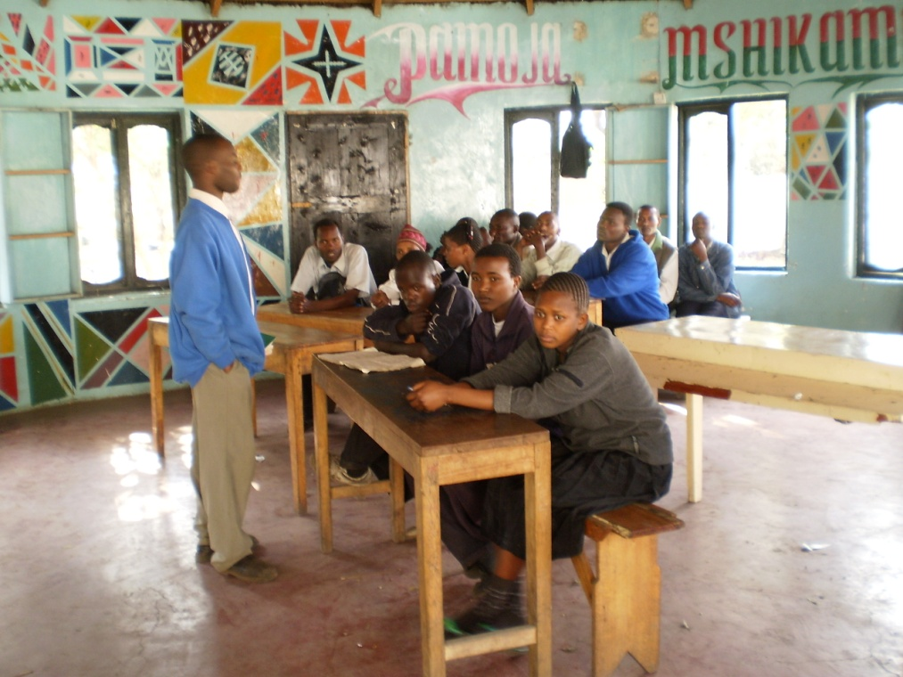
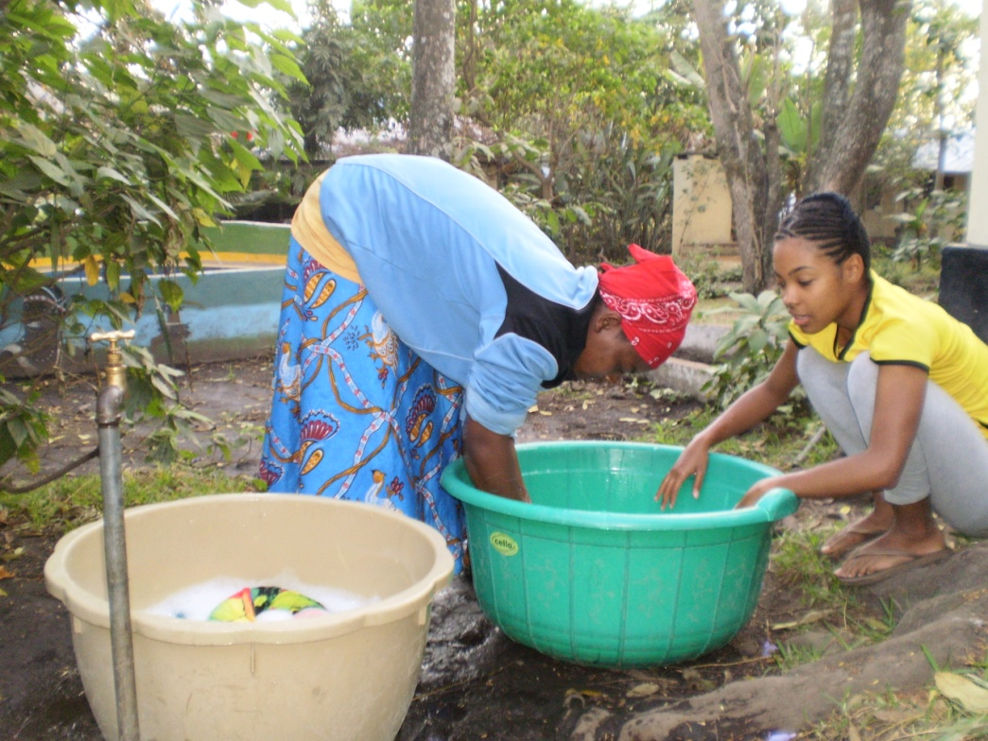
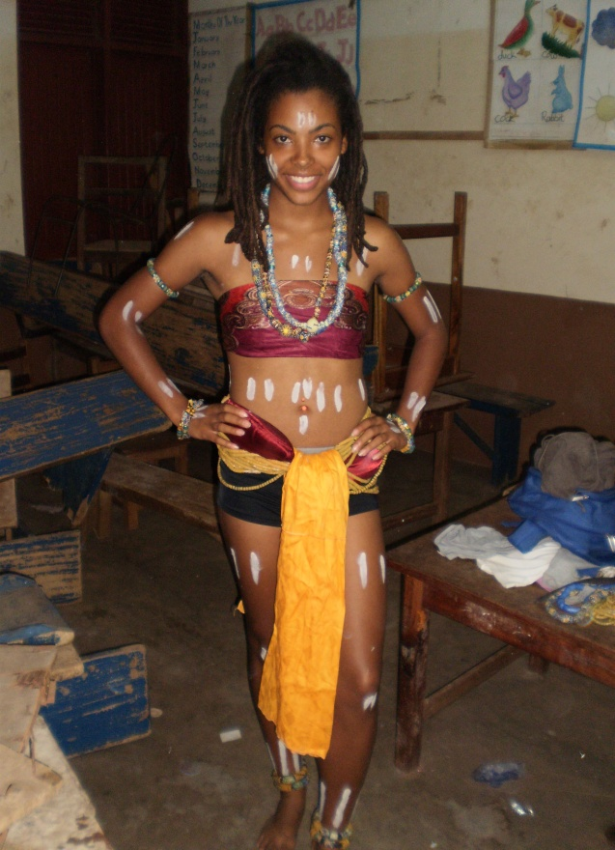
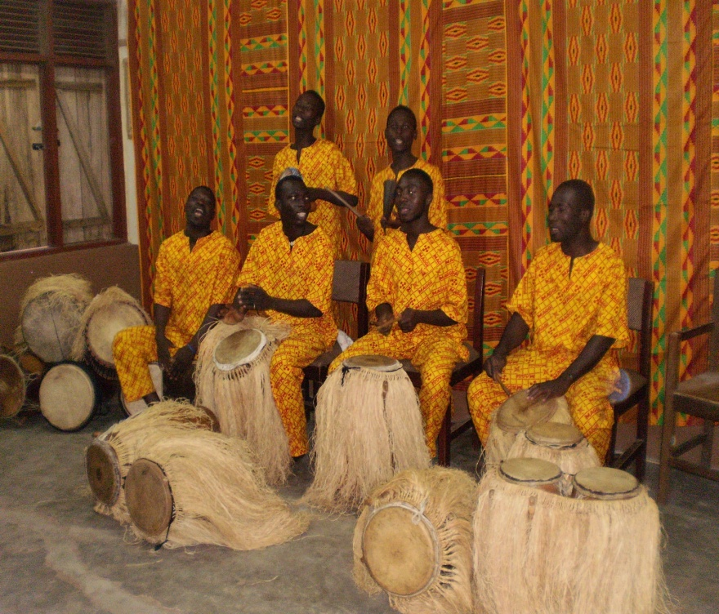
Notes:
Various pictures from my time abroad in Ghana, West Africa and Tanzania, East Africa.
Theyse pictures highlight aspects of the culture that I experienced while there.

Slide 5
What is Cultural Competence?
Cultural competence is a set of congruent behaviors, attitudes, and policies that come together in a system, agency, or among professionals and enable that system, agency, or those professionals to work effectively in cross-cultural situations. (APTA)
Notes:
Definition (1) provided by APTA¹
Cross et al.,Towards a culturally competent system of care, volume I
-Cultural competence is a set of congruent behaviors, attitudes, and policies that come together in a system, agency, or among professionals that enables effective work in cross-cultural situations. (Cross model)

Slide 6
What is Cultural Competence?
Cultural competence is “the process in which the healthcare professional continually strives to achieve the ability and availability to effectively work within the cultural context of the client—family, individual, or community.”
Five constructs of cultural competence (Campinha-Bacote model)
cultural awareness
cultural knowledge
cultural skill
cultural encounters
cultural desire
Notes:
Campinha-Bacote, The Process of Cultural Competence in the Delivery of Healthcare Services.

Slide 7
Behaviors
Attitudes
Skills
Policies
CULTURAL COMPETENCE
Effective care
Cultural Context
Notes:
Simplified and graphic definition of cultural competence.
A set of behaviors, attitudes, skills and policies that provide effective care within the cultural context of the patient (cross-cultural situations)

Slide 8
It’s a process…….
Not an end point
“Cultural competence is the process of becoming, not a state of being.”
Notes:
Developmental process; and education to promote cultural competence in PT should progress along a continuum that enhances the individuals knowledge, attitudes, and skills throughout the educational program, across varied teaching and learning experiences.²

Slide 9
Cultural Competence within APTA
Supported by APTA; several documents highlighting cultural competence within PT.
Operational plan of Cultural Competence
Policies, guidelines, and strategic documents
Guiding Principles to achieve the vision
Consumer-centricity
Access/equity
Advocacy
Notes:
Cultural competence is a component of evidence-based practice and the importance of cultural competence is supported by the APTA.
Definition: Cultural competence refers to the set of skills necessary to understand and respond effectively to the cultural needs
of each patient/client.
The importance of cultural competence in patient care is supported by APTA's Operational Plan on Cultural Competence (.pdf),
-GOAL I: Facilitate the development of culturally competent physical therapists and physical
therapist assistants.
-GOAL II: Increase the number of physical therapists and physical therapist assistants from
racial/ethnic minority groups to reflect the changing demographics of US society
the vision for the profession
numerous other policies, guidelines, and strategic documents.
Policies, guidelines, and strategic documents:¹
-code of ethics for the physical therapist
-APTA Education Strategic Plan
-Competencies of the Transition DPT Graduate
-Minimum required skills of physical therapist graduates at entry-level
-Vision statement of the Physical therapy Profession
-etc.
Policies related to diversity: cultural diversity in public relations, etc.
Multiple areas of the Guiding Principles to achieve the vision relate directly to cultural competence:¹
Consumer-centricity. Patient/client/consumer values and goals will be central to all efforts in which the physical therapy profession will engage. The physical therapy profession embraces cultural competence as a necessary skill to ensure best practice in providing physical therapist services by responding to individual and cultural considerations, needs, and values.
Access/Equity. The physical therapy profession will recognize health inequities and disparities and work to ameliorate them through innovative models of service delivery, advocacy, attention to the influence of the social determinants of health on the consumer, collaboration with community entities to expand the benefit provided by physical therapy, serving as a point of entry to the health care system, and direct outreach to consumers to educate and increase awareness.
Advocacy. The physical therapy profession will advocate for patients/clients/consumers both as individuals and as a population, in practice, education, and research settings to manage and promote change, adopt best practice standards and approaches, and ensure that systems are built to be consumer-centered.
**Thus, achievement of the vision and devotion to cultural competence go hand in hand.**

Slide 10
Benefits of Cultural Competence within Physical Therapy
Adapt patient-therapist interaction & rehab services
Create best plan of care
Enhance patient outcomes
Notes:
Develop culturally sensitive examination and intervention techniques that allow the patient to be comfortable during the visit.
Adapt patient-therapist interaction, rehabilitation services
Create best plan of care
Enhance patient outcomes

Slide 11
Aims of Cultural Competence
Meet the health care needs of all individuals
Eliminate/Lessen health disparities
Notes:
“To promote the delivery of health care services that better address the needs of racial and ethnic minorities, it is increasingly important to improve the cultural competence of health care delivery systems and providers.”
U.S. population becoming more racially diverse and older:
By 2060 the US population will be significantly older and more racially and ethnically diverse.⁵More explicitly, the 65 and older population will double and the 85 and older group will triple by 2060. The United States will become majority-minority for the first time in 2043, and no group will make up a majority.⁵ As society grows older and becomes more diverse healthcare must accommodate these changes to provide optimal care that meet the needs of each patient.
The Pew Commission listed the provision of cultural sensitive care to a diverse society as one of the 21 competencies for health care professionals for the 21st century. To provide appropriate and effective care, HCPs need to understand how culturally learned values and customs affect people’s health beliefs and practices.¹¹
Health disparities are extensive among ethnic groups and are often attributed to a lack of access that results from health care provider insensitivity to cultural needs of the patient.⁶ Health disparities are multi-factorial and cultural competence will not totally eliminate health disparities, but can lessen health disparities.

Slide 12
Models of
Cultural Competence

Slide 13
Campinha-Bacote
Model
Notes:
Her model views cultural competence as an extension of patient centeredness. And at the core of both patient centeredness and cultural competence is the importance of seeing the patient as a unique person.

Slide 14
Constructs of Campinha-Bacote Model (2002)³
Cultural awareness
Cultural knowledge
Cultural skill
Cultural encounters
Cultural desire
Notes:
The major constructs of the model The Process of Cultural Competence in the Delivery of Healthcare Services are cultural awareness, cultural knowledge, cultural skill, cultural encounters, and cultural desire.³
The Process of Cultural Competence in the Delivery of Healthcare Services (Campinha-Bacote, 1998a)⁴
A model that views cultural competence as the ongoing process in which the healthcare provider continuously strives to achieve the ability to effectively work within the cultural context of the client (individual, family, community)
Each construct have an interdependent relationship with each other, and regardless of when the PT enters into the process, all 5 constructs must me addressed and/or experienced. It is the intersection of these constructs that depicts the “true process” of cultural competence. As the intersection becomes larger, health care providers more deeply internalize the constructs on which cultural competence is based.⁴
To demonstrate cultural competency, the practitioner must understand his/her own cultural values and those of other cultures; accept cultural differences in communication, thought processes, and behaviors, and grasp how an individual’s culture impacts on his/her beliefs and actions.⁸
Cultural awareness is defined as the process of conducting a self-examination of one’s own biases towards other cultures and the in-depth exploration of one’s cultural and professional background.
Cultural knowledge is defined as the process in which the healthcare professional seeks and obtains a sound educational base about culturally diverse groups.
Cultural skill is the ability to conduct a cultural assessment to collect relevant cultural data regarding the client’s presenting problem as well as accurately conducting a culturally-based physical assessment.
Cultural encounter is the act of directly interacting with patients from culturally diverse backgrounds.
Cultural desire is the motivation of the healthcare professional to “want to” engage in the process of becoming culturally aware, culturally knowledgeable, culturally skillful and seeking cultural encounters; not the “have to.
Provide example of my experience in Ghana and the difference in perceptions of “time” or and “computer” situation at the hotel.

Slide 15
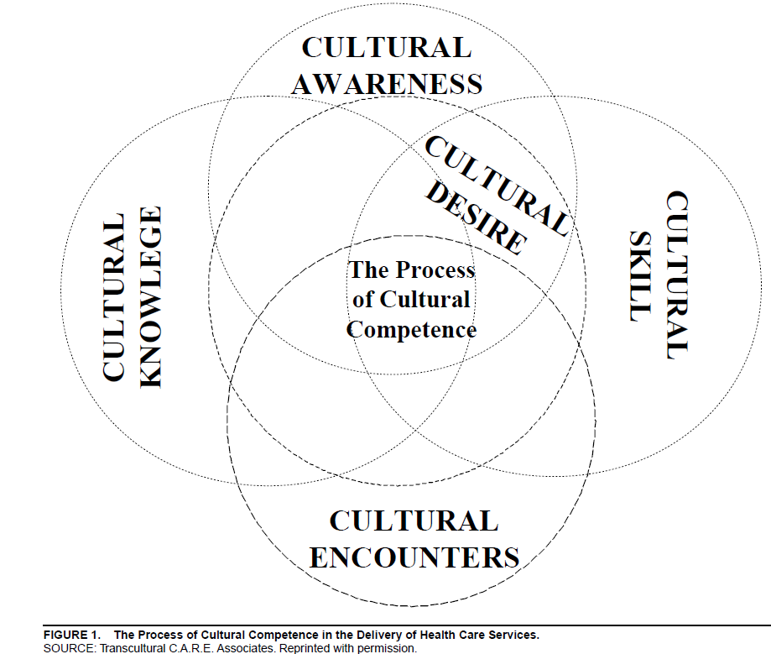
Notes:
Image of Camphina-Bacote process of cultural competence in the delivery of health care services.

Slide 16
Calhane-Pera
Model

Slide 17
Calhane-Pera Model
5 Developmental Stages:
Level 1: no insight
Level 2: minimal emphasis
Level 3: acceptance
Level 4: incorporation
Level 5: integration
Notes:
5 developmental stages:⁷
Level 1: no insight on influence of culture on medical care
Level 2: minimal emphasis on culture in medical setting
Level 3: acceptance of the roles of cultural beliefs, values, and behaviors on health, disease, and treatment
Level 4: incorporation of cultural awareness in daily medical practice
Level 5: integration of attention to culture into all areas of professional life
Can be used to determine where students are developmentally on the continuum and if the desired level has been achieved.

Slide 18
Cross Model

Slide 19
Cross Model (1992)⁸
Cultural destructiveness
Cultural incapacity
Cultural blindness
Cultural precompetence
Cultural competence
Cultural proficiency
Notes:
This model was originally developed to categorize an agency’s state of cultural competence, however, Dupre et al extrapolated the stages to identify the cultural competence stage of individual healthcare professionals.
Cultural competency of an agency or company develops in stages along a continuum from cultural destructiveness (a stage where the agency’s behaviors are detrimental to those of another culture) to cultural competence (where the agency adapts care based on acceptance and respect of cultural differences.)⁸
The highest stage is cultural proficiency (members of the agency practice evidence-based healthcare). And interventions are based on the best research evidence available and the clinicians’ experience and are individually tailored to match the client’s culture-specific background and preferences.
See description on next slide***

Slide 20
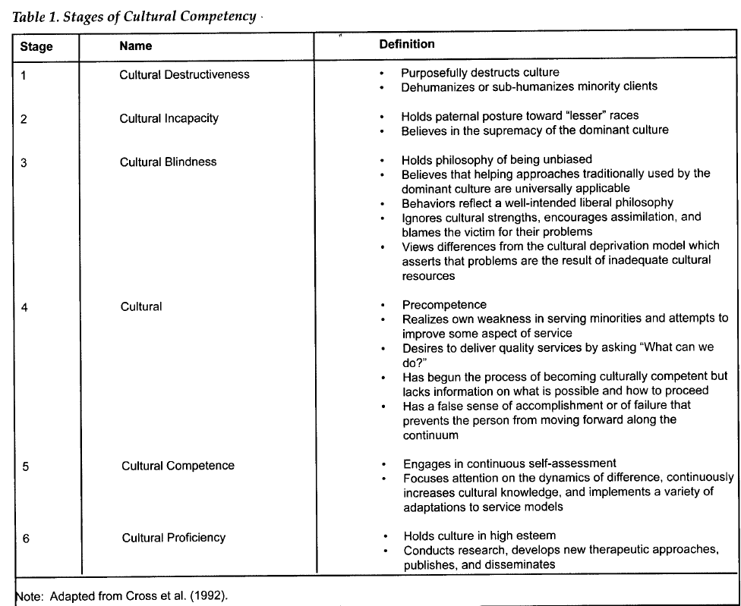
Notes:
Dupre et al provides descriptions of behaviors and attitudes for each of Cross et al.’s stages.⁸

Slide 21
Ways to develop Cultural Competence
Curriculum
Didactic
Clinical
Community-based programs
Pro-bono services
Immersion Learning Experience
International service learning (ISL)
National service learning

Slide 22
International Service Learning (ISL)
“A course-based, credit-bearing educational experience in which students participate in an organized service activity that meets a community need and reflect on their service activity as a means of gaining deeper understanding of course content, a broader appreciation of the discipline, and enhanced sense of civic responsibility and/or a greater interest in an understanding of community life.”¹²
Notes:
Main EE. Nursing student voices: reflections on an international service learning experience. Kentucky nurse. 2013-01;61:10-1.
Properties:
Credit-bearing course
Organized service activity
Community service
Reflection
Connect with prior course content

Slide 23
The impact of ISL on the development of cultural competence among students…….

Slide 24
Research
International learning experiences within nursing led to trans-cultural/international nursing.
Limited research within physical therapy.
Utilization of research from other healthcare fields (nursing, social work, psychology, medicine, etc.)
Notes:
International learning experiences for nursing students were recommended as a means of acquiring greater cultural understanding and sensitivity as early as the 1980’s. This body of work led to the field of trans-cultural nursing that maintains that cultural competence care is essential to satisfying, meaningful, and beneficial care for clients.¹³
Research is limited within physical therapy; thus, the utilization of research from other healthcare fields is required.

Slide 25
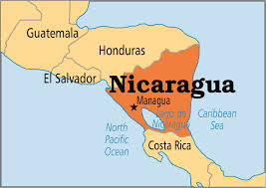
Dupre & Goodgold (2007)⁸
Cultural encounters enhance the development of cultural competency
N=6; 2nd year PT students
2 weeks in San Juan del Sur, Nicaragua
Outcome measure: Cross et al. model of cultural competence
Method: Observation, journal entries, and interviews
Improved cultural sensitivity and competence
Notes:
Image: http://www.operationworld.org/nicr
Findings:
All 5 students met descriptive criteria of Cross et al.'s (1992) Stage 4: Cultural Precompetence. Characteristics of this stage is self-awareness of weakness in the ability to serve individuals of another culture but intention to improve, the desire to deliver quality care, a lack of information on what is possible.....
Applicability:
These results suggest a 2 week international immersion experience can improve cultural sensitivity and cultural competence among DPT students. This serves as a service learning model to develop cultural competence.

Slide 26
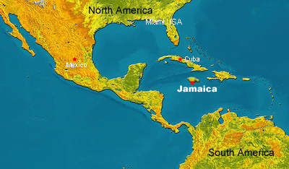
Sawyer & Lopopolo (2004)⁹
Perceived impact of a 1-week PT clinical experience in Jamaica on students
N=8; 3rd year PT students
Outcome measures: Emergent categories and themes
Method: Open-ended questionnaire, focus group discussion
Expanded worldview & view of PT practice and changes within self
Notes:
Image: http://www.jamaicagov.cn/
All 3rd year DPT students at Archadia University.
Open-ended questionnaire; focus group discussion
Findings:
PT students perceived that an 1-week international clinical experience has important, broadening, and lasting benefits to them as professionals, individuals, and members of a global society.
Applicability:
Results suggest an international immersion experience may produce an expanded worldview, an expanded view of physical therapists practice, changes within themselves; and changes within themselves in the role of PT student. These are essential aspects of cultural competence.

Slide 27
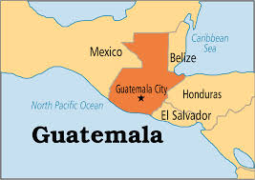
Larson et al (2008)¹⁰
International cultural immersion course in Guatemala.
N= 13; junior and senior nursing students
3-credit elective
Outcome measure: emergent themes and Campinha-Bacote model
Method: in-depth interviews and daily reflective journals
Expanded awareness, knowledge and skills
Notes:
Image: https://encrypted-tbn0.gstatic.com/images?q=tbn:ANd9GcRcpxR2ZJ5DCQSYNAXL2j8cAjkksvzjCe9Mlf3DQfY_hDzDge5T
Qualitative descriptive study that explores the impact of cultural immersion experience on student nurses’ cultural competency. Utilized the five constructs of cultural desire, cultural awareness, cultural skill, cultural knowledge, and cultural encounter by Campinha-Bacote.
3-credit elective designed to introduce nursing students to economic, political, health, and social issues among indigenous Mayan communities. Students attended one-on-one Spanish language classes while in Guatemala.
This course was unique in that it included a combination of intensive language lessons, community service learning projects, and a research design that measured long-term outcomes.
From a nursing education perspective, research on cultural competence suggests that prevalent nursing academic approaches fall short of preparing nurses to work with people of diverse cultures.¹⁰
Sample:
Range from 21-45 years; all females; mostly Caucasian
Method:
data gathered through in-depth interviews and daily reflective journals
Findings:
Three themes that emerged included: navigating daily life, broadening the lens, and making a difference.
Applicability:
Though this study focused on nursing students it provides a framework for PT programs to adopt to develop cultural competency among students and better prepare them for treating diverse patients.
Indication of expanded students’ awareness, knowledge, skills, and encounters with another culture.

Slide 28
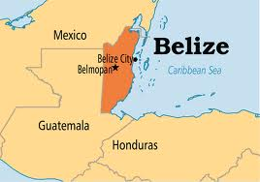
Ekelman et al (2003)¹¹
1 week immersion in a Mayan village in southern Belize
N=5; 4 OT, 1 PT
Outcome measure: emergent themes
Method: journal entries, reflection papers, field notes, and transcription notes from a videotape of a formal discussion
Development of cultural competence beyond knowledge and awareness levels.
Notes:
Image: https://encrypted-tbn1.gstatic.com/images?q=tbn:ANd9GcSvJkUYtGSNVOVyjoh-Hh3Khms3UXDJ_sbkKRb66WL86l3GYz5UqA
Purpose: sought to describe the educational strategies used and to explore student learning and cultural competence skill development that occurred before, during, and after a 1-week immersion experience in a small Mayan village in southern Belize.¹¹
Students enrolled in a research and study abroad course offered through the advanced Master of Science in Health Sciences program at the investigators university.
Utilized the four strategies ussed in HCP education to develop cultural competence;
first the knowledge-oriented strategies that are the most rudimentary and focus on providing sutdents correct and sufficient information about their own and other cultures, using lectures, group discussions, and written and visual materials.
Second, awareness-oriented strategies that emphasize experiential processes and focus on students’ ability to see situations from their own and others’ viewpoint with accuracy. This is an experiential component provides through fieldwork and clinical education, role-playing and values clarification activities, or cultural immersion experiences in which to live and work.
Third, affect-oriented strategies focus on the emotions involved when dealing with value-laden diversity issues. The goal is to facilitate the students ability to empathize with others by participating in activities that require the student to process feelings. Strategies include role play, field experiences using resource people from the host culture, and cultural immersions.
Fourth, skill-oriented strategies strive to nurture the student’s ability to perform effectively in multicultural interactions. After the acquisition of knowledge , awareness and affective competencies, individuals are now able to incorporate cultural knowledge into service delivery.
Findings:
Students developed cultural competence beyond the knowledge and awareness levels. Themes include: anticipation, heightened vigilance, making connections with villagers, meaningful confusion, reflection, relevance to practice.
Applicability:
These results allow students to understand the relationship between culture and professional practice. This study provides educational strategies to develop cultural competence during a 1-week immersion experience.

Slide 29
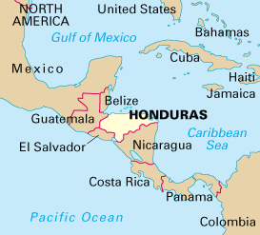
Green et al (2011)¹³
The value of a 10 day ISL experience in Honduras for health care students.
N= not provided; nurse practitioner students, BSN students, medical students
Outcome measures: results of CCA evaluation; and emergent themes from interviews, and follow-up interview questions > 2 years after experience in Honduras.
Method: pretest and posttest using Cultural Competence Assessment (CCA) tool; interviews
Notes:
Image: http://static.ddmcdn.com/gif/willow/geography-of-honduras0.gif
Students brought a mobile clinic to generally inaccessible areas and to engage with people from a cultures very different from their own, therefore, increasing cultural competence.
Outcome measures: Results of CCA evaluation; and emergent themes from interviews, and follow-up interview questions > 2 years after experience in Honduras.
Findings: Four themes emerged from interviews: stepping outside my world, connecting with cultural different people, awe of community and learning innovation. The sample size was too small to determine any statistical significance for the results of the quantitative portion of the study. Also, all of the respondents had some prior cultural training and likely had a higher level of cultural competence than the general population of health care students. Three students participated in a follow-up interview via email that determined the long-term impact of ISL.
Applicability: Though this study focused on nursing students it provides evidence that a international service-learning experience increases the participants ability to provide culturally congruent care. It provides a framework for PT programs to adopt to develop cultural competency among students and better prepare them for treating diverse patients.

Slide 30
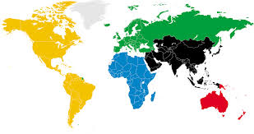
St. Clair et al (1999)
Immersion for 3 weeks in Jamaica, Northern Ireland and England or 2 weeks in Ghana.
N=80; undergraduate and graduate nursing students
Method: participant observation, field note transcriptions, journal entries (qualitative portion). Results from the Cultural Self-Efficacy Scale (CSES) (quantitative portion)
Outcome Measures: CSES and emergent themes
Notes:
Image: https://encrypted-tbn1.gstatic.com/images?q=tbn:ANd9GcRjRChg182-a2XqVSLpFM-HiNcrM5dI0YpJuFmiKmtjhBh8po38
Senior undergraduate and graduate nursing students; 90% of the graduate students had previous short-term international travel experience; 30% of undergraduate students had such experiences. The 120 participants who remained in the U.S. were demographically similar to international group regarding gender and age.
Qualitative portion: participant observation, field note transcriptions, journal entries.
Quantitative portion: results from the Cultural Self-Efficacy Scale (CSES)
Findings: Statistically significant increase in total CSES scores for all students with a mean score of 3.4 (self-efficacy in general cultural skills, mean3.4; self-efficacy in specific cultural skills, mean=3.2; p<.05). And a statistically significant difference on post hoc analysis in general and specific cultural self-efficacy scores between students who participated in international clinical experiences and those who stayed in the U.S. Themes that emerged from student journals include cultural shock; fear of the unknown; being intimidated by the cultural differences; shame resulting from preconceived ideas; and powerlessness in the face of the oppression, poverty, and suffering.
Applicability: Though this study focused on nursing students it provides evidence that a international service-learning experience increases the participants ability to provide culturally congruent care. It provides a framework for PT programs to adopt to develop cultural competency among students and better prepare them for treating diverse patients.

Slide 31
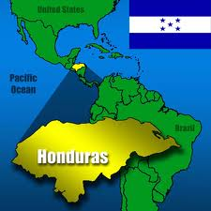
Main et al (2013)
International service learning experience in Belize
N=9; BSN and MSN students
Outcome Measure: emergent themes
Method: journal entries
Increased awareness of their place in a global society and the potential contribution they can make in society.
Notes:
Image: http://www.watermissions.org/Websites/watermissions/Images/Projects/honduras%20with%20flag.jpg
Findings: Eight consistent themes included: expectations and emotions regarding the trip, developing a reciprocal relationship with the community, valuing interdisciplinary collaboration, acquiring knowledge that would impact their future nursing practice, growing personally, making future plans to continue doing service work, recognizing themselves as part of a larger social network and a shared responsibility for social problems, and buying into the interdisciplinary change projects.
Applicability: Findings indicate that ISL opportunities increase students awareness of their place in a global society and the potential contribution they make in society.

Slide 32
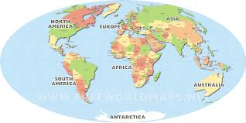
Benefits of ISL¹²⁻¹³
Personal and professional growth
Improved communication skills
Expanded worldview and greater openness to cultural differences
Culturally focused practice
Strengthens interpersonal skills, self-efficacy and social responsibility
Notes:
Image: https://encrypted-tbn3.gstatic.com/images?q=tbn:ANd9GcQWZzPJWEiLiB65qgKgoHV3iQ7kba1B-l88rFipfZj_HMBSmyMH1g
Benefits of ISL (1-4) given by Green et al.
Main et al (5)

Slide 33
Long-Term Impact of ISL
Kollar (2002)¹⁴
N=12; 2-weeks in Guatemala
Gains in substantive knowledge, perceptual understanding, personal growth and interpersonal connections.
Impact on personal and professional life.
Notes:
Kollar et al focused on an international nursing education experience in Nicaragua offered to both undergraduate and graduate nursing students to learn and practice community health nursing in a developing country. It is a 2-week experience. Students had family assignments, community assessments, health clinics (prenatal, newborn, pediatrics, oral rehydration, epidemiology, and family planning). Long-term outcomes of the experience were sought from 12 former students who were asked to describe in their own workds the effect of the Nicaraguan experience in their lives both personally and professionally and to provide examples.
Students showed that gains made in the areas of substantive knowledge (learning a second language, about art, history, foreign policy, etc within the visiting country); perceptual understanding (open-mindedness, a resistance to sterotypes, the ability to empathize with others, and nonchauvinism); personal growth (greater understanding in the realm of cognition, gaining a global perspective, etc.); and interpersonal connections (developing self and relationships) on nursing students had a direct impact on how, where, and why nurses chose to continue their professional practice after earning their BSN and MSN.¹⁴
Overall, an international learning experience can leave a lasting imprint on how nurses learn more about cultural competence in providing nursing care for individuals from diverse cultures.

Slide 34
Long Term Impact Continued….
Evanson (2006)¹³
N=6; 1-week ISL in San Lucas Toliman, Guatemala
Baccalaureate nursing students
Method: individual written narratives and a focus group
Outcomes: emergent themes (next slide)
Notes:
N=6; all were RNs in practice at the time of follow-up. Five had been practicing for 2 years and one practicing for 1 year. Five women and 1 man were subjects with a mean age of 24.8.
Results indicate that short-term international student experience in a developing country can have lasting effects on nurses’professional and personal lives.
Also, international experiences should involve hands-on nursing care to create a lasting connection that leads to meaningful long-term effects.
“The lasting connections made with the Guatemalan people were evidenced in the nurses’ vivid recollections of particular families and groups of children. These enduring memories provided visual reminders of Guatemalan culture and helped establish an ever-present awareness of a global perspective.” (p.414)

Slide 35
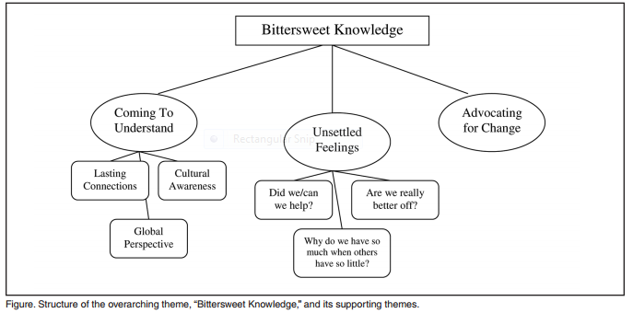
Major & Supporting
Themes¹³
Notes:
Evanson and Zust (2006)¹³
Data analysis revealed the overarching theme of “Bittersweet Knowledge”; its structure and three supporting themes are depicted in the figure above.
The supporting theme “Coming to Understand” represents the positive side of the experience;
“Unsettled Feelings” represents the uncomfortable side of the experience; and
“Advocating for Change”represents the ongoing response to the experience.
“The knowledge and understanding of the Guatemalan people that the nurses gained was counter-balanced by unsettled feelings about their experience and an ongoing struggle to advocate for change in a meaningful way. The knowledge was bittersweet.” (p. 419)

Slide 36
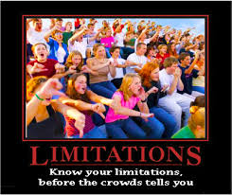
Limitations of Cultural Competence Research
Small sample size
Utilization of various models
Varied curriculum guidelines
Lack of follow-up; long-term impact of ISL on practice
Limited research within physical
therapy
Notes:
Image: https://encrypted-tbn0.gstatic.com/images?q=tbn:ANd9GcSpx9Mv81iqRMaDZ2vE-tSeDIK7eTTdufp0YyB5aeNMpGV7__iW

Slide 37
Examples of past cultural encounters in Guatemala
PT is practiced differently in the hospital
Documentation is limited
Patient:PT ratio in Las Obras is high
Nutritional states and condition of the kids
Different sewage system compared to the U.S.
Perception of student wealth
Notes:
The information below was provided by Darcy Little (committee member):
PT is practiced differently in the hospital there than we are used to. I was very surprised the first year at how passive treatments seemed (modalities, massage on the ortho floor; PROM, dependent transfers I the neuo population). It’s important to remember that it is not our place to jump right in and point out how we would treat differently. To some degree their treatments are passive not only due to differences in education, but also due to limited resources. The patient:PT ratio in Las Obras is quite high. Respecting the education the Guatemalan therapists have, the time and energy they give daily to their patients, etc are all important to keep in mind as we observe their typical way of treating. Documentation is also quite limited and can be surprising to students. I would just challenge participants to take it all in the first few days, withholding judgment until getting more information/seeing more of their circumstances/talking with the therapists there. And if the participant still feels strongly negative about the treatment or documentation, I would challenge the student to continue demonstrating only respect and discuss their observations/judgements with the UNC leaders and seek to learn at least one thing from the Guatemalan therapist, who treats this difficult caseload daily.
It can also be a bit of a shock to see the nutritional states of the kids, the severe joint contractures, etc. You quickly see what happens without the awesome early intervention programs we have in the States.
In the past students have been fairly disgusted by the poor sewage system in Central America, as it means we can’t drink the tap water or throw toilet paper in the toilet (it has to be thrown in the trashcan). It is different and inconvenient compared to what we’re used to. I would challenge the UNC group to keep the negative comments to themselves, particularly when we are in public or in the van with our Guatemalan driver. Most people there understand much more English than they let on and it can be quite offensive/demeaning to hear the criticism.
As university students from the US, our group will seem insanely rich so we will be asked for money and targeted to some degree, which can be disconcerting if you’re not expecting it.
How to prepare….. Be open. Be open to other ways of life. Observe it first, without judgement initially. try to understand the difference, why it may be, etc. Be open to learning from the therapists and patients there. Be willing to be uncomfortable. To think outside the box as our traditional treatment tools may not be there. Remember there are people in the States that live in similar situations, townships in NC that don’t have running water or electricity. Seeing people in this environment can help guide our intervention strategies with people here, Latino or otherwise.

Slide 38
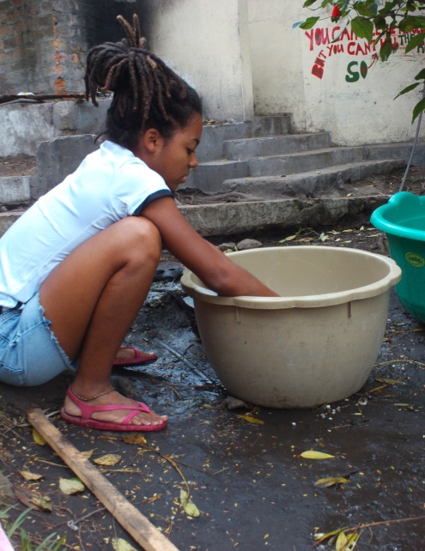
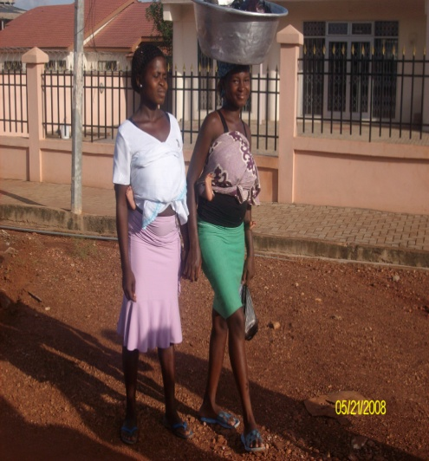
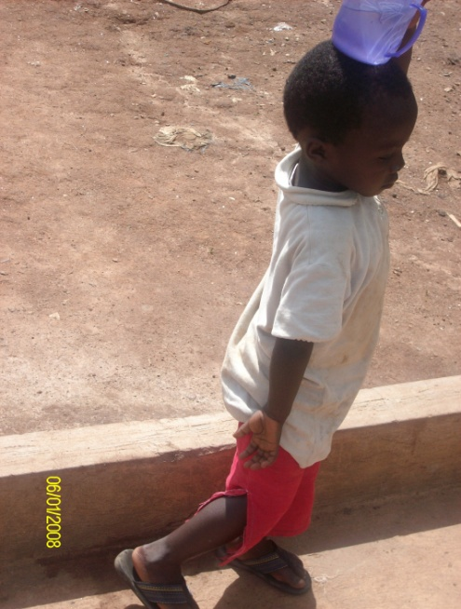
Past encounters continued…..
Antigua versus the rest of the country
Local homes significantly different than our homes
Cost of living; $2/day
Cultural views on disability
Unique causes of low back and
neck pain
Can buy antibiotics over the counter
in farmacias.
Notes:
Information provided by Tara Marshall (committee member):
We stay in Antigua and primarily work out of a privately run facility (operated by the church). Antigua is fairly affluent, and the difference between the "wealthy" city and the rest of the country is stark. When we go to the more rural areas on the trip, it can be shocking to see what the majority of the towns in the country are like.
- Most peoples' homes have dirt floors and are open air - may have a sheet metal roof and no walls.
- The majority of families live on something like $2/day.
- The cultural views on disability are very different than our own. The patients that reside in Las Obras, many were dropped off as babies or children in front of churches because their family could not or would not care for them. From a religious standpoint, I was told that there are 2 views on why a family would be given a disabled child (by God)... 1. God knows that they can handle it (He only puts you through that which you are capable of) or 2. As a punishment, a way to atone for your sins.
- When we did health fairs, many of the people who came to them complained of low back and neck pain. We found out that some of the causes included carrying their babies, toddlers, and young children strapped to their backs all day (sometimes one in front and one in back!), carrying heavy loads on their heads (seriously, saw someone with a case of waters on her head, no hands!), and washing their clothes in sinks that are at roughly knee height, bent over all day.
- You can buy antibiotics over the counter in farmacias,

Slide 39
A successful cross-cultural encounter requires……¹⁶
A sense of adventure
Tolerance for ambiguity & differences
Patience
A sense of humor
Flexibility
Cultural sensitivity
Notes:
…..requires the characteristics above.
Many successful health care professionals have some of the characteristics that are not conducive to working cross-culturally---that is they are task oriented, overachievers, and fearful of “failure”.
How to prepare….. Be open. Be open to other ways of life. Observe it first, without judgement initially. try to understand the difference, why it may be, etc. Be open to learning from the therapists and patients there. Be willing to be uncomfortable. To think outside the box as our traditional treatment tools may not be there. Remember there are people in the States that live in similar situations, townships in NC that don’t have running water or electricity. Seeing people in this environment can help guide our intervention strategies with people here, Latino or otherwise. (Darcy Little)
Provide story of hotel incident when the internet crashed in Ghana.***

Slide 40
References:
APTA. Cultural Competence in Physical Therapy. APTA. Updated September 12, 2013. Accessed February 13, 2014.
Committee on Cultural Competence. Blueprint for Teaching Cultural Competence in Physical Thearpy Education [PDF]. Alexandria, VA: American Physical Therapy Association; 2008.
Campinha-Bacote, J. The process of Cultural Competence in the Delivery of Healthcare Services: A model of care. 2002; 13(3): 181-184.
Campinha-Bacote J. Delivering patient-centered care in the midst of a cultural conflict: the role of cultural competence. Online journal of issues in nursing. 2011-05-31;16:5.
U.S. Census Bureau Projections Show a Slower Growing, Older, More Diverse Nation a Half Century from Now. U.S. Department of Commerce: United States Census Bureau. Available at: http://www.census.gov/newsroom/releases/archives/population/cb12-243.html Posted December 12, 2012. Accessed November 14, 2013.
Saver, C. Cultural Competency benefits patients, therapists. Therapy Insider. June 2007; 6-9.

Slide 41
References:
Blue AV et al. Applying Theory to Assess Cultural Competency. Med Educ Online. 2005;10:1-5.
Dupre A-M, Goodgold S. Development of physical therapy student cultural competency through international community service. J. Cult. Divers. 2007;14:126–134.
Sawyer KL, Lopopolo R. Perceived impact on physical therapist students of an international pro bono clinical education experience in a developing country. J Phys Ther Educ. 2004; 18(2):40-47.
Larson KL, Ott M, Miles JM. International cultural immersion: en vivo reflections in cultural competence. J. Cult. Divers. 2010;17:44–50. Available at: http://www.ncbi.nlm.nih.gov/pubmed/20586365.
Ekelman B et al. Developing Cultural Comptence in Occupational and Physical Therapy Education: A Field Immersion Approach. Journal of Allied Health. 2003; 32(2):131-137.
Main EE. Nursing student voices: reflections on an international service learning experience. Kentucky nurse. 2013-01;61:10-1.

Slide 42
References
Evanson TA. “Bittersweet Knowledge”: The Long-Term Effects of an International Experience. Journal of Nursing Education.October 2006; 45(10):412-419.
Kollar SJ, Ailinger RL. International Clinical Experiences: Long-term Impact on Students. Nurse Educator. January/February 2002; 27(1): 28-31.

Slide 43
QUESTIONS?
Notes:
Sun piercing the clouds in Ghana.

