Slide 1
Multidirectional Instability and Ehlers-Danlos Syndrome: Evaluation and Treatment of the Shoulder
Jessica Rolle, SPT
Spring 2014

Slide 2
Objectives
The learner will be able to:
screen for hypermobility using the Beighton score
identify diagnostic criteria and special tests used for instability and hypermobility
develop basic treatment strategies for multidirectional instability of the shoulder
develop basic treatment strategies for shoulder hypermobility in patients with EDS
recognize important characteristics of EDS to be aware of during evaluation/treatment

Slide 3
Shoulder Anatomy: GH Joint
Static stabilizers^{1,2}
Capsule, labrum
Ligaments
SGHL: resists inferior motion
MGHL: resists anterior and ER motion
IGHL: anterior band resists anterior/inferior motion, posterior band resists posterior/inferior motion
Coracohumeral ligament: resists posterior and inferior motion
Notes:
IGHL: Abduction and ER: prevents anterior/inferior stress
Abduction and IR: prevents posterior/inferior motion

Slide 4
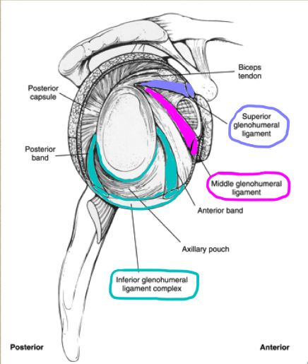
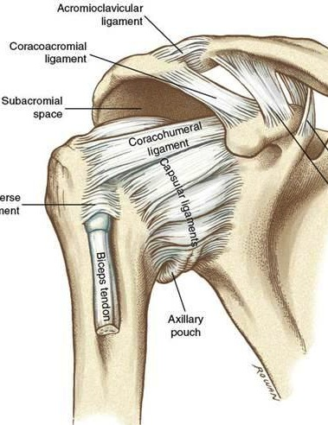
1
3
Lateral View
Anterior View

Slide 5
Shoulder Anatomy: GH Joint
Dynamic stabilizers⁴
Rotator cuff: supraspinatus, infraspinatus, teres minor, subscapularis
Biceps, triceps, pec major/minor, deltoid, trapezius, teres major, serratus anterior, rhomboids, lat dorsi

Slide 6
http://www.nlm.nih.gov/medlineplus/ency/imagepages/19622.htm

Slide 7
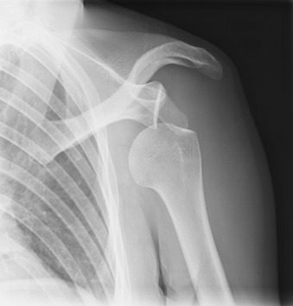
Biomechanics
Glenohumeral Joint
One of the least stable joints in the body
⬆ mobility = ⬇ stability
Must rely on musculature and ligaments
0-30 deg abd = GH;
30-180 deg abd = GH + ST^{5,6}
http://www.sportsinjuryclinic.net/sport-injuries/shoulder-pain/dislocated-shoulder
Notes:
Humeral head has 3-4x greater surface area than glenoid
Humeral head faces medially, posteriorly, superiorly
Glenoid faces laterally, anteriorly, superiorly
30-180 deg ABDUCTION: GH:ST = 2:1 motion (for every 2 degrees the GH joint allows, the ST joint moves 1 degree)
0-30 = 30 GH
30-90 = 30 GH, 30 ST
90-180 = 60 GH, 30 ST
ST motion comes from AC and SC joints (about half and half)

Slide 8
Shoulder Instability^{5,6}
Traumatic (TUBS)
Atraumatic (AMBRII)
Multidirectional instability (MDI): laxity of the glenohumeral joint in multiple directions
Ehlers-Danlos syndrome
Notes:
Most common instability is in anterior direction (due to the orientation of the humeral head on the glenoid)
TUBS stands for Traumatic Unilateral/unidirectional instability caused by Bankart lesion usually needing Surgery and AMBRII stands for Atraumatic, Multidirectional instability, usually Bilateral involvement, Rehab is the first treatment, but may need Inferior capsular shift and tightening of rotator Interval.

Slide 9
MDI Examination
Patient presentation
Pain, muscle guarding, subluxation, dislocation
Special tests⁶
Sulcus test: superior capsule, SGHL
Rockwood test: IGHL (anterior band)
Anterior load and shift: anterior capsule, MGHL, IGHL
Apprehension/relocation test: anterior capsule
Push-pull test: posterior capsule
Jerk test: posterior capsule, posterior labrum
Notes:
Apprehension/relocation = crank test
Since most instability is anterior, several tests for anterior instability

Slide 10
Rehab for MDI⁷⁻⁹
Develop neuromuscular control
Stabilization, proprioception, kinesthetic awareness
Strengthen dynamic stabilizers
Restore scapular motion
Notes:
Kinesthetic awareness: coordination
You can have good RTC strength, but you also need control
Restore scapular motion: if muscles have trigger points/muscle spasm, will restrict motion (strain/counterstrain, dry needling)
-Scapular motion: functional motor control/dynamic stability important within this range

Slide 11
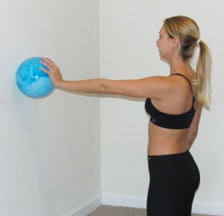
Develop Neuromuscular Control
http://www.perfectlyfitonline.com/2010/11/basic-exercise-for-serratus-anterior/
http://utahshoulderknee.com/words/physical-therapy/shoulder/rotator-cuff-exercise-program-non-operative/
Notes:
Left:
Closed chain: better co-contractions (best way to develop NM control)
Right:
Toss ball against wall…to the left, middle, right

Slide 12
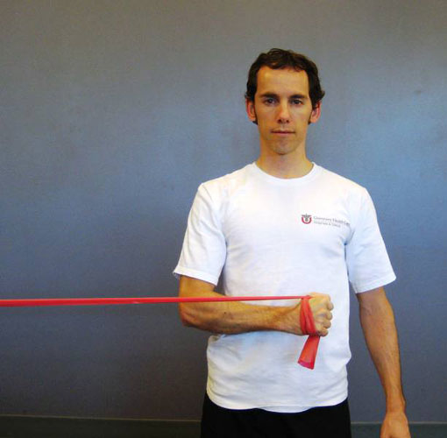
Strengthen Dynamic Stabilizers
http://www.thera-bandacademy.com/tba-exercise-program/Upper-Body-Workout-with-Thera-Band-Elastic-Bands
http://utahshoulderknee.com/words/physical-therapy/shoulder/rotator-cuff-exercise-program-non-operative/
Notes:
Left: Synergistic muscle activation: getting retraction plus ER
Right: IR with TB
Towel roll between arm and body

Slide 13
Restore Scapular Motion
http://www.triggerpointnc.com/trigger-point-therapy.asp
http://www.lindept.com/dry%20needling.htm

Slide 14
Surgical Options
Thermal shrinkage
31-47% failure rate within 2 years^{10,11}
Capsular shift/capsular plication
Arthroscopic or open
Satisfactory results¹¹
Rotator interval closure
May help with anterior stability, but not posterior or inferior directions¹²
Notes:
Capsular shift…open is still gold standard, but arthroscopy saves the supraspinatus
31% failure: Toth, 2011; 47%: Bell, 2010

Slide 15
Ehlers-Danlos Syndrome (EDS)
What is it?
Connective tissue disorder- collagen deficiency
6 subtypes
Typical characteristics¹³
Skin extensibility
Tissue fragility
Joint hypermobility/ligamentous laxity
Prevalence¹³
1 in 2,500 to 1 in 5,000 individuals worldwide
Notes:
Inherited; runs true in families (i.e. if parent has hypermobility type, child will have hypermobility type)
Also known as Benign Joint Hypermobility Syndrome

Slide 16
 | Subtypes of EDS¹³
 | Characteristics | Importance for PTs
Hypermobility Type | Joint hypermobility, skin involvement, chronic pain | Dislocations, subluxations, sprains, pes planus, posture
Classical Type | Skin hyperextensibility, skin fragility, joint hypermobility | Dislocations, subluxations
Vascular Type | Arterial/intestinal/uterine fragility, thin skin | Possible arterial or organ rupture, clubfoot
Kyphoscoliosis Type | Joint laxity, muscle hypotonia, scoliosis, tissue and eye fragility | Gross motor development, ambulation, posture
Arthrochalasia Type | Congenital hip dislocation, joint hypermobility, skin involvement | Dislocations, subluxations
Dermatosparaxis Type | Skin fragility, bruising, sagging skin, large hernias | Bruising
Notes:
Hypermobility: most common; autosomal dominant (no biochemical marker; no genetic testing available); dislocations/subluxations (esp shoulder, patella, and TMJ); velvety skin with/without extensibility, bruising; chronic pain out of proportion to physical and radiological findings (may be muscle spasm, arthritis)
Classical: autosomal dominant (collagen type V); atrophic scars, bruising, hiatal hernia
Vascular: autosomal dominant (collagen type III; can diagnose with skin biopsy); lack of subcutaneous fat; large eyes/thin nose/lobeless ears/short stature; shorter life expectancy; arterial rupture could be fatal; complications with pregnancy
**If a patient with vascular EDS has severe/ripping, chest, abdominal, back pain (diffuse or localized), they should get MRI/CT scan immediately (could have aortic aneurysm/dissection); cerebral arterial rupture may present as altered mental status; carotid-cavernous fistula may present as redness/pain in one or both eyes, pulsating sensation in head (http://www.ednf.org/vascular-veds-emergency-information)
Kyphoscoliosis: very rare; autosomal recessive (deficiency of collagen modifying enzyme; diagnosed with urine test); hypotonia causes gross motor developmental delays; loss of ambulation by 10-30 years old; atrophic scarring, bruising; marfanoid habitus; micro cornea; osteopenia
Arthrochalasia: very rare; autosomal dominant (collagen type I; diagnosed with skin biopsy); recurrent subluxations; bruising, scarring; muscle hyptonia; kyphoscoliosis; mild osteopenia
Dermatosparaxis: very rare; autosomal recessive (procollagen something or other; diagnosed with skin biopsy)
*Joint laxity can get worse with age, in some patients.

Slide 17
Examination
Patient presentation
Characteristics described on previous slide
Diagnosis
Typically made by exclusion of other disorders
Clinical presentation plus family history
Genetic testing¹³
Special tests
Beighton score
Notes:
Exclusion of other disorders: may take years to get a diagnosis of EDS
Genetic testing is not available for hypermobility type

Slide 18
Differential Diagnosis
Marfan syndrome^{14,15}
Affects heart, blood vessels, eyes, bones, lungs
Cutis Laxa¹⁶
Sagging, loose skin
Loeys-Dietz syndrome¹⁴
Vascular involvement
Williams syndrome¹⁴
Joint laxity, low muscle tone
Notes:
Heart and blood vessels: aortic dilation/aneurysm; mitral valve prolapse
Eyes: dislocated lens
Bones: tall, thin build; long arms, legs, fingers, toes; scoliosis
Lungs: pectus excavatum/carinatum; pneumothorax

Slide 19
Beighton Score for Hypermobility
17

Slide 20
Beighton Score for Hypermobility
18

Slide 21
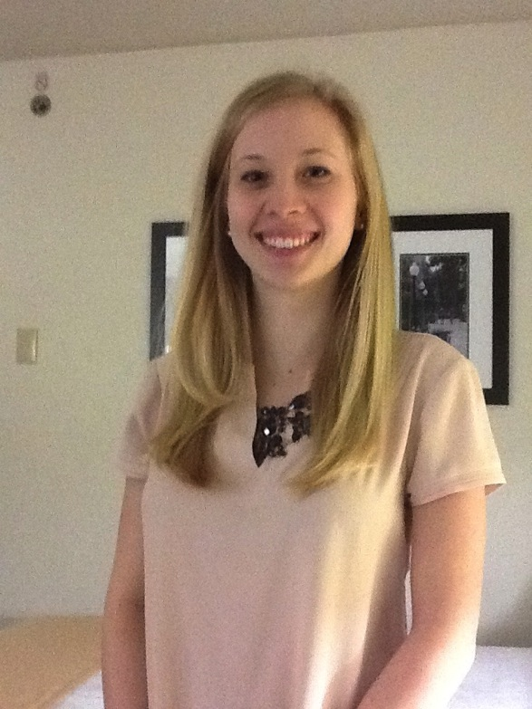
Case Study: Meet Meaghan!

Slide 22
History
21 yo female
EDS- Hypermobility Type
3 right shoulder dislocations; 7 subluxations
Cervical and lumbar spine pain
TMJ issues
Ankle sprains
Knee pain
Orthostatic hypotension

Slide 23
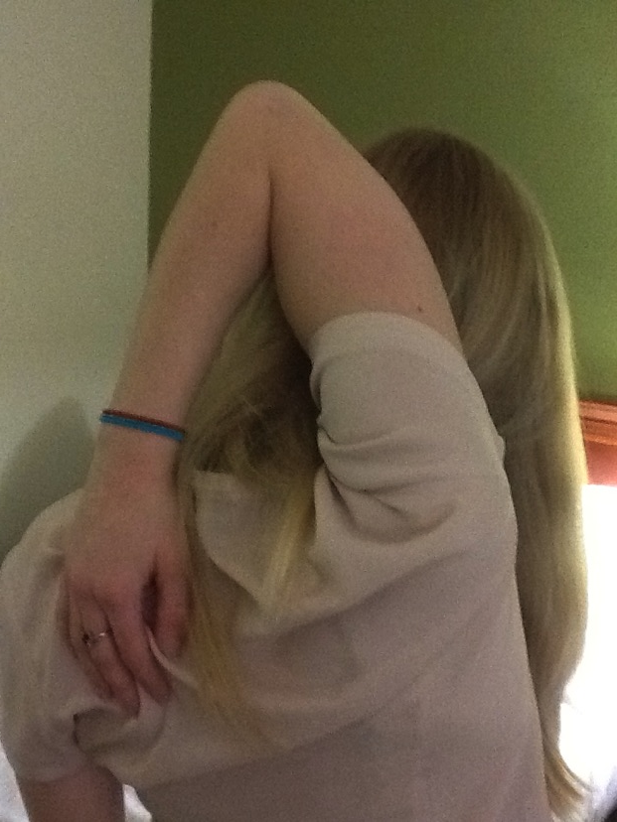
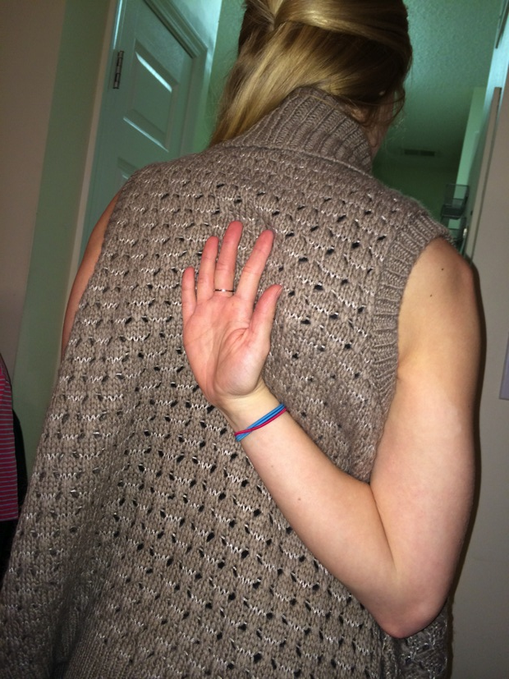
Examination

Slide 24
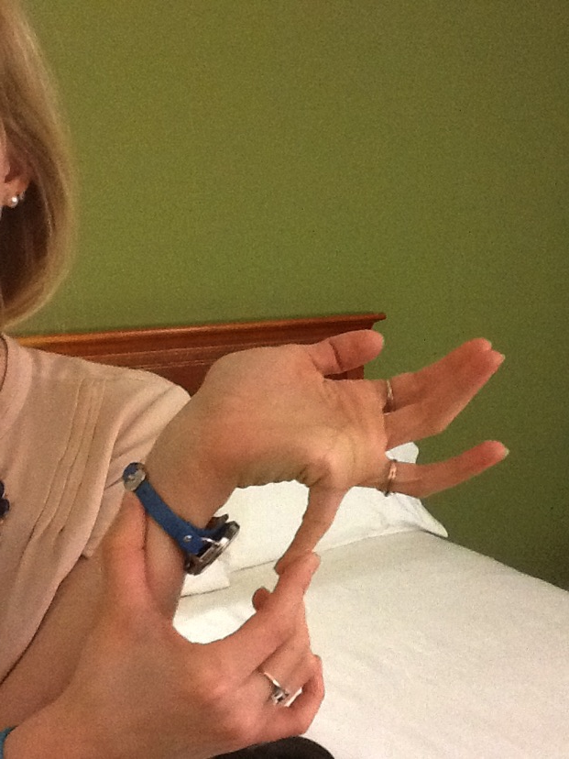
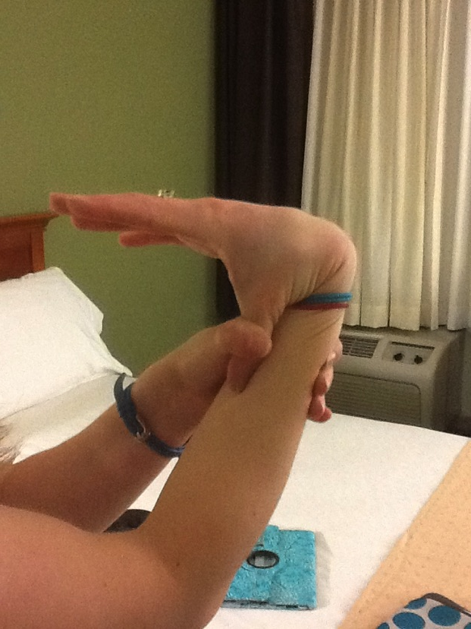
Examination

Slide 25
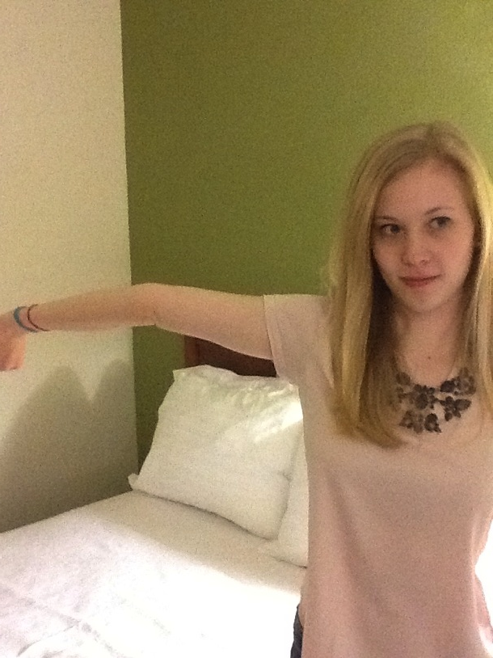
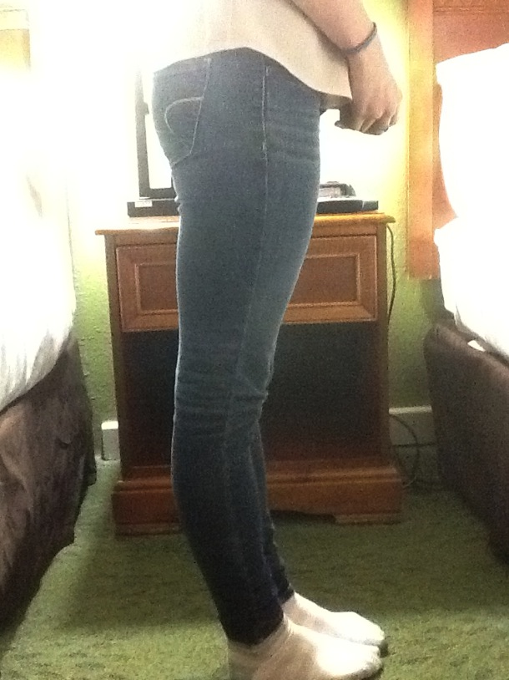
Examination

Slide 26
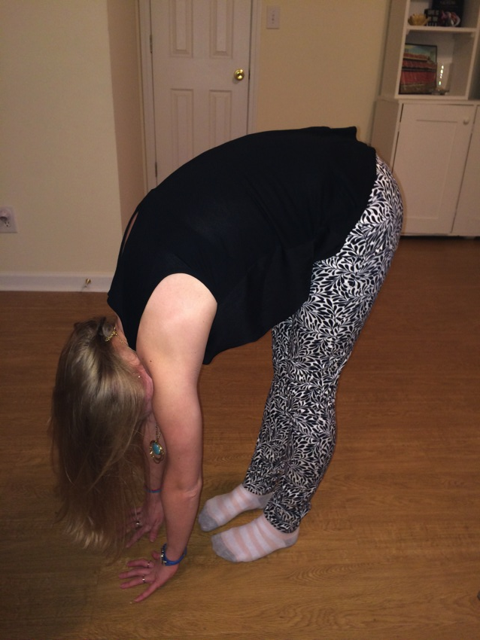
Examination

Slide 27
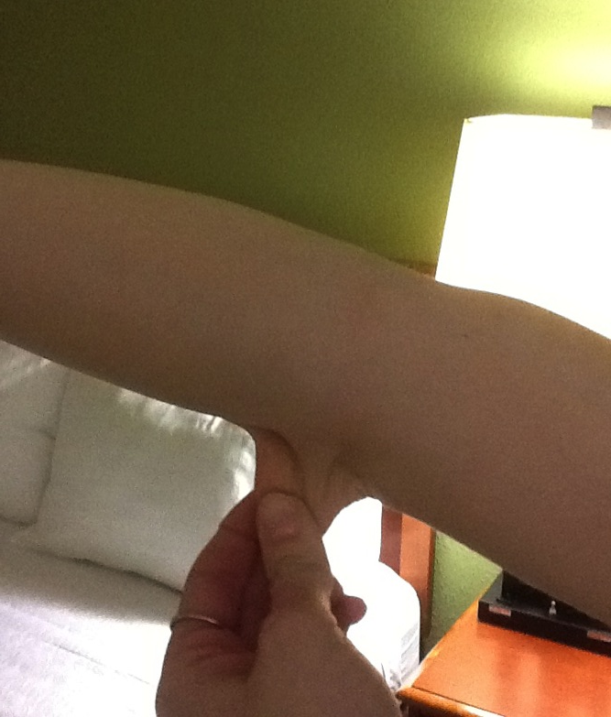
Examination

Slide 28
Meaghan’s Advice…
For PTs: Listen to your patient!
For patients: Do your exercises consistently!

Slide 29
General Rehab for EDS
Exercising in neutral vs. hypermobile range¹⁹
Closed kinetic chain exercises improve proprioception and balance²⁰
Modalities for pain management^{14,21}
Bracing, assistive devices, orthotics^{14,22}
Taping
Aquatic therapy^{23,24}
Use pain as a guide
Notes:
Pacey: don’t stretch into hyperextension, but work on stabilization exercises (very gentle) in hyper-ranges…Pacey found that exercising in both neutral and hyperextension range improved strength and reduced pain
Bracing: ankle, knees, fingers → bracing for sports…not usually at rest (muscles start to rely on brace)
Orthotics: pes planus
Taping: retrains the muscles to know what normal is, proprioceptive awareness
**Be careful with thin skin
Brace: sully stabilizer helps with MDI…can individualize for pt because of various straps

Slide 30
Rehab for Shoulder with EDS
Develop neuromuscular control
Stabilization, proprioception, kinesthetic awareness^{13,21, 25}
Strengthen dynamic stabilizers
Low resistance, high reps²¹
Restore scapular motion
Maintain good posture

Slide 31
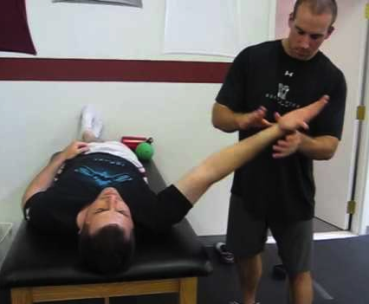
Develop Neuromuscular Control
http://www.youtube.com/watch?v=ywsxrw-VZ7g
www.hep2go.com
Notes:
Kinesthetic awareness: need to know when joint is moving too far (safety range)
PT can change how much force you’re putting on joint…can control it

Slide 32
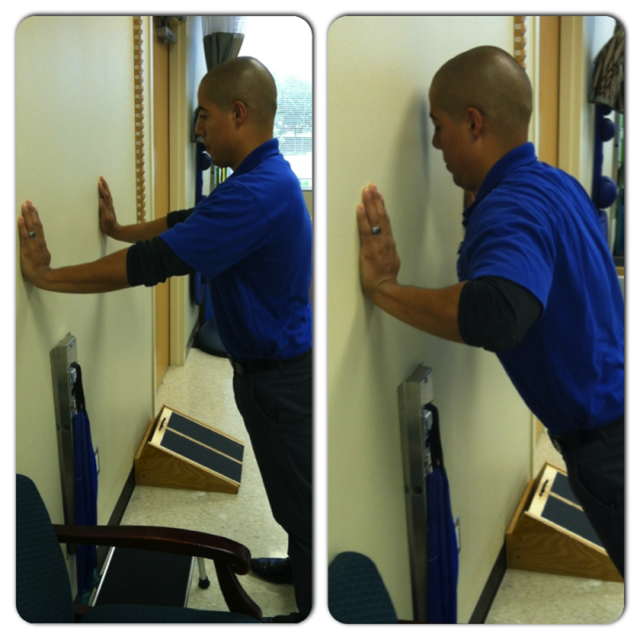
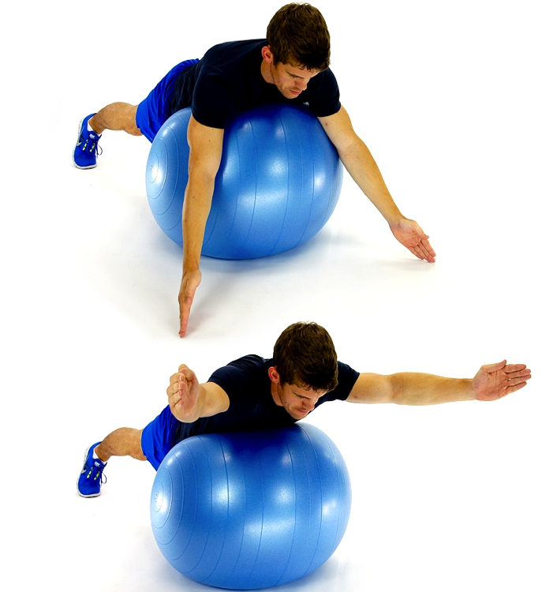
Strengthen Dynamic Stabilizers
www.hep2go.com
www.hep2go.com
Notes:
Stress on anterior structures- MGHL, anterior band of IGHL…stop before elbows go behind trunk
Push up with plus: round back…good for serratus
Core stability important

Slide 33
Restore Scapular Motion
http://www.mkburnabyphysio.com/burnaby-massage-physiotherapy-myofascial-treatment.php
http://www.htibw.com

Slide 34
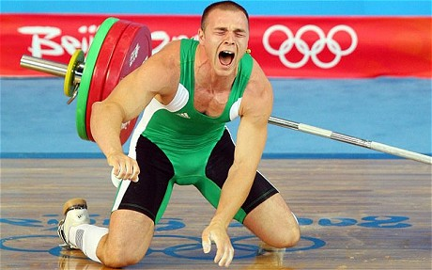
Patient Education
Avoid stretching into hypermobile range
Avoid high-impact activities and heavy lifting that place extra stress on joints^{14,21}
Maintenance of HEP is critical
http://www.telegraph.co.uk/sport/olympics/9128157/London-2012-Olympics-Hungarian-weight-lifter-Janos-Baranyai-ready-to-prove-himself-after-horror-injury.html
Notes:
Lifelong process…must be consistent with performing stabilization exercises

Slide 35
Special Considerations
May bruise and injure easily
Will likely not need stretching as part of treatment plan
Avoid manipulations, grade III/IV mobilizations
Avoid mechanical traction
Use caution when performing Sharp-Purser, Transverse Ligament Test
Be aware of POTS¹³
Notes:
Injured easily: pain is not proportional to physical or radiological findings
Postural orthostatic tachycardia syndrome (may be due to fragility of blood vessels…blood flow sluggish)

Slide 36
Outcome Measures²⁶
Melbourne Instability Shoulder Scale (MISS)
Western Ontario Shoulder Instability Index (WOSI)
Simple Shoulder Test (SST)
Shoulder Rating Questionnaire (SRQ)
Disabilities of the Arm, Shoulder, and Hand Questionnaire (DASH)

Slide 37
Bottom Line
MDI and EDS have similar presentations in the shoulder
Most important treatment = neuromuscular control and stability exercises
Listen to your patient

Slide 38
Thank you!
Mike McMorris, PT, DPT, OCS
Rob Woodside, PT, DPT, COMT, CSCS
Mike Gross, PT, PhD
Meaghan Rolle
First year students

Slide 39
Questions?
https://twitter.com/UNC_PT

Slide 40
References
1. O’Brien SJ, Neves MC, Arnoczky SP, et al. The anatomy and histology of the inferior glenohumeral ligament complex of the shoulder. Am J Sports Med. 1990;18(5):449-456.
2. Burkart AC, Debski RE. Anatomy and function of the glenohumeral ligaments in anterior shoulder instability. Clin Orthop Relat Res. 2002;400:32-39.
3. Neumann D. Kinesiology of the Musculoskeletal System: Foundations for Rehabilitation, 2nd ed. 2009.
4. Hughes M. Glenohumeral joint anatomy, stabilizer, and biomechanics. Orthobullets. http://www.orthobullets.com/sports/3032/glenohumeral-joint-anatomy-stabilizer-and-biomechanics. Updated 01/04/14. Accessed 01/20/14.
5. McMorris M. Scapulohumeral Rhythm. [PowerPoint]. Chapel Hill, NC: University of North Carolina at Chapel Hill, Division of Physical Therapy; 2011.
6. Magee DJ. Orthopedic Physical Assessment. 5th ed. St. Louis, MO: Saunders Elsevier; 2008.
7. Wilk KE, Macrina LC, Reinold MM. Non-operative rehabilitation for traumatic and atraumatic glenohumeral instability. N Am J Sports Phys Ther. 2006;1(1):16-31.
8. Cordasco FA. Understanding multidirectional instability of the shoulder. J Athl Train. 2000;35(3):278-285.
9. Gaskill T, Taylor DC, Millett PJ. Management of multidirectional instability of the shoulder. J Am Acad Orthop Surg. 2011;19(12):758-767.
10. Toth AP, Warren RF, Petrigliano FA, et al. Thermal shrinkage for shoulder instability. HSS J. 2011;7(2):108-114.

Slide 41
References, cont’d.
11. Bell JE. Arthroscopic management of multidirectional instability. Orthop Clin North Am. 2010;41(3):357-365.
12. Provencher MT, Mologne TS, Hongo M, Zhao K, Tasto JP, An KN. Arthroscopic versus open rotator interval closure: biomechanical evaluation of stability and motion. Arthroscopy. 2007;23(6):583-592.
13. The Ehlers-Danlos National Foundation. http://www.ednf.org. Updated 2014. Accessed Sep 2013-Feb 2014.
14. Levy HP. Ehlers-danlos syndrome, hypermobility type. Gene Reviews. http://www.ncbi.nlm.nih.gov/books/NBK1279/. Updated 2012. Accessed 01/15/14.
15. What Are the Signs and Symptoms of Marfan Syndrome? National Institutes of Health. http://www.nhlbi.nih.gov/health/health-topics/topics/mar/signs.html. Updated 10/01/10. Accessed 01/21/14.
16. Cutis Laxa. Genetics Home Reference. http://ghr.nlm.nih.gov/condition/cutis-laxa. Updated 06/2014. Accessed 01/21/14.
17. Sanches SHB, Osorio FL, Udina M, Martin-Santos R, Crippa JAS. Anxiety and joint hypermobility association: a systematic review. Rev Bras Psiquiatr. 2012;34(Suppl1):553-568.
18. Pasinato F, Souza JA, Correa ECR, da Silva AMT. Temporomandibular disorder and generalized joint hypermobility: application of diagnostic criteria. Braz J Otorhinolaryngol. 2011;77(4):418-425.
19. Pacey V, Tofts L, Adams RD, Munns CF, Nicholson LL. Exercise in children with joint hypermobility syndrome and knee pain: a randomised controlled trial comparing exercise into hypermobile versus neutral knee extension. Pediatr Rheumatol Online J. 2013;11(1):30-41.
20. Ferrell WR, Tennant N, Sturrock RD. Amelioration of symptoms by enhancement of proprioception in patients with joint hypermobility syndrome. Arthritis Rheum. 2004;50(10):3323-3328.

Slide 42
References, cont’d.
21. Ehlers-Danlos Syndrome. Physiopedia. http://www.physio-pedia.com/Ehlers-Danlos_Syndrome. Accessed 01/26/14.
22. Management of Ehlers-Danlos Syndrome. EDSers United. https://www.edsers.com/management.html. Accessed 01/26/14.
23. Hinman RS, Heywood SE, Day AR. Aquatic physical therapy for hip and knee osteoarthritis: results of a single-blind randomized controlled trial. Phys Ther. 2007;87(1):32-43.
24. Benefits of Exercising in Water. Koslex. http://hydroco.com/hydroco-benefits-of-water.html. Accessed 02/1/14.
25. Sahin N, Baskent A, Cakmak A, Salli A, Ugurlu H, Berker E. Evaluation of knee proprioception and effects of proprioception exercise in patients with benign joint hypermobility syndrome. Rheumatol Int. 2008;28(10):995-1000.
26. Plancher KD, Lipnick SL. Analysis of evidence-based medicine for shoulder instability. Arthroscopy. 2009;25(8):897-908.

