Slide 1
Childhood Obesity
Implications for Physical Therapy
By: Deidra Debnam, SPT
April 7, 2015
PHYT 701 – Motor Development and Human Movement Across the Lifespan

Slide 2
healthy lifestyles program
“A lifestyle modification program that serves as the foundation
for Duke’s childhood obesity treatments.”¹⁷
Multidisciplinary Team:
Physician
Physician Assistant
*Physical Therapist*
Social Worker
Registered Dietician
Nurse Practitioner
Notes:
http://www.dukechildrens.org/services/nutritional_disorders_and_obesity

Slide 3
Objectives
After the presentation, students will be able to:
Acknowledge physical therapists’ role in promoting health, wellness, and fitness;
Describe physical comorbidities common to children who are obese;
Identify potential physical impairments associated with childhood obesity and their clinical implications;
Explain the effects of obesity across the lifespan (e.g., adulthood).

Slide 4
Presentation outline
Obesity: Definition and Statistics
Role of Physical Therapy
Childhood Obesity and the ICF Model
Obesity and General Health
Obesity and Physical Function
Obesity and Mobility
Obesity-Related Conditions
Obesity Across the Lifespan

Slide 5
Childhood Obesity Implications for Physical Therapy
Definition & statistics

Slide 6
Childhood obesity Defined
Childhood
Body mass index (BMI) above the
95th percentile for age and sex.^{6(S167,168)}
Young Adulthood
Middle Adulthood
Older Adulthood
Infancy
Adolescence
Birth-2y
2-10y (f)
2-12y (m)
10-18y (f)
12-20y (m)
18-40y
40-65y
65y-death
Image Source: Google Images
Notes:
BMI is based on height and weight.
BMI ≥ 30 is also considered obese.

Slide 7
Childhood Obesity By the Numbers
Percentage of Obese Children* (2011)¹¹:
NORTH CAROLINA: 16.1
Kansas: 14.2
Maryland: 15.1
Michigan: 14.8
New Jersey: 10.0
New Mexico: 14.4
New York: 14.5
Ohio: 17.4
South Carolina: 21.5
Utah: 11.6
Vermont: 11.3
Virginia: 14.3
Wisconsin: 13.4
*Children aged 10-17 included in this data
Notes:
The 2014 NC Child Health Report Card indicated a Grade “D” for Weight and Physical Activity.
2014 North Carolina Child Health Report Card. North Carolina Institute of Medicine. Accessed March 31, 2015. Available at http://riversdeveloper.com/wp-content/uploads/2010/08/2014_CHRC-revised.pdf.
The states on this slide represent the home states of the first-year UNC DPT students.

Slide 8
Childhood Obesity Implications for Physical Therapy
Role of PT

Slide 9
Physical therapist role in promotion of health, wellness, and fitness
“The physical therapist of the future will provide primary care that includes
rehabilitation,
primary and secondary prevention,
disease mitigation,
and health promotion
to protect the physical health
and mobility of the population.”^{43(p. 1664)}

Slide 10
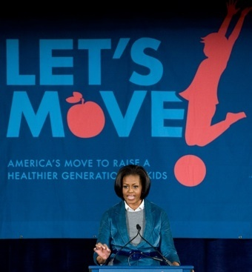
All Images Retrieved from: Google Images
Notes:
Physical therapists can play of very important role in wellness, fitness, and prevention. There are a lot of programs and initiatives whose mission is to reduce the prevalence of obesity.

Slide 11
Physical activity recommendations
60 minutes or more of daily physical activity^{2,4,32,42}
Types^{2,32}
Aerobic (e.g., brisk walking, running, hopping, skipping, jumping rope, swimming, dancing) – most days
Muscle Strengthening (e.g., tug of war, climbing, weights, resistance bands, push-ups, gymnastics) – at least 3 days
Bone Strengthening (e.g. hop scotch, jumping rope, running, sports) – at least 3 days
Notes:
Aerobic: moderate or vigorous activities should be included on most days, with vigorous activity on at least 3 days of the week

Slide 12
Vision Statement for the profession of physical therapy
“Transforming society by
optimizing movement
to improve the human experience.”⁴⁷
Notes:
http://www.apta.org/Vision/

Slide 13
Childhood Obesity Implications for Physical Therapy
ICF Model¹⁹

Slide 14
CHILDHOOD OBESITY
BODY FUNCTIONS
AND STRUCTURE
ACTIVITY
PARTICIPATION
Environmental Factors
Personal Factors
Is obesity the new childhood disability?⁴⁶
Image Source: Jette¹⁹
Notes:
The term disability refers to impairments in body functions and structures, activity restrictions, and participation limitations.

Slide 15
Childhood Obesity Implications for Physical Therapy
General health

Slide 16
Obesity & General health^{20,34}
Dyslipidemia
Hypertension
Nonalcoholic Fatty Liver Disease
Polycystic Ovarian Disease
Obstructive Sleep Apnea
Type II Diabetes
Asthma
Metabolic Syndrome
Psychological Disorders
Dental Health
Notes:
NAFLD: presence of hepatic stenosis in the absence of alcohol use
PCOD: endocrine system disorder
Metabolic Syndrome: insulin resistance related set of characteristics that increases risk of CVD, T2D, and mortality in adults
Psychological: internalizing (anxiety and depressions) and externalizing (ADHD) disorders
Dental Health: cavities

Slide 17
Childhood Obesity Implications for Physical Therapy
Physical function

Slide 18
balance
Poorer Balance (Static and Dynamic)^{13,17}
Impaired balance performance and greater postural sway⁴⁸
Diminished dynamic balance²⁵
Impaired balance due to excess weight
Notes:
Negligible impact on static balance during normal conditions, but under difficult or novel situations, impaired performance and greater postural sway⁴⁸

Slide 19
Lower extremity Findings
Tight Quadriceps¹⁴
Genu Valgum & Genu Recurvatum^{14,44}

Slide 20
pain
Higher prevalence of musculoskeletal pain^{30,44}
Most common site: knee
Higher odds of lower extremity pain^{3,14,23}
Hip, leg, knee, ankle, foot⁴⁴
Positive association between obesity and LBP^{14,30}
“Obesity is an important factor associated with musculoskeletal pain in children.
Relative to the non-obese similar aged counterparts, obese children exhibited significantly higher complaints of pain.”^{14 (p. 343)}

Slide 21
Injuries
Higher odds of LE injuries (fractures, sprains/strains, dislocations)³
Increased risk of LE fracture (foot, ankle, leg, and knee)^{21,44}
Increased risk of ankle injuries⁴⁹
More likely to have LE injuries than nonobese children; same percentage of UE injuries³³
Decreased odds of fracture³⁶
Overweight compared to normal weight (⬆LE fracture)
Notes:
Decreased odds of fracture³⁶ – this study looked at total fractures of both the UE and LE which may explain the decreased odds; Obese individuals are also less active therefore have reduced opportunities to sustain a fracture and excess weight is often associated with increased BMD (bone mineral density)

Slide 22
Childhood Obesity Implications for Physical Therapy
A full understanding of their movement characteristics is needed to guide clinicians in prescribing appropriate physical activity programs for this population.^{26 (p. 190)}
mobility

Slide 23
Movement Analysis – Walking²⁶
Hip Adduction
Knee Abduction (Valgus)
Rearfoot Inversion
Overweight boys collapsed into hip adduction and knee valgus during stance and attempted to compensate with rearfoot inversion
Redistribution of forces in the medial-lateral direction during walking may increase risk of LE soft tissue and skeletal injury
Frontal plane lower extremity
biomechanics during walking
in boys who are overweight
versus healthy weight
Notes:
The hip collapsed into adduction during the stance phase of walking, likely due to the inability of one limb to support the large body mass of these boys during single limb stance.
The adduction position of the hip during stance stresses the lateral hip structures such as the IT band and the greater trochanteric bursa, and alters the internal stresses of the hip joint.
Hip adduction during stance also places the distal femur in a more medial position, which likely places the knee in more valgus. This may be associated with increased stress on the knee in the frontal plane.
Rearfoot inversion throughout the stance phase - this is likely a compensatory strategy during dynamic activity to accommodate for the collapsed position of the knee and hip.

Slide 24
Clinical implications²⁶
Comprehensive musculoskeletal examination and gait analysis
Nonweight bearing and/or low impact physical activities
Examine muscle strength (e.g., hip abductors) and intervene with strengthening exercises
Custom foot orthosis
External medial/lateral support (e.g., knee bracing, ankle taping, functional foot orthotics)
Frontal plane lower extremity
biomechanics during walking
in boys who are overweight
versus healthy weight
Notes:
Comprehensive musculoskeletal examination and gait analysis
Nonweight bearing and/or low impact physical activities
Examine muscle strength and intervene with appropriate strengthening exercises, especially those that influence motions in the frontal plane
Custom foot orthosis to provide added stability during weight-bearing activities and relieve distal muscles from the work of controlling rearfoot and midfoot motions (distal compensations)
External medial/lateral support (e.g., knee bracing, ankle taping, functional foot orthotics) to prevent lower extremity injuries

Slide 25
Movement analysis – jumping²⁷
More knee valgus (abducted) and hip adduction at initial contact
After initial contact, move toward hip abduction and knee adduction
Required more time to control and stabilize their mass
Reached peak moments later in the landing phase
Frontal and sagittal plane biomechanics during
drop jump landing in boys who are obese
Notes:
Differences in timing of peak motions and moments may be evidence for a lack of stability in individuals who are obese when landing from a jump. Individuals who are obese must control greater forces and more momentum when moving due to their increased mass.
This greater time required to stabilize may place individuals who are OB at a greater risk for injury because any unsteadiness during a landing could lead to a fall or compensation with excessive and abnormal movements at distal joints in an attempt to regain proximal stability.

Slide 26
Movement Analysis – Jumping²⁷
Frontal and sagittal plane biomechanics during
drop jump landing in boys who are obese
Image Source: McMillan, et al²⁷

Slide 27
Clinical implications of jumping mechanics²⁷
Increased risk of injury
Decreased stability and control
Functional weakness in hip abductor muscles
Foot Orthotics
Knee/Ankle bracing or taping
Non-weight bearing exercises (cycling or swimming) for individuals with severe LE alignment and/or significant joint instability
Frontal and sagittal plane biomechanics during
drop jump landing in boys who are obese
Notes:
Unsteadiness during a landing increases risk for injury because it could lead to a fall or compensation with excessive and abnormal movements at distal joints in an attempt to gain proximal stability
Children who are obese require more time to perform the same movements during landing, indicative of decreased stability and control
Functional weakness in hip abductor muscles
Foot Orthotics
Knee/Ankle bracing or taping to improve LE alignment and control and decrease risk for injury
Non-weight bearing exercises (cycling or swimming) for individuals with severe LE alignment and/or significant joint instability

Slide 28
“Obesity with lower extremity malalignment has been shown to increase the risk of developing knee osteoarthritis in adulthood, though the mechanism of this development is not clear.”^{26 (p. 187)}
“One concern to PTs working with this population is children who are overweight are typically encouraged to increase physical activity, often with minimal guidance as to how to do this safely (i.e., without damaging their joints and soft tissues).”^{26 (187,188)}
“Increased repetitive loading on poorly aligned lower extremities may lead to significant, permanent changes in the musculoskeletal system, and may contribute to the development of chronic pain and musculoskeletal disorders such as osteoarthritis.”^{26 (p. 188)}

Slide 29
Lower extremity joint power⁴⁰
Greater sagittal plane power phases throughout stance
Hip flexors, knee extensors, ankle plantarflexors
Obese children required greater frontal plane powers at the hip and knee to control external adductor moments during weight acceptance
Hip abductors
Body size and walking cadence affect lower extremity joint power in children’s gait.
Notes:
Require larger sagittal plane powers to control the trunk and prevent collapse of the lower limb, while promoting locomotion through propulsion
Greater mass and walking cadence create a gait cycle that requires greater mechanical power. This may result in more difficulty performing locomotor tasks and decreased motivation to exercise.

Slide 30
Clinical implications⁴⁰
Reduced mechanical efficiency
Greater demand on hip musculature
Soft tissue around the knee is predisposed to trauma and injury due to the increases in knee joint power
Increased force to the foot can promote pain in the triceps surae mechanism, including the Achilles tendon
Body size and walking cadence affect lower extremity joint power in children’s gait.

Slide 31
Joint Biomechanics⁴¹
Overweight participants had greater peak joint moments in the sagittal, frontal, and transverse planes for the hip, knee, and ankle compared with normal weight participants.
Increased peak joint moments increase the risk of joint loading, skeletal malalignment, and injury in overweight children
Effects of pediatric obesity
on joint kinematics and kinetics
during two walking cadences
Notes:
The results revealed that compared with the normal weight group, the overweight participants had significantly greater sagittal, frontal, and transverse plane absolute peak joint moments at the hip, knee, and ankle regardless of walking cadence.

Slide 32
Clinical implications⁴¹
Greater hip flexor and extensor moments – Slipped Capital Femoral Epiphysis
Increased knee abductor moment – ⬆ Risk Genu Valgum
Increased knee adductor moment –Tibia Vara
Increased joint moments in sagittal and transverse planes – Earlier progression of OA
Increased internal rotator moments – Compromises joint stability (e.g. ACL)
Compensations at the foot and ankle – ⬆ Risk stress fractures and foot and ankle pain
Non-weight bearing activities within exercise prescription
Effects of pediatric obesity
on joint kinematics and kinetics
during two walking cadences
Notes:
Greater hip flexor and extensor moments result in increased compressive forces on the capital femoral growth plate – can result in slipped capital femoral epiphysis
Increased knee abductor moments unevenly distribute force across the medial compartment of the knee – increased risk of genu valgum
If the child is predisposed to varus alignment, an increase in knee adductor moment could increase compressive load on the lateral compartment and result in tibia vara.
Increased absolute peak joint moments in the sagittal and transverse planes on the knee can increase the force with which tibiofemoral contact is made during the screw home mechanism. This increase in intraarticular pressure may increase the risk of earlier progression of osteoarthritis in the overweight population.

Slide 33
Childhood Obesity Implications for Physical Therapy
Obesity-related conditions

Slide 34
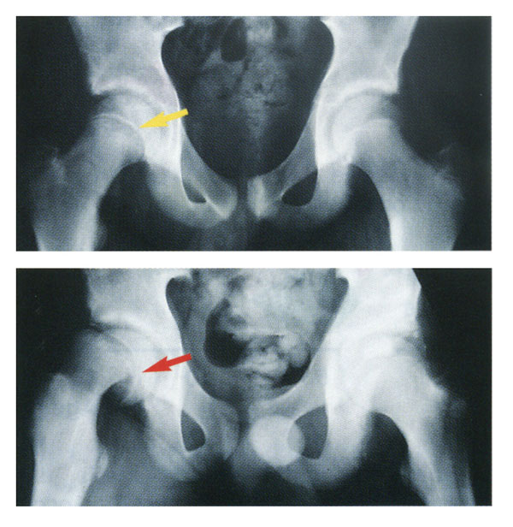
Slipped capital femoral epiphysis
Nontraumatic displacement of the proximal femoral epiphysis from the femoral neck¹⁰
Associated with excess weight and elevated BMI⁷
Image Source:
Seattle Children’s Hospital
Notes:
The term SCFE is a misnomer. It is actually the portion of proximal femur distal to the physis (growth plate) that is displaced anterolaterally and superiorly. This displacement gives the appearance of posterior and inferior displacement of the epiphysis, which in fact remains in normal position in the acetabulum.

Slide 35
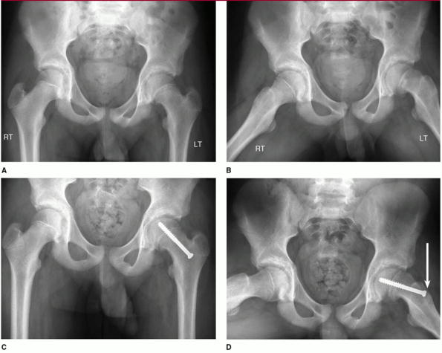
Clinical implications
Surgery – Operative Stabilization⁵
Single-screw fixation
Post surgical rehabilitation – Mobility, ROM (especially IR), Strength (limited weight bearing s/p surgery)
Image Source: Aronsson, et al.⁵
Notes:
Radiographs demonstrating position of the screw in the center of the femoral head, perpendicular to the growth plate, with 8 to 10 mm of threads (4 to 5 threads) engaging the epiphysis. For ideal screw positioning, the bone is entered on the anterolateral aspect (arrow) of the femoral neck.

Slide 36
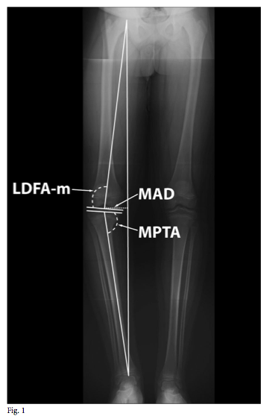
Blount’s disease
Varus deformity of the tibia^{10,45}
Associated with increased weight and obesity^{38,39}
Inhibition of growth in the medial aspect of the proximal tibial physis attributed to abnormal loading
Image Source: Sabharwal, et al³⁷
Notes:
Increased weight and obesity – too great a load can interfere with bone growth (deceleration of growth of the medial proximal tibia)

Slide 37
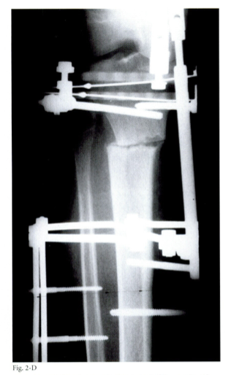
Clinical implications
Lower Extremity Bracing (Early Infantile Blount’s Disease)
Surgery
Hemiepiphysiodesis: restriction of growth laterally^{9.29,37}
Tibial Osteotomy and realignment to correct deformity^{8,16,37}
Image Source: Gordon, et al¹⁶
Notes:
Bracing is ineffective after 3 years of age
Hemi-epiphysiodesis to treat Blount disease is an operation in which the physis is tethered laterally and remaining unrestricted medial physeal growth corrects angular deformities in children. Hemiepiphysiodesis can be accomplished by procedures such as partial physeal ablation (lateral bony hemi-epiphyseodesis), transphyseal screw placement, and staples.
Image shows proximal tibial osteotomy site and the placement of pins of the external fixator

Slide 38
Childhood Obesity Implications for Physical Therapy
Across the lifespan

Slide 39
Obesity throughout the lifespan
“The higher the BMI is in childhood,
the greater the probability of obesity in adulthood.”^{22 (s.197)}
“The impact of pediatric obesity rates, if left unchecked,
will translate into worsening rates of obesity in adulthood.”^{20(p.222)}

Slide 40
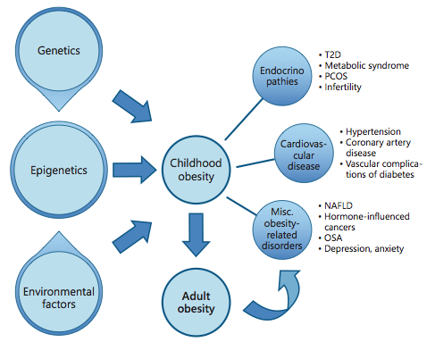
Childhood obesity & Adult consequences
Image Source: Kelsey, et al²⁰
Notes:
T2D = Type II Diabetes, PCOS = polycystic ovarian syndrome, NAFLD = nonalcoholic fatty liver disease, OSA = obstructive sleep apnea

Slide 41
Obesity in adulthood
Obesity in adulthood is know to increase the likelihood of developing²⁰:
Cardiovascular Disease (CVD)
Type 2 Diabetes (T2D) and its associated retinal and renal complications
Nonalcoholic Fatty Liver Disease (NAFLD)
Asthma
Obstructive Sleep Apnea (OSA)
Polycystic Ovarian Syndrome (PCOS)
Infertility
Osteoarthitis
Orthopedic Complications
Psychiatric Disease
Cancer
Other Obesity-related Disorders

Slide 42
Obesity and osteoArthritis
Increased risk of hip and knee osteoarthritis in individuals who are overweight or obese^{24,35}
Severity³¹
BMI correlated with OA severity in patients with varus aligned knees, but not valgus
Age of Replacement Surgery^{11,15}
Age was significantly less when BMI reached 35 kg/m² or more (severely obese)
May require more revision operations over a lifetime
Notes:
Relationship between obesity and osteoarthritis is an interaction between inflammatory and mechanical factors. Visceral and truncal adiposity may act like an endocrine organ releasing proinflammatory hormones such as leptin, tumor necrosis factor-α, and interleukin-1 – hormones that can have direct and damaging effect on joint chondrocytes.¹⁵

Slide 43
The lifespan
Image Source: Sullivan, et al⁴³

Slide 44
Take home points
PTs play an important role in disease and injury prevention, disease mitigation, and health promotion.
Childhood obesity affects multiple body systems and has a negative impact on physical, mental, and social health.
Physical therapists, as “movement specialists,” must recognize impaired movement and promote safer modes of exercise and physical activity for patients that are obese.
Obesity in childhood can lead to obesity in adulthood, which is associated with a decline in overall health and wellness.

Slide 45
references
2014 North Carolina Child Health Report Card. North Carolina Institute of Medicine. Accessed March 31, 2015. Available at http://riversdeveloper.com/wp-content/uploads/2010/08/2014_CHRC-revised.pdf.
Active Children and Adolescents. Office of Disease Prevention and Health Promotion.http://www.health.gov/paguidelines/guidelines/chapter3.aspx. Accessed March 5, 2015.
Adams AL, Kessler JI, Deramerian K, et al. Assocations between childhood obesity and upper and lower extremity injuries. Inj Prev. 2013;19(3):191-197. doi: 10.1136/injuryprev-2012-040341.
AHA’s Recommendation for Physical Activity in Children. American Heart Association. http://www.heart.org/HEARTORG/GettingHealthy/HealthierKids/ActivitiesforKids/The-AHAs-Recommendations-for-Physical-Activity-in-Children_UCM_304053_Article.jsp. Accessed March 5, 2015.
Aronsson DD, Loder RT, Breur GJ, et al. Slipped capital femoral epiphysis: current concepts. J Am Acad Orthop Surg. 2006;14(12):666-679.
Barlow SE, Expert Committee. Expert committee recommendations regarding the prevention, assessment, and treatment of child and adolescent overweight and obesity: summary report. Pediatrics. 2007;120:S164-S192.
Bhatia NN, Pirpiris M, Otsuka NY. Body mass index in patients with slipped capital femoral epiphysis. J Pediatr Orthop. 2006;26(2):197-199.
Birch JG. Blount disease. J Am Acad Orthop Surg. 2013;21(7):408-418. doi: 10.5435/JAAOS-21-07-408.
Castañeda P, Urquhart B, Sullivan E, et al. Hemiepiphysiodesis for the correction of angular deformity about the knee. J Pediatr Orthop. 2008;28(2):188-191. doi: 10.1097/BPO.0b013e3181653ade.
Chan G, Chen CT. Musculoskeletal effects of obesity. Curr Opin Pediatr. 2009;21(1):65-70. doi: 10.1097/MOP.0b013e328320a914.

Slide 46
references
Changulani M, Kalairajah Y, Peel T, et al. The relationship between obesity and the age at which hip and knee replacement is undertaken. J Bone Joint Surg Br. 2008;90(3):360-363. doi: 10.1302/0301-620X.90B3.19782.
Data Resource Center for Child and Adolescent Health, a project of the Child and Adolescent Health Measurement Initiative (CAHMI). State Obesity Profiles, 2011. National Survey of Children's Health.
Deforche BI, Hills AP, Worringham CJ, et al. Balance and postural skills in normal-weight and overweight prepubertal boys. Int J Pediatr Obes. 2009;4(3):175-182. doi: 10.1080/17477160802468470.
De Sá Pinto AL, de Barros Holanda PM, Radu AS, et al. Musculoskeletal findings in obese children. J Paediatr Child Health. 2006;42(6):341-344.
Gandhi R, Wasserstein D, Razak F, et al. BMI independently predicts younger age at hip and knee replacement. Obesity. 2010;18(12):2362-2366. doi: 10.1038/oby.2010.72.
Gordon JE, Heidenreich FP, Carpenter CJ, et al. Comprehensive treatment of late-onset tibia vara. J Bone Joint Surg Am. 2005;87(7):1561-1570.
Goulding A, Jones IE, Taylor RW, et al. Dynamic and static tests of balance and postural sway in boys: effects of previous wrist bone fractures and high adiposity. Gait Posture. 2003;17(2):136-141.
Healthy Lifestyles Program. Duke Children’s Hospital & Health Center. Accessed February 20, 2015. Available at http://www.dukechildrens.org/services/nutritional_disorders_and_obesity
Jette AM. Toward a common language for function, disability, and health. Phys Ther. 2006;86(5):726-734.
Kelsey MM, Zaepfel A, Bjornstad P, et al. Age-related consequences of childhood obesity. Gerontology. 2014;60(3):222-228. doi:10.1159/000356023.
Kessler J, Koebnick C, Smith N, et al. Childhood obesity is associated with increased risk of most lower extremity fractures. Clin Orthop Relat Res. 2013;471(4):1199-1207. doi: 10.1007/s11999-012-2621-z.

Slide 47
references
Krebs NF, Himes JH, Jacobson D, et al. Assessment of child and adolescent overweight and obesity. Pediatrics. 2007;120:S193-S228.
Krul M, van der Wouden JC, Schellevis FG, et al. Musculoskeletal problems in overweight and obese children. Ann Fam Med. 2009;7(4):352-356. doi: 10.1370/afm.1005.
Lievense AM, Bierma-Zeinstra SM, Verhagen AP, et al. Influence of obesity on the development of osteoarthritis of the hip: a systematic review. Rheumatology (Oxford). 2002;41(10):1155-1162.
McGraw B, McClenaghan BA, Williams HG, et al. Gait and postural stability in obese and nonobese prepubertal boys. Arch Phys Med Rehabil. 2000;81(4):484-489.
McMillan AG, Auman NL, Collier DN, et al. Frontal plane lower extremity biomechanics during walking in boys who are overweight versus healthy weight. Pediatr Phys Ther. 2009;21(2):187-193. doi: 10.1097/PEP.0b013e3181a348be.
McMillan AG, Phillips KA, Collier DN, et al. Frontal and sagittal plane biomechanics during drop jump landing in boys who are obese. Pediatr Phys Ther. 2010;22(1):34-41. doi: 10.1097/PEP.0b013e3181cd1868.
McMillan AG, Pulver AM, Collier DN, et al. Sagittal and frontal plane joint mechanics throughout the stance phase of walking in adolescents who are obese. Gait Posture. 2010;32(2):263-268. doi: 10.1016/j.gaitpost.2010.05.008.
Oto M, Yilmaz G, Bowen JR, et al. Adolescent Blount disease in obese children treated by eight-plate hemiepiphysiodesis. Eklem Hastalik Cerrahisi. 2012;23(1):20-24.
Paulis WD, Silva S, Koes BW, et al. Overweight and obesity are associated with musculoskeletal complaints as early as childhood: a systematic review. Obes Rev. 2014;15(1):52-67. doi: 10.1111/obr.12067.
Pearson-Ceol J. Literature review on the effects of obesity on knee osteoarthritis. Orthop Nurs. 2007;26(5):289-292.

Slide 48
references
Physical Activity. Centers for Disease Control and Prevention. Accessed March 15, 2015. Available at: http://www.cdc.gov/physicalactivity/everyone/guidelines/children.html.
Pomerantz WJ, Timm NL, Gittelman MA. Injury patterns in obese versus nonobese children presenting to a pediatric emergency department. Pediatrics. 2010; 125(4): 681–685. doi: 10.1542/peds.2009-2367.
Pulgarón ER. Childhood obesity: a review of increased for physical and psychological comorbidities. Clin Ther. 2013;35(1):A18-32. doi: 10.1016/j.clinthera.2012.12.014.
Richmond SA, Fukuchi RK, Ezzat A, et al. Are joint injury, sport activity, physical activity, obesity or occupational activities predictors for osteoarthritis? A systematic review. J Orthop Sports Phys Ther. 2013;43(8):515-B19. doi: 10.2519/jospt.2013.4796.
Sabhaney V, Boutis K, Yang G, et al. Bone fractures in children: is there an association with obesity. J Pediatr. 2014;165(2):313-318. doi: 10.1016/j.jpeds.2014.04.006.
Sabharwal S. Blount disease: an update. Orthop Clin North Am. 2015;46(1):37-47. doi: 10.1016/j.ocl.2014.09.002.
Sabharwal S, Zhao C, McClemens E. Correlation of body mass index and radiographic deformities in children with Blount disease. J Bone Joint Surg Am. 2007;89(6):1275-1283.
Scott AC, Kelly CH, Sullivan E. Body mass index as a prognostic factor in development of infantile Blount disease. J Pediatr Orthop. 2007;27(8):921-925. doi: 10.1097/BPO.0b013e3181558cd4.
Shultz SP, Hills AP, Sitler MR, et al. Body size and walking cadence affect lower extremity joint power in children’s gait. Gait Posture. 2010;32(2):248-252. doi: 10.1016/j.gaitpost.2010.05.001.

Slide 49
references
Shultz SP, Sitler MR, Tierney RT, et al. Effects of pediatric obesity on joint kinematics and kinetics during two walking cadences. Arch Phys Med Rehabil. 2009;90(12):2146-2154. doi: 10.1016/j.apmr.2009.07.024.
Spear BA, Barlow SE, Ervin C, et al. Recommendations for treatment of child and adolescent overweight and obesity. Pediatrics. 2007;120:S254-S288.
Sullivan KJ, Wallace JG Jr, O’Neil ME, et al. A vision for society: physical therapy as partners in the national health agenda. Phys Ther. 2011;91(11):1664-1672. doi: 10.2522/ptj.20100347.
Taylor ED, Theim KR, Mirch MC, et al. Orthopedic complications of overweight in children and adolescents. Pediatrics. 2006;117:2167-2174.
Thompson GH, Carter JR. Late-onset tibia vara (Blount’s disease). Current concepts. Clin Orthop Relat Res 1990;255:24-35.
Tsiros MD, Coates AM, Howe PR, et al. Obesity: the new childhood disability? Obes Rev. 2011;12(1):26-36. doi: 10.1111/j.1467-789X.2009.00706.x.
Vision Statement for the Physical Therapy Profession. American Physical Therapy Association. http://www.apta.org/Vision/. Last Updated March 12, 2015. Accessed March 25, 2015.
Wearing SC, Hennig EM, Byrne NM, et al. The impact of childhood obesity on musculoskeletal form. Obes Rev. 2006;7(2):209-218.
Zonfrillo MR, Seiden JA, House EM, et al. The association of overweight and ankle injuries in children. Ambul Pediatr. 2008;8(1):66-69. doi: 10.1016/j.ambp.2007.08.003.

Slide 50
acknowledgements
Dale Hamilton, SPT
Andrea Hartzell, PT, DPT, MHS
Michael Murray, SPT
Katie Ollendick, PT, MPT, DPT
Prue Plummer, PhD
Melissa Scales, PT, DPT

Slide 51
Thank You!

Slide 52
Childhood Obesity Implications for Physical Therapy
Questions?

