Slide 1
WELCOME TO THE ONLINE PROGRAM!
Joseph Miller
UNC DPT Program

Slide 2
Introduce Yourself:
In 2-3 minutes….
Name
How long you have had MS?
How comfortable do you feel with technology?
Have you had any recent falls?
What is one thing you like to do for fun or recreation?

Slide 3
Overview of the program
Week 1: Educational Session
Week 2: EXERCISE!
Week 3: Educational Session
Week 4: EXERCISE!

Slide 4
 | Waiver | Physician's Release | Outcomes
V. Swann | x |  | x
Barbara
Thalia |  |  | x
Chuck |  |  | x
Betsy |  | x | x

Slide 5
Objectives for Today
Individuals will
Understand various factors that they can and cannot control with MS
Describe various benefits to wellness decisions involving diet, exercise, and stress management
Understand appropriate recommendations for physical activity with MS
Discuss reasons why they exercise
Discuss reasons why they do not exercise

Slide 6
CONTROL.
Notes:
Throughout today’s presentation, I want you to think about the idea of control. We are going to be talking about some of the things we cannot control, but we are really going focus on the things that we can. Control affects so many areas of our lives. If we do not feel in control of our circumstances, it will affect our stress levels, our relationships, and our overall outlook on life.

Slide 7
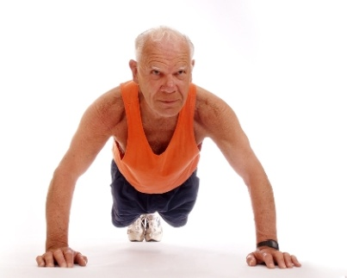
Why Does Exercise & Wellness Matter?
MS .
Wellness.
MS Symptoms like weakness, imbalance, fatigue, etc.
Exercise, Nutrition, & Stress Management
FUNCTION & QOL
Notes:
MS and wellness are very much related. MS affects our ability in engage in healthy behaviors, and the way we take care of ourselves also affects our symptoms and functionality. At this point, everyone is probably familiar with some of the characteristic signs and symptoms of MS. Depending on where MS attacks one’s brain or spinal cord, one could have spasticity or stiff muscles, fatigue, weakness, sensation changes, or bowel and bladder problems. Some of these symptoms are controllable and some are more difficult to modify. MS medications can help prevent the development of future disability, but there is no sure guarantee. On the other hand, there are a number of variables we can control. These include diet, exercise, and stress management. We chose how much we exercise, what we eat, how much we try to sleep at night, and how we manage stress to a certain degree. The benefits of these factors are more guaranteed are and are associated with better outcomes. Both MS-related symptoms and components of wellness all contribute to our collective functionality and quality of life.

Slide 8
Why is Wellness such a Big Deal?
Inactivity = Disability (Motl 2008)
Comorbidity = ↑ Disability
TOP 10 Causes of Death in the US (CDC):
1. Cardiovascular Disease 6. Alzheimer's
2. Cancer 7. Diabetes
3. Respiratory Disease 8. Influenza/Pneumonia
4. Accidents 9. Kidney Disorders
5. Stroke 10. Suicide
Notes:
Why is wellness such a big deal? Physical inactivity has been shown to be related to increased disability in individuals with moderate MS. This means that those who exercise more tend to have lesser disability and are able to do various activities better compared to those who do not exercise. Decreased physical activity and poor lifestyle choices also leads to other complications which we are going to mention. I’m sure all of you can testify that MS is enough to deal with. However, with complications comes even greater disability. Perhaps we cannot control some of symptoms of MS, but we can control our risk for some of these complications.
Notice the top leading causes of death in the US. As we will see on the next slide, many of these can be controlled and prevented with lifestyle choices such diet, exercise, & stress management.
Motl RW, Snook EM, Wynn DR, Vollmer T. Physical activity correlates with neurological impairment and disability in multiple sclerosis. J Nerv Ment Dis. 2008 Jun;196(6):492-5.
http://www.cdc.gov/nchs/fastats/leading-causes-of-death.htm

Slide 9
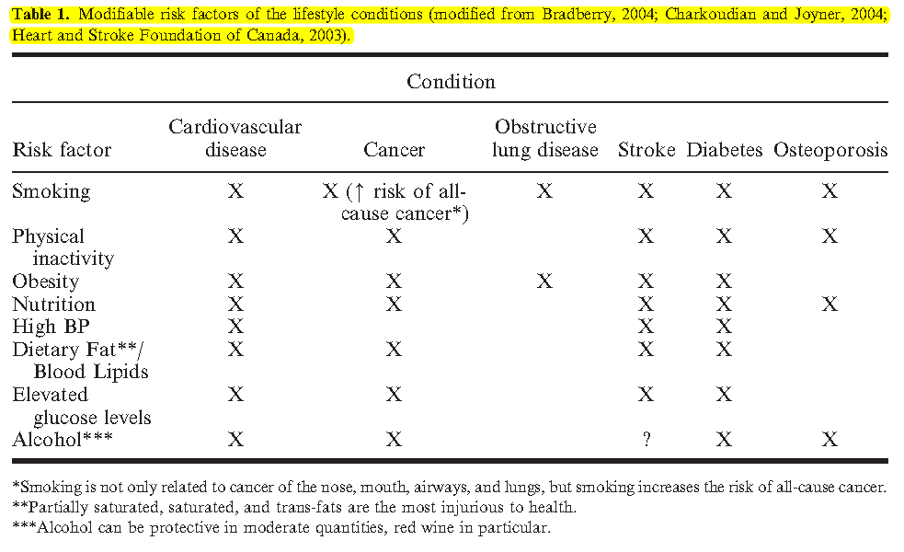
Risk Factors for Various Conditions (Dean 2009)
Notes:
Here we have a chart describing various risk factors for a number of conditions we just mentioned. So if you notice the top row, you will observe several of the causes of death that we just mentioned. Cardiovascular disease, some types of cancer, lung disease, stroke, and diabetes are all complications which can be prevented by modifying some of the things we can control in our lives. Notice the first column which explains all of the risk factors. Now, some of these are easier than others to control. For instance, our family history and genetics plays a role in being overweight, having high blood pressure, and having high cholesterol. But we have control over a number of the other factors, like our diet, exercise, & smoking. I am not aware that any of you smoke, but if you smoke or have friends that smoke, please try to get them to quit. It will improve their outcomes. For this program, We are going to focus on exercise as a means to control symptoms.
Dean E. Physical therapy in the 21st century (Part I): Toward practice informed by epidemiology and the crisis of lifestyle conditions. Physiotherapy Theory and Practice. 2009; 25(5-6): 330-353.

Slide 10
The Influence of Comorbidity
Complications
Disability
Relapse
New Baseline
Time
Notes:
So here we have a chart of the typical disease course of MS. The peaks are relapses and the valleys are remissions (this is different for individuals who have milder or more progressive stages of MS). Thus, someone typically has more disability with a relapse and will recover partially during a remission. Over time, the brain cannot adapt as well, and relapses will result in greater disability. Eventually, most individuals transition to secondary progressive MS, which is this straight line at the end. However, with comorbidity, we have greater disability faster. Thus, I cannot emphasize it enough: we want to maximize the things that we can control.

Slide 11
The Ideal Model with Wellness
Disability
Relapse
Time
Notes:
Here is the ideal model with wellness. An individual is able to recovery back to their baseline functionality after each relapse, and only a gradually increase in disability over time.

Slide 12
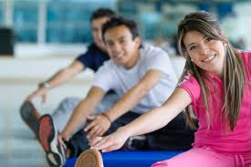
Benefits of Exercise (Dalgas 2008, Briken 2014, Sandroff 2014)
Increased Strength
Increased Endurance
Increased Balance
Decreased pain
Better cognitive function
Learning & Memory
Multitasking
Attention
Improved bowel & bladder function
Notes:
Ah, now we are getting to the good stuff. The benefits of exercise: there are too many to list them all. This is why your physical therapist emphasizes exercise so much…because it’s one of the few medications with a guaranteed payoff. The majority of these benefits come from research focused specifically on MS.
Dalgas, U et al. Multiple sclerosis and physical exercise: recommendations for the application of resistance-, endurance- and combined training. Multiple Sclerosis 2008 Jan; 14(1):35-53.
Briken 2014, Sandroff 2014

Slide 13
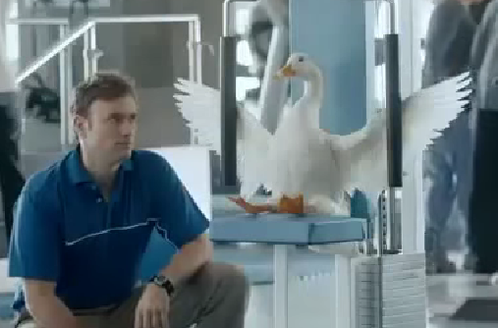
More Benefits of Exercise (Cont.)
Improved bone density
Improved Quality of Life
Improved mood & vitality
Improved Fatigue
Decreased Depression
Increased Socialization
Improved mood & vitality
Notes:
Other improvements of exercise which are not as obvious. One thing that is important to emphasize is the relationship between fatigue and one’s mood. This again goes back to the idea of control. So, imagine you are a poor grad student who has a huge test coming up and he has not had time to study for it. The day comes for the test, he does not feel confident taking the test. Now, he very well may be sleep-deprived from studying the night before. But because he knows he has not properly prepared, his fatigue is only increased. People feel similar when things are not going as expected. We typically make a plan, and if things do not go to plan, it may affect your fatigue. However, I keep coming back to this idea that exercise is something that we can control, and exercise is associated with these benefits.

Slide 14
So How Much Should I Be Doing? (ACSM)
American College of Sports Medicine:
150 minutes of moderate-intensity aerobic training/wk
Strength Training 2-3x/wk
Flexibility Exercise 2-3x/wk
Balance & Coordination Exercises 20-30 min/day
Notes:
So how much exercise is recommended? These are general recommendations for the public. However, I don’t want you to get discouraged if you currently are not meeting these guidelines. I have to admit that I am not currently meeting these guidelines. This is an ideal model, and we are going to talk about what is realistic.
http://www.acsm.org/about-acsm/media-room/news-releases/2011/08/01/acsm-issues-new-recommendations-on-quantity-and-quality-of-exercise

Slide 15
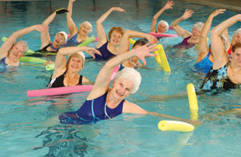
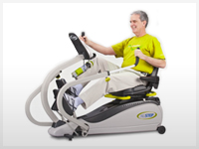
Aerobic Training 150 minutes/wk
30-60 minutes of moderate intensity physical activity 5x/wk OR 20-60 minutes of vigorous physical activity 3x/wk
Short 10 minute sessions are still beneficial
Take breaks to walk longer
Notes:
Emphasize short bouts of activity are still beneficial, and individuals with MS very well may need breaks.

Slide 16
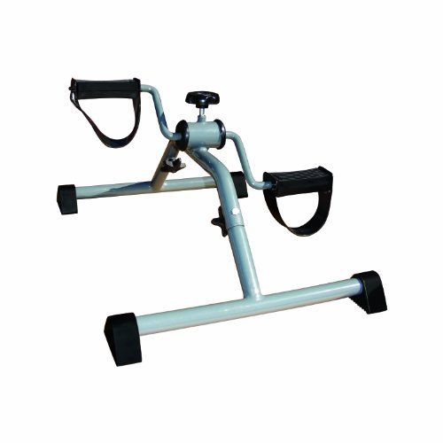
Cap Barbell Upper or Lower Body Cycle
Notes:
$32 on Ebay. There is some research to show that this type of exercise improves endurance, fatigue and mood for individuals with MS who cycled between 15 and 30 minutes. Thus, I would recommend you include some sort of aerobic activity such as walking, cycling, or aquatic therapy.
Briken, 2014

Slide 17
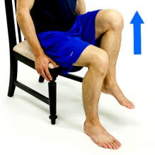
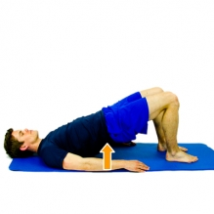
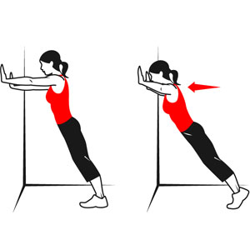
Strength Training 2-3x/wk (Karpatkin 2013)
Working on all the major muscle groups
Recommended 1-2 sets of each exercise with 8-12 reps, fatiguing towards the end of each set. If you are not fatiguing, do more ☺
Take breaks to maximize your exercise intensity
Notes:
Take breaks in between different sets of exercises to get the maximum benefit out of strength training. You can put more power into each exercise if you take breaks in between.

Slide 18
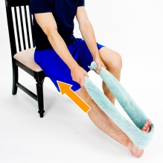
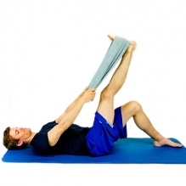
Stretching
Recommended 2-3x/wk, but you may need to stretch each day or twice/day.
Common tight muscles in MS: calf, hamstring, hip flexors, & groin.
Stretch at least 30s at a time
Calf
Hamstrings

Slide 19
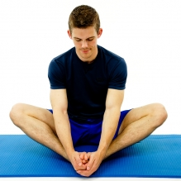
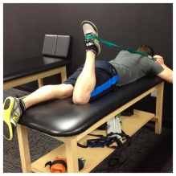
More Stretching
Groin

Slide 20
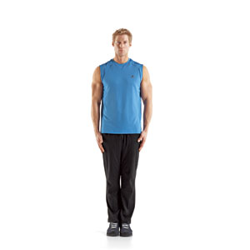
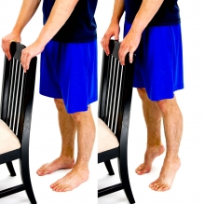
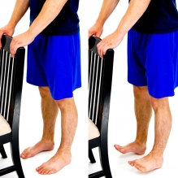
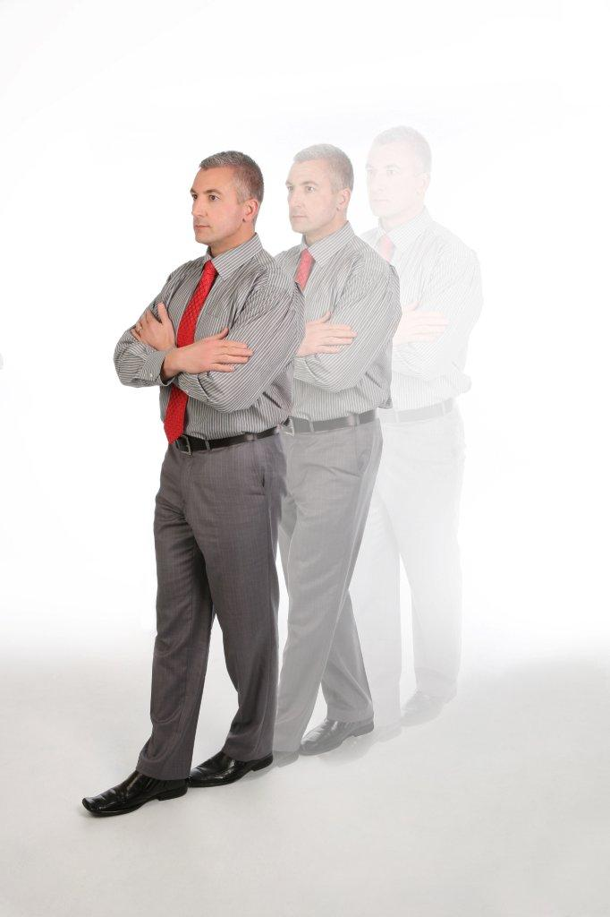
Balance Training
Static (standing) balance vs dynamic (moving balance)
We have a variety of balance systems. Consult a physical therapist for specific balance training
Notes:
There is a difference from static balance which is our balance whenever we are not moving and dynamic balance for when we are moving. For instance, you balance while walking is considered dynamic balance. Both are important to work on to prevent the risk of falls.

Slide 21
Exercise Intensity
Remember to take breaks so that you can do more!
Make sure you can still function the rest of the day after you exercise. Be strategic in how you exercise
Target Intensity (Carter 2013):
50-70% of Maximum Heart Rate (220-age)
Exertional level between 4-7 on a scale from 1-10
Notes:
60-80% HR Max

Slide 22
So, what are we doing online then?
Physical Activity
=
↑ Mobility and ↓ Complications
=
↓ Disability
Notes:
While you may have individual exercises that a physical therapist provides, my intention is to help get individuals with MS involved with routine physical activity. The big question I keep asking myself is how can I get individuals moving to increase mobility & functionality and decrease the risk of other complications. This will ultimately result in decreased disability. We are going to talk about some of the things that get in the way of exercise. I hope that this program will give you more control to manage your exercise.

Slide 23
So, Who’s Responsible for YOUR Exercise? (McLeroy 1988)
Your Community (what is your access to exercise)
Your Attitudes/ Beliefs.
Healthy Behaviors.
What your friends/ family think about exercise
Public Policy (insurance, etc.)
Notes:
So who is responsible for your decision to exercise? Besides our own decision to exercise, there are actually many other influential factors. First of all, you have your attitudes or beliefs: do you get a lot of satisfaction out of exercising? Do you think that it helps? Do you think that it’s feasible?
What your friends and family think about exercise is important too. If you have friends that exercise all the time, you are either going to get sick of them and get new friends, or you’re going to exercise more. Friends and family also make good resources to keep you accountable for exercise.
Your community also influences your decision to exercise. If exercise is readily available, then you’re more likely to engage in it, rather than have to travel across town. Also, if it’s a fairly fit community, you may be more motivated.
Policy influences our decision to exercise as well. If you don’t have insurance, then it’s much more difficult to see a physical therapist, and most insurances now have incentives which may involve wellness initiatives
McLeroy 1988
An Ecological Perspective on Health Promotion Programs

Slide 24
My vision for this group:
Make exercise easily accessible
Change your attitudes & beliefs
Healthy Behaviors.
Meet others who are going through similar struggles
Can’t really change policy in 4 weeks
Notes:
So, my goal for this group is to motivate you to exercise from multiple perspectives. Throughout this brief program, I hope to change some of your attitudes and beliefs about exercise. I want you to understand the benefits, but more importantly I want you to have the confidence to manage a healthy exercise program. I hope give you the opportunity to meet others who are going through similar struggles and who want to also see you succeed in your exercise plan (i.e. social support system). If others are keeping you accountable and challenging you to exercise, you will certainly be more motivated. Finally, I want to make exercise easily accessible and something you feel comfortable doing from home or in a nearby gym. If you would like to continue exercising with the group after this program is over, you are more than welcome to. You can use the google+ community group as much or as little as you feel comfortable. We’re only together for four weeks, and this is going to go fast. But this group is for you all if you want to continue to utilize it.

Slide 25
So, lets Get the Discussion Going:
Where are you on the exercise spectrum?
?
ACSM Guidelines
150min Aerobic
2-3x/wk strength
2-3x/wk Flexibility
20-30min Balance
No Exercise?
Notes:
Throughout each of the sessions, I’ve factored in some time for discussion. Lets get the discussion going. Where are you on the exercise spectrum? Not engaging in physical activity is at one end of the spectrum, and we have following the recommended guidelines on the other end. Are you on one end of the spectrum, or somewhere in between? Lets briefly go around and talk about our preferred method of exercising, and about how much we are doing per week. If 0 is no exercise and 10 is following the recommended guidelines, what level are you at from 0-10?

Slide 26
Question 2: what are your barriers and facilitators
Notes:
we talked about some of the things that influence us to exercise and engage in other healthy behaviors. Something that gets in the way of a healthy behavior is called a barrier. Something that motivates you towards a healthy behavior is a facilitator. What are one or two of your strongest barriers and facilitators to exercise?

Slide 27
Back to the Spectrum Again (Motl 2011)
?
ACSM Guidelines
150min Aerobic
2-3x/wk strength
2-3x/wk Flexibility
20-30min Balance
No Exercise?
Notes:
So here’s our spectrum again, from zero exercise to being gung-ho about it. I think it’s unrealistic for me to ask you all to strive to be at the top end of the spectrum by the end of this program. But what I would ask for you to do is consider striving to achieve just the next level. If you’re current not exercising, then perhaps you should aim to exercise at least once or twice a week. If you’re already exercising a little bit, consider going to the next level. Are you meeting the recommended amount for aerobic training, for strength, flexibility, or balance? I’m going to send out a sheet with some recommendations for different types of exercise. Everyone should be able to do some level of these at home. These are based on evidence which has proven beneficial in individuals with MS. Again, my goal is not for you to try and master exercise over the next few weeks. Rather, I just want to take you to the next level.

Slide 28
Homework for next week
What is your goal for exercising? Be specific
Make it realistic & achievable
What kind of exercise does it involve?
How often are you going to do it?
How are you going to remember?
Who’s going to keep you accountable?
Continue to think about barriers and facilitators to exercise
Read over the Exercise Handout (I will send out) and think about what level you are for each exercise
Notes:
So I have some very simple homework for next week. I want you all to consider writing a goal for your exercise routine. Just 1 goal for the next few weeks. Make it realistic and achievable. If you are currently not exercising, I would not make my goal to exercise 4-5x per week. 1 or 2 times per week is better than 4x/wk if you are still exercising 6 months from now. Habits take a while to form, and my goal is to get you to the next level. Write down this goal. Be specific: write down what you are going to do, how often you are going to do it, how are you going to remember to do it, and who’s going to keep you accountable?
Another piece of homework I have for you this week is to write down your barriers and facilitators to exercise. I want you to continue to think about the things that motivate you or get in the way of exercising. Can you add more facilitators? Are you able to control your barriers? Ultimately, I want to help build your sense of mastery over your exercise routine.

Slide 29
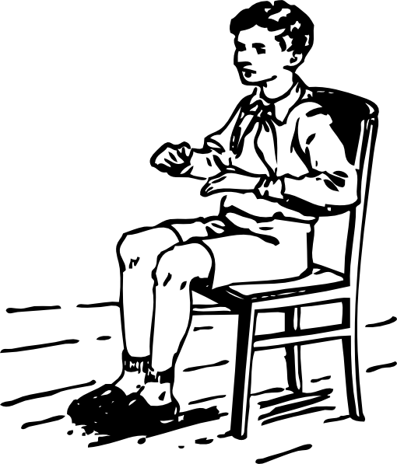
Recommended Setup for Exercise

Slide 30
Tips for Exercise
Lightweight, breathable clothing that allows free movement
Heat Sensitive: wear a neck cooler or a cooling vest
Shoes: athletic or closed-toe
AFO: recommended you wear the AFO for increased stability
Make sure you have appropriate food and water intake beforehand. Sip water throughout to keep you cool.
Take some time to warm up or ease into the exercise
Remember to breathe

Slide 31
References
ACSM (American College of Sports Medicine). ACSM Issues New Recommendations on Quantity and Quality of Exercise. http://www.acsm.org/about-acsm/media-room/news-releases/2011/08/01/acsm-issues-new-recommendations-on-quantity-and-quality-of-exercise.
Briken S, Gold SM, Patra S, Vettorazzi E, Harbs D, Tallner A, Ketels G, Schulz KH, Heesen C. Effects of exercise on fitness and cognition in progressive MS: a randomized, controlled pilot trial. Mult Scler. 2014 Mar;20(3):382-90.
Carter AM, Daley AJ, Kesterton SW, Woodroofe NM, Saxton JM, Sharrack B. Pragmatic exercise intervention in people with mild to moderate multiple sclerosis: a randomised controlled feasibility study. Contemp Clin Trials. 2013 Jul;35(2):40-7.
Dalgas U, Stenager E, Ingemann-Hansen T. Multiple sclerosis and physical exercise: recommendations for the application of resistance-, endurance- and combined training. Mult Scler. 2008 Jan;14(1):35-53.
Dean E. Physical therapy in the 21st century (Part I): Toward practice informed by epidemiology and the crisis of lifestyle conditions. Physiotherapy Theory and Practice. 2009; 25(5-6): 330-353.

Slide 32
References
McLeroy KR, Bibeau D, Stecker A, Glanz K. An Ecological Perspective on Health Promotion Programs. Health Education Quarterly 1988;15(4): 351-377.
Motl RW, Dlugonski D, Wójcicki TR, McAuley E, Mohr DC. Internet intervention for increasing physical activity in persons with multiple sclerosis. Mult Scler. 2011 Jan;17(1):116-28.
Motl RW, Snook EM, Wynn DR, Vollmer T. Physical activity correlates with neurological impairment and disability in multiple sclerosis. J Nerv Ment Dis. 2008 Jun;196(6):492-5.
Karpatkin H. Intermittent strengthening results in improved leg raise function in persons with MS. Paper presented at: 27th Annual Meeting of the CMSC and the 5th Cooperative Meeting of the CMSC-ACTRIMS; May 29-June 1, 2013; Orlando, FL
Sandroff BM, Klaren RE, Pilutti LA, Dlugonski D, Benedict RH, Motl RW. Randomized controlled trial of physical activity, cognition, and walking in multiple sclerosis. J Neurol. 2014 Feb;261(2):363-72.

