Slide 1
Week 3: Fatigue & Spasticity Management
Joseph Miller
UNC DPT Program

Slide 2
Objectives for Today
Individuals will
Understand the role of physical therapists in developing an exercise program
Understand the temporary versus the long-term impact of MS on adverse symptoms and relapses
Improve their knowledge on fatigue
Improve their knowledge on spasticity
Continue to discuss barriers, facilitators, and goal setting for exercise.

Slide 3
Role of Physical Therapists
Help you identify individualized exercise guidelines that are right for you. One formula does not fit everyone…
PTs will help you identify your functional problems and give you specific exercises that will improve functional movement
Monitor your response to exercise and adjust appropriately
Great starting point if you are a beginner
Notes:
Physical therapists can be incredible resources if you have balance, endurance, or strength problems. They can offer individualized programs that fit your functional level. If you try to correct these problems on your own, we may have difficulty finding the right balance or intensity of exercise. Some exercises are just too easy, which will not produce a significant training effect. Some exercises are just too difficult, which causes rapid fatigue or frustration. Oftentimes, patients and therapists have to experiment to find the right balance of exercise. PTs are really good about identifying little subtle problems in the way we move, whether it’s walking, standing, or reaching to get something out of a cabinet. They are also good at recommending alternative or “simpler” exercises which will ultimately help us developed the skills to perform a task
total cardio exerciser
hariette carter

Slide 4
Exercise Intensity
Remember to take breaks so that you can do more!
Make sure you can still function the rest of the day after you exercise. Be strategic in how you exercise
Target Intensity (Carter 2013):
50-70% of Maximum Heart Rate (220-age)
Exertional level between 4-7 on a scale from 1-10
Notes:
Recall this slide about exercise intensity. We want to make exercise both reasonable and challenging. Thus, our perceived effort during exercise should be between about 4 & 7. Recall also that short 10 minute blocks are sufficient to produce gains. How many 10 minute blocks can you do throughout your day? Also, it’s important to find activities or exercises that you can enjoy. The exercises I’ve developed are based on evidence, but you could do similar exercises with activities you enjoy. For instance, you could do some of the exercises while watching TV. Exercise from one commercial break to commercial break, then rest until the next commercial break. Taking short walks, stretching, gardening all count towards our total daily physical activity.

Slide 5
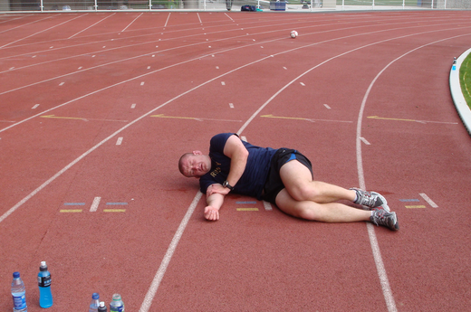
So who gets additional symptoms while exercising?

Slide 6
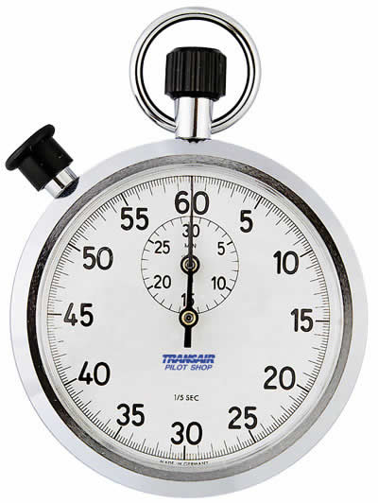
What if I get more symptoms when I Exercise?
“the worsening of the number and/or intensity of sensory symptoms, which is experienced by more than 40% of all MS patients after exercise, is temporal, and will be normalized within half an hour after exercise cessation in most(85%) patients” ^{(Smith, 2006)}
Notes:
Individuals with MS will sometimes experience increased symptoms when exercising due to an increase in core temperature. It can cause individuals to avoid exercising completely. Not good. Remember, inactivity leads to greater comorbidity and disability. The vast body of research suggests that various types of exercises are well tolerated for patients with MS. In all my research, I only recall reading one study where dropouts were an issue for higher exercise intensities. The majority of individuals should expect this increase in symptoms to last for about a half an hour. Note: if you have symptoms that last longer than 24 hours, consult your physician, as you may be having a relapse. However, the vast majority of research also demonstrates that the rate of relapses does not increase as a result of exercise. Thus, most exercise is safe and well-tolerated.

Slide 7
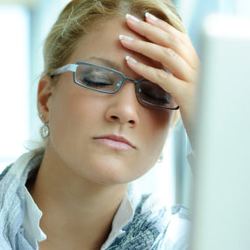
Fatigue & MS (Sullivan 2014, NMSS)
May be the most prominent symptom in individuals who do not have other symptoms
75-95% of individuals with MS (Applebee 2012)
Tends to worsen throughout the day (though not for everyone)
May be aggravated by heat, humidity, and even cold
Not as obvious to friends and family members
Notes:
http://www.nationalmssociety.org/Symptoms-Diagnosis/MS-Symptoms/Fatigue

Slide 8
Contributors (Applebee 2012, NMSS)
Various Causes:
Primary: MS-related fatigue (i.e. lassitude)
Secondary:
sleep
spasticity or bladder dysfunction
increased energy demands
deconditioning
medications
mood/depression
low sense of mastery
Notes:
So there are various contributors to fatigue. There is the primary fatigue that is associated with having MS. This is often described as a feeling of lassitude. It usually comes on quickly and is more severe than what the average person deals with. There are also a number of other causes of fatigue including bladder dysfunction and spasticity which can contribute to sleeping disturbances, increased energy demands (as a result of increased tone or spasticity), medications (baclofen and other medications can cause individuals to feel tired or groggy) and mood, depression, and low sense of mastery. If you do not feel in control of your condition or the circumstances in your life, then that perception is only going to increase and perpetuate the burden in your life.

Slide 9
Managing Fatigue (NMSS)
Medications—stimulants or finding the right balance of muscle relaxants (consult Neurologist)
Sleep regulation (spasticity, urinary problems)
Simply tasks at home (consult PT or OT)
Take breaks (understand your limitations)
Temp regulation/Cooling strategies
Stress management/relaxation training, support group (possibly consult psychology)
Notes:
So there are a number of recommendations to manage fatigue. You can talk to your doctor about fatigue and he/she might prescribe some medication (or they might reduce your dosage of your anti-spasticity medication). Both stimulants and muscle relaxants can play a significant role in your fatigue level. The important thing to remember is to let your healthcare provider know your symptoms so they can adjust accordingly. Your fatigue may improve if you are able to improve your sleep. If you are constantly getting up in the middle of the night to go to the bathroom, perhaps you need to talk to your doctor about urinary problems. If you think you may have sleep apnea, mention that as well, as there are tests. Perhaps it’s a matter of simplifying the tasks in your home. For instance, maybe you organize your kitchen to minimize the amount of work you have to do to prepare a meal. Like putting all of the things you use on a regular basis in easily reachable spots instead of on the top or bottom shelves. Occupational therapists may be resourceful for coming up with energy-saving strategies through various types of equipment.
Read

Slide 10
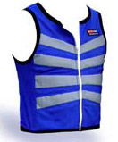
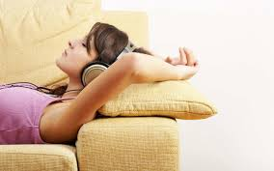
Managing Fatigue (Cont)
Take breaks (understand your limitations)
Temp regulation/Cooling strategies
Stress management/relaxation training, support group (possibly consult psychology)
Notes:
Another suggestion is to simply take breaks throughout your day. Maybe you need to just take a few minutes to close your eyes and let your energy return. It’s better to take short breaks rather than fatigue out and not be able to function for the rest of the day.
In the summer, you may need a cooling vest or a neck cooler. If you have financial need, you can get a free cooling vest through the MS foundation.
Finally, manage the stress in your life. Depression is characterized by decreased satisfaction in food, relationships, and previously enjoyed activities. Psychologists can offer behavioral strategies and breathing techniques. Medication may be helpful in some cases. Perhaps you need to talk your doctor or a psychologist about your anxiety. Maybe you could benefit from a support group. Find some way to increase the control in your life.
Recall aerobic exercise help improve mood, socialization, and depression.

Slide 11
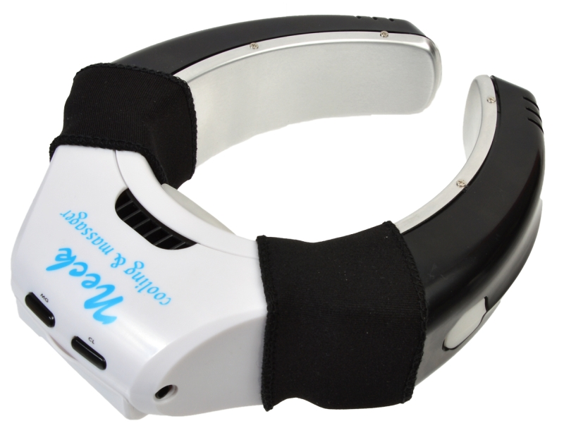
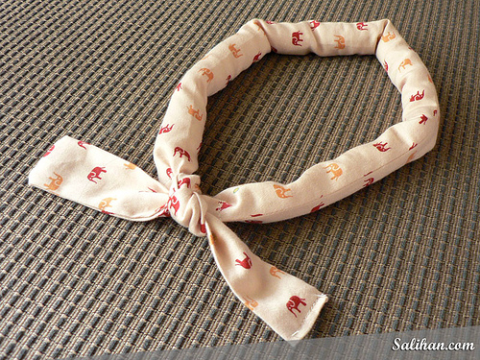
www.firstlinehealth.com
Notes:
firstlinehealth.com

Slide 12
Remember Health = the ability to function well, not necessarily the absence of illness.
Notes:
We all have struggles, and individuals with MS certainly have more struggles and frustrations than the average person. Though, even the average person can dwell on the burdening aspects of their lives and make them seem more significant than they actually are. But if we take a moment to think about our circumstances, we often have a choice as to how we respond. Are we going to let our struggles and impairments define us? Are we going to let these circumstances be the center of our emotions and drive our perception of life? It’s easy to dwell on the negative and complain rather than being hopeful and even thankful for what we do have. Such an attitude will help you develop control and help you manage your fatigue.

Slide 13
Managing Fatigue—Exercise!
Research to show yoga, tai chi, strength, and/or aerobic training improves fatigue
Strength:
Theraband exercises or bodyweight exercises
Group activity such as the exercises we are doing in this program!
Aerobic
Walking, swimming, cycling, arm cycling, dancing
Notes:
So there is evidence to show that exercise helps improve fatigue. Various types of exercises may result in reduced fatigue including strength training, aerobic training, yoga, tai chi, and even theraband exercises. Yoga and tai chi may be relaxing and calming, and there is some positive research for individuals with MS. Exercise also helps improve depression, mood, and socialization, all of which will help improve fatigue.
Also, another significant contributor to fatigue is deconditioning. However, if your muscles are stronger, then they do not have to work as hard whenever you engage in any sort of activity. If you have more endurance, you will not fatigue as quickly either.

Slide 14
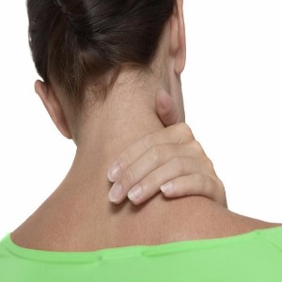
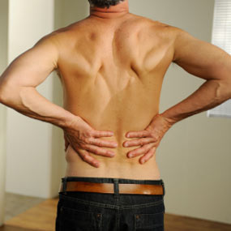
Spasticity & MS (NMMS)
Feelings of stiffness & involuntary muscle spasms
May be mild to severe (and painful)
More common in the legs (hamstrings, quads, and adductors)
Might help some individuals stand up
Notes:
http://www.nationalmssociety.org/Symptoms-Diagnosis/MS-Symptoms/Spasticity

Slide 15
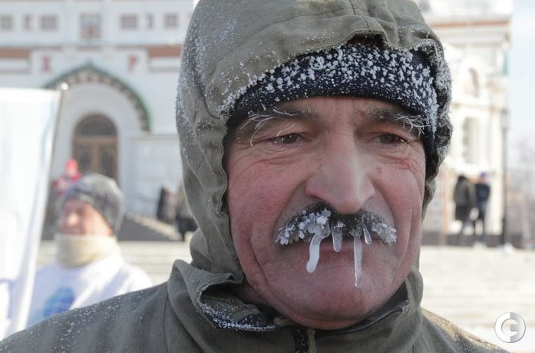
Contributors (NMMS)
Sudden movements/position changes
Heat, cold, or humidity
Sickness, bladder infections
Tight clothing
Fatigue
Stress

Slide 16
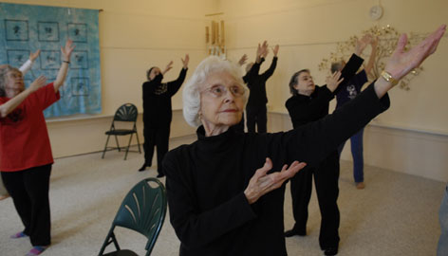
Spasticity Strategies
Medications
Avoid triggers
Stretching
Avoid Contractures
Warm Up
Yoga and Tai Chi
Notes:
Spasticity is different from person to person, which is why you need to talk to your doctor, nurse, physical therapist, or occupational therapist about various strategies and medications. Baclofen and Tizanidine are two of the most common medications to help spasticity. Part of the solution may be avoiding the activities or circumstances which cause spasticity. There have been some subjective reports in the research which demonstrate that stretching results in improved outcomes. Stretching can help prevent the onset of contractures, which is when the tendons and ligaments in joints like the ankle get so stiff that you can no longer move them by stretching. Stretching is also best utilized when the structures are warm. So you should definitely warm up before stretching.
Yoga and Tai Chi may also help relieve some spasticity.

Slide 17
Discussion
Are fatigue and/or spasticity barriers for your exercise?
What are your strategies to overcome these symptoms
It was mentioned that our ability to function well was more of a determinant of health rather than our impairments. Do you agree or disagree?

Slide 18
So How Did It Go?
What’s your new exercise goal?
Did you observe any additional barriers/facilitators to exercise this week?
Notes:
Did you think about any additional barriers or facilitators over the last week? How do you think you can overcome them?

Slide 19
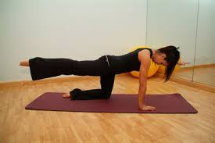
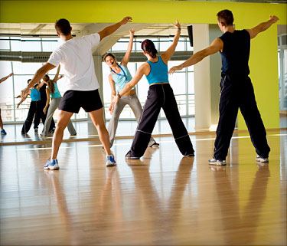
Rewarding
Consider rewarding yourself for exercising
Don’t punish yourself for not meeting your goal…just think positive and do better next week
Notes:
So this week I want to quickly give you two additional tools for promoting physical activity. One way that has been suggested to promote healthy behavior change is by rewards. Over the next week, I want you to think about something you can reward yourself with if you meet your goal. Perhaps it’s a certain type of food, though don’t indulge too much if it’s not a very healthy food. Maybe it’s some kind of activity like an outing. For instance, you could buy tickets to a play if you meet your goal for the next couple of weeks. How are you going to reward yourself for meeting your goal? Rewarding helps us create an incentive for our objective. For instance, I am often motivated to get my schoolwork done early so that I can spend time with my friends. If I always waited until the last minute to do things, then I would be too stressed to do anything and I would become isolated. I also sometimes buy sushi if I’ve had a good week of working out. Thus, the object or event that I look forward to gets paired with the target behavior and makes exercising more motivating. So this week, I want you to think about a way that you can reward yourself for meeting your goal. I’m also going to send you an exercise diary so that you can monitor your exercise over the next week. You can record what you did, the intensity of the exercise, how long you did it, and how you felt afterward. Monitoring your exercise may give you a better idea of what is working and what is not working.

Slide 20
References
Applebee A. MS Clinic Top 10 Questions. [Powerpoint]. UVM. College of Medicine; 2012.
Carter AM, Daley AJ, Kesterton SW, Woodroofe NM, Saxton JM, Sharrack B. Pragmatic exercise intervention in people with mild to moderate multiple sclerosis: a randomised controlled feasibility study. Contemp Clin Trials. 2013 Jul;35(2):40-7.
National MS Society. Fatigue. http://www.nationalmssociety.org/Symptoms-Diagnosis/MS-Symptoms/Fatigue.
National MS Society. Spasticity. http://www.nationalmssociety.org/Symptoms-Diagnosis/MS-Symptoms/Spasticity.
O’Sullivan SB, Schreyer RJ. Multiple Sclerosis. In: O’Sullivan SB, Schmitz TJ, Fulk GD. Physical Rehabilitation. 6th ed. Philadelphia, PA: F.A. Davis; 2014.
Smith, RM et al. Symptom change with exercise is a temporary phenomenon for people with multiple sclerosis. Arch Phys Med Rehabilitation 2006; 87: 723–27.

