Slide 1
Kinect Set-up
The next 10 slides will show you how to set up a Kinect
The process takes approximately 3 minutes

Slide 2
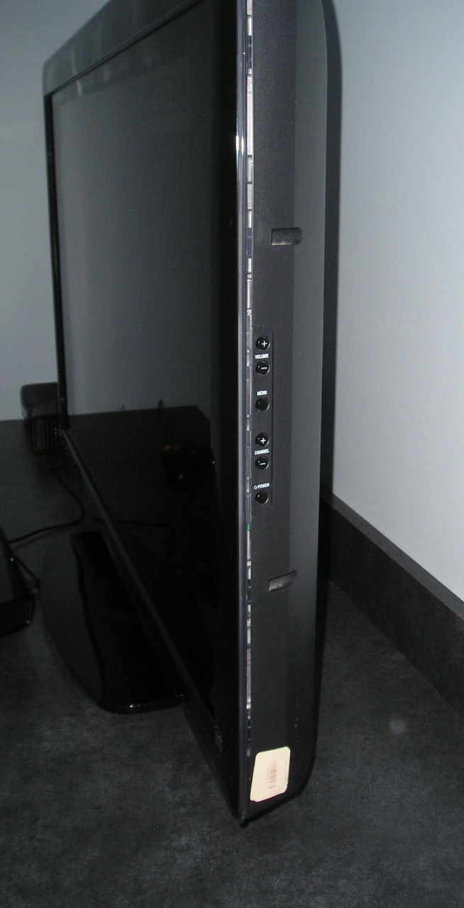
Kinect Set-up
Use the buttons on the side of the TV to:
Turn the display on
Set it to “HDMI3” (channel buttons)

Slide 3
Kinect Set-up
Turn the Kinect on by pressing the round silver button
Open and insert the DVD by pushing the small button on the left

Slide 4
Kinect Set-up
This screen will come up;
Decline the update by pressing button “A” on the controller
Button “A” on Controller

Slide 5
Kinect Set-up
The logos of Microsoft and its partners will display

Slide 6
Kinect Set-up
Follow the screen prompts during the calibration process
The Kinect will suggest where you should stand

Slide 7
Kinect Set-up
Hold your arm abducted until this timer finishes running (about 3 secs)
Use this gesture at any time to pause a game

Slide 8
Kinect Set-up
Kinect Adventures will be launched
Your hand functions as a mouse
Hover your hand over “Start”

Slide 9
Kinect Set-up
Select the “Free Play” option by hovering your hand over it

Slide 10
Kinect Set-up
Select a game, depending on the activity you desire for the patient
In this exemple, hover your hand over Rallyball

Slide 11
Kinect Set-up
Each game will have 3 variations
The first one (leftmost) has the slowest pace
The scenery is different in each variation, but the player’s movements will be the same

Slide 12
Kinect Set-up
The avatar can be changed to a male or female figure
To keep the default avatar, hover your hand over “Skip”

Slide 13
Kinect Set-up
And you can start playing
To pause the game between
patients, use the time-out gesture

