Slide 1
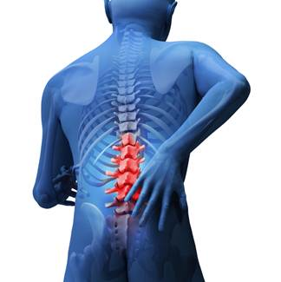
Lumbar spine therapy protocols: 1. Lumbar discectomy/laminectomy 2. Lumbar fusion
Kristel Maes, MS PT, Dip MDT
UNC Therapy Services

Slide 2
Objectives
After this presentation you will be able to:
1. Successfully answer the post-presentation test
2. Explain the surgical procedure to patients
3. Evaluate and create an appropriate plan of care for this patient population
4. Discuss precautions and restrictions regarding the surgery with your patients
5. Select appropriate exercises for return to function

Slide 3
Definitions
Discectomy: A discectomy is the surgical removal of herniated disc material that presses on a nerve root or the spinal cord. The procedure involves removing the central portion of an intervertebral disc, the nucleus pulposus, which causes pain by stressing the spinal cord or radiating nerves.
Laminectomy: A laminectomy is a surgical procedure that removes a portion of the vertebral bone called the lamina. At its most minimally invasive, the procedure requires only small skin incisions. The back muscles are pushed aside rather than cut and the parts of the vertebra adjacent to the lamina are left intact.
Lumbar fusion: A lumbar fusion is surgery to permanently connect two or more vertebrae in the lumbar spine, eliminating motion between them.

Slide 4
Surgeons performing these procedures at UNC
Dr Moe Lim: orthopedic surgeon
Ortho nurse: Veronica Edwards - Fellows
Dr Jaikumar: neurosurgeon
Dr Bhowmick: neurosurgeon
Dr Hadar: neurosurgeon
Neuro nurses: Amber Wilson and Jason Heidecker
Reason for surgery: relief of nerve compression

Slide 5
Evaluation: subjective
Symptoms (pain, P&N, weakness) prior to surgery
Symptoms since surgery
% improvement since surgery
PLOF: self care, work, recreational activities
CLOF: self care, work, recreational activities, medication use, need for DME
Oswestry Disability Index (ODI): current tolerance to functional activities such as sitting, standing, walking, sleeping: guideline for goal setting, G-code determination and to track progress

Slide 6
Evaluation: subjective
Precautions: restrictions / date of surgery and procedure / other
General health
Medication use / use of assistive devices
Work / leisure activities
Patient goals

Slide 7
Evaluation: objective
Observation: Posture: - seated and standing
- incision inspection: signs of infection
L-spine AROM: to patient’s tolerance, willingness to move
Neurological deficits: sensation: light touch, MMT: myotomes, SLR/slump test, reflexes
Gait: quality, use of assistive device
Functional activities: squatting, get up and go test, stairs etc.

Slide 8
Education
Procedure
Posture
Body mechanics
Restrictions
PT plan

Slide 9
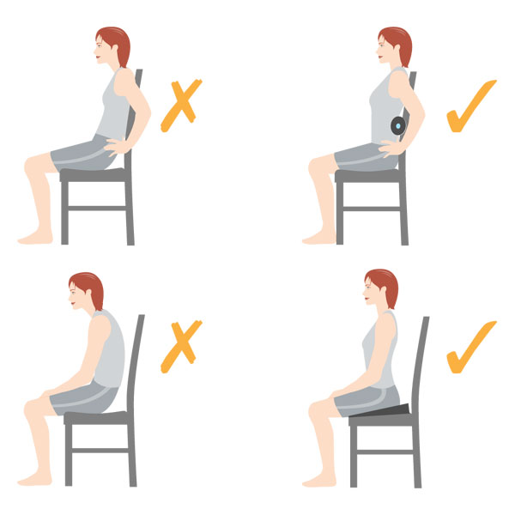
Posture: sitting

Slide 10
Posture: sitting
No slumping or slouching
Limited sitting to no more than 30 minutes for the 1st 6 weeks
Continue to take frequent breaks from sitting to alleviate stress on spine
Use towel roll, lumbar support or wedge to improve sitting posture
Research shows that sitting with a lumbar roll decreases back and referred pain for patients who have back and leg pain (not stenosis or spondylolisthesis) ⁴

Slide 11
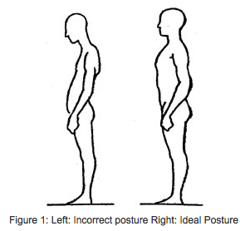
Posture: standing

Slide 12
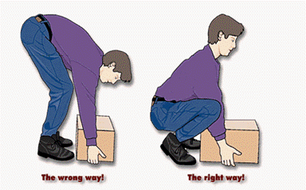
Body mechanics: lifting

Slide 13
Body mechanics: lifting
Spread feet wider than shoulders for a steady support
Keep your back arched
Bend your knees
Keep body weight on your heels
Bring weight close to your body
Don’t move the weight while you squat up and down.

Slide 14
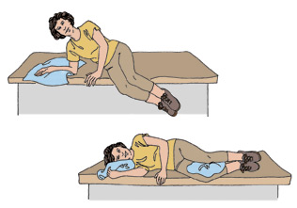
Getting in and out of bed

Slide 15
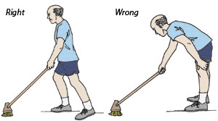
Cleaning

Slide 16
Cleaning
Keep broom or vacuum cleaner close to your body
Move feet as if you are dancing with the vacuum cleaner
Pivot, don’t twist when you change direction
Take side steps when sweeping

Slide 17
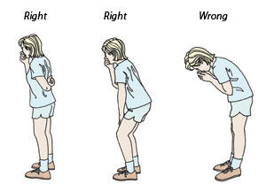
Coughing and sneezing

Slide 18
Lumbar discectomy / laminectomy
Precautions: no repetitive bending / lifting > 10 lbs / no twisting. No running or recreational activities until cleared by MD. ( typically 6 weeks for UNC surgeons)
Start PT at 4-6 weeks post-operatively,⁶ if MD recommends sooner, focus on education of proper posture, body mechanics and endurance activities such as walking . (UNC surgeons typically only send those patients that remain symptomatic)
Healing time: about 6 - 12 weeks

Slide 19
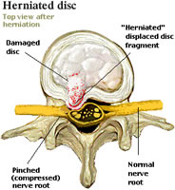
Herniated disc

Slide 20
Procedure: patient position

Slide 21
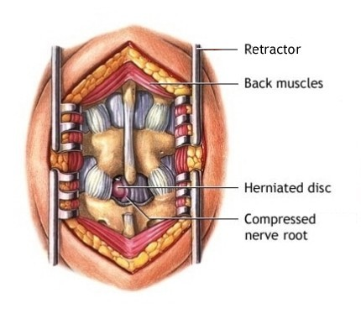
Procedure: incision ~ 2 inches

Slide 22
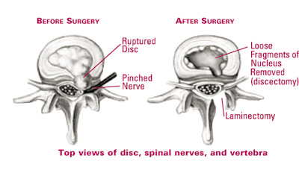
Procedure technique

Slide 23
Goals of rehabilitation
Return spine and patient to normal function
Restore mobility and strength to PLOF
RTW and recreational activities
Educate on proper posture and body mechanics
Teach self-management and prevention techniques

Slide 24
Protocol
Start physical therapy 4 – 6 weeks post-op. ⁶
If patient presents sooner:
- Inspect incision
- Set baselines
- Educate on proper posture and body mechanics
- Review precautions and timeline healing
- Encourage walking and avoiding prolonged bedrest

Slide 25
Exercises: Phase 1
Flexibility: SOC: seated and quadruped, POE, SKC
Core strength: pelvic tilt ¹: prone and supine, with leg lift / kickout, bridges, swimmers: UE only/ LE only, superman, bird dog: UE only/LE only
Endurance: walking at least 30 minutes daily
Education: posture and body mechanics

Slide 26
Exercises: Phase 2
Flexibility: DKC, partial EIL, leg stretches as needed (hamstring / quad)
Core strength: ² Bridges with leg kickout, swimmers, superman, bird dog, squats, standing ITY
Endurance: walking at least 45 – 60 minutes daily, light walk / jog, swimming

Slide 27
Exercises: Phase 3
Flexibility: DKC, EIL
Core strength:³ Bridges with leg kickout, swimmers UE and LE: fast / with weights, crunches, superman, planks, lunges, chops
Stabilization exercises on ball: crunches, bridges, superman, squats
standing core exercises with Theraband / bodyblade, lunges
Sport specific / recreational activities: jogging, biking, swimming, return to sport with specific drills as needed

Slide 28
Exercises: Progressions
Repetitions / sets: 10 – 20 repetitions, 2 – 3 sets
Progressions of exercises to next phase: as tolerated per patient’s symptoms.
PT 1 – 2 times per week 6 – 12 weeks: until goals are met / independent with self-management / maxed out PT benefits / PLOF.

Slide 29
Evidence
Physical therapy started at 4-6 weeks post surgery has shown to decrease short-term pain and disability versus no treatment. ³
High intensity exercises result in lower short-term pain and disability compared to low intensity exercises. ³
No difference between supervised exercise programs and home programs. ⁶
No increase in reoperation rate in those patients that received physical therapy compared to no treatment. ⁶

Slide 30
Evidence
Unclear whether all patients should receive therapy or only those that have remaining symptoms. ⁶ (UNC physicians typically only send those with remaining symptoms)
Neural mobilizations not effective. ⁶
No benefit to starting PT immediately post-operative. ⁶

Slide 31
Lumbar fusion
Precautions: no lifting > 10 lbs for 12 weeks, no twisting, no bending. No running, no recreational activities
Surgery is indicated to STABILIZE spine, so focus should NOT be on flexibility / mobility
Healing time: 6 to 12 months
Brace only prescribed by Dr Lim

Slide 32
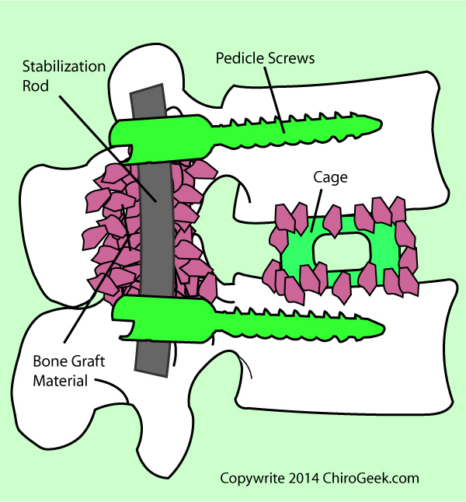
Procedure

Slide 33
Goals of rehabilitation
Stabilize spine
Restore function: self care and household ADL
Return to PLOF / RTW / maximum level of function
Teach self-management and prevention techniques

Slide 34
Exercises: Phase 1
Core strength: pelvic tilt: prone, supine, on all fours or standing, with leg lift / kickout, swimmers: UE only / LE only, bird dog: UE only, hip abduction
Standing: shoulder flexion / abduction, squats ^{4a}
Endurance: walking at least 30 minutes daily
Education: posture, body mechanics, explain the pain, healing process and relaxation techniques ^{1a}

Slide 35
Exercises: Phase 2
Core strength: Bridges, swimmers, superman, bird dog,
Standing ITY, squats, hip abduction, step ups ^{1a, 4a}
Endurance: walking at least 45 – 60 minutes daily, swimming, water exercises

Slide 36
Exercises: Phase 3
Core strength: Bridges with leg kickout, swimmers, crunches, superman, planks, lunges, chops
Stabilization exercises on ball: crunches, bridges, superman, squats
standing core exercises with Theraband / bodyblade, lunges
Use positive reinforcement! ^{1a}

Slide 37
Exercises: Progressions
Repetitions / sets: 10 – 20 repetitions, 2 – 3 sets
Progressions of exercises to next phase: as tolerated per patient’s symptoms.
PT 1 – 2 times per week 6 – 12 weeks: until goals are met / independent with self-management / maxed out PT benefits / PLOF.

Slide 38
Evidence
Limited evidence regarding exercises after lumbar fusion.
1 study showed exercise program started at 6 weeks less beneficial than exercise program started at 12 weeks. ^{2a}
Psychosocial approach important: fear avoidance, behavior. ^{1a,3a}

Slide 39
References discectomy / laminectomy
1. Filiz M, Cakmak A, Ozcan E. The effectiveness of exercise programmes after lumbar disc surgery: A randomized controlled study. Clin Rehabil. 2005;19(1):4-11.
2. Hebert J, Fritz J, Thackeray A, Koppenhaver S, Teyhen D. Early multimodal rehabilitation following lumbar disc surgery: A randomized clinical trial comparing the effects of two exercise programs on clinical outcome and lumbar multifidus muscle function. Br J Sports Med. 2015;49(2):100-6.
3. Kulig K, Beneck G, Selkowitz D, et al. An intensive, progressive exercise program reduces disability and improves functional performance in patients after single-level lumbar microdiskectomy. Phys Ther. 2009;89(11):1145-57.
4. Maynard W, Hawley J, McKenzie R, van Wijmen P. A comparison of the effects of two sitting postures on back and referred pain. Spine (Phila Pa 1976). 1991 Oct;16(10):1185-91
5. McGregor A, Dore C, Morris T, Morris S, Jamrozik K. ISSLS prize winner: Function after spinal treatment, exercise and rehabilitation (FASTER): A factorial randomized trial to determine whether functional outcome of spinal surgery can be improved. Spine (Phila Pa 1976). 2011;36(21):1711-20.
6. Oosterhuis T, Costa L, Maher C, de Vet H, van Tulder M, Ostelo R. Rehabilitation after lumbar disc surgery. Cochrane Database Syst Rev. 2014;3.

Slide 40
References fusion
1a. Abbott A, Tyni-Lenné R, Hedlund R. Early rehabilitation targeting cognition, behavior, and motor function after lumbar fusion: A randomized controlled trial. Spine (Phila Pa 1976). 2010;35(8):848-57.
2a. Oestergaard L, Nielsen C, Bünger C, et al. The effect of early initiation of rehabilitation after lumbar spinal fusion: A randomized clinical study. Spine (Phila Pa 1976). 2012;37(21):1803-9.
3a. Soegaard R, Christensen F, Lauerberg I, Bünger C. Lumbar spinal fusion patients' demands to the primary health sector: evaluation of three rehabilitation protocols. A prospective randomized study. Eur Spine J. 2006;15(5):648-56.
4a. Tarmanen S, Neva M, Dekker J, Hakkinen K, et al. Randomized controlled trial of post-operative exercise rehabilitation program after lumbar fusion: study protocol. BMC Muscoloskelet Disord. 2012;13(123):1-7

