Slide 1
Differential Diagnosis and Treatment of Patellofemoral Pain Syndrome
Patrick McNamara SPT
University of North Carolina- Chapel Hill

Slide 2
Outline/Learning Objectives
Review of anatomy and sources of knee pain
Listeners will recognize pain provocators in the knee
How PFPS presents in the clinic
Listeners will recognize the cluster of complaints individuals with PFPS often present with.
What deficiencies are common among those who complain of PFPS
Individuals will recognize impairments in strength, running mechanics, and limited ROM in the lower extremities common to PFPS.
Treatment approaches in the literature for PFPS
Individuals will understand what the basic literature behind current PFPS treatment advocates for
Notes:
Review anatomy and sources of knee pain
What we hear and see most frequently in patients
A review of current literature.

Slide 3
Common themes and significant differences in PFPS
Notes:
PFPS has common themes, poor movement patterns due to hip weakness/tightness etc. However each individual is different and thus a treatment plan should be comprehensive for their deficiencies.

Slide 4
Common Chief Complaints
Pain with prolonged sitting, ascending stairs, with squatting (2)
More common among women than men.
Anterior knee pain, especially with weight bearing flexed knee activities. (6)
Vague or diffuse? Does it radiate? Where in relation to patella?
Insidious onset of symptoms
May have already tried and failed conservative therapy (6)
Fulkerson – blunt trauma leads to pain/crepitus in the 70-120 degree range of flexion. More likely to injure proximal patellar cartilage
History of prolonged activity or newly started weightbearing activity
Is the pain in running with knee flexed or extended?
Lastly ask about instability/giving way

Slide 5
Knee musculoskeletal anatomy
Adapted from http://www.webmd.com/pain-management/knee-pain/picture-of-the-knee
Notes:
Patella acts to protect the tibiofemoral joint and increase the mechanical advantage of the quadriceps.
Lateral condyle projects further anteriorly. The trochlear groove is more shallow proximally than distally.
The patella is not in the trochlear groove for the first 0-30 degrees of flexion. Can lead to instability and dislocation.
2-5 x body weight can be transmitted through the tibiofemoral joint during functional activities.

Slide 6
Other knee structures
Adapted from http://www.kneeguru.co.uk/KNEEnotes/knee-dictionary/bursa
Notes:
Discuss the bursa, fat pad, anterior synovium, and joint capsule.

Slide 7
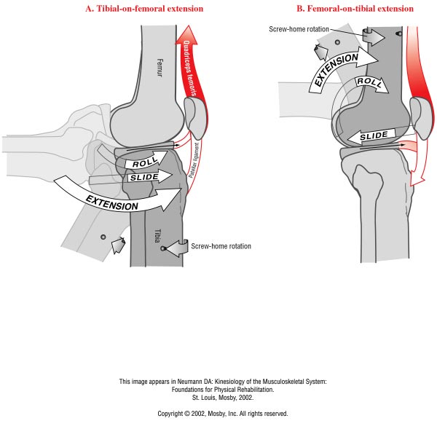
Knee biomechanics
Adapted from Lewek 2013
Notes:
Describe this as closed chain biomechanics. Roll and glide is a combined motion. Open chain is on the left and closed chain on the right. Patella is present to increase the moment arm of the quadriceps and helps to direct the pull of the quadriceps.

Slide 8
Knee biomechanics
Adapted from http://uicptanatomyreviews.blogspot.com/2012/09/knee-handout-from-theresa-in-lab.html
Notes:
Go into detail regarding the screw home mechanism as described in two slides previous.
Full extension is achieved by anterior tibial glide on the femur. Since the medial femoral condyle is longer than the lateral condyle increased anterior motion leads to external rotation of the tibia – the screw home mechanism. Close packed position is knee extension – when the joint is most stable. If unable to get to this point, muscles working excessive amounts, especially during landing on running.

Slide 9
Patellar mechanics-without youtube
Adapted from http://www.rosedalenaturalhealth.com/partnering-with-rnhc/articles-2/patellofemoral-pain-syndrome-%E2%80%9Crunner%E2%80%99s-knee%E2%80%9D/
Notes:
Talk about normal biomechanics, how the quadriceps is involved as well as how the angle of the femur is involved. 5-7 cm of total excursion. Glides inferiorly with flexion and superiorly with extension. Patellofemoral compression dependent on knee angle and quadriceps output force. Higher degrees of flexion lead to greater compression forces. Greatest contact area is in full knee flexion.

Slide 10
Patellar stabilizer angles
Adapted from Waryasz et al. 2008
Notes:
This is how the patella is balanced in it’s excursion superior and inferior.

Slide 11
Proposed pathomechanics
Once thought that chondromalacia was the prime indicator – recent studies show otherwise
Mal-alignment – of patella and femur at extension
Prevailing theory is that the patella tracks laterally and makes increased contact with the femur
Femoral internal rotation
Femoral adduction
Delayed VMO onset compared to VML (10)
Notes:
All speculation at this point!

Slide 12
Pain provocators of the knee Dye et al. 1998
Adapted from Dye et al. 1998
Notes:
Mapping of painful structures of the knee. Destruction of the neurosensory elements may be extremely dangerous after a surgery. Fat pad, anterior synovium, and joint capsule. Fulkerson describes overuse injuries to the subchondral bone, retinacular strain, small nerve injury, or irritation of the peripatellar synovium.

Slide 13
Differential Diagnosis
Plica syndrome
Tibial-femoral OA
Ligamentous (ACL, MCL, LCL, PCL) damage
Meniscal Damage (medial or lateral)
Quad tendinopathy
Neuromas
Patellar stress fracture
Referred pain from lumbar spine or hip joint

Slide 14
Clinical Presentation and possible risk factors
Weakness in:
Knee Extensors – According to recent systematic review – this is the only consistently determined risk factor. (Along with female gender) (16) Measured via isokinetic testing during concentric motion
Hip abductors- an avg of 30% difference from side to side (6,9)
Hip eccentric abduction strength (high values) reduces risk of PFPS development
Hip external rotators (6)
Gastrocnemius during functional testing
Knee Flexor Strength- Mixed results
Tightness in:
HS, IT band, Gastroc, Soleus, Quadriceps (Piva 2005)
Excessive Q angle – Pooled data by Lankhorst suggests not a reliable factor
Aberrant timing of VMO/VL activation (Cowan et al.) (PFPS pop v control, VL activated earlier in functional activities)
BMI
Taller individuals? – Mixed results
Quad atrophy – not based on girth measures, based on imaging studies, no ratio btwn VMO/VL
Notes:
Weakness in the LE is the prevailing theme of modifiable impairments found.
Forest plots for knee extensor and predictive of PFPS are on the 7-17 order of magnitude in favor of PFPS
HS tightness measured by having hip flexed to 90 with thigh on a cross-bar. Other leg strapped to bed. Examiner then passively extended the knee to the point of firm resistance to movement. They also looked at popliteal angle. 145.6+/- 8.7 for PFPS, 153.7+/-10.1 for controls.

Slide 15
Strength Deficits
Robinson et al. – 10 females
29% weakness in hip extension, 23% hip abduction, 14% external rotation compared to contralateral side
Ireland – 15 females
26% weaker in hip abduction and 36% weaker in external rotation
Bolgla-18 females
24% weaker in hip ER, 26% weaker in hip abduction. IR/Adduction similar to controls
Dolak – hip strengthening and quad strengthening groups for 4 weeks then 4 weeks of functional exercises
At 4 weeks hip group had less pain. Increases in LEFS at 8 weeks and 3 months follow up
Barton – 10 case control studies reviewed of EMG of the gluteals during functional tasks
Evidence for delayed and shorter onset of GMed during stair descent (may lead to adduction during gait)
Rathleff – Systematic review/meta-analysis for development of PFPS
No evidence for concentric strength deficits (ER/abduction/IR/extension/adduction/hip flexion) and developing PFPS.
Some evidence for eccentric strength deficits (extension/abduction/ER)

Slide 16
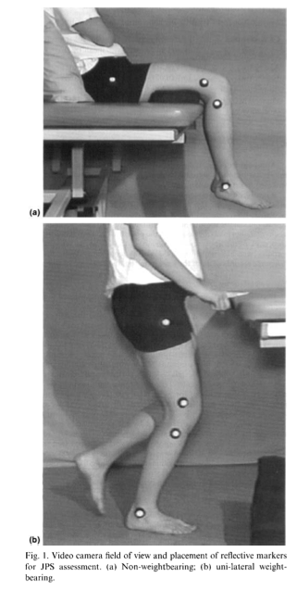
Proprioception deficits
Cross-sectional study with 20 asymptomatic vs 20 PFPS
NWB and WB test for JPS
NWB- knee flexed to 20 or 60 degrees pt. had to replicate
WB- knee flexed to 40 degrees, pt asked to replicate
Relative error- arithmetic difference btwn test/response
Absolute- difference btwn test/response in absolute magnitude
Variable – std deviation from the set of 5
PFPS patients had greater relative, absolute, and variable errors
No statistical correlation btwn pain and JPS
Image adapted from Baker et al.
Notes:
Baker et al study

Slide 17
Collection of Symptoms
Tyler- 35 patients (29 female, 6 males)
Success considered 1.5cm decrease in VAS
21 patients (26 knees) – successful, 14 patients (17 knees) – unsuccessful
39/43 had positive Ober test at baseline
83% that had negative Ober at follow up had successful outcome, 27% that did not have a positive Ober had successful outcome
Normal Ober, Thomas test, and improved hip flexion strength – 93% chance of successful outcome. 2/3 – 75% reached a successful outcome, 27% - for 1/3 and 0% for 0/3.
Piva- compared 30 patients with PFPS to 30 healthy controls
Found no difference in ITB length and hip ER strength
PFPS group has decreased gastroc/soleus length, HS length, quadriceps length
Could discriminate PFPS from healthy controls if grastoc, soleus length decreased and/or hip ER strength

Slide 18
Single Leg Squat
Levinger et al. 2007

Slide 19
Levinger SLS
Subjects asked to perform SLS on affected leg to 45 degrees of knee flexion
Under half reported minor pain
Control subjects – 7.8+/-4.2 degrees of frontal plane movement
PFPS subjects – 11.8+/- 3.6 degrees of frontal plane movement
Nakagawa et al Cross-sectional study of 4 groups (20 female PFPS, age matched pain free females, males with PFPS, and age matched pain free males)
During SLS – PFPS patients showed significantly more:
Ipsilateral trunk lean
Contralateral Pelvic Drop
Hip adduction
Knee abduction
Female PFPS patients showed less EMG activity of glut med (weakness in eccentric testing of the abductors and ERs)
Bolgla et al 2008 found that females with PFPS did not display altered kinematics (but showed significant hip weakness in abductors/ERs) during stair descent.

Slide 20
Biomechanical changes after running
Bazzett-Jones et al 2013
Prospective study looking at biomechanical changes after exhaustive run in college aged indiviiduals (age 18-40). All active.
Healthy vs. PFP individuals diagnosed by AT
38 subjects participated
Strength data – normalized to body mass. Max isometric contractions for hip abduction, ER, hip extension, and lateral trunk flexion.
Did NOT look at knee extension strength!
Peak internal joint moments calculated in stance phase for knee, hip, pelvic, and trunk motions.
Subjects paired for exhaustion protocol on treadmill. RPE and % max HR used

Slide 21
Changes noted
Hip abduction and ER strength significantly reduced in PFP group but not control after the run.
Hip extension strength decreased in PFP both before (by 19%) and after run.
Anterior pelvic tilt, hip flexion moment, and knee flexion peak angle all increased in PFP group after run compared to control.
Post run PFP group demonstrated more knee valgus than control
Post run PFP significantly increased hip extension moment, but control did not change
PFP group also reported significantly more pain than control and baseline

Slide 22
Can kinematics change?
Ferber compared kinematics between 10 PFPS participants and 10 healthy controls
All recreational runners. Studied biomechanics during 20s of treadmill running at 2.55 m/s
Performed hip abduction and hip extension with theraband. Performed daily for 3 sets of 10 over 3 weeks.
Knee valgus angle (in gait) and football “variability” were initially reduced but normalized at follow up in the PFPS group.
Saw concurrent decline in VAS pain.
Bell – screened healthy participants, searching for valgus in DLS, corrected with heel lifts.
10 exercise sessions over 3 weeks to compare exercise and no intervention
Hamstring curls, posterior chain stretches, single leg balance, and star excursion balance techniques used.
Saw decreased valgus in DLS and increased DF ROM with an extended knee
Notes:
Ferber did not discuss what footfall variability was.

Slide 23
Areas to look at – Not just the knee
Souza et al found that females with PFPS displayed the following during running, drop jump, and step down.
Greater peak Hip IR compared to pain free controls (especially in running)
Less torque produced by abductors and hip extensors
Greater glute max recruitment – even though it was weakened
Glute med EMG activity and hip adduction angle were similar btwn groups

Slide 24
Special Tests
Vastus medialis coordination test (Positive Likelihood Ratio – 2.26)
Patellar apprehension test (Positive Likelihood Ratio – 2.26)
Eccentric Step Test (Positive Likelihood Ratio – 2.34)
Taken from a sample of 45 patients complaining of knee pain. Must be independent ambulators and have not undergone a previous knee surgery. Separated into a PFPS and non-PFPS group as diagnosed by an MD. PFPS group patients could not display signs of any other pathology and must report pain with 2 of these: prolonged sitting , squatting, ascending/descending stairs, or kneeling.
A systematic review found similar values, without identifying any tests with better predictive values – that the authors considered valid.
The articles review demonstrated low QUADAS scores.
Notes:
Difficult to assess due to differences in diagnostic criteria among research articles.

Slide 25
Vastus Medialis Coordination Test (3)
Pt supine
Examiner fist under the subject’s knee
Pt extends knee slowly without pressing into or moving off of examiner’s fist.
Pt instructed to achieve full extension
Positive if a lack of coordinated full extension evident
Unable to smoothly extend fully or recruited other muscle groups to achieve full extension

Slide 26
Vastus Medialis coordination test
Adapted from Nijs et al. 2006

Slide 27
Pateller apprehension test
Pt supine and relaxed
Examiner pushes the patient’s patella as laterally as possible
Start point – knee at 30 degree flexion
Grasping the leg with other hand at ankle/heel a slow combined hip/knee flexion performed
Lateral glide held throughout the test
Positive test – if it reproduced the pain or apprehension was evident

Slide 28
Patellar apprehension test
Adapted from Nijs et al . 2006

Slide 29
Eccentric step test
15 cm step – adjusted to 50% of tibial length
Std demonstration given
Instructions
‘Stand on the step, put your hands on your hips and step down from the step as slowly and as smoothly as you can”
Repeated using the other leg
Positive test – knee pain reported during test

Slide 30
Eccentric step test
Adapted from Nijs et al 2006

Slide 31
Outcome Measures
Double blind RCT for conservative tx (quad strengthening vs sham ultrasound)
VAS-usual was the reference standard (looked for change of 1cm or more in VAS-usual, worst, and with activity.
The Anterior Knee Pain Scale (AKPS) has the highest effect size/most responsive
7 point change desired
FIQ, global rating of change also studied
Notes:
Crossley et al (2004)

Slide 32
Who benefits from exercise therapy?
RCT (both groups got advice/information regarding PFPS)
Exercise group got a standardized program (9 treatments over 6 weeks). Static/dynamic quadriceps training, flexibility exercises, and balance work. This became an HEP for 6 weeks.
Participants grouped into symptom duration phases (1-2 months, 2-6 months, 6-12 months, 12+ months)
No significant differences at 3 month and 12 month follow ups on pain, perceived recovery, and functional score.
Trends noted for female sex and longer duration of symptoms (over 6 months).
Could be a result of decreased muscle size/strength due to disuse.
May want to explore other treatment methods (taping/manipulation/orthotics) for shorter durations.
Rathleff- may not see kinematic differences even with symptom reduction.
Notes:
Lankhorst 2015

Slide 33
Exercise for pfps?
Lankhorst et al looked at: sex, age, BMI, duration of symptoms, and intensity of sports played (time) and which predicted best responses to exercise.
Positive trends for female sex and longer duration of symptoms.
Both open and closed kinetic chain exercises both led to quadriceps and knee flexor lengthening, strength improvements, pain during triple jump test, and pain during ADLs like ascending stairs.
More normal VMO/VL ratios, younger age, larger quadriceps on MRI, negative patellar apprehension test, shorter pain duration, and lower frequency of pain – Lack et al.

Slide 34
Dye et al 2001 – Rehab considerations for clinicians
Adapted from Dye et al 2001

Slide 35
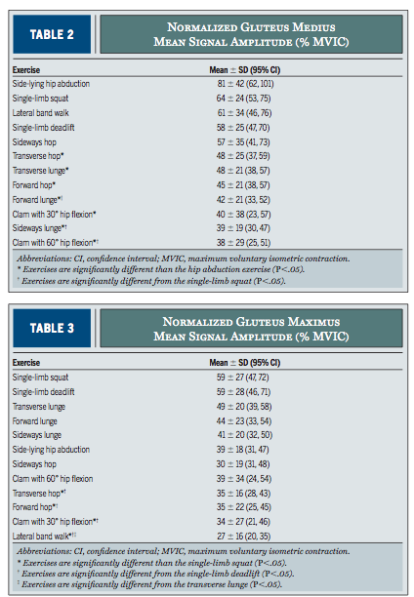
Notes:
Study by Distefano

Slide 36
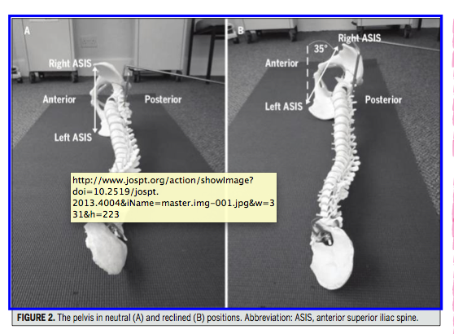
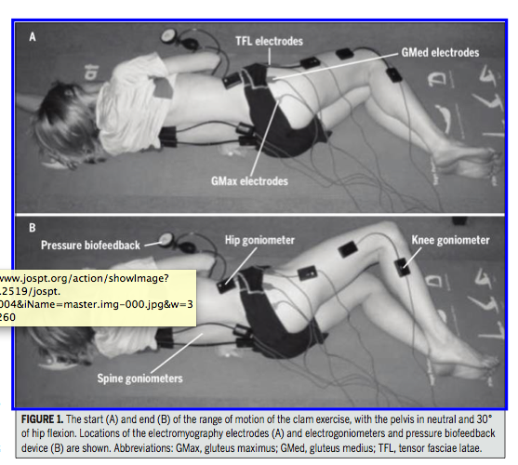
Clamshell Exercise
Neutral pelvis
More hip flexion → increased glut med activity w/o TFL increase
Image adapted from Willcox et al.
Notes:
Willcox et al.

Slide 37
Clamshell EMG
Image adapted from Willcox et al.

Slide 38
Exercises
Image adapted from Youdas et al.

Slide 39
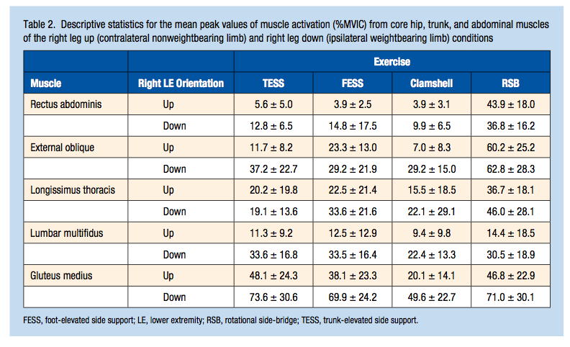
Youdas

Slide 40
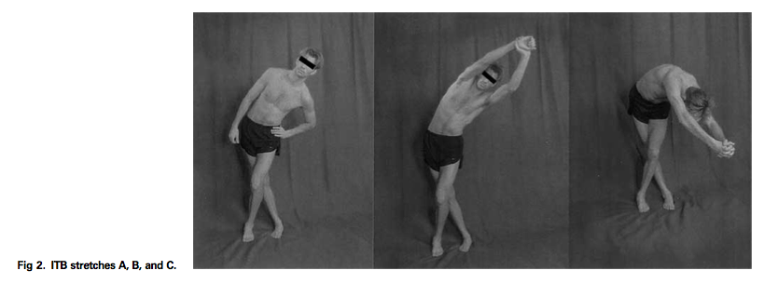
IT Band Stretching
Image adapted from Fredericson et al.
Notes:
Fredericson et al. All three stretches led to increased length of the ITB. Stretch B was most effective in lengthening and providing fore.
Stretch A – 9.84% increase in ITB, stretch B – 11.15%, C – 10.52%.
Average adduction moments at the hip A- 6.8, B- 8.25, and C- 7,16. (%BW x H) Normalized hip and knee adduction moment is determined by the formula (moment arm [m] _ ground reaction vector [N])/(BW [N] _ H [m]) _ 100%, where BW is body weight and H is height.
Average adduction moments around the knee A- 4.86, B 5.62, C 4.75

Slide 41
Prognostic Factors: Quadriceps Strengthening (1)
49 patients with PFPS symptoms for at least 2 months, aged 15-50, and no radiographic presence of OA, osteochondritis dissecans, or loose bodies in the knee.
Positive factors:
1. Smaller knee extensor strength disparity btwn limbs
2. Less pain in the patella apprehension test
3. Less patella crepitation
Notes:
6 week intervention for quad strengthening with rest and NSAIDs.
75% of patients reported feeling better.
Foollow up at 7 years.

Slide 42
Prognostic Factors Cont.
Negative Factors:
1. Taller individuals
2. Older individuals
3. Development of bilateral symptoms
Noteworthy
1. X-Ray and MRI changes in affected knee had NO association with 7 year follow up

Slide 43
Functional stabilization program
RCT 31 female patients btwn 18-30 y/o. Quad Strengthening (n=16) vs. Functional Stabilization (n=15).
All rec athletes (3x per week or more of 30 minutes or more of exercise).
Outcome measures: VAS, LEFS, GRC (Global rating of change), Single leg-triple hop, single leg squat trunk and LE kinematic analysis, trunk muscle endurance, strength of the LE musculature.
Training protocol 3x per week for 8 weeks.
Quad strengthening – stretching of LE and OKC/CKC exercises
Functional Stabilization – first 2 weeks involved enhancement of motor control. Next 3 weeks focused on trunk strengthening, hip strengthening, motor control improvement. Finally patients educated about GRF and knee flexion angle, exercises progressed. Frontal plane alignment emphasized in neutral.
Notes:
De Marche Baldon study.
Inclusion – VAS 3/10 or higher for at least 8 weeks. Anterior or retropatellar pain with at least 3 of ascending/descending stairs, squatting, running, kneeling, jumping, prolonged sitting. Insidious onset.

Slide 44
Outcomes
Baseline VAS worst pain 6.1+/-1.8 for Quad group, 6.6+/-1.1 for Functional Group
At 3 months follow up Quad group (2.5+/-2.7), Functional group (0.9+/-1.5)
FST group – greater eccentric hip abduction/knee flexion Greater trunk endurance.
Decreased trunk inclination/pelvis depression/hip adduction/knee abduction as well as more pelvic anteversion and hip flexion during a SLS.
Improved on triple hop, while Quad group did not
Both groups – improved eccentric strength of hip adductor, ERs, knee extensors.

Slide 45
Exercise summary
Dolak et al. 2011 found both hip strengthening and quad strengthening led to pain reduction at 8 weeks. Hip strengthening significantly decreased pain at 4 weeks
Kushion et al. found similar VMO:VL ratios for 4 different exercises ( SLR-neutral, SLR- ER at hip, Short qrc quad in neutral and short arc quad in hip ER healthy pop).

Slide 46
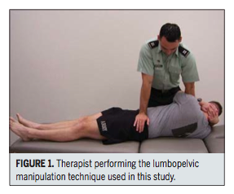
Lumbar Manip CPR
NPRS measured pre and post manip for step up (20cm step), step down, and squat
During squat test- knee flexion angle at first instance of pain measured
Manip performed, if no cavitation, re-performed. Max of 2 per side
Success defined as 50+% improvement in NPRS, +4 or more on the GRC
Mean NPRS for success group – 80+/-17%, non-success 12+/-28%
Median GRC in success was 5, non-success 1
Image adapted from Iverson et al.

Slide 47
Variables assessed
Image adapted from Iverson et al.

Slide 48
CPR items
Image adapted from Iverson et al.

Slide 49
CPR for lumbopelvic manip psychometrics
Image adapted from Iverson et al.

Slide 50
CPR foot orthotics
42 participants, 28 y/o avg with 3 years of symptoms median
Improvement at 12 week follow up, after fitting for orthotic by PT
6 visits to modify and fit orthoses. Pre-fabricated ethylene-vinyl acetate orthotic. Have a 6 degree varus wedge and arch support. (PTs would heat mold, wedge, heel raise addition)
Fit was first designed for comfort then pain free function
Success defined as those that reported a “marked improvement” on a 5-point Likert scale (marked improvement, mod improvement, same, mod worse, markedly worse)
Lack et al. found higher FIQ scores, more forefoot valgus, and higher peak reartfoot eversion had good outcomes

Slide 51
CPR Orthotic Psychometrics
6/7 individuals that met 3 of the 4 criteria were in the success group
Image adapted from Vicenzino et al.

Slide 52
CPR Taping
50 active duty soldiers (27 male, 23 female) ages 18-36
NPRS for step up (20cm step), step down, and squat (knee flexion angle measured)
Success considered 50+% improvement on NPRS or a change of +4 or more on the GRC
Mean improvement change in success group – 63.5+/-24%, GRC 4+/-1.7
Mean in non-success group – 30.6+/-22.4%, GRC 0.4+/-1.8

Slide 53
Taping method
Image adapted from Lesher et al.

Slide 54
CPR Taping
Image adapted from Lesher et al.

Slide 55
Gait Retraining
Rathleff - Retraining runners with high hip adduction peak levels has managed hip pain
Rathleff – high levels of hip IR/adduction in running are risk factors for PFPS development
Teng – compred self-selected, flexed, extended trunk postures in running.
Small but significant (5-7%) reduction in PFJ stress (force/contact area) with flexed position vs extended position.
Notes:
Self-selected (7.3+/-3.6), Flexed (14.1+/-4.8), extended (4.0+/-3.9) degrees of trunk flexion.

Slide 56
RCT MultiModal
Crossley et al 2002 (10)
Inclusion criteria: anterior knee pain with functional activities, insidious onset, positive clinical test (pain with palpation of anterior knee, DLS, or step down)
Exclusion: Other knee pathology (eg ACL tear) or previous surgery on patellofemoral complex, referred pain, or patellar dislocations.
Interventions
Biofeedback via EMG for VMO
Patellar Taping (anterior tilt → medial tilt → glide → fat pad unloading) Provided in this order until 50% reduction in perceived pain
Gluteal muscle strengthening and HEP
Stretching of hip/knee musculature (deep friction massage to lateral soft tissue, HS, patellar mobs, prone anterior hip stretches)
Results
Reduced avg pain, worst pain, and disability after 6 weeks and at 3 month follow up
Notes:
DLS = double leg squat. Both genders, ages 12-40. Patitents taught to independently apply tape.

Slide 57
Crossley (10) – Table 1

Slide 58
Crossley (10) – Table 2

Slide 59
Intervention Crossley

Slide 60
Lumbopelvic Manipulation?
Authors cite evidence that lumopelvic manipulation has been shown to improve quadriceps function for PFPS patients
Evidence also prestnted citing lumbopelvic manipulation as decreasing inhibition noted in the quadriceps
Authors argued that symptom relief may be found after a manip due to increased quadriceps function

Slide 61
Modalities?
Systematic review by Lake et al.
1 study looking at iontophoresis, cryotherapy, US, phonophoresis
Very low quality. Included a strengthening regimen. Unable to determine if any changes as a result of modalities.
3 studies for NEMS
Low quality studies. All included exercise regimens. Could not determine if beneficial
4 studies with EMG biofeedback
One study found short term pain reduction, but in combination with exercise and taping
Useful in retraining the VMO. May or may not help with pain reduction
3 Studies with E-Stim
Short-term pain reduction with high voltage, monophasic pulsed stim
1 study with low-intensity laser
No significant changes found
Notes:
Lake et al study

Slide 62
Case reports (Mascal/Powers)
20 y/o female BMI 22 – part time student and waitress (Patient A)
2 traumatic patella dislocations (falls) – failed PT consisting of walking program and quad strengthening X-Ray unremarkable, symptoms worsening x2 years.
Walking 2 hours or descending 2 flights of stairs set off pain. Wanted to start jogging.
37 y/o female BMI 27 accounts asst for hospital (Patient B)
Insidious onset. Had fallen 3x in the last 1.5 years due to painful buckling. X-rays unremarkable.
“Intermittent throbbing” behind patella, worsened by stair descent. Liked to walk 30-45 mins several times a week, but was limited by pain. Wanted to walk, dance, and ascend/descend stairs pain free.

Slide 63
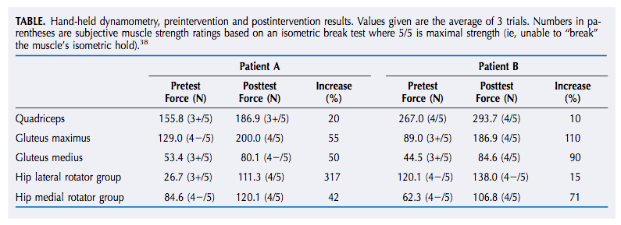
Clinical exam findings
Clinical tests used to rule out rearfoot, tibiofemoral, hip, and lumbar sources of pain.
No obvious patellar alignment/tracking issues in standing/dynamic movements
Both experienced pain with compression and apprehension test as well as in the 0-20 degree range of resisted knee extension
Image adapted from Mascal et al.

Slide 64
Case Studies COntinued
No structural abnormalities found
Gait assessment – “excessive hip adduction, hip IR, and contralateral pelvic drop”
Step down test – significant hip adduction and contralateral pelvic drop → valgus at the knee
Interventions
First targeted glut max/med, hip ERs, and abductors (2-3 sets of 10-15 reps or 3x/week and a total of 6-12 weeks → strength
HEP performed 2x/day
Notes:
Genu varum/valgus, rearfoot varum/valgus, craig’s test, limb length

Slide 65
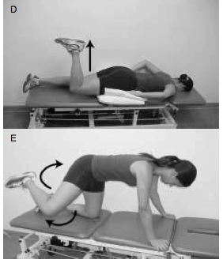
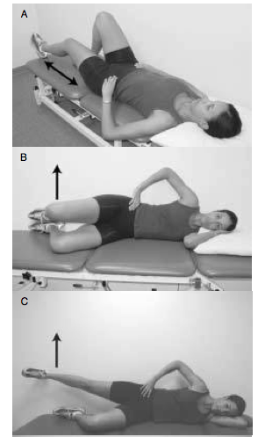
Exercise progression
Non-weight bearing 0-6 weeks
Image adapted from Mascal et al.
Notes:
Pressure cuff under lumbar spine for A, looking at isometric contraction of the TA during heel slides in hooklying. Isometric glute med contractions in sidelying with hips/knees flexed and glute max in prone with one knee flexed to 90. Once these could be done with no compensatory movements progressed to these dynamic exercises
Clamshells for Glut-Med, with palpation of TFL to not activate. Could also do with back against wall so hip in slight extension to promote glute med.
When 2 sets of 15 could be done for B-D, E was provided (fire-hydrants. Could progress with bands or ankle weights.

Slide 66
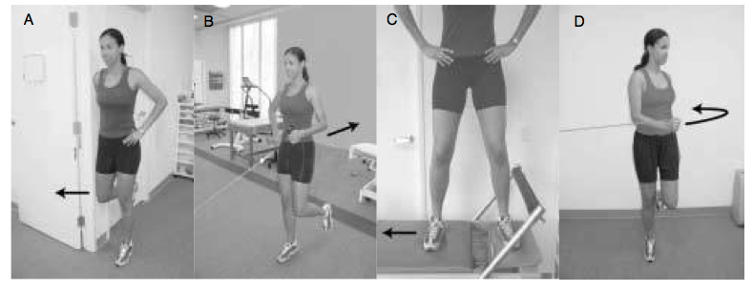
Weight bearing exercises
“Neutral LE alignment” – ASIS and knee remained over 2nd toe with hip in 10 degrees of ER.
Image adapted from Mascal et al.
Notes:
Once pt able to isolate muscle of interest in NWB exercises. Initially wall abductor isometric, then UE activities added (ipsilateral then contralateral.)

Slide 67
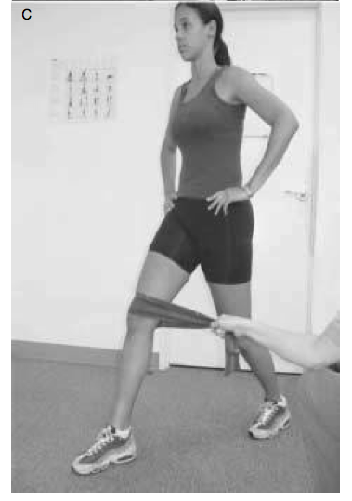
Functional training
Image adapted from Mascal et al.

Slide 68
Outcomes
Kujala Questionnaire (100=no disability)
Pt A 76 Baseline- 85 follow up, Pt B 70 Baseline – 84 Follow up
Pt A – no pain during 10 hr shift, running 2-3 miles no pain, up and down stairs no pain
Pt B – no pain up/down stairs, 2/10 pain if substantial time on her feet, 45 minutes of walking with no pain.
Both showed decreased adduction and hip IR. Pt A had biomechanical follow up indicating 2.6 degrees of ER (baseline 1.4 degrees IR), 2.3 degrees hip adduction (8.7 baseline) and contralateral pelvic drop 1.1 degree (3.9 baseline) during a step-down.

Slide 69
Quadriceps Strengthening exercises
Quad sets
Leg Press/Shuttle Machine
Leg extensions
Supine Quad Extensions
Squats

Slide 70
Quad sets
Adapted from http://www.hep2go.com/exercise_editor.php?exId=13450&userRef=0

Slide 71
Supine quad Extensions
Adapted from http://www.hep2go.com/exercise_editor.php?exId=7978&userRef=0

Slide 72
Knee Extensions 45-90 degrees
Image adapted from Baldon et al.

Slide 73
Leg press 0-45 degrees
Image adapted from Baldon et al.

Slide 74
Wall squats 0-60 degrees knee flex
Image adapted from Baldon et al.

Slide 75
Step-ups/downs 20 cm box
Image adapted from Baldon et al.

Slide 76
Single leg balance
Image adapted from Baldon et al.

Slide 77
Transv abd Ex ball
Image adapted from Baldon et al.

Slide 78
Trunk extensions
Image adapted from Baldon et al.

Slide 79
lunges
Adapted from http://hifitnessclub.wordpress.com/2013/05/22/pre-work-out-warmup-exercise-3-lunges/

Slide 80
Step ups
Adapted from http://www.exercisegoals.com/barbell-dumbbell-stepups.html

Slide 81
Outcome Measures
Anterior Knee Pain Scale MCID is 10 out of a total of 100 points (7)
Visual Analog Pain Scale: MCID is 2 cm out of a total of 10 cm (7)
Notes:
Those not advised were: Functional index questionnaire and global rating of change.

Slide 82
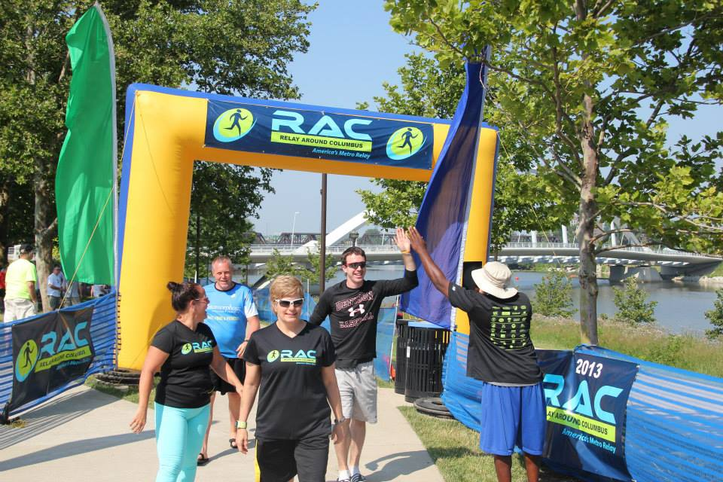
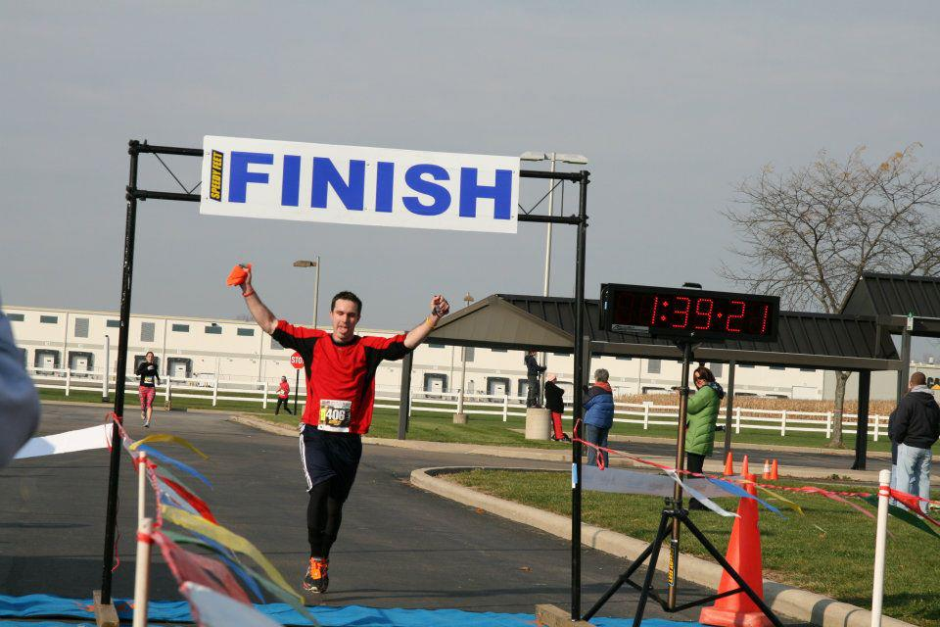
Thanks! Why I’m interested in pfps

Slide 83
References
1. Natri A., Kannus P., Jarvinen M. Which Factors predict the long-term outcome in chronic patellofemoral pain syndrome? A 7-yr prospective follow-up study. (1998) Medicine & Science in Sports & Exercise. 30(11): 1572-1577
2. Cook C, Mabry L, Reiman M, Hegedus E. Best tests/clinical findings for screenings and diagnosis of patellofemoral pain syndrome: a systematic review. (2011) Physiotherapy, doi:10.1016/j.physio.2011.09.001
3. Nijs J., Van Geel C., Van der auwera C., Van de Velde B. Diagnostic value of five clinical tests in patelllofemoral pain syndrome. Manual Therapy (2006) 11: 69-77
4. Souza R., Powers C. Differences in Hip Kinematics, Strength, and Muscle Activation in Subjects With and Without Patellofemoral Pain. (2009) JOSPT. 39(1): 12-19
5. Rabelo N., Lima B., Curcio A., Bley A., Yi L., Fukuda T., Costa L. Neuromuscular training and muscle strengthening in patients with patellofemoral pain syndrome: a protocol of randomized controlled trial. BMC Musculoskeletal Disorders. (2014) 15:157
6. Ireland M., Wilson J., Ballantyne B., Davis I. Hip Strength in Females with and without patellofemoral pain. (2003) 33(11): 671-676
7.Crossley K., Bennell K, Cowan S., Green S. Analysis of Outcome Measures for Persons with Patellofemoral Pain: Which are Reliable and Valid? Arch Phys Med Rehabill (2004) 85: 815-822
8. Fulkerson J. Diagnosis and Treatment of Patients with Patellofemoral Pain. The American Journal of Sports Medicine (2002) 30(3): 447-456
9. Robinson R., Nee R. Analysis of Hip Strength in Females Seeking Physical Therapy Treatment for Unilateral Patellofemoral Pain Syndrome. (2007) JOSPT 37(5): 232-238
10. Crossley K., Bennell K., Green S., Cowan S., McConnell J. Physical Therapy for Patellofemoral Pain : A Randomized, Double-Blinded, Placebo Controlled Trial. (2002) The American Journal of Sports Medicine. 30(6) : 857-865
11. Iverson C., Sutlive T., Crowell M., Morrell R., Perkins M., Garber M., Moore J., Wainner R. Lumbopelvic Manipulation for the Treatment of Patients with Patellofemoral Pain Syndrome: Development of a Clinical Prediction Rule. (2008) J Orthop Sports Phys Ther. 38(6)::297-312
12. Dye S., Vaupel G., Dye C. Conscious Neurosensory Mapping of the Internal Structures of the Human Knee Without Intraarticular anesthesia. (1998) The American Journal of Sports Medicine. 26(6): 773- 777
13. Waryasz G., McDermott A. Patellofemoral pain syndrome (PFPS): a systematic review of anatomy and potential risk factors. (2008) Dynamic Medicine. 7(9): 1-14
14. Dye S. Patellofemoral Pain Current Concepts : AN Overview. (2001) Sports Medicine and Arthroscopy Review
15. Bazzett-Jones D., Cobb S., Huddleston W., Connor K., Armstrong B., Earl-Boehm J. Effect of Patellofemoral Pain on Strength and Mechanics after an Exhaustive Run. (2013) Medicine & Science in Sports and Exercise. 1331-1339
16. Lankhorst N., Bierma-Zeinstra S., Van Middelkoo M. Risk Factors for Patellofemoral Pain Syndrome: A systematic Review. (2012) J Orthop Sports Phys Ther. 42(2): 81-94

Slide 84
references
Lankhorst N., Middelkoop M., Trier Y., et al. Can we predict which patients with patellofemoral pain are more likely to benefit from exercise therapy? A secondary exploratory analysis of a randomized controlled trial. (2015) J Orthop Sports Phys Ther. 45(3): 183-189
Witvrouw E., Lysens R., Bellemans J., et al. Open versus closed kinetic chain exercises for patellofemoral pain. A prospective, randomized study. (2000) The American Journal of Sports Medicine. 28(5): 687-694
Barton C., Lack S., Malliaras P., et al. Gluteal muscle activity and patellofemoral syndrome: a systematic review. (2013) Br J Sports Med. 47: 207-214
Rathleff M., Rathleff C., Crossley K., et al. Is hip strength a risk factor for patellofemoral pain? A systematic review and meta-analysis. (2014) Br J Sports Med. 48
Teng HL., Powers C. Sagittal plane trunk posture influences patellofemoral joint stress during running. (2014) J Orthop Sports Phys Ther. 44(10): 785-792
Ferber R., Kendall K., Farr L. Changes in knee biomechanics after strengthening protocol for runners with patellofemoral pain syndrome. (2011) Journal of Athletic Training. 46(2): 142-149
Bell D., Oates D., Clark M. Two- and 3-dimensional knee valgus are reduced after an exercise intervention in young adults with demonstrable valgus during squatting. (2013) Journal of Athletic Training. 48(4): 442-449
Piva S., Goodnite E., Childs J. Strength around the hip and flexibility of soft tissues in individuals with and without patellofemoral pain syndrome. (2005) J Orthop Sports Phys Ther. 35(12): 793-801
Baldon R., Serrao F., Silva R., et al. Effects of functional stabilization training on pain, function, and lower extremity biomehcanics in women with patellofemoral pain: a randomized clinical trial. (2014) J Orthop Sports Phys Ther. 44(4): 240-251
Lake D., Wofford N. Effect of therapeutic modalities on patients with patellofemoral pain syndrome: A systematic review. (2011) Sports Health. 3(2): 182-189
Youdas J., Boor M., Darfler A., et al. Surface electromyographic anallysis of core trunk and hip muscles during selected rehabilitation exercises in the side-bridge to neutral spine position. (2014) Sports Health. 6(5): 416-421
Bolgla L., Malone T., Umberger B., Uhl T. Hip strength and hip and knee kinematics during stair descent in females with and without patellofemoral pain syndrome. Journal of Orthopaedic & Sports Physical Therapy. (2008) 38(1): 12-18
Dolak K., Silkman C., McKeon J., et al. Hip strengthening prior to functional exercises reduces pain sooner than quadriceps strengthening in females with Patellofemoral Pain Syndrome: A randomized clinical trial. (2011) Journal of Orthopaedic & Sports Physical Therapy. 41(8): 560-570
Tyler T., Nicholas S., Mullaney M., et al. The Role of Hip Muscle Function in the treatment of Patellofemoral Pain Syndrome. (2006) The American Journal of Sports Medicine. 34(4): 630- 636
Iverson C., Sutlive T., Crowell M., et al. Lumbopelvic manipulation for the treatment of patients with patellofemoral pain syndrome: development of a clinical prediction rule. (2008) J Orthop Sports Ther. 38(6): 297-312
Crossley K., Dip G., Bennell K., et al. Physical Therapy for Patellofemoral Pain: A randomized, double-blinded, placebo-controlled trial. (2002) The American Journal of Sports Medicine. 30(6): 857-865
Vicenzino B., Collins N., Cleland J., et al. A clinical prediction rule for identifying patients with patellofemoral pain who are likely to benefit from foot orthotics: a preliminary determination. (2010) Br J Sports Med. 44: 862-866
Kooiker L., Van de Port I., Weir A., et al. Effects of physical therapist guided quadriceps strengthening exercises for treatment of patellofemoral pain syndrome: a systematic review. (2014) J Orthop Sports Phys Ther. 44(x): xxx-xxx
Verma C., Krishnan V. Comparison between McConnell Patellar taping and conventional physiotherapy treatment in the management of patellofemoral pain syndrome – a randomised controlled trial. (2012) JKIMSU. 1(2): 95-104

Slide 85
References
Cowan S., Bennell K., Crossley K. Physical therapy alters recruitment of the vasti in patellofemoral pain syndrome. (2002) Medicine & Science in Sports & Exercise. 1879-1885
Boling M., Bolgla L., Mattacola C., et al. Outcomes of a weight-bearing rehabilitation program for patients diagnosed with patellofemoral pain syndrome. (2006) Arch Phys Med Rehabil. 87: 1428-1435
Distefano L., Blackburn T., Marshall S., et al. Gluteal muscle activation during common therapeutic exercises. (2009) J Orthop Sports Phys Ther. 39(7): 532-540
Callaghan MJ., McCarthy CJ., Oldham JA. Electromyographic fatigue characteristics of the quadriceps in patellofemoral pain syndrome. (2001) Manual Therapy. 6(1): 27-33
Kushion D., Rheaume J., Kopchitz K., et al. EMG activation of the vastus medialis oblique and vastus lateralis during four rehabilitative exercises. (2012) The Open Rehabilitation Journal. 5: 1-7
Fredericson M., White J., MacMahon J., et al. Quantitative analysis of the relative effectiveness of 3 iliotibial band stretches. (2002) Arch Phys Med Rehabil. 83: 589-592
Reiman M., Bolgla L., Loudon J. A literature review of studies evaluating gluteus maximus and gluteus medius activation during rehabilitation exercises. (2012) Physiotherapy Theory and Practice. 28(4): 257-268
Selkowitz D., Beneck G., Powers C. Which exercises target the gluteal muscles while minimizing activation of the tensor fascia lata? Electromyographic assessment using fine-wire electrodes. (2013) J Orthop Sports Phys Ther. 43(2): 54-64
Barton C., Kennedy A., Twycross-Lewis R., et al. Gluteal activation during the isometric phase of squat exercises with and without a swiss ball. (2014) Physical Therapy in Sport. 15: 39-46
Papadopoulos K., Noyes J., Jones J., et al. Clinical tests for differentiating between patients with and without patellofemoral pain syndrome. (2014) Hong Kong Physiotherapy Journal. 32: 35-43
Kettunen J., Harilainen A., Sandelin J., et al. Knee arthoscopy and exercises versus exercise only for chronic patellofemoral pain syndrome: 5-yearfollow up. (2012) Br J Sports Med. 46: 243-246
Lesher J., Sutlive T., Miller G., et al. Development of a clinical predication rule for classifying patients with patellofemoral pain syndrome who respond to patellar taping. (2006) J Orthop Sports Phys Ther. 36(11): 854-866
Baker V., Bennell K., Stillman B., et al. Abnormal knee joint position sense in individuals with patellofemoral pain syndrome. (2002) Journal of Orthopaedic Research. 20: 208-214
White L., Dolphin P., Dixon J. Hamstring length in patellofemoral pain syndrome. (2009) Physiotherapy. 95: 24-28

Slide 86
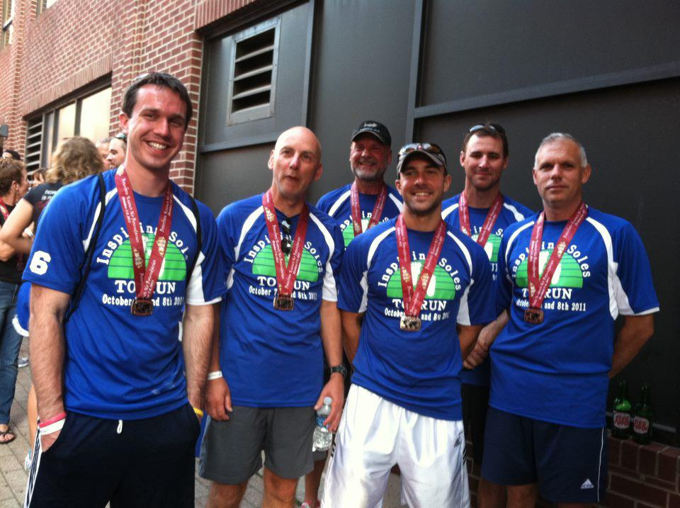
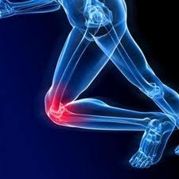
Differential Diagnosis and Treatment of Patellofemoral Pain Syndrome
Patrick McNamara Student Physical Therapist: University of North Carolina at Chapel Hill
Patellofemoral pain syndrome (PFPS) – commonly known as runner’s knee, is often considered a diagnosis of exclusion. There are common complaints, limitations, and clinical presentations that have been used to properly diagnose PFPS. Once a correct diagnosis is made, PFPS treatment is varied, but recent work is indicating quadriceps strengthening should be a key component of the rehab effort. This presentation will detail current evaluation methods, psychometrics of special tests, efficacy of rehab techniques, and key areas to address.
Image adapted from http://ironstruck.com/runners-knee

