Slide 1
Overuse Tendinopathy: Assessment and Intervention Strategies for the Achilles Tendon
Mark Boles, spt

Slide 2
Objectives
Review the anatomy, structure and function of the Achilles tendon
Define overuse tendinopathy
Evaluate a patient with Achilles tendinopathy in an organized and efficient approach
Identify common mechanisms of injury for overuse Achilles tendinopathy
Understand the evidence behind various treatments for overuse Achilles tendinopathy

Slide 3
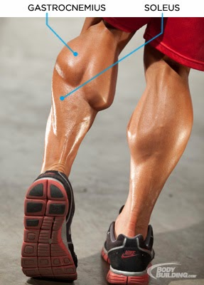
Anatomy
Notes:
Picture: http://www.bodybuilding.com/fun/raising-calves-preston-nobles-training-plan-freaky-lower-legs.html

Slide 4
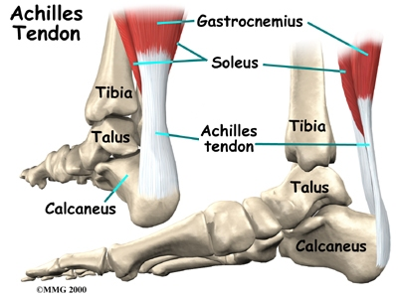
Notes:
The Achilles tendon is the strongest and thickest tendon in the human body.¹ It is the conjoined tendon of the gastrocnemius and soleus muscles and inserts on the posterior surface of the calcaneus.¹
The job of the tendon is to transmit force generated from muscle to bone in order to cause movement.²
Picture: http://www.eorthopod.com/achilles-tendon-problems/topic/29

Slide 5
Composition
Cellular component:
Fibroblasts – about 20% of tissue volume
Extracellular matrix:
Fiber component
Collagen – 95% of dry mass
Elastin – 2% of dry mass
Ground substance
Glycosaminoglycans
Proteoglycans
Glycoproteins
Water
Sharma and Maffulli, 2005; Gross, 1992
Notes:
Understanding the composition and structure of the Achilles tendon helps in understanding the mechanical function of this structure and the mechanisms of injury for overuse tendinopathies.⁷
All collagenous tissues have 3 primary components: cells, fibers, and ground substance:^{2,5,7}
Fibroblasts (AKA tenocytes): form the ECM
Fiber: collagen makes up most of the fiber component and can make up to 95% of the dry weight of tendon. Furthermore, type I collagen makes up about 95% of all collagen present. The high collagen content (specifically type I) gives tendon its stiff properties. There is very little elastin in tendon, which is beneficial, because if tendons are able to elongate too excessively, the forces produced by the muscle would not be effectively transmitted to bone, which would make movement difficult. Elastin fibers provide functional stability to the collagen fibers.²
Ground substance: proteins that bond adjacent collagen fibers together; holds everything together and increases the strength of tendon in response to stress.
Water: represents about 55% of total weight of tendon and is believed to reduce friction, facilitating gliding of fibrils in response to mechanical loading.²

Slide 6
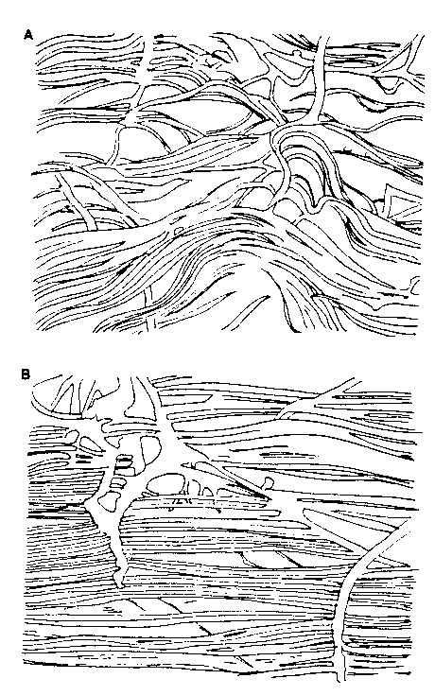
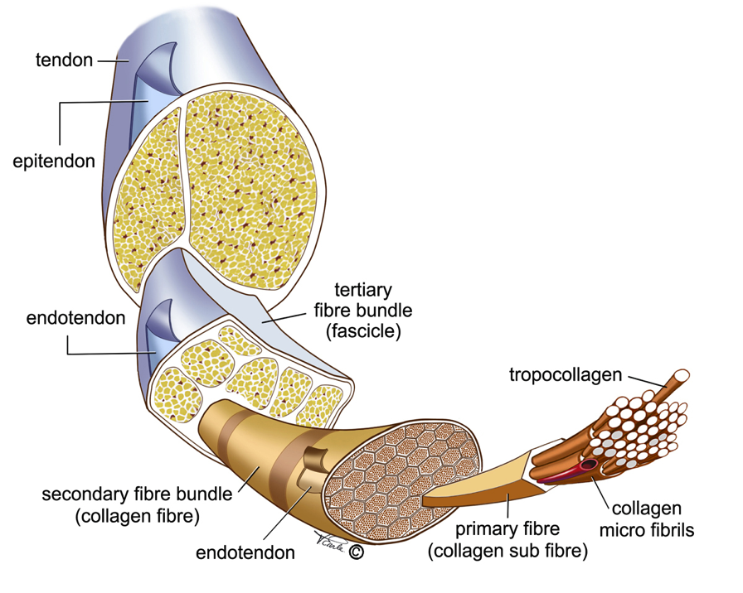
Structure
Gross, 1992
Notes:
In addition to understanding the composition of tendon, one must appreciate the structural organization of this tissue.
Collagen makes up the basic structural unit of tendon.² The more collagen a tissue has, the stiffer and stronger it is. Tendon is stronger per unit area than muscle and its tensile strength equals that of bone.²
It is important to note the parallel alignment of collagen fibers running longitudinally (R picture). The Achilles tendon most often undergoes tensile stress; therefore, this parallel arrangement allows the tendon to effectively resist tensile forces so that contractile energy is not lost during transmission from muscle to bone.²
Top right picture: Both the top and bottom picture is a representation of collagen fiber alignment in healthy tendon. The top picture depicts the tendon at rest with no tensile load, demonstrating a wavy, crimped appearance.⁷
Bottom right: This shows the orientation of fibers when the tendon is under tensile loading, demonstrating a “straightening out” of the fibers in a more parallel orientation.⁷ The elongation of the collagen fibers serves to buffer the tendon from sudden mechanical loading.²
**Left picture: http://vearlemedicalart.com/gallery-2/structure-of-tendons/

Slide 7
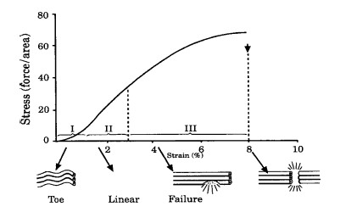
Mechanical Behavior
Doral et al, 2010
Notes:
Stress strain definitions:^{1,7}
Stress = the force crossing a plane of tissue (tensile stress = internal force produced from external load / cross-sectional area)
Strain = the amount of deformation of the tissue (can represent elongation, compression or shear). Will often be elongation, or tensile strain, in the Achilles tendon.
Slope of the curve represents the stiffness of the tissue; steeper slope = stiffer tissue, thus less deformation occurs in response to stress
Ultimate strength is represented by the peak of the curve
Area under the curve = the amount of energy the tissue has absorbed before failure. If the tendon ruptures, all of this energy is released virtually instantaneously (POP!)
Stress-strain curve for tendon:^{1,7,8}
Region I – AKA the “toe” region. The wavy (crimped) configuration is lost when stretched more than 2%.
Region II – collagen fibers exhibit a linear response to increasing strain (parallel orientation). Tendon is able to regain its normal wavy appearance if the strain exerted on it is less than 4%. In vivo studies have shown that Achilles tendons of athletes are sometimes subjected to tensile loads up to 12.5 times their body weight during running.
Region III – at strain levels between 4 and 8% the collagen fibers are starting to slide past one another as the intermolecular cross links fail. At strain levels greater than 8%, macroscopic rupture is produced by tensile failure.

Slide 8
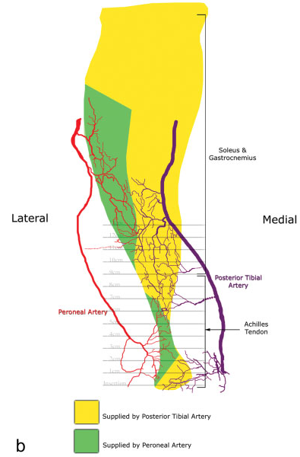
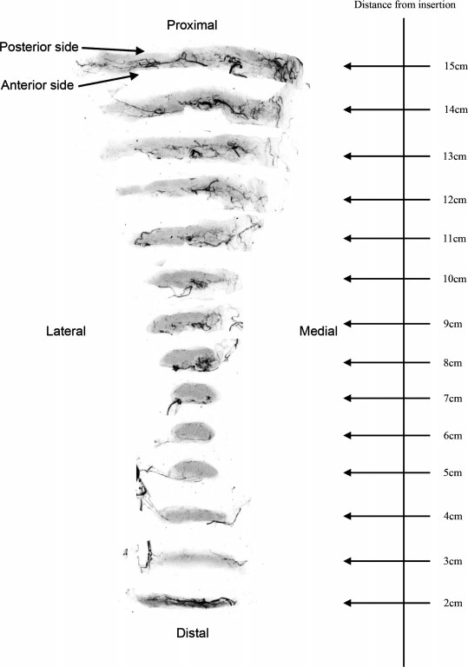
Vasculature
Chen et al, 2009
Notes:
Generally, the Achilles tendon is supplied by the peroneal artery laterally, and the posterior tibial artery medially.
It was originally believed that the peroneal artery and the posterior tibial artery supplied the whole Achilles tendon equally, comprising two vascular territories (lateral and medial).
However, the work by Chen et al³ indicates three vascular territories: the 1)distal and 2)proximal portions of the tendon (the majority of the tendon) is supplied by the posterior tibial artery, while the 3)midsection of the tendon (~4-7 cm from the insertion) is supplied by the peroneal artery.
They also found that there were two areas of anastomosis between the three vascular territories: 1) where the proximal section and midsection meet, 2) where the midsection and distal section meet. Taylor and Palmer⁶ refer to these areas as “choke zones” which is defined as the area between two vascular territories with narrow anastomotic vessels. Indeed, Chen³ found these two areas to be appreciably hypovascular, if not avascular, with fewer and smaller vessels.
The picture on the right demonstrates the hypovascular midsection from 4-7 cm.

Slide 9
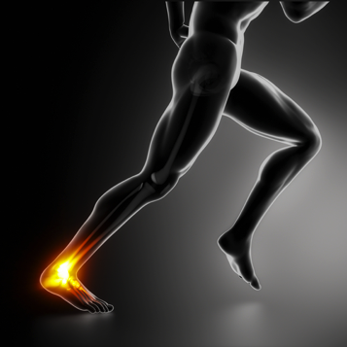
Overuse Tendinopathy
Clinical syndrome characterized by local tissue damage in the form of cellular degeneration leading to a complaint of pain, swelling, and impaired performance.
Khan et al, 1999; Paavola et al, 2002; de Vos et al, 2004; Maffulli et al, 1998
Notes:
Terminology for describing tendon disorders can be very confusing.
Pain, swelling, and impaired performance are highlighted because this can be determined clinically, whereas we are unable to identify with 100% certainty if the patient has degeneration.
Tendinopathy is a general term used as a descriptor of the clinical picture and helps to minimize confusing terminology.¹¹
Picture: http://www.sportsinjuryclinic.net/blog/?p=1221

Slide 10
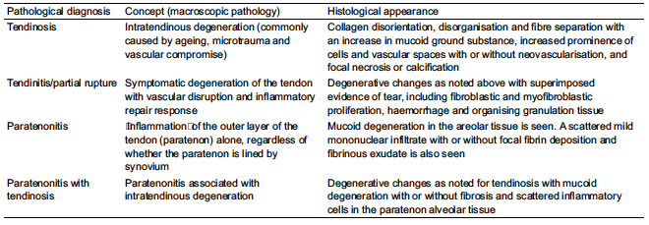
Classification for Tendinopathies
Khan et al, 1999
Notes:
This represents one of many different classifications for tendinopathy, but this is one of the most reliable.⁴ (Basically a good depiction of how the terminology for tendon pathology is confusing)
Very briefly go through these, pointing out the numerous similarities (such as degeneration, mucoid ground substance, abnormal tissue/collagen structure).

Slide 11
Classification of Tendinopathies
Tendinopathy
Tendinosis
Tendinitis/Partial Rupture
Paratendonitis
Paratendonitis with Tendinosis
Notes:
Tendinopathy encompasses all of these pathologies without histologic “proof” of which specific pathology it is.

Slide 12
Terminology
Tendinitis
Tendinosis
Acute
Inflammation
“-itis”
Inflammatory mediators
Localized redness
Localized heat
Chronic
No inflammation
Decreased collagen content
Irregular collagen orientation
Mucoid or lipoid degeneration
Mafulli et al, 1998; Khan et al, 1999; de Vos et al, 2004
Notes:
Have I mentioned that the terminology for tendon disorders is confusing? Have you ever had a patient come to you telling you they have Achilles tendinitis? Better yet, have you ever had a patient come to you with a PT prescription from their MD that says “eval and treat for Achilles tendinitis?” I’m willing to bet the majority of these patients actually did not have tendinitis.
Tendinitis: there has been no convincing evidence of the histopathology that corresponds to true Achilles tendinitis in humans, but some believe the possibility of a brief period of tendinitis occurring before tendinosis.⁴
Tendinosis: implies tendon degeneration without clinical or histological signs of intratindinous inflammation and is often the pathological bases of overuse tendon conditions.¹²
Not necessarily always symptomatic/painful. Although areas of tendinosis are a constant feature of Achilles tendon rupture, the vast majority of patients who have had a rupture never experienced symptoms before the rupture.^{12,13}
Generally, it’s probably fair to say many therapists and physicians understand that when “tendinitis” is used in a clinical context it is being referred to it as a clinical syndrome rather than the specific histopathological nature.⁴ The potential problem with this is if the term is continued to be misused there is potential for some clinicians, athletes, coaches, or patients to underestimate the significance of the condition.
Usually tendinopathy is chronic (tendinosis) by the time we see the patient in clinical practice.⁴ Tendinosis is the major, if not the only, clinically relevant tendon lesion, although minor histopathological variations may exist at different anatomical sites. For example, paratendinitis is histologically different than tendinosis, but often presents the same as tendinosis and responds to treatment the same.
Some authors claim that tendinitis is very rarely observed, if it even exists at all.⁴
The remainder of this presentation will be related to overuse tendinopathy as being a chronic tendinosis-like pathology (unless otherwise stated) because this is the main tendon disorder clinicians see.

Slide 13
Chronology of Symptoms
Acute
Symptoms present for less than 2 weeks
Subacute
Symptoms present for 2-6 weeks
Chronic
Symptoms present longer than 6 weeks
el Hawary et al, 1997
Notes:
It should be noted that these time frames are very arbitrary and are not based on histopathologic or clinical criteria.¹⁰
In my opinion it is important to know the relative timeframe since the patient’s initial onset of symptoms; however, these specific time frames are unable to tell me if there is true degeneration of the tendon tissue. Although tendinosis can only be identified via histopathological confirmation, the therapist can use this general timeline along with there findings from the subjective and objective examination to determine the impairment.

Slide 14
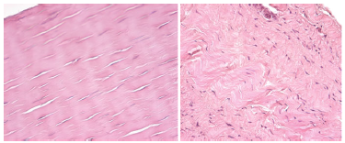
Pathophysiology
Repetitive strain
Microtrauma
Cells unable to repair quick enough
Collagen cross-links separate
Mucoid or lipoid infiltration
Denaturation
de Vos et al, 2004; Paavola et al, 2002; Galloway et al, 2013
Notes:
The etiology, pathogenesis, and natural course of Achilles tendinopathy are largely unknown.¹⁰ This slide summarizes the most commonly accepted theories.
The mechanical theory of overuse tendinopathy:¹⁰ when a tendon has been strained repeatedly to 4-8% strain it is unable to undergo further tension, leading to injury. The tendon becomes fatigued and the ability of the tendon cells to repair the fiber damage is overwhelmed by the repetitive microtrauma. This repetitive strain (ironically often eccentric in nature) leads to a disruption of the tendon structure and the collagen fibers begin to slide past one another, breaking their cross-links and causing tissue denaturation. It is believed that this cumulative microtrauma not only weakens the collagen cross-linking but also affects the noncollagenous matrix as well as the vascular elements of the tendon. The cell matrix reaches a point where it is unable to adapt to the excessive changes in load, thus leading to tendinosis. This process is accompanied by mucoid and/or lipoid infiltration into the tendon, which is basically junk taking up the space of collagen, further weakening the tissue.
Right picture: represents loss of the organized collagen orientation, collagen degeneration, fiber thinning, mucoid or lipoid ground substance infiltrates the ECM.^{5,12}
Fiber thinning = decreased cross sectional area = higher tensile stresses being imposed on the tendon

Slide 15
Populations Commonly Affected
Age between 30 and 50 years
Athletes
Sedentary
Workers with repetitive duties
Men >Women
Carcia et al, 2010
Notes:
Pro, competitive, and recreational athletes. Runners are especially affected, as well as athletes who participate in running intensive sports (football, soccer, basketball, etc.)
Often happens when athletes suddenly increase duration, intensity, or frequency.
Men more than women but limited evidence on this
Sedentary to active: immobilization can cause deranged formation of collagen. Many sedentary (relatively immobilized) individuals are overweight (inc force on tendon), older (natural deleterious effects on tissue), and suddenly decide they want to get back into shape – end up overdoing it and injuring themselves.
“too much too soon”

Slide 16
Risk Factors
Decreased dorsiflexion ROM
Abnormal subtalar ROM
Decreased PF strength
Increased pronation
Increased age
Overweight/obesity
HTN
Increased cholesterol
Diabetes
Smoking
Training errors
Sudden increase in intensity, frequency, and/or duration
Poor footwear
Hill training
Forefoot strike pattern
Carcia et al, 2010
Notes:
Carcia et al, 2010:
DF ROM: those with decreased DF ROM with the knee extended are theorized to experience increased tension on the Achilles tendon, therefore are at greater risk.
Abnormal Subtalar ROM: abnormal increases or decreases in subtalar ROM are associated with Achilles tendinopathy
Inv ROM > 32.5 degrees increases risk of Achilles tendinopathy risk by a factor of 2.8 compared to those who have motion between 26d and 32.5d.
Other literature has shown that a decrease in total (inversion + eversion) passive subtalar joint ROM (<25d) is an increase risk of Achilles tendinopathy
Dec PF Strength: plausible because when running (or walking) the gastroc/soleus eccentrically control anterior translation of the tibia. Weak PF strength = more force required at the tendon.
Inc Pronation: not fully understood why it is linked to tendinopathy but is hypothesized to decrease blood flow. Also, the Achilles tendon has responsibility in decelerating pronation due to its relative medial orientation to the subtalar joint, and may be less capable of attenuating forces in the frontal and transverse planes.
Need to check other areas of the body that can contribute to or be related to pronation (forefoot varus, genu valgus, femoral antetorsion, etc)
Age: although the mean age of those affected is between 30 and 50 years old, there is an increased prevalence of Achilles tendinopathy as age increases.
Degeneration of collagen
Comorbidities can help explain the prevalence of this pathology in the sedentary population
Also think about the comorbidities that hinder blood flow to the already hypovascular tissue (HTN, smoking, diabetes)
Forefoot strike pattern: causes a repetitive eccentric load on the Achilles tendon. Something to ask patient about and observe during examination.

Slide 17
Differential Diagnosis
Rupture
Partial tear
Ossification
Systemic inflammatory disease
Insertional tendinopathy
Posterior impingement
Bursitis
Os trigonum
Referred pain from spine
Carcia et al, 2010; de Vos et al, 2004
Notes:
Therapists must consider differential diagnoses when patients report activity limitations or impairments of body function/structure are not consistent with the patients history, subjective and objective evaluation portion of our examination for Achilles tendinopathy, or when the patient’s symptoms are not resolving with physical therapy.¹⁶
It is suggested that acute ruptures are often secondary to an underlying chronic impairment.¹⁷ Consider a complete or partial rupture if onset of symptoms was acute – meaning the patient can identify a specific time and mechanism of injury when onset of pain occurred. Complete ruptures can usually be heard and definitely felt when it happens.
It is important to rule out a possible pain referral to the calf from the spine (L5-S1). Neuromeningeal provocation tests can be used if there is suspicion of referred pain from the spine.¹¹ (Straight leg raise, slump test)

Slide 18
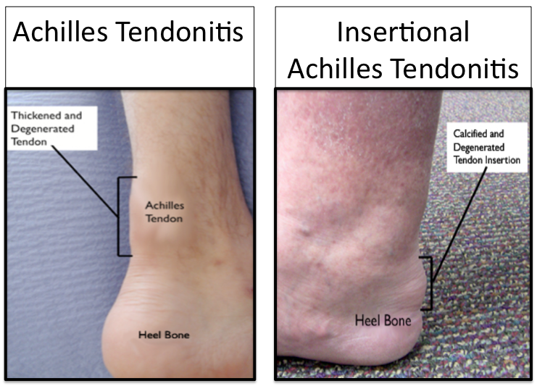
Midportion vs. Insertional
Midportion
Insertional
TTP 2-7cm proximal to calcaneus
Most common location for tendinopathy
Swelling at central posterior aspect of calcaneus
TTP at calcaneus
May have calcification
NSAIDs, rest and very gradual return to activity
de Vos et al, 2004
Notes:
Overuse tendinopathy most often occurs in the midportion of the tendon (2 to 7cm proximal to the insertion on the calcaneus), but it can also occur directly at the insertion site at the tendon-bone junction (within 2cm of insertion).¹⁵
Insertional tendinopathies should be taken into account and examined due to the many other structures in the area that can cause similar pain:¹⁵
retrocalcaneal or superficial bursitis: usually a painful soft tissue swelling that is palpable medial and lateral to the Achilles.¹¹
Impingement between posterior part of the calcaneus and Achilles tendon (‘Haglund’s deformity’)
Bone fragment (calcification or avulsion)
Or a mixture of any of the above
Beginning treatments should be very conservative; rest, ice, NSAIDs. Return to function should be even more gradual than midportion tendinopathies. Eccentrics are not very effective with this pathology.
Because midportion is much more common, the remainder of this presentation will focus on midportion tendinopathy in order to respect time constraints.
Remember how the midportion is the least vascular area of the whole tendon (almost avascular)? Probably isn’t a coincidence that midportion tendinopathies are much more common.
Picture: http://runnerunleashed.com/2013/04/26/are-you-running-with-pain-in-your-heel-it-could-be-achilles-tendonitis/

Slide 19
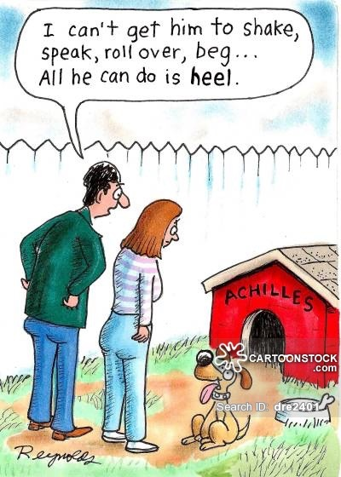
Evaluation
Notes:
Picture: https://www.cartoonstock.com/directory/r/roll_over.asp

Slide 20
Patient History
Duration of impairment
Pain pattern:
location, intensity, frequency, duration, type
Mechanism of injury (if acute)
Previous Achilles tendon problems?
Course of events since onset
Aggs/eases
Medical treatments?
Paavola et al, 2002
Notes:
The patients history should provide the majority of the information to make the diagnosis of Achilles tendinopathy.¹⁰
Duration of impairment: time of initial onset, and time between initial onset and first visit to physician or therapist
Location of pain: Important to distinguish insertional vs. midportion. Have patient point to exact area of pain with one finger.
Intensity: Is it so bad you can’t walk? How bad does it get from 0-10?
Frequency: how often during the day? How soon after you wake up/walk/run? Constant?
Duration: how long after beginning exercise/activity do you notice the pain? How long after exercise/activity does it diminish?
Type: burning? Sharp? Dull? Achy? Numbness/tingling? Throbbing? Stiff?
Course of events: gradual? Sudden/acute? Progressively worse each week?
Aggs/eases: positions and activities that make it better or worse
Medical treatments: such as corticosteroids.

Slide 21
Subjective
Gradual onset
Localized pain/stiffness following period of inactivity
Relieved with exercise
Pain after exercise
Pain during exercise
“Achy/Dull/Stiff”
Mild, “annoying” pain --> too painful for activity, limp
Aggs: walking, activity, pain descending stairs
Eases: rest, ice, NSAIDs
Carcia et al, 2010; Saxena et al, 2013
Notes:
This slide contains subjective comments commonly heard from someone with Achilles tendinopathy.
Gradual pain: often times early on in the disease process patients will report stiffness in the Achilles when waking up in the morning that is relieved with activity. Over time this progresses to the patient noticing pain towards the end or after exercise. Further progresses to pain during all activity, sport, or weight bearing activities, which is usually when they come to us.
Most common complaint of Achilles tendinopathy is the pain-induced limitation in sports and sports-related activities; ADLs only minimally affected.¹⁰
Pain often caused during all weight bearing activities and sometimes at rest.¹⁰
Ice shouldn’t be used before activity because of analgesic effect: masks pain, can lead to further damage
NSAIDs controversial: overuse tendinopathy not an inflammatory issue. Analgesic effect can still mask the pain and lead to further damage

Slide 22
Objective
Observation
ROM
MMT
Reflexes (S1)
Dermatomes
Foot Mechanics
Special Tests
Palpation
Outcome Measures
Notes:
**Follow the provided foot screening handout to identify what needs to be done in standing vs. sitting vs. supine vs. prone
Observation: mainly in standing. Start your assessment the moment you get them from the lobby; can observe gait pattern without them knowing you are assessing it.
Have them stand statically – do they stand on both legs equally or tend to favor one leg?
Have them walk up and down a hall – what is their gait pattern?
Pelvic alignment
Knee: varus, valgus, recurvatum
Position of patellae
Observation of running pattern if they are a runner
ROM: Trunk, hip, knee, foot
MMT: hip, knee, foot
Reflexes: Achilles (S1); can help identify a possible neurological differential diagnosis, such as sciatica
Dermatomes: can also help identify a possible neurological differential diagnosis
Everything else gets its own slide

Slide 23
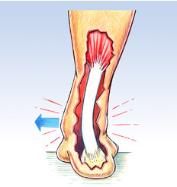
Foot Mechanics
Foot pronation
Subtalar joint ROM
Longitudinal arch angle
Forefoot alignment
Talocrural ROM
Gross, 1995; Carcia et al, 2010
Notes:
As previously mentioned in the risk factors section, excessive pronation is linked to Achilles tendinopathy. It is, therefore, important to assess the patient for this.
Gross, 1995:
If forefoot is aligned in varus, this can lead to excessive pronation in weight bearing. If you find the patient has forefoot varus, check the patients forefoot and rearfoot mobility. Hypermobility will usually lead to overpronation in patients with forefoot varus.
If the patient has a large longitudinal arch in NWB and a small longitudinal arch angle in weight bearing (flat foot), the patient probably has hypermobility somewhere that is leading to pronation
Other examination techniques that can help identify a possible cause or relation to excessive pronation are provided on the foot screening handout provided. Below is a quick explanation:
Navicular drop test: increased inferior displacement of navicular tubercle in weight bearing can indicate longitudinal arch/midfoot collapse = excess pronation
Rearfoot to leg angle: Gives us an idea of what the foot is doing during midstance. Larger angle = increased subtalar joint pronation. Rearfoot may be overly everted to compensate for forefoot varus malalignment)
Medial talonavicular bulge: excessive protrusion of talar head medially during weight bearing in single leg stance. The talus adducts on the calcaneus in single leg stance and brings the navicular with it. Would likely see this bulge in heel off point during gait cycle possibly due to tight gastroc/soleus. If gastroc/soleus are tight, the foot may dorsiflex at the subtalar joint (component of pronation) causing the talus to adduct.
Tibial torsion: excessive tibial torsion (toed-out foot) may be related to excessive pronation
Craig test: excessive femoral anteversion or retroversion may be related to excessive pronation
Patella facing medially: may indicate femoral anteversion. Can be related to excessive pronation.
Excessive genu valgus: may be related to excessive pronation.
Genu Recurvatum: Can be caused by tight triceps surae.
A lack of dorsiflexion can lead to excessive tensile stress on the Achilles tendon in all weight bearing activities; can certainly be a contributing factor to tendinopathy.
Furthermore, tight triceps surae can cause pronation; if the patient can’t get adequate dorsiflexion at the talocural joint, they will get the required DF somewhere else, such as the subtalar joint. Remember, DF is a component of pronation.
Picture: http://www.wherefeetloveus.com/foot-health/injuries/achilles-tendonitis.aspx

Slide 24
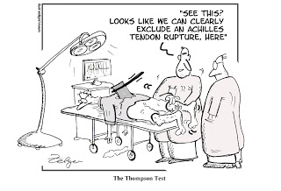
Ruling Out Complete Rupture
Thompson Test

Slide 25
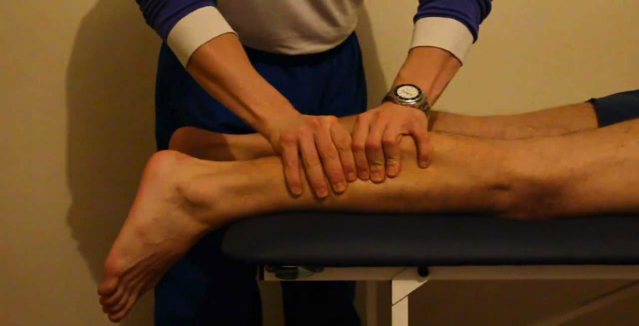
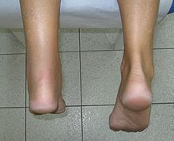
Thompson (“Squeeze”) Test
Thompson, 1962:
Patient prone with ankles over the edge of the table. Therapist squeezes the calf muscles
Positive = absence of plantar flexion
Notes:
Asses for possible tendon rupture.
A lot can be learned just from the patient history: if they mentioned that it was a sudden/immediate onset of pain and felt/heard a “pop” then you may suspect a rupture.
Be careful not to assume the Achilles is not ruptured if the patient is able to plantarflex the foot while in NWB; the long flexor muscles can perform this function in a NWB position even with a rupture of the Achilles.
***Unable to find psychometrics for this test
Pictures: http://i.ytimg.com/vi/phy9qIYAshQ/maxresdefault.jpg
http://en.wikipedia.org/wiki/Simmonds'_test

Slide 26
Ruling Out Spine
Straight Leg Raise
Slump Sit Test

Slide 27
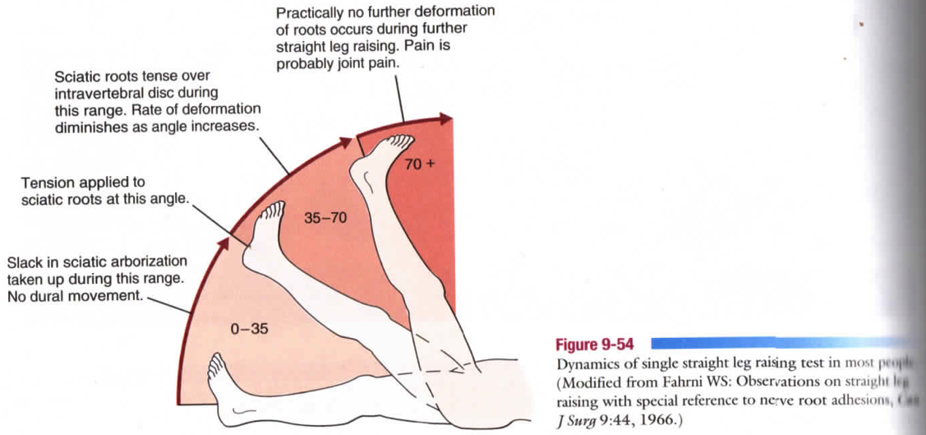
Straight Leg Raise
Cochrane Review, 2011
Positive only if pain is within the 30-70 degree range
Sensitivity = 0.87 – 0.95; Specificity = 0.18 – 0.40
Magee, 2008 pp. 564
Notes:
Perform as needed if you suspect a possible spinal origin of pain.
Pain below 30 or above 70 is unlikely to be from a nerve root irritation.
The specificity is low in this test largely because there are many other things that may cause a patient to report a false positive, such as tight hamstrings or gastrocs or hip joint pathology. If the patient demonstrates a positive, consider performing the slump sit test.
The high sensitivity helps us rule out a disc lesion/nerve root compression if the patient demonstrates a negative test.

Slide 28
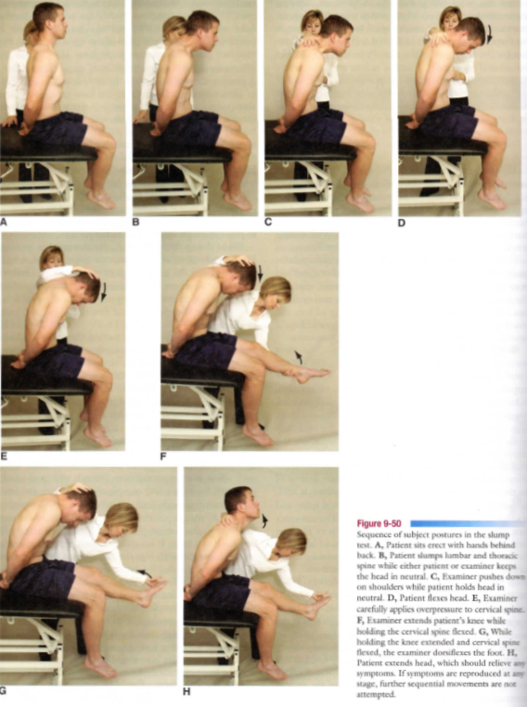
Slump Test
Cochrane Review, 2011
Sensitivity = 0.44 – 0.87; Specificity = 0.23 – 0.63
Magee, 2008
pp. 560

Slide 29
Ruling In Overuse Tendinopathy
Achilles tendon palpation test
Arc Sign
Royal London Test

Slide 30
Achilles Tendon Palpation Test
Maffulli et al, 2003
Patient prone with legs hanging off table. Gentle palpation of the entire Achilles tendon performed by squeezing the tendon between the thumb and index fingers.
Positive = pain with palpation 2-6cm proximal to insertion
Sensitivity 0.58; Specificity 0.84
Notes:
The higher specificity indicates this test is better for ruling in Achilles tendinopathy
Picture: http://i.ytimg.com/vi/a9FI_0HpQ5Y/hqdefault.jpg

Slide 31
Arc Sign
Maffulli et al, 2003
Patient positioned in prone with ankles hanging over the edge of the table and is asked to actively plantar flex and dorsiflex
Positive = the identified localized area of swelling moves proximal and distal with the tendon during the active motion
Sensitivity = 0.52; Specificity = 0.83
https://www.youtube.com/watch?v=zhP0CAsQr7U
Notes:
**Hard to see the nodule in the video but this gives an idea of how the test is performed.

Slide 32
Royal London Test
Maffulli et al, 2003
Patient prone on table with ankles hanging over edge. Therapist identifies area most tender to palpation, then asks the patient to actively dorsiflex the ankle and hold. Therapist palpates the area of maximal tenderness again.
Positive = decrease or absence of pain with palpation when ankle is actively dorsiflexed.
Sensitivity = 0.54; Specificity = 0.91
https://www.youtube.com/watch?v=nM3yu_TR4H8

Slide 33
Palpation
Skin and subcutaneous tissue
Temperature
Erythema
Muscle guarding or spasm
Attachment site to muscle and bone
Tenderness at rest? At extremes of ROM?
Tendon sheaths and bursa
Thickness
Crepitus
Joints
Nitz et al, 1997
Notes:
Warm temp and/or erythema would likely indicate an inflammatory issue (acute); probably wouldn’t have these signs with chronic tendinopathy
Check for muscle guarding, spasm, trigger points of triceps surae
A tender, nodular swelling is sometimes present; these tender nodules may move when the ankle is PF and DF, as described by the Arc sign.¹⁰
Joints: check all anatomic components of the synovial joint, including bones, capsule, ligaments, change in shape or deformity, tenderness, swelling, positional deficits.¹⁴

Slide 34
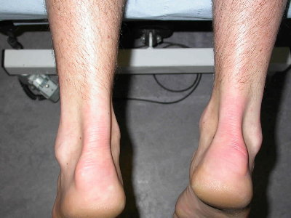
Measuring Size of Affected Area
Notes:
Palpate the area starting outside the location of pain and move in towards are of discomfort. As soon as the patient says they feel pain make a mark at this spot with a pen. Continue to palpate through the tender area and out to the other side to where they patient says they no longer feel pain; mark this spot with a pen. The therapist can now objectively measure the diameter of the painful area.
The pain intensity from tendinopathies don’t necessarily decrease as much over time as the area of the tendinopathy. Tendinopathies tend to centralize/shrink over time. This measurement can help show that the area of pain is decreasing with PT.
Special thanks to Dr. Gross, Advanced Orthopedics Elective, Fall 2014.
Picture: http://www.thefootandankleclinic.com/achilles-tendonitis.htm

Slide 35
Outcome Measures
Victorian Institute of Sport Assessment (VISA-A)
The Foot and Ankle Ability Measure
Single Limb Toe Raises
Single Leg Stance
Carcia et al, 2010; Silbernagel et al, 2006
Notes:
Carcia et al, 2010:
VISA-A: developed to specifically assess the severity of Achilles tendinopathy. Consists of 8 items that assess stiffness, pain, and function. Acceptable levels of reliability and validity have been reported. Has demonstrated sensitivity to change following an intervention.
FAAM: is a region specific instrument designed to assess activity limitations and participation restrictions for people with general MSK foot and ankle disorders, including Achilles tendinopathy. Consists of a 21-item ADL subscale and separately scored 8-item sports subscale. Has strong evidence for content validity, construct validity, test-retest reliability and responsiveness.
Silbernagel et al, 2006
Single Limb Toe Raises: Unilateral heel raises with knee in full extension at a pace of about 1 repetition every 2 seconds until unable to complete a full repetition due to fatigue or pain. Patients performed fewer heel raises on the symptomatic side (22 ± 9.9) compared to asymptomatic side (24 ± 9.1). Obviously this difference was not statistically significant (P=.07). However, this study included individuals with bilateral Achilles tendinopathy. Furthermore, the subjects wore a weight belt with 10% of their body weight in order for the researchers to assess when the participants terminated the test due to fatigue, not muscular discomfort. This test may be clinically useful for patients with unilateral tendinopathy if tested without extra weight to determine the difference between the affected and non-affected based on pain rather than fatigue.
Single Leg Stance:
Is not included in the in the papers by Carcia or Silbernagel, nor could I find evidence showing this to be a reliable/valid measurement for Achilles tendinopathy. However, it is a quick and easy way to objectively measure how long they can tolerate standing on the affected leg compared to the unaffected leg, seeing as many people with this pathology have pain in weight bearing. Could be useful in demonstrating how much the patient’s pain has improved over time with PT.
Special thanks to Dr. McMorris

Slide 36
Prognosis
Low vascularity
Few reparative cells
Low metabolic rate
Patience!
Conservative treatment favorable
Significant dec pain and function: 6-12 weeks
4-6 months recommended for full recovery
Paavola et al, 2000; Roos et al, 2004; Johnston et al, 1997
Notes:
Must consider the tendon’s vascularity and low metabolic rate, as well as the few reparative cells because the tissue has been damaged. Therapists must educate patients on the importance of being patient (see what I did there?) with this injury, and emphasize a gradual return.
However, conservative treatment shows favorable outcomes:
Most patients will report significant pain reduction after 6-12 weeks of PT, and often times much sooner than this. However, it generally takes 4-6 months for full recovery.^{16,18,20,22}
Full recovery does not necessarily mean it will take 4-6 months for the pain to completely subside. But that is a reasonable timeframe to completely reverse the collagenous breakdown that has occurred from chronic tendinopathy. Tendons are not metabolically active and take time to regenerate. And remember, someone with tendinopathy doesn’t necessarily have to have pain. After D/C from PT in about 6-12 weeks, the patient should continue with their HEP to continue strengthening the tendon and reducing risk of reoccurrence of pain or rupture.

Slide 37
Treatment for Tendinitis
Therapists who regularly work with athletic teams are more likely to identify and treat a tendinitis that has occurred within the first few days of onset
Notes:
Again, very rare we will see this in the clinic, but for those who supervise athletic teams, treatments are provided on the following slide

Slide 38
R.I.C.E.
Rest
Ice
Compression
Elevation
NSAIDs
de Vos, et al 2004; Paavola et al, 2002
Notes:
**Rest, ice and NSAIDs are underlined because those treatments are what is supported in literature. I was unable to find sound evidence supporting compression and elevation (except on google) but I included them 1) because they are associated with inflammation and pain relief, 2) because it is something any physical therapist or patient could try: if it helps, do it…if not, don’t do it, and 3) because it really goes well with this cool background.
**Advisor and committee: what are your experiences/thoughts?
Anti-inflammatory meds (NSAIDs) are commonly used: but remember, as therapists, we can’t prescribe anything. Be careful what you say and how you say it. May be advisable to tell athletes who have asthma NOT to take NSAIDs due to potentially dangerous side effects, or to check with their MD first.
The patient should be removed from the sport/activity for several days
Cryotherapy helps control pain, edema, inflammatory cascade, muscle spasm
Modify any movement abnormalities (heel lift, stretching for tight triceps surae)
Progressive return to activity. All activity should be pain free.

Slide 39
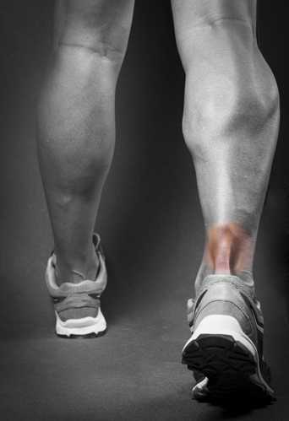
Treatment for Overuse Tendinopathy
Orthotics
Stretching
Manual therapy
Strengthening
Iontophoresis
Low-level laser therapy
Return to activity

Slide 40
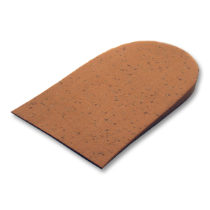
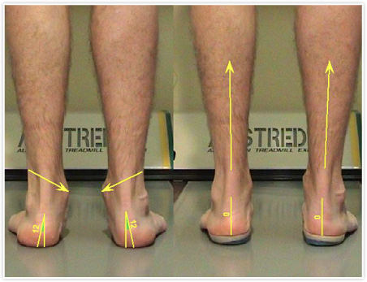
Orthotics & Heel Lift
Mayer et al, 2007:
31 runners with chronic Achilles tendinopathy randomized to PT, custom orthotic, or rest
Pain reduced to <50% of the baseline after PT or wearing orthotic
Notes:
Correction of any malalignments (if the patient has one that you suspect is contributing to tendinopathy) should be one of the first things we intervene to correct because this can often be the underlying impairment we are looking for.¹⁵ Addressing the underlying impairment is what will promote good long-term outcomes.
Orthotic intervention that has shown to be effective in reducing excessive pronation secondary to forefoot varus and a fallen longitudinal arch includes a medial forefoot wedge.³⁰
Medial forefoot and rearfoot post can decrease excessive rearfoot eversion during gait and has been shown beneficial in treatment of Achilles tendinopathy.⁷
A foot orthosis can be used to reduce pain and alter ankle and foot kinematics while running in patients with Achilles tendinopathy.¹⁶
Overall, not much evidence on heel lifts in relieving symptoms of AT. Heel lift can be used to reduce stress on the Achilles tendon, especially those who lack dorsiflexion ROM, by putting the triceps surae on slack.¹⁶ Use in the initial stages to put the tendon at rest and gradually take away as the patient gains DF ROM
Pictures: http://www.camberwellroadpodiatry.com.au/excess-foot-pronation
http://www.foothealthcare.com/shop/cork_heel_lifts

Slide 41
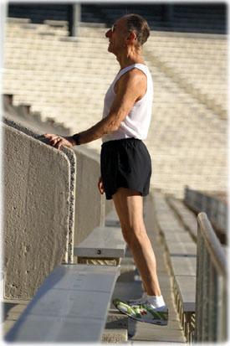
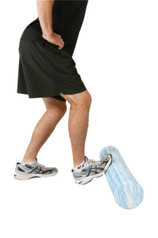
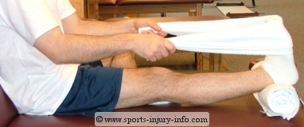
Stretching
Notes:
There really isn’t much evidence on the effectiveness of stretching. This is probably because stretching is typically just one component of a physical therapy intervention and is rarely studied independently. I mean let’s be serious, who is going to prescribe a patient who has Achilles tendinopathy solely stretching exercises?
It should still be implemented to reduce pain and improve function in those who have limited DF ROM.¹⁶
Also need to address potential tightness at the hip and knee.
Pictures: http://www.racewalk.com/stretching/calfStretch02.php
http://www.catalystsportstherapy.com/stretching-guides/lower-leg-foot-stretches.html
http://www.sports-injury-info.com/acl-reconstruction-pre-surgery-exercises.html

Slide 42
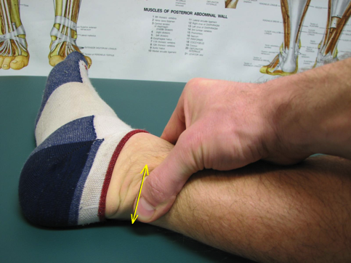
Manual Therapy: Cross Friction Massage
Joseph et al, 2012:
There tends to be positive effects of DFM for treating tendinopathy, but further evidence is required
Carcia et al, 2010:
DFM is recommended to reduce pain, and improve mobility and function in Achilles tendinopathy
Notes:
The evidence behind deep friction massage (DFM) seems to be similar to the evidence behind stretching: there isn’t an enormous amount of support behind it.
Gross, 1992:
DFR one of the first modalities used with patients with tendinopathy. Given for 5-15 minutes depending on size of structure, beginning in non-painful area progressing through symptomatic area to the other side, ending in a non-painful area. Pain is not uncommon for the first few days after treatment. May want to use cryotherapy after treatment.
Picture: http://therunningpt.com/tag/achilles-tendonitis/

Slide 43
Strengthening
Roos et al, 2004:
Randomized to eccentric exercises, night splint, or combination of both
Eccentric group reported significantly less pain and able to return to sport quicker than splint-only group
Rees et al, 2008:
Compared eccentric & concentric loading of the Achilles tendon
High frequency oscillations occurred more during eccentric loading than concentric loading
May show greater benefit for healing
Notes:
Eccentric exercises are commonly the “go-to” exercise clinicians choose for strengthening, improving function and decreasing pain in those with AT. There is an extensive amount of research supporting the use of eccentric loading in this population. In addition to the two examples provided in this slide, there has also been a recent systematic review showing the effectiveness of eccentric loading.⁴¹ Eccentric overload training results in a direct histological effect on the injured tendon resulting in a reduction in stiffness and better functioning, but the reasoning behind this is unclear.⁴²
Rees et al (2008): found that high frequency oscillations occur more commonly during eccentric than concentric loading. This difference has been proposed to achieve a greater therapeutic benefit by providing more stimulus for tendon remodeling. More studies are required to gain a better understanding of this, but this may be the beginning of an answer to an unsolved question: why do eccentric exercises work for this population
It should be noted that no definite answer can be given to the question of whether eccentric overload training has a more beneficial effect than concentric exercises on pain and function in patients with Achilles tendinopathy due to the poor methodology of many of the studies.⁴³ For example, Mafi et al⁴⁴ showed benefit of eccentric exercises over concentric exercises in their randomized controlled trial, but the intervention for the concentric group consisted of theraband exercises, whereas the eccentric group were given book bags full of heavy weights to wear when performing the eccentric exercises.
Bottom line: eccentrics DO work, but concentrics can also be incorporated into the exercise plan as well. Towards the end of the program, heavy eccentrics may be more beneficial in order to prepare for return to activity/sport.
Other: address other potential areas of weakness, such as hip external rotators and abductors.

Slide 44
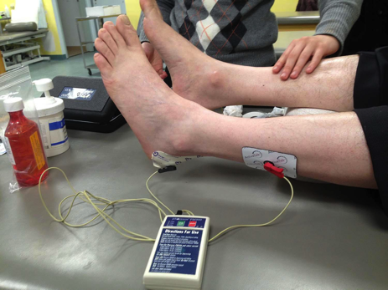
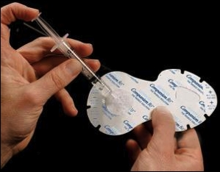
Iontophoresis
4 treatments of iontophoresis given over 4 weeks
Experimental: 3 ml dexamethasone
Control: saline solution
Experimental group demonstrated greater improvements in pain and function at 6 weeks, 6 months, and 1 year.
Neeter et al, 2003
Notes:
There is moderate evidence supporting the use of ionto with dexamethasone to help decrease pain and improve function; should be considered for patients with increased pain (first few PT visits).¹⁶
Pictures: http://www.italianjournalsportsrehabilitation.com/2015/01/01/acetic-acid-iontophoresis-for-the-treatment-of-insertional-achilles-tendonitis/
http://www.electrotherapy.org/modality/iontophoresis

Slide 45
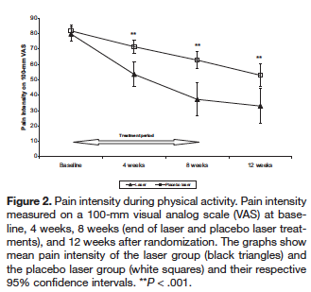
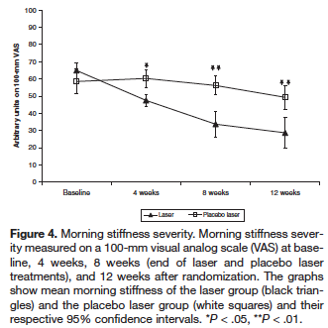
Low-Level Laser Therapy
Stergioulas et al, 2008
Enhanced outcomes in those treated with LLLT and eccentric exercises compared to those treated with placebo LLLT and eccentric exercises
Notes:
LLLT has been shown to reduce cell apoptosis and promote collagen fiber synthesis, thereby modulating the regenerative process.³³
There is also evidence from a systematic review with meta-analysis showing that LLLT has favorable outcomes for the treatment of nonregional specific tendinopathy.³⁴
LLLT power densities above 50 mW/cm² seem to inhibit fibroblast activity and collagen production, so keeping power density low is important if using this modality.³³

Slide 46
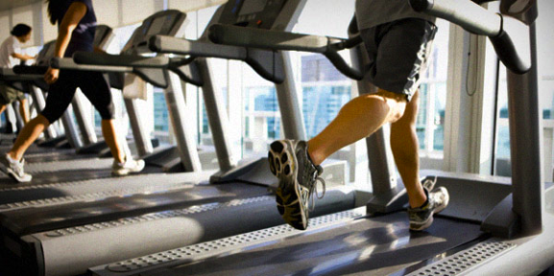
Return to Activity
Gradual return
Early absence of pain may not be a good indicator
Correct training errors
Maximal eccentric loading before discharge
Education!
Notes:
Gross, 1992:
Recommends that a gradual return to the offending activity can be initiated when the patient reports no pain with walking and when only vigorous palpation of the tendon during an isometric muscle contraction elicits pain.
The key to returning to full participation in activity is that it is gradual, even if the patient’s pain significantly decreases in the first couple weeks of treatment. Absence of pain may not be the best guide, especially if their pain decreases early. Why? Because we know the tendon is still weak.
Before discharge the therapist should load the muscle-tendon unit by having the patient perform maximal eccentric contractions. It is important this is done in a controlled environnent in order to prepare the patient for a possible unexpected maximal eccentric contraction back out on the field (uncontrolled environment).
Have the patient perform their activity/sport for you in the clinic. Ex) if they are a jogger, progress them back to jogging in the clinic; correct any issues that may have caused the tendinopathy, such as forefoot strike pattern or too much “bounce” when they run.
Education: always imperative. The education provided often depends on the patient. For example, if the patient is a middle aged overweight individual they should be encouraged to lose weight. Gradual progression into a workout regimen; don’t overdo it. Possible referral to dietitian? Education on smoking cessation, controlling diabetes and/or HTN prn.
Pictures: http://www.wakeforestsports.com/sports/m-footbl/spec-rel/091112aaa.html
http://hiit-blog.dailyhiit.com/hiit-life/fitness/master-machines-massive-muscles-8-treadmill/

Slide 47
“Non-PT” Treatments
Corticosteroids
Platelet-rich plasma injections
Extracorporeal shockwave therapy
surgery

Slide 48
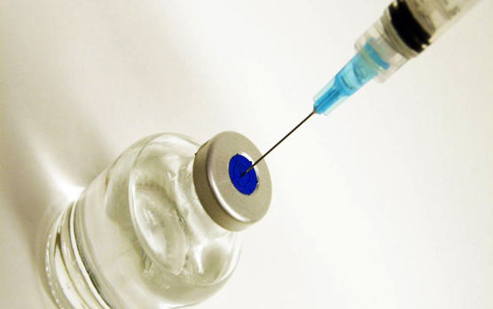
Corticosteroids
Coombes et al (2010):
Beneficial in short term but worse than other treatments in intermediate and long terms
Da Cruz et al (1988):
No significant benefit in treatment of Achilles tendinopathy
Kennedy et al, 1976:
Weakens tendon up to 14 days after injection
Avoid vigorous muscular activity at least 2 weeks after local steroid injection
Notes:
Coombes et al, 2010 (systematic review of RCTs): shows strong evidence that corticosteroid injection is beneficial in the short term for treatment of tendinopathy but is worse than other treatment options in the intermediate and long terms. They actually report negative long-term outcomes and high recurrence rates.
Should be noted that this systematic review only included 7 Achilles tendinopathy studies compared to 34 studies of UE tendinopathies: UE probably wont have as many adverse events, such as a rupture, because they are NWB tendons.
DaCruz et al, 1988: injections should only be given in the peritendionous region (not directly into the tendon) to avoid rupture. Found no significant benefit of corticosteroid injection for treatment of Achilles tendinopathy.
Kennedy et al, 1976: found that 1) physiologic doses of local steroid placed into a normal tendon weakens it significantly for up to 14 days post injection (keep in mind these are normal tendons and not degenerated tendons that are seen in tendinopathy); 2) the restoration of function by 14 days is due to the formation of an amorphous material that is just a precursor of collagen; 3) the biomechanical disruption of steroid is directly related to collagen necrosis. These authors recommend avoidance of vigorous muscular activity for at least 2 weeks after receiving local steroids; if possible, multiple injections should be avoided.
Take home message: Steroids should be avoided if at all possible. They don’t address the primary problem leading to tendinopathy and are deleterious to collagen (makes the tendon weaker than it already is). Many patients (athletes in particular) may receive an injection, start to feel better because of the analgesic effects, and continue performing in vigorous/repetitive activities. This further injures the tendon because the pain is masked not telling the patient to stop. Moreover, the patient is at a higher risk for rupture. If patients have a history of recent steroid injection in the Achilles, therapists must be careful not to overload the tendon too soon and educate the patient!
Pic from: http://www.adamsmith.org/blog/healthcare/get-the-olympic-rulebook-out-of-our-private-lives-and-legalize-steroids/

Slide 49
Platelet-Rich Plasma
de Vos et al, 2010:
No significant difference in improvement on the VISA-A between PRP and control groups
de Vos et al, 2011:
Used ultrasonographic techniques to assess if PRP injections lead to enhanced tendon structure and neovascularization
No significant between-group difference in change in tendon structure or neovascularization
Notes:
PRP is hypothesized to reverse the effects of tendinopathy by stimulating revascularization and enhancing healing at a microscopic level.³⁶
Platelets derived from whole blood using cell-separating systems provide a release of various growth factors and promote tissue repair.
Disappointing results in clinical studies, including randomized, prospective placebo controlled trials for Achilles tendinopathy:
De Vos (2010): one group received PRP and the other group received saline (placebo). Both groups underwent “usual” therapy of eccentric exercises. Both groups improved significantly on the VISA-A after 24 weeks but there was no significant difference between the two groups: PRP group improved by 21.7 points, placebo improved by 20.5 points.
De Vos (2011): Same methods as previous study but used ultrasonographic techniques to asses tendon structure and neovascularization. Both groups showed improvement of tendon structure and neovascularization but no between-group difference noted.

Slide 50
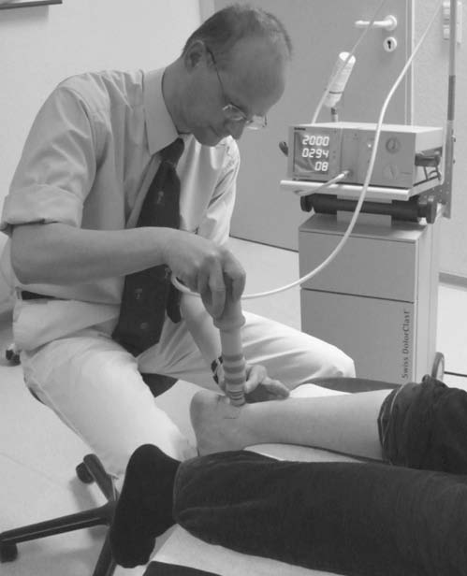
Extracorporeal Shock Wave Therapy
Rompe et al, 2007:
Eccentric loading and shock wave therapy showed comparable results at 4-month follow-up
Rompe et al, 2009:
ESWT combined with eccentric program better than eccentric exercises alone.
Notes:
The rationale is to address the failed healing response by stimulating the tissue to begin the inflammatory process (i.e. promote healing).¹⁹
Rompe et al, 2007: the study shows comparable outcomes between the eccentric group and the ESWT group; however, the eccentric group was given instructions on their exercise protocol at baseline, and assessed once again after 6 weeks. This may lead one to question the true clinical significance of this intervention, seeing as many patients are treated by their therapist on a weekly basis. Although it was implicated that participants documented each treatment session on standardized forms, compliance to the eccentric intervention was not reported. This leaves me to wonder how much exercise the patients really performed during this intervention. If the compliance forms demonstrated a lack in exercise compliance, it would be plausible to conclude that the results for the eccentric group are lower than what is presented in this article.
ESWT shows good promise for Achilles tendinopathy recovery.¹⁹

Slide 51
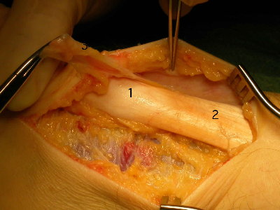
Surgery
If conservative treatment unsuccessful
Generally older age
Fibrotic adhesions
Degenerative nodules
Restore vascularity
Favorable outcomes with postoperative treatment
Paavola et al, 2000; Saxena et al, 2013
Notes:
Surgery usually only indicated if conservative management has failed.
Younger people (average age 33) tend to respond to conservative treatment better than older (average age 48) -> older people undergo surgery more often than young.¹⁰
Removal of fibrotic adhesions and degenerative nodules helps restore vascularity
Picture: http://www.thefootandankleclinic.com/achilles-tendonitis.htm

Slide 52
Conclusions
The histopathology of overuse tendon conditions is generally called tendinosis
Tendinopathy is diagnosed by the presence of pain, swelling, impaired performance
Chronic, midportion Achilles tendinopathy is most commonly seen in the clinic
Treatment promoting a gradual return and should address the underlying cause of pathology
Extra caution needs to be taken if a recent history of corticosteroid injection

Slide 53
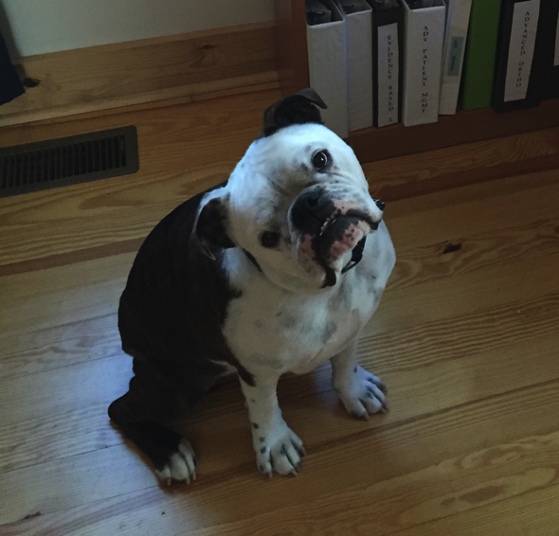
Thank you for your time
Questions?

Slide 54
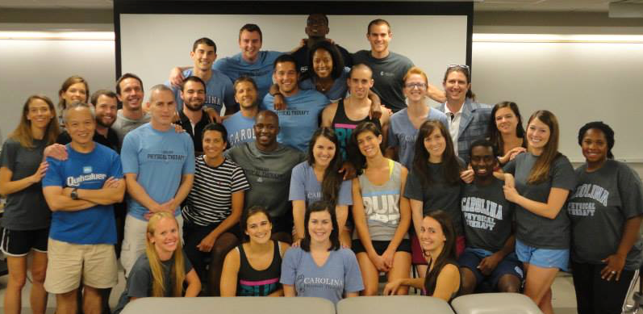
Special thanks to my Capstone advisor, Mike Gross, and committee members, Mike McMorris and Jennifer Thomas
C/O
2015

Slide 55
References
Doral MN, Alam M, Bozkurt M, et al. Functional anatomy of the Achilles tendon. Knee Surg Sports Traumatol Arthrosc. 2010;18:638-43.
James R, Girish K, Balian G, et al. Tendon: biology, biomechanics, repair, growth factors, and evolving treatment options. J Hand Surg. 2008;33A:102-12.
Chen TM, Rozen WM, Pan WR, et al. The arterial anatomy of the Achilles tendon: anatomical study and clinical implications. Clin Anat. 2009;22:377-85.
Khan KM, Cook JL, Bonar F, et al. Histopathology of common tendinopathies. Sports Med. 1999;27(6):393-408.
Sharma P, Maffulli N. Tendon injury and tendinopathy: Healing and repair. The Journal of Bone and Joint Surgery. 2005;87A(1):187-202.
Taylor GI, Palmer JH. The vascular territories (angiosomes) of the body: Experimental study and clinical applications. Br J Plast Surg. 1987;40:113-41.
Gross MT. Chronic tendinitis: pathomechanics of injury, factors affecting the healing response, and treatment. JOSPT. 1992;16(6):248-61.
Komi PV. Relevance of in vivo force measurements to human biomechanics. J Biomech. 1990;23(suppl 1):23-34.
El Hawary R, Stanish WD, Curwin, SL. Rehabilitation of tendon injuries in sport. Sports Med. 1997;24:347-58.
Paavola M, Kannus P, Jarvinen TAH, et al. Achilles tendinopathy. The Journal of Bone and Joint Surgery. 2002;84A(11):2062-76.

Slide 56
References
De Vos RJ, d’Hooghe PP, Leeuw P, et al. “Achilles Tendinopathy.” In The Ankle in Football. Springer Paris. 2004:213-33.
Maffulli N, Khan KM, Puddu G. Overuse tendon conditions: time to change a confusing terminology. The Journal of Arthroscopic and Related Surgery. 1998;14(8):840-3.
Waterston SW, Maffulli N, Ewen SWB. Subcutaneous rupture of the Achilles tendon: Basic science and aspects of clinical practice. Br J Sports Med. 1997;31:285-98.
Nitz AJ, Bellew JW, Hazle CR: Evaluation of musculoskeletal disorders. In: Malone TR, McPoil T, Nitz AJ (Eds): Orthopedic and sports physical therapy. Mosby – Year Book, Inc., 1997, pp165-189.
Alfredson H, Lorentzon R. Chronic Achilles tendinosis: recommendations for treatment and prevention. Sports Med. 2000;29(2):135-46.
Carcia CR, Martin RL, Houck J, et al. Achilles pain, stiffness, and muscle power deficits: Achilles tendinitis. J Orthop Sports Phys Ther. 2010;40(9):A1-A26.
Galloway MT, Lalley AL, Shearn JT. The role of mechanical loading in tendon development, maintenance, injury, and repair. J Bone Joint Surg Am. 2013;95:1620-8.
Paavola M, Kannus P, Paakkala T, et al. Long-term prognosis of patients with Achilles tendinopathy. An observational 8-year follow-up study. Am J Sports Med. 2000;28:634-42.
Saxena A, Longo UG, Denaro V, et al. “Insertional and Midsubstance Achilles Tendinopathy.” In Sports Nedicine and Arthroscopic Surgery of the Foot and Ankle. Verlag London. 2013:167-86.
Roos EM, Engstrom M, Langerquist A, et al. Clinical improvement after 6 weeks of eccentric exercise in patients with mid-portion Achilles tendinopathy – a randomized trial with 1-year follow-up. Scand J Med Sci Sports. 2004;14:286-295.

Slide 57
References
Rompe JD, Nafe B, Furia JP, et al. Eccentric loading, shock-wave treatment, or a wait-and-see policy for tendinopathy of the main body of the tendo achillis: a randomized condrolled trial. Am J Sports Med. 2007;35(3):374-83.
Johnston E, Scranton P, Pfeffer GB. Chronic disorders of the Achilles tendon: results of conservative and surgical treatments. Foot Ankle Int. 1997;18:570-4.
Sibernagel KG, Gustavsson A, Thomee R, et al. Evaluation of lower leg function in patients with Achilles tendinopathy. Knee Surg Sports Traumatol Arthrosc. 2006;14:1207-17.
Maffulli N, Kenward MG, Testa V, et al. Clinical diagnosis of Achilles tendinopathy with tendinosis. Clin J Sports Med. 2003;13:11-15.
Thompson TC. A test for rupture of the tendoachilles. Acta Orthop Scand. 1962;32:461-5
Neeter C, Thomee R, Silbernagel KG, et al. Iontophoresis with or without dexamethasone in the treatment of acute Achilles tendon pain. Scand J Med Sci Sports. 2003;13:376-82.
Coombes BK, Bisset L, Vicenzino B. Efficacy and safety of corticosteroid injections and other injections for management of tendinopathy: a systematic review of randomized controlled trials. Lancet. 2010;376:1751-67.
Kennedy JC, Willis RB. The effects of local steroid injections on tendons: a biomechanical and microscopic correlative study. Sports Med. 1976;4(1):11-21.
DaCruz DJ, Geeson M, Allen MJ, et al. Achilles paratendonitis: an evaluation of steroid injection. Brit J Sports Med. 1988;22(2):64-5.
Gross MT. Lower quarter screening for skeletal malalignment – suggestions for orthotics and shoewear. JOSPT. 1995;21(6):389-405.

Slide 58
References
Van der Windt D, Simons E, Riphagen II, et al. Physical examination for lumbar radiculopathy due to disc herniation in patients with low-back pain. Cochrane Review. 2011;2:1-74.
Joseph MF, Taft K, Moskwa M, et al. Deep friction massage to treat tendinopathy: a systematic review of a classic treatment in the face of a new paradigm of understanding. J Sports Rehabil. 2012;21:343-53.
Stergioulas A, Stergioula M, Aarskog R, et al. Effects of low-level laser therapy and eccentric exercises in the treatment of recreational athletes with chronic Achilles tendinopathy. Am J Sports Med. 2008;36:881-7.
Tumilty S, Minn J, McDonough S, et al. Low level laser treatment of tendinopathy: a systematic review with meta-analysis. Photomed Laser Surg. 28:3-16.
Rompe JD, Furia J, Maffulli N. Eccentric loading versus eccentric loading plus shock-wave treatment for midportion Achilles tendinopathy: a randomized controlled trial. Am J Sports Med. 2009;37:463-70.
Foster TE, Puskas BL, Mandelbaum BR, et al. Platelet-rich plasma: from basic science to clinical application. Am J Sports Med. 2009;37(11):2259-2272.
De Vos RJ, Weir A, van Schie HT, et al. Platelet-rich plasma injection for chronic Achilles tendinopathy: a randomized controlled trial. JAMA. 2010;303(2):144-9.
De Vos RJ, Weir A, Tol JL, et al. No effects of PRP on ultrasonographic tendon structure and neovascularization in chronic midportion Achilles tendinopathy. Br J Sports Med. 2011;45(5):387-92.
Mayer F, Hirschmuller A, Muller S, et al. Effects of short-term treatment strategies over 4 weeks in Achilles tendinopathy. Br J Sports Med. 2007;41(7):e6.

Slide 59
References
Rees JD, Lichtwark GA, Wolman RL, et al. The mechanism for efficacy of eccentric loading in Achilles tendon injury; an in vivo study in humans. Rheumatology (Oxford). 2008;47:1493-7.
Sussmilch-Leitch SP, Collins NJ, Bialocerkowski AE, et al. Physical therapies for Achilles tendinopathy: systematic review and meta-analysis. Journal of Foot and Ankle Research. 2012;5(15):1-16.
Silbernagel KG, Thomee R, Thomee P, et al. Eccentric overload training for patients with chronic Achilles tendon pain – a randomized controlled study with reliability testing of the evaluation methods. Scand J Med Sci Sports. 2001;11:197-206.
Kingma JJ, de Knikker R, Wittink HM. Eccentric overload training in patients with chronic Achilles tendinopathy: a systematic review. Br J Sports Med. 2007;41:e3:1-5.
Mafi N, Lorentzon R, Alfredson H. Superior short-term results with eccentric calf muscle training compared to concentric training in a randomized prospective multicenter study on patients with chronic Achilles tendinosis. Knee surg, Sports Traumatol, Arthrosc. 2001;9:42-7.
Magee DJ. Orthopedic physical assessment. St. Louis, MO: Saunders Elseiver. 2008:560,564.

