Slide 1
Scotland Memorial Hospital (SMH)
-ICU Early Mobility Pilot Program
-Interdisciplinary Program & Protocol Development
- Implementation within the not-for profit hospital
-Two-Year Follow-up Assessment

Slide 2
Scotland Memorial: Overview
Location: Laurinburg, NC (southeast NC)
Private inpatient facility
Short-term acute care facility
general medical & Surgical
Non-trauma center
Voluntary not-for-profit
154 beds (total) ICU: 7 beds
2014:
Patient visits to ER: 43,349
general admissions: 6,443

Slide 3
Early mobility what-a-who?!?
The question to ask is WHY mobilize critically ill patients.
Answer: PREVENTION
Weakness
Long-term impairment of physical function
Altered movement
Bone de-mineralization
due to lack of weight bearing and AROM within the line of gravity
Increase risk of falls-based injury & fracture
Notes:
Weakness can be from disuse (sarcopenia) and neuromuscular causes. Movement patterns altered due to poor proprioception and kinesthesia

Slide 4
Early Mobilization & inaccurate Perceptions
Keep in mind that many outside or within skilled rehabilitation are completely unaware or have an incomplete or misinformed idea of what early mobility entails
Immediately equate early mobilization to the ambulation of those on mechanical ventilation.
In actuality a process of improving a patients functional mobility in a progressive manner based on patient vitals and their stability
Supine rolling/Bed→Sitting/AROM→Standing/AROM→Ambulation
Notes:
During my advocating efforts for awareness and the need for early mobility at SMH it became very clear the degree of reservation most of the nursing staff and some rehab team members had about such protocols.
Clear and thorough education is imperative!! Not just “Bagging and Dragging” the patient down the hallway but rather a step-wise mobility progression/protocol based on vital signs and patient response much like with mobilization in the acute/rehab hospital settings.
Working towards improving and preserving basic A/PROM and functional mobility
Activities promoting reciprocal NM-activation activities in supine, sitting, standing
Preservation of somatosensory function, NMS-control/sequencing the trunk/spine as well as proximal joint locations necessary to produce efficient functional ambulation
-overall improved activity tolerance and functional reserve

Slide 5
Strength deficits in the ICU
Muscle weakness is prevalent in the ICU and may predict mortality and morbidity of critically ill patients.
Combination of critical illness myopathy (CIM) and critical illness polyneuropathy (CIP)¹⁵
CIP thought to contribute to more persistent disability.¹⁵
Prospective studies reveal 50-90% of ICU patients demonstrated electrophysiological abnormalities associated with CIP.¹⁵
Notes:
Obtaining accurate strength measures in the critical care setting can be a complex task influenced by a variety of factors
Clinical examination muscle strength in ICU is often limited by inadequate arousal, attention or cognitive performance and likely less valid with increased complexity of the measuring method
CIP: associated distal sensory impairment & may impact execution and coordination during handgrip dynamometry testing or other methods of strength assessment such as MMT
Local factors such as pain, arterial or venous catheters, edema, or fractures may additonally impact accurate muscle strength measurement

Slide 6
Muscle Strength Deficit & effects
Its hard to treat weakness when you test incorrectly within specific patient populations
Objective, reliable, and sensitive tools to measure muscle strength are imperative
MMT useful?
Handheld dynamometry (HHD) and handgrip dynamometry (HGD)
When the patient has MMT of 3 or greater, HHD shows greater validity
Notes:
The Medical Research Council (MRC) scale is a ordinal scale (0-5) very similar to MMT grading to measure volitional muscle strength test for cooperative patients even in healthy pt. populations.
-Also dependent on subjective assessment and non-reliable.
HHD & HGD utilize a continuous scale that is objective
More valid and sensitive to patients who may be uncooperative or with cognitive deficit.
Reliability of isometric handgrip strength was assessed in two studies with in total 63 patients where interrater and intra-rater reliability was found to vary between 0.93-0.97 and 0.85-0.91, respectully
MCID would need to be improvements of at least 50% to reflect a true change in muscle strength

Slide 7
A paradigm shift of the past
Previous models emphasize and should REMAIN to keep patient stable
Bed rest is the most prevalent activity within the ICU/step-down
Long-term functional outcomes often never reach previous fxn baseline.
Equally important has been the recognition that pain, oversedation and delirium associated with increased morbidity and mortality¹¹
Notes:
-Gait is not just about strength but rather coordinated, efficent repetiive efficient motion that is UNCONSIOUS. When it becomes a consious activity the patient will lose dual-task capability as to maintain balance and stability during ambulation and functional mobility
its hard to have good gait mechanics→ secondary injurys→further movement deficits
Its not just about walking either, in hospitals who are unfamilar with these protocols, many of weary due to a picture of ripping patients out of bed when it is really a very progressive vital-sign based progression
- Bed Mobility
- resistive exercises at bedside
- keeping motor control, UE/LE strength and somatosensory functioning intact for when they are able to step-down to acute→decreased length of hospital stay and for areas where there is no recources outside of primary care, optimizing functional mobility and ambulation potential prior to discharge is imperative.

Slide 8
More on sedation & Delirium
“Triad of anesthesia” underscores the pharmacodynamics and interactions among hypnotics, analgesics and muscle relaxants
“The ICU triad” recognizes that pain, agitation, and delirium and their approach to management are inextricably linked¹¹
Better to treat the condition/disease rather than masking.

Slide 9
Sedation Breaks
Sedatives should be used only when pain and delirium have been addressed
Use of singular pharmacologic/non-pharmacologic means
Routine Interruption of sedative infusions with discretion by clinicians lead to:
Fewer days undergoing mechanical ventilation
Shorter ICU stay.^{11,12}
Increased opportunity to complete early and continued mobilization during ICU stay^{11,12}
Sedation breaks + spontaneous breathing trials has been shown to also Increased survival.^{11,12}

Slide 10
Negative effects of over sedation
MRI studies have shown a positive association between the duration of delirium in the ICU and both cerebral atrophy and cerebral white-matter disruption.¹³
Among patients in the ICU, the duration of delirium was cut in half with early mobilization during interruptions in sedation.¹⁴

Slide 11
The Large and Growing Older Adult Population
Numerous studies have highlighted the detrimental effects of functional decline in hospitalized older adults
Importance of baseline functional status in predicting discharge outcomes
Covinsky et al (17)
Studied 2293 older adults‘ and monitored ADL function during an acute hospital stay.
found that 35% of patients had worse ADL function at discharge as compared with preadmission baseline.
Patients older than 85 years had rates of functional decline exceeding 50%.

Slide 12
How it effects the Rehab specialist’s
ICU related weakness has shown to
increase lengths of stay in Acute-care and IPR
decrease outcomes achieved with later rehab interventions upon hospital discharge
Increases instances of re-admittance
Increases the financial burdens in the long and short-term for hospitals continuum of care and US tax payers
Critical care accounts for 1% of the US GNP equaling 90 Billion dollars annually
Notes:
This kind of program can especially help rural communities with patient populations
1 wk bed rest dec mm strength by 20 percent
1 wk bed rest will dec. BMD 1% per week
Within rural and underserved areas patient population predominantly medicaid/medicare throughout their life which allocates inadequate amount of skilled rehabilitation with group payment plans and HMO’s restrict visits after leaving the hospital
- Combined with lack in available community resources for the patients to maintain postive outcomes achieved in primary care and most importantly to facilitate long-term behavior change.
Utilizing early mobilization for ALL patients whichever unit they are admitted to at not-for-profit rural hospitals like SMH as well as larger urban centers gives patients the best chance to reach previous fxn baselines with the amount of therapy time they get allotted.
Disconnect between those working up the chain with critically ill and those working in outpatient entities (they don’t ever see or realize the deficit the patient leaves with)

Slide 13
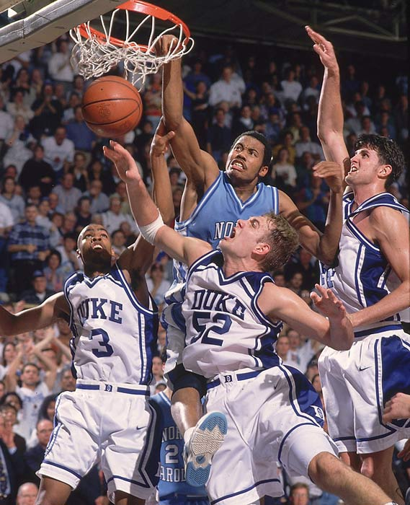
And we do this all for the reward…..
Consistent ,Positive
outcomes

Slide 14
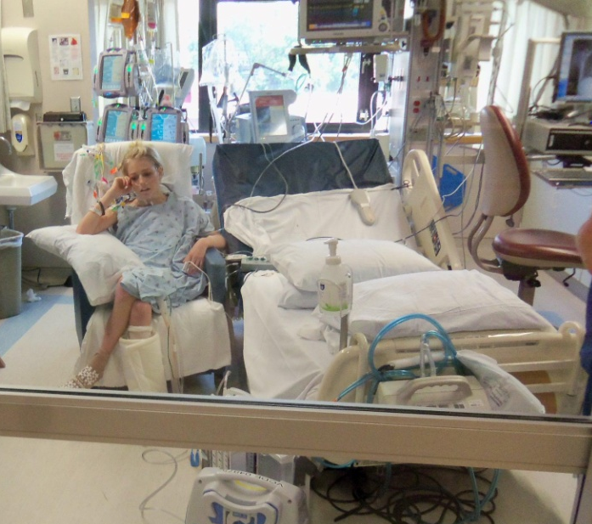
Outcome of Early Mobilization: pt mobility
.Department of Medicine, LDS Hospital, Pulmonary and Critical Care Division, Brigham Young University
1449 safely implemented “activity events”
16% sitting on EOB
31% sitting in a chair
53% amublating
Ranges for 5ft-600ft
Only 1% percent falls with no dislodging of lines, leads and tubes associated with life sustaining equipment.

Slide 15
Early Mobility Outcomes: Fxn at DC
.2009, Schweickert and colleagues reported findings from a prospective randomized trial of very early PT/OT from the inception of respiratory failure requiring mechanical ventilation.
Early mobilization protocols led to a 1.7-fold increase in patients who were functionally independent upon hospital discharge (59% vs. 35%, P = .02).
Those who received early mobilization group went directly home after hospitalization compared to the control group (43% vs. 24%, P = .06).
Those who received early mobilization achieved greater ambulation distances while in the hospital (33.4 vs. 0 m, P = .004)
Also more ventilator free days (23.5 days vs. 21.1 days; P = .05)

Slide 16
Outcomes of Early Mobility with UE
Burtin et al. (2009) RCT
Efficacy with early exercise using a bedside bicycle ergometer
Hypothesized prolonged stays in medical and surgical ICUs results
The 6-min walk at DC for intervention patients vs. control (196 m vs 143 m, p= .05)
SF-36 Health Survey of physical function higher for patients in the intervention group (21 vs 15, p=.05)
quadriceps force at hospital discharge was better in the intervention group
Notes:
Bedside bicycle ergometer: May be a good choice for patients with large LE injury or inability to ambulate while in the ICU due to physical or cognitive deficits.
Those in intervention group used the bedside ergometer at least 1x per day
Quadricep force is a strong predictor of ambulatory capacity.

Slide 17
Early mobility outcomes
. Brahmbhatt et al. Critical care 2010
.104 mechaniclly ventilated patients
-49 received Early mobility thereapy
-55 received just sedation breaks
. 59% of the patients that revieved early mobility achived
Independent functional status compared to 39% in the control
(p=0.02)
.Intervention group had more ventilator free days (p=0.05)
*** there was one adverse event in 498 activity sessions

Slide 18
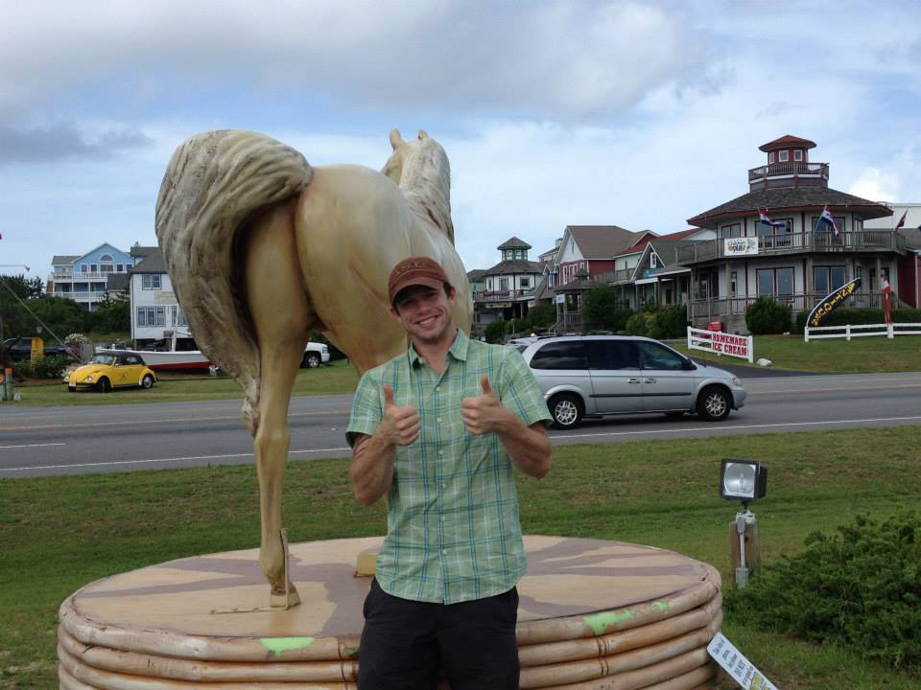
So good background info but now what?

Slide 19
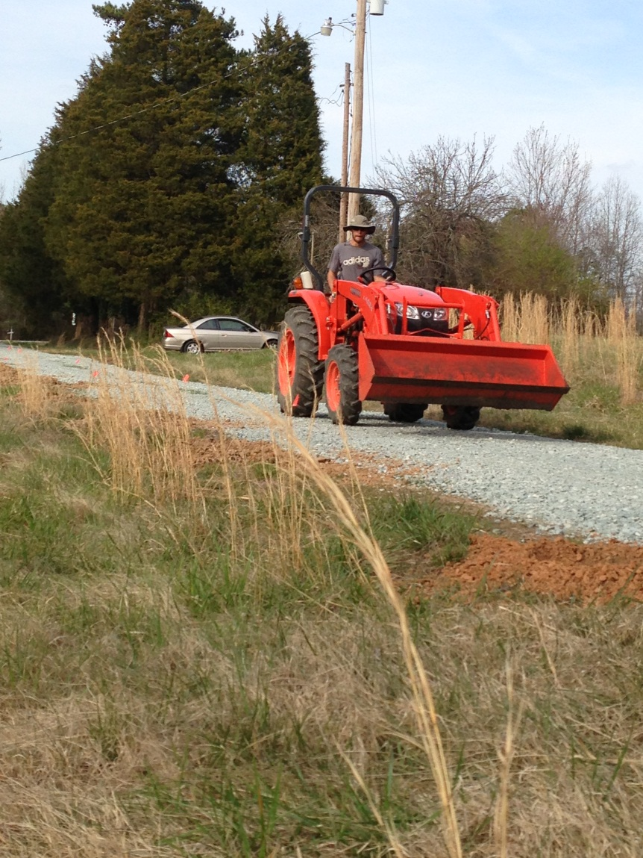
Get up,
go to work, ADVOCATE !!!
. Evidence based outcomes
- efficient implementation
- Outcomes based research
- Cost effectiveness
- Cross-training health Care
professionals
- reducing apprehensions
Notes:
The success of such programs hinges on a cultural shift within all health professionals and hospital entities

Slide 20
Steps to developing early mobilization at SMH
Step 1: Develop an interdisciplinary team
Cross-training and increased awareness
Interdisciplinary awareness of duties is imperative
Allows efficient provision of quality care regarding the concept and implementation of ICU early mobility
Team consists of
RN, CNA, PCT, PT, PTA, OT, Respiratory Therapist, Physicians, student clinicians, and most importantly patient-FAMILY (many roles)
Notes:
Concentrate on what your task is but also where you teammate is and where they will or may need to go (OBSTACLES) by:
1- Personal in-service demonstrations from ICU nurses, Respiratory therapists, PT, OT regarding their professional duties, scope of practice,
qualifications as to establish trust amongst one another and in clinical judgment regarding who to mobilize and who to not
2- Statement of need to PCP, ICU nursing staff about the importance and potential benefit with implementation of protocol
3- Convey Nurses are the driving force for early referrals and for successful program implementation (48 hr optimal time frame!!!)
-Still need to get the physicians to sign off on the PT orders etc.
-PCP must have trust in the nursing staff to make the right judgment about when the patient is stable and ready for mobility
4- Hospital centered program developmentWhen based in the not for profit hospital arena, many rehab departments are understaffed and usually will only have 1 or 2 PT on the floor
-FLOATING: is regular occurrence with hospital based employees in rehab, OPPT, HHPT etc will come in and cover acute floor.
-Everyone at SMH is up to date and proficent with Early mobility protocol and the acute care environment
-One sole PT therapist at SMH and floating gives flexibility with scheduling and compliance/consistency of the SMH early mobility protocol
5- By healthcare workers of the ICU increasing awaremess of what Inpatient Acute rehab does as well as IPR increases understanding of patient canidates that are suitable for early mobility and rehabilitation, giving all a clear outlook as to provide quality, INDIVIUALIZED patient-centered care. That is safe for the patient.
6- Why this presentation is more of an evidence based how-to session so that all healthcare professionals on each level of rehab and hospital unit are aware and in understanding of what is gong on at the beginning (ICU) and end of the health care continuum.
7-Team Formation of a successful early mobility protocol can be equated to a team sport
-safety, efficient and sucessful early mobility each team member must know your job and where you are but
also know where you will be as well as where you teamate will be, what to do if shit hits the fan

Slide 21
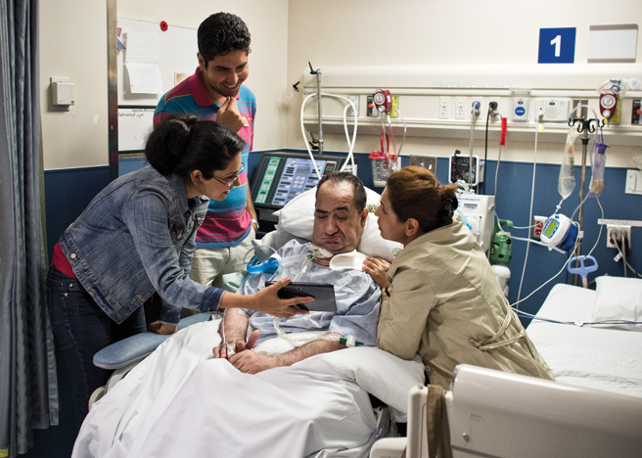
Steps to developing early mobilization at SMH
2. Establish a preliminary protocol for early mobility within the assembled team-members
Must be individualized to the hospital you are practicing within.
FAMILY BASED EARLY MOBILITY
The first draft is not set in stone
Notes:
For the initial protocol we have decided to work within the two lead ICU nurses and their respected caseload’s
-Small ICU unit (7 bed)
-Include all types of patients minus SCI. Includes SOB RESECTIONS, Cardiac, pulmonary as well as long term vented patients when appropriate.

Slide 22
Benefit of Incorporating Family into ICU Mobility
Family based early mobility is imperative at SMH.
Llimited staffing and availability
With proper skilled instruction and education and comfort the family can serve many imperative roles with active participation
Coach
Motivator
Historian
Consistent Implementation of non-skilled interventions
Decreased sense of helplessness by Family
gives comfort & increased QOL
Notes:
Utilizing family members in ICU early mobility protocol was more cost and time effective by allowing them to complete PROM AAROM techniques where skilled rehabilitative therapies are not necessarily required
Safe implementation requires family education and inservice/interest meetings, PT’s OT’s participating in ICU rounds to screen for interests in protocol advocating such interest during early mobility team meetings.
At SMH we prepared Laminated booklets of AROM, PROM, BW PA at the patients bedside for the family

Slide 23
Safety Considerations for Early Mobility
Table 2: Stiller(2007).
Safer to increase the intensity of activity slowly and progressively as each treatment is tolerated
General physiological principle and clinical acumen guide clinical practice
Activity should be selected based on assessment of patient’s underlying cardiovascular and respiratory reserve
Activity should be determined from the patient’s response to previous mobilization treatments

Slide 24
Safety Considerations for Early Mobility
Appropriate activity duration and frequency are extremely variable for critically ill patients
Duration and frequency depend on patient’s underlying condition
Mobilization should be functional as possible
If possible, a short warm-up period should be accomplished
Patient safety should be considered during all phases of a mobilization activities

Slide 25
SMH Pilot Protocol: Exclusion Criteria
Unable to understand or interpret English
Presence of pelvic, long bone fractures or in in skeletal traction
If intubated, and less than <72 hours
Full spinal precautions
Presence of acute traumatic brain injury or increased ICP
Fio2 < 60%, RR<12, PEEP<10, O2 sat <90
Facial trauma or known difficult airway
BMI > 40
Presence of metastatic lung disease

Slide 26
Steps to developing early mobilization at SMH
Step 3: Establish outcome measures that are feasible, sensitive, valid and reliable sensitive
Define outcomes of interest which accurately illustrate the value of ICU-EM programs
Multiple functional outcome measures to provide small and large scales of change
ID improvement or worsening of function
Decrease presence of floor effect
At SMH: PARAGON
incorporates multiple types of functional outcomes together each scale proven accurate, (KUH, FIM,)
Notes:
- Applicable to ambulatory and non-ambulatory patients
Early & accurate patient prognoses with strong correlation and prediction of:
DC destination
Care given during hospital stay and transition of functional mobility after inpatient stay

Slide 27
The ICU Mobility Scale
Developed by multidisciplinary group
critical care physicians (8)
physical therapists (8)
Registered nurses (2)
Usable by all members of multidisciplinary ICU team
Possess Content Validity
Feasible to administer and record
High inter-rater reliability across all professions
Notes:
Abilitiy to quckly easily and reliably reportthe highest level of mobiliztion in the ICU is important for safe clinical practice
-Enables consistency and efficency of implemtning mobility protocol

Slide 28
ICU intensive care mobility Scale (IMS)
NUM | Classifacation | Definition
0 | None (lying supine) | Passively rolled/exercised by staff; 0 AROM
1 | Sitting/bed exercise | Bed mobility activities, exercise, AROM
2 | Passive bed→chair | Hoist, passive life or slide trasnfer to chair or over EOB
3 | Sitting EOB | Active completion supine→sit EOB w/ or w/o assist
4 | Standing | WB through LE in standing positon w/ or w/o assist
5 | Active bed→chair | Active participation bed→chair transfer with variable level of assist
6 | Marching in place @bedside | Alternate stepping in place (must complete > 4 steps)
7 | Walking +2 assist | Walking away from bedside/chair (at least 5m) with +2 assistance
8 | Walking +1 assist | Walking away from bedside/chair (at least 5m) with +1 assistance
9 | Mod-I walking (AD) | Walking away from bedside/chair (at least 5m with only AD assistance
10 | Independent walking | Walking away from bedside /chair (at least 5m with no assist or with use of AD
Notes:
Presneill et al. 2014 (19)
-Implemented IMS within 2 ICU’s in Australia
-11-point early mobility scale
-Average time to complete <1min
High inter-rater reliability by therapists ( 0.83; 95%CI: 0.76-0.90) and moderate to high by nurses (0.76; 95%CI: 0.56-0.83)

Slide 29
Consistency in vision = quality of care
Consistency in protocol implementation
Consistency inclusion and exclusion criteria
Consistent weekly meetings
Barriers
Positive feedback
Constructive criticism with change for the better
Outcomes tracking past DC

Slide 30
Sample Early Mobility Minutes
Thank you again for taking time to meet this morning. I wanted to recap on points made and the action plan. Let me know if there are any discrepancies. Also please find attached the adapted Progressive Mobility Protocol for nursing from CMC.
General points made:
We will be conducting a pilot program initially, involving select members of all disciplines:
Nursing: Tina Revels, RN, Krystie Grooms, RN
Nursing Specialist/Coordinator: Jamie Bromley-Turner, RN
Physical Therapy: Jennifer Sanford, PT, Kim Byrne, PTA
Occupational Therapy: Menar Malloy, OT
Respiratory Therapy: Melissa Mace, RT
Patient populations who would be best candidates for pilot program:
Post-bowel resection/post-surgical patients
Post resuscitation/post hypothermia who have had neuromuscular blocks
Patients weaning from vent
Team members given copy of adapted Progressive Mobility Protocol
This is adapted from a protocol used for all ICU patients in CMC system for general early mobility by nursing staff and assists when determining time for PT to be initiated.
Continue rounding between Therapy, Respiratory and Nursing on ICU, 10:30 a.m. daily.
Notes:
Early mobility minutes were recorded and typed-up and emailed to all mobility team members for reference as needed.
Improvement of program objectivity and consistency of implementation

Slide 31
Sample Early mobility Minutes cont.
Action Plan to be completed for next meeting: 8th August, 2013 Nursing members to peruse Progressive Mobility Protocol and modify as needed, to be presented next meeting
Therapy team to devise ROM protocol for use of nursing staff and for family training
Therapy team to devise Therapy Progression Protocol and address concerns re: arterial lines/pulmonary artery catheterization
Respiratory therapy to provide a brief inservice to team to discuss ventilator settings/mechanics and safe parameters for mobilizing patient (see literature/protocols published in previously sent literature)
COMPLETED ACTION: Nursing provided job description for PCT/unit secretary on ICU clarifying ability to assist with body mechanics, such as ambulation, turning, positioning, transfer to wheelchairs/stretchers, and provide range of motion.
Next Early Mobility Team meeting scheduled Thursday, August 8th, 8:30 a.m. at third west staff lounge.
Thank you for your excellence in your professional service.

Slide 32
SMH Early Mobility Protocol
Fit exclusion critera
N
Y
No Mobility
VSS A&O x 1 in bed?
Y
N
VSS w/rolling during linen change & hygiene?
Y
N
A/AAROM, rolling, bed mobility
Notes:
VSS: Vital Sign Stability

Slide 33
VSS > 5 min w/ AROM & Bed mobility?
Terminate mobilty session
Y
N
Pt follows >/= 75% of commands?
Y
N
prolonged non-VSS
Transfer supine→sitting EOB
Return to supine/HOB elevated
-VSS > 5min w/ sitting EOB?
-2/5 strength against gravity?
VSS< 5min
Y
N
< 2/5 MMT: AAROM in sitting EOB
-LE & UE A/AAROM, reaching,seated marching

Slide 34
-VSS> 5min at EOB A/AAROM
-No dizziness or large orthostatic change
Remain EOB activity/static sitting
Y
N
+2 assist sit→stand
-VSS > 5 min static standing
-No dizziness or large orthostatic change
-Pt hold >/= 75% of body weight?
-Pt follow 100% of commands?
-Lower back to sitting;
Cont vital s instability terminate session
Y
N
Begin pre-gait exercises
-Standing @ EOB
-Sway weight shift ant/post/laterally
-step forward/back with assist
-Reciprocal marching with assist
-Lateral Stepping along EOB
Notes:
You will continue this trend with increasing ambulation distance as tolerated and pt remains VSS

Slide 35
2-year Follow-Up Assessment
Program still in place but consistency lacking
Decreased staffing
3 RN
1 PT, 1 PTA, 2 OT (not assigned to ICU)
No appreciable decline regarding re-admissions or total LOS
7 bed ICU + Short-term care facility
Means the problem of decreased early mobilization is more systemic-based (throughout SMH)
Implemented Hospital Wide Survey (provided on capstone site.
Notes:
Inadequate staffing is a very common barrier to consistent implementation of ICU early mobility even with designation of “floater” to help cover Acute PT, otherwise nobody to initiate evaluation and deem indicated for mobility
LOS: Length of Stay in ICU is usually shorter in nature (< 1 week) and the percentage of patients who require long-term mechanical ventilation >72 hours is rare.
-Usually these patients are transferred to larger trauma centers in Charlotte and/or Greenville NC
Lack of early mobility is thus more systemic across all step-down units of SMH. As such I developed a survey to identify why this hesitance continues to exist, from what factions of SMH employees and alternate barriers present which are attenuating inconsistency with Early mobility protocol

Slide 36
2-Year Follow-up Assessment continued.
Difficulty establishing culture of early mobility
Increased amount of employee turnover within all positions
Including ICU charge nurse on Mobility team
Decreased instance of full-time employees due to location and outside resources available
Many times SMH uses part-time, traveling health professionals

Slide 37
ICU Mobility: Just one recourse
Other options have been conceived regarding extended primary care services for acute/chronic conditions such as MI,CVA, TBI
Interdisciplinary coordination along different aspects of care continuum
Opportunities for current clinicians & student clinicians
2015 AHEC grant: Interdisciplinary Rural Health Pilot projectUNC Allied Health Department
PACE community health center, Burlington NC
Notes:
Interdisciplinary coordination may also take the form of health promotion programs or community health clinics which provide resources for successful transition and maintenance of outcomes upon DC from primary care
PACE: Medicare reimbursable entity which provides primary care entities such as PCP, RN, PT, OT, SLP, Rec. therapy as well as community center recreational opportunities.
-Eligibility includes over the age of 55yo, live within 60 min radius of facility and currently living independently at home
-Goal maintiance and of positive outcomes from previous care
-Culture of independence rather than enabling
-Development of dual-task health promotion activities with education to facilitate increased social interaction and increased amount of late life leisure activity with hopefully greater motivation to continue positive health behaviors and motivation to create behavior change of those behaviors known to be maladaptive.

Slide 38
Alternate examples of resources
The GENESIS protocol: Padula CA et al. (2009)
Impact of a nurse-driven mobility protocol on functional decline in hospitalized older adults and explored whether a mobility protocol would maintain or improve functional status from admission to discharge and reduce LOS.
The researchers recruited a convenience sample (N = 50) of adults 60 years or older, who were admitted with medical diagnoses to 1 of 2 nursing units (n = 25 each). Inclusion criteria included an LOS of 3 or more days
This study was conducted at The Miriam Hospital, a private 247-bed, not-for-profit, acute care teaching hospital in Providence, Rhode Island
Nurses trained and supported to integrate a multicomponent geriatric program, Geriatric Friendly Environment through Nursing Evaluation and Specific Interventions for Successful Healing (GENESIS), into their model of nursing care delivery
Notes:
Padula Cynthia et al (2009)
Cognitive status was determined by completion of a Mini-Mental Status Examination with a score of 24 or more. Medical patients were selected to avoid potential limitations in mobilization frequently associated with the surgical experience.

Slide 39
GENESIS CONT.
Protocol: directed to question orders for bed rest as well as to routinely evaluate the necessity of obstacles to mobility such as urinary catheters.
Nursing Evaluation and Specific Interventions for Successful Healing (GENESIS), into their model of nursing care delivery.
It is a priority of certified nurse assistants to walk GENESIS patients 3 to 4 times per day and also to assist patients to the chair for meals and the bathroom or commode for toileting.
formal, intensive 3-day continuing education units program related to principles of geriatric nursing care.
The GENESIS program includes a RN driven mobility protocol; that specific protocol served as the intervention for this research.
Functional status was operationalized using the modified Barthel Index (BI)20 and the Up and Go test.21 The BI is a subjective measure that measures the capacity of an individual to perform identified ADL
Ambulating in the hallway seemed to be more effective than chair rest and even ambulating in the room. This may be because ambulation in the hall requires significant strength, balance, and coordination processing
Notes:
Subjects in the treatment group had a lower fall-risk score on admission than the control group, but the difference was not significant (7.5 treatment vs 9.5 control; P = .07). The treatment group fall-risk level also was lower (1.86 treatment vs 2.4 control; P = .04), suggesting that the treatment group was at lower fall risk on admission.
Barthel Index scores significantly improved from the admission baseline for the treatment group (P = .05) by +11.5, with control group scores improving by 6.9 (not significant). The control group demonstrated a statistically significant decrease in function between preadmission to discharge (P = .006
treatment group ambulated in the hallway earlier (2.7 days treatment vs 4.9 days control, P = .007) and more often (3.12 times treatment vs 2.44 times control; NS). The treatment group had significantly shorter LOS (4.96 days treatment vs 8.72 days control; P < .001).

Slide 40
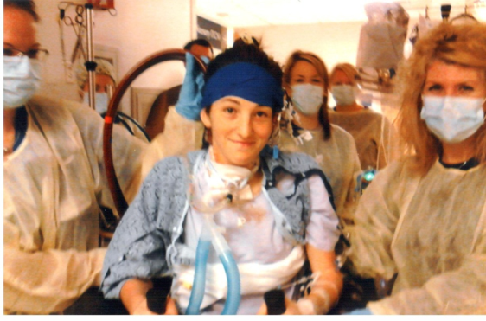
So in conclusion…
lets go to work
And get people back to work

Slide 41
Refrences:
Christiana S Perme, PT. Rober E Southhard, MD. David L. Joyce MD, George P Noon MD, Marthias Loabe MD, PhD. "Early Mobilization of LVAD Recipients Who Require Prolonged Mechanical Ventilation." Clinical Investigation (2006): 130-134. Department of Physical Therapy and occupational therapy, Methodist Hospital.
Dang, L, Stephanie MSN, RN, ACNS-BC. "ABCDE's of ICU early mobility." Critical care nursing (2013): 163-168
Ling-Ling Chiang, Li-Ying Wang, Chin-Pyng Wu, Huey-Dong Wu and Yin-tai Wu. "Effects of Physical Training on Functional Status in Patients With Prolonged Mechanical Ventilation." Physical Therapy (2006): 1271-1281.

Slide 42
References:
Naishadh Brahmbhatt, Raghavian Murugan Eric, B Milbrant. "Early mobilization improves functional outcomes in critically ill patients." Critical Care (2010): 1-3.
Pawlik J. Amy, Kress P. John. "Issues Affecting the Delivery of Physcial Therapy Services for Individuals With Critical Illness." Critical Illness: Special Series (2013): 256-265.
"Ramona O. Hopkins, PhD et al." Critical Care Clinics (2007): 81-96. Department of Medicine, Pulmonary and Critical Care Division, LDS Hospital,Psychology Department and Neuroscience Center,Brigham Young University.
Rukstele Christina D, MSN, RN and BSN, RN Gagnon M. Mary. "Making Strides in Preventing ICU-Acquired Weakness, Involving Family in Early Progressive Mobility." Critical Care Nursing Q (2013): 141-147.

Slide 43
References:
Smith K. Barbra, PhD, PT, Gabrielli Andrea MD, Paul W. Davenport, PhD. (PhD)., "Effect of Training on Inspiratory Load Compensation in Weaned and Unweaned Mechanically Ventilated ICU Patients", Respiratory Care (2013):
Truong, D Alex, Eddy Fan, Brower G Roy and Needham M Dale. "Bench-to bedside review: mobilizing pts in the ICU-from pathophysiolgy to clinical trials." Critical Care (2009): 10. Johns Hopkins University, critical care medicine, physical rehabilitation .
Ubaldo J. Martin, MD, Luis Hincaple, RTP, RPT Mark Nimchuck and PhD, Genard J Criner, MD John Gaughan. "Impact of whole-body rehabilitation in patients recieving chronic mechanical ventilation." Critical Care Medicine (2006): 2259-2266.
Reade C. Michael et al. Sedation and Delirium in the Intensive Care unit, N Engl J Med, 2014; vol 370: 444-455

Slide 44
References continued
Kress JP, Pohlman AS, O’Connor MF,Hall JB. Daily interruption of sedative infusions in critically ill patients undergoing mechanical ventilation. N Engl J Med 2000;342:1471-7.
Gunther ML, Morandi A, Krauskopf E et al. The association between brain volumes,delirium duration, and cognitive outcomes in intensive care unit survivors:the VISIONS cohort magnetic resonance imaging study. Crit Care Med 2012;40:2022-32.
Schweickert WD, Pohlman MC, Pohlman AS, et al. Early physical and occupational therapy in mechanically ventilated,critically ill patients: a randomised controlled trial. Lancet 2009;373:1874-82.
Editorials and Commentaries, Muscle Strength Measurement in the ICU: Not everything that can be counted counts, Journal of Criticall Care, 2013; vol 28: 96-98

Slide 45
References
Vanpee, Goele et al. Assessment of Limb Muscle Strength in Critically Ill Patients: A systematic Review. Critical Care Med, 2014; vol 42:701-711
Baldwin CE et al. Muscle strength assessment in critically ill patients with handheld dynamometry: An investigation of reliability, minimal detectable change, and time to peak force generation. Journal Crit Care, 2013; vol 28: 77-96
Covinsky KE, Palmer RM, Fortinsky RH, et al. Loss of independence in activities of daily living in older adults hospitalized with medical illnesses: increased vulnerability with age. J Am Geriatr Soc. 2003;51(4):451–458
Presneill et al. Feasibility and inter-rater reliability of the ICU Mobility Scale, Heart and Lung, 2014, 19-24
Padula CA et al. Impact of nurse-driven mobility protocol on functional decline in hospitalized older adults, Journal of nursing care quality, 2009; volume 24 (4): 325-331

