Slide 1
Patellofemoral pain syndrome
Dale Hamilton
University of North Carolina at Chapel Hill

Slide 2
Learning Objectives
Be familiar with the prevalence of Patellofemoral Pain Syndrome (PFPS)
Understand the anatomy and structures of the knee
Understand the biomechanics of the knee
Be familiar with the steps of a physical examination of patients with PFPS
Be familiar with interventions for PFPS

Slide 3
Order of business
Significance of Patellofemoral Pain Syndrome (PFPS)
Pathology of PFPS
Anatomy and structures of the knee
Biomechanics of the knee
Physical Examination of patients with PFPS
Intervention for PFPS based on the etiology

Slide 4
Significance of PFPS
Most common cause of knee pain in sports medicine clinics (Halabchi et al, 2013; Davis et al, 2010)
Occurs at a rate of 7% in active young adults, with females being more susceptible (Crossley, 2002; Ferber, 2003; Johnston and Gross, 2004)
Represents 16% to 25% of injuries in runners (Fredericson & Powers, 2001; Johnston and Gross, 2004; Dixit et al, 2007)
Affects 25% of the general nonathletic population (Johnston and Gross, 2004; Herrington & Al-Sherhi; 2007)
Notes:
Patellofemoral pain syndrome (PFPS) or runners is the most common cause of knee pain in sports medicine clinics.
Females are more likely to develop the condition due to different in anatomical structures.
Females larger hip width to femoral length ratio, which leads to greater hip adduction, hip internal rotation, and larger Q angle (graphic on slide 14).

Slide 5
Anatomy & Function of the knee
Bones & Ligaments, Muscles

Slide 6
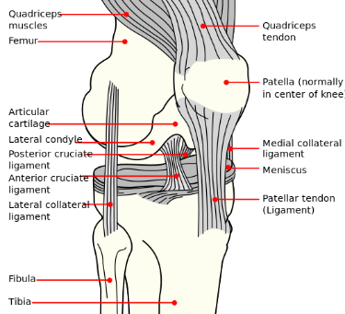
Anatomy of the knee
Synovial hinge joint
  Extension/flexion
    0-135° degrees
  Hyperextension
    0-15
  Medial/lateral rotation
    20-30°/30-40°
Functions
  Support function
  Mobility function
Hertling & Kessler
Notes:
Talk about the different bony and ligamentous structures of the knee

Slide 7
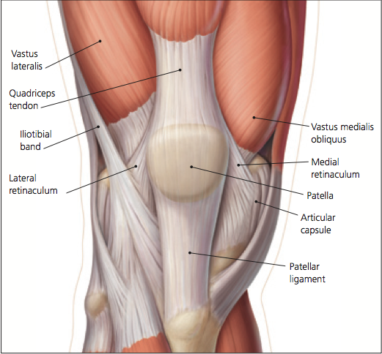
Anatomy of the knee
Dixit et al
Notes:
Anterior view of right knee.
Dynamic stability of the patellofemoral joint provided by quadriceps tendon, patellar tendon, vastus medialis oblique (VMO), vastus lateralis, and IT band.
VMO provides medial force to support patellar.
Static stability provided by articular capsule, femoral groove, medial and lateral retinacula, and patellofemoral ligaments.

Slide 8
Knee Biomechanics
Osteokinematics & Arthrokinematics

Slide 9
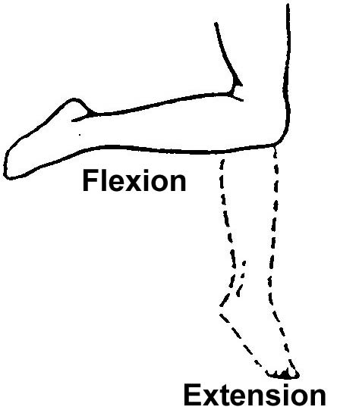
Osteokinematics
Movements between two segments. For example:
Flexion
Extension
External Rotation
Internal Rotation
Notes:
Flexion
Closed Chain: During closed chain flexion (foot planted on the ground), the femoral condyles roll posteriorly and glide anteriorly, while the femur rotates internally on the tibia.
Open Chain: During open chain flexion, the tibia glides anteriorly on the femur while the tibia externally rotates.
Extension
Closed Chain: During closed chain extension, the femoral condyles roll anteriorly and glides posteriorly on the tibia, while the femur rotates externally.
Open Chain: During open chain extension, the tibia glides posteriorly on the femur as the tibia internally rotates.
Screw-Home
The mechanism that locks and unlocks the knee during stance phase of gait that occurs due to the rotation between the tibia and femur as the knee transitions to or from terminal extension. The rotation of the tibia and femur occurs between full extension (0 degrees) and 20 degrees of knee flexion.
Note to self:
During the gait cycle, knee flexion begins at initial contact of the ipsilateral extremity and peaks at about the time of toe-off of the contralateral extremity. This represents about 60% of the gait cycle.
Patellofemoral joint reaction force is dependent on the angle of knee flexion and the tension of the quadriceps muscle (Powers, 1998).

Slide 10
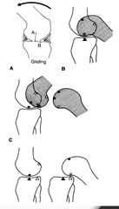
Arthrokinematics
Accessory motions of the knee.
Roll
Glide (or slide)
Spin
Hertling & Kessler
Notes:
Arthrokinematics
Roll – rolling of one joint surface on another. Multiple points on one surface contacts multiple points of the other.
Slide or Glide – linear movement of a joint surface parallel to the plane of the adjoining joint surface. Single pint on one surface contacts multiple points on the other.
Spin – rotation of the movable joint surface on the fixed adjacent surface. Single point on one surface rotates on a single point on the other joint surface.

Slide 11
Pathology of PFPS
Causative Factors, Signs & Symptoms

Slide 12
Causative Factors
Multiple factors contribute to the development of PFP.
Theories Behind Causative Factors:
Proximal factors
Local Factors
Distal factors
Overuse
Powers, 2001 and Davis & Powers, 2010

Slide 13
Causative factors
Proximal Factors
Soft tissue tightness (Fredericson & Powers, 2001)
Altered hip kinematics in the frontal and transvers (Powers et al, 2002; Powers 2003 et al; Ferber et al, 2003; Davis & Powers, 2010)
Weakness of the hip abductors (Dierks et al, 2008; Davis & Powers 2010)
Notes:
Proximal Factors
Soft Tissue Tightness
Tightness of the iliotibial band (ITB) can contribute to lateral patellar tilt an excessive pressure on the lateral patella.
Distal fibers of the ITB blend with fibers of the lateral patellar retinaculum, thus affecting normal patella excursion with tightness
Altered hip kinematics in the frontal and transvers
Frontal Plane: Increased hip adduction angle. This is especially in females where they demonstrate greater hip adduction velocity than men, which is due to a greater hip width to femoral length ratio.
Transverse Plane: Increased internal rotation of the femur results in a larger Q angle, moving the patella medially thereby increasing the lateral forces on the patella.
NOTE: If femoral rotation remains through out the entire gait/running cycle, femoral anteversion should be suspected.
Weakness of hip abductors
Hip abductor weakness contribute to greater peak femoral adduction during stance phase of running.
Excessive femoral adduction contribute to knee valgus, which increase the lateral forces acting on the patella.
Increased lateral forces on the patella increases contact pressure between the lateral femoral condyle and lateral facet of the patella. This, in addition to the repetitive nature of running can lead to PFPS.
Delayed gluteus medius activity relative to the vastii muscles during stair-stepping tasks.
NOTE: Dierks and colleagues noted that it is unclear whether hip weakness in runners resulted in PFPS or if the weaker muscles were a consequence of disuse due to the pain associated with PFPS.

Slide 14
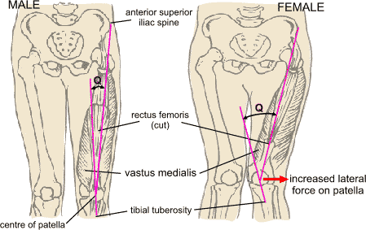
The Q-Angle
Notes:
Q Angle – The Q angle is measured as the angle formed by the intersection of the line drawn from the anterior superior iliac spine (ASIS) to the midpoint of the patella and the proximal extension of the line drawn from the tibial tuberosity to the midpoint of the patella.

Slide 15
Causative factors
Local Factors
Abnormal patellofemoral joint mechanics (Bolgla et al, 2011; Davis, 2009; Fredericson & Powers, 2001; Powers 1998)
Altered kinematics in the frontal plane (knee valgus) (Powers, 2003)
Impaired muscle function such as VMO: VL ratio (Souza et al, 1991)
Notes:
Local Factors
Abnormal Patellofemoral joint mechanics
Abnormal patella tracking caused by an increased Q angle.
Decreased contact area at the patellofemoral joint = increased reaction force during weight bearing = increased joint stress
$Normal Pressure=\frac{Force}{Contact Area} vs. ↑Pressure=\frac{↑Force}{↓Contact Area}$
Altered Kinematics in the frontal Plane
Valgus at the knee would increase the Q angle resulting in a medially displaced patella (with respect to the ASIS). This increases the lateral pull on the patella
VMO:VL Ratio
Souza et al found that individuals with unilateral PFP demonstrated decreased VMO: VL ratio bilaterally.
The decreased VMO:VL IEMG ratios in both knees of an individual with unilateral PFPS suggests that abnormal muscle activation patterns may interact with biomechanical factors in explaining the cause of unilateral PFPS.

Slide 16
Causative factors
Distal Factors
Abnormal* subtalar joint (STJ) pronation (Tiberio, 1987; Powers, 2003)
Normal STJ pronation occurs during the first 25 to 30% of the gait cycle (Powers, 1995; Powers, 2003)
Pathomechanics (Tiberio, 1987):
  Abnormal STJ pronation drives tibial internal rotation.
  Tibial internal rotation drives compensatory femoral internal rotation to achieve unlocking of screw-home.
  Therefore, abnormal STJ pronation → Tibial IR → Femoral IR → Increased forces at patellofemoral joint → patellofemoral pain.
  *Abnormal = being excessive or occurring at the wrong time
Notes:
Distal Factors
Abnormal subtalar joint pronation
Abnormal pronation is thought to contribute to patellofemoral joint dysfunction. Abnormal = excessive or occurring at the wrong time as in when supination should be occurring. Normal STJ pronation occurs during the first 30 % of the gait cycle. During this time, the tibia internally rotates.
The distinct biomechanical relationship between the rarefoot and the tibia occurs due to the close fit of the talus within the ankle mortise. As a result, the tibia internally rotates with the transverse plane motion of the talus when the STJ pronates during the stance phase of the gait cycle.
Internal rotation of the tibia changes the tibiofemoral joint mechanics. External rotation of the tibia should occur during STJ supination during late midstance phase of the gait cycle. However, excessive or prolonged STJ pronation results in a delay in tibial external rotation. Therefore, a compensatory internal rotation of the femur occurs, causing relative external rotation of the tibia in order to unlock the screw-home mechanism to promote flexion of the knee.
Compensatory internal rotation of the femur increases compression forces on the lateral articular surface of the patella and the lateral condyle of the femur causing pain at this patellofemoral articulation.

Slide 17
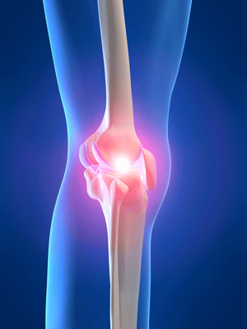
Causative factors
Overuse
Overuse of the knee joint Fredericson & Powers, 2001
Lack of significant findings on physical exam such as normal patellar mechanics and normal lower extremity function suggests that the source of patellofemoral pain may be related to overuse.
  This is often seen in athletes
Notes:
Overuse
With normal patellar and lower extremity mechanics and function, PFPS could be a result of a training schedule that is too rigorous

Slide 18
Signs & symptoms
Clicking or grinding of the patella
Pain with the following activities:
  Running
  Jumping
  Squatting
  Kneeling
  Ascending/descending stairs
  Sitting for prolonged periods of time
  Pain on palpation
Crossley et al, 2002; Piva et al, 2005; Tyler et al, 2002; Østerås et al, 2013; Nakagawa et al, 2013; Nakagawa et al, 2008
Notes:
PFPS is characterized by clicking or grinding of the patella, pain with running, squatting, jumping, ascending/descending stairs, and sitting for a prolonged period of time. It is also painful upon palpation.

Slide 19
Physical examination
Subjective, Physical Exam

Slide 20
Subjective
Location of pain
Types of symptoms
Pain severity
Mechanism of injury
Past history of knee injuries
Level of function prior to injury

Slide 21
Physical Exam
Observation
  Perform integumentary assessment: Look for swelling, signs of trauma
  Look for static posture anatomical deviations that may lead to dynamic biomechanical dysfunctions
Palpation
  Sensation, joint line, pain and tenderness

Slide 22
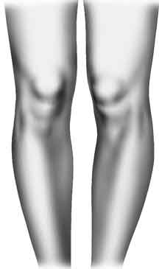
Physical Exam
Standing Assessment
Assess for:
  Varus/valgus
  Knee hyperextension
  Squinting patella
  Rearfoot angle
  Step down test
  Squinting Patellae

Slide 23
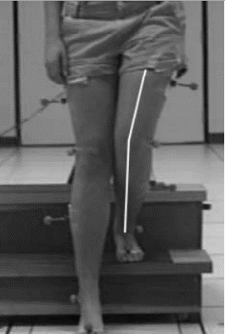
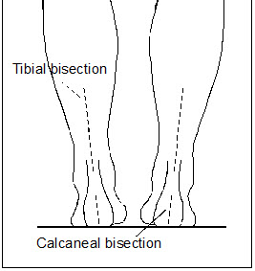
Step down test
Rearfoot Angle
Powers, 2003
Notes:
Step down test
During step down test, if excessive knee valgus is seen, assess whether it is coming from femoral adduction relative to the pelvis, tibial abduction relative to the femur, or a combination of both. The photo above shows femoral adduction relative to the pelvis because the position of the tibia is relatively vertical.
Excessive femoral adduction during dynamic tasks could be due to weakness of the hip abductors.
Tibial abduction may be the result of excessive STJ pronation.
Rearfoot angle
This is measured as an acute angle between the distal midline of the leg and midline of the calcaneus (Johnston and Gross, 2004).

Slide 24
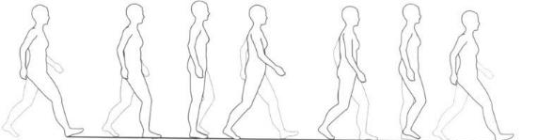
Physical Exam
Dynamic Gait Analysis
  Access for Trendelenburg gait
  Assess for excessive foot pronation/supination
  Assess for tibia and femur rotation
  Assess Q angle and biomechanics of patella during running/walking

Slide 25
Physical Exam
Sitting Exam
  Patella orientation
  Hip external rotation strength
  Hip internal rotation strength
  Quad strength
  Hamstring strength

Slide 26
Physical Exam
Supine Exam
Active/Passive Knee ROM
VMO coordination test
Patellar mobility
Patellar tracking
Patellar tilt
Patellar grind
Pivot shift test
Thomas test for iliopsoas flexibility
Patellar apprehension test
Leg-length
90-90 test for hamstring flexibility
Valgus & Varus stress tests at 30 degrees
Plica test
McMurray test
Lachman test
Anterior draw test
Posterior draw test
Posterior Sag Sign

Slide 27
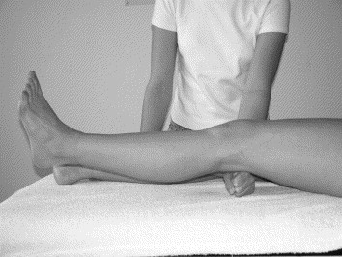
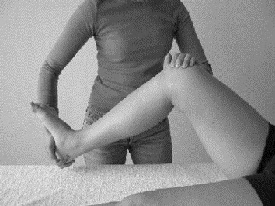
VMO Coordination
Patellar Apprehension
Nijs, 2006
Notes:
VMO Coordinate test
The patient is supine, and the examiner places his/her fist under the subject's knee and asks the patient to extend the knee slowly without pressing down or lifting away from the examiner's fist. The test is considered positive if the patient either has difficulty smoothly accomplishing extension or recruits either the extensors or flexors of the hip to accomplish extension.
Patellar Apprehension Test
The patient is supine and the examiner uses one hand to push the patient's patella as lateral as possible, in order to obtain a lateral patellar glide. Starting with the knee flexed at 30°, the examiner grasps the leg at the ankle/heel with the other hand and performs a slow, combined flexion in the knee and hip. The test is considered positive when it reproduces the patient's pain or when apprehension is present.

Slide 28
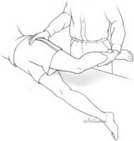
Physical Exam
Side-lying Exam
Prone Exam
Ober test for TFL and ITB flexibility
Hip abductor strength
Hip extensor strength
Apley’s compression
Apley’s distraction
Forefoot varus
Gastroc/Soleus flexibility
Craig test (for femoral anteversion/retroversion)
Tibial torsion
Ober Test

Slide 29
Differential Diagnoses
Conditions to rule out

Slide 30
Differential Diagnoses
Diagnoses to Rule Out
ACL/PCL injury
MCL/LCL instability
Meniscus tear/pathology
Medial/lateral instability
Plica Syndrome
ITB Friction

Slide 31
Differential Diagnoses
Meniscus Injury
Condromalacia
+ McMurray’s test
– Apley’s Distraction
+ Apley’s Compression
Pain is due to damage to cartilage under the patella possibly caused by overuse or patella maltracking.
+ Clark’s test
+ Patella grind test
Tight ITB
Pain with prolonged sitting
Grinding of the knee with flexion and extension

Slide 32
Differential Diagnoses
ACL Injury
PCL Injury
+ Lachman’s test
+ Anterior Drawer test
+ Pivot Shift test
+ Posterior Drawer test
+ Posterior Sag Sign

Slide 33
Differential Diagnoses
MCL Injury
LCL Injury
+ Apley’s Distraction test (excess motion/pain with external rotation)
+ Valgus stress test
+ Apley’s Distraction test (excess motion/pain with internal rotation)
+ Varus stress test

Slide 34
Differential Diagnoses
Plica Syndrome
ITB Friction
+ Medial Plica test
Pain with palpation along medial edge of patella
Audible clicking in the knee with flexion/extension
No other notable findings on exam
+ Ober test
Subjective reports of changes in training schedule such as increased mileage, altered terrain, or change in shoes (McConnell, 2014)

Slide 35
PFPS Presentations
Patella Instability, Patella Malalignment, Excessive Knee Valgus

Slide 36
Diagnosis Clusters
Patella Instability
Female
Patella alta
Knee buckling or giving way
Femoral anteversion and/or external tibial torsion
Squinting patellae
Q angle > 20 degrees
Pain with lateral movement of patella
+ Apprehension test (laterally)
+ Thomas test (tight rectus femoris)
Weakness of quad muscles (knee extensors)
Recurrent subluxation of the patella
Patella hypermobility
Davis & Powers, 2010; McConnell, 2014
Notes:
Patella Instability
Females, having a wider pelvis usually have a greater Q angle. Females are also likely to have patella alta. Both of these conditions are associated with PFPS.

Slide 37
Diagnosis Clusters
Patella Malalignment
Female
Joint laxity
Quadriceps and VMO weakness/atrophy
Restricted gliding of the patella either medially or laterally
Tight passive lateral structures (ITB and lateral retinaculum) with patella tilt test
McConnell, 2014
Notes:
Weakness or atrophy of the VMO causes the patella to drift laterally during knee extension.

Slide 38
Diagnosis Clusters
Excessive Knee Valgus (Due to STJ Pronation)
Tibial abduction during step down test (Powers et al, 1995)
Increased rearefoot angle (Powers et al, 1995)
Excessive STJ pronation durance stance phase of gait (Powers, 2003)
  STJ pronation causes tibial internal rotation, which leads to compensatory internal rotation of the femur, which increases lateral forces on the patellofemoral joint (Tiberio, 1987; Powers, 2003).
STJ pronation could be due to (Gross, 1995):
  Forefoot varus (excessive forefoot eversion)
  Tight calf muscles
  Inclination of the distal third of the tibia towards midline (tibial varum)
Notes:
Tibial abduction is indicative of excessive STJ pronation. This can been seen on exam with an increased rearfoot angle. The patient will demonstrate increased knee valgus during the step down test.
The clinician should assess the main cause behind STJ pronation.
Forefoot varus – this malalighment causes the forefoot to be elevated from the support surface resulting a compensatory pronation of the STJ to bring the medial side of the forefoot down to meet the support surface.
Tight calf muscles – prevents STJ dorsiflexion, therefore the ground reaction force causes the STJ to produce an eversion moment (a component of STJ pronation) in a compensatory manner during stance phase of gait.
Tibial varum – Medial articular compressive stresses and lateral soft tissue tensile stresses at the knee may result in the distal tibia being inclined towards midline. This elevates the medial foot from the support surface. As a result, the STJ compensates by over pronating in order to get the medial aspect of the foot on the ground.

Slide 39
Diagnosis Clusters
Excessive Knee Valgus (Due to Hip Weakness)
Trendelenburg sign during dynamic gait assessment
Femoral adduction or internal rotation while tibia remains vertical during step down test (Powers et al, 1995)
Weakness in the hip musculature during MMT
  Gluteus maximus and gluteus medius, and the deep rotators (Powers, 2003).
Notes:
Due to weak hip abductors and external rotators relative to the hip adductors and internal rotators, the femur collapses into internal rotation during gait. This causes medial displacement of the patella, which increases the lateral forces acting on the patella resulting in pain.

Slide 40
interventions

Slide 41
Intervention
PF Instability
McConnell Taping
  Lateral tracking – The edge of the tape is applied at the lateral edge of the patella and pulled medially and tapped to the medial aspect of the patient’s knee.
  Medial Tracking – The edge of the tape is applied on the lateral edge of the patella. Use fingers to pull skin towards the medial aspect of the knee. Place tape on the medial side of the knee using hamstring tendons as an anchor.
  Lateral Rotation – Tape is placed at the lateral edge of the inferior pole of the patella, then pulled medially and cephalward.
McConnell, 2014
Notes:
NOTE: Taping must be specific to the patient based on the patella position (glide, tilt, rotation). The worst component is always corrected first and the effect of each piece of tape on the patient’s symptoms should be evaluated by reassessing the painful activity. It may also be necessary to correct more than one component.

Slide 42
Intervention
PF Maltracking/Instability
Exercises with McConnell Taping
  Taping along with exercises were more effective than taping or exercises alone.
  Daily exercises included:
    Isometric quad contractions in sitting
    Bilateral and unilateral quarter squats
    Controlled step-downs (forwards, backwards, and laterally)
    Isometric hip external rotation into wall while standing
    Stretches: quadriceps, hamstrings, gastrocnemius, and ITB for 4 reps for 20 seconds each.
  Also consider closed and open chain exercises for quad strengthening (Herrington & Al-Sherhi; 2007)
Whittingham, et al, 2004
Notes:
NOTE: It is theorized that McConnell taping technique helps to align the patella in the trochlear so that patients can perform strengthening exercises they were unable to do due to pain. The mechanism of how taping affects PFPS is unclear, but has been shown to reduce symptoms by at least 50% (Fredericson & Powers, 2001).
Quad strengthening should include weight bearing and non-weight-bearing exercises:
A six week progressive quad strengthening program performed 3 times per week
Seated knee extension from 90 degrees
Seated leg press starting with knees at 90 degrees
Both groups had similarly significant improvement at the end of 6 weeks when compared with the control group.

Slide 43
Intervention
Hip Weakness
Posterolateral hip strengthening
  Target the hip abductors, hip extensors, and external rotators (Khayambashi et al; 2014)
  Target the gluteus maximus & gluteus medius
Quadriceps strengthening as a supplement provides additional benefits (Nakagawa et al, 2008)
  A five times per week 6-week strengthening program of hip abductors and lateral rotators (intervention) vs. quad strengthening alone (control) found that subject in the intervention group had improved function and less pain during activity.
Notes:
Exercises may include:
Hip Abductors:
Side lying clamshells, fire hydrant, side lying hip abduction
Hip External Rotators:
Isometric hip external rotation into wall while standing
Hip Extensors:
Single-legged squats, lunges, bridging, glut sets,
Quadriceps:
Seated knee extension (long arc quads), leg press, straight leg raise, isometric quad sets

Slide 44
Intervention
STJ Pronation
Custom orthotics are more effective in improving symptoms of PFPS in individuals who demonstrate excessive STJ pronation (Johnston & Gross 2004)
  Custom orthotics provide maximal biomechanical control as compared to off the shelf orthotics (Fredericson & Powers, 2001)
Methods of correcting STJ Pronation(Gross, 1995):
    Forefoot varus – An orthotic with medial forefoot wedge
    Tight calves – Stretching as well as orthotic with heel wedge
    Tibial varum – custom orthotic with medial heel post
Shoe recommendation: Straight lasted shoe with high density midsole material
Notes:
The theory is that reducing foot pronation with custom orthotics influences patellofemoral tracking through a reduction of internal rotation of the tibia and consequently, compensatory internal rotation of the femur.
Forefoot varus – The wedge elevates the support surface to the medial side of the inverted forefoot.
Tight calves – Patient should perform stretching while wearing shoes with prescribed heel wedge.
Tibial varum – Medial wedge brings support surface up to meet the arch of the foot, which prevents over-pronating of the STJ
Shoes – straight lasted shoe to support medial aspect of foot and the higher density midsole material is resistant to deformation limiting the magnitude and duration of pronation.

Slide 45
Intervention
Overuse
Lack of significant findings on physical exam suggests that the source of PFPS symptoms could be related to overuse.
Treatment program should focus on rest and activity modification.
Evaluate the athlete’s training program for errors including:
  Increased intensity too quickly
  Increased distance too quickly
  Inadequate recovery time
  Excessive running on hills
Fredericson & Powers, 2001
Notes:
If physical exam reveal normal patellar mechanics, normal lower extremity function and kinematics, consider overuse of the knee joint. This is mostly seen in the athletic population.

Slide 46
Intervention
One more??
Text here

Slide 47
Closing words
Management of patellofemoral syndrome requires an understanding of the factors contributing. The clinician must develop a strong, individualized treatment program for the patient with PFPS and should take into consideration all of these potential contributing factors. Importantly, abnormal motions relating to PFPS can originate from the ankle and upward, from the hip and pelvis downward, or a combination of both.
Abnormalities associated with PFPS are not universal as individuals who appear to have the same presentation could have different lower-extremity kinematics that contribute to the problem. This information must be used to guide the physical exam in order arrive at the appropriate treatment option(s).

Slide 48
References
Halabchi F, Mazaheri R, Seif-barghi T. Patellofemoral pain syndrome and modifiable intrinsic risk factors; how to assess and address? Asian J Sports Med. 2013;4(2):85-100.
Crossley K, Bennell K, Green S, Cowan S, Mcconnell J. Physical therapy for patellofemoral pain: a randomized, double-blinded, placebo-controlled trial. Am J Sports Med. 2002;30(6):857-65.
Dixit S, Difiori JP, Burton M, Mines B. Management of patellofemoral pain syndrome. Am Fam Physician. 2007;75(2):194-202.
Piva SR, Goodnite EA, Childs JD. Strength around the hip and flexibility of soft tissues in individuals with and without patellofemoral pain syndrome. J Orthop Sports Phys Ther. 2005;35(12):793-801.
Tyler TF, Nicholas SJ, Mullaney MJ, Mchugh MP. The role of hip muscle function in the treatment of patellofemoral pain syndrome. Am J Sports Med. 2006;34(4):630-6.
Østerås B, Østerås H, Torstensen TA, Torsensen TA. Long-term effects of medical exercise therapy in patients with patellofemoral pain syndrome: results from a single-blinded randomized controlled trial with 12 months follow-up. Physiotherapy. 2013;99(4):311-6.
Nakagawa TH, Serrão FV, Maciel CD, Powers CM. Hip and knee kinematics are associated with pain and self-reported functional status in males and females with patellofemoral pain. Int J Sports Med. 2013;34(11):997-1002.
Nakagawa TH, Muniz TB, Baldon Rde M, Dias maciel C, De menezes reiff RB, Serrão FV. The effect of additional strengthening of hip abductor and lateral rotator muscles in patellofemoral pain syndrome: a randomized controlled pilot study. Clin Rehabil. 2008;22(12):1051-60.

Slide 49
References
Bolgla LA, Boling MC. An update for the conservative management of patellofemoral pain syndrome: a systematic review of the literature from 2000 to 2010. Int J Sports Phys Ther. 2011;6(2):112-25.
Hertling D, Kessler RM. Management of Common Musculoskeletal Disorders, Physical Therapy Principles and Methods. Lippincott Williams & Wilkins; 2006.
Magee DJ. Orthopedic Physical Assessment. Elsevier Health Sciences; 2008.
Powers CM, Perry J, Hsu A, Hislop HJ. Are patellofemoral pain and quadriceps femoris muscle torque associated with locomotor function?. Phys Ther. 1997;77(10):1063-75.
Souza DR, Gross MT. Comparison of vastus medialis obliquus: vastus lateralis muscle integrated electromyographic ratios between healthy subjects and patients with patellofemoral pain. Phys Ther. 1991;71(4):310-6.
Mcconnell J. Rehabilitation and nonoperative treatment of patellar instability. Sports Med Arthrosc. 2007;15(2):95-104.
Khayambashi K, Fallah A, Movahedi A, Bagwell J, Powers C. Posterolateral hip muscle strengthening versus quadriceps strengthening for patellofemoral pain: a comparative control trial. Arch Phys Med Rehabil. 2014;95(5):900-7.
Herrington L, Al-sherhi A. A controlled trial of weight-bearing versus non-weight-bearing exercises for patellofemoral pain. J Orthop Sports Phys Ther. 2007;37(4):155-60.
Powers CM, Chen PY, Reischl SF, Perry J. Comparison of foot pronation and lower extremity rotation in persons with and without patellofemoral pain. Foot Ankle Int. 2002;23(7):634-40.

Slide 50
References
Davis IS, Powers CM. Patellofemoral pain syndrome: proximal, distal, and local factors, an international retreat, April 30-May 2, 2009, Fells Point, Baltimore, MD. J Orthop Sports Phys Ther. 2010;40(3):A1-16.
Whittingham M, Palmer S, Macmillan F. Effects of taping on pain and function in patellofemoral pain syndrome: a randomized controlled trial. J Orthop Sports Phys Ther. 2004;34(9):504-10.
Powers CM, Maffucci R, Hampton S. Rearfoot posture in subjects with patellofemoral pain. J Orthop Sports Phys Ther. 1995;22(4):155-60.
Powers CM. The influence of altered lower-extremity kinematics on patellofemoral joint dysfunction: a theoretical perspective. J Orthop Sports Phys Ther. 2003;33(11):639-46.
Fredericson M, Powers CM. Practical management of patellofemoral pain. Clin J Sport Med. 2002;12(1):36-8.
Powers CM. Rehabilitation of patellofemoral joint disorders: a critical review. J Orthop Sports Phys Ther. 1998;28(5):345-54.
Johnston LB, Gross MT. Effects of foot orthoses on quality of life for individuals with patellofemoral pain syndrome. J Orthop Sports Phys Ther. 2004;34(8):440-8.
McConnell, J. Rehabilitation Considerations for Nonoperative management of patellofemoral Conditions. In: West RV, Colvin AC. The Patellofemoral Joint in the Athlete. Springer; 2013.

Slide 51
Thank you!

