Slide 1
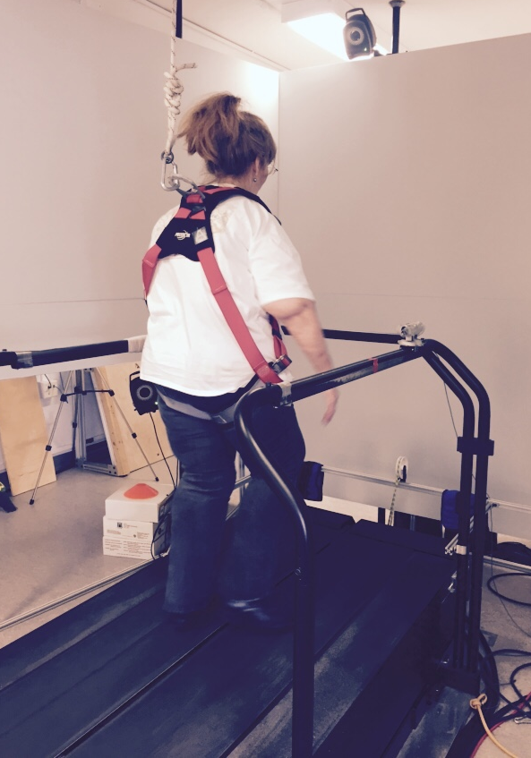
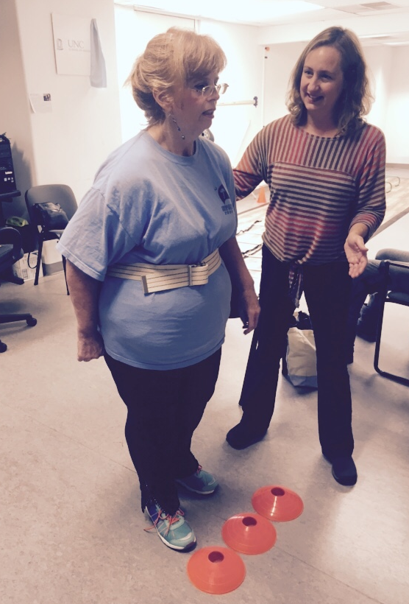
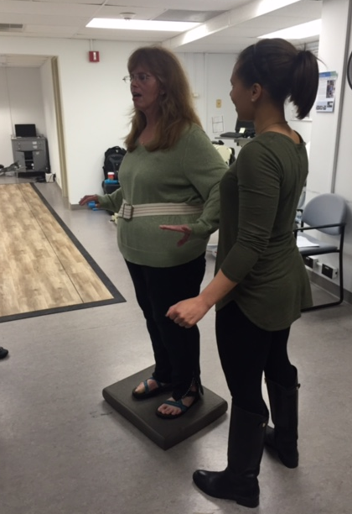
DALFAMPRIDINE COMBINED WITH PHYSICAL THERAPY MAY IMPROVE TREATMENT EFFECTS IN DALFAMPRIDINE NON-RESPONDERS WITH MULTIPLE SCLEROSIS: A CASE STUDY
Alexis A Williams¹, Corinne J Bohling¹, Ellese Nickles¹, Silva Markovic-Plese¹, Mark Skeen², Barbara Giesser³, Prudence Plummer¹
¹University of North Carolina at Chapel Hill, Chapel Hill, NC; ²Duke University Medical Center, Durham, NC; ³University of California Los Angeles, Los Angeles, CA
INTRODUCTION
RESULTS AND OUTCOMES
Dalfampridine extended-release (Ampyra ®) (D-ER) is a pharmacological treatment commonly prescribed to individuals with multiple sclerosis (MS) to improve walking speed
60% of people who take D-ER do not demonstrate clinically relevant improvement (“non-responders”)
A clinically important improvement with D-ER is defined as ≥20% increase in gait speed
No published studies examining the potential of physical therapy (PT) to augment the treatment effects of D-ER.
OBJECTIVES
After 2 weeks on D-ER treatment, the participant demonstrated a 7% improvement in gait speed on theT25FW, indicating that she is a non-responder. After 6 weeks of D-ER + PT, she demonstrated a 21% gait speed increase.
No clinically significant change in balance was captured by the Mini BESTest over the course of treatment.
To examine the effects of D-ER combined with PT after a period of D-ER alone on:
Gait Speed
Dual-task performance
Balance
Cognition
Fatigue
Patient-reported outcomes related to disability and walking impairment
SUMMARY
After 6 weeks of D-ER + PT, the participant demonstrated clinically significant improvements on the T25FW, single-task and dual-task gait speeds, ABC, MSIS-29, MSWS-12, and FSST, all of which were retained at follow up. Conversely, the participant showed greater improvement in dual-task interference on cognitive processing speed (reaction time while walking) during the D-ER only phase, indicating a greater effect from D-ER than from D-ER + PT.
METHODS
Greater improvement in cognitive processing speed during dual task activity was demonstrated during the D-ER only phase, suggesting a greater effect from D-ER than from D-ER + PT.
CONCLUSION
For individuals with MS who have experienced a sub-meaningful response to D-ER, combining PT with D-ER may improve:
gait speed
dual-task performance
perceived disease impact
The results suggest that further investigation of the combination of PT and D-ER in people with MS is warranted, as well as examination of whether PT (without D-ER) is an effective alternative to D-ER in those who are non-responders to the pharmacological intervention.
Progressive improvement was demonstrated on the MSIS-29 from visit 1 to visit 4 with an overall clinically significant improvement of 62.5 points.
ACKNOWLEDGEMENTS
The participant also demonstrated clinically significant improvements on the ABC (24.3 points) and the MSWS-12 (62.5 points) between visits 2 and 4.
This pilot study was supported by funds provided to Dr. Prue Plummer by the University of North Carolina at Chapel Hill
Image 1
Image 2
Image 3
Examples of PT intervention including treadmill walking (image 1), coordination training (image 2), and balance training (image 3)
Notes:
Right now there is not room to add in a description of the Methods Figures – however, if you feel this is necessary, we can try and re-configure the poster to accommodate those descriptions
Red highlighted words = keep them or not?
Figure 4 explanation (final bullet for Results and Outcomes): advice/input on wording

