Slide 1
Aquatic Therapy and Rehabilitation
Genevieve Monroe, SPT at UNC-CH

Slide 2
Objectives
At the completion of this presentation, the learner will be able to…
List contraindications and indications of using AT
Describe the physiological and therapeutic benefits of AT
Demonstrate understanding of the basic principles of AT
Discuss the key points of research presented from specific neurological populations with potential patients in the in-patient rehab setting.

Slide 3
Contraindications & Indications for Aquatic Therapy

Slide 4
Contraindications
Fever
Open wounds, Contagious rash, or Infectious disease
Hx of uncontrolled seizure
Allergic to chlorine
Autonomic dysreflexia
Incontinence/colostomy; Indwelling catheter
Significant cognitive impairments
Tracheotomy or G-tube
Uncontrolled Hypo/hyper- tension
Fear of water
Unstable cardiac conditions or vital signs
Behavior that would compromise safety
Chronic infections (ex UTIs or ear infections)
Medically unstable

Slide 5
Indications
Pain
Gait deviations
Immobility
Weakness
Dis-coordination
Partial weight bearing
Decreased endurance
Flexibility
Posture training
Balance
Recreation
Inability to perform movement against gravity
Edema
Love of water

Slide 6
Basic Principles of Aquatic Therapy

Slide 7
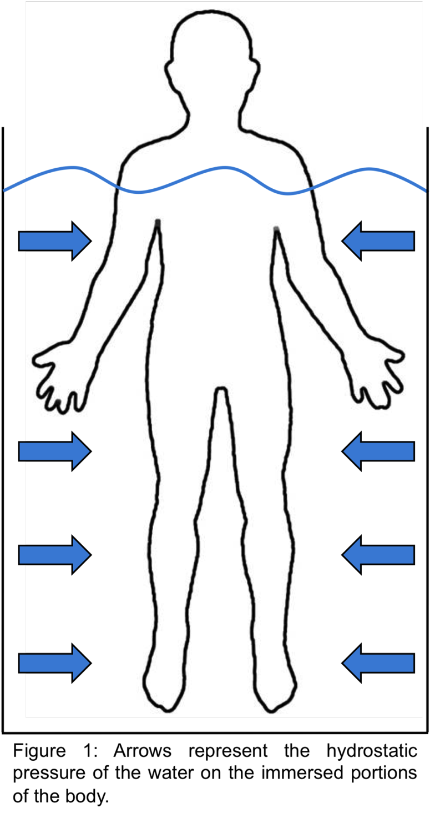
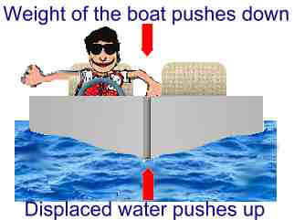
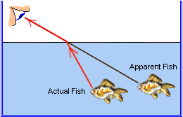
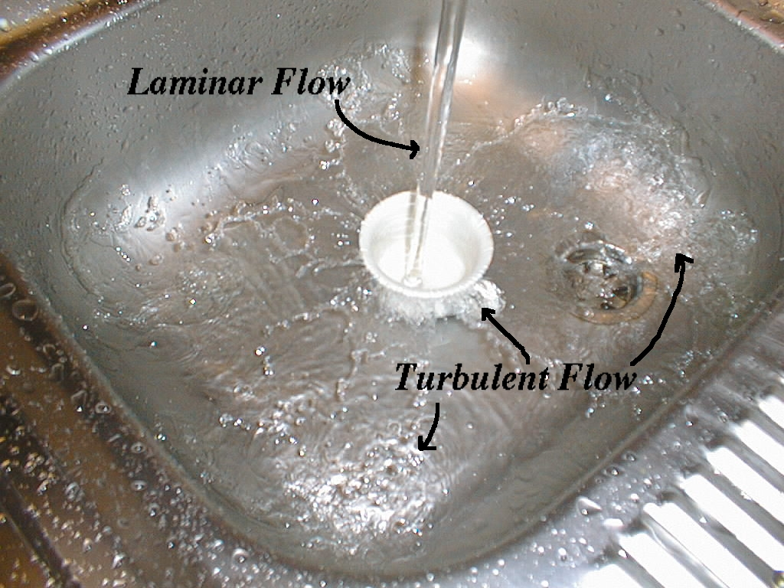
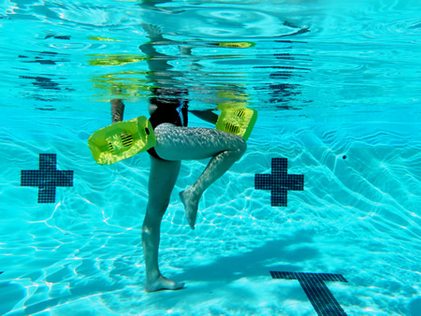
Basic Principles of Aquatic Therapy
Relative density
Buoyancy
Assisted, Resisted, Supportive
Hydrostatic pressure
Resistance
Refraction
Fluid Dynamic properties
of water
Streamline vs. turbulent water
Eddies, wakes, and drag force

Slide 8
Benefits of Aquatic Therapy

Slide 9
Physiological Benefits: “Water immersion affects several body systems including the respiratory, cardiovascular, renal, musculoskeletal, neuromuscular, and psychosocial systems”
Increases
Respiratory rate
Blood supply to the muscles
Muscle metabolism
Superficial circulation
Heart rate
Amount of blood returned to the heart
Metabolic rate
Decreases
Blood pressure
Edema of submerged body parts
Reduced sensitivity of sensory nerve endings
General muscular relaxation

Slide 10
Therapeutic Benefits
Increases
Ease of joint movement
Muscular strength and endurance in cases of excessive weakness
Peripheral circulation (skin condition)
Reduces
Pain sensitivity
Gravitational forces
Improves
Respiratory muscles
Body awareness, balance, and proximal trunk stability
Patient morale and confidence (psychosocial)
Decreases muscle spasm
Promotes muscular relaxation

Slide 11
The Research…

Slide 12
Effects of an aquatic therapy approach (Halliwick-Therapy) on functional mobility in subacute stroke patients: A randomized controlled trial
Objective: To evaluate the effects of an aquatic physiotherapy method (Halliwick-Therapy) upon mobility in the post-acute phase of stroke rehabilitation
Design: Randomized Controlled Trial
Setting: In-patient rehabilitation
Participants: Adult patients after first-ever stroke in post-acute inpatient rehabilitation at least two weeks after the onset of stroke (n = 30).

Slide 13
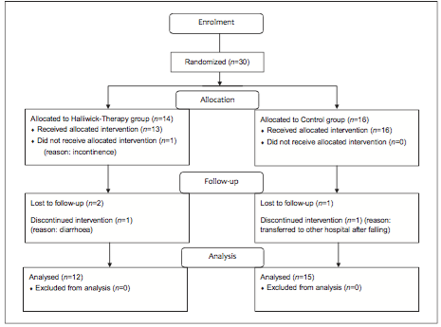

Slide 14
Effects of an aquatic therapy approach (Halliwick-Therapy) on functional mobility in subacute stroke patients: A randomized controlled trial
Interventions: In the Halliwick-Therapy group (n = 14) the treatment over a period of two weeks included 45 minutes of aquatic therapy three times per week and a conventional physiotherapeutic treatment twice a week. Subjects in the control group (n = 16) received conventional physio-therapeutic treatment over a period of two weeks five times per week.

Slide 15
What is Halliwick?
Originally developed by James McMillian in 1950 to teach clients with a physical disability to swim and to make them independent in water
Based on the 10 point program that encompasses the process of achieving a stable posture followed by independent movement in water.
4 Phases
Phase 1- Mental Adjustment and Disengagement
Phase 2- Rotational Control (transverse, longitudinal, and combined)
Phase 3- Upthrust/Mental Inversion, Balance in Stillness, and turbulent gliding
Phase 4- Simple Progression, Basic (Halliwick) movement

Slide 16
Effects of an aquatic therapy approach (Halliwick-Therapy) on functional mobility in subacute stroke patients: A randomized controlled trial (2013)
Outcome measures: The primary outcome variable was postural stability (Berg Balance Scale). Secondary outcome variables were functional reach, functional gait ability and basic functional mobility.
Results: Compared to the control group, significantly more subjects in the Halliwick-Therapy group (83.3% versus 46.7%) attained significant improvement of the Berg Balance Scale (P < 0.05). Improvement of the functional gait ability was significantly higher in the Halliwick-Therapy group (mean (SD) 1.25(0.86)) than in the control group (mean (SD) 0.73 (0.70)) (P < 0.1). The mean differences of improvements in functional reach and basic functional mobility were not statistically significant between groups.

Slide 17
Effects of an aquatic therapy approach (Halliwick-Therapy) on functional mobility in subacute stroke patients: A randomized controlled trial
Conclusions: This study indicates that Halliwick-Therapy is safe and well tolerated in stroke patients in post-acute rehabilitation and has positive effects upon some aspects of mobility.
Clinical Message:
Aquatic physiotherapy with application of the Halliwick-Therapy in combination with conventional physiotherapy may effectively improve postural stability and gait ability in stroke patients in a subacute rehabilitation phase.
This study indicates a safe application of the Halliwick-Therapy after a minimum of two weeks post stroke.

Slide 18
Other Neurologic Populations: Is AT Recommended?
Dementia ✔
Parkinson’s Disease ✔
Multiple Sclerosis ✔
Amyotrophic Lateral Sclerosis ✗
Huntington’s Disease ✗
Chronic Stroke Survivors ✔
Compromised Heart Function and Heart Failure ✔

Slide 19
Discussion

Slide 20
Thank You

Slide 21
References
Brody, L. T., & Geigle, P. R. (2009). Aquatic exercise for rehabilitation and training. Champaign, IL: Human Kinetics.
Thorp, D. 2013. Aquatic Therapy [power-point presentation]. Chapel Hill, NC
Tripp, F., & Krakow, K. (2013). Effects of an aquatic therapy approach (Halliwick-Therapy) on functional mobility in subacute stroke patients: A randomized controlled trial. Clinical Rehabilitation, 432-439.
Neville, C., Henwood, T., Beattie, E., & Fielding, E. (n.d.). Exploring the effect of aquatic exercise on behaviour and psychological well-being in people with moderate to severe dementia: A pilot study of the Watermemories Swimming Club. Australasian Journal on Ageing, N/a-N/a.
Plecash, A., & Levitt, B. (n.d.). Aquatherapy for neurodegenerative disorders. Journal of Huntington's Disease, 3(1), 5-11. doi:10.3233
Dong Koog Noh, Lim, J., Shin, H., & Paik, N. (n.d.). The Effect Of Aquatic Therapy On Postural Balance And Muscle Strength In Stroke Survivors -- A Randomized Controlled Pilot Trial. Clinical Rehabilitation, 966-976.
Meyer, K., & Leblanc, M. (2008). Aquatic therapies in patients with compromised left ventricular function and heart failure. Clin Invest Med, 31(2), E 90-7.
Halliwick. (2015). http://www.twu.edu/inspire/halliwick-method.asp. Retrieved June 11, 2015.

