Slide 1
ThE Baseball Elbow
BY: Lauren Kozar

Slide 2
Objectives
Gain an understanding of what is occurring biomechanically during the 6 stages of overhand pitching, including the forces placed on the UE and the muscles needed to counterbalance said forces.
Be able to educate patients on injury prevention and implement strategies to reduce the risk of UCL tears in baseball pitchers.
Be able to explain the different treatment options and their prognoses for UCL injuries.
Be able to establish an evidenced-based rehabilitation program for a baseball pitcher that is post-op UCL repair via the docking procedure. Be able to establish an evidenced-based return to play protocol for baseball pitchers that have undergone UCL reconstruction via the docking procedure.
Be able to provide appropriate pitch counts for different age groups of pitchers.
Notes:
Read slide

Slide 3
Baseball Statistics

Slide 4
“Baseball is an island of activity amidst a sea of statistics”^{unknown}
15 million play organized baseball in the United States/year¹
868 = Major League Baseball (MLB) players²
5.7 million = children in 8th grade or below¹
The remaining 9.3 million are high school and collegiate athletes
Incidence of UCL Tears³
25-30 Major League Baseball pitchers undergo Tommy John surgery per year
15% of minor league pitchers experience Tommy John surgery per year
Younger pitchers are undergoing the procedure at an unprecedented rate
Notes:
Baseball is all about the stats so lets begin there…
There are about 15 million children and adults that play organized baseball in the United States/year¹
868 of which are MLB players, 5.7 million are children in 8th grade or below, and the remainder are adolescents and young adults
The rate of elbow injuries in baseball is actually relatively low; however, the number of elbow injuries is quite significant due to the large number of baseball players so we sports medicine physical therapists are likely going to encounter these injuries in clinic.
Thus, it is imperative for our professional development and the treatment of our patients that we have a solid understanding of the clinical presentation of UCL tears, in addition to the most successful treatment options and the best return to play protocols.
That being said, considering recent changes in surgical techniques for the treatment of Ulnar collateral ligament tears, I decided to develop this project so I could share information regarding this new “docking technique” that was introduced at the Hospital for Special Surgery’s 10th Annual Sports Medicine Symposium.
And as you can see approximately 25-30 Major League Baseball pitchers undergo Tommy John surgery per year
15% of minor league pitchers experience Tommy John surgery per year
And although “accurate numbers are difficult to find regarding amateur athletes, anecdotal evidence suggests that younger pitchers…

Slide 5
data Supporting the rise in UCL tears amongst Baseball pitchers¹
Reprinted from Fleisig G, 2012.¹
Notes:
Here is patient data from Andrews Sports Medicine and Orthopedic Center that supports the rise in cull tears amongst baseball pitchers

Slide 6
Anatomy and Biomechanical Review
Notes:
So why are there so many UCL injuries in baseball pitchers. In order to fully understand this problem, its important to have an understanding of the anatomy and biomechanics of the elbow

Slide 7
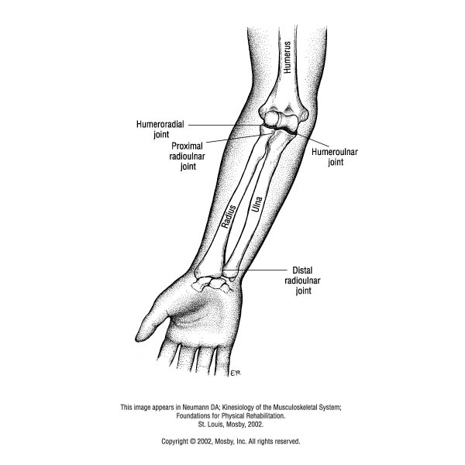
Anatomy^{4,5}
Complex Synovial Joint
Humeroulnar joint
Humeroradial joint
Proximal radioulnar joint
Distal radioulnar joint
2 Degrees of Freedom
Modified Hinge = Flexion and Extension
Pivot = Pronation and Supination
Modified Hinge Joint
Pivot Joint
Notes:
As we know the elbow is a complex synovial joint made up of humeroulnar and humeroradial joints, which are known as modified hinge joints b/c their axis is not in one specific plane since the medial trochlea projects further distally than the lateral side.
It is also composed of the proximal and distal radial joints, which are pivot joints
Overall, the elbow has 2 DOF, with the modified hinge joints allowing flexion and extension and the pivot joints allowing pronation and supination

Slide 8
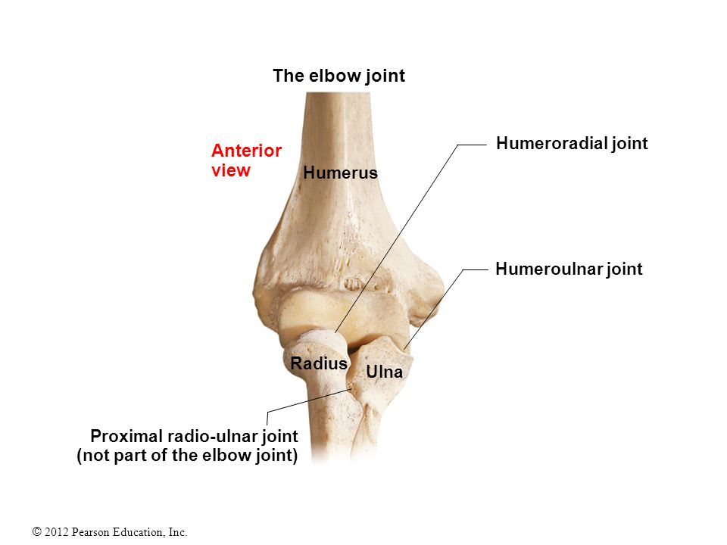
Humeroulnar Joint^{4,6}
Largest and strongest articulation in elbow jt.
Stability – arises from bony configuration
Mobility – arises from the very large articular surface
The trochlea provides approx. 300º of articular surface
Axis = angled slightly more distally (5-15º) on the medial side
Fovea Capitus Radius. Upstore. http://www.upstore.me/fovea-capitis-radius.html. Accessed February 25, 2017.
Notes:
The humerulnar joint is the largest and strongest articulation
A majority of this stability arises from the bony configuration
For example, in extension, the olecranon of ulna fits snuggly into olecranon fossa of humerus
And the coronoid process of ulna fits snuggly into coronoid fossa of humerus when the elbow is flexed
Despite the stability of the joint it has a significant amount of mobility due to the very large articular surface of the trochlea
In fact the articular surface of the trochlea is so large that it provides approximately 300 degrees of articular surface
And as I stated on the previous page, the axis of the joint is angled more distally on the medial side

Slide 9
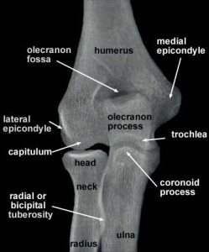
Humeroradial Joint
Significantly smaller articulation^{4,6}
Little bony stability⁴
Provide a bony block to valgus motion → may become a site for injury
No significant WB component⁴
Anatomy of radiograph of upper limb – radiographs of the shoulder, elbow, hand. Pinterest. https://www.pinterest.com/pin/394979829790354221/. Accessed February 25, 2017.

Slide 10
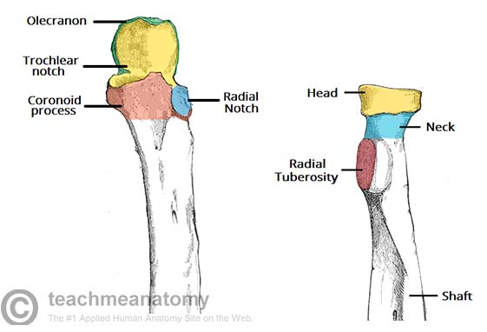
Radioulnar joint⁷
Radial head rotates around proximal ulna
Distal radius rotates around distal ulna
Radius and ulna are held tightly together between proximal and distal articulations by an interosseous membrane
Reprinted from TeachMeAnatomy, 2016⁸
Notes:
Finally, we have the radioulnar joint
The radial head rotates around the proximal ulna and the distal radius rotates around the distal ulna
These 2 bones are held tightly together between their proximal and distal articulations by an interosseous membrane, which allows for a substantial amount rotary motion b/w the 2 bones

Slide 11
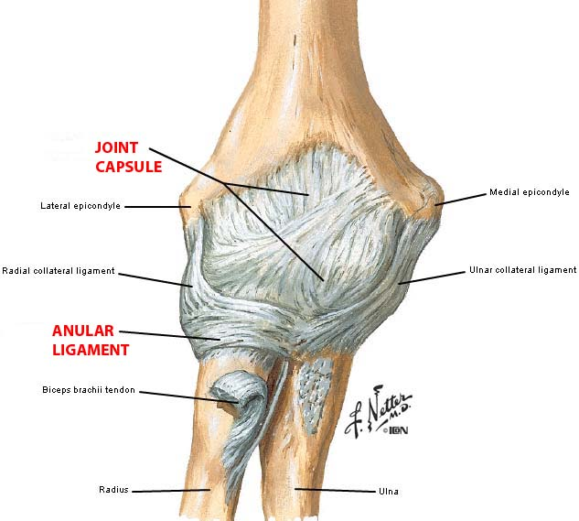
Capsular and Ligamentous Support⁴
Capsule is fairly large, loose, and weak
Anterior and posterior capsule = weakest
Capsule is reinforced by ligaments on medial and lateral sides
Annular ligament
Medial (Ulnar) Collateral Ligament
Lateral (Radial) Collateral Ligament
Joints of upper limb. UNMC.edu. https://www.google.com/search?q=elbow+ligaments+and+capsule&espv=2&biw=942&bih=919&source=lnms&tbm=isch&sa=X&ved=0ahUKEwiFtZ66tYTMAhUB7yYKHXdkBUsQ_AUIBigB#imgrc=7VKiNC3b-iOZnM%3A. Accessed April 10, 2016.
Notes:
The joint capsule contains: humeroulnar, humeroradial, and radioulnar joint and it is fairly large, loose, and weak especially in the anterior and posterior capsule
It is reinforced by ligaments on both the medial and lateral sides, and this ligaments include:
Annular ligament – anchors radial head to ulna
Medial (Ulnar) Collateral Ligament – provides stability against valgus forces
Lateral (Radial) Collateral Ligament – provides stability against varus forces

Slide 12
Medial (Ulnar) Collateral Lig.⁴
Resists valgus force
Taut in full extension
3 components
Anterior: primary restraint to valgus stress
Posterior: weak, but provides some assistance against valgus stress
Transverse: assists with restraint against valgus stress
Stotts J. Understanding jimmy butler’s UCL elbow strain. In Street Clothes. http://instreetclothes.com/2015/03/02/understanding-jimmy-butlers-ucl-elbow-sprain/. Published March 2, 2015. Accessed April 10th, 2016.
Notes:
Here we have a picture of the medical collateral ligament or the UCL
Because this presentation is about UCL tears amongst baseball pitchers, I want to go into a little more detail about the anatomy and biomechanics of the UCL…
The UCL has 3 components b/c ligaments are only good at resisting stresses in 1 direction so we need several ligaments angled in diff directions to provide increased stability to the joint….Thus, the UCL has an anterior band…

Slide 13
Structural Resistance to valgus Stress changes with Elbow flexion angle⁹
 | Extended | 90° Flexion
MCL | 31% | 54%
Joint Capsule | 38% | 10%
Bone Contact | 31% | 33%
Elbow Flexion → looser joint capsule and less bony congruency so these structures no longer resists a valgus stress well.
In other words, the UCL (MCL) is the primary restraint to valgus loads when the elbow is flexed, especially at 90º
Notes:
Although the UCL is the primary restraint to valgus stress, the degree of resistance changes depending on the amount of elbow flexion.
For example, when as the degree of elbow flexion increases, the joint capsule becomes more loose and there is less bony congruency so there is greater demand on the UCL to resist valgus stress
And when the degree of elbow extension increases, resistance to a valgus stress is almost equally shared among the UCL, joint capsule, and boney articulation

Slide 14
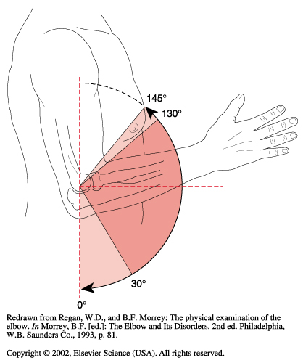
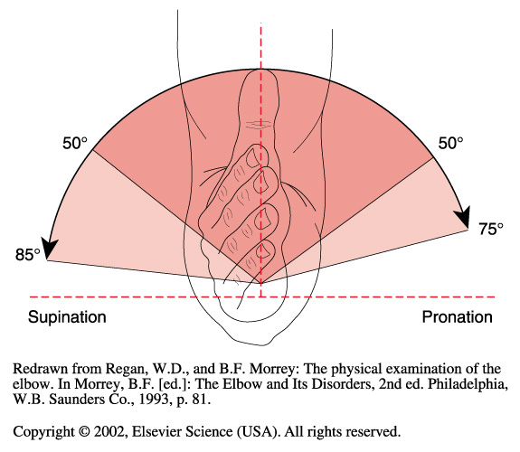
Osteokinematics:
Flexion and Extension⁴
Normal AROM = 5º- 0º - 145º
Functional AROM = 30º - 130º
Side Note: no articulation between radius and humerus in full extension
Pronation and Supination⁵
Normal AROM = 85º supination - 75º pronation
Functional AROM = 50º supination - 50º pronation
Notes:
Here is some more general knowledge of the elbow. As we know, the normal AROM for the elbow is from 5 degrees of hyperextension to 145 degrees of flexion and the functional ROM is from 30 degrees of flexion to 130 degrees of flexion

Slide 15
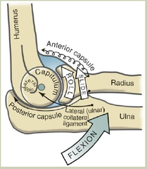
Arthrokinematics:⁴
Open Kinetic Chain
Concave ulnar surface (trochlear notch) on convex humerus (trochlea)
ulna slides and rolls in the same direction
Concave radius (fovea) on convex humerus (capitulum)
radius slides and rolls in the same direction
American University. Elbow and forearm. StudyBlue. https://www.studyblue.com/notes/note/n/52615elbow-and-forearm/deck/14759783. Published May 26, 2015. Accessed April 10, 2016.
Notes:
Here we have elbow arthokinematics and these are important to know during the rehab process in case ROM becomes an issue.
In both instances the distal segment is concave so the roll and slide occur in the same direction

Slide 16
Post-Surgical Contractures:
Prone to flexion contractures¹¹
Intimate congruency of the joint
Tight lateral joint capsule
Anterior capsule adhesions
Excessive scar tissue formation in brachialis
Notes:
As said on the previous slide, contractures may become an issue during the rehab process and they are actually quite common following UCL reconstruction.
These patients are most at risk for flexion contractures due to the intimate congruency of the joint, particularly the humeroulnar joint, the tightness of the lateral elbow capsule, the tendency of the anterior capsule to scar and develop adhesions, and the tendency of the brachialis muscle to have excessive scar formation following injury

Slide 17
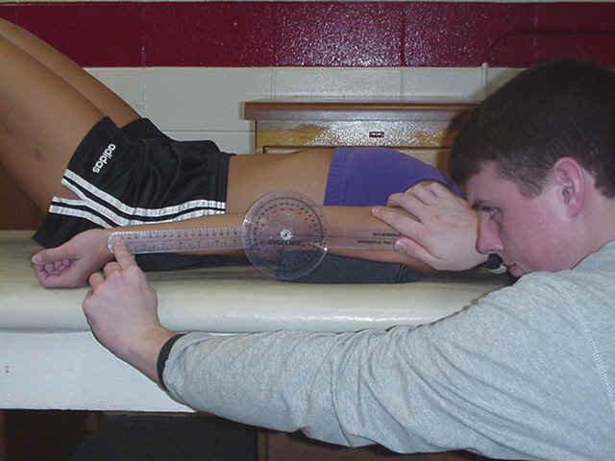
Post-Surgical Contractures:
GOAL = restore pre-operative ROM NOT non-dominant elbow ROM¹²
Wright et al:¹³
Elbow extension loss =7.9°
Elbow flexion loss = 5.5°
Ellenbecker et al:¹⁴
Elbow flexion loss: 5°
Significant reduction in wrist extension
Elbow and Radioulnar Goniometry. AT UWA. http://at.uwa.edu/gon/elru.htm. Accessed February 25, 2017.
Notes:
When the patient does develop contractures, our goal is to restore preoperative ROM so we either need to measure the patient’s elbow ROM prior to surgery or we need to ask the patient if they had any ROM deficits in their dominant arm because it is not appropriate to compare their dominant elbow ROM to the contralateral side because most pitchers develop elbow ROM restrictions in their dominant arm.
A study by Wright et al reported that the average loss of elbow extension was 7.9° and that the average loss of flexion was 5.5° in 33 throwing athletes
Furthermore, a study by Ellenbecker et al., reported an average loss of 5° in elbow flexion in a population of 40 healthy professional baseball pitchers. They also found significantly less wrist extension ROM on the dominant arm because of tightness of the wrist flexor musculature.

Slide 18
Pitching mechanics
A comprehensive understanding of the fundamental mechanics to baseball pitching

Slide 19
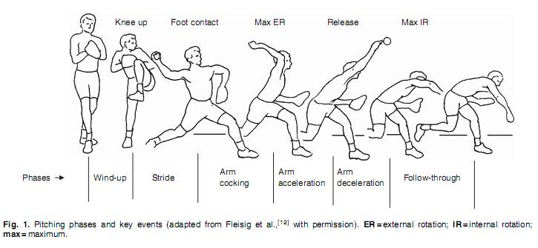
Thrower’s shoulder. Physiopedia. http://www.physio-pedia.com/Thrower's_Shoulder. Accessed April 10, 2016.

Slide 20
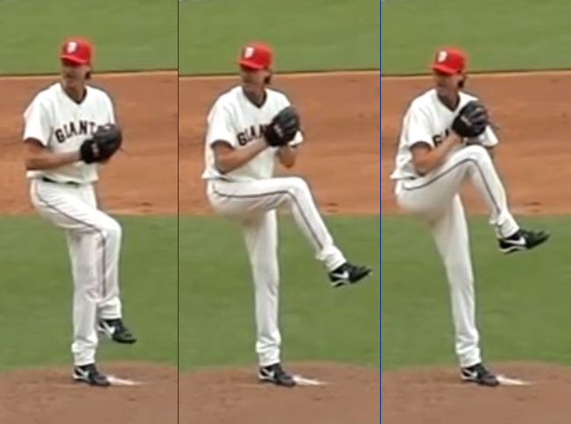
Stage 1: The Wind-up
Throwing motion initiated in wind-up phase¹⁵
Definition: initial movement to maximum knee lift of stride leg¹⁶
Sets the timing pattern and tone¹⁷
Low risk of injury¹⁷
Low muscle activity¹⁷
Pitching wind-up. QCBaseball.com. http://www.qcbaseball.com/pitching/pitching-windup.aspx. Published 2015. Accessed April 10, 2016.
Notes:
The wind-up initiates the throwing motion, and it sets the timing pattern and tone for the remainder of the pitching motion
It is defined as the time from initial movement to maximum knee lift
And according to indwelling EMG, muscle activity is below 21% MVC for the rotator cuff, scapular stabilizers and the deltoid musculature so the patient is typically at a low risk of injury during this phase

Slide 21
Stage 1: The Wind-up
Shoulders aligned between 2nd base and home plate with hands at chest height → stable center of mass ¹⁷
Stance leg maintains position of balance in slight knee flexion¹⁵
Isometric quad contraction
Hip abductors work to maintain a level pelvis
Weak quads or hip abductors = unstable base
Notes:
During this phase the shoulders should be aligned between 2nd base and home plate c hands at chest height. This helps create a stable center of mass
The stance leg will maintain the position of balance, while in slight knee flexion. Thus, you need a strong isometric quad contraction and hip abductors.
When these are weak, the pitcher will have an unstable base, which is one of many faulty mechanics that can increase stress on the upper extremity

Slide 22
Stage 1: The Wind-up
Faulty Mechanics → increased stress on UE¹⁷
Poor balance at max knee lift secondary to poor LE strength and trunk control
Premature forward movement toward home plate
COG that is positioned too far posteriorly
Notes:
Other faulty mechanics that result in increased stress on the upper extremity include:

Slide 23
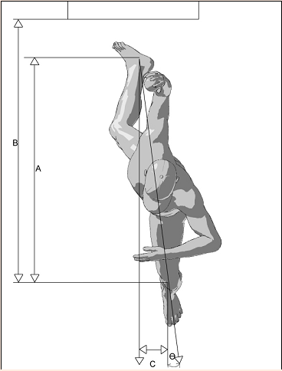
Stage 2: The Stride
Purpose: develop linear velocity towards home plate¹⁵
Concluded when the stride leg makes contact with the ground¹⁵
Stride hip = ER¹⁵
Stance hip = IR¹⁵
Stride length = 85-100% body height^{15, 17}
Fleisig GS. The Biomechanics of Baseball Pitching. Doctoral Thesis. University of Alabama 1994.
Notes:
Stage 2 is the stride phase
Its purpose is to develop linear velocity towards home plate, and it is concluded when the stride leg makes contact with the ground
During this phase, the stride hip = ER ^{and} the stance hip = IR¹⁵
The stride length = 85-100% of the pitcher’s body height. Typically larger is better because greater stride lengths allow for greater duration in trunk rotation meaning there is increased potential for force development so they are less likely to use their should to generate excess force

Slide 24
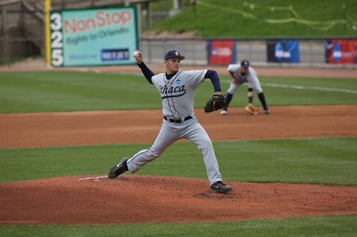
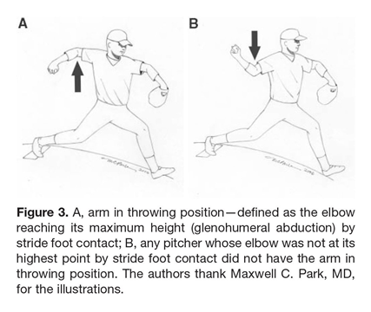
Stage 2: The Stride
Shoulder abduction = 90º ± 10º¹⁵
Elbow flexed & pronated¹⁷
Hand is on top of ball¹⁷
Foot angle = approx. 15º away from center of mound¹⁶
Hip abductors maintain stable pelvis¹⁸
Knee and hip extensors eccentrically complete stride to foot contract¹⁷
Pitching Mechanics – Therapeutic exercise. Overhead Athlete. http://overheadathlete.weebly.com/pitching-mechanics.html. Accessed February 25, 2017.
Clients.chrisoleary.com. http://clients.chrisoleary.com/Pitching/The-Epidemic/Proper-Pitching-Mechanics. Updated 2016. Accessed April 20, 2017.
Notes:
Also during this phase, the shoulder should be abducted to about 90 degrees, the elbow should be flexed anywhere from 80 to 100 and pronated so the ball faces b/w 2nd and 3rd base, and the hand should always be on top of the ball
The foot angle should be approximately 15 degrees away from the center of the mound
Hip abductors on the stance leg continue to maintain a stable pelvis and trunk during coiling
And the knee and hip extensors eccentrically contract to complete the stride to foot contact

Slide 25
Stage 2: The Stride
Faulty Mechanics → increased stress on UE¹⁷
Reduced stride length
Stride Leg
Reduced hamstring extensibility
Reduced hip ER
Reduced strength (glute max/min, piriformis, and obturator internus)
Stance Leg
Reduced hip flexor and hip IR extensibility
Reduced strength (TFL, glute medius, hamstrings)
Notes:
Faulty mechanics that result in increased stress on the upper extremity during the stride phase include:
Reduced stride length, which can result from reduced hamstring extensibility, reduced hip ER, and reduced strength in the glute max, glute min, piriformis, and obturator internus of the stride leg
It can also result from reduced hip flexor and hip IR extensibility and reduced strength in the TFL, glute med and hamstrings on the stance leg
Trunk rotation prior to proper scap positioning can also increase stress on the UCL

Slide 26
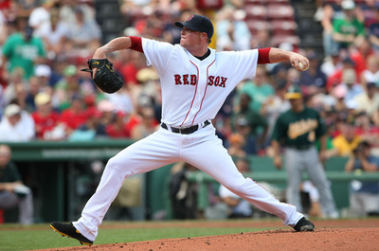
Stage 2: The Stride
Faulty Mechanics → increased stress on UE¹⁷
Trunk rotation prior to proper scapula positioning
Inadequate stride foot direction
Inadequate stride direction
Inadequate knee flexion angle
Reduced shoulder abduction
Pitching Mechanics – Therapeutic exercise. Overhead Athlete. http://overheadathlete.weebly.com/pitching-mechanics.html. Accessed February 25, 2017.
Notes:
Inadequate stride foot direction can also lead to increased stress on the UE.
Ideally, the stride foot direction should be towards home plate or slightly towards 3rd base for R-handed pitchers. If the pitcher is excessively closed, he is forced to throw across his body to reach the strike zone. If too open, then the pitcher is forced to rotate their pelvis too early causing the arm to lag behind the body, increasing the valgus stress on the UCL
If the stride foot angle is not 15 degrees from the midline of the mound, this can also increase the stress on the UE.
Finally, reduced shoulder abduction 2/2 decreased strength and endurance in the ROC muscles and scap stabilizers can also increase stress in the UE. This can be most easily identified by looking at elbow position.

Slide 27
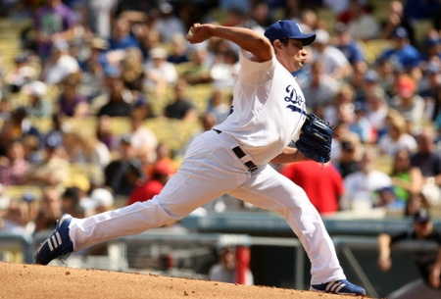
Stage 3: Arm cocking
Definition: begins when stride foot makes contact with ground and concludes when the arm is maximally ER^{15,17}
Pelvis rotates toward target followed by trunk rotation^{15,17}
Stride leg creates a stable base^{15,17}
Abdominal obliques prevent excessive hyperextension of lumbar spine^{15,18}
Scapula retracts and tilts upward^{15,18}
Arm acceleration phase of baseball pitching. Biomechanical Principals of Pitching in Baseball. http://baseballpitchbiomechanics.blogspot.com/. Published June 17, 2015. Accessed April 10, 2016.
Notes:
Stage 3 is referred to as arm cocking, and it begins when the stride foot makes contact with ground and concludes when the arm is in max ER
During arm cocking, the pelvis rotates toward home plate at 400-700 degrees/second, which is followed by trunk rotation towards the target.
As this occurs, the knee extends on the stride leg creating a stable base for trunk rotation and flexion
Abdominal obliques also contract to prevent excess lumbar hyperextension during upper torso rotation and flexion. The internal oblique fires on the lead leg, and the external oblique fires on the stance leg.
The rhomboids, levator, and teres minor retracts and upwardly rotate the scapula

Slide 28
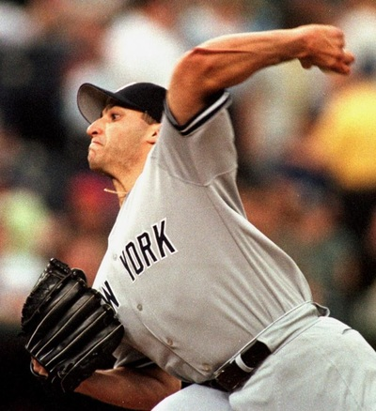
Stage 3: Arm cocking
Elbow flexed to 95°¹⁸
Eccentric triceps contraction limits full elbow flexion¹⁸
Shoulder abducted to 90-95°¹⁸
Max ER = 165-185º^{15,17,18,19}
Critical moment = terminal arm cocking^{15,18}
High force on the GH joint
High valgus torque on the elbow
Pitching Mechanics – Therapeutic exercise. Overhead Athlete. http://overheadathlete.weebly.com/pitching-mechanics.html. Accessed February 25, 2017.
Notes:
During arm cocking the elbow remains flexed as the triceps contract eccentrically to resist max elbow flexion
The shoulder abducts to approx. 90 or 95 degrees
The arm also reaches maximum ER of 165 to 180 degrees via humerothoracic rotation. According to EMG studies the infraspinatus and teres minor are most responsible for max ER
And this position of max ER is known as the critical arm moment or terminal arm cocking, which is characterized by extremely high IR torque on the GH joint and extremely high valgus torque on the elbow.
The forearm flexor and pronator muscle masses generate varus torque to oppose this large valgus torque

Slide 29
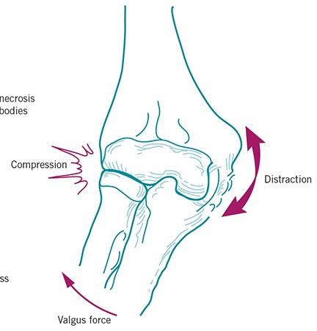
Critical Moment = High stress At Elbow^{15,19,20}
Valgus torque on elbow @ max ER = 63 Nm – 120 Nm
UCL strength ≈ 55% of 63 Nm ≈ 35 Nm
Medial Shear Force of 300 N = 67 lbs.
“Equates to five12 lbs. bowling balls hanging off your hand with every pitch”
Lateral compressive force of 900 N = 202 lbs.
Reprinted from Sports Performance Institute, 2016¹⁶
Notes:
As I just said, there is a lot of stress placed on the elbow during the critical moment of the pitch.
In fact, the valgus torque on the elbow @ max ER can range from 63-100 Nm. The UCL torque is approx.. 55% of the 63 Nm, or 35 Nm; however, the UCL torque strength is only 35 Nm so every pitch has potential to damage UCL but that doesn’t happen because osseous structures and soft tissue like the pronator teres absorb some of the force
There is also a medial shear force of 300 N or approximately 67 lbs., and research has found that this equates to approximately 5 12 lbs. bowling balls hanging from a pitcher’s hand with every pitch
There is also a lateral compressive force of 900 N or 202 lbs.

Slide 30
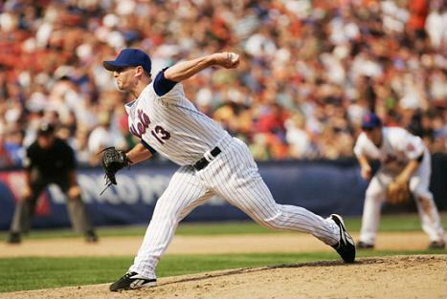
Stage 3: Arm cocking
Faulty Mechanics → increased stress on UE³⁹
Excessive adduction of the shoulder horizontally
Leading with the elbow
Pitching Mechanics – Therapeutic exercise. Overhead Athlete. http://overheadathlete.weebly.com/pitching-mechanics.html. Accessed February 25, 2017.
Notes:
During arm cocking, a pitcher who excessively adducts the shoulder horizontally, (i.e., leads with the elbow), will increase the anterior shoulder force, medial elbow force, and horizontal adduction shoulder torque.

Slide 31
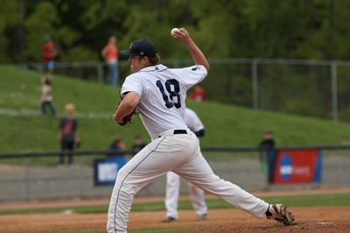
Stage 4: Arm acceleration^{15,17,18}
Definition: begins at max ER and ends at moment of release
Trunk moves from hyperextension into forward flexion
Stride leg continues to extend
Shoulder moves into IR and horizontal add
Arm IR velocity > 10,000º/sec
Pitching Mechanics – Therapeutic exercise. Overhead Athlete. http://overheadathlete.weebly.com/pitching-mechanics.html. Accessed February 25, 2017.
Notes:
Stage 4 is known as the arm acceleration phase
During this phase the trunk moves from hyperextension into about 32-55 degrees of flexion.
That obviously requires significant contraction of the rectus abdominus, abdominal obliques, and lumbar paraspinal muscles
During this phase the stride leg continues to extend
The shoulder rapidly moves into IR and horizontal adduction. In fact, the arm IR velocity can be in excess of 10000 deg/sec or 1600 RPM. The muscles responsible for this powerful IR moment include the subscapularis, pec major, and latissimus dorsi.

Slide 32
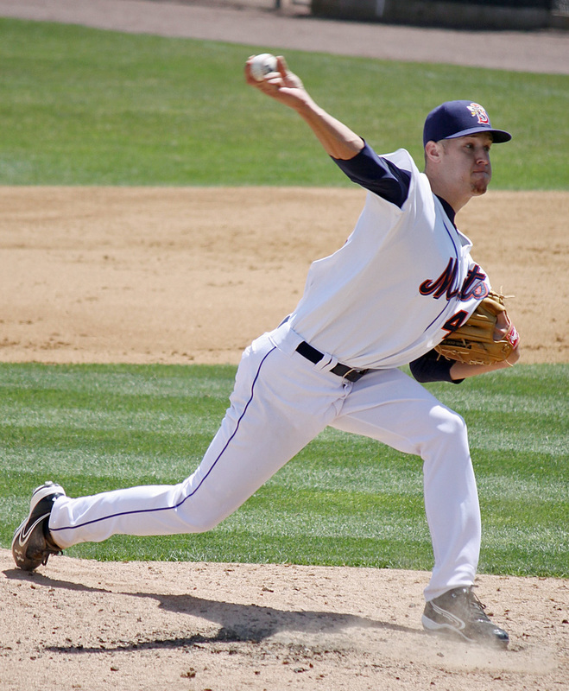
Stage 4: Arm acceleration
Elbow extends at 3000º/sec^{15,17,18,19}
Elbow is in approx. 25º of flexion at ball release^{17,18}
Shoulder is at 90º-100° abd at ball release^{15,17,18}
Scapula is protracted at ball release^{17,18}
Pitching Mechanics – Therapeutic exercise. Overhead Athlete. http://overheadathlete.weebly.com/pitching-mechanics.html. Accessed February 25, 2017.
Notes:
Elbow also extends rapidly at about 3000º/sec. Elbow extension results from a combination of the centrifugal force generated by the rotating torso and the concentric contraction of the triceps.
At ball release the elbow is in approx. 25 degrees of flexion and the shoulder should have maintained its position of 90° to 100° of abduction in relation to the trunk
Also at ball release, the scaupla should have moved into the protracted position in order to maintain a stable base for the humeral head, and this is achieved via the serratus anterior

Slide 33
Stage 4: Arm Acceleration
Faulty Mechanics → increased stress on UE¹⁷
Excessive lateral trunk lean → hand-on –top ball release
Reduced lateral trunk lean → side-arm throwing
Notes:
Excessive lateral trunk flexion can cause an over‐the‐top ball release point while a decreased angle has an inherent risk of releasing the ball with a sidearm throwing mechanism.
Sidearm tracking of the arm through acceleration can contribute to an cumulative microtrauma placed on the medial elbow structures, primarily the UCL

Slide 34
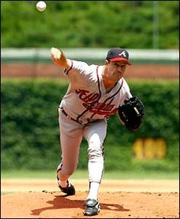
Stage 5: Arm Deceleration
Definition: begins with ball release and ends with shoulder in max IR^{15,17,18,21}
Arm horizontally adducts across body as arm continues to IR^{15,17,18}
End shoulder position = max IR, 35° horizontal add, and 100° abd^{17,18}
Stance foot leaves ground as the trunk rotates over the lead leg¹⁷
Elbow extension is decelerated by eccentric contraction of elbow flexors^{15,17,18,21}
Greg Maddux. Pinterest. https://www.pinterest.com/kingmeatlanta/atlanta-braves/. Accessed April 10, 2016.
Notes:
Stage 5 is characterized by arm deceleration, which begins with ball release and ends when the shoulder is in max IR
During this phase, the arm horizontally adducts across body as arm continues to IR until the arm is in max IR and 35 degrees of horizontal adduction
The teres minor, infraspinatus and posterior deltoid muscles act eccentrically as a restraint to humeral head translation while the serratus and rhomboids aid in scapular stability during deceleration as the arm is extended towards home plate during the follow through
The stance foot leaves the ground completely as the trunk rotates over the lead leg
And elbow extension is decelerated primarily by eccentric contraction of elbow flexors, but the triceps, anconeus and wrist flexors aid in deceleration. The compression forces created at the elbow due to contraction of these muscles has been recorded as high as 90% of the pitcher’s BW

Slide 35
Stage 5: Arm Deceleration
Scapula de-rotates from upward position and returns to anterior tilted position¹⁵
Most excessive forces placed on GH joint^{15,18}
400 N posterior shear force
300 N inferior sheer force
>1000 N of compressive forces
Large adduction torques
Large distraction forces are counterbalanced by contraction of shoulder rotator cuff (ROC)^{15,18,21}
Distraction force on GH joint = 71-124% BW^{18,22}
Greg Maddux. Pinterest. https://www.pinterest.com/kingmeatlanta/atlanta-braves/. Accessed April 10, 2016.
Notes:
Scapula de-rotates from upward position and returns to anterior tilted position. As this occurs, contraction of the traps, rhomboids, and serratus anterior maintain stability of the scapula
There are also excessive posterior and inferior shear forces occurring at the glenohumeral joint, in addition to elevated compressive forces (> 1000 N) and adduction torques, which result in large distraction forces on the GH joint at ball release.
These distraction forces can be as high as 124% of the pitcher’s BW
That being said, these force can range anywhere from 71 to 124, with the higher distraction forces typically occur in professional baseball pitchers
These large distraction forces are opposed by the posterior shoulder muscles including the ROC, latissimus dorsi, and posterior deltoid

Slide 36
Muscle Actions¹
ROC Muscles:
Supraspinatus - first 30° of shoulder abduction
Infraspinatus – shoulder ER
Teres Minor – shoulder ER
Subscapularis – shoulder IR
ALL STABILIZE THE HUMERAL HEAD
4 very important muscles. Victoria Welless. http://www.victoriawellness.com/4-very-important-muscles/. Published 2016. Accessed April 10, 2016.
Notes:
Here is a picture of those muscles that are opposing those large distraction forces

Slide 37
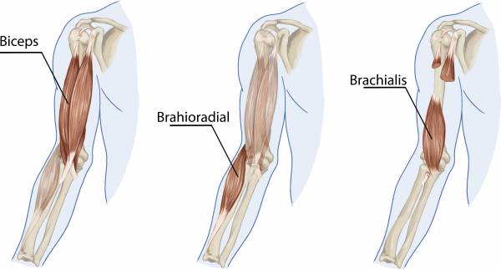
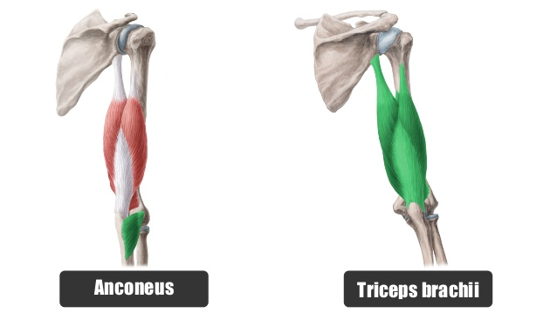
Muscle Actions¹
Primary Elbow Flexors:
Biceps Brachii
Most efficient at 90º
Brachialis
Secondary Elbow Flexors
Brachioradialis
Extensors:
Triceps
Anconeus
Kelso T. Two-jointed Muscles of the Arm. Breaking Muscle. https://breakingmuscle.com/learn/two-jointed-muscles-of-the-arms-how-to-train-them. Accessed February 20, 2017.
Kenhub Anatomy. Muscles of the arm. Slideshare. http://www.slideshare.net/Kenhub_Anatomy/muscles-arm-34616637. Published 2013. Accessed February 20,2017.
4 very important muscles. Victoria Welless. http://www.victoriawellness.com/4-very-important-muscles/. Published 2016. Accessed April 10, 2016.
Notes:
And depicted here are the muscles that aid in deceleration of elbow extension

Slide 38
Stage 5: Arm Deceleration
Faulty Mechanics → increased stress on UE⁴⁰
Not bending at hips
Not allowing the arm to follow through and end with the hand between the knee and ankle
Maintaining back foot on the mound
Notes:
Some of the common faulty mechanics during the deceleration phaseinclude: Standing up tall after ball release and not bending the back , not letting the throwing hand finish between the knee and ankle, and not allowing the back foot and leg to roll over so it can be pulled off the mound and swung around.

Slide 39
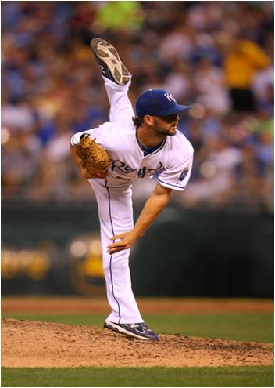
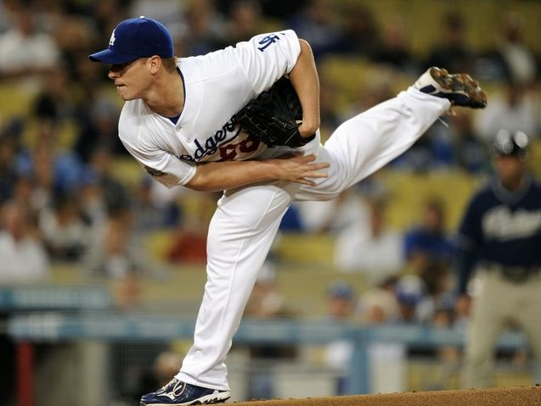
Stage 6: Follow Through^{15,18}
Definition: continued deceleration and flexion of trunk over stride leg
Deltoid and ROC continue to decelerate the shoulder
Arm position ends in approx. 60º of horizontal adduction
Ends with pitcher in fielding position
7 reasons baseball pitchers should not do year round throwing programs. Harford Sports Performance Center. http://harfordsportsonline.com/7-reasons-baseball-pitchers-should-not-do-year-round-throwing-programs-part-2/. Published 2011. Accessed April 10, 2016.
Pitching Mechanics – Therapeutic exercise. Overhead Athlete. http://overheadathlete.weebly.com/pitching-mechanics.html. Accessed February 25, 2017.
Notes:
Stage 6 is the follow through
During this phase there is continued deceleration and flexion of the trunk over the stride leg
The deltoid and ROC continue to contract to decelerate the shoulder, but to a lesser degree
The arm ends in a position of approximately 60 degrees of horizontal adduction and the pitchers
After ball release the pitcher assumes a fielding position

Slide 40
Injury Prevention
Assessing Mechanics and Strengthening

Slide 41
Youth Baseball Pitchers

Slide 42
Factors that increase risk of UCL injuries in youth Baseball:
Age ≥ 9²³
>100 throws per day²³
>80 pitches per game²⁴
>100 innings pitched/year²⁵
Pitching more than 8 months/year²⁴
Pitching fatigued²⁴
Playing pitcher AND catcher²⁵
Thoracic kyphosis angle ≥ 30°²³
Elbow extension deficit ≥ 5°²³
Technique flaws²⁴
Notes:
Age ≥ 9 = 2.7x greater risk for UCL injury in 1 year than those under 9
>100 throws per day
Throwing more than 80 pitches per day quadruples the risk for UCL injuries
Pitching more than 100 innings/year also significantly increases one’s risk for UCL injuries. In fact, these pitchers are 3.5 times more likely to injure their UCL
Pitching competitively for more than 8 months per year increases their risk by fivefold
Those that pitch while fatigued are more 36x more likely to injury their UCL
Playing pitcher and catcher
Having a thoracic kyphosis angle ≥ 30° increases a pitcher’s for UCL injuries by 2.5. Thoracic kyphosis angle was also the highest predictor for UCL injuries in a study by Sakata et al., which also assessed factors like PROM for GH ER and IR, PROM for elbow flexion and extension, PROM for ER and IR of the hip, IR and ER strength of the shoulder, age, sex, years of baseball played, number of balls thrown, and number of episodes of pain during pitching.
Technique flaws also increase risk of UCL injuries, and we will go into more details about those on the next slide

Slide 43
Factors that increase risk of UCL injuries in youth baseball:
Technique flaws
Increase lateral trunk lean AWAY from the pitching arm^{24,26}
Hand under ball during stride phase²⁴
Late arm rotation²⁴
Excessive or insufficient ER²⁴
Excessive elbow flexion²⁴
Improper shoulder abduction²⁴
Notes:
Technique flaws can include anything that differs from the ideal form previously discussed. That being said, researchers have found common problems amongst this population that is associated with exceptionally high risks for injury. These include:
Increase lateral trunk lean AWAY from the pitching arm. Although ball velocity increases with this pitching form, it actually increases the moments at both the GH joint and the elbow. In fact, for every 10° increase in trunk lateral flexion, the IR moment at the GH joint increases by 2.5 Nm and the valgus moment at the elbow increases by 3.7 Nm.
Other factors include:

Slide 44
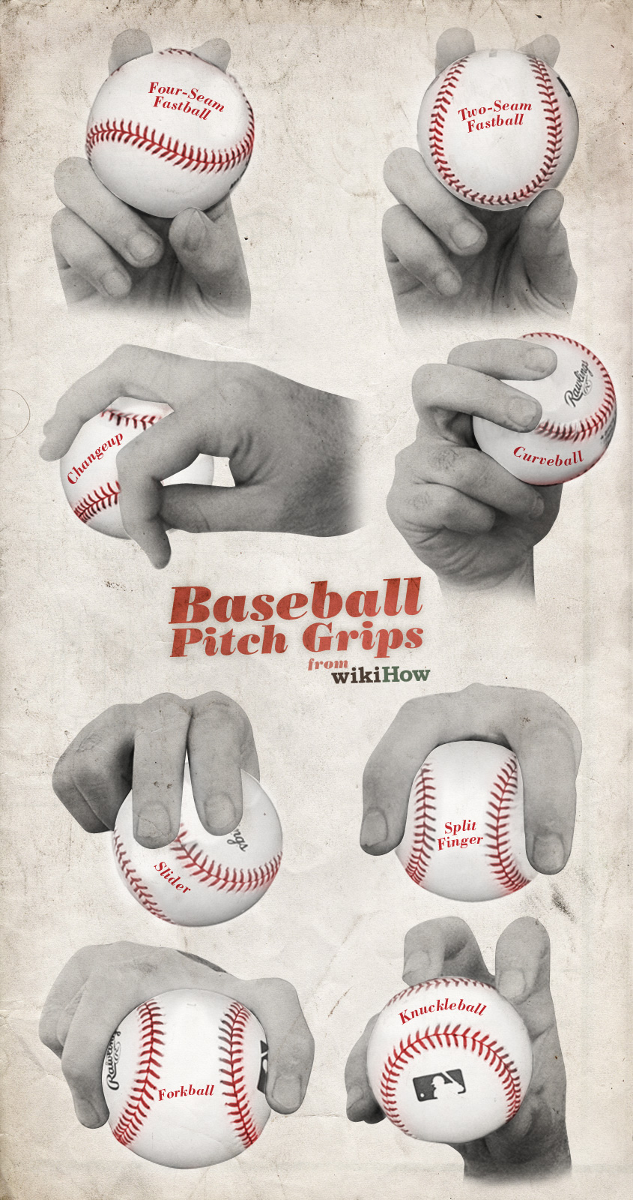
Factors that increase risk of UCL injuries in youth baseball:
Pitches Matter:
Different pitches cause higher internal varus moments on the UCL
Curveballs vs. Fastballs¹⁵
Fastballs
Curveballs vs. Sliders²⁵
Sliders
MYTH: CURVEBALLS ARE ASSOCIATED WITH HIGHER RATES OF UCL TEARS
How to pitch a baseball. Wikihow. http://www.wikihow.com/Pitch-a-Baseball. Accessed April 10, 2016.
Notes:
The type of pitch also matters.
For a very long time, it was thought that curveballs were one of the primary culprits in UCL tears; however, recent literature has found that both fastballs and sliders stress the UCL significantly more than curveballs!!
That being said, curveballs are associated with significantly higher forces on the GH joint. In other words, they are associated with UE injuries just NOT at the elbow.

Slide 45
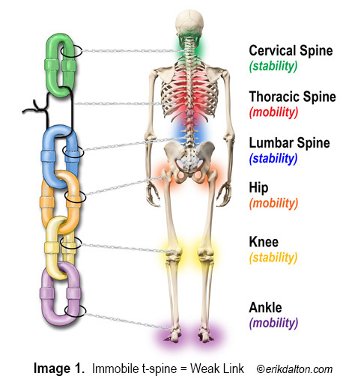
Never forget about the kinetic Chain²⁷
Any deficits in the kinetic chain can result in added stress at the elbow joint
Hip/core weakness
Poor lower extremity balance
Hip rotation deficits
Scapular dyskinesia
Shoulder ROM deficits
Total rotational motion²⁸
“Possibly” glenohumeral internal rotation deficit (GIRD)²⁸
http://phoenix-pt.com/pains-soreness-and-cures-understanding-the-kinetic-chain-concept/. Published 2015. Accessed February 20,2017.
Notes:
Pitching involves the entire kinetic chain so any deficits in the chain can result in added stress at the elbow joint, increasing the risk for UCL injuries.
These can include:
Hip and core weakness
Poor lower extremity balance
Hip rotation deficits
Scapular dyskinesia
Shoulder ROM deficits
In fact, a study by Altcheck et al. found that a deficit in total rotational motion is associated with a UCL tear in both high school and collegiate baseball players. Although GIRD was not found to be significantly different between the group that developed UCL tears and the group that did not, it was present in both groups and the researchers concluded that it should not be ignored as a potential risk factor for injury.

Slide 46
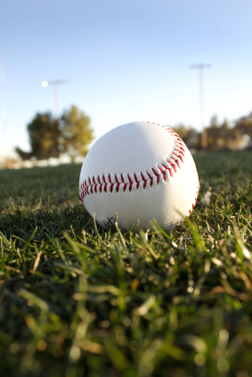
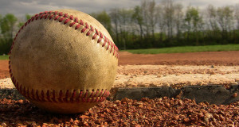
Recommendations to Minimize Risk:²⁹
If 3 out of 5 of the following parameters were performed correctly then:
Less valgus stress on the elbow
Improved pitching efficiency
Reduced shoulder and elbow pain in adolescent pitchers
5 Factors:
Leading with the hips
Hand on top positions
Arm in throwing position
Closed shoulder position
Stride foot towards home plate
Koehler J. When police officers commit assult. Koehler Law. http://koehlerlaw.net/2010/05/on-assault-by-police-officers/. Published 2010. Accessed February 20, 2017.
Balls to the Walls. 27 Outs Baseball. http://www.27outsbaseball.com/milb/balls-wall/. Published 2015. Accessed February 25, 2017.
Notes:
So now that we know what predisposes child and adolescent aged pitchers to UCL injuries, what can be done to prevent them?
Well, research has found that if 3 out of 5 of the following parameters were performed correctly then the pitcher had…
The five factors included:
Leading with the hips: if the pitchers hips open towards home plate before their shoulders, then they can generate more momentum.
Hand on top of the ball: this allows the arm to get in throwing position sooner. Plus, there is less valgus torque on the elbow
Arm in proper throwing position: when the front foot makes contact with the ground, the elbow should be flexed to 90 and the forearm should be perpendicular to the ground
Closed shoulders: prevents pitcher from opening too soon, which can lead to hyperangulation of the shoulder
Stride foot towards home plate: under/over rotation results in inefficient energy transfer and improper timing of trunk rotation

Slide 47
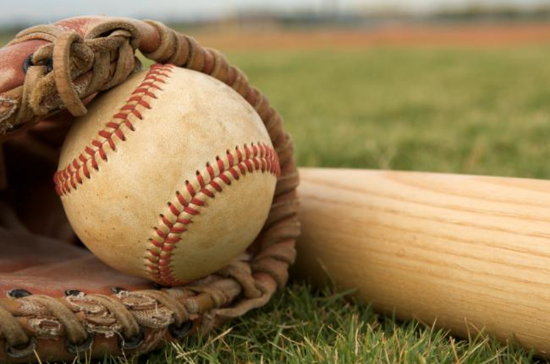
Recommendations to Minimize Risk:^{15,24}
Avoid techniques that increase valgus torque on elbow:
Total baseball. Totalsportscomplex.com. http://totalsportscomplex.com/baseball/. Published 2014. Accessed April 10, 2016.
Notes:
In other words, we want to avoid hand under ball positioning, in addition to

Slide 48
Additional Recommendations:²⁴
NO overhand throwing of ANY KIND for at least 2-3 months/year
NO competitive baseball for at least 4 months/year
NO more than 100 innings in games/year
Watch for signs of FATIGUE
Decreased ball velocity
Decreased accuracy
Upright trunk position
Dropped elbow
Increased time between pitches
ALWAYS follow limits for pitch count & days of rest
Notes:
No overhead throwing of any kind for at least 2 to 3 months per year. Ideally, 4 months if possible.
No competitive baseball pitching for at least 4 months per year.
Do not pitch more than 100 innings in games in any calendar year.
Follow limits for pitch counts and days rest.
Watch and respond to signs of fatigue, which include: decreased ball velocity, decreased accuracy, upright trunk during pitching, dropped elbow during pitching, or increased time between pitches. If a youth pitcher complains of fatigue or looks fatigued, rest is recommended

Slide 49
Youth Baseball Pitch Counts
AGE | DAILY MAX (PITCHES IN GAME) | REQUIRED REST (PITCHES)
 |  | 0 Days | 1 Days | 2 Days | 3 Days | 4 Days
7-8 | 50 | 1-20 | 21-35 | 36-50 | N/A | N/A
9-10 | 75 | 1-20 | 21-35 | 36-50 | 51-65 | 66+
11-12 | 85 | 1-20 | 21-35 | 36-50 | 51-65 | 66+
13-14 | 95 | 1-20 | 21-35 | 36-50 | 51-65 | 66+
15-16 | 95 | 1-30 | 31-45 | 46-60 | 61-75 | 76+
17-18 | 105 | 1-30 | 31-45 | 46-60 | 61-75 | 76+
19-22 | 120 | 1-30 | 31-45 | 46-60 | 61-75 | 76+
More details regarding appropriate pitching distances and age specific recommendation to minimize UE injuries can be found at the following site
CLICK HERE: http://m.mlb.com/pitchsmart/pitching-guidelines/
Guidelines for Youth and Adolescent Pitchers. Pitch Smart. http://m.mlb.com/pitchsmart/pitching-guidelines/Accessed February 26, 2017.

Slide 50
Additional Recommendations:²⁴
AVOID pitching on multiple teams with overlapping seasons
AVOID pitching if the pitcher c/o elbow or shoulder pain until evaluated by a sports medicine physician
Learn and utilize good pitching mechanics ASAP
AVOID using radar guns
NO playing pitcher AND catcher
AVOID early sports specialization
Notes:
Avoid pitching on multiple teams with overlapping seasons.
Learn good throwing mechanics as soon as possible. The first steps should be (1) basic throwing, (2) fastball pitching, and then (3) changeup pitching.
If a pitcher complains of pain in his elbow or shoulder, discontinue pitching until evaluated by a sports medicine physician.
Avoid using radar guns.
A pitcher should not also be a catcher for his team. The pitcher-catcher combination results in many throws and may increase the risk of injury.
Inspire youth pitchers to have fun playing baseball and other sports. Participation and enjoyment of various physical activities will increase the youth’s athleticism, while also minimizing his risk for injury secondary to early sports specialization

Slide 51
When to intervene?²³
Early intervention is key!
Ideally intervene by age 9
~1/4th of baseball pitchers aged 9-12 have elbow pain
~60% of players aged 7-12 have radiographic abnormalities at the elbow joint
Notes:
Early intervention is key
Ideally, we want to intervene by age 9 because
1/4th of baseball pitchers aged 9-12 have elbow pain
And 60% of players aged 7-12 have radiographic abnormalities at the elbow joint , such as medial epicondyle fragmentation and osteochondritis dissecans of the capitellum

Slide 52
Elite Baseball Pitchers

Slide 53
Factors that increase risk of UCL injuries in Elite Pitchers:
Lower degrees of humeral torsion in dominant arm³⁰
Smaller side-to-side differences in humeral torsion³⁰
Higher degrees of humeral retrotorsion³¹
Fewer days between consecutive games³²
Smaller repertoire of pitches³²
Higher pitch count per game³²
Smaller stature³²
Higher pitch/mean pitch velocity^{32,33}
Notes:
Higher degrees of torsion indicate that the distal articular surface of the humerus is externally rotated relative to the humeral head and greater and lesser tuberosities, and as previously said, humeral torsion is generally symmetrical from side to side except in overhead throwing athletes, who typically have a higher degree of torsion in their dominant arms from adaptive changes in response to the chronic repetitive stress of pitching. When pitchers DO NOT have this increase in humeral torsion, research has found that they are more at risk for UCL tears.
Smaller side-to-side differences in humeral torsion have also been found to increase a pitchers risk of UCL tears.
Humeral retrotorsion , which is when the humeral head is oriented more posteriorly than normal, can also increase a player’s risk for UCL tears. The theory behind this is that increased humeral retrotorsion prolongs the late-cocking and early-acceleration phases and exposes the UCL to higher stresses and increased risk of injury. That being said, too little retrotorsion increases the risk for significant shoulder pathologies indicating that there is an ideal range of acquired retrotorsion in the dominant arm to decrease the risk of injury. Obviously, genetics in some people may make this impossible, and in such instances it is important to educate these pitchers on their risks and responsibilities associated with pitching based on their individual torsion profile.
A study by Whiteside et al. found that risk of UCL injury also increased with fewer days between consecutive games, a smaller repertoire of pitch variations, a less pronounced horizontal release location, a higher mean pitch count per game, a smaller stature, and a higher mean pitch speed. Although this study found a decreased risk for UCL injuries with side-arm pitching, other studies have found increased risk of UCL tears with side-arm pitching so whether or not increased horizontal adduction at ball release reduces risk of UCL injuries is currently inconclusive. Future research is needed on this topic.
In regards to fewer days between consecutive games – the longer the duration b/w games the longer the arm has to rest, minimizing the risk of cumulative stress.
In regards to having an increased risk of UCL injury due to a small repertoire of pitches, the researches believe that throwing a greater variety of pitches prevents repetitive, uniform loading of the UCL, in turn reducing the risk of injury.
Although not as significant of a factor, the researchers found that for every one pitch increase in the mean number of pitches per game over a 12-month period, the pitchers risk of UCL tears increased by 2%.
The researchers didn’t really go into detail about the how a small stature contributes to UCL tears, but they did find that for every 1 m/s increase in mean pitch speed, the pitcher was 38% more likely to injure his UCL.

Slide 54
Factors that increase risk of UCL injuries in Elite Pitchers:
# of fastballs³⁴
GIRD³⁵
Improper Pitching Mechanics
Factors that increase external valgus torque on the elbow³³
Late trunk rotation³³
Reduced shoulder ER^{19,33}
Excessive elbow flexion³³
Greater shoulder abduction ROM¹⁹
Higher mean peak horizontal adduction angular velocities19
Reduced elbow flexion in late cocking and early acceleration¹⁹
Notes:
The percentage of fastballs thrown, is also a significant risk factor for UCL injury. A 2% increase in risk for UCL injury was found with every 1% increase in the number of fastballs thrown, with 48% of fastballs thrown serving as a significant threshold for requiring reconstruction. In this study, pitch velocity did not have a significant association with increased risk of UCL tears, however, throwing at a high velocity for a greater percentage of time (i.e., throwing a higher percentage of fastballs compared with off-speed pitches) appeared to place more stress on the elbow, resulting in to more elbow fatigue and overuse and subsequent UCL injury.
GIRD and improper pitching mechanics are also associated with increased risk of UCL injuries.
In regards to improper pitching mechanics
Greater shoulder abduction ROM when the stride foot makes contact with the ground, higher mean peak horizontal adduction angular velocities (mean 933°±320°/s), reduced elbow flexion in the late cocking and early acceleration phases when there is the highest amount of external valgus torque, and reduced peak shoulder ER torque were all associated with increased risk of UCL tears

Slide 55
Recommendations to reduce risk:
Establishing a research supported pitch count for games³²
Extra day of rest between games³²
Increasing to 6-man pitching rotations³²
Increased repertoire of pitches³²
Proper pitching mechanics^{19,33}
Notes:
Obviously we cannot change the anatomical predispositions some pitchers have to UCL injuries nor can we ask the pitcher’s to reduce the velocity of their pitches BUT we can recommend things like an evidenced-based limit in the number of pitches allowed per game, an extra day of rest between games, increasing to a 6-man pitching rotation rather than the current 5-man rotations, and increasing the number of pitches in a pitcher's repertoire to reduce their risk of UCL injuries.
Currently, there is a 100 pitch limit in the MLB but this was selected arbitrarily and has no evidence supporting it so we definitely need more research in this area. That being said, one study found that 16 less pitches per game equates to one day of rest in regards to decreased risk for UCL injuries.
And in regards to increased pitch repertoire, for every additional pitch in a pitcher’s repertoire their risk of UCL injuries reduces by 33%

Slide 56
Diagnosis
A proper diagnosis is essential for a good prognosis

Slide 57
Subjective Examination:^{36,37,38}
Follow typical subjective and objective examination, being sure to take a thorough history. Combine findings with imaging results.
History of Present Condition
Symptoms (both):
Acute: sudden “pop” followed by a drop in velocity
Chronic (more common):
medial and/or posteromedial elbow pain for 1+ year
diminished accuracy, velocity, control, stamina, and/or strength
Ulnar nerve symptoms
Decreased velocity, control, endurance, or loss of ability to throw²⁴
Pain in medial or posterior elbow pain during
late cocking
acceleration
deceleration
Notes:
Diagnosis of UCL injury is often difficult, requiring an integrative summation of a detailed history, thorough physical examination, and supportive imaging.
A “pop” may be heard or felt if the injury is acute; whereas, during chronic injuries, the patient usually reports chronic, episodic medial or posterior elbow pain that has usually been occurring for over a year or more and is accompanied by a reduction in accuracy, velocity, control, stamina, and/or strength.
Over time, the repetitive valgus stress can cause a traction neuropraxia to the ulnar nerve, resulting in ulnar nerve symptoms. This actually occurs in 40% of cases.
That being said, both injuries can result in decreased velocity, control, endurance, and loss of ability to throw. They both can also cause medial or posteromedial elbow pain that is usually worse during the late cocking and acceleration phases. The deceleration phase can also aggravate the elbow due to the valgus extension overload seen during this phase.
For those that don’t know what valgus extension overload is, it is a condition that occurs when the valgus torque of pitching is combined with deceleration producing high compression and shear forces acting on the posteromedial olecranon and the posteromedial trochlea. This may cause posteromedial trochlea chondromalacia, chondral flap formation, osteochondrosis, subchondral erosion, a subchondral insufficiency fracture, and marginal exostosis formation.

Slide 58
Objective Examination:³⁶
Follow typical subjective and objective examination, being sure to take a thorough history. Combine findings with imaging results.
Inspection
Special Tests
TTP at or near UCL origin
Possibly TTP in posteromedial elbow
Assess integrity of flexor-pronator mass
Evaluate for cubital tunnel syndrome
Valgus Stress Test
Milking Maneuver
Moving Valgus Stress Test
Notes:
On inspection, you will likely find that they are TTP at or near the UCL insertion on the medial epicondyle. You may also find that they are TTP over the posteromedial elbow 2/2 that valgus extension overload during deceleration.
During the inspection, also be sure to assess the integrity of the flexor-pronator muscle mass because their attachments are near the UCL and also be sure to assess for possible cubital tunnel syndrome
The special tests for the UCL include the valgus stress test, milking maneuver and moving valgus stress test

Slide 59
Imaging³⁶
X-rays
posteromedial osteophyte secondary to valgus extension overload
MRI
thickened ligament, calcifications, and/or tears
Looking for T-sign
MRA
Can diagnose full and partial-undersurface tears
Looking for a T-sign
Dynamic US
Not very accurate
Can be used to assess laxity with valgus stress dynamically
Sjsu D. Forearm and elbow pathologies. Lecture presented at: Kaiser Permanente Medical Group Santa Teresa Medical Center; Spring 2008; San Jose, Ca.
Notes:
In regards to imaging, these injuries are best identified using an MRI or MRA, but x-rays may be useful in identifying posteromedial osteophytes 2/2 valgus extension overload. In very rare instances, a physician may order a dynamic US to assess the integrity of the ligament while valgus stress is applied, but these test are not very accurate.
In the pictures we have an MRI of a UCL tear and the red arrows are pointing to what they call the “T-sign,” which is a classic finding with UCL tears.

Slide 60
Acute vs Chronic:²⁵
Typical Presentation
Acute UCL Injury
Chronic UCL Injury
Feel “pop” after a single pitch
Swelling
Pain localized just distal to the medial epicondyle
Possible bony avulsion
Symptoms typically present for 1+ year
Rupture of chronically attenuated ligament
Usually misdiagnosed as tendonitis
Often accompanied by
PM impingement
Ulnar neuropathy
Flexor and pronator tendonitis
Distinguish UCL injury by positioning the arm in 30 degrees of flexion and palpating along the length of the ligament (less bony stability)
Notes:
So to further compare acute vs chronic UCL injuries, lets start off talking about the typical presentation we see for acute UCL tears. With the acute UCL tears the patient will feel a pop after a single pitch, there will be swelling, pain localized just distal to the medial epicondyle, and possibly a bony avulsion
As previously mentioned, chronic UCL injuries typically have symptoms for at least a year
Also, chronic injuries are usually associated with impingement or tendonitis to the pronator muscle and possibly ulnar nerve injuries. In order to differentiate UCL injuries from these injuries, the therapist must position the arm in 30 degrees of flexion. In this position, there is little bony stability so you are more likely to get a positive valgus test and you can easily palpate the UCL in this position.

Slide 61
Treatment Options + Prognoses

Slide 62
Non-Operative:^{27,41,42,43}
Effectiveness is unclear
Timing/patient age = a critical issue
Post-surgical rehab is > 12 months
Delayed surgery could lead to the loss of 2 seasons
Return to play rate: 21-42%
Notes:
The effectiveness of non-operative care for the treatment of UCL tears is rather unclear amongst the baseball population.
For example
In a study by Retting et al, only 42% of overhead throwing athletes were able to return to their sport at the level they were playing prior to injury with an average return to play time of 24.5 weeks
In another study by kim et al, 39 baseball pitchers with UCL injuries received conservative rehabilitation for 6 weeks. At the end of 6 weeks, 12 pitchers had a significant improvement in pain (80-100%). These pitchers continued with conservative rehab (6 weeks to 6 months), and 8 out of the 12 or 67% were able to return to competitive baseball; but overall, only 21% (8/31) of those treated with conservative treatment were able to return to competitive baseball. The other 27 pitchers that continued to have medial-side elbow pain after rehab had to have UCL reconstruction surgery.
Whereas a study by Furushima et al, reported a return to play rate of 82% when treating a partial UCL tear with conservative treatment, but only 33% success rate when treating a complete UCL tear with conservative treatment.
Not to mention, if a physician opts for conservative treatment, and that turns out to be unsuccessful, then the patient has at least 12 additional months of rehab following surgery possibly resulting in a loss of 2 seasons rather than just 1
In other words, it is very important to consider timing and the patient’s age when selecting the most appropriate course of action

Slide 63
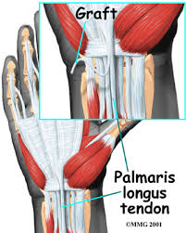
Operative:²⁷
Techniques
Jobe (Original Tommy Johns)
Modified Jobe (Current Tommy Johns)
Docking
Modified Docking
Interference screw
Graft Types
Autograft = preferred
Palmaris longus = preferred
Gracilis = 2nd option
Allograft = not as well understood
Wrist Ligament injuries. eOrthopod. http://eorthopod.com/ligament-injuries-of-the-wrist/. Accessed April 13, 2017.
Notes:
Typically, UCL reconstruction is indicated if the patient is a throwing athlete with a complete UCL tear; if the patient has a partial tear that failed conservative rehabilitation; or if the patient is a symptomatic non-throwing athlete after a minimum of three months of rehabilitation
The different surgical options include: the job, the modified jobe, the docking procedure, the modified docking procedure, and the interference screw technique. And I will go into more detail about these on the following slides.
When surgeons perform UCL reconstructions they typically use an autograft because allografts are not as well understood.
And surgeons typically prefer to use the palmaris longus, but if a patient does not have a palmaris longus they will often times use the gracilis tendon.

Slide 64
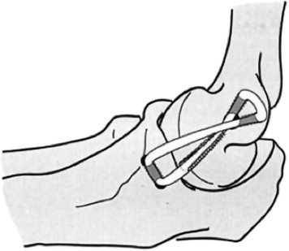
Jobe:^{27,44,45}
1st performed in 1974
Not great outcomes
High complication rate
Not used unless absolutely necessary
Reprinted from Bowers et al., 2010²⁶
Notes:
The Jobe was the 1st UCL reconstruction technique and it was 1st performed in 1974 to the LA Dodgers pitcher, Tommy John
Although it had greater return to play rates compared to conservative treatment, which was 1% at the time, it didn’t actually have great outcomes. Only about 63% of the baseball players returned to play.
It also had high complication rates (approx 32%)., and most of the complications were related to ulnar neuropathy.
Thus, this technique is no longer used unless absolutely necessary.
During the procedure they detach the flexor-pronator mass from the medial epicondyle and perform a sub-muscular transposition of the ulnar nerve to anterior cubital fossa. The UCL is then re-constructed with an autograft in a figure-8 configuration through 2 drill holes in the ulna and 3 holes in the medial epicondyle.
As previously stated, the palmaris longus is the preferred graft because it can withstand up to 357 N, which is actually greater than that of the anterior bundle of the UCL (260 N).

Slide 65
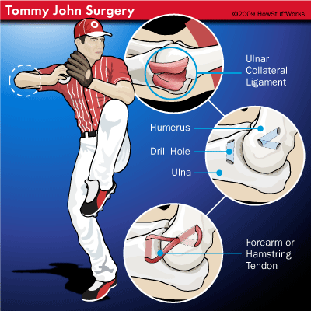
Jobe Technique:^{27,44,45}
Detach the flexor-pronator mass
Do sub-muscular transposition of the ulnar nerve
Re-construct UCL with an autograft in a figure-8 configuration
2 drill holes in ulna
3 drill holes in humerus
Dempsy L. Tommy johns surgery. HowStuffWorks. http://health.howstuffworks.com/medicine/modern-technology/surgery-change-baseball1.htm. Published February 11, 2009. Accessed April 12, 2016.
Notes:
During the Jobe, the surgeon detaches the flexor-pronator mass from the medial epicondyle and performs a sub-muscular transposition of the ulnar nerve to anterior cubital fossa. Then, the surgeon reconstructs the UCL with an autograft of the palmaris longus tendon in a figure-8 configuration through 2 drill holes in the ulna and 3 holes in the medial epicondyle

Slide 66
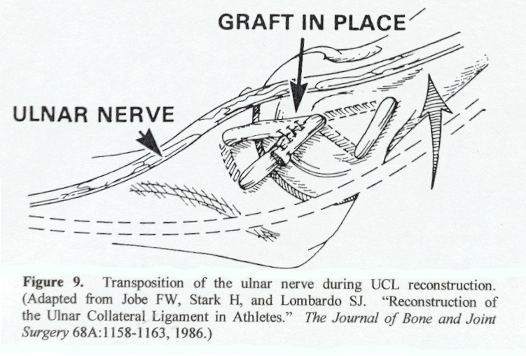
Modified Jobe:^{27,44,45}
Excellent long-term success rate
Less strain on the patient
Figure 8 configuration + subcutaneous transposition of the ulnar nerve to anterior cubital fossa
Return to play rate: 83-100%
Complication rate: 5-20%
http://www.keyword-suggestions.com/dWxuYXIgY29sbGF0ZXJhbCBsaWdhbWVudA/. Accessed April 8, 2017.
Notes:
Although the Jobe offered improved patient outcomes compared to conservative treatment, there were very high complications rates, which lead to the creation of the “Modified Jobe”
And the Modified Jobe is what we typically think of when we say Tommy Johns surgery
During this technique, surgeons continue to use the figure 8 configuration; however, they do a subcutaneous transposition of the ulnar nerve to the anterior cubital fossa, in turn, preserving the flexor-pronator muscle mass
Compared to patient that underwent the Jobe, these patients had significantly better outcomes as indicated by an 83% return to play rate.
And this technique also reduced the complication rate by at least 10%. Again, ulnar nerve neuropathies continue to be one of the most common post-operative complication; however, posteromedial impingement is another common complication.

Slide 67
Docking:^{27,44,46,47,48}
Developed by David Altcheck et al.
Less risky than the Jobe and Modified Jobe (6% complication rate)
Less bone removed
Muscle splitting, no muscular detachment
No transposition
Elbow arthroscopy routinely performed before UCL reconstruction
Simplifies graft tensioning and improves fixation⁴⁷
Return to play rate: 90.0-92.0%
Complication rate: 3.0-5.5%
Notes:
This technique was developed in 1995 by David Altcheck and his colleagues.
Overall, this technique is less risky than the Jobe and Modified Jobe because
It utilizes a muscle splitting “safe zone” approach, rather than muscular detachment of the pronator flexor muscle mass
They reduce the number of humeral drill holes from 3 holes to a single hole, meaning there is less bone removed. As the 2 strand of the palmaris graft pass through the single hole
There is no routine transposition of the ulnar nerve – meaning there is less risk for ulnar nerve injury
This technique also calls for routine elbow arthroscopy prior to UCL reconstruction, which allows the surgeons to confirm the presence of UCL insufficiency and it allows them to treat intraarticular pathologic conditions, particularly those in the posteromedial compartment of the elbow joint.
Slightly more favored technique in clinical and biomechanical testing because it simplifies graft tensioning and it has improved fixation methods.
(DO NOT READ: a properly placed Krackow stitch with No. 1 Ethibond suture allowed the surgeon to pull maximally on the graft while tying over a bony bridge, providing strong fixation and greatly facilitating graft tensioning.)

Slide 68
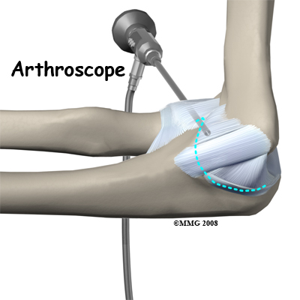
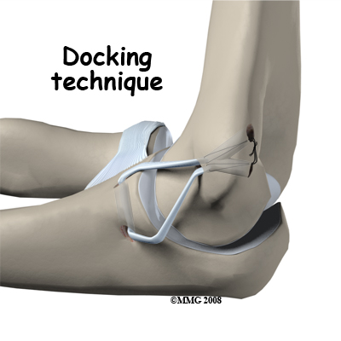
Ulnar Collateral Ligament Reconstruction (Tommy John Surgery). Houston Methodist Leading Medicine. http://www.houstonmethodist.org/orthopedics/where-does-it-hurt/elbow/ulnar-collateral-ligament reconstruction/. Updated 2017. Accessed April 9th, 2017.
Notes:
As in tommy johns surgery, the surgeon uses a 2 strand palmaris longus graft and loops the graft through a bony tunnel in the ulna but in the docking technique BOTH ends of the graft, not just one end, are passed through the single tunnel in the humerus, with the sutures exiting posteriorly through smaller drill holes. One suture is tied down or “docked” first, allowing the surgeon to then the surgeon tensions the other side of the graft, taking out all of the creep, prior to docking it. These sutures are both tied over a posterior bony bridge.

Slide 69
Modified Docking:^{44,45,48,49}
Developed by Paletta et al.
Overall technique is the same
Minor differences:
arthroscopy is no longer routinely performed
4 strand palmaris longus graft
slight difference in humeral bone tunnel preparation
Return to play rate: 92.0-95.0%
Complication rate: 4.3-5.0%
Ulnar Collateral Ligament Reconstruction (Tommy John Surgery). Houston Methodist Leading Medicine. http://www.houstonmethodist.org/orthopedics/where-does-it-hurt/elbow/ulnar-collateral-ligament reconstruction/. Updated 2017. Accessed April 9th, 2017.
Notes:
The modified docking procedure was first discussed by Paletta et al.
The overall technique is the same; however, routine arthroscopy is no longer performed, a 4 strand palmaris longus graft is used rather than a 2 strand, and there are slight difference in humeral bone tunnel preparation

Slide 70
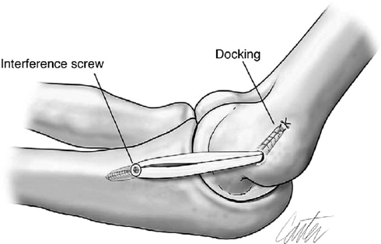
Interference Screw^{45,46}
AKA: Dane TJ Procedure
Technique:
Ulnar interference screw fixation and humeral docking
Muscle splitting
No arthroscopy
No ulnar nerve transposition
Return to play rate: 86.0%
Complication rate: 18.0%
Jones KJ, Osbahr D, Schrumpf MA, Altchek DW. Ulnar collateral ligament reconstruction in throwing athletes: a review of current concepts. AAOS exhibit selection.Journal of Bone and Joint Surgery. 2012; 94(8):e49.
Notes:
The interference screw technique, or the Dane TJ Procedure, was developed because prior techniques were not able to restore the biomechanical strength of the native UCL
It uses the same tunnels and docking mechanism on the humeral side
But on the ulnar side, the graft is fixed into a single hole with a Bio-Tenodesis screw to achieve interference fixation of the graft within the ulnar tunnel

Slide 71
How do you define/measure return to play rates??
Conway Job Scale^{44,46,47,48,49,51,52,53}
No validity or reliability
Notes:
On the previous slides I listed the return to play rates for the various treatment options, but what is actually meant by a complete return to play? How did the researchers objectively measure return to play?
Well, in a majority of the literature available on this topic, researchers utilized the Conway Jobe Scale, which is a self-report tool that is neither valid nor reliable and it is prone to recall bias.
Conway Jobe: An excellent result indicates that the pitcher was able to compete at the same level or higher than that before the injury for more than twelve months. A good result indicates that the pitcher was able to compete at a lower level for more than twelve months or was able to throw in daily batting practice. A fair result indicates that the pitcher was able to return to a recreational level. A poor result indicates that the pitcher was unable to participate in his or her overhead sport.

Slide 72
How do you define return to play rates??
Andrews-Timmerman Score^{44,51,52,53}
No validity
Kerlan-Jobe Orthopedic Clinic Shoulder and Elbow Score^{44,51,54,55}
STRONG construct validity
Notes:
Researchers have also used the Andrews-Timmerman Score, which involves a subjective component where researchers ask the pitcher about his current level of activity, in addition to the presence of any pain, locking, or swelling. The Exam also includes an objective evaluation, during which, the researcher assesses for an elbow flexion contracture, the arc of forearm pronation and supination, and the total arc of elbow motion.
Unfortunately, studies have found that this tool also lacks validity
Some studies have assessed return to play using the Kerlan-Jobe Orthopaedic Clinic Shoulder and Elbow Score, which is a validated tool that can effectively distinguish between pain during performance, no pain during performance, and not playing due to pain in professional baseball players; and/or rate of return to the same, higher, or lower level of competition.
Although the Kerlan-Jobe has strong construct validity, it is not used as commonly as the other measures

Slide 73
Why are we basing patient prognoses and outcomes on studies that draw conclusions from measures that are not Valid OR reliable? Does A successful Outcome following UCL reconstruction involve more than just A “return to the same competitive level of play?”
1.
2.
Notes:
These results raise two important questions:
(1) why are we basing our patient prognoses and outcomes on the results of studies that drew conclusions from measures that were not valid or reliable?
(2) Doesn’t a successful outcome following UCL reconstruction involve more than just a “return to the same competitive level of play?”

Slide 74
Outcome measure → Pitching Performance Statistics:^{56,57,58}
1. UCL reconstruction is not usually career ending
2. No statistically significant difference in pitching performance between pitchers with and without a history of UCL reconstruction
3. No studies differentiate between the effects of different UCL reconstruction techniques
Notes:
These questions have started to lead to the development of studies that utilize more specific outcome measures related to pitching performance statistics post UCL reconstruction, but there are very few studies that assess performance statistics at this time.
In fact, this past year when I was conducting a literature search for my CAT on the effects of the Docking Procedure and the Modified Jobe (Tommy’s Johns) on pitching performance in baseball pitchers, I only found 3 studies that assessed specific pitching performance outcomes following UCL reconstruction like average velocity, peak velocity, innings pitched, games played, games started, innings per game, ERA, WHIP, wins, winning percentages, losses, saves, batters faced, and innings pitched per year, as well as hits, runs, home runs allowed, strikeouts, batters walked, and batters struck per inning
All 3 of the studies were retrospective cohorts ranging from level II to level III evidence and I drew the following conclusions from the studies:
(1) UCL reconstruction is not usually a career ending procedure for MLB baseball pitchers. In fact, a majority of MLB pitchers have a high rate of return to pitching in MLB baseball following UCL reconstruction.
(2) Following UCL reconstruction, most pitchers do not have statistically significant differences in pitching performance outcomes compared to pitchers without a history of UCL reconstruction that match in sex, age, body mass index (BMI), years of experience in the MLB, pitching performance in the MLB, year of injury, pitching position, and handedness.
(3) Future research is warranted that investigates pitching performance following different UCL reconstruction techniques because no studies to date have differentiated between the effects of the Docking Technique and Tommy John Surgery on post-reconstruction pitching performance among MLB players. These studies need to perform a priori power analyses, and they should include information regarding post-operative protocols and changes in pitching position/styles in order to improve the clinical significance of the results.

Slide 75
Prognosis Synopsis:
(+) prognosis
Operative
A majority return to pitching with biomechanics similar to non-injured professionals²⁴
(-) prognosis
Non-operative
Decreased velocity, control, endurance, or inability to throw⁵⁰
Notes:
As we learned from previous slides, non-operative return to play rates are very low. In those pitchers that do regain the ability to throw, they typically return with a significant decrease in velocity, control, endurance

Slide 76
Rehabilitation

Slide 77
Non-Operative Guidelines:³⁰
Proximal Tear
Distal tears
PRP (platelet rich plasma) injection
Rest x 2 weeks
Normal Shoulder Rehab – strengthening and control
Kinetic Chain
(+/-) PRP injection
Rest x 6 weeks
Normal Shoulder Rehab – strengthening and control
Kinetic Chain
Throwing Program @ 13 weeks

Slide 78
Phase 1: Immediate Post-op Phase

Slide 79
Phase 1 Goals:^{59,60}
Modified Jobe
Protect healing tissue
Minimize pain and swelling
Limit muscular atrophy
Docking Procedure
Protect healing tissue
Minimize pain and swelling
Immediate restoration of elbow ROM
Independent HEP
Notes:
During phase 1 both the modified jobe and the docking procedure aim to protect the healing tissue by minimizing pain and inflammation
Although both aim to reduce pain, inflammation, and muscle atrophy, only the docking procedure allows for immediate AROM of the elbow
The docking procedure also emphasizes the importance of a HEP

Slide 80
Phase 1:^{59,60}
Modified Jobe
Docking Procedure
Week 1:
Posterior splint at 90° elbow flexion
Elbow compression dressing (2-3 days)
Exercises
Wrist AROM for flexion/extension
Gripping
Shoulder/scapular isometrics (except for IR and ER)
Biceps isometrics
Cryotherapy
Weeks 1-4:
Precautions:
Wear brace at all times
NO PROM of the elbow
Functional brace set at 30° to 90°
Exercises
Elbow AROM in brace
Wrist AROM
Shoulder/scapular isometrics
Cryotherapy
Establish a HEP
Notes:
During phase 1 of the rehab process, patients undergoing the Modified Jobe are required to wear a posterior splint for at least 1 week, which locks the elbow in 90 degrees of flexion. The modified Jobe rehab protocol also places greater emphasis on the need for a compression dressing early on in therapy.
Both groups are allowed to do wrist AROM; however, those undergoing the modified jobe are restricted to wrist flexion and extension.
As you can see, the modified jobe patients are also allowed to do gripping exercises, shoulder isometrics with the exception of ER and IR, and bicep isometrics.
Unlike those that underwent the Jobe, patient that undergo the docking procedure are allowed to do AROM for elbow flexion and extension within the 30 to 90 degrees, which their functional brace is set to
These patients can also do scapular isometrics.
That being said, its important to cautions our patients to wear their brace at all times and to avoid PROM at the elbow
Both protocols also advise the use of cryotherapy to minimize the pain and swelling.

Slide 81
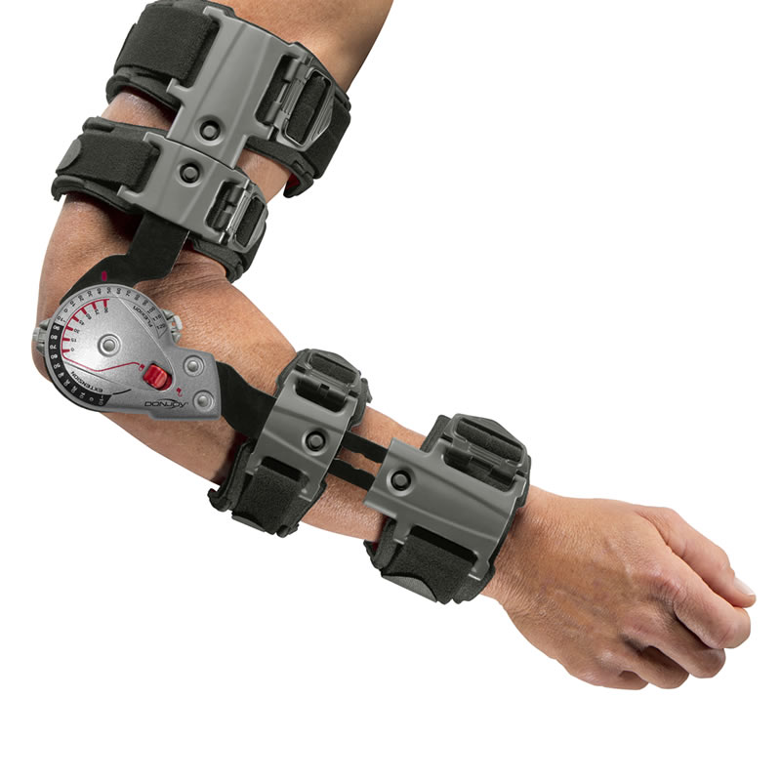
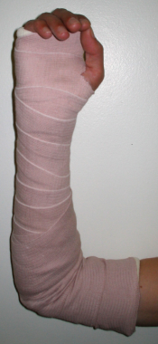
Phase 1:^{59,60}
Modified Jobe
Docking Procedure
Week 2:
Functional brace set at 30º to 90º
Exercises
Continue exercises from week 1
Initiate wrist isometrics
Initiate elbow extension isometrics
Week 3:
Functional brace set at 15º to 110º
Same procedure from week 1-4
Arm and Elbow Supports. PhysioRoom. http://www.physioroom.com/product/Donjoy_X_ACT_Elbow/2033/39639.html. Updated 2017. Accessed April 13, 2017.
McCullough L. Posterior Elbow Splinting. Medscape. http://emedicine.medscape.com/article/80089-overview. Updated October 12, 2015. Accessed April 13, 2017.
Notes:
During Week 2 of the Modified Jobe protocol, the patient receives a functional brace set at 30º to 90º
The patient continues the exercises from week 1, but the PT should add in wrist isometircs and elbow extension isometrics
By week 3 of the modified docking protocol, the functional brace is advanced to 15º to 110º
During this time, the docking procedure protocol remains the same. There are no changes from week 1 to week 4.
And pictured in the bottom right is the posterior splint used in week 1 of the modified docking procedure and the functional brace is on the far right

Slide 82
Criteria for advancement into phase 2:^{59,60}
Modified Jobe
Meet ROM guidelines
Low, controlled pain
Minimal swelling
Docking Procedure
Meet ROM guidelines
Low, controlled pain
Minimal swelling
Notes:
In order for patients to advance to phase 2 of the rehab process following both the modified jobe and docking procedure, they must have meet the ROM guidelines. Their pain should also be relatively low and well controlled, and they should have minimal swelling.

Slide 83
Post-operative Phase 2:

Slide 84
Phase 2 Goals:^{59,60}
Modified Jobe
Promote healing of repaired tissue
Gradual increase in elbow ROM
Regain and improve muscular strength
Docking Procedure
Promote healing of repaired tissue
Continue to minimize pain and swelling
Achieve 15º-115º for elbow AROM
Notes:
During phase 2 of the modified jobe rehab protocol, the goals are to promote healing of the repaired tissue, gradually increased elbow ROM, regain muscular strength, and begin to improve muscular strength
During phase 2 of the docking procedure protocol, the therapist should also promote healing of the repaired tissue, with extra emphasis on continuing to minimize pain and swelling. During this phase the patient should also achieve elbow AROM from 15 degrees to 115 degrees

Slide 85
Phase 2:^{59,60}
Modified Jobe
Docking Procedure
Week 4-5:
Functional brace set at 10º-110º
Exercises
Light resistance exercises at wrist and elbow
Stretch into elbow extension
Progress shoulder strengthening emphasizing the ROC
IR and ER isometrics at neutral
UBE
Grip
Scar massage
Weeks 4-6:
Precautions:
Wear brace at all times
AVOID PROM of the elbow
AVOID valgus stress
Functional brace set at 15º-115º
Exercises
Continue elbow AROM in brace
Begin elbow isometrics in brace
Scapular stabilization exercises
Notes:
During weeks 4 and 5 the functional brace is set at 10 degrees to 110 degrees.
During this time the PT can utilize low load long duration stretching if the patient is lacking elbow extension.
The PT should also begin the patient on light resistance exercises for the wrist in all planes of motion and for the elbow just in flexion and extension.
The PT needs to progress the shoulder strengthening program, emphasizing strengthening of the ROC. Common exercises during this phase include: prone rows, prone extension, and prone horizontal abduction
The patient can also do standing flexion, standing abduction or standing scaption
During this phase the patient can also begin IR and ER isometrics in neutral
He may do the UBE at a low resistance, and he should continue with grip strengthening activities.
During this phase scar mobes should also be implemented
During weeks 4 through 6 for the docking procedure, the patient should continue to wear the brace at all times, which should be set at 15 degrees to 115 degrees. PROM of the elbow and valgus stress to the elbow should be avoided during this time.
The therapist should emphasize continued elbow AROM in the brace and the use of modalities as needed.
The PT should also initiate elbow isometrics in the brace and scapular stabilization exercises with proximal resistance.
As with any rehab POC the therapist should also modify the HEP as needed.

Slide 86
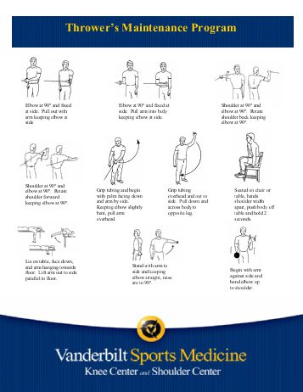
Phase 2:^{59,60}
Modified Jobe
Docking Procedure
Week 6-8:
Discontinue brace
Exercises
Progress elbow strengthening exercises
Progress shoulder ER strengthening
Begin Throwers 10 Program
Exercise Program for Throwers (baseball). Yumpu. https://www.google.com/search?q=throwers+10+program&espv=2&source=lnms&tbm=isch&sa=X&ved=0ahUKEwjnzt7jx6TTAhVGiVQKHXHVCr0Q_AUIBigB&biw=754&bih=710#imgrc=lDep0cLIYA6eIM. Accessed April 14, 2017.
Notes:
During weeks 6-8 of the modified jobe post-op protocol the functional brace should be discontinued and the patient should focus on AROM outside of the brace.
If his ROM is restricted, PROM and joint mobilizations at end range coupled with distraction may be implemented
Strengthening activities should focus on the muscle surrounding the elbow joint and shoulder, particularly the shoulder ER. Common exercises during this phase include: progressive resistance exercises at the elbow with dumbbells, push up plus on swiss ball, t-band exercises for IR and ER at the shoulder, and PNF D2 patterns
During this time the athlete can also begin the throwers 10 program

Slide 87
Criteria for advancement into phase 3:^{59,60}
Modified Jobe
Full elbow AROM
Low, controlled pain
Minimal swelling
UE and LE MMT = 5/5
Ext rotation/Int rotation ratio of 67%
Ankle DF equal bilat
50º of bilat. trunk rotation
Docking Procedure
Elbow ROM 15º-115º
Low, controlled pain
Minimal swelling
Notes:
In order for patients to advance to phase 2 of the rehab process following both the modified jobe and docking procedure, they must have meet the ROM guidelines. Their pain should also be relatively low and well controlled, and they should have minimal swelling. The Modified Jobe has several additional requirements like UE and LE strength = 5/5 on MMT. They also require the patient to have an ER to IR ratio of 67%, ankle DF ROM must be equal bilat, and the patient must be able to achieve 50º of trunk rotation bilat.

Slide 88
Post-operative Phase 3:

Slide 89
Phase 3 Goals:^{59,60}
Modified Jobe
Maintain full elbow ROM
Increase strength, power, and endurance
Improve muscular control
Gradually initiate sporting activates
Docking Procedure
Restore full ROM
All upper extremity strength 5/5
Begin to restore upper extremity endurance
Notes:
During phase 3 of the modified docking procedure the goal is to maintain full elbow ROM, while also increasing UE strength, power, and endurance without exacerbation
The PT should also work on improving UE muscular control.
During this phase the patient can gradually return to baseball activities as well.
The goals for the docking procedure are somewhat similar and include: the restoration of full elbow ROM, UE strength of 5/5 for all major muscle groups during MMT, and implementation of UE endurance activities.

Slide 90
Phase 3:^{59,60}
Modified Jobe
Docking Procedure
Week 9-11:
Eccentric training
Continue isotonic program and Throwers 10
PNF diagonals
Scapular strengthening and stabilization exercises
Core exercises
Initiate double arm plyometrics
Weeks 12-13:
Initiate single arm plyometrics
Initiate interval hitting program
Weeks 6-12:
Precautions:
Minimize valgus stress
Avoid PROM
Avoid pain with any activity
Exercises:
Continue elbow AROM
Stretch into elbow extension
Begin isotonics
UBE
Scapular stabilization exercises
PNF diagonals
Eccentric training
Discontinue brace
Notes:
During Weeks 9 and 10 for the modified jobe protocol, we want to initiate eccentric elbow flexion and extension exercises
The patient should also continue with his isotonic strengthening program for the forearm and wrist and he should continue with the throwers 10 program
During these weeks it is also safe for the PT to implement manual resistance in the PNF diagonal patterns
It is also important to emphasize scapular strengthening and core exercises because as we learned deficits at the shoulder, core, and the rest of the kinetic chain can increase the stress on the UCL during pitching
By week 11 the pitcher can implement double arm plyometrics – NO one arm activities.
And by week 12, they can begin single arm plyos and can begin an interval hitting program
During weeks 6-12 for docking procedure protocol, the patient needs to continue to perform elbow AROM, but he can also begin low load, long duration stretching into elbow extension.
He can do isotonic exercises for the scapula, shoulder, elbow, and wrist but shoulder ER and IR strengthening and pronation/supination strengthening should be avoided until week 8.
During this phase it is also appropriate to include the UBE, scapular stabilization exercises, PNF diagonals, and UE eccentric training when the patients UE strength is adequate.

Slide 91
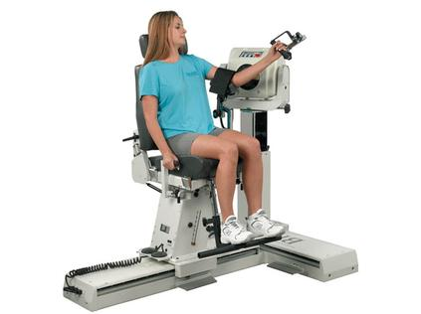
Phase 3:^{59,60}
Modified Jobe
Modified Jobe
Week 14-15:
Initiate functional exercise/light sporting activities
Weeks 16-17:
Continue UE strengthening
Continue Core strengthening
Continuing UE plyometrics
Isokinetic testing
System 4 Pro. Biodex. http://www.biodex.com/physical-medicine/products/dynamometers/system-4-pro. Updated 2017. Accessed April 14, 2017.
Notes:
Unlike the Docking post-op protocol, phase three of the Modified jobe protocol extends through week 16.
During this time, the patient can begin light sporting activities and by week 16 the therapist can perform isokinetic testing on the patient. Isokinetic testing should focus on shoulder IR and ER at 90, 180, and 300 degrees per second. Acceptable values for the isokinetic test that will allow the patient a complete return to activity include
A non-dominant shoulder to dominant shoulder strength of 90%
The strength of the shoulder ERs should be at least 65% of that if the IRs

Slide 92
Criteria for advancement into phase 4:^{59,60}
Modified Jobe
None Identified
Docking Procedure
Pain-free
Full elbow ROM
All UE strength 5/5 on MMT

Slide 93
Post-operative Phase 4:

Slide 94
Phase 4 Goals:^{59,60}
Modified Jobe
Continue to increase strength, power, and endurance in UE musculature
Gradual return-to-sport activities
Docking Procedure
Restore full UE strength and flexibility
Restore normal neuromuscular function
Prepare for return to activity
Notes:
In case you haven’t noticed by now, the modified jobe has a much faster post-op protocol. By Phase 3 patients that had the modified jobe are working to further increase the strength, power, and endurance in their UE musculature, while also doing a gradual return to baseball.
Those patients that had the docking procedure are striving to regain full UE strength, flexibility and nueuromuscular control in order to PREPARE for return to play activities

Slide 95
Phase 4:^{59,60}
Modified Jobe
Docking Procedure
Weeks 18+:
Begin Competitive Throwing Progression AFTER physician clearance
Weeks 12-16:
Precautions:
Pain-free plyometrics
Advance IR/ER exercises to 90/90 position
Full UE flexibility program
Continue UE neuromuscular drills and endurance activities
Begin UE plyometrics
Implement LE and trunk strengthening
Notes:
During phase 4, patients that had the modified jobe can begin their return to competitive throwing once they have clearance from their surgeon
During phase 4 of the docking procedure post-op protocol patients are to continue their UE neuromuscular drills and endurance activities, but now they can do UE strengthening for IR and ER in the 90/90 position and they can begin UE plyos
During this phase, the PT should also incorporate LE and trunk strengthening.

Slide 96
Criteria for advancement into phase 5:⁵⁹
Docking Procedure
Complete plyometrics without symptoms
Normal UE flexibility
Notes:
In order for patient to advance to phase 5 following the docking procedure they must be able to complete UE plyos without symptoms and they must have normal UE flexibility
There is no phase 5 for the modified jobe

Slide 97
Post-operative Phase 5:

Slide 98
Phase 5 Goals:⁵⁹
Docking Procedure
Return to activity
Prevent re-injury

Slide 99
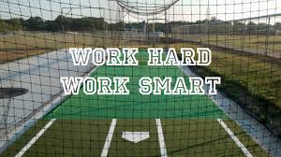
Phase 5:⁵⁹
Modified Jobe
Docking Procedure
Weeks 16+:
Precautions:
STOP throwing or hitting if significant pain develops
Avoid loss of strength and flexibility
Isokinetic Testing
Week 16: begin interval throwing
Week 20: begin hitting program
Continue strengthening and flexibility program
How to have a productive “Batting Practice” session. Art of Baseball. http://artofbaseball.net/how-to-have-a-productive-batting-practice-session/. Accessed Updated 2013. April 15, 2017.
Notes:
During post-op phase 5, those that had the docking procedure can receive isokinetic testing. If the patient achieves the isokinetic results previously described and they get the all clear from their surgeon, then they may begin an interval throwing program at week 16 and a hitting program at week 20.
During this time it is important for the athlete to stop activity if he feels significant pain in his elbow.
It is also important for him to continue his UE strengthening and flexibility program in order to maintain the appropriate amount of strength and flexibility required for overhand throwing.

Slide 100
Criteria for discharge⁵⁹
Docking Procedure
Pain-free
Independent with Home Exercise Program
Independent with throwing/hitting program

Slide 101
Key Points during the Rehab process:^{59,60,61}
Restore normal UE ROM
Restore Posterior Shoulder Flexibility
Normalize NM Function – need a posterior strengthening bias
Improve endurance
Improve power and speed
Address kinetic chain
Isolated forearm strengthening
Return to throwing needs to be gradual, individualized, and allows for adequate rest/recovery
Notes:
Overall, the post-op progressions are relatively similar in that they both:
Aim to restore normal UE ROM
They emphasize the importance of restoring posterior shoulder flexibility
They want to normalize NM functioning by
Normalizing scapular function
Restoring ROC balance
Performing eccentric training because the elbow flexors, ER, and scap retractors must work very hard to oppose the large distractive forces during deceleration
Restoring proprioception throughout the entire throwing ROM
And by the performance of overhead activities
They want to improve endurance because there is a loss of proprioception with fatigue
They want to improve power and speed through UE plyos
They aim to address the entire kinetic chain
And they stress the importance of isolated forearm strengthening

Slide 102
Key differences during the rehab Process:
Splint vs. brace
Restoration of full wrist AROM
Initiation of elbow isometrics
Initiation of elbow isotonics
Initiation of low load, long duration stretching
Timing of core strengthening
Initiation of plyos
Return to sport
Notes:
That being said, some of the main differences include:
The use of a posterior splint for the first week following the modified jobe, where as the docking post-op protocol immediately has the patient in the functional brace
Another difference is when full wrist AROM is restored. Following the docking procedure patients can immediately move throughout their full wrist ROM; however, those patient that the job are restricted to flex and extension for at least 2 weeks.
Another significant difference is when elbow isometrics are initiated. Following the jobe the patient can begin elbow isometrics at 2 weeks, but the patient must wait until 4-6 weeks to do these after the docking procedure
Due to the difference in initiation of isometrics, there is also a significant difference in the initiation of elbow isotonics. During week 4-5 following the modified jobe the patient can begin light resistance exercises, but those that had the docking procedure must refrain from isotonics until weeks 6 through 12
Another significant difference is when low load long duration stretching into elbow extension can be implemented. Following the modified jobe this can be started during weeks 4 and 5, but it must be withheld until weeks 6 through 12 following the docking procedure
The modified jobe also emphasizes earlier core strengthening. This is typically initiated between weeks 9 and 11, whereas its withheld until weeks 12 through 16 following the docking procedure.
The modified jobe also intimates plyos about 3 weeks before the docking procedure
Although the post-op protocol for the modified jobe progresses more rapidly overall, throwing is actually initiated about 2 weeks earlier for the docking protocol (18 weeks vs 16 weeks)
That being said, hitting progressions are added significantly earlier in the modified jobe post op protocol. The jobe initiates hitting at weeks 12 and 13, whereas the docking procedure waits until week 20

Slide 103
Functional Activities:
Interval Throwing Program:⁶⁰
The Ohio State University Throwing Progression: https://osuwmcdigital.osu.edu/sitetool/sites/sportsmedicinepublic/documents/rehab_protocols/ThrowingProgression_Baseball.pdf
Hitting Program:⁶¹
Dry swings → off the tee → soft
toss → live BP
Mound Program: 9 months⁶¹
Return to Game: 12-16 months⁶¹
Baseball. PCMAG. http://www.pcmag.com/article2/0,2817,2489437,00.asp. Published 2015. Accessed April 12, 2016.
Notes:
When it comes time for the return to functional activities, The Ohio State University has an excellent Interval Throwing Program, and it has been included in your PT Guides along with a more in depth breakdown of the rehab protocols that we just discussed
Also, when you finally implement a hitting program for your patient it is important to begin with dry swings progressing to tee hitting, soft toss, and finally live BP
In most instances the patient will be ready for a mound program by 9 months, and can typically return to games by 12-16 months

Slide 104
Future Research:
1. “Should evaluate the specific degree of humeral torsion that is associated with increased risk UCL injury in order to enhance risk assessment, aid in player development, and injury prevention.”³⁰
2. Determine an appropriate pitch count limit per game in the MLB
3. Differentiate between the effects of different UCL reconstruction techniques on pitching performance statistics

Slide 105
Key Messages¹²
Important to understand mechanics for both the treatment and prevention of UE injuries in youth and professional baseball pitchers
Need efficient transfer of forces to reduce the stress on the shoulder and elbow
Injuries can occur even with good mechanics secondary to overuse
Future research is needed on this topic

Slide 106
The END…Any Questions?

Slide 107
Work Cited
Fleisig G, Andrews J, Cutter G, Weber A, Loftice J, McMichael C, Hassell N, Lyman S. Risk of Serious Injury for Young Baseball Pitchers A 10-Year Prospective Study. American Sports Medicine Institute. 2012; 4(5):419-424.
MLB Staff. Opening day rosters feature 230 players born outside the U.S. MBL.com. http://m.mlb.com/news/article/198283814/week-ahead-yasiel-puig-among-trade-candidates/. Published April 6, 2015. Accessed August 29, 2016.
Andrews. Tommy john FAQ. Pitch Smart USA. http://m.mlb.com/pitchsmart/tommy-john-faq. Updated February 12, 2016. Accessed August 29, 2016.
Lewek M. Elbow/Forearm. Lecture presented at: the University of North Carolina Chapel Hill; October 20, 2014; Chapel Hill, NC. Accessed April 10th, 2016.
Hacke J. Elbow, wrist and hand. Lecture Presented at: the University of North Carolina Chapel Hill; Fall 2015; Chapel Hill, NC. Accessed April 10th, 2016.
LaPres J. Articulations. Lecture Presented at: Lone Star College – North Harris; 2012; Houston, Tx. Accessed April 10th, 2016.
Floyd RT. The elbow and radioulnar joints. Lecture presented at: Kean University; Union and Hillside, NJ. Accessed April 10th, 2016.
Jones O. The radioulnar joints. TeachMeAnatomy. http://teachmeanatomy.info/upper-limb/joints/radioulnar-joints/. Published April 3rd, 2016. Accessed April 10th, 2016.
Morrey BF. Articular and ligamentous contributions to the stability of the elbow joint. The American Journal of Sports Medicine. 1983; 11(5): 315-319. doi:10.1177/036354658301100506. http://ajs.sagepub.com.libproxy.lib.unc.edu/content/11/5/315.full.pdf+html. Accessed April 10, 2016.
The throwing elbow. Lecture presented at: HSS Sports Medicine Symposium; April 8th, 2016; New York City, NY.
Wilk K, Arrigo C, Andrews JR. Rehabilitation of the elbow in the throwing athlete. JOSPT. 1993; 17(6):305-317.
Wilk KE, Marcina LC, Cain EL, Dugas JR, Andrews JR. Rehabilitation of the overhead athlete’s elbow. Sports Health. 2012; 4(5):404-414.
Wright RW, Steger-May K, Wasserlauf BL, O’Neal ME, Weinberg BW, Paletta GA. Elbow range of motion in professional baseball pitchers. The American Journal of Sports Medicine. 2006; 34(2):190-193.
Ellenbecker TS, Mattalino AJ, Elam EA, Caplinger RA. Medial elbow joint laxity in professional baseball pitchers. A bilateral comparison using stress radiography. Am J Sports Med. 1998 May-Jun; 26(3):420-4
Sgori T. Biomechanics: are our bodies made to throw a baseball? Lecture Presented at: HSS Sports Medicine Symposium; April 8th, 2016; New York City, NY.
Escamilla R, Andrews JR. Shoulder Muscle Recruitment Patterns and Biomechanics during Upper Extremity Sports. Sports Med 2009; 39 (7): 569-590.

Slide 108
Work Cited
Calabrese GJ. Pitching mechanics, revisited. Int J Supports Phys Ther. 2013; 8(5): 652-660.
Seroyer ST, Nho SJ, Bach BR, Bush-Joseph CA, Nicholson GP, Romeo AA. The kinetic chain in overhead pitching: its potential role for performance enhancement and injury prevention. Sports Health. 2010; 2(2):135-146.
Werner SL, Murray TA, Hwakins RJ, Gill TJ. Relationship between throwing mechanics and elbow valgus in professional baseball pitchers. J Shoulder Elbow Surg. 2002;11:151-155.
Fleisig GS, Andrews JR, Dillman CJ, Escamilla RF. Kinetics of baseball pitching with implications about injury mechanisms. Am J Sports Med. 1995 Mar-Apr;23(2):233-9.
Werner SL, Fleisig GS, Dillman CJ, Andrews JR. Biomechanics of the elbow during baseball pitching. J Orthop Sports Phys Ther. 1993 Jun;17(6):274-8.
Werner SL, Guido JA, Stewart GW, McNeice RP, VanDyke T, Jones DG. Relationship between throwing mechanics and shoulder distraction in collegiate baseball pitchers. Journal of Shoulder and Elbow Surgery. 2007; 16(1):37-42.
Sakata J, Nakamura E, Suzukawa M, Akaike A, Shimiizu K. Physical risk factors for a medial elbow injury in junior baseball players a prospective cohort study of 353 players. AJSM. 2017; 45(1):136-143
Fleisig GS, Andrews JR. Prevention of elbow injuries in youth baseball. Sports Health. 2012;4(5):419-424.
Fleisig GS, Andrews JR, Cutter GR, Weber A, Loftice J, McMichael C, Hassell N, Lyman S. Risk of serious injury for young baseball pitchers: a 10 year prospective study. AJSM. 2010; 39(2):253-257.
Solomito M, Garibay EJ, Woods JR, Ounpuu S, Nissen CW. Lateral trunk lean in pitchers affects both ball velocity and upper extremity joint motions. AJSM. 2015; 43(5):1235-1240.
Altcheck DW. Biomechanics: are our bodies made to throw a baseball? Lecture Presented at: HSS Sports Medicine Symposium; April 8th, 2016; New York City, NY
Notes:
3. Fleisig GS, Andrews JR, Dillman CJ, Escamilla RF. Kinetics of baseball pitching with implications about injury mechanisms. Am J Sports Med. 1995 Mar-Apr;23(2):233-9.

Slide 109
Work Cited
Garrison JC, Cole MA, Conway JE, Macko MJ, Thigpen C, Shanley E. Shoulder range of motion deficits in baseball players with an ulnar collateral ligament tear. American Journal of Sports Medicine. 2012; 40(11):2597-2603
Davis JT, Limpisvasti O, Fluhme D, Mohr KJ, Yocum LA, Elattrache NS, Jobe FW. The effect of pitching biomechanics on the upper extremity in youth and adolescent baseball pitchers. Am J Sports Med. 2009 Aug;37(8):1484-91. doi: 10.1177/0363546509340226.
Polster JM, Bullen J, Obuchowski NA, Bryan JA, Soloff L, Schickendantz. Relationship between humeral torsion and inury in professional baseball pitchers. The American Journal of Sports Medicine. 2013; 41(9):2015-2021.
Noonan TJ, Thigpen CA, Bailey LB, Wyland DJ, Kissenberth M, Hawkins RJ, Shanley E. Humeral torsion as a risk factor for shoulder and elbow injury in professional baseball pitchers. Am J Sports Med. 2016 Sep;44(9):2214-9. doi: 10.1177/0363546516648438.
Whiteside D, Martini DN, Lepley AS, Zemicke RF, Goulet GC. Predictors of ulnar collateral ligament reconstruction in major league baseball pitchers. The American Journal of Sports Medicine. 2016; 44(9)2202-2209.
Anz A, Bushnell BD, Griffin LP, Noonan TJ, Torry MR, Hawkins RJ. Correlation of torque and elbow injury in professional baseball pitchers. The American Journal of Sports Medicine. 2010; 38(7):1368-1374.
Keller RA, Marshall NE, Guest JM, Okoroha KR, Jung EK, Moutzouros V. Major league baseball pitch velocity and pitch type associated with risk of ulnar collateral ligament injury. Journal of Shoulder and Elbow Surgery. 2016; 25(4):671-675.
Dines JS, Frank JB, Akerman M, Yocum LA. Glenohumeral internal rotation deficits in baseball players with ulnar collateral ligament insufficiency. The American Journal of Sports Medicine. 2009; 37(3):566-570.
Miller m, Hatch D. Medial UCL injury and valgus instability. OrthoBullets. http://www.orthobullets.com/sports/3079/medial-ucl-injury-and-valgus-instability. Published July 12, 2015. Accessed April 11, 2016.
Langer P, Fadale P, Hulstyn M. Evolution of the treatment options of ulnar collateral ligament injuries of the elbow. Br J Sports Med. 2006 Jun; 40(6): 499–506.
Sjsu D. Forearm and elbow pathologies. Lecture presented at: Kaiser Permanente Medical Group Santa Teresa Medical Center; Spring 2008; San Jose, Ca.
Notes:
3. Fleisig GS, Andrews JR, Dillman CJ, Escamilla RF. Kinetics of baseball pitching with implications about injury mechanisms. Am J Sports Med. 1995 Mar-Apr;23(2):233-9.

Slide 110
Work Cited
Fortenbaugh D, Fleisig GS, Andrews. Baseball pitching biomechanics in relation to injury risk and performance. Sports Health. 2009 Jul; 1(4): 314–320. doi: 10.1177/1941738109338546.
Ellis S. Pitching Faults. The Complete Pitcher. http://www.thecompletepitcher.com/pitching_faults.htm Accessed April 1, 2017.
Rettig AC, Sherrill C, Snead DS, Mendler JC, Mieling P. Nonoperative treatment of ulnar collateral ligament injuries in throwing athletes. Am J Sports Med. 2001;29(1):15–17.
Kim NR, Moon SG, Ko SM, Moon WJ, Choi JW, Park JY. MR imaging of ulnar collateral ligament injury in baseball players: value for predicting rehabilitation outcome. Eur J Radiol. 2011 Dec;80(3):e422-6. doi: 10.1016/j.ejrad.2010.12.041.
Furushima K, Itoh Y, Iwabu S. What are the Risk Factors for Failure after Conservative Treatment of Ulnar Collateral Ligament Injuries of the Elbow in Baseball Players? Orthop J Sports Med. 2013 Sep; 1(4 Suppl): 2325967113S00015. doi: 10.1177/2325967113S00015.
Watson JN, McQueen P, Hutchinson MR. A systematic review of ulnar collateral ligament reconstruction techniques. Am J Sports Med. 2014;42(10):2510-2516. doi:10.1177/0363546513509051
Redler LH, Degen RM, McDonald LS, Altcheck DW, Dines JS. Elbow ulnar collateral ligament injuries in athletes: can we improve our outcomes? World J Orthop. 2016 Apr 18; 7(4): 229–243.
Bowers AL, Dines JS, Dines DM, Altcheck DW. Elbow medial ulnar collateral ligament reconstruction: Clinical relevance and the docking technique. Journal of Shoulder and Elbow Surgery. 2010. 19(2); 110-117. doi:10.1016/j.jse.2010.01.005.
Rohrbough JT, Altchek DW, Hyman J, Williams RJ, Botts JD. Medial collateral ligament reconstruction of the elbow using the docking technique. Am J Sports Med. 2002;30:541–548
Vitale MA, Ahmad CS. The outcome of elbow ulnar collateral ligament reconstruction in overhead athletes: a systematic review. Am J Sports Med. 2008;36:1193–1205
Paletta GA, Wright RW. The modified docking procedure for elbow ulnar collateral ligament reconstruction: 2 year follow-up in elite throwers. The American Journal of Sports Medicine. 2006.
Sjsu D. Forearm and elbow pathologies. Lecture presented at: Kaiser Permanente Medical Group Santa Teresa Medical Center; Spring 2008; San Jose, Ca.
Notes:
3. Fleisig GS, Andrews JR, Dillman CJ, Escamilla RF. Kinetics of baseball pitching with implications about injury mechanisms. Am J Sports Med. 1995 Mar-Apr;23(2):233-9.

Slide 111
Work Cited
Erickson BJ, Bach BR, Cohen MS, et al. Ulnar Collateral Ligament Reconstruction: The Rush Experience. Orthop J Sport Med. 2016;4(1). doi:10.1177/2325967115626876.
Koh JL, Schafer MF, Keuter G, Hsu JE. Ulnar collateral ligament reconstruction in elite throwing athletes. Arthroscopy. 2006;22(11):1187-1191. doi:10.1016/j.arthro.2006.07.024.
Smith M, Calfee R, Baumgarten K, Brophy R, Wright R. Upper extremity-specific measures of disability and outcomes in orthopedic surgery. The Journal of Bone and Joint Surgery. 2012; 94(3):277-285.
Kraeutler M, Ciccotti M, Dodson C, Frederick R, Cammarota B. Kerlan-Jobe orthopedic clinic overhead athlete scores in asymptomatic professional baseball pitchers. Journal of Shoulder and Elbow Surgery. 2013; 22(3):329-332.
Cain EL, Andrews JR, Dugas JR, et al. Outcome of ulnar collateral ligament reconstruction of the elbow in 1281 athletes: Results in 743 athletes with minimum 2-year follow-up. Am J Sports Med. 2010;38(12):2426-2434. doi:10.1177/0363546510378100.
Erickson BJ, Gupta AK, Harris JD, et al. Rate of return to pitching and performance after Tommy John surgery in Major League Baseball pitchers. Am J Sports Med. 2014;42(3):536-543. doi:10.1177/0363546513510890.
Gibson BW, Webner D, Huffman GR, Sennett BJ. Ulnar collateral ligament reconstruction in major league baseball pitchers. Am J Sports Med. 2007;35(4):575-581. doi:10.1177/0363546506296737
Wymore L, Chin P, Geary C, et al. Performance and Injury Characteristics of Pitchers Entering the Major League Baseball Draft After Ulnar Collateral Ligament Reconstruction. Am J Sports Med. August 2016. doi:10.1177/0363546516659305
Ellenbecker TS, Wilk KE, Altchek DW, Andrews JR. Current concepts in rehabilitation following ulnar collateral ligament reconstruction. Sports Health. 2009; 301-313.
Wexner Medical Center. Ulnar Collateral Ligament Reconstruction Guideline. Wexner Medical. https://wexnermedical.osu.edu/~/media/Files/WexnerMedical/Patient-Care/Healthcare-Services/Sports-Medicine/Education/Medical-Professionals/UlnarCollateralLigamentReconstruction.pdf?la=en. Accessed April 12th, 2017
Levinson M. Rehabilitation and return to play following UCL reconstruction: the HSS experience. Lecture Presented at: HSS Sports Medicine Symposium; April 8th, 2016; New York City, NY

