Slide 1
Amputee Clinic
Process, Guidelines & Other FAQ

Slide 2
Objectives
Following this presentation, participants will be able to:
  Identify three cognitive or physical capabilities for successful use of a prosthesis
  Identify three criteria needed for referral to Amputee Clinic
  Describe at least two tasks a veteran should be able to accomplish without assistance prior to a referral to Amputee Clinic
  Place an appropriate consult to Amputee Clinic

Slide 3
What is Amputee Clinic?
CGVAMC Clinic for Veterans to assess whether veteran meets requirements for a trial of a prosthetic (px) limb
Physiatrist: general health, strength, skin
Physical or kinesio therapist: activity tolerance, ROM, cognitive
Prosthetist: makes recommendations for px
Notes:
Amputee Clinic is for veterans who have undergone lower limb amputation surgery and are ready to be assessed for whether they meet the requirements for trial of an prosthetic limb
Physiatrist: medical assessment of general health, co-morbidities, progression of co-morbidities, strength, skin and incision
Physical or Kinesio therapist: stamina/activity tolerance, ROM, cognition
Prosthetist: (3) 4 contract Prothetists at each clinic that make recommendations for most appropriate prosthesis

Slide 4
Amputee Clinic
Previously:
  Medical assessment
  Issued px limb & educated in px care and gait training @ (CLC)
Currently:
  Medical assessment
  Rehabilitation assessment & guidelines
  Trial of px care and gait training (CLC)
  Issued px limb if able to demonstrate ability to handle increased responsibility
Notes:
During time at CLC, pt is put through cognitive testing to determine if he/she able to handle increased responsibility of px limb.
Why important? Once issued px limb, pt at risk for developing blisters if px not worn properly, increased risk for falls due to neuropathy in sound limb,
Leads to potential injury resulting of infection from open blister (requiring additional amputation), or fracture from falls.

Slide 5
Guidelines for Amputee Clinic
Transfers
  Stand up from chair without help
Gait
  Walk with walker for >20’ without help
Endurance
  Stand with walker >5 min without sitting
Skin Care
  No wounds on either leg
Mental Health
  Follow instructions with multiple steps
Notes:
Guidelines assessed at CLC in Acute Surgical and Preprosthetic phase

Slide 6
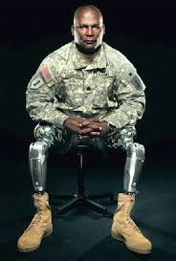
Estimated cost 2016
$777,500
Notes:
Estimated cost of NEW prosthesis, calendar year 2016. ~$450K were TFA, $327K were TTA
Does not include ‘new sockets’ - these individuals have been using their limbs like they were intended.

Slide 7
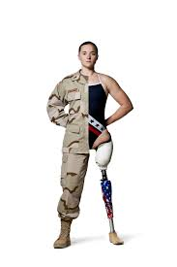
Estimated cost 2016
Average cost of a power WC = $4,000-$12,000/WC
Medical cost resulting from prolonged immobility (pneumonia, uncontrolled DM, pressure ulcer) = ?
Notes:
More beneficial to individual and VA to keep patients mobile, walking or independent as possible.

Slide 8
Stages of Rehabilitation
Preoperative
Amputation surgery/dressing
Acute postsurgical
Preprosthetic
Prosthetic prescription/fabrication (Amputee Clinic)
Prosthetic training
Community integration
Vocational rehabilitation
Follow-up
Notes:
The highlighted stages are the areas Rehab can have the most influential results.
-Acute postsurgical → begin monitoring surgical site, begin shaping residual limb, begin pain control measures.
-Pre-prosthetic → educating pt on importance of skin care, improving physical deficits (ROM, strength, balance), and begin to determine cognitive status
-(Amputee Clinic) → medial assessment and provide input on physical and cognitive issues
-Prosthetic training→ teaching pt donning/doffing px, gait training, and continue education skin care
-Community integration→ ambulation level, unlevels, stairs, navigating bus and community businesses

Slide 9
Gailey, et al. 2002
Amputee Mobility Predictor (AMP) – tool used to predict ability
Inter-rater reliability = very good
Intra-rater reliability = very good
AMP = good construct validity, ‘readiness to ambulate’. Comparable to 6-Minute Walk

Slide 10
Larner, 2003
Skills needed
  Physical Domain
  Cognitive Domain
  Cognitive assessments:
    Kendrick Objective Learning Test (KOLT) → Learning ability, dementia middle age
Conclusion = Level of Amputation + Learning skill correctly predicts success 81%
Notes:
Rehab following amputation multifactorial
*Physical Domain = (Strength, ROM, Coordination, praxia, balance, )
Early detection → make correction
*Cognitive Domain = Visuospatial, memory, judgment, initiation, problem solving )
Not easily detected → well into rehab process
KOLT only measure showing significant difference between AmpPro and AmpNoPro

Slide 11
Schoppen, et al. 2003
Functional use at 1yr = 49%
Mortality at 1yr = 26-39%
Functional prognosis less positive if unable SLS
Memory most important mental predictor
Conclusion= Predict success →Age, SLS, Cog Impairment
Notes:
Small prospective cohort study by Shcoppen et al. N=46 Age=73.9yo 72%TTA, 11%TFA

Slide 12
O’Neill & O’Neill, 2008
Systematic Review
  8/13 studies – cognition predicted outcomes
  6/13 studies – age predicted outcomes
  Reliable predictors –
    Age, Level of amp, Cognition, Dementia, Balance, Co-morbidities
    Cognitive domains – Memory, visuospatial, executive function,
      language.
Notes:
Systematic review of 13 studies →majority of studies showed cognition predicted success of using px
Need to learn new complex sequence of task
Adverse effects if sub-steps incorrectly sequenced or missed

Slide 13
Sansam, et al., 2009
Cognition consistent predictor of walking ability
  Kendrick Objective Learning Test (KOLT) –
    correctly predicts outcome 70% cases
    accuracy increases to 81% when level amp considered
SLS = + predictor of success
Pre-op walking status = + predictor

Slide 14
O’Neill & O’Neill, 2008 (continued)
High rate of attrition, use of px (TTA)
  50% of patients fitted with definitive socket
  40% of patients use px infrequently or NOT at all at 1year follow up.
    Verbal fluency predictive of #hrs of wear – initiation of use
Notes:
Prosthesis can be counterproductive
Incr expectation of Independent mobility
Incr risk for falls → orthopedic injury

Slide 15
Coffey, et al., 2012
Cognitive ability → suitability of px vs. WC
  Ability to learn new skill & adapt to diff situations
Cognitive Impairment more prevalent among LE amp vs general population.
Cognitive domains:
  Memory, attention, concentration, visuospatial fxn, organization, problem solving, executive fxn
Notes:
Literature review by Coffey et al
1. Need to look at alternative solutions
2. Most prevalent causes Amputation linked to dec. cognitive fxn → PVD, DMII
3. Reasons for cognitive ability:
Memory -> able to remember care for px limb and sound limb
attention-> needed for care of sound limb – skin inspection, blisters, rubbing within the px
visuospatial -> donning liner for correct alignment of pin system socket
problem solving -> ability to understand when to add sock ply, controlling volume through dietary measures
executive function-> understanding the whole gestalt

Slide 16
Fleury, Salih & Peel, 2013
75% LE Amputation occur pt >65yo
  Inc age = dec success & return to Independence
Cognitive Impairment = contraindication to px
AKA = <1/3 success rate
90% Amputation vascular in nature
  Co-morbidities affect success
  75% with concomitant heart disease
  Inc energy expenditure → Heart dz apparent
  (the following slide demonstrates effects of energy expenditure)
Notes:
A Literature Review of [?] studies
Majority of our vet population >65yo
3. Cognitive impairment as a contraindication for px
4. AKA success rate poor (>66% not candidates)→Therefore need to consider alternate forms of mobility
4. Vascular includes PVD and DMII.
Majority of our vet population have co-morbidities
Heart Dz will affect abiltiy to use px

Slide 17
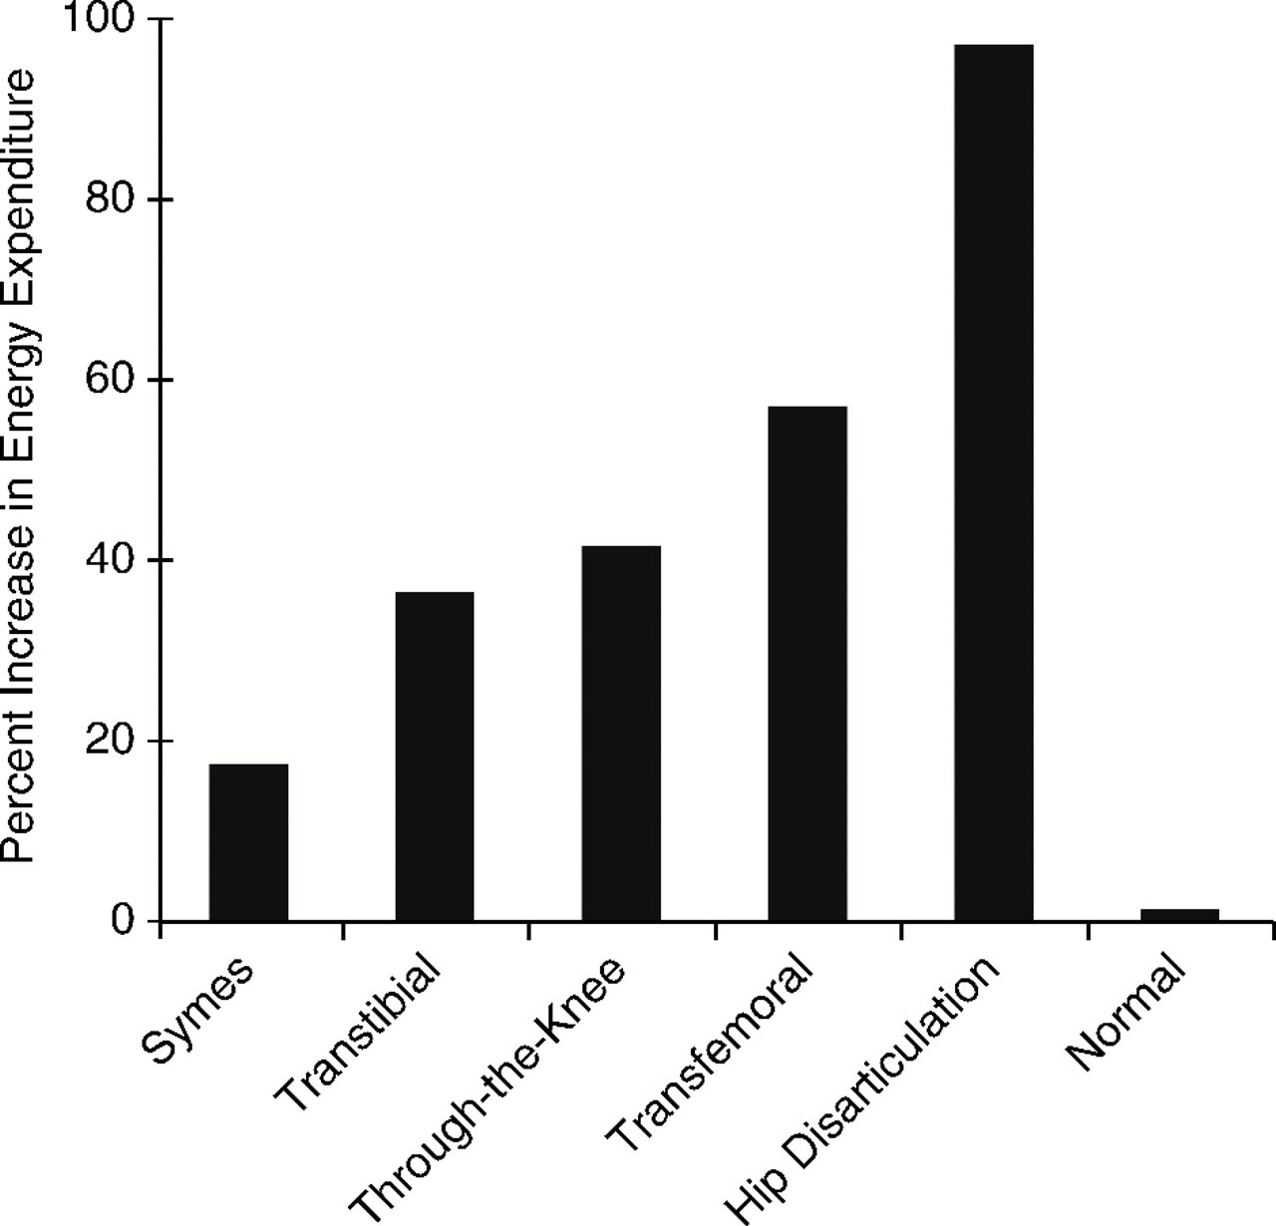
Effects on Physical Systems
Esquenazi, A., & DiGiacomo, R. (2001). Rehabilitation after amputation. Journal of the American Podiatric Medical Association, 91(1), 13-22 10p.

Slide 18
Kahle, et al., 2016
Meta-analysis N=21 studies
Predictive factors for prosthetic success:
  SLS
  Cognition & Mood disturbance
  Gender
  Cause of amputation
  Pre-amputation living status
Notes:
Why predictive factors
SLS = balance capability, physical strength, ROM in sound limb
Cognition = ablilty to sequence steps for donning/doffing, safety awareness
Cause of Amp = Traumatice vs PVD (incl DM) linked to cognitive decline
Pre-amp living = how independent were they prior to amputation

Slide 19
Mundel, et al., 2016
Retrospective, population-based cohort study
  N=93 patients >18yo
  Age + prior walking ability associated with success
  Every 10 yr aging significantly decreases probability of success prosthetic use

Slide 20

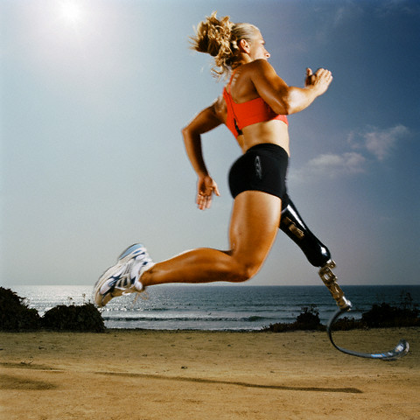
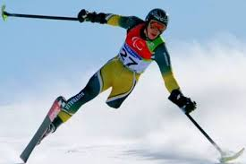
Review → Guidelines
Transfers
Gait
Endurance
Skin Care
Cognition/Mental health
Notes:
Review of guidelines to determine if veteran is an appropriate candidate for referral to Amputee Clnic

Slide 21
Flow Diagram
Notes:
To limit confusion, provided flow diagram for Amputee Clinic consults

Slide 22
Amputee Clinic Brochure
Notes:
As confusing as it is for MDs, it is more confusing for Veterans. As a result I have put together a brochure to help Veterans understand the process.

Slide 23
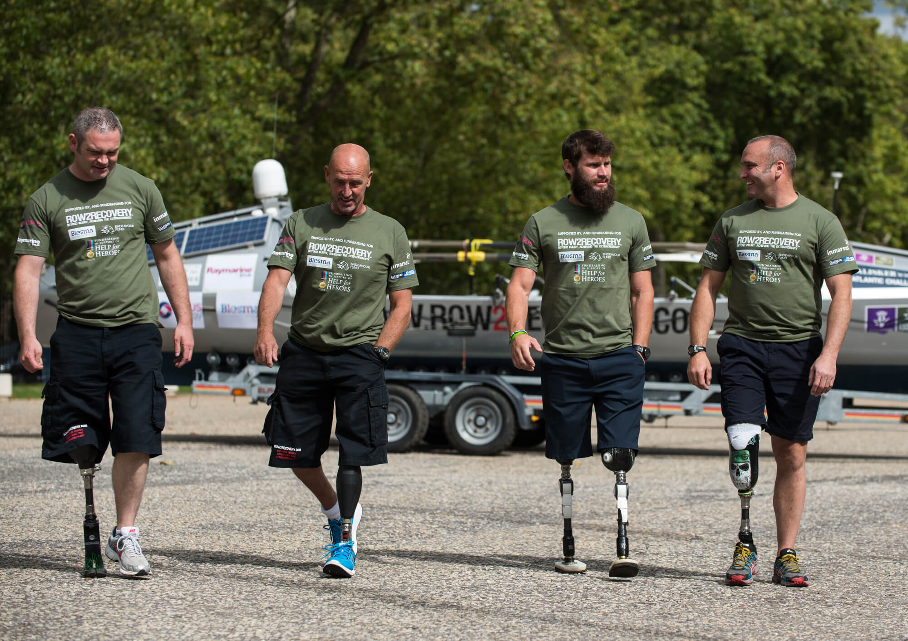
Amputee Clinic is for veterans who have undergone lower limb amputation surgery and are ready to be assessed for whether they meet the requirements to try an artificial limb called a prosthetic limb.
The Amputee Clinic team includes a physiatrist (medical doctor who specializes in treating illnesses that affect how we move), several prosthetists (specialists who make the prosthetic limb), and a physical or kinesio therapist.
The purpose of this clinic is to determine if the veteran will be able to care for their existing limb, the prosthetic limb, and be able to use the prosthetic limb safely.
The physiatrist will assess your general health, strength, skin care, and the sensation in your lower leg.
The therapist will assess your activity tolerance, range of motion and your ability to correctly follow directions.
The prosthetist will help decide what prosthetic limb is best suited for your abilities.
Guidelines for Approval
Transfers: able to stand up from a chair without help.
Gait: able to walk with a walker for at least 20 feet with limited help.
Endurance: able to stand with a walker for 5 minutes without sitting.
Skin care: no wounds on either leg.
Mental health: able to follow instructions that have multiple steps. A brief mental health assessment may be needed.
Approved? Now what?
Once approved by the Amputee Clinic, you will be fitted with a prototype prosthetic limb called a ‘test socket’ specifically made to fit you.
You will be admitted to the Community Living Center (CLC) to learn how to safely use the prosthetic limb.
You will learn how to put on/take off the limb, how to walk, and how to manage changes in the skin and volume of the leg, which happens with walking.
During your stay at the CLC, the rehabilitation team will assess how well you are adjusting to the increased responsibilities of having a prosthetic limb.
If you demonstrate you are able to handle these responsibilities, the test socket will be converted to a permanent socket before you discharge home.
Notes:
As confusing as it is for MDs, it is more confusing for Veterans. As a result I have put together a brochure to help Veterans understand the process.

Slide 24
Questions?

