Slide 1
Physical Therapy (PT) for Patients with MS
Jessica Reynolds, SPT
Notes:
:00-:01 Hi, I am Jessica Reynolds. I’m in my final year of the doctorate of physical therapy program here at UNC, and I’m also an MS Scholar. As an MS Scholar, I’ve had additional opportunities for clinical rotations, educational experiences, and involvement with the population with MS here in the Triangle.
I appreciate the opportunity to speak to all of you today. Thank you for your commitment to excellence working with patients who have MS. I’m here to discuss the benefits of physical therapy for this population, to provide insight about what patients are doing in physical therapy, and to help you determine when to refer a patient to PT.

Slide 2
OutLine
The Research: PT and dalfampridine
Benefits of PT
PT Interventions across ability levels
Referring a patient to PT
Q&A
Exit slips
Notes:
:01-:02 In the time that we have together, I’ll strive to highlight current research about PT, discuss the benefits of PT, share examples of PT interventions, and discuss when to prescribe PT for a patient. I’ll also leave time to answer your questions. Please feel free to ask questions throughout the presentation. We’ll stop about 5 minutes before you need to leave and so that you have time to complete a brief exit slip. I’m using these to check for understanding as a part of the evaluation process of this presentation.

Slide 3
PICO QuestION:
In a 30 year old woman with RRMS who ambulates without an assistive device, is aerobic exercise or dalfampridine more effective for improving gait speed?
Notes:
:02-:03 I’d like to start with a brief review of the evidence through the lens of a PICO question. This PICO question is from a Critically Appraised Topic conducted last fall. I’ll send it via email after our meeting today in case you’d like to review it further.
(READ ALOUD QUESTION)
I asked this particular question since complications of MS can lead to a decrease in gait speed, which can in turn decrease a person’s functional mobility, independence, and level of participation in the community.

Slide 4
Clinical Bottom Line
About 1/3 of patients with MS significantly improve gait speed after taking dalfampridine
Aerobic exercise (1-3x/week, ≥4 weeks) may benefit a greater percentage of patients with MS than dalfampridine and seems more effective for dalfampridine non-responders
It is unclear whether aerobic exercise or dalfampridine is a superior intervention in dalfampridine responders
Notes:
:03-:05 --I’ll let you reference the specific details of the CAT in your own time, but here’s a general overview of the findings: (READ). In addition to the benefits of exercise for the general population, we can see that it also influences gait speed. As PTs, we’re trained to develop a progressive exercise and treatment program, taking the unique needs of each patient into account to provide the appropriate level of challenge.

Slide 5
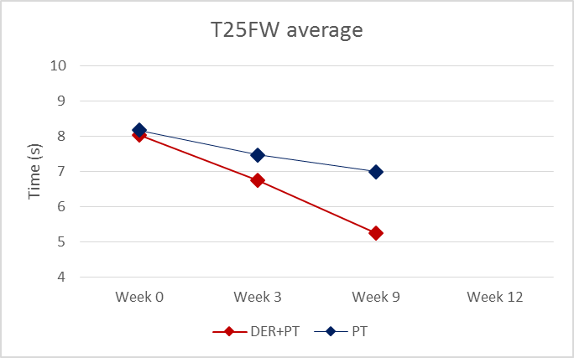
Effect of physical therapy with and without dalfampridine on gait in people with MS
Whitney Huryta, Jessica Reynolds, Silva Markovic-Plese, Prue Plummer
n=6
3 received PT only (PT)
3 received dalfampridine + PT (DER + PT)
DER + PT
Wk 3- nonresponders to dalfampridine (15.8% improvement)
Wk 9- additional improvement of 22.4% (total: 34.7%)
PT appears to enhance the effects of DER on gait speed
Notes:
:05-:09 Dr. Marckovic-Plese has collaborated with Dr. Plummer, Whitney Huryta and I to examine the impact of PT with and without dalfampridine on gait in people with MS. We know that PT and dalfampridine can improve gait speed in patients with MS, but no previous studies compared the interventions or looked at their combined impact.
--So far, 6 people have completed the study. I’ve highlighted the results we’ve seen from those six. (Explain groups). Data: Here at Week 0, the average baseline for the two groups was very similar. Week 3 assessed the effectiveness of dalfampridine only for the DER + PT group. You can see the group in red represents dalfampridine + PT. While they improved at this point, they were nonresponders to dalfampridine with only a 15.8% improvement on gait speed as measured by the T25FW. The criteria for being a responder is a 20% improvement. At Week 3, the PT only group had received no intervention. Between weeks 3 and 9, everyone received PT 2x weekly. (Walk through highlighted datapoints, acknowledge that 15.8% improvement on T25FW is considered “non-responder” b/c it doesn’t meet the 20% threshold.)
--These results were also consistent for self-selected gait speed, dual-task gait speed, and self-rated improvement in walking study.
--Week 12 served as a follow-up period. We weren’t able to gather data from all 6 participants, so we do not have a reported average yet for this point.
--You can see in the graph that those who received dalfampridine initially demonstrated modest improvements in gait speed, but then the slope of the line increased between weeks 3 and 9 when they received dalfampridine on top of PT.

Slide 6
WHAT can A physical therapist do for patients with MS?
EVALUATE
CREATE GOALS AND A TREATMENT PLAN
CHALLENGE AND PROGRESS
EDUCATE
Notes:
:09-:11 You’ll find these notes on page 1 if your handout
EVALUATE: Provide a thorough evaluation of patient, including: functional mobility, falls risk, balance, strength, flexibility, spasticity, gait analysis. We use specific outcome measures so that we can
CREATE INDIVIDUALIZED GOALS AND A TREATMENT PLAN: The treatment plan is aligned the patient’s unique goals. Typically, primary goals are designed around improving functional mobility to enhance community participation and are made with patient input.
CHALLENGE AND PROGRESS Progress patients through a treatment plan at an appropriately challenging level.
EDUCATE patients about their condition, the importance of exercise, how to exercise with MS, energy management, thermosensitivity, and avoiding falls.
We can also recommend and train patients on the use of assistive devices and/or orthoses (if necessary) to maximize safety and independence with ambulation.

Slide 7
What does a patient do in PT?
Videos
Pictures
Notes:
:11-:16 Has anyone here had the chance to observe any PT sessions for patients with MS? I’d like to provide a little more context with some examples of patient interventions. First, we’ll start examining a few videos and pictures that demonstrate a common PT interventions.

Slide 8
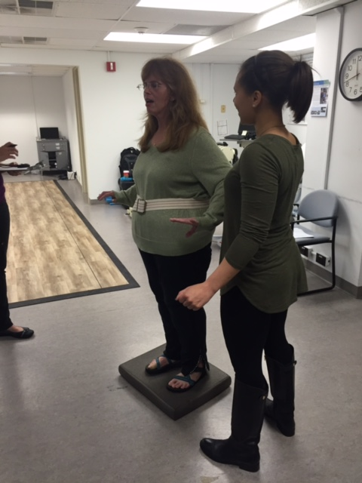
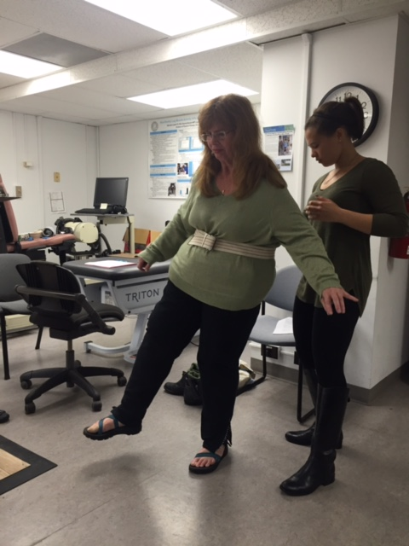
Notes:
The patient’s balance is being challenged by varying her base of support and support surface. In the first picture, she’s standing on foam- more difficult to stand on than even ground.
We can make either of these activities more challenging by reducing visual input (asking pts to close their eyes), or asking them to divide their attention between this task and another (counting backwards, naming objects in a category, etc.)
We’re asking patients to get into a position that is really challenging to sustain and something that isn’t possible to safely perform on their own. It’s important to provide a sufficient challenge in order for the patients to improve. The physical therapist guards closely and uses a gait belt to keep the patient safe.

Slide 9
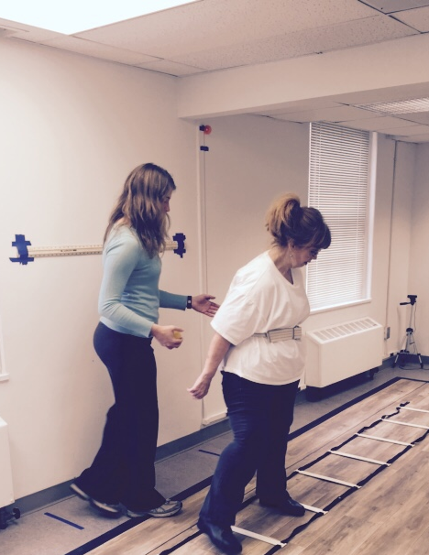
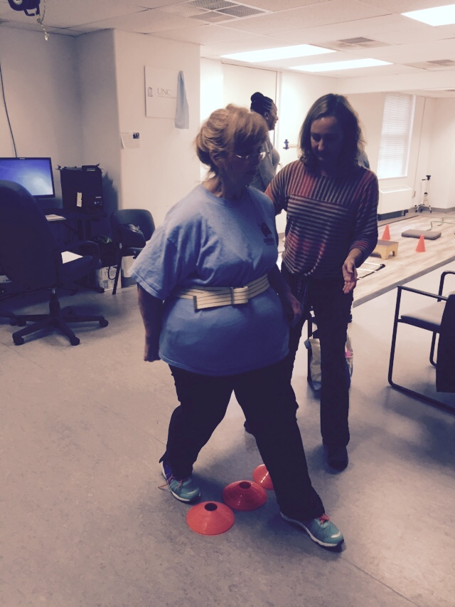
Notes:
Task-specific Gait training- negotiating obstacles while maintaining balance, picture on the left is also strengthening hip abductors while walking sideways
These activities help with very specific daily tasks, i.e. Walking to your car, navigating a tight space, stepping over a curb or object on the floor. Again, we might make this even more challenging by adding a dual tasking cognitive component.

Slide 10
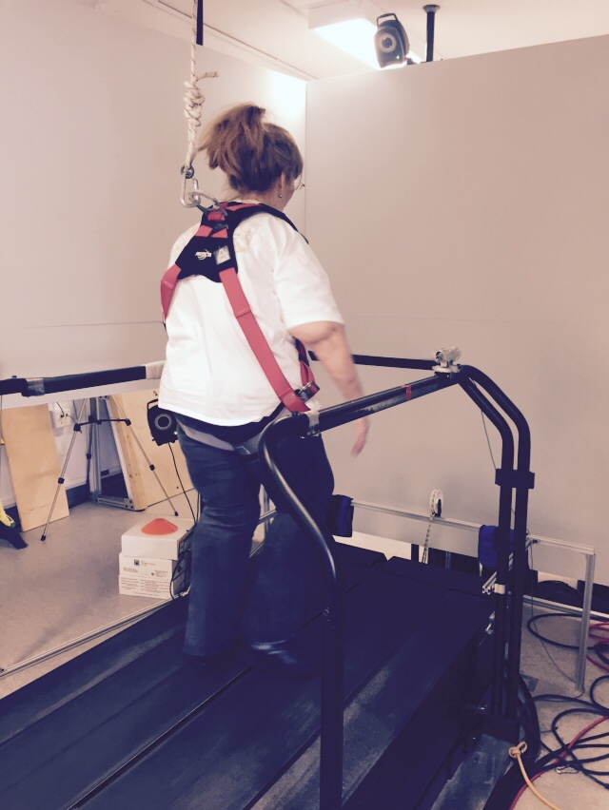
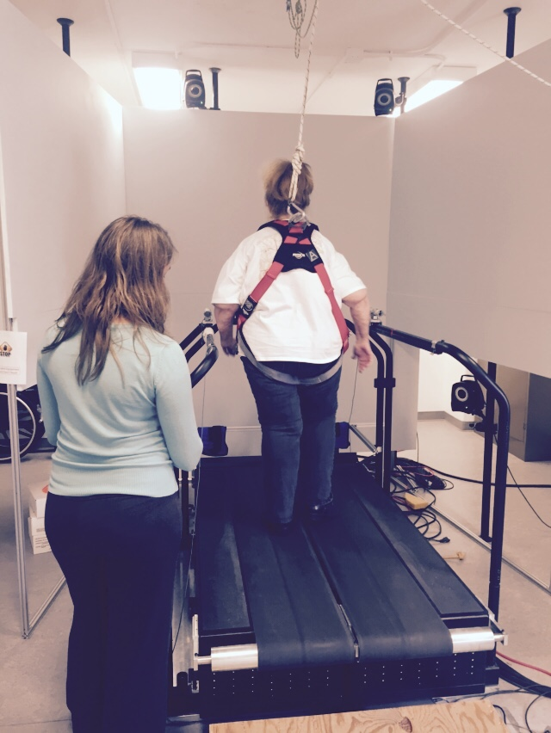
Notes:
Treadmill training- the patient is safely in a harness, this activity may or not be weight-assisted depending on the level of the patient. Here, we would perform interval training at a gait speed just beyond the level of comfort for the patient. Fast enough to challenge them, but feasible for them to accomplish . We can also vary the incline and/or the direction walked to further challenge the patient. With some patients, we’ll place targets on the treadmill and/or objects to step over to vary the level of challenge. With patients who have an inhibited VOR reflex, we may place two targets at different sides of the wall in front of them so that they have to look from side to side.

Slide 11
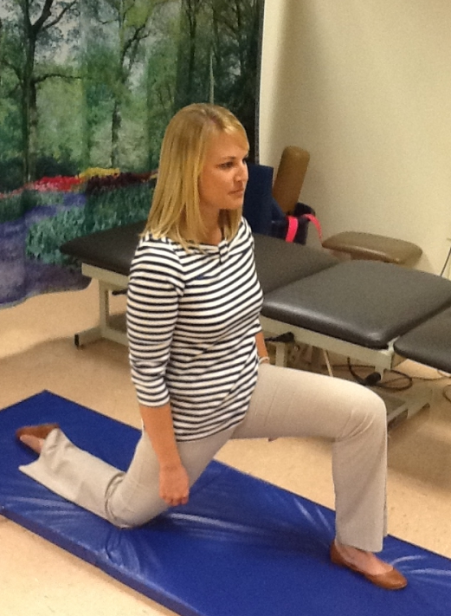
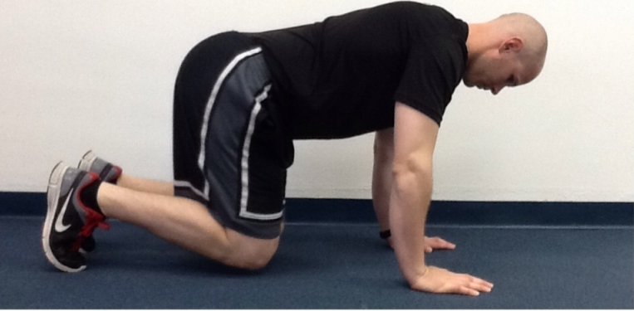
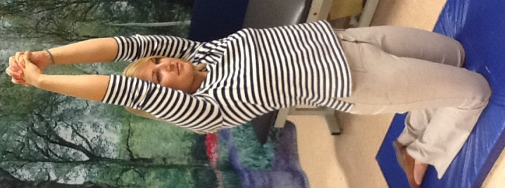
INTERVENTIONS | RATIONALE
Gait training (with or without an assistive device or parallel bars) | Train movement patterns for efficient, safe mobility
Standing and/or walking on uneven surfaces and over obstacles | Improved ability to ambulate on uneven ground, stepping over objects in one’s path, etc.
Narrow walking | Improved ability to ambulate in narrow paths (i.e. between two tightly parked cars in a parking lot)
Vestibulo-Ocular Reflex (VOR) exercises (in sitting, standing, or walking) | To improve the functioning of the vestibular system if VOR Reflex is impaired
Dynamic movements | Improved stability and balance
Responses to perturbations | Improved response to perturbations to maintain balance and avoid falls
Functional strengthening of antigravity muscles (example: prone to quadruped to tall kneeling transitions and exercises, sit to stand transitions, marching, etc.) | Patients often show weakness initially in the hip flexors, knee flexors, and ankle dorsiflexors which can impact gait
INTERVENTIONS | RATIONALE
Functional strengthening of antigravity muscles (example: prone to quadruped to tall kneeling transitions and exercises, sit to stand transitions, marching, etc.) | Patients often show weakness initially in the hip flexors, knee flexors, and ankle dorsiflexors which can impact gait
Notes:
:16-17: This chart can be found in your packet. It describes some examples of common physical therapy interventions. For example… (DESCRIBE 2) . We’re looking at strength and balance training as well as gait in a multi-dimensional, task-oriented approach and constantly challenging the patients. The patients may be challenged even more vigorously if they’re dalfampridine responders to further build upon their progress.
www.hep2go.com

Slide 12
How can PT benefit patients of different ability levels?
Notes:
:17-:19 PT is appropriate for patients across all disability levels with MS. While all patients can benefit from PT, the individualized goals and treatment will vary depending upon the patient’s current level of function. You’ll find a resource developed by the APTA in your handout that explains various PT interventions that might be used across different EDSS categories.

Slide 13
How can PT benefit patients of different ability levels?
Rehabilitative
EDSS 0-3.5 Little Disability | EDSS 4-5.5 Mild Disability | EDSS 6.0-7.5 Moderate Disability | EDSS 8-9.5 Severe Disability
Task-specific training of relevant skills (eg, balance, gait, reaching) | Task-specific training of relevant skills (eg, balance, gait, reaching) | Modify tasks and activities to maximize participation
Preventive
EDSS 0-3.5 Little Disability | EDSS 4-5.5 Mild Disability | EDSS 6.0-7.5 Moderate Disability | EDSS 8-9.5 Severe Disability
Falls prevention | Falls prevention programs | Continued falls prevention programs and initiation of appropriate caregiver training | Caregiver training in transfers, a home exercise program, and bed mobility to ensure patient safety
Notes:
:17-19 Here’s an example from your handout. (Walk through how the same task is modified at different levels).
For example, stepping over an obstacle using no assistive device and stepping onto a foam surface Moderate disability, may perform similar task, but use an assistive device Severe- APTA didn’t list anything here, but in a nonambulatory patient, we’d still work on reaching tasks in sitting to challenge balance.

Slide 14
When should I prescribe PT?
Notes:
:19-23

Slide 15
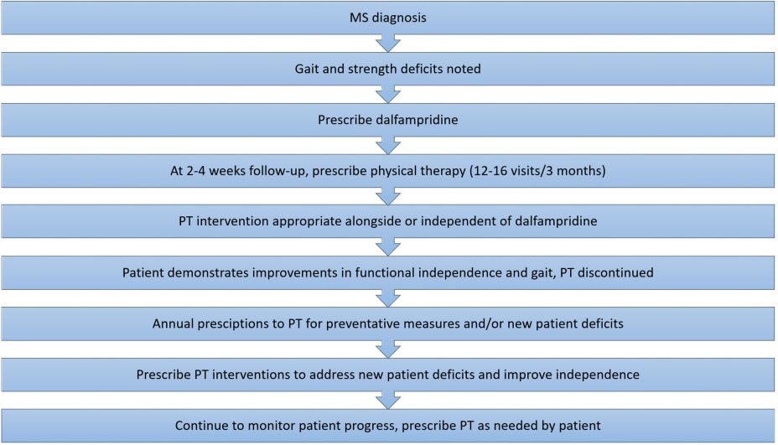
Notes:
:19-23 Here’s a sample timeline of interactions with a patient who has just been diagnosed with MS. You can see that we recommend prescribing physical therapy at the follow-up session after dalfampridine has been prescribed. Evidence suggests that patients experience the most benefits when at least 3 months of physical therapy are prescribed. Outside of Medicaid which only covers 3 visits, insurance companies typically cover 20-30 visits of OT/PT combined in one year. Just like you check in with your patients annually, annual check-ups with a PT are also important for patients with MS to address new deficits and to prevent secondary weakness from inactivity. I’ve included a resource in your packet that details how to refer patients to the CRC for PT.

Slide 16
References
1. Huryta WW, Reynolds JH, Markovic-Plese S, Plummer P. Effect of physical therapy with and without dalfampridine on gait in people with multiple sclerosis. March 2017. (In progress)
2. Newman MA, Dawes H, van den Berg M, Wade DT, Burridge J, Izadi H. Can aerobic treadmill training reduce the effort of walking and fatigue in people with multiple sclerosis: a pilot study. Mult Scler J. 2007;13(1):113-119. doi:10.1177/1352458506071169.
3. Romberg A, Virtanen A, Ruutiainen J, et al. Effects of a 6-month exercise program on patients with multiple sclerosis: A randomized study. Neurology. 2004;63(11):2034-2038. doi:10.1212/01.WNL.0000145761.38400.65.
4. Goodman AD, Brown TR, Krupp LB, et al. Sustained-release oral fampridine in multiple sclerosis: a randomised, double-blind, controlled trial. Lancet. 2009;373(9665):732-738. doi:10.1016/S0140-6736(09)60442-6.
5. International Organization of Multiple Sclerosis Rehabilitation Therapists. Promoting Successful Rehabilitation Outcomes in Multiple Sclerosis. http://03c68c1.netsolhost.com/wordpress1/?p=904. Published April 2002. Accessed February 15, 2017.
6. American Physical Therapy Association Website. PT Now: Multiple Sclerosis Clinical Summary. http://www.ptnow.org/ClinicalSummaries/QuickDetail.aspx?cid=343ee67d-7ea5-494c-92f2-95959b7c6781. Published January 12, 2015. Accessed February 17, 2017

Slide 17
QUESTIONS?

