Slide 1
Cranial Molding Deformity: Prevention & Treatment in the NICU
Elizabeth Lynch
2017

Slide 2
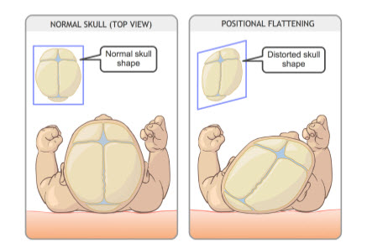
What is Cranial Molding Deformity (CMD)?^{1,2}
Alteration in the normocephalic shaping of the skull
Due to an external mechanical force
Generally mild and reversible

Slide 3
Prevalence of CMD^{1,2}
Up to 48% of newborn infants
Newborns are particularly susceptible
Younger age = increased malleability of the skull

Slide 4
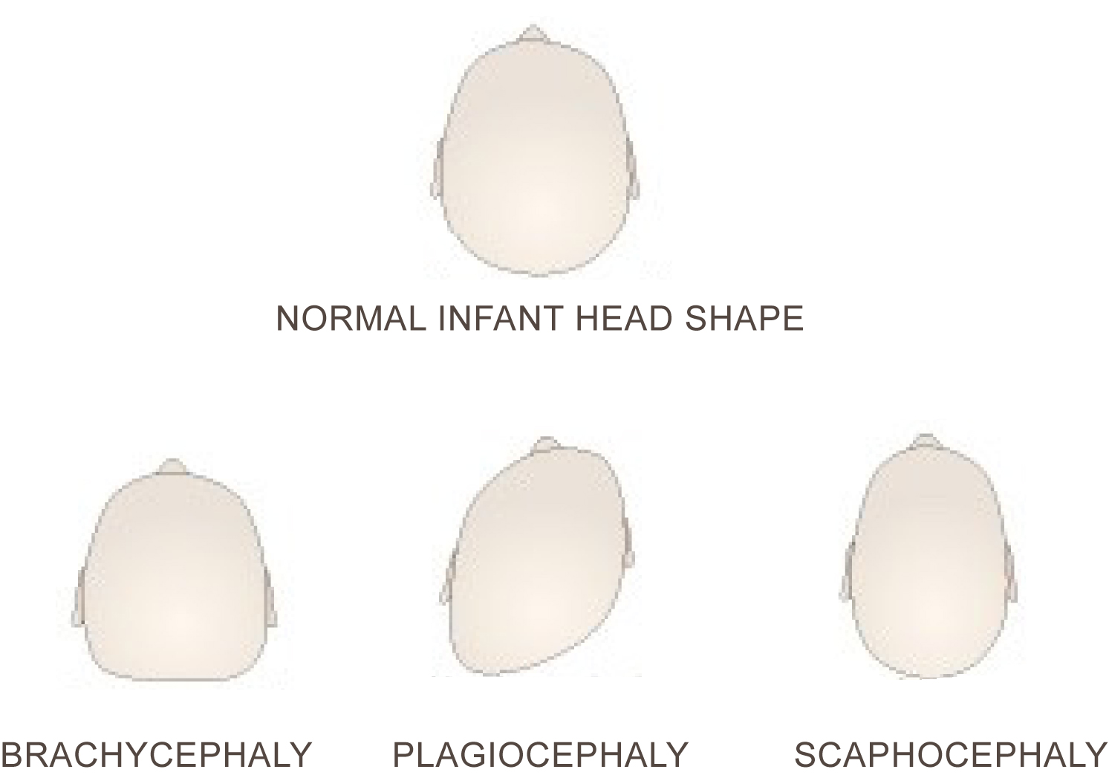
Abnormal Cranial Shapes
DOLICHOCEPHALY

Slide 5
Plagiocephaly^{3,4,5}
“Oblique head”
Unilateral flattening of the occiput
Peak prevalence is 4 months of age

Slide 6
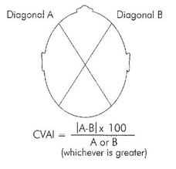
Cranial Vault Asymmetry Index^{6,7}
CVAI < 3.5
WNL
CVAI > 3.5
Plagiocephaly

Slide 7
Brachycephaly^{4,5}
Symmetrical deformity
Bilateral flattening of the posterior cranium
Skull appears wider and more spherical

Slide 8
Dolichocephaly⁸
“Long head”
Also referred to as scaphocephaly
Skull becomes longer and more narrow

Slide 9
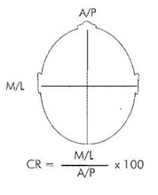
Cranial Index^{6,8,9}
CI < 76%
Dolichocephaly
76% ≤ CI < 93%
WNL
CI ≥ 93%
Brachycephaly

Slide 10
“Back to Sleep”¹⁰
1992: American Academy of Pediatrics
1994: U.S. Public Health Service
SIDS
CMD

Slide 11
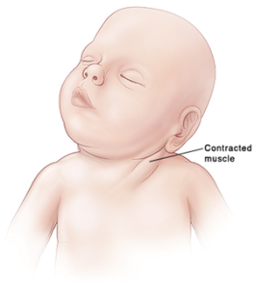
Torticollis^{1,5}
CMD

Slide 12
Additional Risk Factors
Plagiocephaly
Dolichocephaly
Male^{5,11}
Gestational Diabetes¹¹
First-born rank^{5,11}
Intrauterine constraint⁵
Assisted Delivery^{5,11}
Neck problems⁵
Multiple Pregnancy¹¹
Supine Position⁵
Prematurity¹²
Female¹²
Breech Position¹
Extended Hospitalization at Birth¹²
Prematurity¹²
Brachycephaly
Intrauterine constraint¹¹
Supine Position¹³

Slide 13
Prematurity¹²
“Very preterm” infants:
(Born at <32 weeks gestational age)
38% → plagiocephaly
73% → dolichocephaly
“Late preterm” infants:
(Born between 32 and 36+6 weeks)
28% → dolichocephaly

Slide 14
What about Helmet Therapy?^{2,6}

Slide 15
Currently used in NICUs…¹⁴
Blanket Rolls
Frederick T. Frog
DandleROO, DandleROO2, DandleROO Lite, or DandleWrap
Sundance Fluidized Full-body Mattress or Tube (a.k.a. “Zflo”)
Sundance Fluidized Utility Pillow
Gel-E Donut
Tortle Midliner / Tortle Air

Slide 16
Frederick T. Frog¹⁵
Frog-shaped device that contains adjustable beads
Supports developmental head positioning in prone, supine, and side-lying

Slide 17
Gel-E Donut^{16,17}
Gel-filled pillow with non-porous skin
Used to promote skin integrity and prevent CMD due to prolonged immobility

Slide 18
Fluidized Full-body Mattress¹⁸
Fluidized, mattress-like device
“Zero flow” from gravity
Supports the entire body in prone, supine, or side-lying

Slide 19
Fluidized Utility Positioner^{18,19}
Fluidized, pillow-shaped device
“Zero flow” from gravity
Supports the head, neck, and shoulders in prone, supine, or side-lying

Slide 20
DandleROO^{20,21}
Containment device made of stretchable cotton
Designed to simulate womb-like environment for preterm infants

Slide 21
Tortle Midliner²²
Lightweight beanie with two adjustable support rolls
Used to prevent head preference issues and asymmetry
Smaller infants (≤ 3000 g)

Slide 22
Tortle Air²²
Lightweight beanie with one adjustable support roll
Used to prevent head preference issues and asymmetry
Larger infants (≤ 9000 g)

Slide 23
Cranial Cup^{19,23}
Orthotic device with layers of removable foam
Supports the body in supine and semi-side-lying positions
Designed for infants ≥ 1000 g

Slide 24
Evidence for Intervention¹⁷
McLane et al
Descriptive pilot study of 54 healthy children
To compare interface pressures of various pediatric support surfaces
A 2.75-inch Delta foam overlay alone and in conjunction with the Gel-E Donut produced the lowest occipital pressure in infants <2 years of age

Slide 25
Evidence for Intervention²¹
Zarem et al
Survey of 76 neonatal nurses and therapists
To determine perceptions of positioning for premature infants in the NICU
DandleROO → “ideal method of neonatal positioning”
62% of nurses and 86% of therapists
DandleROO → easiest method of positioning to utilize in the NICU
44% of nurses and 57% of therapists

Slide 26
Evidence for Intervention¹⁹
Degrazia et al
RCT to assess the effectiveness of the cranial cup in preventing CMD in hospitalized infants
Experimental Group: moldable positioner and cranial cup (n = 35)
Control Group: moldable positioner (n = 27)
Rotating between the Sundance fluidized utility positioner and the cranial cup is associated with decreased development of CMD in the NICU compared to use of the fluidized utility positioner alone

Slide 27
Evidence for Intervention²³
Knorr et al
Prospective descriptive study
To assess the effectiveness of the cranial cup in correcting CMD in hospitalized premature infants
The cranial cup is effective for normalizing head shape in hospitalized premature infants
BUT: No control group for comparison

Slide 28
Overall…
Evidence is lacking in regards to positioning devices that are commonly utilized with premature infants in NICUs
However, intervention early in life is very important for optimal outcomes in the prevention and treatment of CMD
*Patient-centered* - focus on what’s best for each individual baby

Slide 29
Future Research
High quality RCTs and systematic reviews of RCTs → increase the level of evidence
Specificity regarding intervention protocols → improve clinical relevance
Long-term follow up → determine effects of interventions over time

Slide 30
References
Bronfin DR. Misshapen Heads in Babies: Position or Pathology?. The Ochsner Journal. 2001;3(4):191-199.
Steinberg J, Rawlani R, Humphries L, et al. Effectiveness of Conservative Therapy and Helmet Therapy for Positional Cranial Deformation. Plastic and Reconstructive Surgery. 2015;135(3):833-842. doi:10.1097/prs.0000000000000955.
Persing J, James H, Swanson J, Kattwinkel J. Prevention and Management of Positional Skull Deformities in Infants. PEDIATRICS. 2003;112(1):199-202. doi:10.1542/peds.112.1.199.
Feijen M, Franssen B, Vincken N, van der Hulst R. Prevalence and Consequences of Positional Plagiocephaly and Brachycephaly. Journal of Craniofacial Surgery. 2015;26(8):e770-e773. doi:10.1097/scs.0000000000002222.
Looman W, Kack Flannery A. Evidence-Based Care of the Child With Deformational Plagiocephaly, Part I: Assessment and Diagnosis. Journal of Pediatric Health Care. 2012;26(4):242-250. doi:10.1016/j.pedhc.2011.10.003.
Wilbrand J, Schmidtberg K, Bierther U. Clinical Classification of Infant Nonsynostotic Cranial Deformity. The Journal of Pediatrics. 2012;161(6):1120-1125.e1. doi:10.1016/j.jpeds.2012.05.023.
Plagiocephaly Severity Scale. Atlanta, GA: Children's Healthcare of Atlanta; 2015. Available at: https://pediatricapta.org/special-interest-groups/HB/ORTH_961942_PlagiocephalyScale_BWInfo.pdf. Accessed March 1, 2017.
McCarty D, Peat J, Malcolm W, et al. Dolichocephaly in Preterm Infants: Prevalence, Risk Factors, and Early Motor Outcomes. American Journal of Perinatology. 2016;34(04):372-378. doi:10.1055/s-0036-1592128.
Hutchison B, Hutchison L, Thompson J, Mitchell E. Quantification of Plagiocephaly and Brachycephaly in Infants Using a Digital Photographic Technique. The Cleft Palate-Craniofacial Journal. 2005;42(5):539-547. doi:10.1597/04-059r.1.
Changing Concepts of Sudden Infant Death Syndrome: Implications for Infant Sleeping Environment and Sleep Position. PEDIATRICS. 2000;105(3):650-656. doi:10.1542/peds.105.3.650.

Slide 31
References
Aarnivala H, Valkama A, Pirttiniemi P. Cranial shape, size and cervical motion in normal newborns. Early Human Development. 2014;90(8):425-430. doi:10.1016/j.earlhumdev.2014.05.007.
Ifflaender S, Rüdiger M, Konstantelos D, et al. Prevalence of head deformities in preterm infants at term equivalent age. Early Human Development. 2013;89(12):1041-1047. doi:10.1016/j.earlhumdev.2013.08.011.
Deformational Plagiocephaly & Cranial Remolding In Infants. Alexandria, VA: APTA Section on Pediatrics; 2007. Available at: https://pediatricapta.org/includes/fact-sheets/pdfs/Plagiocephaly.pdf. Accessed March 5, 2017.
McCarty DM, Eberbach M, Peat J. Therapeutic Practices for Cranial Molding Deformity in the Neonatal Intensive Care Unit: A National Survey. Manuscript in preparation. 2017.
Philips Frederick T. Frog. Philips. 2017. Available at: http://www.usa.philips.com/healthcare/product/HC989805603341/frederick-t-frog-positioning-aid. Accessed March 17, 2017.
Philips Gel positioning aids. Philips. 2017. Available at: http://www.usa.philips.com/healthcare/product/HC92025/gel-positioning-aids-family-of-gelfilled-infant-positioning-products. Accessed March 17, 2017.
McLane K, Krouskop T, McCord S, Fraley J. Comparison of Interface Pressures in the Pediatric Population Among Various Support Surfaces. Journal of Wound, Ostomy and Continence Nursing. 2002;29(5):242-251. doi:10.1097/00152192-200209000-00007.
NICU Therapeutic Positioning. Sundance Solutions. 2017. Available at: http://sundancesolutions.com/neonatal/. Accessed March 17, 2017.
DeGrazia M, Giambanco D, Hamn G, Ditzel A, Tucker L, Gauvreau K. Prevention of Deformational Plagiocephaly in Hospitalized Infants Using a New Orthotic Device. Journal of Obstetric, Gynecologic & Neonatal Nursing. 2015;44(1):28-41. doi:10.1111/1552-6909.12523.
Dandle ROO. Dandle•LION Medical. 2017. Available at: http://www.dandlelionmedical.com/products/dandle-roo/. Accessed March 18, 2017.

Slide 32
References
Zarem C, Crapnell T, Tiltges L, et al. Neonatal Nurses' and Therapists' Perceptions of Positioning for Preterm Infants in the Neonatal Intensive Care Unit. Neonatal Network: The Journal of Neonatal Nursing. 2013;32(2):110-116. doi:10.1891/0730-0832.32.2.110.
Home - Tortle Medical. Tortle Medical. 2017. Available at: http://tortlemedical.com. Accessed March 18, 2017.
Knorr A, Gauvreau K, Porter C, Serino E, DeGrazia M. Use of the Cranial Cup to Correct Positional Head Shape Deformities in Hospitalized Premature Infants. Journal of Obstetric, Gynecologic & Neonatal Nursing. 2016;45(4):542-552. doi:10.1016/j.jogn.2016.03.141.
Additional Images:
Helmet Therapy | The Craniofacial Foundation of Utah. Cranioutahcom. 2017. Available at: http://cranioutah.com/helmet-therapy/. Accessed March 20, 2017.
Head Shape Deformities - EARLYstart. EARLYstart. 2017. Available at: http://earlystartpt.com/early-signs-to-look-for/head-shape-deformities/. Accessed March 20, 2017.
Actionorthosante.ca/english. Actionorthosante.ca. 2017. Available at: http://actionorthosante.ca/english/Plagiocephaly-Severity-Scale.php. Accessed March 20, 2017.
Aiga A. Treating Torticollis and Plagiocephaly - Lucie's List. Lucie's List. 2017. Available at: https://www.lucieslist.com/lucies-list-blog/2014/07/29/treating-torticollis-and-plagiocephaly/. Accessed March 24, 2017.
Plagiocephaly and Baby Flat Head Syndrome Treatment Band - Cranial Technologies. Cranial Technologies. 2017. Available at: http://www.cranialtech.com. Accessed March 24, 2017.

Slide 33
Questions?
Thank You

