Slide 1
Shoulder Overuse in SCI:
Intervention Strategies for Physical Therapy Students
Amanda Friedline Weber, SPT
University of North Carolina at Chapel hill

Slide 2
Outline
Objectives
Shoulder Pain: Causes & Prevalence
Transfers
  Evidence and Video
Shoulder Exercise Programs
  Evidence and Videos
Clinical Pearls
Questions
Survey!

Slide 3
Objectives
By the end of this presentation, students will be able to:
  Describe shoulder overuse injuries in patients with spinal cord injuries, including the prevalence and impact on function
  Identify and apply current evidence supporting interventions to prevent shoulder overuse and/or decrease pain and improve function in individuals with SCI, including shoulder exercise programs and transfer technique modifications
  Provide appropriate instruction and feedback to patients performing interventions, including sitting pivot transfers and shoulder exercises
  Display confidence in implementing interventions to prevent shoulder overuse and/or decrease pain and improve function in patients with SCI

Slide 4
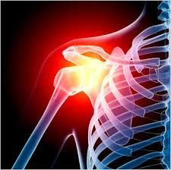
Shoulder Overuse: Cause & Prevalence ¹⁻⁴
Increase in UE weight-bearing demands
  Transfers, pressure relief, WC propulsion
Shoulder Pain: 30-60%
  Greater in adult-onset WC users vs. child-onset WC users (p<0.008)
Positively correlated with time since injury
  (~20 years 70% individuals)
Conditions include: SAI, RC pathology, OA, biceps tendinitis, myofascial pain syndrome
Level of Injury Impacts sensorimotor system
https://www.google.com/imgres?imgurl=http%3A%2F%2Fwww.csp.org.uk%2Fsites%2Ffiles%2Fcsp%2Fimagecache%2Ffull_column%2Fxray_pain.jpg&imgrefurl=http%3A%2F%2Fwww.csp.org.uk%2Fimages%2Fxray-shoulder-pain-graphic&docid=pz-EPiLBGEgYiM&tbnid=d3i3gTLoSjK5IM%3A&vet=1&w=347&h=346&bih=657&biw=1422&q=shoulder%20pain%20graphic&ved=0ahUKEwiv4Yrmv5XSAhUPySYKHXzLDeAQMwgcKAAwAA&iact=mrc&uact=8

Slide 5
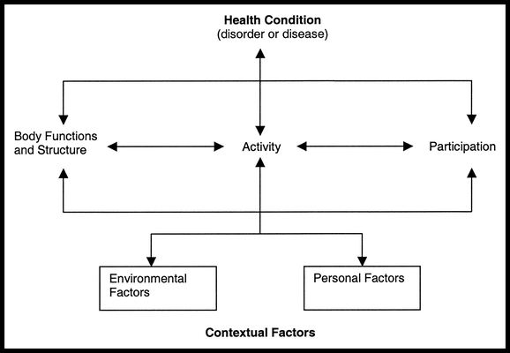
ICF Model Implications ⁵

Slide 6

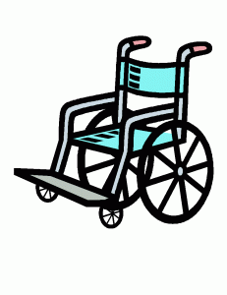


Evidence – Transfers ^{1,6,7}
Individuals with SCI perform 15-35 transfers/day
Transfers rank among most taxing activity in individuals with SCI
LE’s support ~30% Body Weight during Sitting Pivot Transfer
https://clipartfest.com/categories/view/f5013aa7af7261cea95b2db3f18d7d45cf797e85/cartoon-cars-clip-art.html
http://www.clipartkid.com/cartoon-bed-cliparts/
http://www.clipartfinders.com/wheelchair-race-clipart.html
http://www.clipartkid.com/cartoon-toilet-cliparts/

Slide 7
Phases of Sitting Pivot Transfer ⁸
Pre-lift
Lift
Post-lift

Slide 8
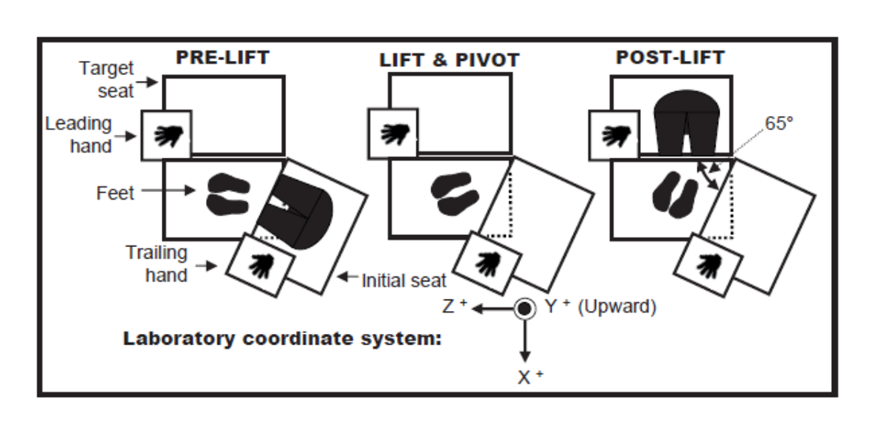
Evidence – Sitting Pivot Transfer ⁸
Significant body weight supported by UE’s
Vertical Reaction Forces:
  Greater & occurred earlier in trail arm - both transfers
  Highest value in trail hand - transfer to higher target seat
  Highest value in lead hand - transfer at level height
Horizontal Reaction Forces:
  Greater in trail arm

Slide 9
Evidence – Phases of sitting pivot transfer ⁸
Pre-lift:
  Rapid trunk flexion + large mass forward momentum causing horizontal force
Lift:
  Trail hand vertical force: ~40% body weight
  Trail hand horizontal force: ~8% body weight
  High mechanical demands of shoulder flexors, adductors, elbow extensors
Post-lift:
  Trail hand unloads as weight is shifted to lead hand until buttocks contacts transfer target

Slide 10
Evidence – Three Sitting Pivot transfers ²
Lift Phase:
  Trail hand forces greater in head hips, abducted arm
No technique reduced force across all 3 joints
Hand placement influenced UE kinematics more than trunk position
Increased peak posterior shoulder force with head hips/IR transfer

Slide 11
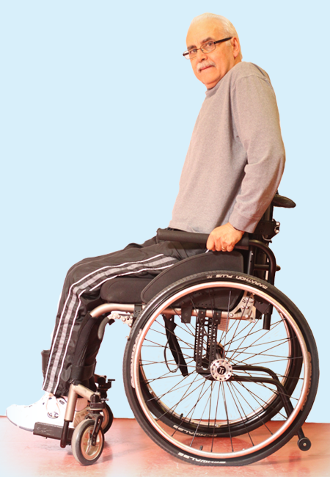
Evidence – Weight Relief vs. Sitting Pivot Transfer ⁷
  Weight Relief Lift:
    Greater superior directed shoulder force
  Sitting Pivot Transfer:
    Greater posterior directed shoulder force (trailing arm > lead arm)
    Shoulder adductor/flexor moments (trailing arm > lead arm)
  WRT & SPT:
    Superior directed force at elbow
http://www.spinalcordessentials.ca/handouts/pressure-relief-techniques/

Slide 12
Evidence – Effect of level of injury ^{8,9}
6
No significance effect on forces under feet/hands for T4-T11 injury
Trunk Impairments
  Impaired trunk musculature Demonstrated greater forward trunk flexion angle with greater wrist extension and elbow flexion angles

Slide 13
Evidence: Preferred vs. non-preferred direction ⁶
  Relative muscle demand & muscle work via EMG similar for both directions
  Anterior deltoid muscular demand:
    Trail arm > lead arm in both directions
2

Slide 14
Evidence – Effect of hand placement ¹⁰
Lower hand position increased forward trunk flexion, lateral flexion, and rotation
Anterior shoulder shear stress greater when hand in lower position
Lateral shoulder shear stress greater when hand in level position

Slide 15
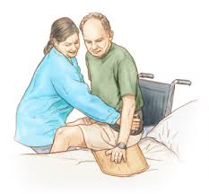
Clinical Pearls ^{6, 7,9}
Use transfer aids until patient demonstrates
appropriate strength
Focus on shoulder strengthening programs
Alternate lead arm (direction) transferring
  Trail arm sustains > 2x load than lead arm with SPT
Utilize alternative pressure relief techniques
https://www.google.com/imgres?imgurl=https%3A%2F%2Fs-media-cache-ak0.pinimg.com%2Foriginals%2F7f%2Fe3%2Fdd%2F7fe3dd529ec4ca22ccc29c0e1a3d01d4.jpg&imgrefurl=https%3A%2F%2Fwww.pinterest.com%2Fmariadallas%2Fintervention-ideas-for-patients-with-spinal-cord-i%2F&docid=mf141eqBckZ47M&tbnid=gVcIaL9Rk62kwM%3A&vet=1&w=300&h=278&bih=657&biw=1422&q=SCI%20performing%20slideboard%20transfer&ved=0ahUKEwj4zdv3n5fSAhWE1CYKHXKsC1AQMwgeKAEwAQ&iact=mrc&uact=8

Slide 16
Clinical Pearls ^{2,9}
Current shoulder pathology?
What is the goal?
What is the level of injury?
“IT DEPENDS!”

Slide 17
Videos - Transfers

Slide 18
Videos - Transfers

Slide 19

BREAK!!!
http://www.bianoti.com/jumping-jacks-cartoon.html

Slide 20
Evidence – Shoulder Exercise Programs ^{11,12}
Middaugh et al.
  8 week HEP, 1x/day
  EMG biofeedback
  EMG + HEP > HEP
  Statistical and clinical significance
Mulroy et al.
  12 week HEP, 3x/week
  Reduction of chronic pain evidenced by WUSPI
  No changes in wheelchair propulsion speed
  Reported statistical significance
  Clinical significance

Slide 21
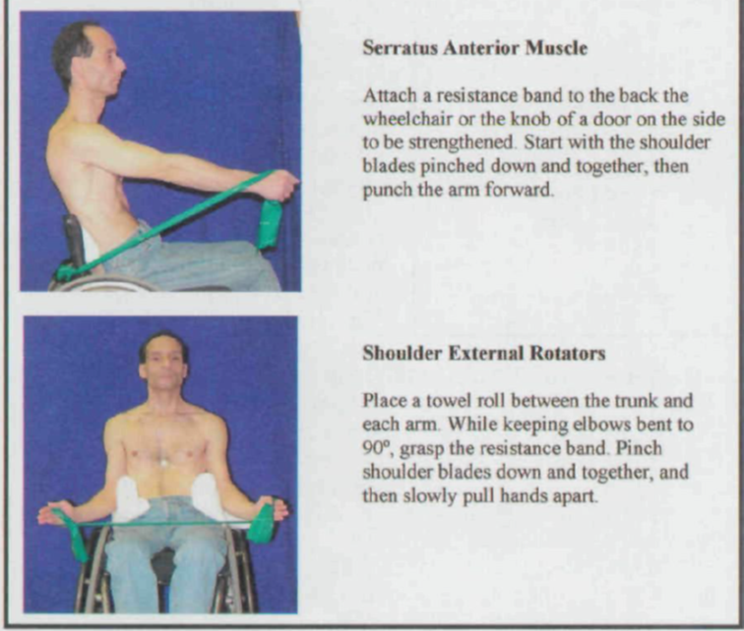
Evidence – shoulder exercise programs ¹³
Nawoczenski et al.
  8 week HEP
  EMG used at baseline
  Exercise dosage not provided
  Statistical and clinical significance (with caution)
  Generalization should be to patients with full innervation of scapular musculature

Slide 22
Shoulder Programs – clinical pearls ¹¹⁻¹³
HEP can decrease pain and increase function in patients suffering from shoulder pain
EMG biofeedback paired with HEP is beneficial
Movement optimization feedback - role
  Degree of influence of each intervention is unclear as both were provided to the same group

Slide 23
Video – Upper trapezius Stretch

Slide 24
Video – Pectoralis Stretch

Slide 25
Video – Row/Scapular Retraction

Slide 26
Video – External rotation

Slide 27
Video – Serratus Anterior Punch

Slide 28
Video – Diagonal pattern

Slide 29
Video Critique
What did I do well?
What could I have done better?

Slide 30
Clinical resources ⁴
Paralyzed Veterans of America - Preservation of Upper Limb Function Following Spinal Cord Injury: http://www.pva.org/atf/cf/%7BCA2A0FFB-6859-4BC1-BC96-6B57F57F0391%7D/cpg_upperlimb.pdf

Slide 31

Questions
Email Address:
  amanda_friedline-weber@med.unc.edu
https://www.google.com/url?sa=i&rct=j&q=&esrc=s&source=images&cd=&cad=rja&uact=8&ved=0ahUKEwjayMvro5fSAhWDKyYKHfhsB3cQjRwIBw&url=https%3A%2F%2Freallearningforachange.com%2F2015%2F03%2F11%2F7-ways-to-not-answer-a-question-when-you-are-presenting%2F&bvm=bv.147448319,d.eWE&psig=AFQjCNE8gcLN1ywAQea-FqCXf8fTOlj7Jg&ust=1487425972171839

Slide 32

Feedback
https://www.surveymonkey.com/r/WF3VSBK
https://www.google.com/search?q=monkey+pic&espv=2&biw=1280&bih=595&source=lnms&tbm=isch&sa=X&ved=0ahUKEwiC9IunxYXNAhVBcz4KHQ99CIcQ_AUIBigB#tbm=isch&q=happy+monkey+pic&imgrc=rUuFkbfBzD9SJM%3A

Slide 33

Acknowledgements
https://www.pinterest.com/pin/432064157976889961/

Slide 34
references
Haubert LL, Mulroy SJ, Hatchett PE, et al. Car Transfer and Wheelchair Loading Techniques in Independent Drivers with Paraplegia. Front Bioeng Biotechnol. 2015;3:139. doi:10.3389/fbioe.2015.00139.
Kankipati P, Boninger ML, Gagnon D, Cooper RA, Koontz AM. Upper limb joint kinetics of three sitting pivot wheelchair transfer techniques in individuals with spinal cord injury. J Spinal Cord Med. 2015;38(4):485-497. doi:10.1179/2045772314Y.0000000258.
Sawatzky BJ, Slobogean GP, Reilly CW, Chambers CT, Hol AT. Prevalence of shoulder pain in adult- versus childhood-onset wheelchair users: a pilot study. J Rehabil Res Dev. 42(3 Suppl 1):1-8. http://www.ncbi.nlm.nih.gov/pubmed/16195958. Accessed January 18, 2017.
Veterans of America P. Preservation of Upper Limb Function Following Spinal Cord Injury: A Clinical Practice Guideline for Health-Care Professionals.
Gutierrez DD, Thompson L, Kemp B, Mulroy SJ, Physical Therapy Clinical Research Network, Rehabilitation Research and Training Center on Aging-Related Changes in Impairment for Persons Living with Physical Disabilities. The relationship of shoulder pain intensity to quality of life, physical activity, and community participation in persons with paraplegia. J Spinal Cord Med. 2007;30(3):251-255. http://www.ncbi.nlm.nih.gov/pubmed/17684891. Accessed February 5, 2017.
Gagnon D, Koontz AM, Brindle E, Boninger ML, Cooper RA. Does upper-limb muscular demand differ between preferred and nonpreferred sitting pivot transfer directions in individuals with a spinal cord injury? J Rehabil Res Dev. 2009;46(9):1099-1108. http://www.ncbi.nlm.nih.gov/pubmed/20437316. Accessed January 18, 2017.
Gagnon D, Nadeau S, Noreau L, Dehail P, Piotte F. Comparison of peak shoulder and elbow mechanical loads during weight-relief lifts and sitting pivot transfers among manual wheelchair users with spinal cord injury. J Rehabil Res Dev. 2008;45(6):863-873. http://www.ncbi.nlm.nih.gov/pubmed/19009472. Accessed January 18, 2017.

Slide 35
references
Gagnon D, Nadeau S, Noreau L, Dehail P, Gravel D. Quantification of reaction forces during sitting pivot transfers performed by individuals with spinal cord injury. J Rehabil Med. 2008;40(6):468-476. doi:10.2340/16501977-0192.
Desroches G, Gagnon D, Nadeau S, Popovic MR. Effects of sensorimotor trunk impairments on trunk and upper limb joint kinematics and kinetics during sitting pivot transfers in individuals with a spinal cord injury. Clin Biomech. 2013;28(1):1-9. doi:10.1016/j.clinbiomech.2012.11.001.
Kim SS, Her JG, Ko TS. Effect of different hand positions on trunk and shoulder kinematics and reaction forces in sitting pivot transfer. J Phys Ther Sci. 2015;27(7):2307-2311. doi:10.1589/jpts.27.2307.
Mulroy SJ, Thompson L, Kemp B, et al. Strengthening and Optimal Movements for Painful Shoulders (STOMPS) in Chronic Spinal Cord Injury: A Randomized Controlled Trial. Phys Ther Clin Res Netw.
Middaugh S, Thomas KJ, Smith AR, Mcfall TL, Klingmueller J. EMG Biofeedback and Exercise for Treatment of Cervical and Shoulder Pain in Individuals with a Spinal Cord Injury: A Pilot Study. Top Spinal Cord Inj Rehabil. 2013;19(4):311-323. doi:10.1310/sci1904-311.
Nawoczenski DA, Ritter-Soronen JM, Wilson CM, Howe BA, Ludewig PM. Clinical trial of exercise for shoulder pain in chronic spinal injury. Phys Ther. 2006;86(12):1604-1618. doi:10.2522/ptj.20060001.

