Slide 1
Patient-centered Care for Individuals with Multiple Sclerosis:
Identifying and Incorporating Patient Perspectives into Practice
Jessica Anderson, SPT

Slide 2
Learning Objectives
Define patient-centered care and evidence-based practice
Understand the purpose and objectives of this research project
Summarize key themes from the data
Incorporate key takeaways into personal approach to goal-setting and treatment for individuals with multiple sclerosis (MS)
Notes:
By the end of this presentation, you will be able to: (go over objectives).

Slide 3
What is patient-centered care¹?
Incorporate patient’s preferences, needs and values
Empowerment of patients
Shared decision making
Treating the Disease
Treating the Patient
Notes:
Patient-centered care (PCC) is a term that describes the shift away from “treating the disease” and the shift towards “treating the patient^{”1.} In PCC, healthcare practitioners focus on developing a therapeutic relationship with patients, so as to better understand their preferences, needs and values, and include them in shared decision making concerning their plan of care. By empowering patients to take an active role in their care and choice of treatment, we can improve treatment outcomes and adherence¹.
If we are practicing patient-centered care, we should be taking into account what patients value from the creation of goals to the implementation of our intervention…. But how are we determining that our treatment is effective? Let’s keep this in mind as we continue with the presentation.

Slide 4
What is evidence-based practice²?
Best Research Evidence
Clinical Expertise
Patient Values and Preferences
Notes:
EBP: balance of 3 important aspects of care that should be applied to clinical decision-making concerning a patient’s plan of care. Balancing the three can be difficult, and as a student I have seen a focus on research evidence (finding the perfect RCT to support a clinical technique or desired outcome) to the detriment of clinical experience and patient preference.

Slide 5
What is “effective” physical therapy?
What is a “clinically meaningful outcome” in physical therapy ?
No “accepted” definition for walking treatments^{3,4}
Objective Outcome Measures
Subjective Outcome Measures
Notes:
After a review of the literature, we found that a gap in knowledge concerning treatment outcomes is that there is no accepted definition for what a “clinically meaningful outcome” for patients with MS is. Research by Goodman et al on the effects of extended release oral dalfampridine in MS identified that this medication increased walking speed between treatment groups but this improvement does not “give a sense of clinical meaningfulness of the treatment effect”^{3,4}. Outcome measures will play a role in guiding decision-making, but do the outcome measures we use capture what a patient values in therapy outcomes? Does an outcome measure’s minimal clinically important difference (MCID) actually capture the smallest change that a patient would identfiy as important? How do we know if physical therapy treatment has been effective?

Slide 6
“Treatment options for walking difficulties in multiple sclerosis (MS): patient and provider perspectives”
Notes:
Qualitative research conducted by Dr. Prue Plummer, assisted by Andrea Stewart and myself.

Slide 7
Research Objectives
Engage persons with MS and healthcare providers on their perspective on what constitutes effective walking treatment
Determine what factors into treatment selection
Identify what is considered a meaningful treatment outcome
Notes:
Go over objectives.

Slide 8
Data Collection
Focus Group
4 individuals with MS
Moderated, recorded, and transcribed
Interview
1 individual with MS
Recorded and transcribed
Survey
Ongoing
Notes:
Recruitment via word of mouth, flyer shared by local practitioners and the NMSS to individuals and support groups
Age ranged from late 40s to mid 70s and diagnoses included RRMS and PPMS.
Interview conducted over the phone, and was recorded and transcribed.
This research is currently ongoing:currently presenting preliminary data but a survey has been made to continue to collect information on the topic

Slide 9
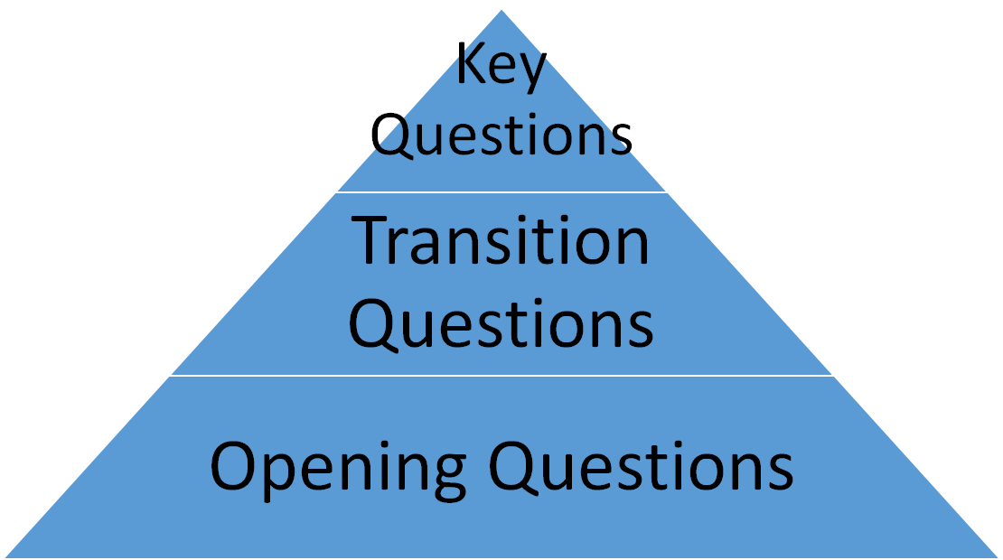
Question Route⁵
Notes:
In qualitative research, the researcher is trying to understand, explore and examine the thought processes, attitudes and experiences of a target population⁵. They are able to do this by conducting interviews, focus groups or observing participants in the target setting. We chose to use focus groups and interviews to determine patient persepctives on the efficacy of walking treatment. The question route is extremely important and must follow a triangular structure to guide participants from the introduction of the topic to the key question⁵.

Slide 10
Opening Questions
Today we are going to be talking about the sorts of difficulties you can experience due to MS, especially related to walking, and some of the treatments that can help improve your walking, such as physical therapy. When I say the words, “physical therapy,” what is the first thing that comes to mind?
Now I want you tell us about some of the experiences you have had with physical therapy or physical therapists.
Notes:
Purpose: make participants feel comfortable and open up. Set the stage for discussion.

Slide 11
Transition Questions
Tell us about some of the difficulties you experience as a result of your MS that limit your walking or your ability to move around and do the things you want to do?
Think back to the last time you went to physical therapy:
What was your goal? What did you want to achieve from physical therapy?
What do you think was the most effective part of your physical therapy?
What do you think was the least effective part of your physical therapy?
Notes:
Purpose: naturally guide conversation by narrowing topic of discussion to hone in on key questions

Slide 12
Key Questions
How do you know if a treatment has been effective?
What is the most important thing to you that has to improve or change for you to feel like you have benefited from a particular treatment or therapy?
What is most important to you when choosing a treatment option – how much it helps you, how much it costs, or how easy it is to do (e.g., taking a pill versus participating in PT)?
Notes:
What we are trying to identify via the discussion.

Slide 13
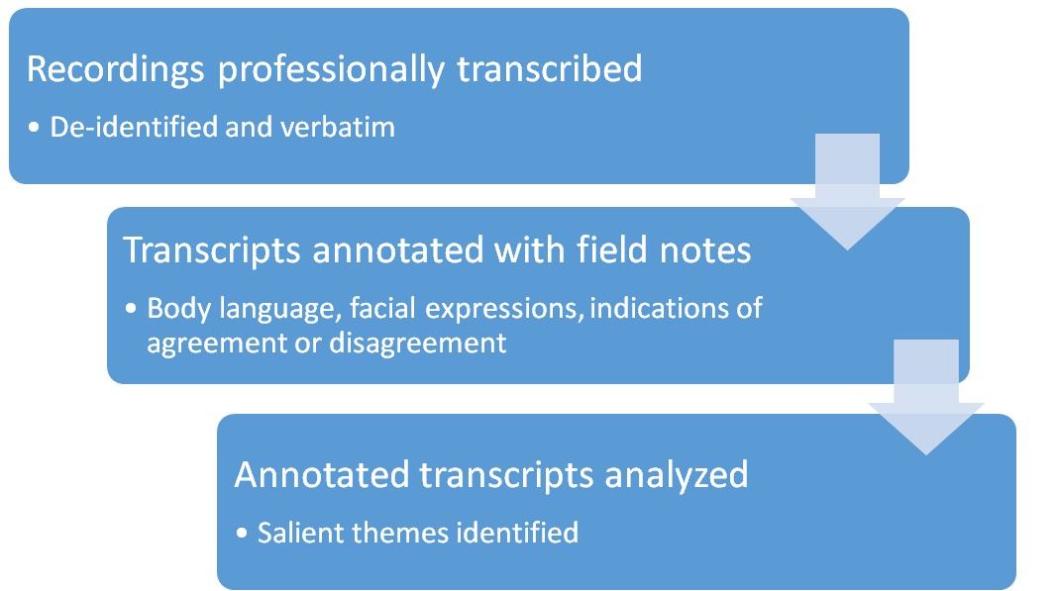
Thematic Analysis⁶
Notes:
Andrea and I read the transcripts, incorporated our notes on body language, and identified key themes from the data
Recordings professionally transcribed
Transcripts annotated with key observations from session
Annotated transcripts were analyzed, salient themes identified, and matrix created
All work was peer reviewed to increase dependability of the findings⁶

Slide 14
What We Learned: Key Themes
Notes:
Now I will go through some of the key themes we found while analyzing the transcripts from the focus group and interview. Granted with an n of 5 there aren’t any conclusions we can draw to the general population (individuals with MS) but this information does provide a starting point for additional questions, research, and self-reflection.

Slide 15
Experience with Physical Therapy
Beneficial
“First impressions [of physical therapy] is gift from god”
Frustrating
“I just feel like a lot of exercises that I've gotten just end up being kind of frustrating and nearly useless because I cannot do them as effectively as I'd like to…But I just feel like I still haven't gotten the exercises that would really make a big difference.”
Notes:
Read quotes. While the overall consensus was that physical therapy was beneficial, some participants did express frustration with various aspects of physical therapy and with physical therapists they worked with. In this instance, this participant seems to feel there is a disconnect between what she is given in PT and the treatment outcome she would like to have.

Slide 16
Experience with Physical Therapy
Lack of Shared Decision-Making
“'Cause they didn't listen to me you know, like, it's okay to be a physical therapist, but you also need to listen…But, to me, they didn't listen to me, so I didn't feel they were working on the things that I needed. You know like, we share notes, you know, you're my therapist, I'm your patient, and we're going to share with each other what's going on. And you're going to give me suggestions, and I'm going to give you suggestions, and you have to take my suggestion, you know, it's very important to me.”
Notes:
Read quote. Shared decision making is an integral part of patient-centered care, and this participant had an experience where her physical therapist was not employing this technique in practice which ultimately resulted in this participant not feeling heard which negatively impacted her therapy session.

Slide 17
Experience with Physical Therapy
Lack of patient education
“Although sometimes I can't, I have a hard time um, putting together a specific exercise and how it's going to help me walk…I don't quite get the muscle group and what it does when I walk that we're working on.”
“When you feel like it makes you more tired and more frustrated to try to do things that are almost impossible to do, then it makes you kind of give up on those particular exercises.”
Notes:
Read quotes. While we can’t draw any conclusions based off of two particpants, these quotes could highlight the importance of educating patients on why we chose a certain exercise and how it will help them reach their goals, so as to improve patient buy-in and treatment adherence/compliance with HEP.

Slide 18
Experience with Physical Therapy
Guilt over non-compliance
“I never do my um, routine at home that I do in physical therapy.”
“Home exercises programs are, they're- it's difficult to carve out [time].”
“Probably don't do as much as I've been instructed to do.”
Notes:
Read quotes. Guilt was a resounding theme expressed by all participants. Reflect on how you plan to motivate HEP compliance in practice. Do you plan on incorporating motivational interviewing or behavior change strategies? Can anyone provide an example of motivational interviewing or behavior change strategy?
In motivational interviewing you assist the patient explore what their reason/intention is for change (ie. doing their HEP) and empower them to develop their own plan based on what motivates them. This is accomplished using the OARS communication technique (open questions, affirmation, reflective listening, and summary reflections).
Example of behavior change strategy is using stages of change to identify the patient’s readiness to change and provide guidance based on the stage they are in (Precontemplation, contemplation, preparation, action and maintenance).

Slide 19
Experience with Physical Therapy
Creative Solutions
“The most useful PT things that I've done are things where the therapist had been aware of adapting the physical therapy to like my surroundings and making it easy and simple things I could do. That I didn’t have to spend half my day trying to get the equipment in the right place… I was much more compliant.”
“[My therapist] made it where I could do the exercises like all day, throughout the day and she taught me tricks for like, how to remember to do them several times a day and, that was really, totally great.”
Notes:
Read Quotes. One way to address guilt over non-compliance is to find creative solutions to increase the likelihood of compliance. These patients found that adaptations and strategies their therapists taught really helped them get the most out of their therapy.

Slide 20
Determining treatment effectiveness: PT
Maintenance
“Not getting worse.”
“ I don't have any great expectations at this point but I would like to be able to keep at least doing what I can do.”
Notes:
This sentiment was expressed by all participants. How do you think you will quantify maintenance in practice? Have you discussed the use of subjective outcomes measures and objective outcome measures in class? Would you use one or the other, or both to quantify change?

Slide 21
Determining treatment effectiveness: PT
Quality of Life Improvements
“Can I do a little bit more than I used to do?... am I sleeping better?...am I in less pain?”
“Well, I think a lot of it is just whether I feel like I can get around more easily and if I don't get tired out as much.”
“... ‘Well, am I better than I was?’...the same as I was a year ago. Then that's where I have to look through notes...I've learned to keep notes.”
Notes:
Read quotes. Are maintenance and QoL improvements as ways to determine treatment effectiveness surprising? Is this something you have witnessed in practice?

Slide 22
Determining treatment effectiveness: PT
Functional Improvement
“I've had a lot of physical therapy and people that have worked with me and pushed me really hard, and it did help, and as long as I kept doing it, which I did, 'cause I started doing stairs, you know, not a lot, but you know, maybe five- five steps by myself and to me that's uh, improvement.”
“I think I would need to feel like my thigh muscle was more functional. That I was able to lift my leg up better. That I wouldn't have the spasticity that I have often in that leg. And that I could raise my toes better than I can right now. So, those would be probably the main things I'd like to have happen.”
Notes:
While maintenance and quality of life improvements are relatively subjective measures of treatment effectiveness, we also found that patients also value objective functional improvement though as noted in the maintenance quotes, it’s not always expected due to the progressive nature of MS.

Slide 23
Determining treatment effectiveness: Medication
Self-testing
“I have gone off it for about 48 hours to see if it makes any difference and I do think it does help some. It's not a really dramatic difference but I did notice a difference when I stopped it for a couple of days… Without the Ampyra, it really kind of dragged even more.”
“Stop taking it… if you’re taking something for fatigue and you’re not sure it’s working, knock it off for a couple days, you’ll find out if it’s working.”
Notes:
When determining if a medication is effective or not the consensus from the participants was to stop taking the medication to test its effects on the body This is an important finding, and deserves to be looked into further, because some drugs will automatically make you feel worse immediately after stopping them. Patient education is needed to address this practice.

Slide 24
The “right” therapist
Therapist characteristics
“[What] I really like about [that clinic] is all the therapists, not only do they work together, they remember you. And I think there's a certain personality you need to be a physical therapist or an effective physical therapist. And I think they all exhibit that down there.”
“Don’t tell me , here, go on the Nu Step for you know, 10 minutes and I’ll be back. I don’t want to hear that you know? You [the physical therapist] need to be there and find out how I’m ticking.”
“They [the physical therapists] didn't listen to me, so I didn't feel they were working on the things that I needed.”
Notes:
One of the in the resounding themes and a main point of emphasis was the importance of finding the right therapist. In fact, finding the right therapist factored into if the patient felt the therapy was beneficial and into their choice of treatment. Based on the data, qualitites that are associated with an effective physical therapist are empathy, listening/communication skills and experience working with PwMS.
Provide context for each quote and read quote.

Slide 25
The “right” therapist
Experience treating individuals with MS
“I think the other thing to is, so many of them are trained with MS, they know not to get you to, to overdo it. They understand MS patients.”
“they [current physical therapy clinic] don't seem to have a lot of physical therapists who are specifically trained in MS and MS related therapies and so I would like to feel like somebody that was my physical therapist had a really good understanding of the difficulties… a little more understanding maybe of what the limitations are of MS.”
Notes:
Presenter bolded phrase for emphasis. Read quotes. Experience was associated with quality of care as seen by the quotes above. One participant even referred to her physical therapist who had experience treating individuals with MS as wonder woman because “she knows when I should stop before I know when I know I should stop.” While I can’t confidently conclude this, I think that level of trust in her therapist helps treatment buy-in.

Slide 26
Factors influencing treatment choice
Healthcare Provider
“I think I was the one who had to bring up the physical therapy, put in a request for it.”
“I'm the one that has to advocate for myself.”
“And as far as physical therapy goes, it's often what, like finding the right therapist who understands me. And will work with my needs.”
Notes:
General consensus from all participants, read quotes above. Once again, when participants were asked what influences their treatment choice, the idea of finding the right therapist came up, along with the need to advocate for whatever choice they want to make. As a healthcare provider, it is important to recognize that what you recommend or suggest factors into a patient’s choice in treatment. Patient education and advocating for the patient as well should be always be incorporated into practice.

Slide 27
Factors influencing treatment choice
Insurance
“I guess the way the insurance works, it's like, you have so few PT treatments a year and having kind of constant PT throughout the year really makes a difference.”
“I guess cost is certainly something because my insurance will pay for a certain number of sessions…”
Notes:
Read quotes. As you may already know, insurance and the amount of sessions insurance covers unfortunately factors into a PwMS treatment choice.

Slide 28
Factors influencing treatment choice
Accessibility
“Probably partly how hard or easy it is to get to the actual therapy session.”
“A lot of it is the ease of accessibility for me.”
Notes:
Read Quotes. Accessibility, or the ease to get to and from physical therapy appointments as well the ease of getting into and out of the clinic itself was one of the key factors playing into treatment choice. While you may not have control over transportation difficulties or the accessibility of where you are on clinical rotation, it is important to factor this in as either a barrier or facilitator for treatment compliance. Accessibility is also something you can advocate for on behalf of your patients by putting them in contact with local resources like EZ-Rider or a volunteer transportation service.

Slide 29
Key Takeaways
Practice active listening
Mutually define “improvement” with patients
Practice shared-decision making
Delve deeper in your goal-setting
Use patient reported outcome measures
Educate patient on treatment choices
Notes:
Based on themes identified in research the following are key takeaways are (read above)… while these may seem like common sense, it’s important to identify how we do this in practice…it’s important to reflect on what you do to identify patient preference and how you incorporate them into the goal-setting process. You must delve deeper in your goal-setting, if they say they want to walk “better” you need to find out what “better” means and what is motivating the need for “better”. What in their life are they unable to do that they want to be able to do. Take the time to figure out what your patient wants from therapy, so that you can target your treatment using what they find important.

Slide 30
Suggested Patient Reported Outcome Measures⁷
Highly Recommended:
12-Item MS Walking Scale
MS Impact Scale (MSIS-29)
MS Quality of Life (MS QoL-54)
Recommended:
Activities-Specific Balance Confidence Scale
Modified Fatigue Impact Scale
MS Quality of Life Inventory
Notes:
As you got out onto clinical rotations, please consider using these patient reported outcome measures recommended by the MS-EDGE task force. These measures should provide you and your patient with subjective information that can better guide their therapy goals and progress achieved through physical therapy. Clinical, objective outcome measures should be used as well but because MS is a progressive disease what the patient views as progress or progression towards meeting goals may not always be captured with an objective measure.

Slide 31
Gaps in Knowledge
Define improvement and clinically meaningful
Evidence-based ways to engage patients with MS in shared decision-making
Effectiveness of patient-report outcome measures
Notes:
After conducting this research project, these are some of the gaps in knowledge that we identified. We need to determine if it is possible to define what is considered improvement and clinically meaningful for a population like PwMS or is the disease so variable that this isn’t possible. While the idea of shared decision-making is generally accepted, it seems like some patients still are not being sufficiently included in goal-setting and treatment course. Is there an EBP way to engage PwMS? Does educational matierals need to be created to better enhance this process? Are patient reported outcome measures the most efficient and effective way to measure change or is objective measures and direct questioning just as effective? How much time should go into determining how patients define improvement and should this be standardized?
While we were not able to find the answers to these questions, I hope this presentation has helped everyone reflect on the importance of facilitating patients in acheiving a “clinically meaningful” outcome and on the importance of exhibiting the qualities of an effective physical therapist.

Slide 32
Questions?

Slide 33
Sources
Golan D, Staun-Ram E, Miller A. Shifting paradigms in multiple sclerosis: from disease-specific, through population-specific toward patient-specific. Curr. Opin. Neurol. 2016;29(3):354-361. doi:10.1097/WCO.0000000000000324.
Overview - Introduction to Evidence-Based Practice - LibGuides at Duke University Medical Center. Available at: http://guides.mclibrary.duke.edu/c.php?g=158201&p=1036021. Accessed April 15, 2018.
Goodman AD, Brown TR, Krupp LB, et al. Sustained-release oral fampridine in multiple sclerosis: a randomised, double-blind, controlled trial. Lancet 2009;373:732-738.
Goodman AD, Brown TR, Edwards KR, et al. A phase 3 trial of extended release oral dalfampridine in multiple sclerosis. Ann Neurol 2010;68:494-502.
Plummer P. Focus group methodology. Part 1: Design considerations. Int. J. Ther. Rehabil. 2017;24(7):297-301.
Plummer P. Focus group methodology. Part 2: Considerations for analysis. Int J Ther Rehabil 2017;24(8):345-351.
MS-EDGE Outcome Measures for In- and Out-Patient Rehabilitation. MS EDGE Task Force website http://www.neuropt.org/docs/ms-edge-documents/ms-edge_rehab_recs5417E23D4B53.pdf?sfvrsn=2. Accessed April 15, 2018.

