Slide 1
The Role of Terrain and Balance Confidence on Gait Speed and Spatiotemporal Measures
Capstone Research by
Stacy Harris and Alan Levinson

Slide 2
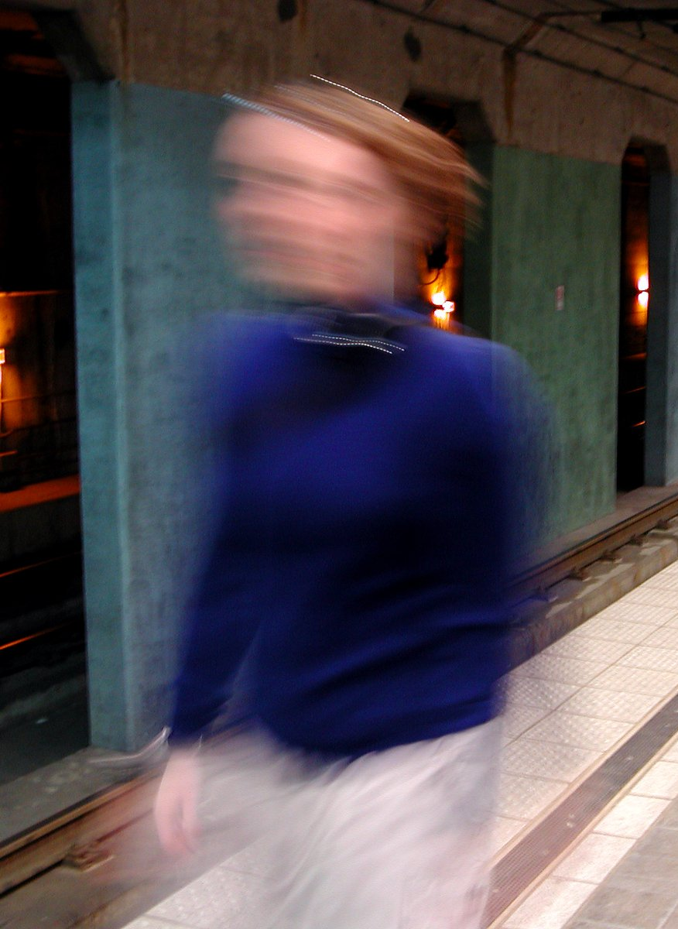
The Significance of Gait Speed & Confidence
Goal for Physical Therapists to improve gait in people with mobility deficits.
Predicts health status and disability.¹
Good measure of mobility performance.²
Normative values established using the 10 meter walk test in healthy adults.³
Greater confidence may be associated with greater mobility

Slide 3
Why look at spatiotemporal measures & Confidence?
To $↑$ gait speed, $↑$ step length and/or cadence.^{4,5}
Changes in step length and/or cadence^{5,7,8}
Walking downhill and uphill⁹
Confidence is associated with improved functional ability and mobility performance.⁶

Slide 4
What about outdoor terrains?
Full participation in life roles and activities.
No studies compare indoor speed to outdoor community terrain.
If we understand how step length and cadence change on various surfaces, it can help us to better inform our instruction and treatment!

Slide 5
Purpose
The purpose:
To explore change in gait speed between smooth, firm clinic setting and various outdoor terrains, and determine influence of balance confidence.
Hypothesis:
Gait speed will be reduced in outdoor terrains, and those with decreased confidence will demonstrate a greater reduction in gait speed, step length, and cadence.

Slide 6
Subjects
49 participants:
27 female
Average Age 65.2
Diagnoses:
19 with Parkinson’s or Stroke
23 with MSK complaints or Trauma
7 other conditions
23 with a history of Falls:
Range from 1 to 12 in the past year
2.4 falls on average, per faller
Assistive Devices, orthotics, prosthetics:
8 used cane (1 used knee brace)
2 used Bioness
2 wore ankle braces
1 wore an ankle foot orthotic
1 used a trans-femoral prosthetic
1 used bilateral trans-tibial prosthetics
1 participant had a shoe lift

Slide 7
Data Collection
Table 1
Terrain | Distance (meters)
10MWT (indoors) | 10
Large Pavers | 21.9
Sand | 4.2
Gravel (up/downhill) | 11.9
Mulch | 6
Small Pavers | 5.8
10 Meter Walk Test –
At the CRC gym – 1 Trial
5 Outdoor Terrains –
Community Challenge Course – 1st loop, gravel downhill, 2nd loop, gravel uphill
Video recorded of all participants
Activities Balance Confidence Scale
Collected for 26 participants
Participants used the same assistive device, prosthetic, and/or orthotic for all data collection.

Slide 8
Data Processing
Start and Finish times and Number of steps recorded for each participant.
Calculations using data
Time for each terrain in seconds (finish – start)
Average gait speed in m/s (distance/time)
Cadence in number of steps per minute (steps/time)
Step length in meters (distance/steps)

Slide 9
Statistical Analysis – Gait Parameters
There was a significant main effect across all terrains for
Gait Speed (p < 0.001; η_{p}² = 0.644)
Cadence (p < 0.001; η_{p}² = 0.323)
Step length (p < 0.001; η_{p}² = 0.597)
Gait speed was significantly slower on sand, mulch, and going up and downhill on gravel (all p < 0.023).
No significant change on large and small pavers
Cadence and step length were significantly reduced on sand and going up and downhill on gravel (all p < 0.006 and p < 0.017, respectively).
No significant change on mulch, large pavers, or small pavers

Slide 13
Statistical Analysis – Step length/Cadence
Step length $∆$+ cadence $∆$ $→$ Gait speed $∆$
From 10MWT condition to the sand, mulch, and up and downhill gravel
Combination of step length and cadence changes accounted for
>94% of the variance, 10MWT $→$sand speed (p < 0.001, R² = 0.938)
$→$mulch speed (p < 0.001, R² = 0.962)
$→$downhill gravel speed (p < 0.001, R² = 0.937)
$→$ uphill gravel speed (p < 0.001, R² = 0.938)

Slide 14
Statistical Analysis – Confidence
Balance Confidence (ABC) is NOT related to changes in mobility measures
Gait speed (all p > 0.202); Step length (all p > 0.064); Cadence (all p > 0.507)
Clinic Speed (10MWT) IS correlated to $∆$ in velocity
Sand (p=0.009; r=0.370)
Gravel Downhill (p=0.001; r=0.449) and Gravel Uphill (p<0.001; r=0.619)
Clinic Speed (10MWT) IS correlated to $∆$step length
Gravel Downhill (p=0.001; r=0.558) and Gravel Uphill (p=0.014; r=0.348)

Slide 15
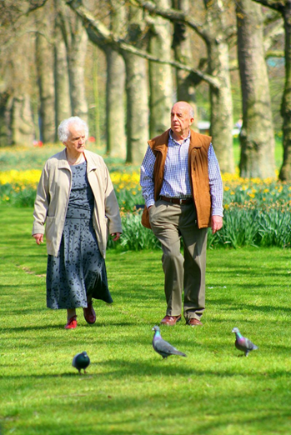
What does this mean for PT?
The gait speed of patients observed indoors during a 10MWT is not representative of the speed they will use when walking on various outdoor terrains.
Physical therapists should be training patients on the terrains they expect them to encounter once they reenter the community along with other interventions targeting dynamic balance and strength.
Patient’s perceived confidence does not predict mobility performance in the community. Caution is required to reduce over-confidence errors and under- confidence reduction of activity.

Slide 16
Acknowledgements
UNC Center for Rehabilitation Care – Physical Therapists and Staff
Catherine “CJ” Jacobs, PT, DPT
Dr. Michael Lewek, PT, PhD

Slide 17
REFERENCES:
All Images from www.freeimages.com
Guralnik JM, Ferrucci L, Pieper CF, et al. Lower extremity function and subsequent disability: consistency across studies, predictive models, and value of gait speed alone compared with the short physical performance battery. J Gerontol A Biol Sci Med Sci 2000;55(4):M221-31.
Barnett C, Vanicek N, Polman R, et al. Kinematic gait adaptations in unilateral transtibial amputees during rehabilitation. Prosthet Orthot Int 2009;33(2):135-147. doi:10.1080/03093640902751762.
Bohannon RW. Comfortable and maximum walking speed of adults aged 20-79 years: reference values and determinants. Age Ageing 1997;26(1):15-19.
Zijlstra W, Rutgers AWF, Hof AL, Van Weerden TW. Voluntary and involuntary adaptation of walking to temporal and spatial constraints. Gait Posture 1995;3(1):13-18. doi:10.1016/0966-6362(95)90804-2.
Oberg T, Karsznia A, Oberg K. Basic gait parameters: reference data for normal subjects, 10-79 years of age. J Rehabil Res Dev 1993;30(2):210-223.
Myers AM, Powell LE, Maki BE, Holliday PJ, Brawley LR, Sherk W. Psychological indicators of balance confidence: relationship to actual and perceived abilities. J Gerontol A Biol Sci Med Sci 1996;51(1):M37-43.
MacLellan MJ, Patla AE. Adaptations of walking pattern on a compliant surface to regulate dynamic stability. Exp Brain Res 2006;173(3):521-530. doi:10.1007/s00221-006-0399-5.
Hausdorff JM. Gait dynamics, fractals and falls: finding meaning in the stride-to-stride fluctuations of human walking. Hum Mov Sci 2007;26(4):555-589. doi:10.1016/j.humov.2007.05.003.
Sun J, Walters M, Svensson N, Lloyd D. The influence of surface slope on human gait characteristics: a study of urban pedestrians walking on an inclined surface. Ergonomics 1996;39(4):677-692. doi:10.1080/00140139608964489.

