Slide 1
Progressive Return to Activity (PRA)
Rehab Recommendations for Service Members post-mTBI
By Caroline Cleveland, SPT
Notes:
Photo by Gaetan Lee http://commons.wikimedia.org/wiki/File:Chimp_Brain_in_a_jar.jpg

Slide 2
Goals
Identify the founding principles of PRA
Identify patients who are appropriate for the PRA protocol
Appropriately apply PRA guidelines to progress patients through the rehab process
Identify clinical and patient education resources
Share honest feedback on actual practice and anticipated practice
Notes:
Identify the founding principles of PRA
Identify patients who are appropriate for the PRA protocol
Appropriately apply PRA guidelines to progress patients through the rehabilitative process
Identify measures
Identify progression parameters
Know when to refer back to PCM
Identify available resources to further guide employment of PRA in clinical practice
Share honest feedback on actual practice previous to presentation, as well as anticipated changes to clinical practice following presentation

Slide 3
Agenda
Why PRA?
The Protocol
Red Flags and Required Referral
Check on Learning
Additional Resources
Survey and Evaluation

Slide 4
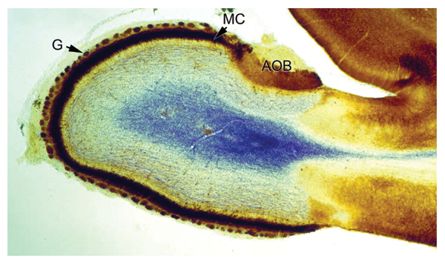
Why PRA?
Notes:
Goal: Identify the founding principles of PRA as an intervention
Photo by Oldak Quill http://commons.wikimedia.org/wiki/File:Section_through_olfactory_bulb_16_days_old_rat_brain.jpg

Slide 5
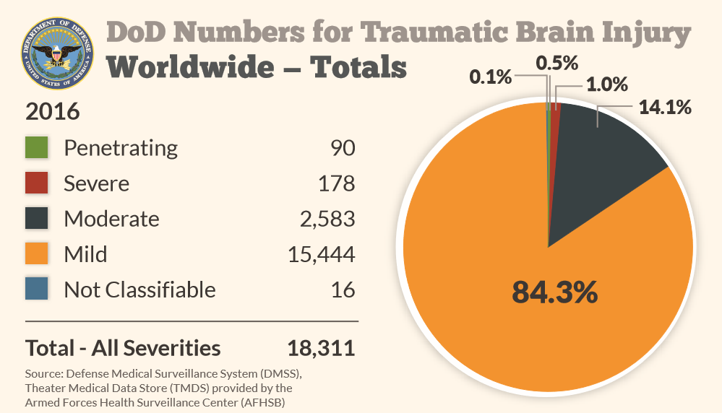
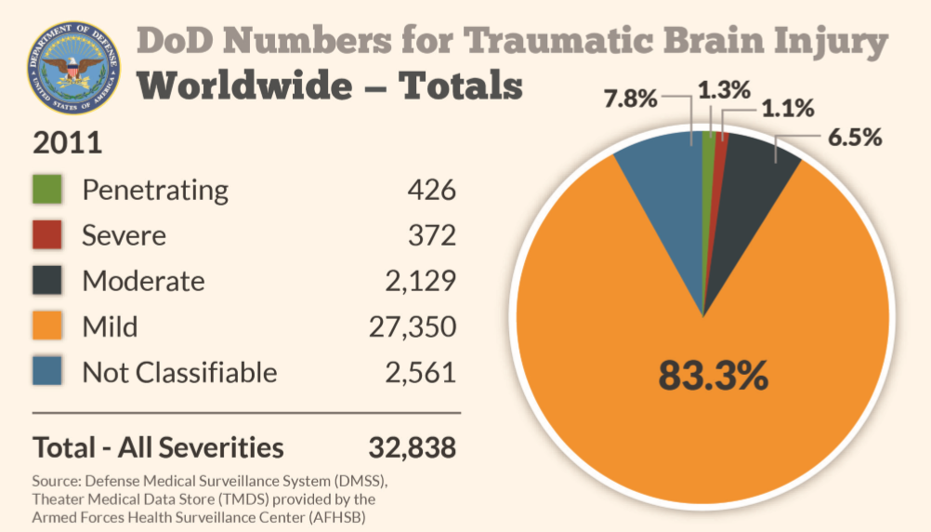
Incidence Consequence Resilience Guidance
Notes:
mTBI=concussion: LOC 0-30min, alteration in consciousness up to 24hr, PTA 0-1d, normal CT (Assistant Secretary of Defense for Health Affairs. Health Affairs Memorandum. Traumatic Brain Injury: Definition and Reporting 2007)
Incidence: (http://dvbic.dcoe.mil/dod-worldwide-numbers-tbi)
Consequence:
“mild” diagnosis can have severe impairments, especially if not properly managed and/or additional concussive events
personal and professional (readiness for deployment, command, etc)
individual and collective (military family, unit readiness, mission accomplishment, DoD and VA fiscal costs)
Resilience/Recovery:
early intervention, symptom management, and return-to-duty are critical to offset costs and suffering, but how can we support the healing the brain? rest vs activity?
Guidance: gaps in previous guidance; rest vs activity; PRA fills the gaps (more specific to SMs and include cognitive/visual/vestibulo-ocular) acute concussion only, 1st and 2nd concussion in 12mo
Why PRA = to provide standardized care based on current evidence; protocol only applicable to acute concussion within 24hours; more chronic concussion may require graded exercise test to establish sub-symptomatic threshold at which to progress exercise/exertion from
Picture from Defense Veterans Brain Injury Center. DoD Worldwide Numbers for TBI Worldwide Totals. http://dvbic.dcoe.mil/files/tbi-numbers/WorldwideTotals2016Nov14-2017508.pdf. Published November 14, 2017. Accessed February 1, 2018. Update with 2017 data when 4th Quarter is available.

Slide 6
The Protocol
Notes:
Goal: Identify patients who are appropriate for the PRA protocol
Photo by Oldak Quill http://commons.wikimedia.org/wiki/File:Section_through_olfactory_bulb_16_days_old_rat_brain.jpg

Slide 7
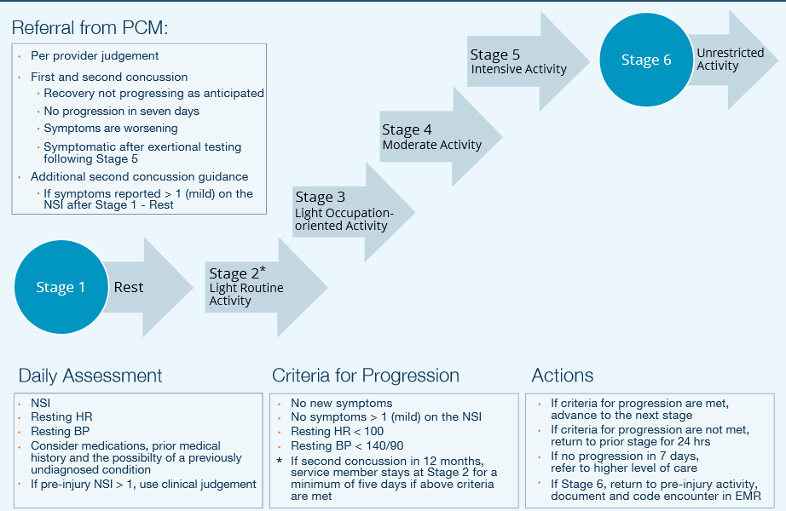
Overview
Notes:
6 stage progression of activities in physical, cognitive, and balance/vestibular domains
Return to pre-injury level (symptom resolution vs asymptomatic)
Eligible: 1st and 2nd mTBI (3rd+ refer to higher level of care for comprehensive eval/treat)
If symptom resolution after 24hr AND no symptom exacerbation on exertional testing (2min 65-85% TMHR) → return to duty
If symptomatic after 24hr OR symptomatic with exertional testing →
Prescribe self-guided PRA OR refer to rehab provider for supervised PRA
2nd concussion gets 5 extra days in stage2 for total of 7 days rest (24hr + stage1 24hr + stage2 5d)
How to progress? Daily assessment measures, meet criteria, actions (forward, backward, rest, refer)
Let’s start with assessment measures and progression criteria from stage 1 …
Picture from DVBIC & DCoE for Psychological Health and Traumatic Brain Injury. Progressive Return to Activity Following Acute Concussion/Mild Traumatic Brain Injury: Guidance for the Rehabilitation Provider in Deployed and Non-deployed Settings. DCoE Clinical Recommendation, 2014.

Slide 8
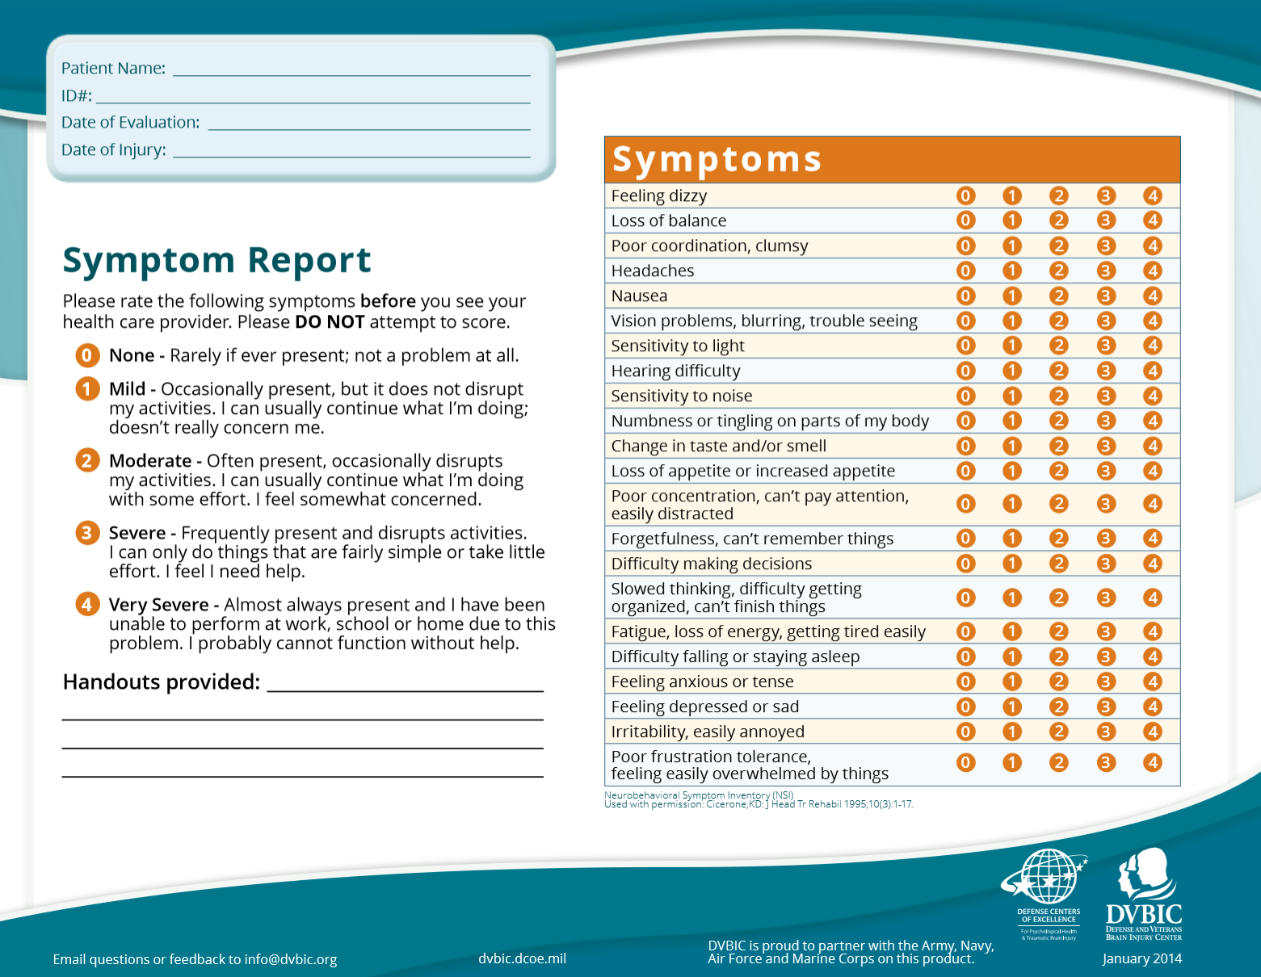
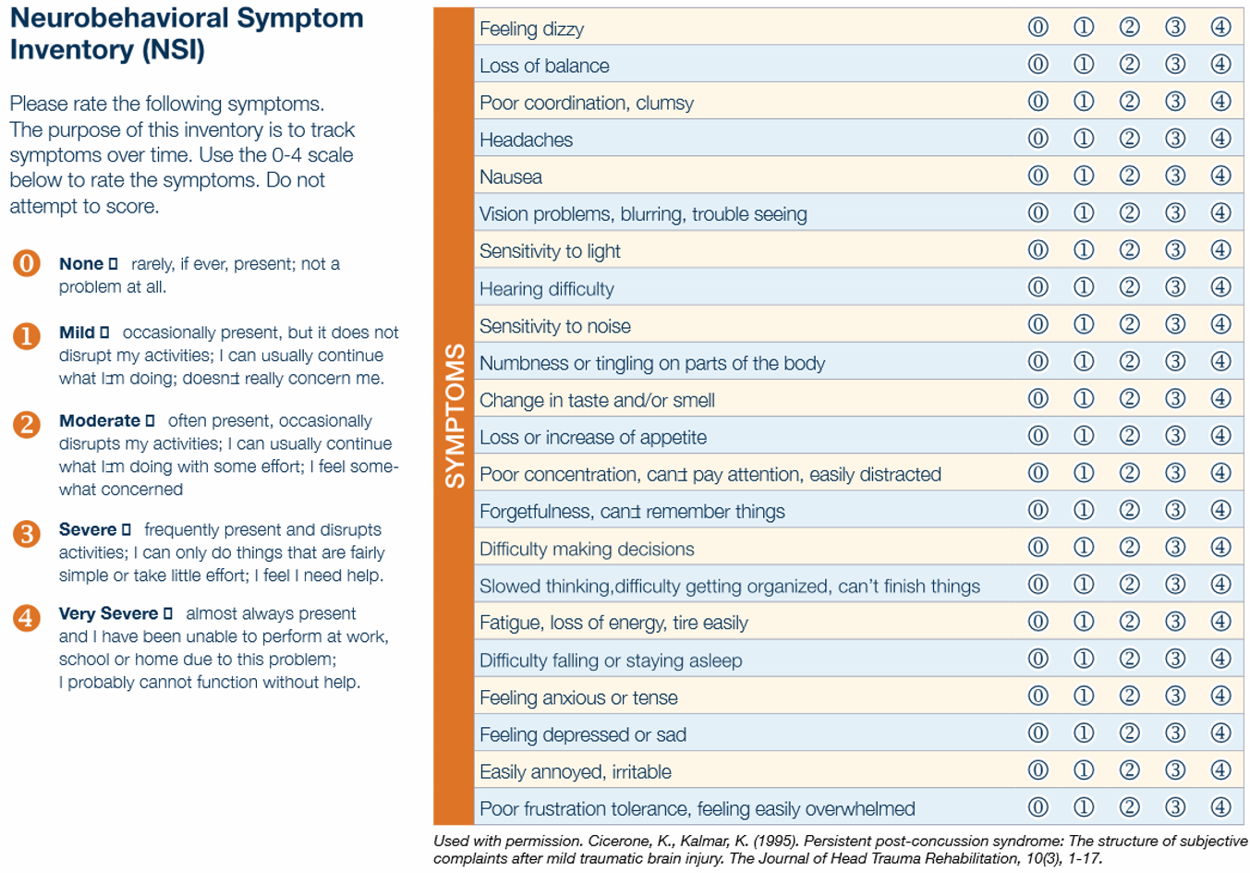
Measures
HR_{rest} < 100bpm
BP_{rest} < 140/90mmHg
Neurobehavioral
Symptoms Inventory
Key: somatosensory
cognitive
affective
% Age-Predicted HR_{max}
Rate of Perceived Exertion (RPE)
Notes:
Before every session
HR_{rest}
BP_{rest}
NSI-22 (somatosensory, cognitive, and affective)
Each stage guided by HR_{max} and RPE
Picture from DVBIC & DCoE for Psychological Health and Traumatic Brain Injury. Progressive Return to Activity Following Acute Concussion/Mild Traumatic Brain Injury: Guidance for the Rehabilitation Provider in Deployed and Non-deployed Settings. Training Slides, 2014.

Slide 9
Stage 1: Rest
Physical Activities | Cognitive Activities
Balance/Vestibular Activities | AVOID | DO NOT
Note
RPE 6-8 (extremely light), HRmax
Walk at an easy pace for short distances (i.e. bathroom, meals)
Sit down and rest when you need to
Breathe (no Valsalva)
Sleep at least 6-8hrs at night
Rest in a quiet, low light environment
Wear corrective lenses and sunglasses as needed
Rest from screens (i.e. TV, phone) at least once an hour
Slow and limited range of head and body movement when changing positions to limit symptoms
Limit head-below-heart positions (i.e. bring foot to knee shoe tying)
Caffeine
Tobacco
Work, Study,
Drink alcohol,
Play video games,
Drive, Exercise,
Exert so that your heart races
Notes:
Goal: symptom resolution
Wear: comfortable clothes
Physical: +HR_{rest} +BP_{rest} + NSI; encourage healthy sleep habits through every phase

Slide 10
Stage 2: Light Routine
Note
Physical Activities | Cognitive Activities
Balance/Vestibular Activities | AVOID | DO NOT
RPE 7-11 (light)
Max 30min activity (1:8 rest) i.e. 4hr
Walk on level surfaces; Take stairs
Stationary bike with no resistance
Stretch
Limit lifting of light objects
Max 30min light activity (1:2rest)
Simple, familiar, single tasks
i.e. Disassemble and clean weapon Read magazine, Play cards, Email
Increase light and noise exposure
Increase speed and range of head and body movement in daily routine
Head turn/tilt and body bending*
Increase shifts in visual focus
Caffeine
Tobacco
Crowded areas
Drink alcohol,
Play video games,
Do pushups, situps, pullups, or repetitive lifting,
Drive
* as tolerated
Notes:
Goal: introduce and promote limited effort
Wear: uniform and boots
Physical: +continue healthy sleep habits +HR_{rest} +BP_{rest} + NSI
Balance/Vestibular: body forward/backward bending (i.e. bend forward to make bed, bend forward to tie shoes with feet on floor); increase shifts in visual focus (i.e. far to near, right to left), toss and catch a small foam ball
Avoid: crowded areas where jostling may occur (and aggravate vestibular symptoms)

Slide 11
Stage 3: Light Occupational
Note
Physical Activities | Cognitive Activities
Balance/Vestibular Activities | AVOID | DO NOT
RPE 10-12 (light)
Max 60min activity (1:4rest) i.e. 4hr
Walk briskly (elliptical, stair climber)
25% normal reps pullup, situp, pushup, plank
Lift/carry <20lb but not repetitively
Max 30min activity (1:2rest)
Simple/unfamiliar or complex/familiar task involving moving and scanning
i.e. Shop for one item at store, Vehicle maintenance,
Increase light and noise exposure
Increase speed of eye, head and body while moving
Challenge balance in varying terrain and light conditions
Aim weapon, prone to standing
Ride in car as passenger
Caffeine
Tobacco
Repetitive lifting
Drink alcohol,
Play video games,
Participate in combatives or contact sports,
Drive
Notes:
Goal: increase light activities that require combined use of physical cognitive and or balance skills
Wear: helmet and equipment
Physical: +continue healthy sleep habits +HR_{rest} +BP_{rest} + NSI
Cognitive: scanning/distractions
Balance/vestibular: ride in car as passenger and switch focus form far to near

Slide 12
Stage 4: Moderate Activity
Physical Activities | Cognitive Activities
Balance/Vestibular Activities | AVOID | DO NOT
Note
RPE 12-16 (somewhat hard)
Max 90min activity (1:4rest) i.e. 6hr
Hike 3mph without load
Jog*, Submax resistance training*
50% max reps pullup, situp, pushup, plank; Non-contact sports
20-40min activity (1:2rest) i.e. 80min
Problem solving, Remember verbal instructions, Remember to do a task at a specific time, Dual-task/shift
i.e. Grocery shopping, Landnav, Manage appointments, Video games
Fast visual tracking in all directions
Total body movements i.e. jumping
Challenge balance in uneven terrain without foot visualization
Ride in car as passenger
Caffeine
Tobacco
Drink alcohol,
Participate in combatives or contact sports,
Drive
Notes:
Goal: increase intensity and complexity of activities
Wear: PPE (helmet, body armor, eyepro, etc)
90min:6h or 60min:4hr or 30:2
Physical: job/resistance as tolerated; +continue healthy sleep habits +HR_{rest} +BP_{rest} + NSI
Cognitive: landnav = map reading and orienteering/walking
Can play video/strategy games now

Slide 13
Stage 5: Intensive Activity
Physical Activities | Cognitive Activities
Balance/Vestibular Activities | AVOID | DO NOT
Note
RPE 16+ (very hard)
Resume normal exercise and duty routine, except combatives/contact
Max run and resistance training
Max reps pullup, situp, pushup, plank
Max 50min activity (1:2rest)
Problem solving, remember verbal instructions, multi-task/shift, teach/train
Drive (or drive simulator, supervised)
Radio coms, marksmanship, tactics
Fast head and eye movements while scanning and moving
Running and agility under full load
Challenge balance with smoke/fog, night vision goggles, or bright lights
Ride in car as passenger longer
Caffeine
Tobacco
Drink alcohol,
Participate in combatives or contact sports,
Go outside wire in combat zone
Notes:
Goal: introduce activity of duration and activity that parallels the SM typical role, function, and tempo
Cognitive: teach/train = verbal instruct someone how to perform a procedure and monitor and correct their performance
Balance/vestibular: agility (combat rolls)
How might it be (or not be) feasible for SMs to abstain from driving until Stage 5?

Slide 14
Stage 6
Unrestricted Activity
Notes:
Goal: return to pre-injury activities
Pending HR_{rest} +BP_{rest} + NSI post stage 5
Send back to PCM for follow up and official clearance

Slide 15
Red Flags and Referrals
Altered consciousness
Seizures
Repeated vomiting
Double vision
Worsening headache
Disoriented to people or place
Unusual behavior
Slurred speech
Unsteady on feet
UE or LE weakness or numbness
Pupillary asymmetry
Progressively declining neuro exam
Refer to Provider if:
Red flag is observed
Fail to progress to next stage in 7 days
Symptoms are worsening
Notes:
Red Flags: typically occur within first several hours-days post-mTBI; URGENT indication for imaging and/or higher level of medical care, refer to ER with follow up with PCM
Unusual behavior is unusual for the patient/SM (i.e. confused, irritable)
Other (less urgent) Referrals: In addition to red flags requiring immediate referral back to the PCM or higher level of care, indicators for less urgent referrals are required if: the SM does not progress for 7 days, symptoms worsen, or the SM is still symptomatic following exertional testing at stage 5. While referrals are per PCM judgement, they may include specialists to assess neurological, cardiological, audiological, or ophthalmological causes of continued impairment (i.e. autonomic, vestibular, etc). Thus, it would not be appropriate for the SM to return to the PCM to simply repeat the PRA with the PCM but rather to investigate limitations beyond pure exertional.

Slide 16
Check on Learning
Notes:
Goal: Appropriately apply PRA guidelines to progress a variety of patients through the rehab process
Photo by Oldak Quill http://commons.wikimedia.org/wiki/File:Section_through_olfactory_bulb_16_days_old_rat_brain.jpg

Slide 17
Scenario 1
Notes:
1st concussion, yesterday completed stage1, today measures are: HRrest 90bpm, BPrest 120/85, all NSI <1 and no new symptoms
Progress to stage2
Picture from DVBIC & DCoE for Psychological Health and Traumatic Brain Injury. Progressive Return to Activity Following Acute Concussion/Mild Traumatic Brain Injury: Guidance for the Rehabilitation Provider in Deployed and Non-deployed Settings. DCoE Clinical Recommendation, 2014.

Slide 18
Scenario 2
Notes:
2nd concussion, 24 hr mandatory rest then enter PRA protocol with 24 hr rest at stage 1 (48 hr total rest) completed 24hr in stage 1 and 24hr in stage2 yesterday, today measures are: HRrest 100bpm, BPrest 140/90, all NSI <1 and no new symptoms
Stay in stage 2 (for 5 days total) because it is 2nd concussion; min 7 days prior to potentially progressing to stage 3
Picture from DVBIC & DCoE for Psychological Health and Traumatic Brain Injury. Progressive Return to Activity Following Acute Concussion/Mild Traumatic Brain Injury: Guidance for the Rehabilitation Provider in Deployed and Non-deployed Settings. DCoE Clinical Recommendation, 2014.

Slide 19
Scenario 3
Notes:
3rd concussion … “comprehensive concussion evaluation” neurology, neuropsych, neuro-optometry, PT/vestibular, and possibly neuroimaging DODI 6490.11
Picture from DVBIC & DCoE for Psychological Health and Traumatic Brain Injury. Progressive Return to Activity Following Acute Concussion/Mild Traumatic Brain Injury: Guidance for the Rehabilitation Provider in Deployed and Non-deployed Settings. DCoE Clinical Recommendation, 2014.

Slide 20
Scenario 4
Notes:
Completed stage3 yesterday, todays measures are: HRrest 97bpm, BPrest 135/88, all NSI <1 one with no new symptoms, during activity one symptoms increases in severity >1
Cease activity, rest remainder of day and resume PRA at stage3 following day (the last stage they started and tolerated without issue)
Picture from DVBIC & DCoE for Psychological Health and Traumatic Brain Injury. Progressive Return to Activity Following Acute Concussion/Mild Traumatic Brain Injury: Guidance for the Rehabilitation Provider in Deployed and Non-deployed Settings. DCoE Clinical Recommendation, 2014.

Slide 21
Scenario 5
REFER
Notes:
Completed stage4 yesterday, todays measures are: HRrest 96bpm, BPrest 145/89, all NSI <1 and no new symptoms
Also, today is the 7th day that the SM has been unable to progress to stage 5
Important to keep track of what the issue is so as to communicate with PCM and refer to cardiology vs neurology depending on issue. In this case it’s BP which may warrant cardiology referral. Symptomology such as dizziness may warrant VOR/gaze stability assessment, concentration issue may warrant sleep study, behavioral issue may warrant neuropsych consult
Picture from DVBIC & DCoE for Psychological Health and Traumatic Brain Injury. Progressive Return to Activity Following Acute Concussion/Mild Traumatic Brain Injury: Guidance for the Rehabilitation Provider in Deployed and Non-deployed Settings. DCoE Clinical Recommendation, 2014.

Slide 22
Scenario 6
REFER
Notes:
Completed stage4 yesterday, todays measures are: HRrest 80bpm, BPrest 120/82, all NSI <1 and no new symptoms
But you notice that SM’s speech is slurred
Do not proceed, refer immediately to PCM and potentially to ER for CT MRI if neuro screen indicates (as opposed to alcohol or drug induced)
Red flag for neuroimaging (neuroimaging CR)
Picture from DVBIC & DCoE for Psychological Health and Traumatic Brain Injury. Progressive Return to Activity Following Acute Concussion/Mild Traumatic Brain Injury: Guidance for the Rehabilitation Provider in Deployed and Non-deployed Settings. DCoE Clinical Recommendation, 2014.

Slide 23
Scenario 7
Notes:
Completed stage5 yesterday, todays measures are: HRrest 79bpm, BPrest 131/86, all NSI <1 and no new symptoms
Progress to stage6!
For all stages and pt interactions it's so important to document the pts response to activity, reasons for holding at stages, and the medical decision making behind clearance for RTD. DODI 6490.11 is a key resource for all providers.
Picture from DVBIC & DCoE for Psychological Health and Traumatic Brain Injury. Progressive Return to Activity Following Acute Concussion/Mild Traumatic Brain Injury: Guidance for the Rehabilitation Provider in Deployed and Non-deployed Settings. DCoE Clinical Recommendation, 2014.

Slide 24
Additional Resources
Notes:
Goal: Identify clinical and patient education resources
Photo by Oldak Quill http://commons.wikimedia.org/wiki/File:Section_through_olfactory_bulb_16_days_old_rat_brain.jpg

Slide 25
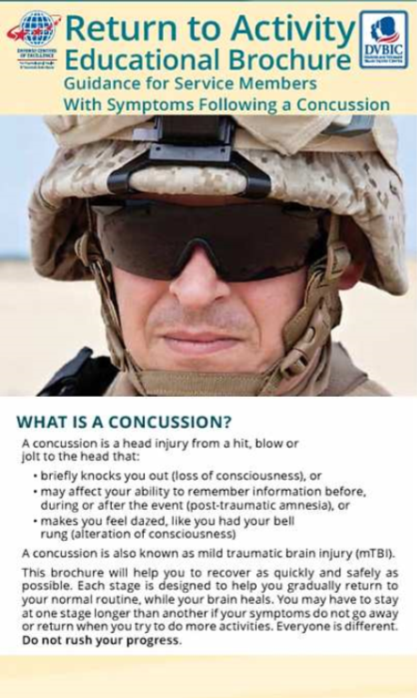
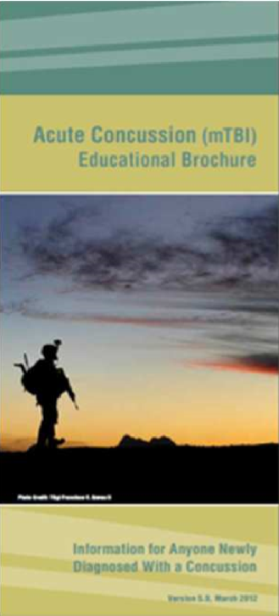
Resources
DVBIC.DCOE.MIL
Clinicians
Clinical Support Tools
Patients and Caregivers
Acute Concussion Educational Brochure
Return to Activity Education Brochure
Patient Activity Guidance After Concussion Sheets
Healthy Sleep Fact Sheet

Slide 26
Questions & Comments
Please fill out your anonymous survey to help inform this clinical education effort.
Thank you for your time and participation!
If you think of something later, please contact me at caroline_cleveland@med.unc.edu
Notes:
Goal: Share honest feedback on actual practice and anticipated practice
Photo by Oldak Quill http://commons.wikimedia.org/wiki/File:Section_through_olfactory_bulb_16_days_old_rat_brain.jpg

Slide 27
References
Acute Concussion Educational Brochure: Information for Anyone Newly Diagnosed With a Concussion. Version 5.0. DVBIC. 2012.
Alla S, Sullivan J, McCrory P. Defining asymptomatic status following sports concussion: fact or fallacy? Brit J Sports Med. 2012;46:562-569
Chapman JC, Diaz-Arrastia R. Military traumatic brain injury: a review. Alzheimer’s and Dementia. 2014;10:S97-S104.
Defense Centers of Excellence for Psychological Health and Traumatic Brain Injury. Concussion Management in Deployed Settings version 4.0. Published 2012. Available at https://health.mil/Search-Results?query=Concussion%20Management%20Algorithm. Accessed on February 12, 2018.
Defense Veterans Brain Injury Center. DoD Worldwide Numbers for TBI Worldwide Totals. 2017.
Defense and Veterans Brain Injury Center. Joint theater trauma system clinical practice guideline: Management of mild traumatic brain injury (mTBI)/concussion in the deployed setting. Joint Theater Trauma System; 2008:7-8.
Department of Defense Instruction 6490.11: Policy Guidance for Management of Mild Traumatic Brain Injury/Concussion in the Deployed Setting. Department of Defense, 2012.
DVBIC & DCoE for Psychological Health and Traumatic Brain Injury. Progressive Return to Activity Following Acute Concussion/ Mild Traumatic Brain Injury: Guidance for the Primary Care Manager in Deployed and Non-deployed Settings. DCoE Clinical Recommendation, 2014
DVBIC & DCoE for Psychological Health and Traumatic Brain Injury. Progressive Return to Activity Following Acute Concussion/Mild Traumatic Brain Injury: Guidance for the Rehabilitation Provider in Deployed and Non-deployed Settings. DCoE Clinical Support Tool, 2014.

Slide 28
References
Gaetz M, Iveron G. Sex differences in self-reported symptoms of aerobic exercise in non-injured athletes: implications for concussion management programmes. Br J Sports Med. 2009;43(7):508-513.
Giza C, Kutcher J, Ashwal S, et al. Summary of evidence-based guidelines update: evaluation and management of concussion in sports. Neurol. 2013;80(24):2250-2257.
Gregory E, West T, Cole W, et al. Use of a multi-level mixed method approach to study the effectiveness of a primary care progression return to activity protocol after acute mild traumatic brain injury/concussion in the military. Contemp Clin Trials. 2017;52:95-100.
Guidice R, Izzo R, Manzi M, et al. Lifestyle related risk factors, smoking status, and cardiovascular disease. High Blood Pressure & Cardiovas Prev. 2012;19(2):85-92.
Leddy J, Cox J, Baker J, Wack D, Pendergast D, Zivadinov R, Willer B. Exercise treatment for postconcussion syndrome: a pilot study of changes in functional magnetic resonance imaging activation, physiology, and symptoms. J Head Trauma Rehab. 2013;28(4):241-249
Lovallo W, Wilson M, Vincent A, et al. Blood pressure response to caffeine shows imcomplete tolerance after short term regular consumption. Hypertension. 2004;43:760-765
Lutz R, Kane S, Lay J. Evidence-based diagnosis and management of mTBI in forward deployed settings: the genesis of the USASOC neurocognitive testing and postinjury evaluation and treatment program. J Spec Oper Med. 2010;10(1):23.
Maerlender A, Rieman W, Lichtenstein J, Condiracci C. Programmed physical exertion in recovery from sports-related concussion: a randomized pilot study. Dev Neuropsychol. 2015;40(5):273-278
Management of Concussion/mTBI Working Group. VA/DoD clinical practice guideline for management of concussion/mild traumatic brain injury. J Rehabil Res Dev. 2009;46(6):CP1-68
McCrory P, Meeuwisse W, Aubry M, et al. Consensus statement on concussion in sport – the 4th International Conference on Concussion in Sport held in Zurich, November 2012. Br J Sports Med. 2013;47:250-258.
McCulloch K, Goldman S, Lowe L, et al. Development of clinical recommendations for progressive return to activity after military mild traumatic brain injury: guidance for rehabilitation providers. J Head Trauma Rehabil. 2015;30(1):56-67.

Slide 29
References
McKee A et al. Military-related traumatic brain injury and neurodegeneration. Alzheimer’s and Dementia. 10;3:S242-S253.
Neuroimaging following MildTraumatic Brain Injury in the Non-Deployed Setting. DcoE Clinical Recommendation, 2013.
Patient Activity Guidance After Concussion: Patient Education Tool. DVBIC. 2014.
Ponsford J, Willmott C, Rothwell A, et al. Impact of early intervention on outcome following mild head injury in adults. J Neurol Neurosurg Psych. 2002;73:330-332.
Return to Activity Educational Brochure: Guidance for Service Members with Symptoms Following a Concussion. DVBIC. 2017.
Silverberg N, Iverson G. Is rest after concussion “the best medicine?” Recommendations following concussion in athletes, civilians and military service members. J Head Trauma. 2013;28(4):250-259
Tanielian T et al. Invisible Wounds of War: Psychological and Cognitive Injuries, Their Consequences, and Services to Assist Recovery. Santa Monica, CA: RAND Corporation, 2008.
University of North Carolina at Chapel Hill. The University of North Carolina at Chapel Hill Sport Concussion Policy. NC: Matthew Gfeller Sport-Related TBI Research Center; 2010.
Williams V et al. Diagnoses of traumatic brain injury not clearly associated with deployment, active component, U.S. Armed Forces, 2001-2016. Medical Surveillance Monthly Report. 2017. 24;3:2-8.

