Slide 1
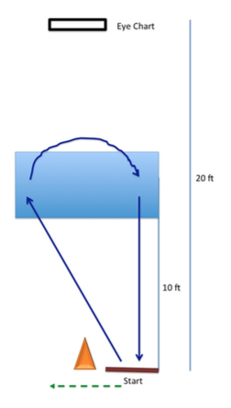
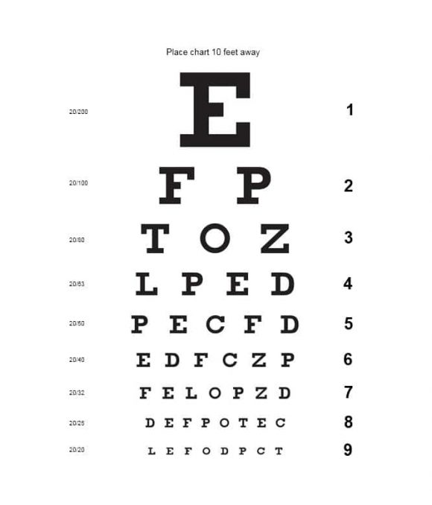
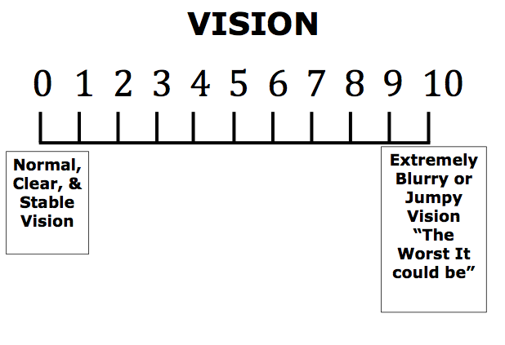
Characterization of Healthy Control Group in the Performance of the POWAR-TOTAL
Kellie Adams, SPT¹, Julianna Prim, MS¹, Amy Cecchini, DPT², and Karen McCulloch, PT, MS, PhD, NCS¹
¹Division of Physical Therapy, Allied Health Sciences, University of North Carolina at Chapel Hill, ²Geneva Foundation at Intrepid Spirit Center- Fort Bragg
Background
POWAR-TOTAL
Concussion History
The Portable Warrior Test of Tactical Agility (POWAR-TOTAL) is a dual-task performance-based assessment that will provide immediate feedback and requires minimal space, time, and technology
Ecologically valid and clinically feasible
Created with the future goal of aiding clinicians in determination of readiness to return-to-duty among service members
Dual-task performance highlights cognitive and motor deficits following mTBI
Demographic Data- Healthy Controls (n=45)
Age | 28.39 (SD= 7.09) years
Sex | Males: 41 subjects Females: 4 subjects
Time Serving | 7.25 (SD= 7.19) years
Deployments | 1.57 (SD= 2.55) deployments
Months Deployed | 10.27 (SD= 16.48) months
Prior Concussions | 2 (SD= 8) concussions, median=1 (0-50)
Sleep | 6.29 (SD= 1.15) hours
Table 2. Demographic Data of Healthy Controls
Motor component: getting up, running, combat roll, running backward, running forward, roll, running backward
Cognitive Component: grid coordinate working memory
Dual-task: motor and cognitive components performed together
Table 3. Healthy Control Differences Based on Concussion History
(t–test unless other wise noted, ^chi-square)
Variable | No History of mTBI (n= 22) | History of 1+ mTBI (n=23) | Group Differences
Visual Acuity (pre-test) | 8.36 (1.68) | 8.43 (1.24) | p= 0.87
Vision Clarity (pre-test) | .50 (0.96) | 1.52 (1.78) | p= 0.02*
ST Motor trial (sec) | 13.45 (2.18) | 14.28 (1.73) | p= 0.16
ST Cognitive task (of 8) | 7.09 (1.44) | 6.78 (1.31) | p= 0.46
Avg DT Motor (sec) | 13.50 (2.51) | 14.04 (1.71) | p= 0.40
Avg DT Cog (of 8) | 6.21 (1.38) | 6.25 (1.49) | p= 0.94
DT Cost Motor | -0.002 (0.06) | 0.01 (0.07) | p= 0.41
DT Cost Cognitive | -0.08 (0.31) | -0.05 (0.28) | p= 0.77
Visual Acuity post-test | 8.36 (1.71) | 8.39 (1.47) | p= 0.95
Visual Clarity post-test | 0.82 (1.30) | 1.87 (1.71) | p= 0.03*
Deployment History Yes(No) | 5 (17) | 14(9) | p= 0.01*^
Objectives
Research Assistant (at start of trial)
“Charlie-Tango-8-4-5-1-9-2”
“Charlie-Tango-8-4-5-1-9-2”
Characterize and measure performance of the healthy control group to understand prioritization of motor vs. cognitive tasks during a dual-task assessment
Participant recites words & numbers recalled at end of trial
Results
Dual-task Effect = (single-task value–dual-task value) x100
single-task value
Methods
Participants: 45 healthy active-duty service members with the following criteria: absence of brain injury in the past two years, no history of severe TBI, status deemed deployable
Vision test, 2 single motor trials, single cognitive task (grid-coordinate memorization), 3 dual-task trials (motor & cognitive), vision test
Conclusions
Healthy controls demonstrate minimal dual-task motor interference in the POWAR-TOTAL task, demonstrating on average 10% cognitive dual-task cost. A history of >1 concussions is associated with history of deployments and self-report of reduced visual clarity prior to and after test trials. Healthy active duty individuals prioritization of attention in this task provides a comparison for service members recovering from mTBI. This data will assist in the establishment of guidelines for determination of return-to-duty readiness using the POWAR-TOTAL.
Table 1. Mean Single-Task (ST), Dual-Task (DT) components, and Dual-Task Costs for Healthy Control Subjects
Trial | Mean (SD)
Single Task Cognitive (of 8) | 6.93 (SD= 1.37) coordinates
Single Task Motor | 13.87 (SD= 1.98) seconds
Dual-Task Cognitive (of 8) | 6.23 (SD= 1.42) coordinates
Dual-Task Motor | 13.78 (SD= 2.13) seconds
Dual-Task Motor Cost | 0.01 (SD= 0.06) seconds
Dual-Task Cognitive Cost | -0.10 (SD= 0.29) coordinates
The views expressed herein are those of the author(s) and do not reflect the official policy of the Department of the Army, Department of Defense, or the U.S. Government.
This work was funded by the Department of Defense, W81XWH-17-2-0046
Healthy controls demonstrated prioritization of motor performance over cognitive performance. Of those subjects that prioritized motor performance, there was a concurrent dual-task cognitive cost in 13 subjects, while 21 subjects performed better in dual-task conditions for both motor and cognitive performance.
This work was funded by the Department of Defense, W81XWH-17-2-0046
This work was funded by the Department of Defense, W81XWH-17-2-0046

