Slide 1
The Influence of
Background and External Exposures on Non-Cognitive Traits in Doctor of Physical Therapy Applicants
Conor McClure, SPT
Dr. Marcus Roll, PT, DPT, NCS, CBIS
Dr. Chad Cook, PT, PhD, MBA, FAPTA
Cannon Hanebuth, SPT
Daniela Ortiz, SPT
Dr. Deborah Givens, PT, DPT, PhD

Slide 2
Why Non-Cognitive Traits?
Emotional intelligence correlates with grade point average in nursing students
  Sharon and Grinberg, 2018
Emotional intelligence correlates with academic success in medical students
  Cook CJ, Cook CE, Hilton TN, 2016
Improved patient outcomes and adherence to treatment plans when clinicians possess desirable non-cognitive traits
  Koenig et al., 2013
The biopsychosocial model and psychologically informed practice require:
Patient-centered care
Interpersonal skills
Strong therapeutic alliance
  Keefe FJ, Main CJ, George SZ, 2018
Therapeutic alliance:
Personal flexibility, confidence, conscientiousness, extraversion, tolerance for ambiguity, grit, etc.
“Therapist effect” on chronic disease, pain?
Ackerman SJ, Hilsenroth MJ, 2003
Buining et al., 2015
Kooijman et al., 2019

Slide 3
Background: Previous research
“A novel tool for evaluating non-cognitive traits of doctor of physical therapy learners in the United States” (Roll et al., 2018)
“Non-cognitive traits”
  Emotional intelligence
  Interpersonal skills
  Social intelligence
  Psychological flexibility
  Grit
  Etc.
Cross-sectional survey study
  Duke, Colorado, Indianapolis universities
  Cohort: 298 first- and second-year DPT students

Slide 4
Background: Development of Survey
Developed using items from non-proprietary, non-cognitive measures:
Schutte Self Report Emotional Intelligence Test
Interpersonal Reactivity Index (IRI)
Intolerance of Uncertainty Scale (IUS)
Measuring Social Intelligence (MSI)
Psychological Flexibility Questionnaire
Short Grit Scale (Grit-S)
Face Validity:
  143 items → 68 items
Dimensional analysis:
  SPSS (IBM, ver. 24.0)
  68 items → 39 items
Three latent non-cognitive domains:
Adaptability (16 items)
  Intolerance of Uncertainty Scale
  Psychological Flexibility Questionnaire
Intuitiveness (12 items)
  Schutte Self Report Emotional Intelligence Test
  Measuring Social Intelligence Short Grit Scale
Engagement (11 items)
  Interpersonal Reactivity Index
  Psychological Flexibility Questionnaire

Slide 5
Purpose
If desirable non-cognitive traits associate with improved academic performance, occupational performance, and clinical outcomes...
How can we predict and identify aspiring healthcare professionals who might possess these traits?
- - -
“Examine the relationship of background and previous experiential exposures on the development of non-cognitive traits such as emotional intelligence, interpersonal skills, and psychological flexibility in Doctor of Physical Therapy applicants.”

Slide 6
Methods: Initial Steps
Survey administered to DPT applicants at Duke University
  Class of 2022 (n = 174)
  92% completed survey (n = 160)
  Qualtrics survey
  Research purposes, would not affect admission decision
Descriptive and demographic information extracted from Physical Therapy Centralized Application Service (PTCAS)
  Deidentified — name → numerical identifier

Slide 7
Methods: Data Extraction
Background characteristics via PTCAS included:
Age
Gender
Underrepresented minority status
First generation in one’s family to attend college
Physical therapy shadowing hours
  Paid
  Volunteer
  Total
Prior applicant to DPT program
From a school district where 50% of less of graduates go to college
Graduated from a high school from which a low percentage of seniors received a high school diploma
Family lives in a medically underserved area
Family receives public assistance
English as a second language
Military experience
Undergraduate school ranking by U.S. News

Slide 8
Methods: Data Analysis
Qualtrics and PTCAS data compiled into Excel document
SPSS (IBM Corp., Armonk, NY, USA)
  Roll & Cook
Population means and standard deviations: T-test
Continuous variables: Pearson coefficient
Dichotomous variables: Phi coefficient
Statistically significant: p < .05
Extreme non-cognitive domains: Survey response of 1 or 5 on Likert Scale

Slide 9
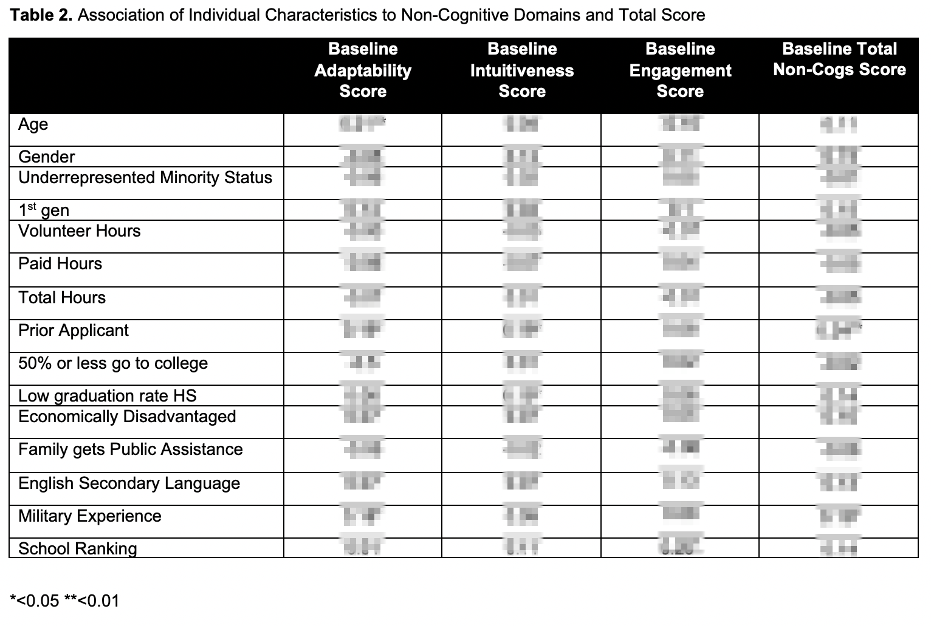
Results: Characteristics ⇄ Non-Cog Domains
Notes:
Numerical results have been intentionally “censored” until final publication.

Slide 10
Results: Characteristics ⇄ Non-Cog Domains
Adaptability
  Age (p < .01)**
  Prior applicant (p < .05)*
  Military experience (p < .05)*
Intuitiveness
  Prior applicant (p < .05)*
  Low graduation rate high school (p < .05)*
Engagement
  Undergraduate school ranking (p < .05)*
Total Non-Cognitive Score
  Prior applicant (p < .01)**
  Military experience (p < .05)*

Slide 11
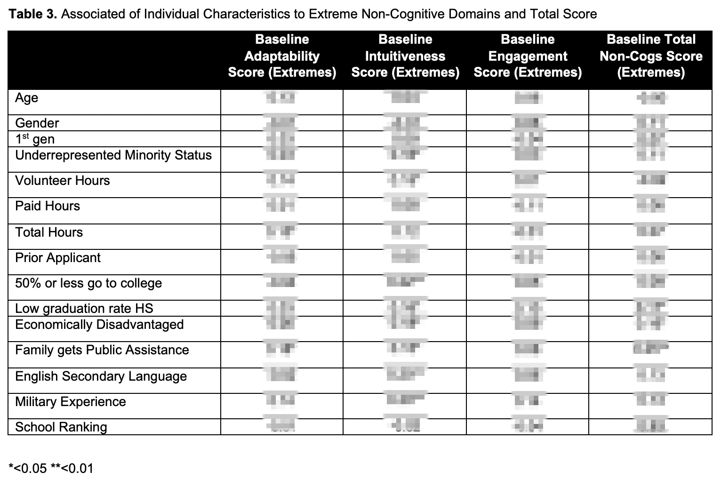
Results: Characteristics ⇄ Extreme Non-Cog Domains
Notes:
Numerical results have been intentionally “censored” until final publication.

Slide 12
Results: Characteristics ⇄ Extreme Non-Cog Domains
Adaptability
  Total shadowing hours (p < .05)*
  Family receives public assistance (p < .05)*
Intuitiveness
  50% or less high school graduates go to college (p < .01)**
  English as a second language (p < .01)**
  Military experience (p < .01)**
  Underrepresented minority status (p < .05)*
  Low graduation rate high school (p < .05)*
  Socioeconomically disadvantaged area (p < .05)*
  Family receives public assistance (p < .05)*
Engagement
  N/A
Total Non-Cognitive Score
  Low graduation rate high school (p < .05)*
  Socioeconomically disadvantaged area (p < .05)*
  Family receives public assistance (p < .05)*

Slide 13
Discussion
Many positive correlations, but generally weak.
Background Characteristics and Non-Cognitive Domains:
  Common themes:
    Prior applicant to DPT program
    Military experience
Background Characteristics and Extreme Non-Cognitive Domains:
  Common themes:
    Family and areas with poor socioeconomic status
    Areas with poor high school graduation rates, college admissions
    English as second language and minority status

Slide 14
Discussion, cont.
Unanswered Questions:
Do these characteristics reliably predict desirable non-cognitive traits?
  Significant, but not strong, associations
Are background characteristics useful for admissions committees?
Do environmental factors develop desirable traits or simply select for desirable traits?
Is extreme response style (top and bottom 15% in total non-cog scores) in this survey a desirable trait?
Limitations:
Length of survey
Survey taken on interview day
Survey answered honestly?
Limited to PTCAS data

Slide 15
Future Directions
Survey will continue to be administered to incoming classes
  Analysis might benefit from larger and more diverse cohorts
Multivariate analysis?
“Nature vs. Nurture”
  Relative contributions of environment and heritability
Concurrent Validity:
  Track cohorts over time
  Investigate non-cognitive correlations with:
    Academic performance
    NPTE pass rates
    Become clinical instructor?
    Join residency program?

Slide 16
Acknowledgements
Dr. Marcus Roll, PT, DPT, NCS, CBIS
Dr. Chad Cook, PT, PhD, MBA, FAPTA
Cannon Hanebuth, SPT
Daniela Ortiz, SPT
Dr. Deborah Givens, PT, DPT, PhD

