Slide 1
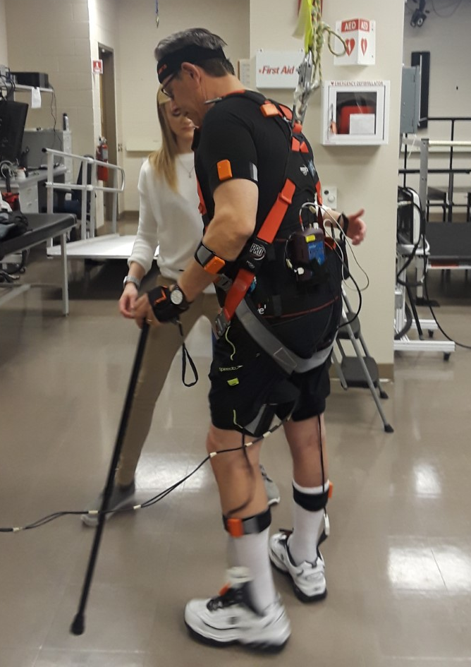
Predicting Trips During Walking for Individuals Post-Stroke
Division of Physical Therapy
Kristen Massey, SPT, Kristen Shumaker, SPT, Michael Lewek, PT, PhD
University of North Carolina at Chapel Hill
Introduction
Treadmill & Over Ground Walking
Falls are the leading cause of impaired functional independence and community mobility after stroke¹
Consequences of falls include fractures, fear of falling, disability, and psychosocial issues^{1,2}
Trips and trip-related falls are highly prevalent after stroke, particularly during walking
Caused by intrinsic or extrinsic factors²
Determining cause of trip-related falls can lead to fall prediction
Prediction of falls can lead to improved prevention interventions
Walking trials
Split-belt treadmill vs. over ground
30-60 second trials
Induction of trips
Cognitive challenge (dual task)
Altered walking speed
Removal of bracing and handrails
Head turns
GRF and joint kinematic measurements
Vicon motion capture system, force plates (treadmill)
Moven and Pedar systems (over ground)
Discussion
Purpose
Results
Falls after stroke are commonly associated with inattention or divided attention during a task (i.e. walking).³
External distractions requiring head turns or turning are one of the most common causes of falls after stroke.
Potentially due to:
reduced attentional resources
inability to direct those resources to separate tasks simultaneously.⁴
Participants only tripped when walking without the use of an assistive device (cane, handrail).
After stroke, individuals who use walking aids have been found to use slower gait speeds compared to individuals who walk independently. Walking aids improve community ambulation, stability, and help prevent falls.⁵
Participant trips also occurred in later trials for both treadmill and over ground walking, most likely attributed to fatigue, a common contributor to trips/falls in patients post-stroke⁶
Delayed occurrence of trips also attributed to participant’s slow development of trust in overhead safety harness and willingness to trip
Purpose: To predict when a trip will occur based on intrinsic factors during gait
Baseline Testing;
no medical clearance for walking exercise
Methods
Baseline Testing + Treadmill Testing + Overground Walking
Participant Demographics/Inclusion Criteria
Study sample | n = 6 (5 male)
Time since stroke | > 6 months
Assistive Device | AFO (n = 2), cane (n = 2)
History of falls | > 1 in past 6 months
Walking requirements | Uninterrupted, unassisted > 2 minutes Speed 0.4-1.2 m/s
Physical impairment | LE hemiparesis
Baseline Testing;
Too high functioning; No trips
Baseline Testing + Treadmill Testing; No trips
References
Baseline Testing and Outcome Measures
Trip Promoting Strategies
Salot P, Patel P, Bhatt T. Reactive Balance in Individuals With Chronic Stroke: Biomechanical Factors Related to Perturbation-Induced Backward Falling. Phys Ther. 2016;96(3):338-347
Weerdesteyn V, de Niet M, van Duijnhoven HJR, Geurts ACH. Falls in individuals with stroke. J Rehabil Res Dev. 2008;45(8):1195-1213.
Schmid AA. Circumstances and consequences of falls among people with chronic stroke. Journal of rehabilitation research and development. 2013;50(9):1277-1286.
Chan, W N, Tsang NW. The performance of stroke survivors in turning-while-walking while carrying out a concurrent cognitive task compared with controls. Plos One. 2017;1 (12).
Ricci N. A., Ferrarias G. P., Molina K. I., Dib P. M., & Alouche S. R. Gait speed and falls self-efficacy in individuals with hemiparesis after stroke. Fisioterapia e Pesquisa, 2015;22(2), 191-196.
Rybar MM, Walker ER, Kuhnen HR, et al. The stroke-related effects of hip flexion fatigue on over ground walking. Gait Posture. 2014;39(4):1103-1108. doi:10.1016/j.gaitpost.2014.01.012
MMT, ROM, reflex testing
Fugl-Meyer (LE)
Stroke Impact Scale (SIS)
Activities-Specific Balance Confidence Scale (ABC)
Berg Balance
4 Square Step Test
Star Cancellation Test
Self-selected gait speed (comfortable, fast)
93…86…79…
Change speeds
Head turns
Cognitive challenge
Remove bracing
and assistive devices
Funding provided by NIH/NICHD (R21 HD098570)

