Slide 1
Back School: Therapist’s Instructions
The information in this handout can be used to help educate your patients on how to manage their low back pain. This guide can be used with the patient handout. General information about low back pain, risk factors, structure and function of the spine and correct posture and movement are provided. It is important to understand that not all parts of this handout will be necessary to teach your patients. Use your judgment to determine which parts will be beneficial for your patients. You may incorporate additional treatment interventions such as modalities and therapeutic exercises as needed.
Contents
Part 1: Structure and Function of the Spine Pg. 2
Part 2: Overview of LBP and Risk Factors Pg. 3
Part 3: Management of LBP – Activity Pg. 4
Part 4: Management of LBP – Posture Pg. 5-6
Part 5: Management of LBP – Lifting Pg. 7

Slide 2
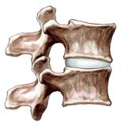
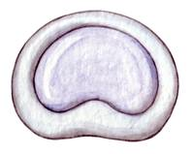
Part 1: Structure and Function
Explain the anatomy of the spine including a general introduction of the vertebrae and its components, nerves and muscles.
Describe the protective, supportive and movement functions of the spine.
Discuss how low back pain is typically caused by normal wear and tear of these structures and how this can cause pain and interfere with the functions of the spine.

Slide 3
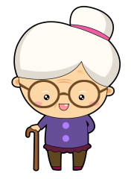
Part 2: Overview and Risk Factors
Explain to the patient that low back pain is common and can typically be managed with self-care.
Discuss risk factors for low back pain including non-modifiable (age and genetics) and modifiable (improper body mechanics, poor activity levels, weight gain, and smoking) risk factors.
Suggest lifestyle changes that could help prevent future low back pain episodes such as using proper body mechanics, exercising regularly, eating a healthy diet or quit smoking.

Slide 4
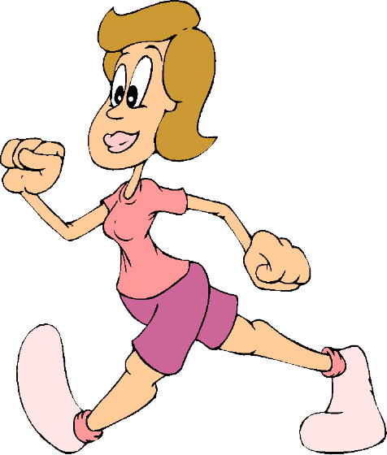
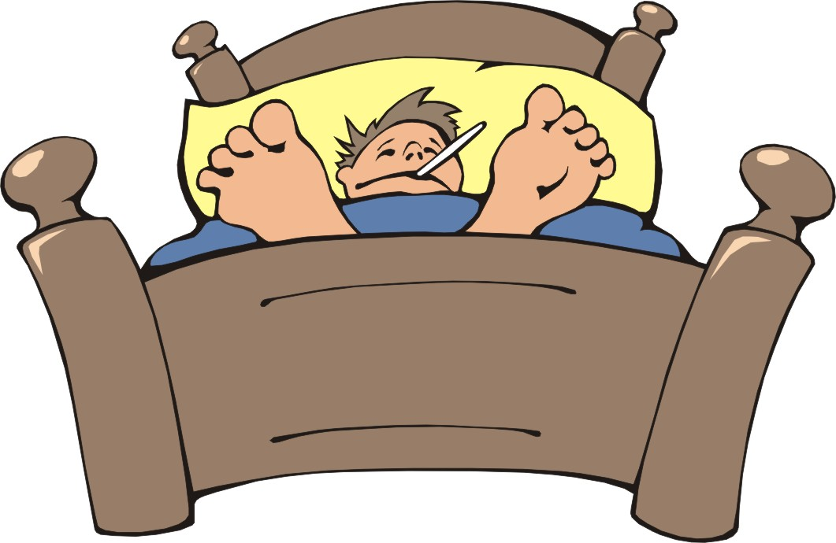
Part 3: Activity
Encourage the patient to participate in aerobic exercise regularly such as walking to help manage low back pain.
Explain that activity helps keep the muscles strong and supportive.
Help the the patient understand that bed rest should be limited and that this could make the back pain worse. However, inform patients to avoid activities that aggravate their pain.

Slide 5
Part 4: Posture
Sitting Posture
Demonstrate bad sitting posture and explain to the patient why these positions are not good for the spine.
Demonstrate and describe good sitting posture. Patients should sit on surfaces where both their feet can rest comfortably on the floor and hips positioned slightly higher than the level of the knees.
You may provide the patient with different cues and techniques to help facilitate good posture such as placing a rolled towel behind the low back in sitting.

Slide 6
Part 4: Posture
Standing Posture
Demonstrate bad standing posture and explain to the patient why these positions are not good for the spine.
Demonstrate and describe good standing posture, emphasizing the protective mechanism of the normal physiologic curves of the spine.
Provide the patient with different cues and techniques to help facilitate good standing posture such as keeping feet hip-distance apart and bearing weight equally on both feet.

Slide 7
Part 5: Lifting
Lifting Objects
Define, instruct and practice proper lifting mechanics.
Emphasize avoiding twisting of the spine or bending at the waist.
Provide the patient with cues such as holding the object close to their body and near waist height before lifting.
Suggest to the patient that if the object is too heavy to lift try pushing, pulling or asking a friend for help.

Slide 8
Final Thoughts
The therapist should remember to educate a patient only on the sections of this handout that apply to that patient. Recall that this information is only a guide and the therapist should include additional educational and treatment interventions as needed.

