Slide 1
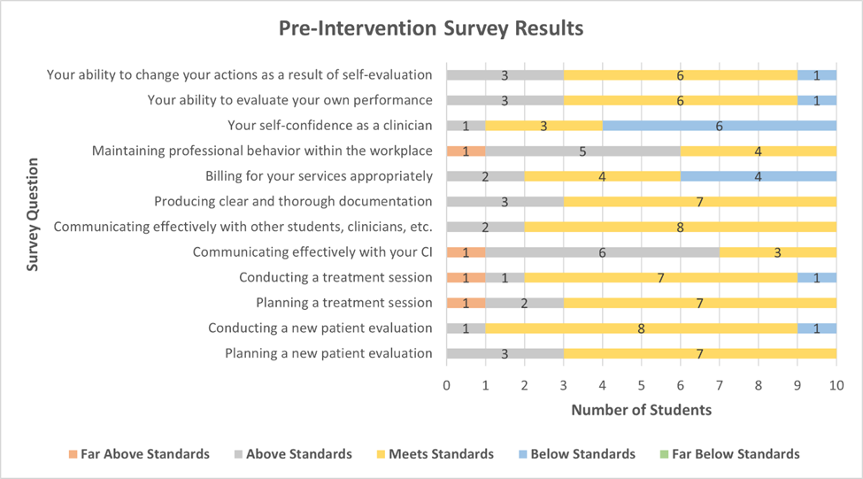
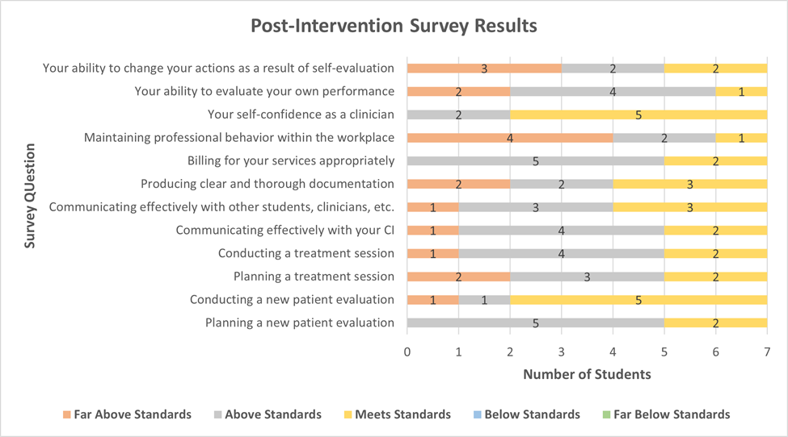
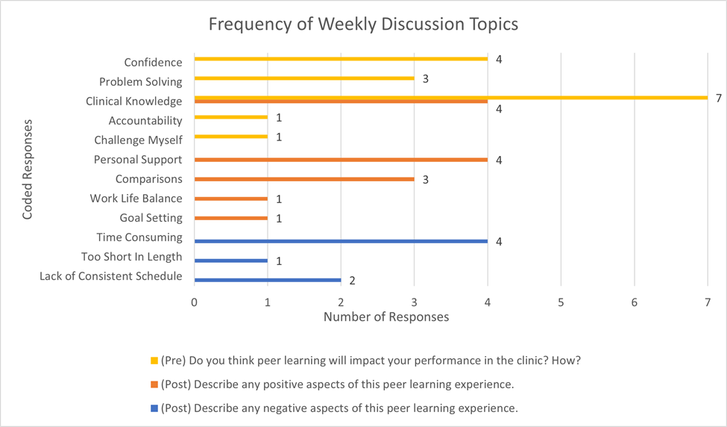
The Efficacy of Peer Learning on DPT Student Confidence
with Clinical Effectiveness
Tejasee Phatak, SPT; Division of Physical Therapy, University of North Carolina Chapel Hill
Faculty Advisor: Lisa Johnston, PT, MS, DPT
INTRODUCTION
RESULTS
CONCLUSIONS
.
.
Self-perceived improvements were identified in several aspects of clinical education, however, the improvements cannot be entirely attributed to the PBL experience. Increased time in a clinical environment would logically contribute to the reported improvements. Since students who did not participate in this study did not complete the surveys, it is unreasonable to conclude that the two groups performed significantly differently. Several students stated they were optimistic that the PBL experience would provide them with ideas to apply to patient care. While patient care was discussed in all 4 weeks and stated as a positive factor of PBL, “personal support” was listed as the greatest incentive for participating in a future PBL experience. Personal support was provided to build each others’ self-confidence. This support later evolved to involve concepts of independence, self-advocacy, and work-life balance.
Students stated that a PBL experience would be more beneficial in the first year of the curriculum, when personal support is more valued. Using PBL during the third year was reported to be time consuming, and students noted they were busy with other academic coursework simultaneously.
Peer-based learning (PBL) has been used as an educational tool in various formats over time. Team-Based Learning (TBL)^{1,} Reciprocal Peer Coaching (RPC)², multiple student to instructor ratio models, and many other strategies have been studied for the contributions they make to clinical education.
While extensive research has been conducted surrounding PBL in the clinic, studies are lacking about PBL outside the clinical environment. Concerns about adequate staffing³, meeting productivity standards⁴, and CI stress³ have limited widespread implementation of the 2:1 model. This study examines students’ opinions about how peer discussions outside the clinical environment shape their clinical confidence and knowledge.
Figure 1: 3.33% of participants reported a certain skill was Far Above Standards, 26.67% Above Standards, 58.33% Meets Standards, and 11.67% Below Standards. No students responded in the Far Below Standards category for any of the questions. As displayed in Figure 1, 60% of students felt they were Below Standards in “Your self-confidence as a clinician,” and 40% of students felt they were Below Standards in “Billing for your services appropriately.” The four responses of Far Above Standards were in the categories of professionalism, communication with the CI, planning a treatment session, and conducting a treatment session.
Figure 2: 20.24% of participants reported a certain skill was Far Above Standards, 44.05% Above Standards, and 35.71% Meets Standards. No students responded in the Below Standards or Far Below Standards categories. Per Figure 2, the highest frequency of Far Above Standards responses were in “Maintaining professional behavior within the workplace” and “Your ability to change your own actions as a result of self-evaluation.” 100% of students responded at a level of Meets Standards or above for the “self-confidence” and “billing” questions, which had the greatest percentage of Below Standards responses prior to the PBL experience.
METHODS
.
Participants were recruited from the UNC DPT Classes of ‘21 and ‘22. Ten students volunteered. Students self-selected a partner in a similar clinical setting. The resultant pairs included two inpatient, two outpatient, and one mixed-setting pair.
Pre- and post- intervention surveys were administered for students to rate themselves in various clinical aspects on a five-point Likert scale. Both surveys included three open-ended questions about the students’ initial opinions of PBL, pros and cons of PBL, and the structure of the intervention. The students participated in a four-week PBL intervention. They were required to meet at least once per week to discuss topics related to their experiences during their concurrent clinical experience. Suggested discussion topics were emailed to participants in advance of the week, though students were instructed to speak about any topic they wish regarding their experiences. Students submitted a brief Weekly Discussion Form to inform the primary investigator (PI) regarding the topics they spoke about. At the conclusion of the four weeks, students participated in a phone call with the PI to collect additional information about the PBL experience including their suggestions for altering PBL interventions administered in the future.
.
STUDENT REFLECTIONS
Pre-PBL:
“I believe it will boost my confidence and help me problem solve my struggles/issues I am facing.” (Student A1)
“I believe it could add a level of accountability, leading me to challenge myself in clinic…” (Student A6)
Post-PBL:
“It was nice to discuss patient cases with another student who is in a similar situation and compare productivity and caseload to know that we are somewhat similar at this point.” (Student B2)
“Just tough sometimes to fit in one more thing throughout the week when we're already juggling Capstone, classes, clinicals, and some of us jobs or a social life.” (Student B6)
Figure 3: The qualitative data was coded by the PI and faculty advisor. Students expected their clinical knowledge to improve the most after participating in the PBL intervention (7 responses). Confidence (4) and problem-solving skills (3) were also predicted to improve. Clinical knowledge (4), personal support (4), and the ability to compare oneself with a peer (3) were the most frequently reported positives of PBL. On the other hand, the negatives were noted to be the time-consuming nature of PBL (4), lack of consistent schedule (2), and short length of intervention (1).
REFERENCES
Huang C-Y, Wang Y-H. Toward an Integrative Nursing Curriculum: Combining Team-Based and Problem-Based Learning with Emergency-Care Scenario Simulation. Int J Environ Res Public Health. 2020;17(12). doi:10.3390/ijerph17124612
Matthewman LJ. Reciprocal peer coaching: A constructivist methodology for enhancing formative assessment strategy in tertiary education. International Coaching Psychology Review. 2017;13(1).
Timmerberg, J.F & Stolfi, A.M. (2014) Perceived challenges in clinical education: Perspectives from various stakeholders. Combined Sections Meeting. Las Vegas.
Ladyshewsky RK, Bird N, Finney J. The impact on departmental productivity during physical therapy student placements: An investigation of outpatient physical therapy services. Physiotherapy Canada. 1994;46(89-93).

