Slide 1
How to Recognize Motor Impairments: A Resource for Educators
Alexis Nottage, SPT

Slide 2
Objectives
Define motor impairment and be familiar with common diagnoses that contribute to motor impairments.
Understand the role of classroom teachers in identifying motor impairments.
Identify common motor impairments within the classroom.
Define each component of the M.A.T.C.H. strategy and discuss implementation at each part.
Describe the proper seating posture and position for children in the classroom and brainstorm ways to achieve better posture through seating options.

Slide 3
What is a motor impairment?¹
Difficulty performing a movement or loss of function in a body part or limb
Examples:
Falling or tripping
Falling out of chair when raising hand
Difficulty with handwriting
Notes:
https://medium.com/nyc-design/web-accessibility-for-physical-or-motor-impairments-4fe5e170e375

Slide 4
What is a motor delay?²
When children are unable to do something that most other children their age are able to do
Examples:
Not being able to jump at recess with other children
Inability to use scissors
Notes:
http://clipart-library.com/jumping-rope-cliparts.html

Slide 5
Fine Motor vs. Gross Motor³
Small muscle groups
Turning a page
Handwriting
Using scissors
Large muscle groups
Walking
Jumping
Hopping
Running
Catching
Kicking a ball
Ascending/descending stairs
Balance
Body Awareness

Slide 6
What contributes to motor delay?⁴
Premature birth
Genetic causes
Down Syndrome
Neurologic disorders
Muscular dystrophy
Cerebral palsy
Developmental Disorders
Autism
Developmental Coordination Disorder
Hormonal Causes
Hypothyroidism
Lack of exposure to gross motor activity
Often observed in the preschool population
Worsened by the pandemic
Notes:
Many different factors can contribute to motor delay
DCD is one of them, but the signs of DCD can also signal motor impairment or dyspraxia generally, so we will view signs of motor impairments (which are signs and symptoms of DCD) generally throughout the presentation

Slide 7
Developmental Coordination Disorder⁵
5-6% of school-aged children
Can occur on it’s own or present with learning disabilities, speech/language impairments, and/or attention deficit disorder

Slide 8
Teachers’ Beliefs About Identification⁶
A survey in Australia looked at key stakeholders and their familiarity with DCD
82% of teachers believed they should play a role in identifying warning signs of the disorder
80% believed children have been labeled as lazy or defiant when motor skill impairments were contributing to their behavior

Slide 9
The Role of Classroom Teachers
Classroom teachers often identify children with motor problems⁷
More likely to identify motor problems in the absence of disruptive behavior rather than in the presence of disruptive behavior⁷
More likely to recognize gross motor impairments compared to fine motor impairments⁷
When compared to parent reports of motor competence
Teachers identified difficulties associated with balance while parents⁸ identified balance and manual dexterity components⁸
Notes:
Stress importance of recognizing these signs as potential motor delay, as it can be a threat to a child’s success in school if they are labeled as “lazy” or “defiant”
More likely to identify motor problems in absence of disruptive behavior compared to when disruptive behavior is present
Disruptive behavior seems to play a role in masking the attention that motor problems receive

Slide 10
Signs of Motor Impairment⁵
Poor muscle strength (especially in the core muscles)
Slouching/slumping
Sliding out of chairs
Leaning to one side
Problems with fine motor skills (lack of hand strength)
Gripping a pencil
Too much pressure on paper
Difficulty using scissors
Notes:
fine motor skills (e.g., pre-printing tasks, cutting with scissors, doing up buttons or zippers), or both.

Slide 11
Signs of Motor Impairment⁵
Clumsiness/Awkwardness
Knocking objects over, bumping into obstacles, spilling
Balance
Poor balance when walking around classroom
Avoid activities at recess that require balance
Notes:
The child may appear to be clumsy or awkward in his/her movements.
He/She may bump into, spill or knock things over frequently.

Slide 12
Signs of Motor Impairment⁵
Difficulty with Gross Motor Skills
Ball catching, jumping, skipping, running
More difficulty with activities that require response to changes in environment
Sports, jumping rope
Increased difficulty when both sides of the body need to work together
swinging a bat, climbing at recess
Notes:
The child may experience difficulty with gross motor skills (e.g., running, hopping, climbing),

Slide 13
Signs of Motor Impairment⁵
Emotional/Behavior Characteristics
Uninterested or avoid physical activities
frustration , decreased self-esteem, lack of motivation
Avoid socializing with peers especially on playground
Dissatisfied with performance
Resistant to changes in routine
Notes:
The child may avoid or appear to be uninterested in particular activities, especially those that require physical activity. The child may experience secondary emotional problems, such as low frustration tolerance, decreased self-esteem, and lack of motivation.

Slide 14
Signs of Motor Impairment⁵
Difficulty with Activities of Daily Living:
Dressing
Eating using utensils
Difficulty with Instructions and Organization;
Requires more effort and coordination to get materials out, stay organized, and plan ahead
Results in difficulty completing work on time
Notes:
The child may have difficulty learning new motor skills. Once learned, however, certain motor skills may be performed quite well while others may be performed poorly.
The child may have difficulty with activities of daily living. For example, dres

Slide 15
In the absence of other issues…
Such as:
Academics
Intellectual
Language
All other skills may be strong, with just motor skills seeming delayed.
Notes:
The child’s motor skills might not match his/her abilities in other areas. For example, intellectual and language skills may be quite strong while motor skills are delayed.

Slide 16
Participation Patterns in Children with DCD⁹
Children with DCD had:
Limited participation diversity
Participated less frequently
Opted for more quiet activities that were more socially isolated
Notes:
Puts this population at risk, as social-emotional learning is important and having relationships with other students in their class will aid in their success

Slide 17
Case Study: Lauren, a 5th grade student¹⁰
Lauren is a diligent worker who tries very hard to please her parents and her teachers. She attends well in class and works well independently. She has tremendous difficulty in completing written work, whether in printing or writing. She sits rigidly at her desk, holds her pencil in a very tight grasp and frequently puts holes in the paper due to the pressure she puts on her pencil. She erases her work excessively. She appears to be very anxious in class and gets quite teary several times a week. She has one friend who is in another class that she plays with consistently at recess, but otherwise keeps to herself. Her parents are concerned as Lauren frequently says she doesn’t feel well and doesn’t want to go to school. She often cries in the morning before the bus arrives to take her to school.

Slide 18
Teacher Observations¹⁰
Lauren is a diligent worker who tries very hard to please her parents and her teachers. She attends well in class and works well independently. She has tremendous difficulty in completing written work, whether in printing or writing. She sits rigidly at her desk, holds her pencil in a very tight grasp and frequently puts holes in the paper due to the pressure she puts on her pencil. She erases her work excessively. She appears to be very anxious in class and gets quite teary several times a week. She has one friend who is in another class that she plays with consistently at recess, but otherwise keeps to herself. Her parents are concerned as Lauren frequently says she doesn’t feel well and doesn’t want to go to school. She often cries in the morning before the bus arrives to take her to school.
Notes:
Lauren exhibits some warning signs of difficulty with motor skills

Slide 19
What can we do?¹⁰
M.A.T.C.H
M - modify the task
A- alter your expectations
T - teaching strategies
C - change the environment
H - help by understanding

Slide 20
Modify the Task¹⁰
Handwriting
Copy notes and allow student to highlight information
Scissors
Pre-cut student’s materials but allow them to attempt to cut something out to practice
Recess
Facilitate inclusion in games and play with alternatives to activities that they cannot do
Provide large or underinflated balls to make throwing/catching tasks easier

Slide 21
Alter Your Expectations¹⁰
How much the student can do
To what level the student can complete the task
If working on speed, lower expectations on quality of product
If working on accuracy, allow more time for student to complete the task

Slide 22
Teaching Strategies¹⁰
Place students into groups with similar abilities
Emphasize fun and participation
Keep activities as routine as possible
Have children self-evaluate how much time they spend on a task to facilitate time management skills
Break activities into smaller parts or steps
When demonstrating a new skill to the class, allow the child in question to demonstrate the skill with hand-over-hand instruction

Slide 23
Change the Environment¹⁰
Seating
More on next slide
Provide visual cues/labeling to help keep desk organized
Reduce the amount of movement that is required to complete an activity to help reduce fatigue

Slide 24
Seating
Seating
Closer to board or to teacher
Seat child toward the end of the row to reduce barriers and obstacles for tripping
In close proximity to a buddy that could help
Facilitates social learning
Allow student to work in different positions
Sitting or standing

Slide 25
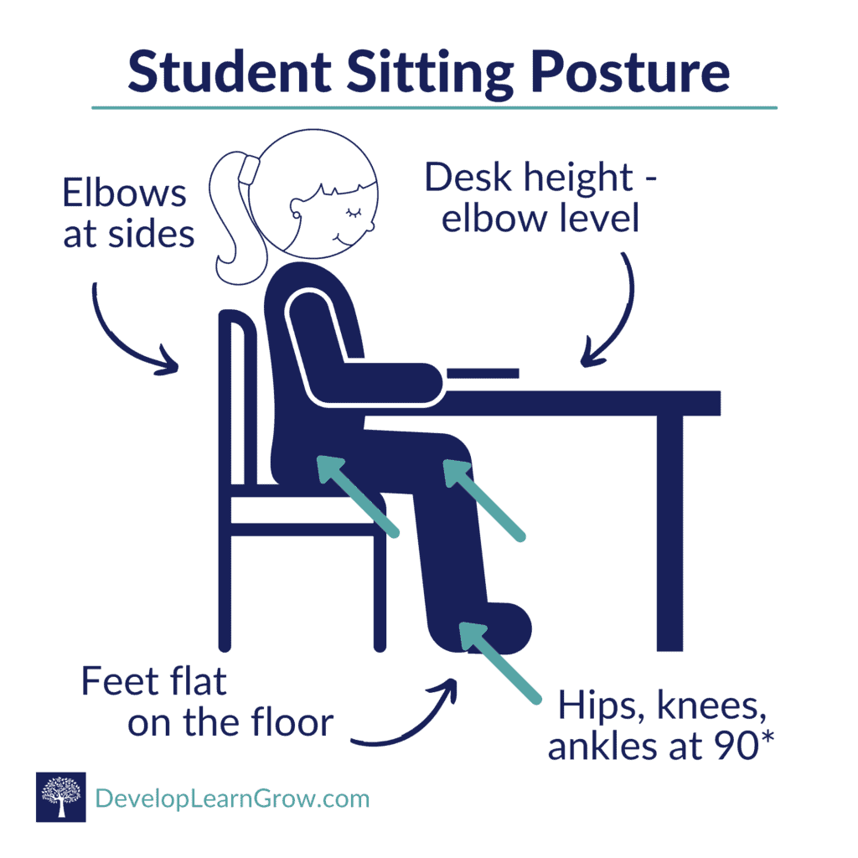
Seating¹¹
Uses core muscles
Good breathing mechanics = more oxygen to the brain
Supports good handwriting
Feet flat on floor provides stability
Reduces fatigue and allows hands to move freely
Notes:
https://developlearngrow.com/correct-sitting-posture-for-your-student/

Slide 26
Seating
If feet aren’t touching floor…
Use textbooks or object underneath feet to promote stability

Slide 27
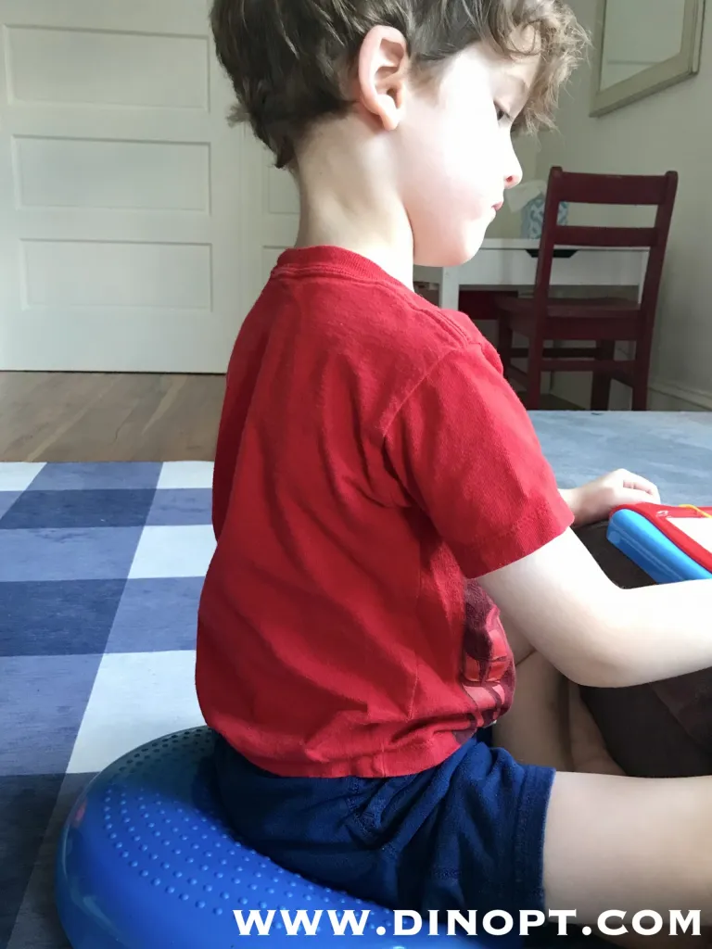
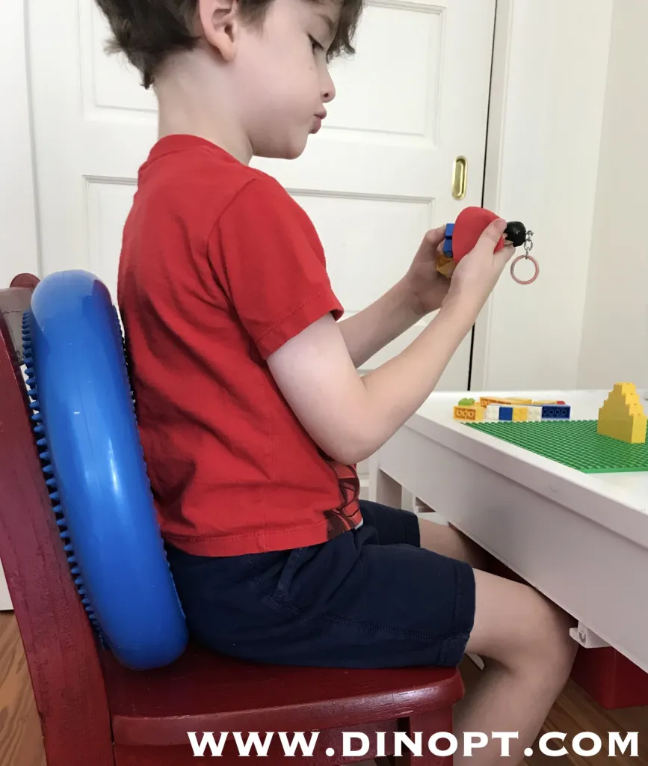
Wobble Cushion
Promotes core stability, trunk engagement, balance, and postural awareness
Provides input on the child’s back to encourage upright posture
Notes:
https://blog.dinopt.com/alternative-seating-options/

Slide 28
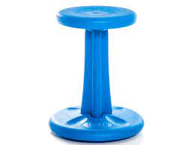
Wobble Stool
Promote trunk strength and stability
Allows for weight shifting and postural awareness
Need supervision initially to ensure safety and appropriate coordination
Notes:
The Wobble Stool is a dynamic sitting option, promoting trunk strength & stability. The Wobble Stool allows for weight shifting and postural awareness.
Note that wobble stools are a tool for growth, as they help promote strength and coordination, and are not necessarily a solution

Slide 29
Desk and Writing Intervention
Desk/Writing
Pencil grips
Slant board or large 3-ring binder for sloped writing surface
Spring loaded or loop scissors
Different writing utensils to reduce pencil pressure like gel pens or thinner markers

Slide 30
Help by Understanding¹⁰
Reassure the child when he or she has difficulty
Provide positive encouragement and positive feedback when child is working on a new task

Slide 31
Back to Lauren…
Difficulty in completing written work
holds her pencil in a very tight grasp and frequently puts holes in the paper due to the pressure she puts on her pencil
Sits rigidly at her desk
Anxious, teary, doesn’t want to go to school, cries
one friend in a different class, keeps to herself
Notes:
Slanted desk, gel pen, thin markers
Wobble stool
Positive encouragement, seat her with a buddy or near teacher desk, facilitate a relationship with someone else in the class

Slide 32
Conclusion
Teachers will come across students with motor impairments that are not eligible to receive special education, and therefore, physical therapy services
However, it is important for all school staff to help individual students participate in all aspects of the school day
Implications for Multi-Tiered System of Support
Providing alternative tasks and accomodations within the classroom can help address these impairments
ASK YOUR SCHOOL PHYSICAL THERAPIST FOR HELP!
Notes:
Able to provide resources and ideas as a consult to the student’s needs
Mention implication for MTSS and PT being consultant for these types of needs even if the student does not qualify for individual physical therapy services

Slide 33
References
Physical and motor impairment | Disability and health | Specific support needs | Additional support | Parent Zone. Accessed April 18, 2022. https://education.gov.scot/parentzone/additional-support/specific-support-needs/disability-and-health/physical-and-motor-impairment/
AAP Motor Delay Tool. Accessed April 18, 2022. https://www.healthychildren.org/English/MotorDelay/Pages/default.aspx
Scahill LD, Kooros K, Barinaga R, et al. Gross Motor Skills. In: Volkmar FR, ed. Encyclopedia of Autism Spectrum Disorders. Springer New York; 2013:1459-1462. doi:10.1007/978-1-4419-1698-3_179
What conditions or disorders are commonly associated with Down syndrome? | NICHD - Eunice Kennedy Shriver National Institute of Child Health and Human Development. Accessed April 18, 2022. https://www.nichd.nih.gov/health/topics/down/conditioninfo/associated
Missiuna, C. Children with Developmental Coordination Disorder: At Home and in the Classroom. https://canchild.ca/system/tenon/assets/attachments/000/000/159/original/dcdrevised.pdf
Hunt J, Zwicker JG, Godecke E, Raynor A. Awareness and knowledge of developmental coordination disorder: A survey of caregivers, teachers, allied health professionals and medical professionals in Australia. Child Care Health Dev. 2021;47(2):174-183. doi:10.1111/cch.12824
Rivard LM, Missiuna C, Hanna S, Wishart L. Understanding teachers' perceptions of the motor difficulties of children with developmental coordination disorder (DCD). Br J Educ Psychol. 2007;77(Pt 3):633-648. doi:10.1348/000709906X159879
Discrepancies between Parent and Teacher Reports of Motor Competence in 5–10-Year-Old Children with and without Suspected Developmental Coordination Disorder Li Ke 1 , Anna L. Barnett 2,* , Yun Wang 1 , Wen Duan 3 , Jing Hua 4 and Wenchong Du 5,*
Jarus T, Lourie-Gelberg Y, Engel-Yeger B, Bart O. Participation patterns of school-aged children with and without DCD. Res Dev Disabil. 2011;32(4):1323-1331. doi:10.1016/j.ridd.2011.01.033
Children with Motor Difficulties in Grade 5/6: A Resource for Educators.McMaster University Accessed at https://canchild.ca/system/tenon/assets/attachments/000/001/313/original/MATCH_Motor_Difficulties_5-6.pdf.
Correct Sitting Posture for Kids - An Important Tip! - DEVELOP LEARN GROW. Accessed April 18, 2022. https://developlearngrow.com/correct-sitting-posture-for-your-student/
Notes:
https://unc.az1.qualtrics.com/jfe/form/SV_9oZH3Ezg17tmmlU
pre/post test survey

