Slide 1
Return to Sport (RTS) Guideline: Arthroscopic Hip Labral Repair Anatomy, Surgery, Rehabilitation and Sport Specific Guidelines
Abby Greaney, SPT

Slide 2
Objectives
Review and understand anatomy of hip and mechanism of labral tears + Femoroacetabular Impingement (FAI)
Determine risk factors and signs/symptoms of hip labral tears
Understand different types of surgical repair for labral tears
Understand difference in protocols, commonalities and importance of variation
Understand RTS phase and what criteria is involved
Review Outcome measures common for arthroscopic surgery
Have general understanding for different sports and why difference in rehabilitation is important for biomechanics and decreasing risk of re-injury

Slide 3
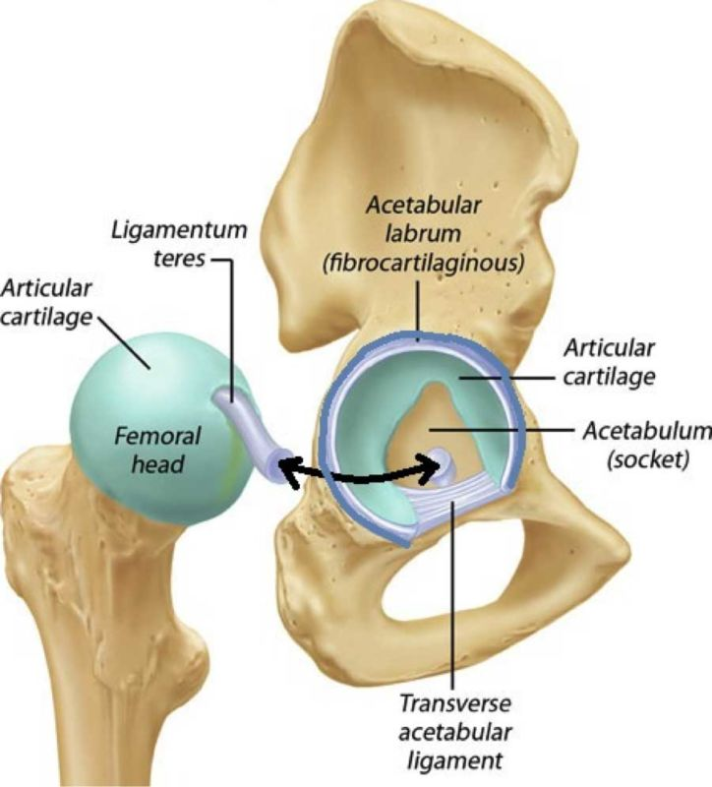
Hip Anatomy
Ball and socket joint protected by multiple ligaments, articular cartilage, the acetabular labrum and muscles
Acetabular Labrum:
Stability enhanced by:
Fibrocartilaginous ring that covers 170° of the acetabulum¹
Widest and thinnest in anterior half; thickest in posterior half
Ligaments:
Iliofemoral, ischiofemoral and pubofemoral
A
Notes:
Image source: https://physiolounge.co.uk/what-is-an-acetabular-labral-tear/

Slide 4
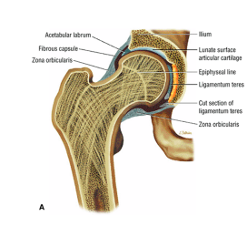
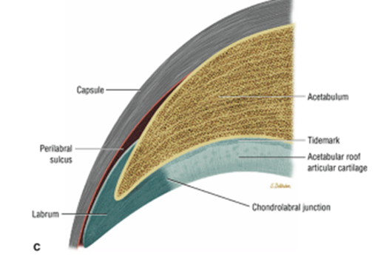
Acetabular Labrum Review
Functions:¹
Shock absorption
Joint lubrication
Pressure distribution
Protection for articular cartilage
Increase joint depth to aid in stability
Vascularization:
From outer 1/3-1/2
Fiber Orientation:
// anteriorly
_|_ posteriorly
Merges w/articular cartilage
B
Notes:
Image Source: https://musculoskeletalkey.com/the-hip/#F29-3
Most tears occur superiorly/anteriorly and can occur by either being a mid-substance tear through the labrum or detachment from articular cartilage- can also lead to avulsion fracture of hip if AC becomes detached

Slide 5
Risk Factors for Labral Tears¹
Femoroacetabular Impingement (FAI)
Trauma
Repetitive microtrauma
Capsular laxity/hip hypermobility
Developmental Hip Dysplasia (DHD)- pediatric
Joint degeneration
Notes:
Researchers have found most people with labral tears have FAI- not necessarily a causation but found high correlation
Trauma: subluxation or dislocation of femoral head
Capsular laxity/hip hypermobility
Can stem from underlying collagen disorders or hormonal influences on capsular tissue
Abnormal loading in hip ER can create iliofemoral ligament laxity
Seen a lot in athletes due to positioning/kicking/twisting
Developmental Hip Dysplasia (DHD)
Shallow acetabulum
Femoral anteversion or retroversion
Decreased distance from center of femoral head to axis of femoral shaft
Joint degeneration

Slide 6
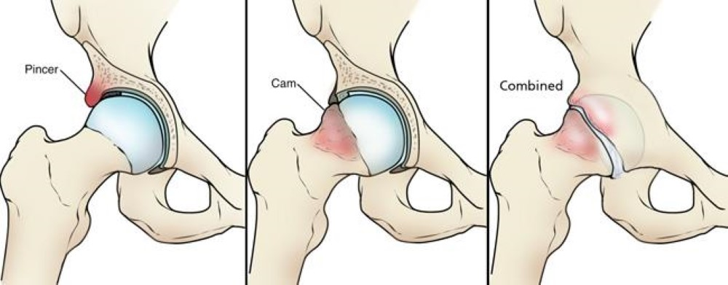
FAI Types and Effects on Labrum
FAI Types
CAM
Pincer
Combined
Congenital or acquired (during sport)
Effects on Labrum
Compression of anterior superior labrum between acetabular rim and anterior femoral neck
Insidious onset or traumatic
Leading cause of hip pathology in athletes
Can lead to early onset progressive osteoarthritis²
C
Notes:
Daily movement can cause these labral tears
Impingement is due to basic dysfunctional shape of femoral neck or acetabulum
Photo: https://orthoinfo.aaos.org/en/diseases--conditions/femoroacetabular-impingement/
Cam-type FAI is where there is an abnormal femoral head-neck junction, leading to impingement between the femur and the acetabular rim during ROM, especially flexion and internal rotation. Pincer-type FAI is where there is acetabular overcoverage, leading to impingement of the labrum during hip ROM. Lastly, Mixed or Combined-type FAI is where there is a combination of Cam and Pincer FAI, also leading to impingement of the acetabular labrum during hip ROM.
Congenital FAI: may begin at birth through genetic component
Acquired FAI: can develop overtime, through repetitive movements, etc. through environmental component
FAI tends to be a combination of genetics and environmental influence

Slide 7
Signs and Symptoms of Labral Tear⁵
Groin or anterior hip pain
Hip clicking**
Catching and locking sensation
Sensations of hip instability
Increase in pain with activities
Sitting
Sit<>Stand
Descending Stairs
Notes:
Hip clicking is considered largest sign of labral tear

Slide 8
Labral Repair: Incidence and Prevalence in Athletes
Arthroscopic surgery for labral correction:
Increased by 85% since 2011³
6% of athletes who complain of hip pain are diagnosed with FAI and labral tears⁴
Females 2x more likely to have surgery²⁻⁴
9+ years of playing a sport + being >16 y.o.= 4.9 times more likely to have labral pathology compared to those those who are less experienced⁴
Notes:
Generally repair performed to superior/anterior portion of labrum
35% of the 85% increase were labral repairs³
Males 8x more likely to have Cam FAI than females, Cam-type FAI most often diagnosed in 66% of athletes⁴

Slide 9
Surgery
91.6% success rate after 10-year follow up⁹
Indications: symptoms persisting despite conservative management, concurrent FAI
Contraindications: significant hip OA, uncorrected DHD, asymptomatic patient
Types of Surgery:
Debridement
Repair**
Reconstruction**
Notes:
We will briefly discuss debridement and reconstruction since these are also types of surgery to correct labral tears but the rest of the presentation will focus on labral repair and the process of returning to sport

Slide 10
Surgery Cont.
Potential complications
Surgical: traction related complications, portal placement related complications, inadvertent chondral and labral damage, instability, inadequate correction of FAI⁶
Post-operative: excessive leaking of fluid, femoral neck fracture and avascular necrosis, heterotrophic ossification, DVT, neuropraxia⁶
Long-term: prevalence of hip OA in athletes who had surgery is much higher than those who didn’t⁴

Slide 11
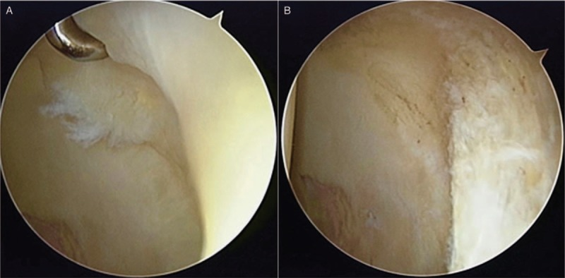
Surgery: Debridement (arthroscopic)⁵
Part of labrum removed
Worse long-term outcomes due to loss of suction seal effect
Beneficial for immediate pain relief
More likely to lead to OA due to loss of contact area between acetabulum and head of femur
D
Notes:
Image also from article

Slide 12
Surgery: Reconstruction (open or arthroscopy)⁵
Performed when repair is too difficult or previous debridement is irreparable
Autograft or allograft
ITB, ligamentum teres capitis, gracilis
Allograft- more consistent, not limited to length of harvested tissue from host, less prone to fraying/swelling
Arthroscopic v Open
Arthroscopic- less scarring, reduce bodily disfigurement, prevent infection, dec post op pain
*Questionable suction-seal effect restored?

Slide 13
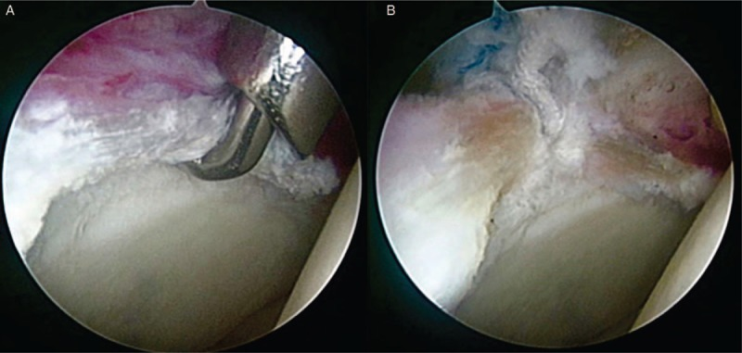
Surgery: Repair⁵
Improved outcome over debridement
Prevents degeneration of hip joint and maintains stability of joint
Performed if labral tissue is adequate
Looped repair for small labrum
Labral base refixation for larger labrum
D
Notes:
Main focus of the rest of the presentation as well as the guideline
Looped Repair: In situations of a small labrum (less than 5-mm width), a looped repair may be better than a pierced design as sufficient quality and quantity tissue may not be present to pass a penetrating instrument through the labrum and tie an arthroscopic knot with tension
Labral base refixation: the labrum would be pierced through to attach back to the acetabulum if the labrum is >5mm width

Slide 14
Physical Therapy Goals for Post-Op
Correcting/optimizing biomechanical alignment
Control tensile/compressive forces--caused by
Force contribution from glutes during active hip EXT
Force contribution from iliopsoas during active hip FLX
Neuromuscular control
Address patterns of abnormal muscular recruitment
PNF
Strengthening of weak or inhibited musculature
Addressing issues at other parts of the LE kinetic chain
Orthotics
Taping
Notes:
Once pain is under control*
Ultimate goal: get them back to where they want to be/what they want to do
Analyze foot, knee and hip alignment
PNF can be utilized to improve rotational patterns as well as flexion/extension following surgery

Slide 15
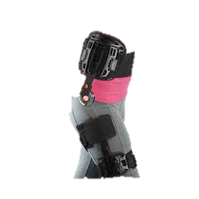
Physical Therapy: Protocol for Post-Op Treatment⁷
Each surgeon has their own protocol they have created
Variable in all aspects, some commonalities
Typically include:
ROM restrictions
WB precautions
Exercises per phase (sometimes by week)
Criteria to move through phases
Criteria for RTS (if warranted)
E
Notes:
Protocols are typically created either by the surgeon or their rehab team depending on if they have one through their arthroscopic center
Protocols vary in all aspects including ROM restrictions, exercises to perform and when to perform them and WB precautions

Slide 16
Physical Therapy: Protocol for Post-Op Treatment⁷
Goals:
Control pain
Prevent muscle inhibition and hip flexion tendonitis
Protect repair
Proper gait mechanics- w/and w/o ADs
Core and LE strengthening
Neuromuscular control with all activity
Agility and balance training
RTS when strength and dynamic control approved
Notes:
*general goals through the whole course of PT treatment, not for a specific phase

Slide 17
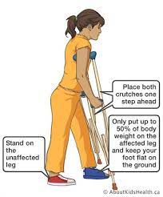
Physical Therapy: Protocol for Post-Op Treatment⁷
ROM Restrictions
Flexion <90°, Extension <10°, Abd <30°, ER <20° x2wks
Add <10° x6wks
IR no limits as long as pain free
Hip flexion brace (0-90°) x6wks
WB Precautions
Either Foot Flat WB or PWB w/bilateral crutches x3-6wks
Wean off between weeks 4-6
F

Slide 18
Physical Therapy: Protocol for Post-Op Treatment⁷
Initial Phase (wks 1-4):
Week 1: ankle pumps, PROM, heel slides, stationary bike, LE isometrics
Week 2: quadruped rocking, LAQ, psoas stretching prone
Week 3: standing 4-way hip, more LE stretching, aquatic therapy* if incision healed
Week 4: SLS, counter plank, bridging (SL), crunches, minimal resistance bike
Intermediate Phase (wks 5-8):
Week 5: increase resistance stationary bike
Week 6: forward elliptical, modified squats, swimming*, bird dogs
Week 7: wall sits, modified plank, kneeling hip flexor stretch, foam roll quads/ITB
Week 8: lateral step downs, high knee stepping, progress SL balance
Notes:
DO NOT WORRY ABOUT MEMORIZING THIS, this is just an example of what some exercises look like in each phase, different doctors will ask for different things and as you treat these patients and change plan of care, you will learn which exercises are better, how your athletes will handle them, etc.
Discuss Aquatic therapy later on

Slide 19
Physical Therapy: Protocol for Post-Op Treatment Cont.⁷
Advanced Phase (wks 9-11):
Week 9: progress closed chain balance activity, progress bridging activity
Week 10: incorporate bosu balance training
Week 11: SL pallof press
RTS Phase (wks 12+):
Week 12: gentle plyometrics, lateral agility, running progression, golf drills
Weeks 15-16: Z/W cuts, cariocas, sport specific drills, return to running, hill training, functional sports testing

Slide 20
Physical Therapy: Protocol for Post-Op Treatment⁷
Criteria to Move to Next Phase
Initial Phase
ROM >75% uninvolved side, hip flexion to 90° pain free, no pain w/phase 1 exercises, minimal compensation during activity
Intermediate Phase
Hip flexion >105°, pain and Trendelenburg free gait, hip flexion strength 60% uninvolved side, other strength 70% uninvolved side
Advanced Phase
Full AROM pain free, hip flexion strength >70-90% uninvolved side, other strength 80% uninvolved side
Notes:
This is not all inclusive, it is just some of the criteria from the compilation I made doing my systematic review, a highlight of the big ones

Slide 21
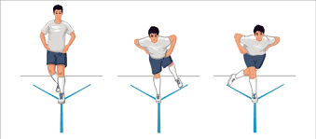
Physical Therapy: Protocol for Post-Op Treatment⁷
RTS Criteria
Minimum 12-24 weeks post-op
Full ROM pain free
Hip strength involved = uninvolved
Hop tests >90% limb symmetry
Y Balance Test Limb Symmetry >80% uninvolved
Able to perform sport specific testing pain free
Completion of Functional Sports Test
G
Notes:
Obviously this is not all of them and each athlete will have specific motions or activities they need to be able to perform prior to RTS
12-24 weeks seems like a wide range, but that is because through various studies, a few surgeons suggest 12 weeks is enough, HOWEVER, most will agree that 20-24 weeks is needed for proper healing and strength return

Slide 22
Aquatic Therapy Post-Op⁸
Once wounds healed:
Ambulation in H₂O improves gait mechanics under appropriate loads and minimizes stress to joint
Light jogging using floatation device @ 2-3 wks
Limit flexion >90 degrees for 10 days
Still limited research performed but has been found to improve outcomes when accessible

Slide 23
Return to Sport
Rate:
59-93% depending on research article^{10,11}
Elite/professional athletes ~93%¹¹
Bilateral:¹²
Elite/professional athletes 100%
Collegiate athletes 67%
High school athletes 47%
Athletes likely to RTS between 5.7-7.4 months post-op^{10,11}
Career length varies¹⁰
Notes:
Elite/professional athletes have a higher RTS rate likely due to higher income, motivation levels and access to rehabilitation
The average length of time for athletes to return to sport varies dependent on surgical protocol (consisting of temporal and physical criteria) and whether the sport is contact or non-contact
There is minimal data to show how long an athlete’s career will be after surgery, but one report states that on average, an athlete will play about 3.2 more seasons or 3.6 more years of the sport before quitting or retiring.¹⁷ According to Menge et al, 87% of NFL athletes who underwent arthroscopic surgery returned to play at an average of 7.4 seasons.²²

Slide 24
Barriers to Return to Sport
Factors:^{10,14,15}
Prolonged rehabilitation
Fear of re-injury
Result of progressive disability post-op
Potential negative impact on work
Quality of rehabilitation program
Persistent hip pain
Self-efficacy for RTS
Lack of social support
Mental health
Psychological readiness¹⁶
This Photo by Unknown Author is licensed under CC BY-SA-NC
Notes:
Athletes who are trying to return to sport but see the slow rate will likely face anxiety and depression, screening mental health using outcome measures like the Hip-RSI or other mental health questionnaires can help to determine if they need a referral to another provider for support
Athletes should be counselled about procedure and timeline for RTS often and how it will impact their mental health

Slide 25
Difficulty of Creating a Single RTS Guideline
Reasons:^{17,18}
Lack of comparative studies
Surgical protocol variance
Temporal and physical criteria
Experience by surgical/rehabilitation team
Location of labral tear
As well as extent of tear and supplemental procedures
External pressure from coaches/athletes¹⁹
Notes:
PTs need to be aware of external pressure and mind surgical protocols to avoid malpractice and re-injury of the athlete- ADVOCATE

Slide 26
Outcome Measures
International Hip Outcome Tool (iHOT)²⁰
Questionnaire for hip disorders
Approved for arthroscopic procedures
2 forms: iHOT-33 and iHOT-12
Copenhagen Hip and Groin Outcome Score (HAGOS)²¹
Similar to iHOT
Recommended for use with another outcome measure
Hip Outcome Score- Sport Subscale (HOS-SSS)²²
Self-report measure with specific sport subscale
Reliable and valid for athletes w/arthroscopic procedure
Vail Hip Sport Test (HST)²³
Limited reliability/validity for this test
Recommended for its movement screens and functional tests
Notes:
iHOT: assesses areas of: ADLs, coordination, functional mobility, gait, life participation, mental health, pain, QOL, seating, strength and stress/coping; iHOT-12 recommended for clinical use
HAGOS: assesses pain, symptoms, physical function in daily living, physical function in sport and recreation, participation in physical activities, hip/groin related QOL; recommended to use either HAGOS or iHOT due to their similarities
HOS-SSS: 9 items evaluating individual’s ability to perform athletic related tasks such as running a mile or swinging a golf club; recommended to use in conjunction with another outcome measure
HST: measures SL knee bends, lateral agility, diagonal agility, forward box lunges; recommended in conjunction with hop tests for RTS testing

Slide 27
Considerations for Specific Sports
Football/Hockey
Frequently test athletes in FADIR position for impingement and sufficient hip ROM and mobility²⁴
Baseball/Lacrosse
Be sure to understand proper throwing mechanics and how hips can affect power/speed of throw²⁵
Dance/Cheerleading/Gymnastics
Demonstrate appropriate abduction and flexion strength as well as performing repetitive movements into these direction²⁶
Running/Sprinting
Analyzing running mechanics and correcting for malalignment or gait will be most important²⁷
Notes:
Football/hockey: physical contact/trauma and wide range of motion cause tears/impingement, CAM-type is most common FAI, high risk RTS, focus on deep squatting, cutting, sprint starts, trunk stabilization
Baseball/lacrosse: leg drive is correlated with throwing velocity, athletes who display compromised stride distance or lead leg foot placement are likely to display weakness and ROM limitations of the hip, can lead to excessive internal rotation, adduction and flexion of the hip, leading to impingement and labral tears, in lacrosse, excessive hip internal rotation while shooting a lacrosse ball leads to anterior-superior impingement of the labrum, as well as acute trauma due to colliding with other players, areas to focus on during PT include: analyzing throwing mechanics (pitching or with lacrosse stick), cutting and agility drills, sprint starts, running and single leg dynamic activities
Dance: require flexibility and moving the hips into extreme range of motion, especially flexion and abduction, PT sessions should include high repetition for all exercises in a large range of motion to ensure the athlete can handle the demands of the sport. Analyzing mechanics for basic movements such as jumps, leaps, turns and tumbling will be important for these athletes to ensure proper form
Running: repetitive hip flexion/IR +FAI leads to tears, increases hip joint load up to >5 times the body weight, medium-low risk of re-injury, areas to focus on during PT include: single leg dynamic activity and plyometrics, running, sprint starts, strengthening hip abductors

Slide 28
References:
Groh MM, Herrera J. A comprehensive review of hip labral tears. Curr Rev Musculoskelet Med. 2009;2(2):105-117. doi:10.1007/s12178-009-9052-9
Ejnisman L, Ricioli Júnior W, Queiroz MC, Vicente JRN, Croci AT, Polesello GC. Femoroacetabular Impingement and Acetabular Labral Tears - Part 1: Pathophysiology and Biomechanics. Rev Bras Ortop. 2020;55(5):518-522. doi:10.1055/s-0040-1702964
Zusmanovich M, Haselman W, Serrano B, Banffy M. The incidence of hip arthroscopy in patients with femoroacetabular impingement syndrome and labral pathology increased by 85% between 2011 and 2018 in the united states. Arthroscopy. 2022;38(1):82-87. doi:10.1016/j.arthro.2021.04.049
Heerey, J. J., Kemp, J. L., Mosler, A. B., Jones, D. M., Pizzari, T., Scholes, M. J., Agricola, R., & Crossley, K. M. (2019). What is the prevalence of hip intra-articular pathologies and osteoarthritis in active athletes with hip and groin pain compared with those without? A systematic review and meta-analysis. Sports Medicine, 49(6), 951–972. https://doi.org/10.1007/s40279-019-01092-y
Su T, Chen GX, Yang L. Diagnosis and treatment of labral tear. Chin Med J (Engl). 2019;132(2):211-219. doi:10.1097/CM9.0000000000000020
Nakano N, Lisenda L, Jones TL, Loveday DT, Khanduja V. Complications following arthroscopic surgery of the hip: a systematic review of 36 761 cases. Bone Joint J. 2017;99-B(12):1577-1583. doi:10.1302/0301-620X.99B12.BJJ-2017-0043.R2
Mutch, A. (2022). Systematic Review of Surgical Protocols. [Unpublished manuscript]. University of North Carolina at Chapel Hill.
Garrison JC, Osler MT, Singleton SB. Rehabilitation after arthroscopy of an acetabular labral tear. N Am J Sports Phys Ther. 2007;2(4):241-250.
Carton P, Filan D, Mullins K. Survivorship rate and clinical outcomes 10 years after arthroscopic correction of symptomatic femoroacetabular impingement. Am J Sports Med. 2022;50(1):19-29. doi:10.1177/03635465211055485
Elwood R, El-Hakeem O, Singh Y, Shoman H, Weiss O, Khanduja V. Outcomes and rate of return to play in elite athletes following arthroscopic surgery of the hip. Int Orthop. 2021;45(10):2507-2517. doi:10.1007/s00264-021-05077-3

Slide 29
References Cont’d
11. Memon, M., Kay, J., Hache, P., Simunovic, N., Harris, J. D., O’Donnell, J., & Ayeni, O. R. (2018). Athletes experience a high rate of return to sport following hip arthroscopy. Knee Surgery, Sports Traumatology, Arthroscopy, 27(10), 3066–3104. https://doi.org/10.1007/s00167-018-4929-z
12. Rosinsky PJ, Kyin C, Lall AC, Shapira J, Maldonado DR, Domb BG. Rate of Return to Sport and Functional Outcomes After Bilateral Hip Arthroscopy in High-Level Athletes. Am J Sports Med. 2019;47(14):3444-3454. doi:10.1177/0363546519885354
13. Menge TJ, Bhatia S, McNamara SC, Briggs KK, Philippon MJ. Femoroacetabular impingement in professional football players: return to play and predictors of career length after hip arthroscopy. Am J Sports Med. 2017;45(8):1740-1744. doi:10.1177/0363546517700118
14. Ko SJ, Terry MA, Tjong VK. Return to sport after hip arthroscopy for femoroacetabular impingement syndrome: a comprehensive review of qualitative considerations. Curr Rev Musculoskelet Med. 2020;13(4):435-441. doi:10.1007/s12178-020-09634-y
15. Weber AE, Bolia IK, Mayfield CK, et al. Can We Identify Why Athletes Fail to Return to Sport After Hip Arthroscopy for Femoroacetabular Impingement Syndrome? A Systematic Review and Meta-analysis. Am J Sports Med. 2021;49(6):1651-1658. doi:10.1177/0363546520956292
16. Wörner T, Thorborg K, Webster KE, Stålman A, Eek F. Psychological readiness is related to return to sport following hip arthroscopy and can be assessed by the Hip-Return to Sport after Injury scale (Hip-RSI). Knee Surg Sports Traumatol Arthrosc. 2021;29(5):1353-1361. doi:10.1007/s00167-020-06157-4
17. Domb BG, Stake CE, Finch NA, Cramer TL. Return to sport after hip arthroscopy: aggregate recommendations from high-volume hip arthroscopy centers. Orthopedics. 2014;37(10):e902-5. doi:10.3928/01477447-20140924-57
18. Cvetanovich GL, Lizzio V, Meta F, et al. Variability and comprehensiveness of north american online available physical therapy protocols following hip arthroscopy for femoroacetabular impingement and labral repair. Arthroscopy. 2017;33(11):1998-2005. doi:10.1016/j.arthro.2017.06.045
19. Ardern CL, Glasgow P, Schneiders A, et al. 2016 Consensus statement on return to sport from the First World Congress in Sports Physical Therapy, Bern. Br J Sports Med. 2016;50(14):853-864. doi:10.1136/bjsports-2016-096278

Slide 30
References Cont’d
20. International hip outcome tool. Shirley Ryan AbilityLab. (n.d.). Retrieved February 8, 2022, from https://www.sralab.org/rehabilitation-measures/international-hip-outcome-tool
21. Mohtadi NG, Griffin DR, Pedersen ME, et al. The Development and validation of a self-administered quality-of-life outcome measure for young, active patients with symptomatic hip disease: the International Hip Outcome Tool (iHOT-33).
22. Tijssen, M., van Cingel, R., van Melick, N. et al. Patient-Reported Outcome questionnaires for hip arthroscopy: a systematic review of the psychometric evidence. BMC Musculoskelet Disord 12, 117 (2011). https://doi.org/10.1186/1471-2474-12-117
23. Rehabilitation and Performance Center at Vail. (2007). Hip Sport Test . Vail, Colorado
24. Ross JR, Khan M, Noonan BC, Larson CM, Kelly BT, Bedi A. Characterization and Correction of Symptomatic Hip Impingement in American Football Linemen. HSS J. 2018;14(2):128-133. doi:10.1007/s11420-018-9605-9
25. Klingenstein GG, Martin R, Kivlan B, Kelly BT. Hip injuries in the overhead athlete. Clin Orthop Relat Res. 2012;470(6):1579-1585. doi:10.1007/s11999-012-2245-3
26. Cianci A, Sugimoto D, Stracciolini A, Yen Y-M, Kocher MS, dʼHemecourt PA. Nonoperative management of labral tears of the hip in adolescent athletes: description of sports participation, interventions, comorbidity, and outcomes. Clin J Sport Med. 2019;29(1):24-28. doi:10.1097/JSM.0000000000000503
27. Loudon JK, Reiman MP. Conservative management of femoroacetabular impingement (FAI) in the long distance runner. Phys Ther Sport. 2014;15(2):82-90. doi:10.1016/j.ptsp.2014.02.004

Slide 31
References:
Images:
What is an acetabular labral tear?: The physio lounge. The Physio Lounge | Your Physical Health & Performance Is Our Priority. (2020, November 1). Retrieved September 26, 2021, from https://physiolounge.co.uk/what-is-an-acetabular-labral-tear/.
Themes, U. F. O. (2016, May 28). The hip. Musculoskeletal Key. Retrieved September 26, 2021, from https://musculoskeletalkey.com/the-hip/#F29-3.
Femoroacetabular impingement - orthoinfo - aaos. OrthoInfo. (n.d.). Retrieved September 26, 2021, from https://orthoinfo.aaos.org/en/diseases--conditions/femoroacetabular-impingement/.
Hip pain explained - star physical therapy: Tennessee: TN. STAR Physical Therapy | Tennessee | TN. (2018, March 22). Retrieved September 26, 2021, from https://www.starpt.com/hip-pain-explained/.
T scope hip brace. Breg, Inc. (2022, March 7). Retrieved April 19, 2022, from https://www.breg.com/products/hip-bracing/hip-bracing-post-op/t-scope-hip-brace/
AboutKidsHealth. (n.d.). Retrieved April 19, 2022, from https://www.aboutkidshealth.ca/crutchwalking
| Y-balance test (YBT). | download scientific diagram. (n.d.). Retrieved April 19, 2022, from https://www.researchgate.net/figure/Y-balance-test-YBT_fig4_352285619

