Slide 1
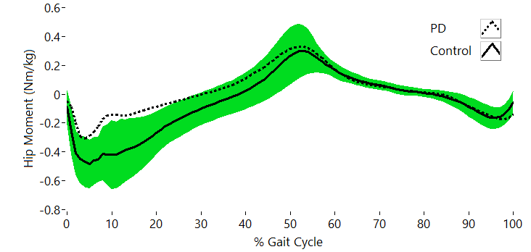
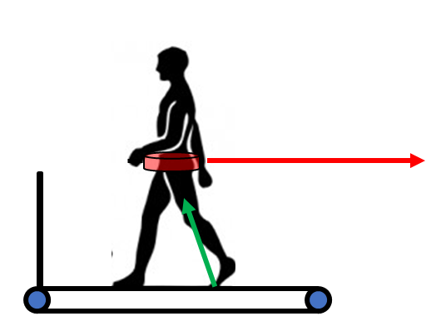
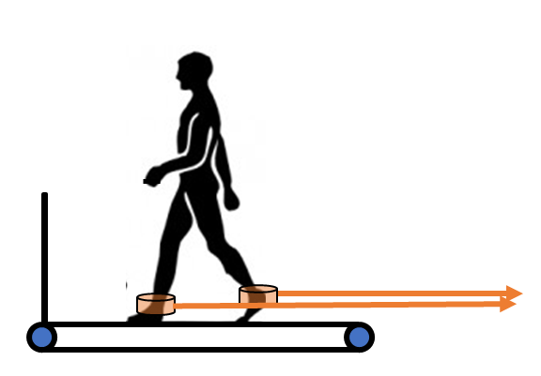
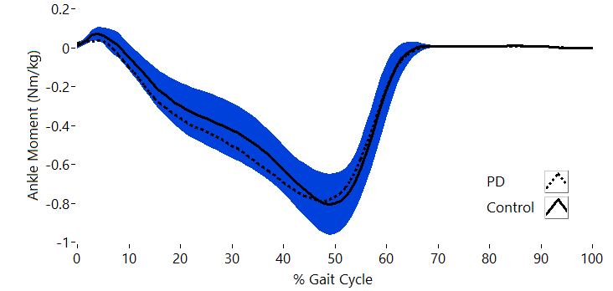
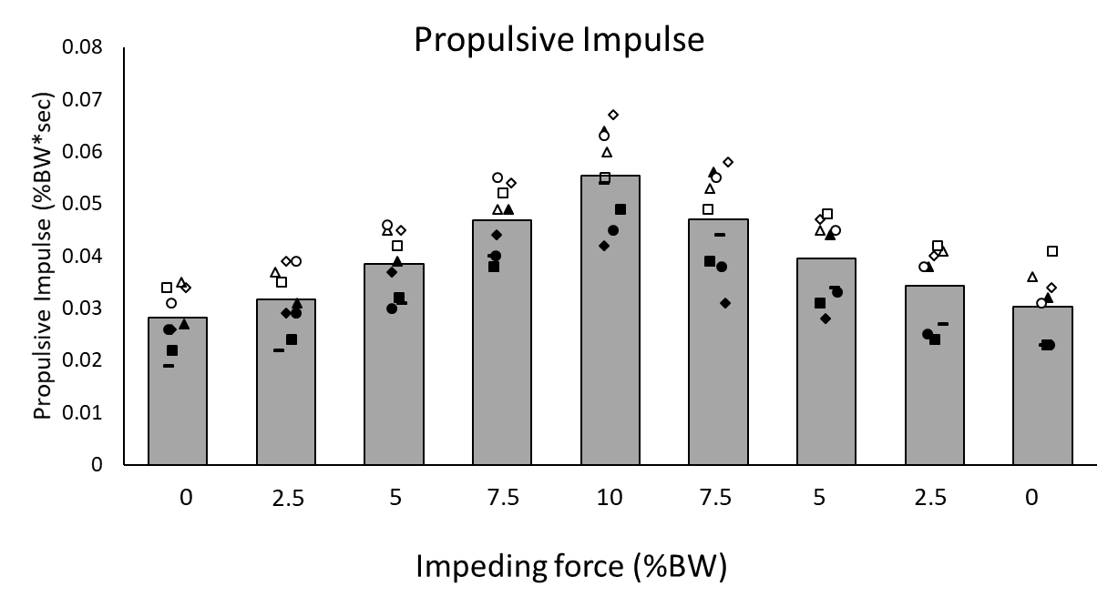
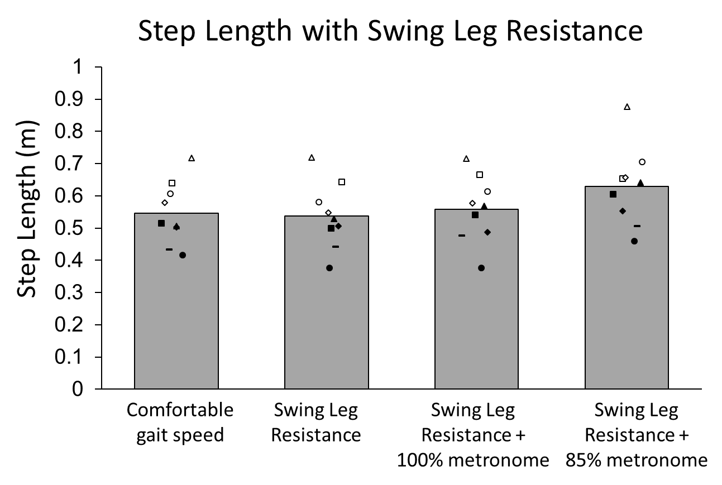
ASSESSING LIMB PROPULSION AND GAIT KINETICS USING RESISTANCE IN EARLY- STAGE PARKINSONS DISEASE
Stephanie Casnave*¹, Emily Hayworth*¹, Chelsea J Parker², David Rowland², Nina Browner³, Michael D. Lewek^{1,2}
(1) Division of Physical Therapy, (2) Human Movement Science Curriculum, (3) UNC Department of Neurology, University of North Carolina at Chapel Hill
Introduction
Methods/Results
Individuals with Parkinson disease (PD) often experience gait deviations including freezing of gait, decreased step lengths, and a shuffling step pattern that may lead to falls¹
Despite known deficits in spatiotemporal aspects of gait, relatively little is known about the underlying limb and joint kinetics in people with PD
PD and Control Demographic and Baseline Gait Data
 | PD Group N=9 | Control Group N=11
Gender | 5 male, 4 female | 2 male, 9 female
Age (years) | 62 ± 15 | 63 ± 11
Hoehn & Yahr | Stage 1 (n=4), 2 (n=2) and 3 (n=3) | -
Disease Duration (years) | 5 ± 3.5 | –
Mini BESTest | 26 ± 1 | –
Comfortable Gait Speed | 1.14 ± 0.19 | 1.20 ± 0.18
Propulsive Impulse | 0.028 ± 0.005 | 0.030 ± 0.005
Step Length (m) | 0.55 ± 0.10 | 0.58 ± 0.07
HE Impulse | -0.05 ± 0.03* | -0.11 ± 0.05*
HF Impulse | 0.07 ± 0.04 | 0.06 ± 0.03
PF Impulse | -0.28 ± 0.05 | -0.25 ± 0.07
All participants walked on an instrumented treadmill for 1 min at comfortable speed
PD Group additionally walked with:
PD vs. Control Hip Kinetics
Posterior resistance applied to pelvis which was increased from 0 to 10% BW in 2.5% increments to challenge propulsion/push-off
Posterior resistance applied to both ankles at 2.5% BW resistance to challenge swing leg advancement
Objectives
To determine limb and joint kinetics during gait in people with PD
To examine how deficits (and a potential reserve) in push-off or leg swing might contribute to shortened step lengths for people with PD.
Hypothesis: People with PD will have reduced hip flexor torque (during swing) and reduced ankle plantar flexor torque during push-off compared to unimpaired individuals yet be able to increase step lengths with increased hip flexor and ankle plantar flexor torque.²
PD vs. Control Ankle Kinetics
Discussion
In early-stage PD, gait kinetics are not as disrupted as originally thought, but reduced hip extension torque might be an early indicator of gait degeneration
Contrary to our hypothesis, hip flexion and ankle plantarflexion impulse were not different between groups, nor did those muscle groups increase torque in response to biomechanical challenges
Participants with PD increased HE torque in response to needed demands
Given the baseline deficits in HE torque, this augmentation may provide a possible target for interventions
Decreased hip flexion impulse at greater pelvic resistances (>7.5% BW)
possibly due to trade-off in torque requirements^{3,4}
Leg swing resistance easily overcome → inadequate resistance force?
PD participants: increased leg swing against resistance, suggesting a reserve in leg swing mechanics.⁵
Limb Propulsion Challenge via Pelvic Resistance
 | 0% BW | 2.5% BW | 5% BW | 7.5% BW | 10% BW
HE Impulse | -0.044±0.027 | -0.052±0.028*† | -0.063±0.036* | -0.075±0.035*† | -0.091±0.039*†
HF Impulse | 0.080±0.037 | 0.077±0.037 | 0.076±0.038 | 0.070±0.035*† | 0.065±0.033*
PF Impulse | -0.272±0.048 | -0.269±0.049 | -0.275±0.050 | -0.281±0.050 | -0.294±0.047*
Leg Swing Challenge via Ankle Resistance
 | Baseline | Ankle (no metronome) | Ankle + 100% metronome | Ankle + 85% metronome
Propulsive Impulse | 0.028±0.005 | 0.030±0.005* | 0.034±0.005* | 0.043±0.009*
HF Impulse | 0.075±0.042 | 0.066±0.031 | 0.063±0.034 | 0.060±0.026
PF Impulse | -0.282±0.051 | -0.280±0.049 | -0.293±0.039 | -0.341±0.063*
HE Impulse | -0.045±0.028 | -0.067±0.033* | -0.079±0.043* | -0.093±0.044*
References
Mazzoni P, Shabbott B, Cortes JC. Motor control abnormalities in Parkinson’s disease. Cold Spring Harb Perspect Med. 2012;2(6):a009282.
Baudendistel ST, Schmitt AC, Roemmich RT, Harrison IL, Hass CJ. Levodopa facilitates improvements in gait kinetics at the hip, not the ankle, in individuals with Parkinson’s disease. J Biomech. 2021;121:110366.
Penke K, Scott K, Sinskey Y, Lewek MD. Propulsive forces applied to the body’s center of mass affect metabolic energetics poststroke. Arch Phys Med Rehabil. 2019;100(6):1068-1075.
Browne MG, Franz JR. More push from your push-off: Joint-level modifications to modulate propulsive forces in old age. PLoS ONE. 2018;13(8):e0201407.
Washabaugh EP, Augenstein TE, Krishnan C. Functional resistance training during walking: Mode of application differentially affects gait biomechanics and muscle activation patterns. Gait Posture. 2020;75:129-136.
*= p>0.05; † = statistically different compared to the preceding condition

