Slide 1
Rock Climbing Injuries
Sammi Iannucci
3rd year PT Student
UNC Chapel Hill
Capstone Project
Notes:
Combining rock climbing knowledge with anatomy/physiology and training principles and research on rehab techniques
Something I wanted to put together to have for PTs who want to learn about the unique demands of climbing and for climbers to know about preventing injury and understanding the medical side a bit

Slide 2
Identify the most common injuries in rock climbing
Identify risk factors that contribute to injury development
Understand need for appropriate warm-up and training load to mitigate injury
Recognize when to rest and de-load and seek help from a physical therapist
Gain an understanding of rehab principles for climbers
Learning Objectives

Slide 3
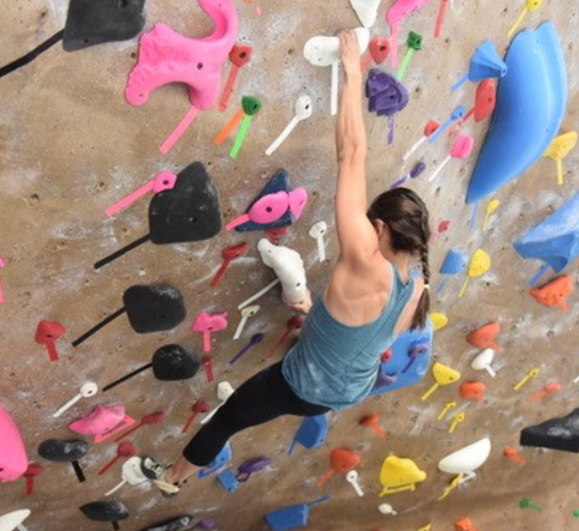
Injury Prevalence²
Common overuse injury
Sustained high load isometric contractions of upper extremity to hold full/near full bodyweight
Explosive moves
Extreme overhead positions
Contorted lower body positions
Growing sport but little formal training and load management
More and more young competitive climbers has led to rising numbers of growth plate fractures
Notes:
High load on immature skeleton, failure to monitor training load

Slide 4
Climbing Injuries by Location³
Notes:
Fingers are the most commonly injured so we are going to focus on that in this powerpoint, and go through 5 diagnoses

Slide 5
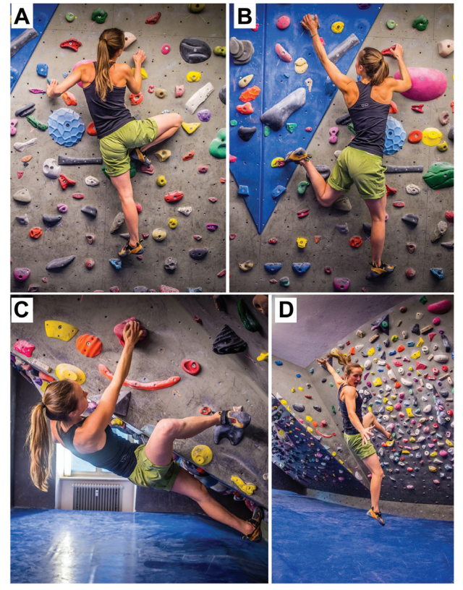
Knee Injury Prevalence¹
Bouldering > sport climbing
Mechanisms
High step, drop knee, heel hook, and an uncontrolled fall
Common climbing knee injuries
Meniscal tears, iliotibial band sprains, and ACL injuries
Non-competitive > competitive
Medial meniscal tears significantly more common in non-competitive climbers and they underwent more surgical procedures
This may suggest a need for strengthening of the dynamic knee stabilizers - quads and hamstrings, stretching of the ITB, and downclimbing
Notes:
Just threw this knee injury analysis in here since the LE is often overlooked in climbing training
Meniscus tears can occur when routes require the climber to use a frog position with knee flexion and external rotation, applying an upward pushing force.

Slide 6
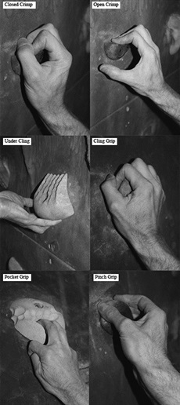
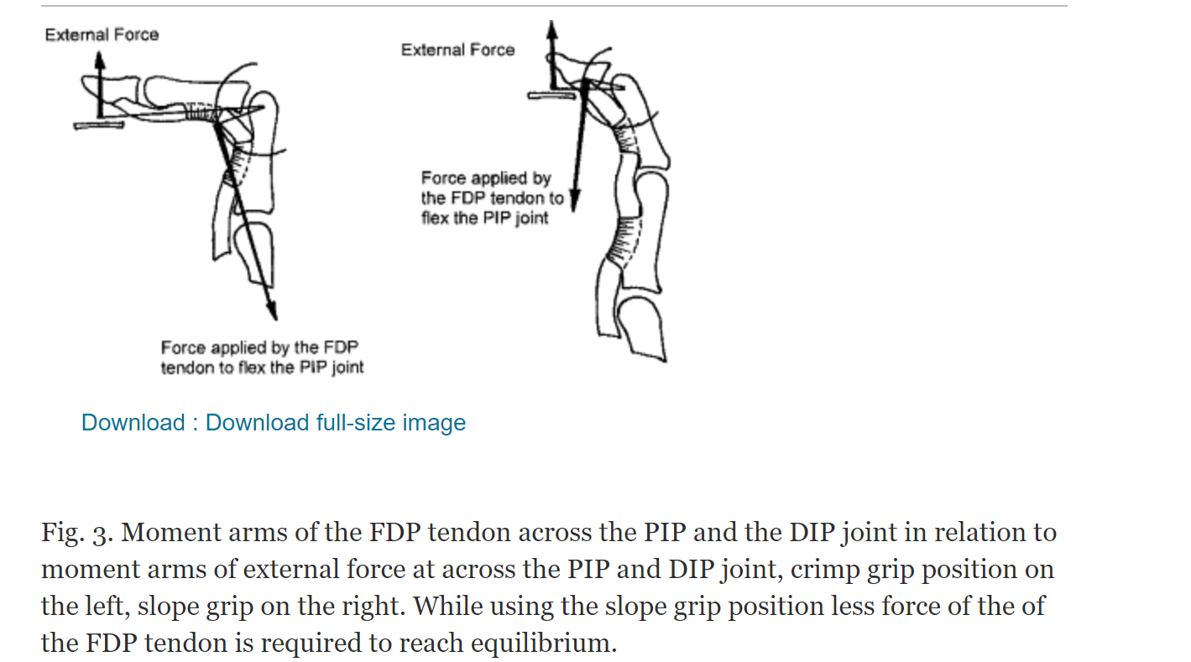
Risk Factors^{4,8}
Lead climbing
Increasing age
Increasing years of climbing experience
Higher skill level
Higher climbing intensity
Notes:
Increased skill level comes smaller holds, higher use of crimp grip which puts more stress on finger joints/tendons
So more knee injuries in less experienced (from last slide) climbers but more finger injuries in more experienced climbers? That would make sense
In the crimp grip the FDP generated more flexion force in small sized holds whereas the FDS generated more force in the larger holds. During the slope grip the FDP was more effective than the FDS. While both tendons were loaded, the flexion force was always greater during crimp grip compared with the slope grip.
Crimp-FDP generated more force, this is the one that inserts all the way across DIP joints (this grip is always capable of stronger flexion force with both tendons than slope)
Slope-FDS

Slide 7
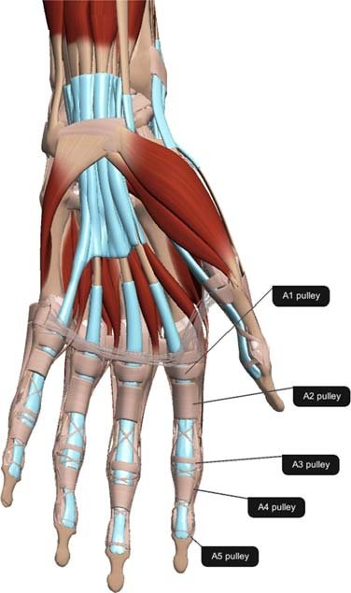
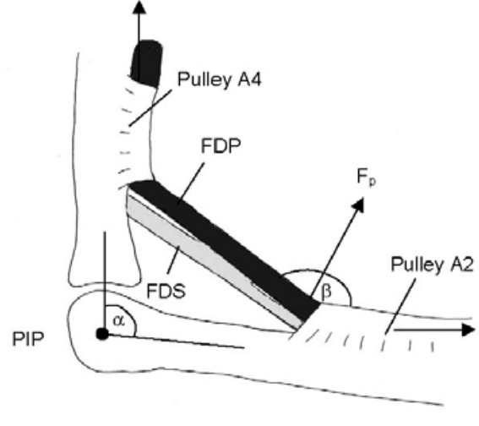
Pulleys^{3,4,7,17}
MOI | sudden dynamic loading, repetitive loading with crimps
Signs and Symptoms | pain/tenderness/swelling on palmar side, audible pop, >2mm tendon-bone-distance (TBD) on ultrasound
Treatment | relative rest, H taping, splints, progressive resistance training, rarely surgery
Return to sport | full return to sport after conservative treatment may be 6-12wks depending on severity, 6 mos for post-op
Notes:
Most common climbing injury overall
A4>A2>A3
A4 and A2 especially which attach directly to bone
CRIMPS
Pulleys are the annular connective tissue that wrap around the finger flexor tendons on the palmar side of the fingers to hold them down to the bone like eyelets on a fishing rod.
One RCT shows that when taping is used on fingers with pulley tears, strength was able to be increased by 13%, but in healthy fingers, there was no effect on strength. H-tape when used on the injured fingers was also able to decrease the Tendon-Bone-Distance by 16%. Its application for this use makes sense in the case of rupture to slightly help reduce bowstringing of the flexor tendon and reduce some of the tension that otherwise would be placed on the injured pulley, but it seems with all pulleys intact and that flexor tendon already approximated to the bone, there is no difference.
H tape procedure: A tape of a length of 10 cm and a width of 1.5 cm is cut in half longitudinally from both ends, leaving a bridge of 1 cm standing in the middle (Figure 5a). After adjusting the proximal straps at the distal end of the proximal phalanx, the PIP joint is flexed and the remaining two distal straps are wrapped tightly around the proximal part of the middle phalanx

Slide 8
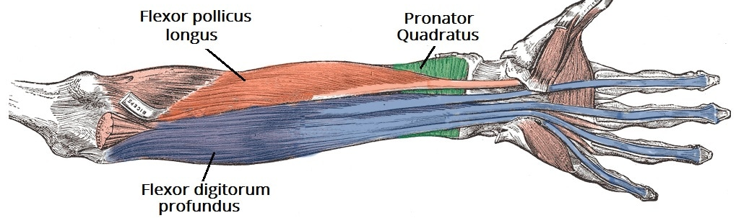
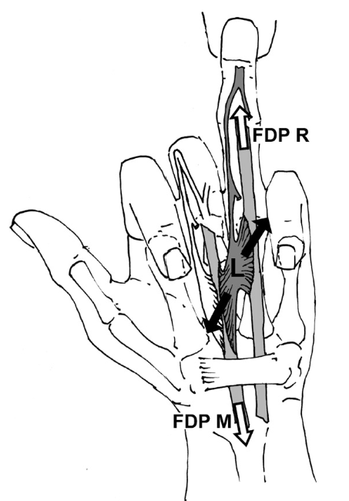
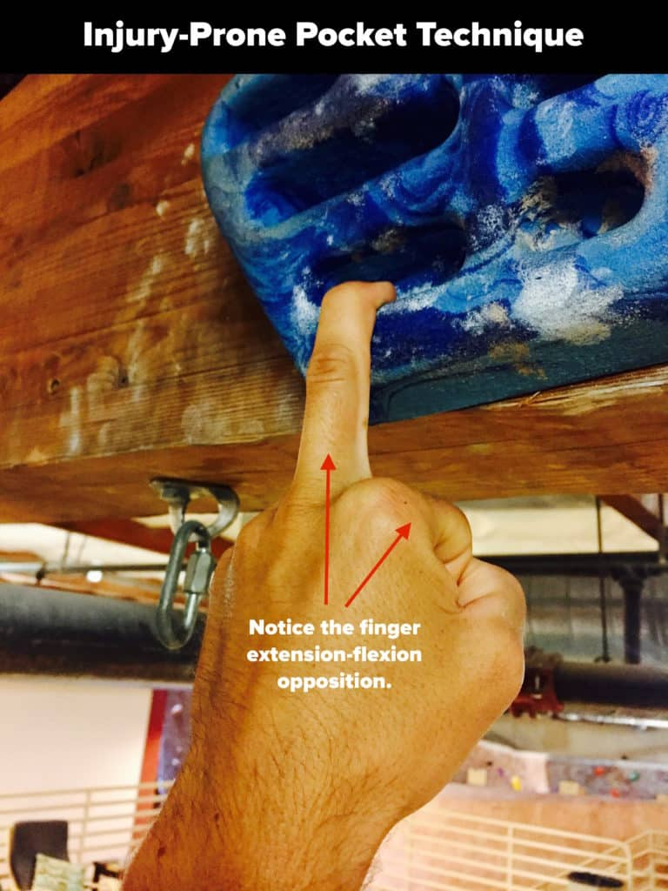
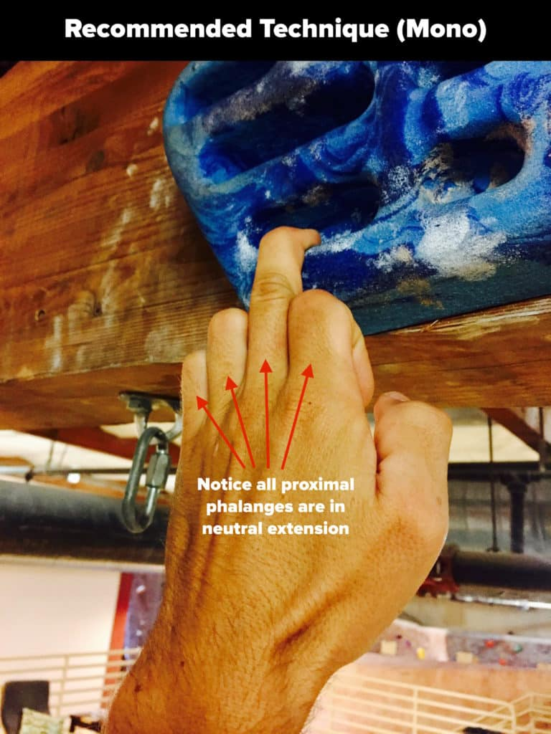
Lumbrical Strain^{6,18}
MOI | Quadriga effect, dynamic loading in one or two finger pocket, feet cut
Signs and Symptoms | Pain on palmar aspect when loading one finger
Treatment | Buddy taping to only load fingers together during healing, progressive strengthening in pockets, re-educate pocket grip mechanics with quadriga effect in mind
Return to sport | 6 weeks
Notes:
POCKETS
Little, ring, and middle fingers share a muscle belly FDP, index finger has its own muscle belly within the FDP
3rd and 4th lumbricals
Quadriga effect: pocket grip stronger with other fingers in flexion too since they share a common muscle belly but also causes a lot of shearing to lumbricals

Slide 9
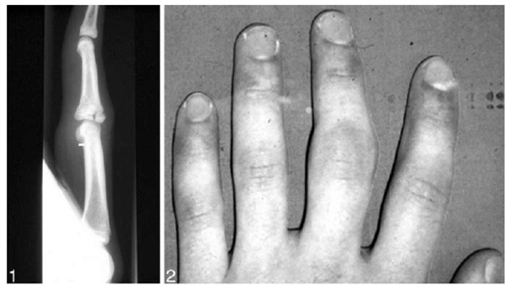
Epiphyseal Finger Stress Fracture^{9,10,19}
MOI | High training load on an immature skeleton, no single traumatic event
Signs and Symptoms | Pain and swelling over dorsal aspect of PIP, PIP may be held in slight flexion, pain during crimps, flexion AROM and PROM deficit, evidence on imaging
Treatment | Load reduction, surgery if conservative fails
Return to sport | 8 months average
https://www.thebmc.co.uk/growth-plate-stress-fractures-in-teenage-climbers
Meyers Return to Climb Protocol
Week 1: 2 sessions, 25% of normal training time, jugs only with large feet, relatively vertical walls
Week 2-3: 3 sessions per week, 50% of normal training time, steeper walls allowed
Week 4-5: 4 sessions per week, 75% of normal training time, large edge half crimps and easy dynos
Week 6-8: >4 sessions per week, 100% of normal training time, small crimps, kilter, comps
Notes:
Middle phalanx, middle finger > ring finger
Around puberty when growth plate is most vulnerable, 13 years old, males as the growth plates fuse earlier in girls, becoming more and more common
81% saltar harris type 3
Prior to starting the return to climb protocol, the youth climber must be pain free, have full range of motion of joints of the finger, have minimal swelling over the growth plate, and have evidence of healing on radiographs including bridging bone across epiphyseal lucency and normal appearance of physis.
Can result in deformity if not allowed to heal, articular surface incongruency and OA
Total load might be better calculated for each individual rather than the imprecise percentage model proposed by Meyer

Slide 10
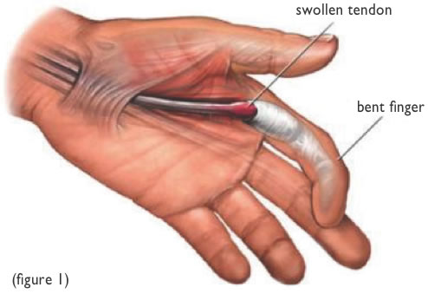
Finger Flexor Tenosynovitis^{11,12}
https://www.thebmc.co.uk/growth-plate-stress-fractures-in-teenage-climbers
MOI | Excessive tendon loading such as with vigorous training and frequent use of crimp grip causing friction between pulley and tendon, increase in training
Signs and Symptoms | Pain/tenderness/swelling over palmar surface of fingers, ultrasound can detect a “halo” of fluid around the tendon, AROM more painful than PROM
Treatment | NSAIDs, splint, ice, taping, tendon glides, extensor antagonist training, hangboard isometrics, shockwave therapy, cortisone injections for persistent cases
Return to sport | 8 weeks
Healthy Viewpoints–UnderstandingTrigger Finger (oakleafsurgical.com)
Notes:
Acute overuse injury, inflammation of tendon sheath, frequent cumulative microtrauma may not allow enough time for the tendons to heal
Similar to area of pulley pain
can have rapid onset from one hard session or slower onset from constant overuse
FDP – flexes DIP, jugs, open grip
FDS – flexes PIP, full crimp
Progression to trigger finger

Slide 11
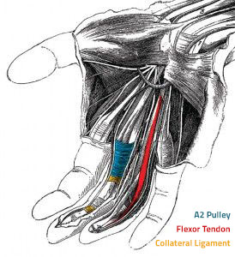
Collateral Ligament/Joint Capsule/Palmar Plate Injury
MOI | High stress to passive joint structures through pulling on pockets or hand jams, finger gets stuck or overextended, sideways forces such as in a gaston or side pull
Signs and Symptoms | PIP laxity/tenderness/swelling, dynamic stress, imaging abnormalities
Treatment | Immobilization with splinting, buddy taping or casting, surgery only required for chronic instability
Return to sport | Variable
https://www.bouldercentre.com/news/finger-injuries-and-climbing
https://www.orthobullets.com/hand/6039/digital-collateral-ligament-injury

Slide 12
Prevention
Safety¹⁴
Adequate mats, helmets, downclimbing, proper fitting harness
Warmup
Temperature, metabolic, neural and psychology-related effects²¹
Mobility
Crimp position, shown to increase physiologic bowstringing of flexor tendons, 50 moves each hand⁸
Appropriate training load^{4,9}
Prevent overuse
Rest days
Rest between climbs
Notes:
Warmup
Both passive and active warm-up can evoke temperature, metabolic, neural and psychology-related effects, including increased anaerobic metabolism, elevated oxygen uptake kinetics and post-activation potentiation.²¹
After a warming-up, the course of the tendon could become more even and regular preventing peak forces at distinct points of the flexor tendon sheath⁸
“distance of bowstringing over the distal edge of the A2 pulley in the crimp grip position increased by 0.6 mm (30%, from 1.15 to 1.75 mm) after about 100 climbing moves which accords to 50 cyclic loads in crimp grip for each hand.”⁸ This would be about 3 middle to long routes to be ready for maximum loading
Both taping and weight training reduced injury rates in sport climbing and bouldering. However, the authors did not find any support for stretching, yoga, using instructors, regulating equipment usage, taking supplements, heating hands before climbing, and corticosteroid injections as injury prevention measures for sport climbing.⁴

Slide 13
Prevention cont.
Youth considerations⁹
Take at least one month off a year
Avoid early specialization
Avoid double dynos and hanging with additional weights
Caution with Kilter, moon, hang boards
Limit full crimping
Strength training
Eccentric and closed kinetic chain exercises to build strength specifically needed for climbing, learn proper functional coordinated motor patterns, practice conscious concentration of muscle activation, and to promote resilient tissues²⁰
Antagonist strengthening to encourage a more neutral joint position and posture¹³
Proximal stability¹⁵ for distal mobility¹⁶
Notes:
Less structured sport than most, lack of coaching and formal training, important to make sure you are monitoring load, listening to body
Core stability can help improve hip mobility which is important for climbers to be able to stay close to the wall, utilize a high foot positions, and prevent injury.
Strength training
1 – strengthening the muscles involved in performing proper movement; 2 – formation of functional movement to develop exercises for coordinated work of the muscles of the torso, upper and lower extremities.
Closed chain: hand/foot is fixed and cannot move, why - most climbing is closed chain and training closed chain promotes eccentric contractions, use whole kinetic chain (UE core and LE), and train co-contractions, examples include pushups and pullups vs free weights

Slide 14
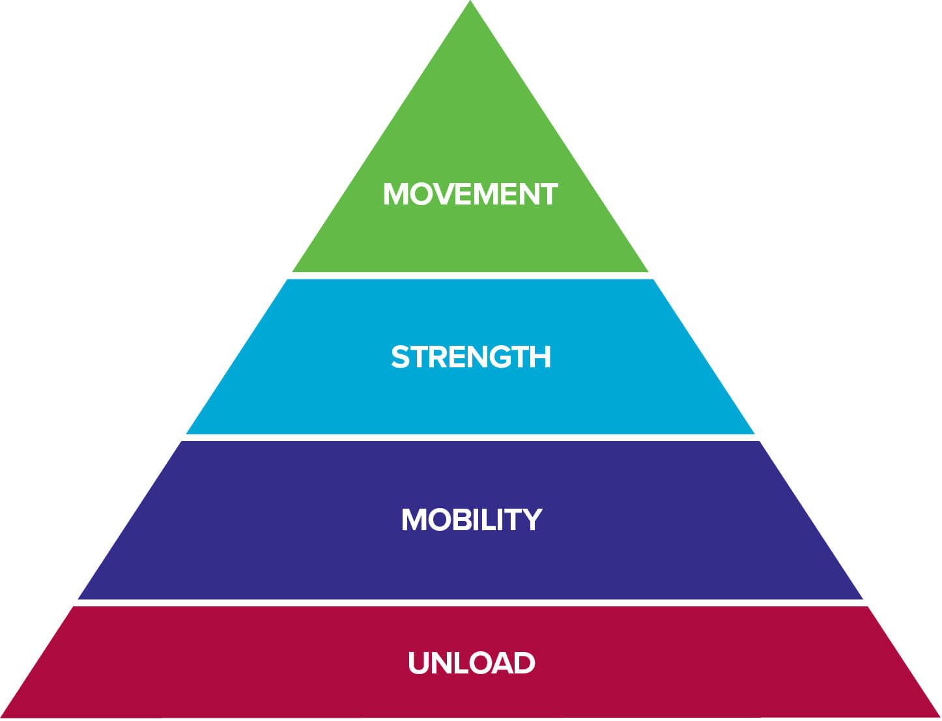
When to see a PT
Pain
That is getting worse
Persistent
Present after a traumatic fall/ incident
Significant weakness
Numbness/tingling
Pre- and post-surgical conditioning and strengthening

Slide 15
References
Lutter C, Tischer T, Cooper C, et al. Mechanisms of Acute Knee Injuries in Bouldering and Rock Climbing Athletes. Am J Sports Med. 2020;48(3):730-738. doi:10.1177/0363546519899931
Jones G, Schöffl V, Johnson MI. Incidence, Diagnosis, and Management of Injury in Sport Climbing and Bouldering: A Critical Review. Curr Sports Med Rep. 2018;17(11):396-401. doi:10.1249/JSR.0000000000000534
Schöffl V, Popp D, Küpper T, Schöffl I. Injury trends in rock climbers: evaluation of a case series of 911 injuries between 2009 and 2012. Wilderness Environ Med. 2015;26(1):62-67. doi:10.1016/j.wem.2014.08.013
Woollings KY, McKay CD, Emery CA. Risk factors for injury in sport climbing and bouldering: a systematic review of the literature. Br J Sports Med. 2015;49(17):1094-1099. doi:10.1136/bjsports-2014-094372
Jones G, Johnson MI. A critical review of the incidence and risk factors for finger injuries in rock climbing. Curr. Sports Med. Rep. 2016; 15:400–9. doi: 10.1249/JSR.0000000000000304. PubMed PMID: 27841811.
Schweizer A. Lumbrical tears in rock climbers. J. Hand Surg. Br. 2003; 28:187–9.
Schneeberger M, Schweizer A. Pulley ruptures in rock climbers: Outcome of conservative treatment with the pulley-protection splint—a series of 47 cases. Wilderness & Environmental Medicine. 2016;27(2):211-218. doi:10.1016/j.wem.2015.12.017
Schweizer A. Biomechanical properties of the crimp grip position in rock climbers. J Biomech. 2001;34(2):217-223. doi:10.1016/s0021-9290(00)00184-6
Meyers RN, Schöffl VR, Mei-Dan O, Provance AJ. Returning to Climb after Epiphyseal Finger Stress Fracture. Curr Sports Med Rep. 2020;19(11):457-462. doi:10.1249/JSR.0000000000000770
Bartschi N, Scheibler A, Schweizer A. Symptomatic epiphyseal sprains and stress fractures of the finger phalanges in adolescent sport climbers. Hand Surg Rehabil. 2019; 38:251–6.
Schöffl V, Strohm P, Lutter C. Efficacy of corticosteroid injection in rock climber's tenosynovitis. Hand Surg Rehabil. 2019;38(5):317-322. doi:10.1016/j.hansur.2019.07.004
Simon, A. Rock climbing finger tenosynovitis. The Climbing Doctor. https://theclimbingdoctor.com/rock-climbing-finger-tenosynovitis/. Published February 19, 2023. Accessed April 3, 2023.
Vagy J. Train antagonist strength for climbing. The Climbing Doctor. https://theclimbingdoctor.com/how-to-train-antagonist-muscle-strength-for-climbing/. Published November 19, 2022. Accessed April 5, 2023.
Peterson C, Ceraulo A. Caring for Climbers. Curr Sports Med Rep. 2015;14(5):397-403. doi:10.1249/JSR.0000000000000200
Moreside JM, McGill SM. Hip joint range of motion improvements using three different interventions. J Strength Cond Res. 2012;26(5):1265-1273. doi:10.1519/JSC.0b013e31824f2351
Draga P, Ozimek M, Krawczyk M, et al. Importance and Diagnosis of Flexibility Preparation of Male Sport Climbers. Int J Environ Res Public Health. 2020;17(7):2512. Published 2020 Apr 7. doi:10.3390/ijerph17072512
Schoffl I, Einwag F, Strecker W, Hennig F, Schoffl V. Impact of taping after finger flexor tendon pulley ruptures in rock climbers. J Appl Biomech. 2007;23(1):52-62. doi:10.1123/jab.23.1.52
DeStefano M. Pocket change - adapting the way you pull on pockets. The Climbing Doctor. https://theclimbingdoctor.com/pocket-change-adapting-the-way-you-pull-on-pockets/. Published November 19, 2022. Accessed April 7, 2023.
Jones G, Johnson R, Schöffl V, et al. Primary Periphyseal Stress Injuries of the Fingers in Adolescent Climbers: A Critical Review. Curr Sports Med Rep. 2022;21(12):436-442. Published 2022 Dec 1. doi:10.1249/JSR.0000000000001016
Kozin S, Cretu M, Kozina Z, et al. Application of closed kinematic chain exercises with eccentric and strength exercises for the shoulder injuries prevention in student rock climbers: a randomized controlled trial. Acta Bioeng Biomech. 2021;23(2):159-168.
McGowan CJ, Pyne DB, Thompson KG, Rattray B. Warm-Up Strategies for Sport and Exercise: Mechanisms and Applications. Sports Med. 2015;45(11):1523-1546. doi:10.1007/s40279-015-0376-x

Slide 16
Resources
Dr. Jason Hooper
Hooper's Beta (hoopersbeta.com)
Hooper's Beta – YouTube
Dr. Jared Vagy
The Climbing Doctor Homepage - The Climbing Doctor
The Climbing Doctor - YouTube
Book called Climb Injury Free
Breaking Beta The Science of Climbing Podcast
Notes:
Both have instagrams as well

Slide 17
THANK YOU

